Slide 1
POM Set up for PFChang's

Slide 2














Automation Framework - POM ARCHITECTURE
OR
Pages
Testcases
Test Scripts
Execution
Test Data
Add failed script
files in Report
Add passed script
files in Report
Stored in our
location
Detailed
Report
TSR
Reports with screenshots

Slide 3
Page Object Model Advantages
Object repository is independent of testcases.
Page access logic is centralized in one place, making maintenance much easier.
Code becomes less and optimized because of the reusable page methods in the
POM classes.
Faster than other keyword-driven/data-driven approaches.
Methods get more realistic names which can be easily mapped with the operation
happening in UI.
Establish the relation between pages directly in code ,So that performing an operation remains in the same page or navigate to another page.

Slide 4

Object Repository
#Register Page
Register.Emailaddress.name=accountEmail
Register.Password.name=password
Register.Firstname.name=firstName
Register.Lastname.name=lastName
Register.Phone.name=phoneNumber
Register.Zip.name=zipCode
Register.createaccount.XPath=//button[@o-compile='page.createButtonLabel']
Register.month.name=monthSelected
Register.day.name=daySelected
Register.submit.XPath=//button[@o-compile='page.birthdayNoteSubmitButton']
Register.alerttext.XPath=//span[@class='ng-scope']
Test Data

Slide 5
Rules to be followed while creating Pages in POM
Every page should be created as a separate class.
All Pages will have to inherit common wrapper methods.
All Pages should have a constructor where you need to
verify the landing page.
Every Action/Verification on each element should be a
method of the page.
Every method should return the page where it landed.

Slide 6
Page Specific Methods(Create Account)
public PFCreateAccount enterEmailaddress(String data) {
enterByName(prop.getProperty("Register.Emailaddress.name"), data);
return this;
}
public PFCreateAccount enterPassword(String data) {
enterByName(prop.getProperty("Register.Password.name"), data);
return this;
}
public PFCreateAccount enterFirstname(String data) {
enterByName(prop.getProperty("Register.Firstname.name"), data);
return this;
}
public PFCreateAccount enterLastname(String data) {
enterByName(prop.getProperty("Register.Lastname.name"), data);
return this;
}
public PFYourAccount clickloginSubmit() {
clickByXpath(prop.getProperty("Login.submit.XPath"));
return new PFYourAccount();
}

Slide 7
Test Data
Test Case (Successful Registration)
public class PF002_SuccessfulRegistration extends PFChangWrappers{
@Test(dataProvider="fetchData")
public void register(String emailaddress, String passWord,String fname, String lname,String phone,String zipcode,String value, String dayvalue) {
new PFHomePage()
.clickRegister()
.enterEmailaddress(emailaddress)
.enterPassword(passWord)
.enterFirstname(fname)
.enterLastname(lname)
.enterPhone(phone)
.enterZip(zipcode)
.clickCreateMyAccount()
.month(value)
.day(dayvalue)
.clickSubmit()
.clickLogout();
} }

Slide 8
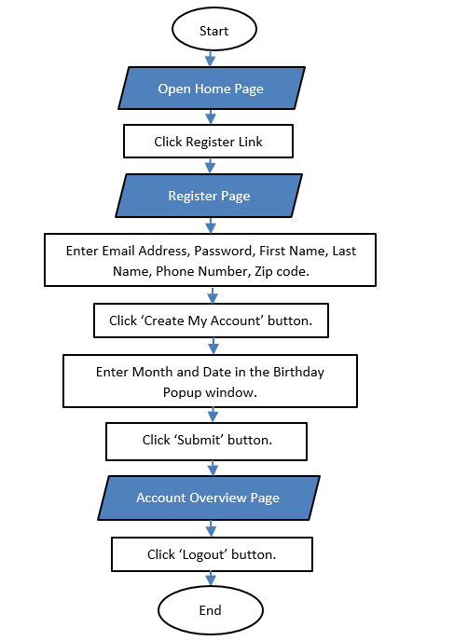
Test Data
Test Data
Test Data
Flow Chart for one Test case

