Slide 1




Hierarchical Time Series Analysis
Predictive Analytics of Climate Stress Impact on the Italian Mediterranean Buffalo
Presented by
Mohammad Sheikh
Supervisors
Dr. Luca Barbierato
Dr. Matteo Santinello
November 2025
Predictive Analytics of Climate Stress Impact on the Italian Mediterranean Buffalo

Slide 2



Prediction
Classification
Clustering
Predictive Analytics of Climate Stress Impact on the Italian Mediterranean Buffalo

Slide 3
Prediction
The hierarchy is a mathematical constraint.
The numbers must add up.
Predictive Analytics of Climate Stress Impact on the Italian Mediterranean Buffalo

Slide 4


Example
How many tourists are going to visit Italy?
How about Piemonte?
How about Torino?
Predictive Analytics of Climate Stress Impact on the Italian Mediterranean Buffalo

Slide 5
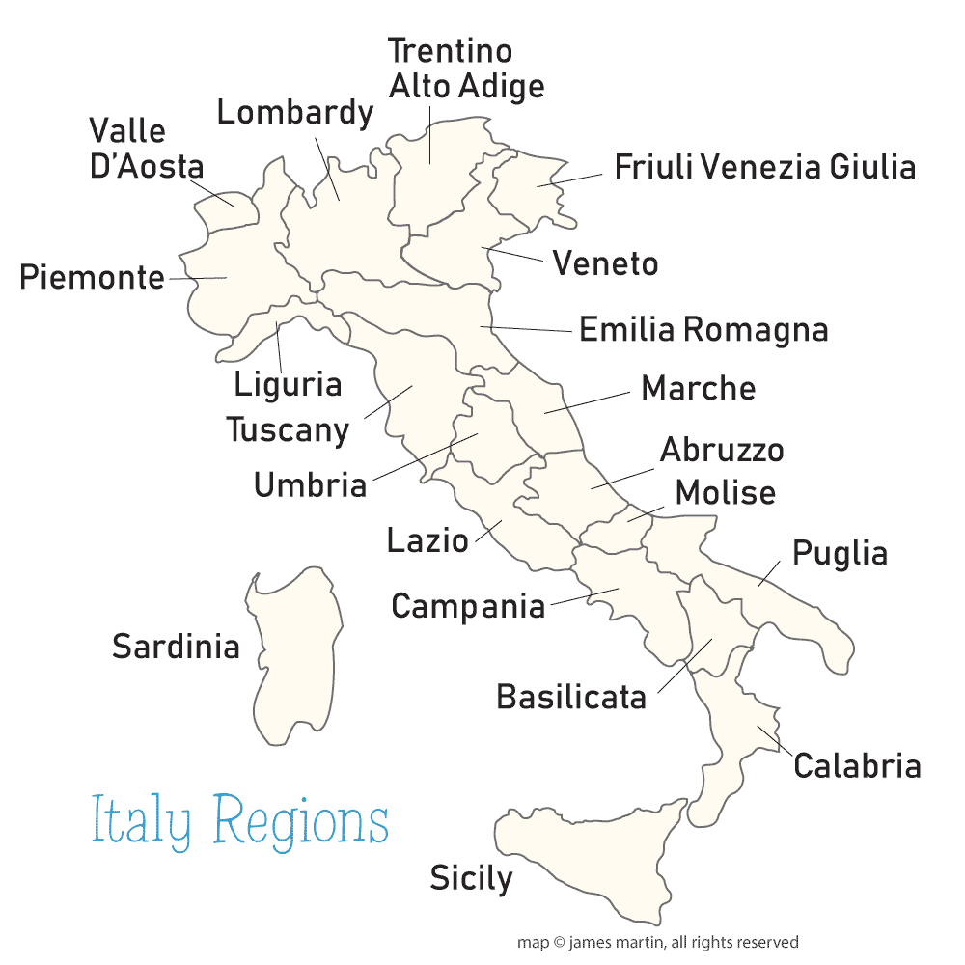
Italy has 20 Regions
Predictive Analytics of Climate Stress Impact on the Italian Mediterranean Buffalo

Slide 6
We need forecasts for the whole of Italy, for each region and for each city.
Predictive Analytics of Climate Stress Impact on the Italian Mediterranean Buffalo

Slide 7
Approach 1 : Top Down
Predictive Analytics of Climate Stress Impact on the Italian Mediterranean Buffalo

Slide 8





Forecast
2/3
1/3
Lazio
Lombardy
4/5
1/5
8/9
1/9
Rome
Rieti
Milan
Cernobbio
Predictive Analytics of Climate Stress Impact on the Italian Mediterranean Buffalo

Slide 9
Problem : it is not accurate on the bottom levels
Predictive Analytics of Climate Stress Impact on the Italian Mediterranean Buffalo

Slide 10
Approach 2 : Bottom UP
Predictive Analytics of Climate Stress Impact on the Italian Mediterranean Buffalo

Slide 11
Lazio
Lombardy
Forecast
Rome
Rieti
Milan
Cernobbio
Predictive Analytics of Climate Stress Impact on the Italian Mediterranean Buffalo

Slide 12
Problem : add up problem, sum of child forecasting is not equal to their parent
Predictive Analytics of Climate Stress Impact on the Italian Mediterranean Buffalo

Slide 13
What is optimal solution?
Hierarchical Reconciliation
Predictive Analytics of Climate Stress Impact on the Italian Mediterranean Buffalo

Slide 14
Forecast
Forecast
Lazio
Lombardy
Forecast
Rome
Rieti
Milan
Cernobbio
Predictive Analytics of Climate Stress Impact on the Italian Mediterranean Buffalo

Slide 15
Hierarchical Reconciliation
A model will be trained on the data[XGBoost, ...].
Forecast on the data using current model.
Reconcile the predicted values using statistical approaches.
Predictive Analytics of Climate Stress Impact on the Italian Mediterranean Buffalo

Slide 16
Hierarchical Reconciliation
MinT : minimize the variance between reconciled values and base forecast error.
ERM : minimize the error between actual values and reconciled values.
Predictive Analytics of Climate Stress Impact on the Italian Mediterranean Buffalo

Slide 17
Base model for prediction
XGBoost + MinT
  Handles Climate Data
  Hierarchical Coherence Guaranteed
  Highly interpretable
Predictive Analytics of Climate Stress Impact on the Italian Mediterranean Buffalo

Slide 18
Base model for prediction
Neural Network- Based
  Handles Climate Data
  Hierarchical Coherence NOT Guaranteed
  Low interpretability
Predictive Analytics of Climate Stress Impact on the Italian Mediterranean Buffalo

Slide 19
Prediction
Classification
Clustering
Predictive Analytics of Climate Stress Impact on the Italian Mediterranean Buffalo

Slide 20
Classification
The hierarchy is not a constraint to be fixed.
Supervised task, needs to assign Labels.
Labeling is different for each approaches.
Predictive Analytics of Climate Stress Impact on the Italian Mediterranean Buffalo

Slide 21
Approach 1
Feature-Based
Predictive Analytics of Climate Stress Impact on the Italian Mediterranean Buffalo

Slide 22
Feature-Based Classification
Create tabular data based on avg of past days.
Assign label to each row as YES/NO.
Apply a model to train on the data. [Random Forest]
Classify based on level:
  Animal at risk ? (Yes/No)
  High stress event? (Yes/No)
Predictive Analytics of Climate Stress Impact on the Italian Mediterranean Buffalo

Slide 23
Feature-Based Classification : Labeling
Animal_ID | Farm_ID | Day | Milk | SCC | THI
A-101 | Farm-A | 1 | 20 | 100 | 22
A-101 | Farm-A | 2 | 19 | 110 | 23
A-101 | Farm-A | 3 | 18 | 120 | 26
A-101 | Farm-A | 4 | 17 | 150 | 27
A-101 | Farm-A | 5 | 15 | 260 | 28
A-101 | Farm-A | 6 | 14 | 200 | 25
Goal: Predict a "High SCC Event"
High SCC Event ➔ SCC > 250
Predictive Analytics of Climate Stress Impact on the Italian Mediterranean Buffalo

Slide 24
Feature-Based Classification : Labeling
Goal: Predict a "High SCC Event"
Train on the new table.
Animal_ID | Day | scc_lag_1 | avg_THI_last_3_days | Farm_ID (Hierarchical) | event_in_next_2_days (Label)
A-101 | 3 | 110 | 23.7 | Farm-A | 1 (Yes)
A-101 | 4 | 120 | 25.3 | Farm-A | 1 (Yes)
A-101 | 5 | 150 | 27.0 | Farm-A | 0 (No)
Predictive Analytics of Climate Stress Impact on the Italian Mediterranean Buffalo

Slide 25
Approach 2
Deep Learning
Predictive Analytics of Climate Stress Impact on the Italian Mediterranean Buffalo

Slide 26
Deep Learning Classification
Takes fixed-length snippet as input [3-day, 7-day]
Assign label to each snippet based on whether high-risk event occurred in 2 days later.
Apply a model to learn on the data. [1D-CNNs or LSTMs]
Predictive Analytics of Climate Stress Impact on the Italian Mediterranean Buffalo

Slide 27
Deep Learning Classification : Labeling
Animal_ID | Farm_ID | Day | Milk | SCC | THI
A-101 | Farm-A | 1 | 20 | 100 | 22
A-101 | Farm-A | 2 | 19 | 110 | 23
A-101 | Farm-A | 3 | 18 | 120 | 26
A-101 | Farm-A | 4 | 17 | 150 | 27
A-101 | Farm-A | 5 | 15 | 260 | 28
A-101 | Farm-A | 6 | 14 | 200 | 25
Goal: Predict a "High SCC Event"
High SCC Event ➔ SCC > 250
Predictive Analytics of Climate Stress Impact on the Italian Mediterranean Buffalo

Slide 28
Deep Learning Classification : Labeling
Animal_ID | Farm_ID | Day | Milk | SCC | THI
A-101 | Farm-A | 1 | 20 | 100 | 22
A-101 | Farm-A | 2 | 19 | 110 | 23
A-101 | Farm-A | 3 | 18 | 120 | 26
A-101 | Farm-A | 4 | 17 | 150 | 27
A-101 | Farm-A | 5 | 15 | 260 | 28
A-101 | Farm-A | 6 | 14 | 200 | 25
Goal: Predict a "High SCC Event"
High SCC Event ➔ SCC > 250
X (The 3-Day Input Snippet) | Label
[[20, 100, 22], [19, 110, 23], [18, 120, 26]] | 1 (Yes)
[[19, 110, 23], [18, 120, 26], [17, 150, 27]] | 1 (Yes)
[[18, 120, 26], [17, 150, 27], [15, 260, 28]] | 0 (No)
Predictive Analytics of Climate Stress Impact on the Italian Mediterranean Buffalo

Slide 29
Prediction
Classification
Clustering
Predictive Analytics of Climate Stress Impact on the Italian Mediterranean Buffalo

Slide 30
Clustering
The hierarchy is not a constraint to be fixed.
The hierarchy levels provide different "lenses" for clustering.
Predictive Analytics of Climate Stress Impact on the Italian Mediterranean Buffalo

Slide 31
Animal-Level
Clusters individual animals
  Cluster 1: "Resilient Animals”.
  Cluster 2: "Vulnerable Animals".
Farm-Level
Clusters entire farms
  Cluster A: "High-Performance Farms".
  Cluster B: "Poorly-Managed Farms".
Predictive Analytics of Climate Stress Impact on the Italian Mediterranean Buffalo

Slide 32
Approach 1
Feature-Based
Predictive Analytics of Climate Stress Impact on the Italian Mediterranean Buffalo

Slide 33
Feature-Based Clustering
  Creates a profile for each animal/farm based on avg features.
  Applies K-means on the profiles.
  Clusters animals/farms based on different types.
pros
  Highly interpretable and Computationally fast
cons
  It uses Average of features instead of day-to-day data
Predictive Analytics of Climate Stress Impact on the Italian Mediterranean Buffalo

Slide 34
Approach 2
Shape-Based
Predictive Analytics of Climate Stress Impact on the Italian Mediterranean Buffalo

Slide 35
Shape-Based Clustering
  Extracts fixed-day data and compare with others.
  Applies dynamic Time Warping to find similarity.
  Clusters animals/farms based on behavioral patterns:
    Cluster 1: “Fast Recovery”
    Cluster 2: “No Recovery”
Predictive Analytics of Climate Stress Impact on the Italian Mediterranean Buffalo

Slide 36
pros
  Finds Behavioral Patterns
  Works on raw data
cons
  Computationally Expensive
Predictive Analytics of Climate Stress Impact on the Italian Mediterranean Buffalo

Slide 37
Hierarchical Time Series Analysis
Predictive Analytics of Climate Stress Impact on the Italian Mediterranean Buffalo
Presented by
Mohammad Sheikh
Supervisors
Dr. Luca Barbierato
Dr. Matteo Santinello
November 2025

