Slide 1

Predictive Analytics of Climate Stress Impact on the Italian Mediterranean Buffalo
Physiological and Productive Responses
Prof. Luca Barbierato
Prof. Matteo Santinello
Mohammad Sheikh
Department of Control and Computer Engineering
Dipartimento di Automatica e Informatica

Slide 2
Dataset Overview & Base Variables

Slide 3
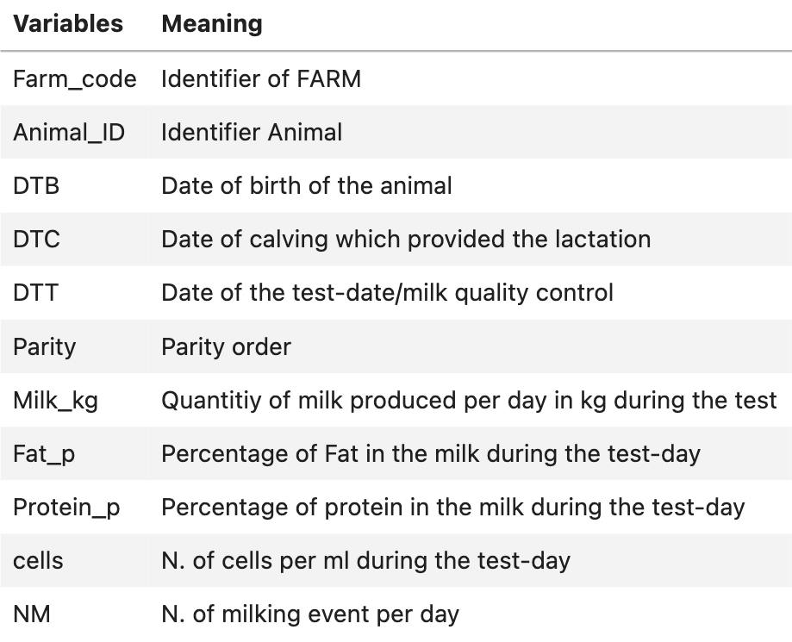
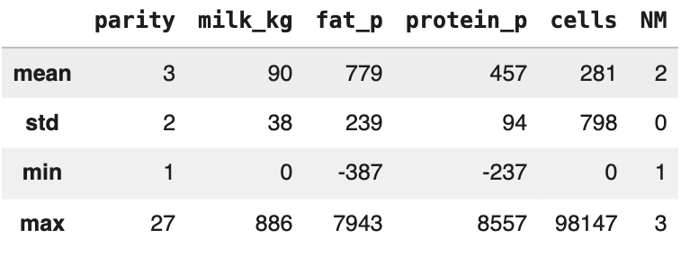
Dataset Overview & Base Variables
Animal Data
Total Number of Data : 2,593,267
Null values : 1873 in DTB
error values : 118,300 in All Variables
Descriptive statistics for numerical columns

Slide 4
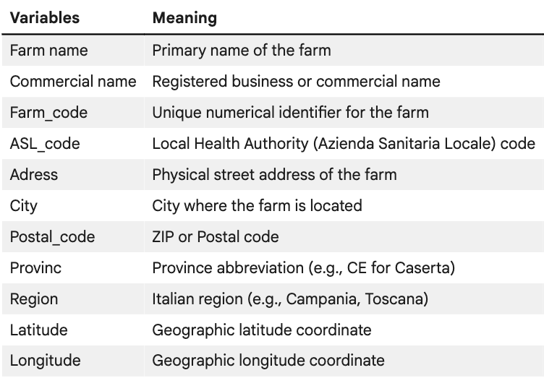
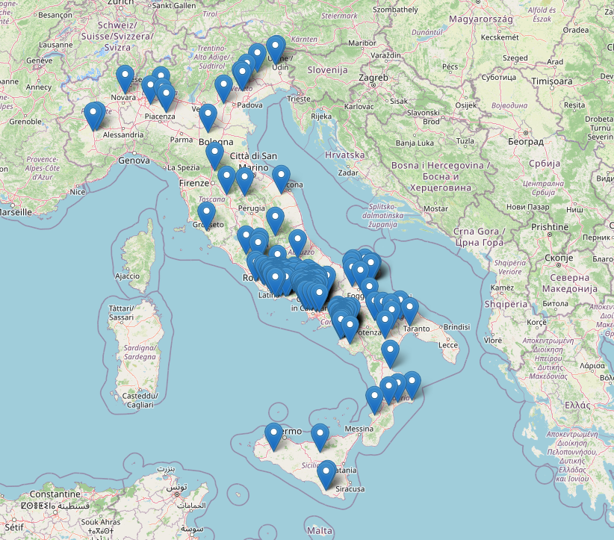
Dataset Overview & Base Variables
Farm Data
Total Number of Data : 329
Null values : 1 in Provinc

Slide 5
Calculated Variables (FeatureEngineering)

Slide 6
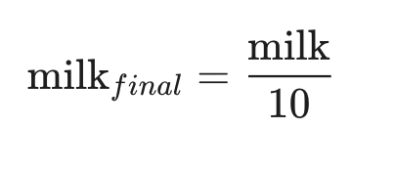
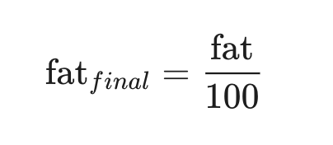
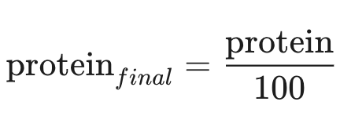
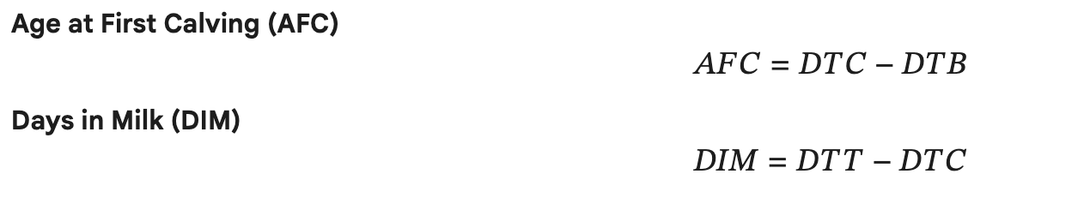
Feature Engineering
Scaled variables
New Variables
Date of Birth
Date of Calving
Date of Test

Slide 7
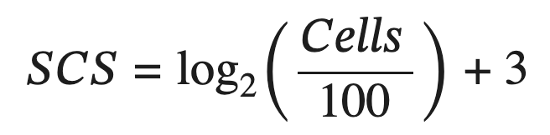
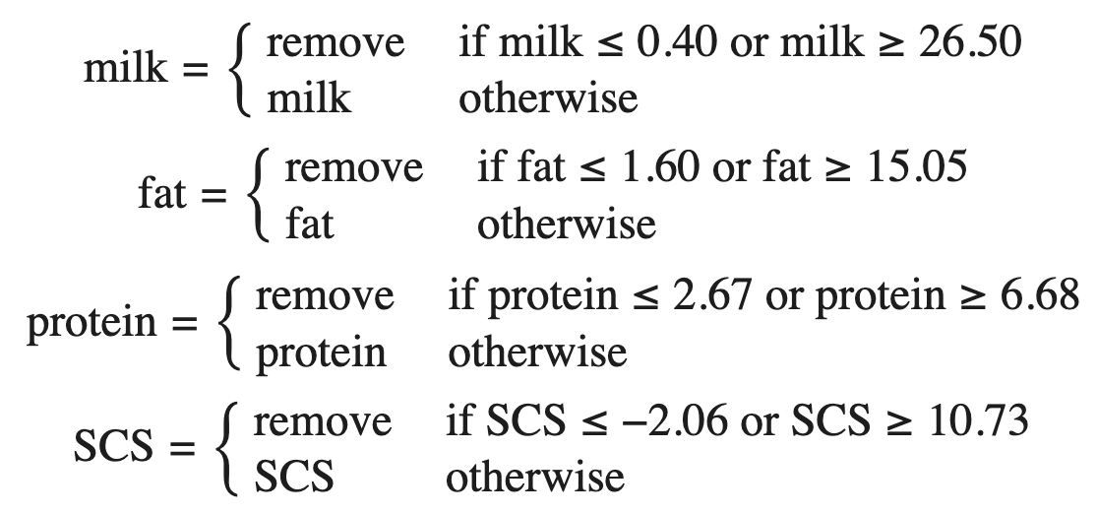
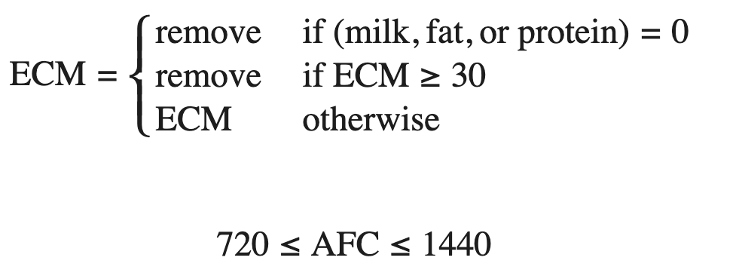


Feature Engineering
New Variables
Component Thresholds

Slide 8
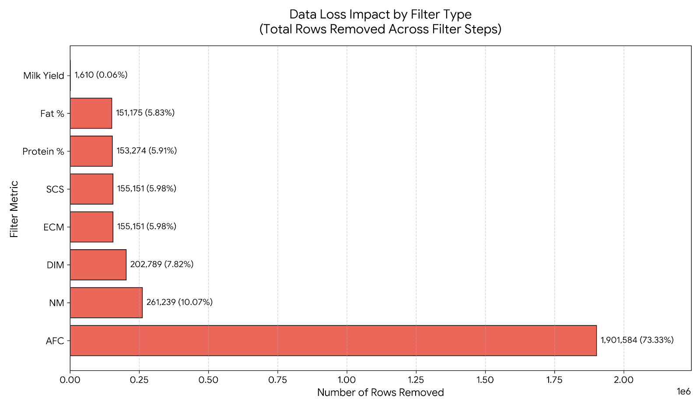
Data Loss Impact by Filter Type

Slide 9
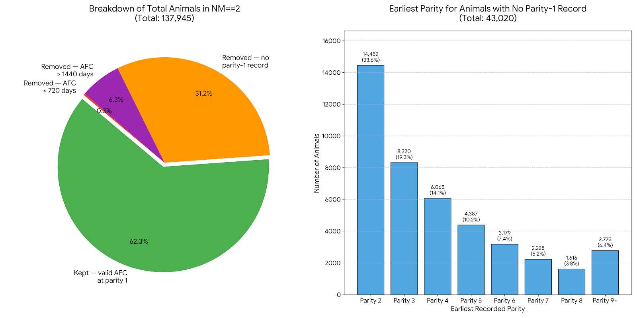
Adjusting AFC Filter
Correct Logic:
Look only at parity 1 rows
Filter AFC between 720–1440 days
collect those Animal_IDs
Keep all records (all parities) for those animals
Drop everyone else
Outcome:
Data Retained (62.3%):
Valid data at Parity 1
Data Removed (37.7%):
31.2% Missing Parity 1 records
6.5% fell outside ranges

Slide 10
Adjusting AFC Filter
Correct Logic:
Look only at parity 1 rows
Filter AFC between 720–1440 days
collect those Animal_IDs
Keep all records (all parities) for those animals
Drop everyone else
Outcome:
Data Retained (62.3%):
Valid data at Parity 1
Data Removed (37.7%):
31.2% Missing Parity 1 record
6.5% fell outside ranges

Slide 11
Adjusting AFC Filter
Correct Logic:
Look only at parity 1 rows
Filter AFC between 720–1440 days
collect those Animal_IDs
Keep all records (all parities) for those animals
Recover parity-2 starters via AFC estimation.
Drop everyone else
Outcome:
Data Retained (62.3%):
Valid data at Parity 1
Data Removed (37.7%):
31.2% Missing Parity 1 record
6.5% fell outside ranges

Slide 12
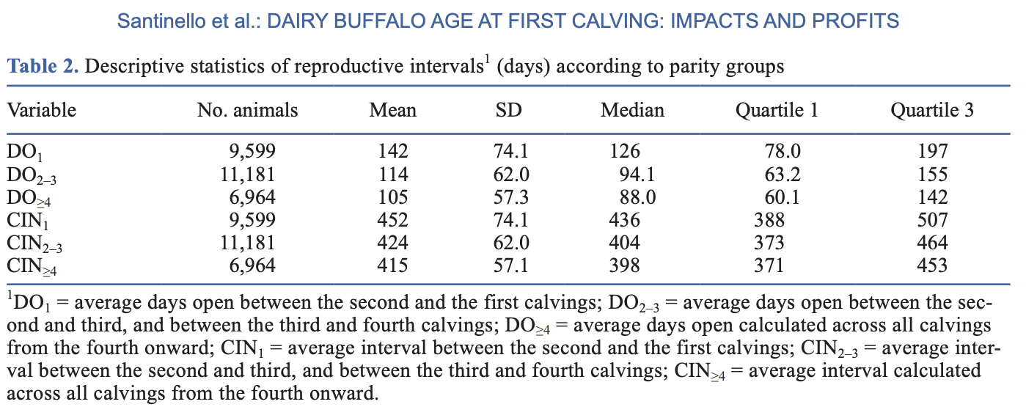
Recover parity-2 starters via AFC estimation.
AFC_estimated = AFC_at_parity_2 – Calving_Interval(CIN)
Filter AFC_estimated between 720–1440 days
M. Santinello, G. Neglia et al., "The cost of being early or late: Biological and economic outcomes of age at first calving in dairy buffaloes,” in J. Dairy Sci., vol. TBC, no. TBC, pp. TBC, 2025, doi: 10.3168/jds.2025-27467.
Outcome:
Data Retained (62.3%):
Valid data at Parity 1
Data Removed (37.7%):
31.2% Missing Parity 1 record
6.5% fell outside ranges

Slide 13
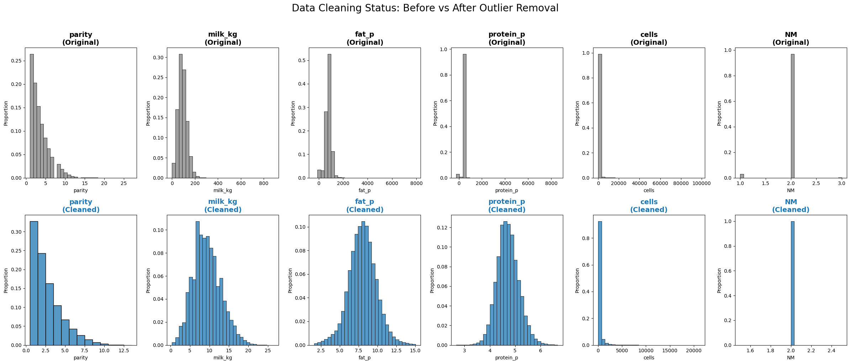
Dataset Overview & Base Variables

Slide 14
Weather Data

Slide 15
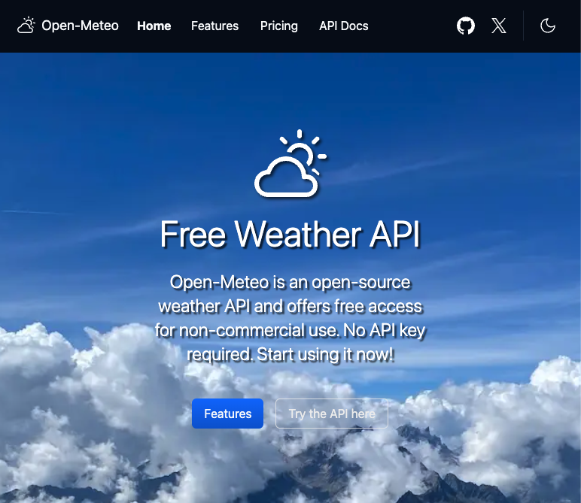
Weather Data
Open-Meteo weather API
Period : Hourly
Start Date : 2013-01-01
End Date : 2025-12-31
Location : 329 individual locations
Variables :
Temperature_2m
relative_humidity_2m
wind_speed_10m

Slide 16
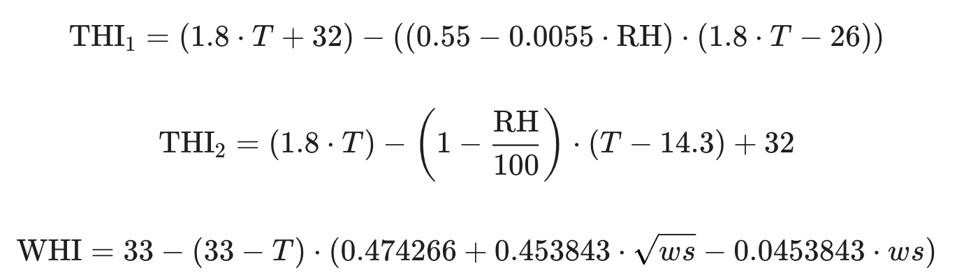
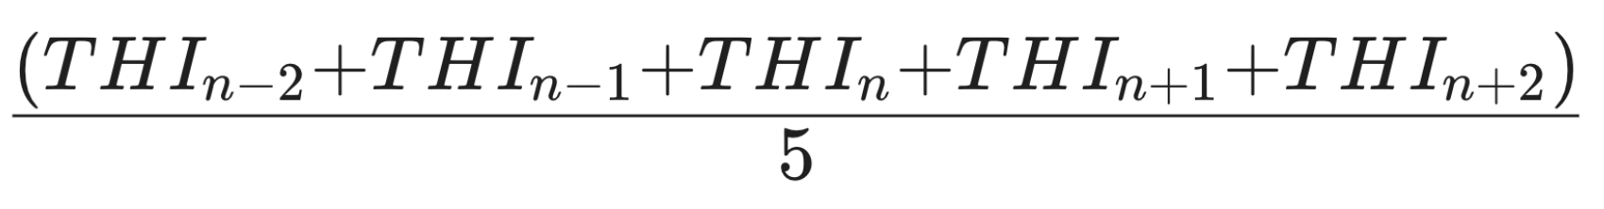
Additional Features
THI_1
THI_2
THI Composit =
WHI
Aggregate on THI_1, THI_2, WHI (min, max, average)
Lag Features on THI_1, THI_2, WHI, Temperature, Humidity, Wind(1-day, 2-day, 3-day)
Lag Features on Milk, Protein(1-record, 2-record)

Slide 17
Merged Data

Slide 18
Merged Data
ECM
SCS AFC
DIM
temperature_avg temperature_max temperature_min
humidity_avg
humidity_max humidity_min wind_speed_avg
wind_speed_max wind_speed_min THI_1_avg THI_1_min
THI_1_max THI_2_avg
THI_2_min THI_2_max WHI_avg WHI_min WHI_max
t_avg_lag1/2/3 h_avg_lag1/2/3 ws_avg_lag1/2/3 THI_1_avg_lag1/2/3 THI_2_avg_lag1/2/3
WHI_avg_lag1/2/3
THI_1_Compose
THI_2_Compose
Milk_kg_lag1/2
Protein_p_lag1/2
671,655 records
81,119 Animals
314 Farms
57 columns:
Farm_Code
Animal_ID
dtb dtc dtt parity milk_kg
fat_p protein_p cells NM

Slide 19
Hierarchical Structure

Slide 20
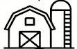

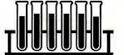
Our Case Representation in HTS
Level 0
TOTAL
Farm Level
Animal Level
Milk Level

Slide 21
What This Stage Does?
Outputs
Y_df
Three key outputs produced: Y_df, S_df, tags
All outputs saved to parquet / JSON for the forecasting stage
Long-format panel
all series × all dates
S_df
Summing matrix
n_series × n_bottom
Coherence
Check
tags
Level → series ID
dictionary
Raw Data
Monthly
Resample
Hierarchy
Construct
Visualise
df_monthly
Y_df · S_df · tags
Plot

Slide 22
What This Stage Does?
Outputs
Three key outputs produced: Y_df, S_df, tags
All outputs saved to parquet / JSON for the forecasting stage
Y_df
Long-format panel
all series × all dates
Farm_CODE Animal_ID dtt milk_kg
521513 IT003990057639 2013-06-04 6.8
521513 IT003990057639 2013-07-02 8.0
521513 IT003990057639 2013-09-03 7.8
521513 IT003990057639 2013-10-02 8.2
521513 IT003990057639 2013-11-04 5.2
S_df
Summing matrix
n_series × n_bottom
Raw Data
Coherence
Check
tags
Level → series ID
dictionary
Monthly
Resample
Hierarchy
Construct
Visualise
df_monthly
Y_df · S_df · tags
Plot

Slide 23
What This Stage Does?
Outputs
Three key outputs produced: Y_df, S_df, tags
All outputs saved to parquet / JSON for the forecasting stage
Y_df
Long-format panel
all series × all dates
Farm_CODE Animal_ID dtt milk_kg
521513 IT003990057639 2013-06-01 6.8
521513 IT003990057639 2013-07-01 8.0
521513 IT003990057639 2013-09-01 7.8
521513 IT003990057639 2013-10-01 8.2
521513 IT003990057639 2013-11-01 5.2
S_df
Monthly
Resample
Summing matrix
n_series × n_bottom
Coherence
Check
tags
Level → series ID
dictionary
Raw Data
Hierarchy
Construct
Visualise
Y_df · S_df · tags
Plot

Slide 24
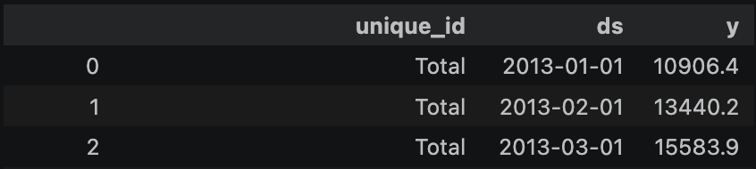
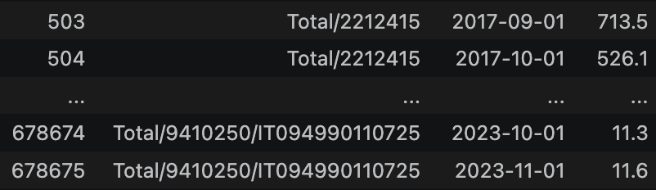
What This Stage Does?
Outputs
Three key outputs produced: Y_df, S_df, tags
All outputs saved to parquet / JSON for the forecasting stage
Y_df
Long-format panel
all series × all dates
Y_df
S_df
Hierarchy
Construct
Summing matrix
n_series × n_bottom
Coherence
Check
tags
Level → series ID
dictionary
Raw Data
Monthly
Resample
Hierarchy
Construct
Visualise
df_monthly
Y_df · S_df · tags
Plot

Slide 25
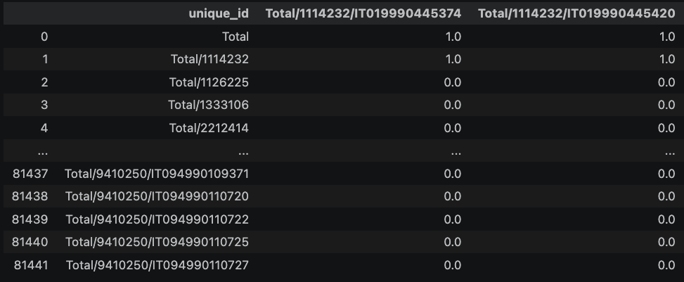

What This Stage Does?
Outputs
Three key outputs produced: Y_df, S_df, tags
All outputs saved to parquet / JSON for the forecasting stage
Y_df
Long-format panel
all series × all dates
S_df
S_df
Hierarchy
Construct
Summing matrix
n_series × n_bottom
Coherence
Check
tags
Level → series ID
dictionary
Raw Data
Monthly
Resample
Visualise
df_monthly
Plot

Slide 26
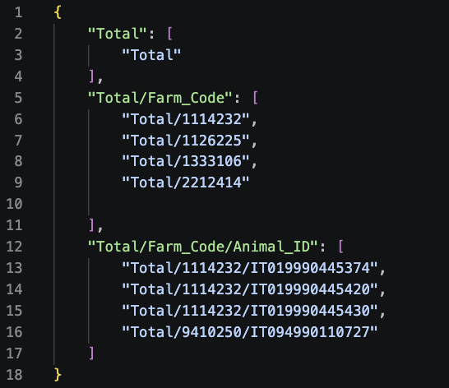
What This Stage Does?
Outputs
Three key outputs produced: Y_df, S_df, tags
All outputs saved to parquet / JSON for the forecasting stage
Y_df
Long-format panel
all series × all dates
Tags
S_df
Hierarchy
Construct
Summing matrix
n_series × n_bottom
Coherence
Check
tags
Level → series ID
dictionary
Raw Data
Monthly
Resample
Visualise
df_monthly
Plot

Slide 27
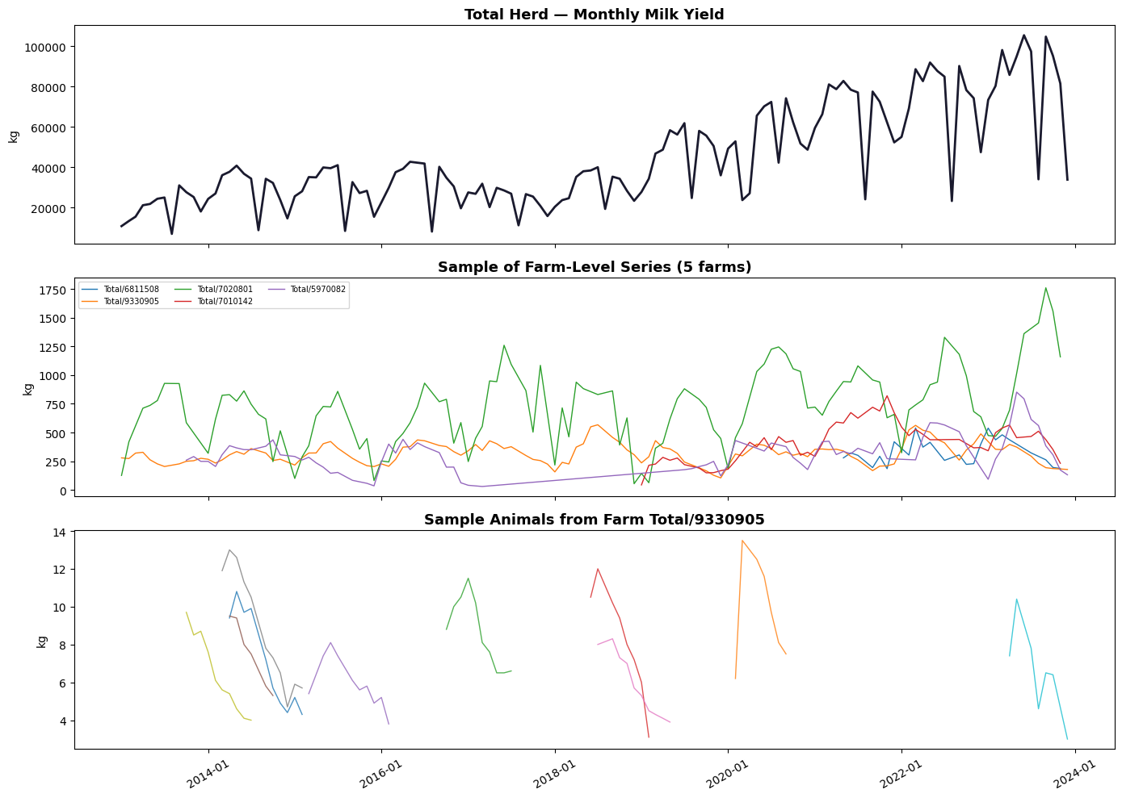
What This Stage Does?
Outputs
Three key outputs produced: Y_df, S_df, tags
All outputs saved to parquet / JSON for the forecasting stage
Y_df
Long-format panel
all series × all dates
S_df
Visualise
Summing matrix
n_series × n_bottom
Coherence
Check
tags
Level → series ID
dictionary
Raw Data
Monthly
Resample
Hierarchy
Construct
df_monthly
Y_df · S_df · tags

Slide 28
What This Stage Does?
Outputs
Three key outputs produced: Y_df, S_df, tags
All outputs saved to parquet / JSON for the forecasting stage
Y_df
Long-format panel
all series × all dates
S_df
Visualise
Summing matrix
n_series × n_bottom
Coherence
Check
tags
Level → series ID
dictionary
Raw Data
Monthly
Resample
Hierarchy
Construct
df_monthly
Y_df · S_df · tags

Slide 29
Correlation

Slide 30
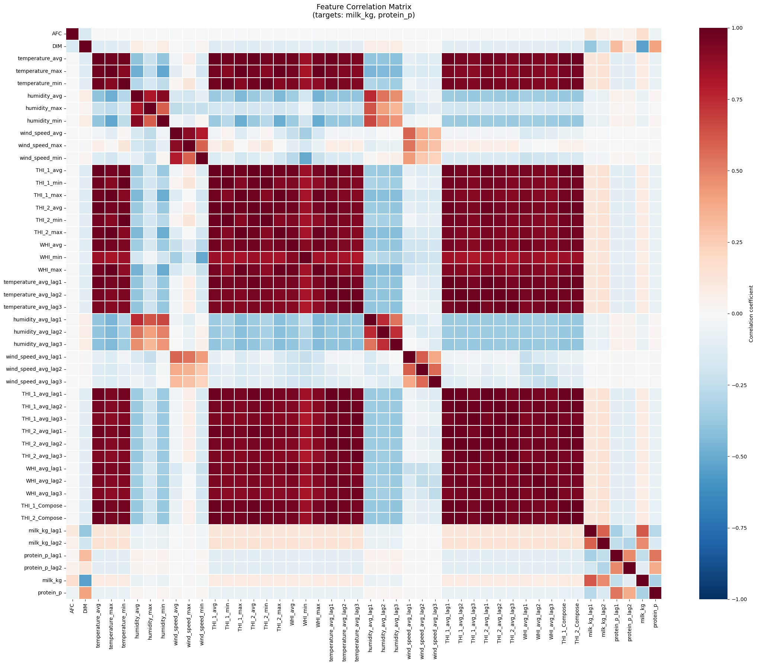
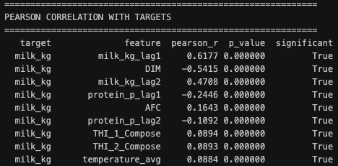
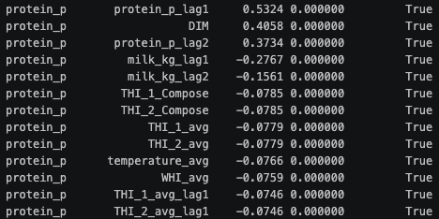
Correlation HeatMap

Slide 31
Correlation HeatMap

Slide 32
Predictive Analytics of Climate Stress Impact on the Italian Mediterranean Buffalo
Physiological and Productive Responses
Prof. Luca Barbierato
Prof. Matteo Santinello
Mohammad Sheikh
Department of Control and Computer Engineering
Dipartimento di Automatica e Informatica

