Slide 1

Predictive Analytics of Climate Stress Impact on the Italian Mediterranean Buffalo
Physiological and Productive Responses
Prof. Luca Barbierato
Prof. Matteo Santinello
Mohammad Sheikh
Department of Control and Computer Engineering
Dipartimento di Automatica e Informatica

Slide 2
Dataset Overview & Base Variables

Slide 3
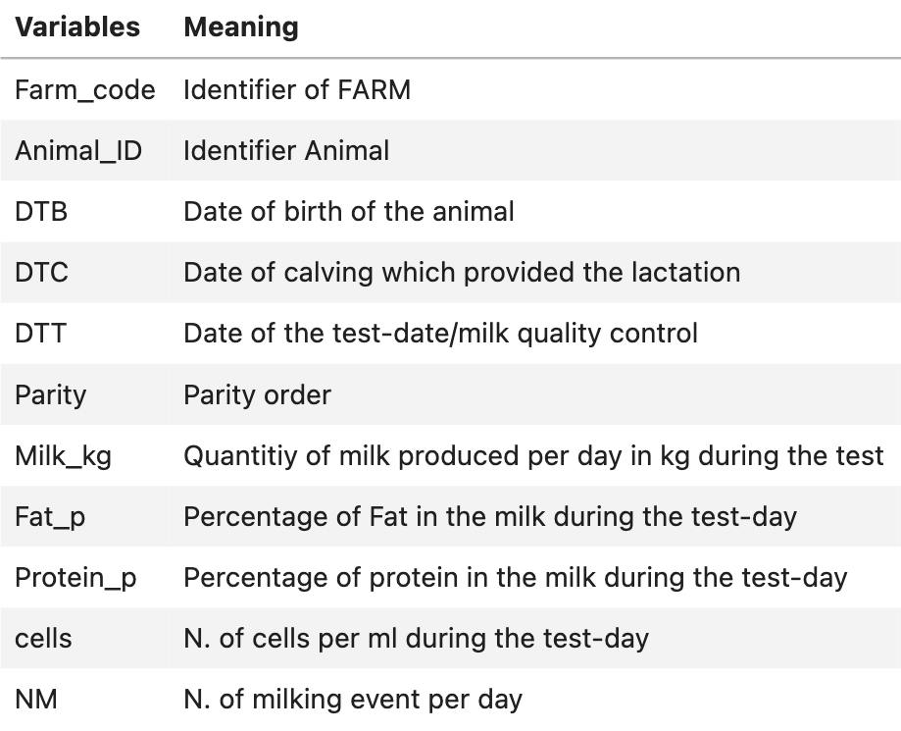
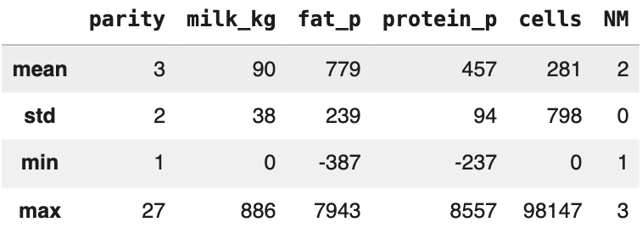
Dataset Overview & Base Variables
Animal Data
Total Number of Data : 2,593,267
Null values : 1873 in DTB
error values : 118,300 in All Variables
Descriptive statistics for numerical columns

Slide 4
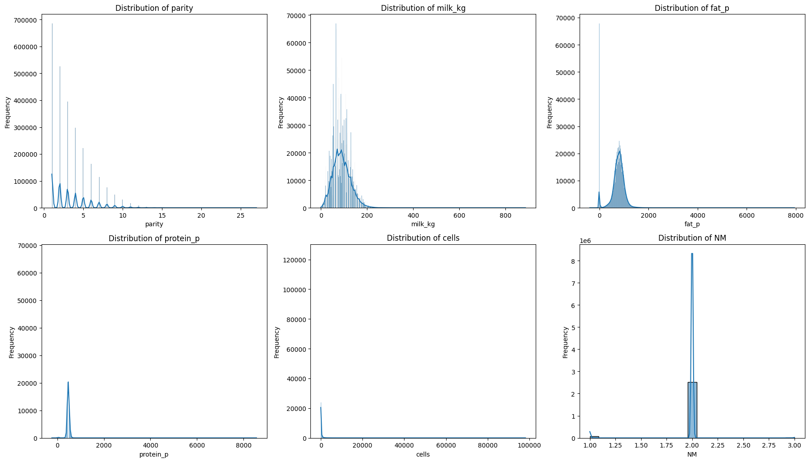
Dataset Overview & Base Variables
data visualizations for numerical columns. [Unprocessed]

Slide 5
Dataset Overview & Base Variables
data visualizations for numerical columns. [Unprocessed]

Slide 6
Dataset Overview & Base Variables
data visualizations for numerical columns. [Unprocessed]

Slide 7
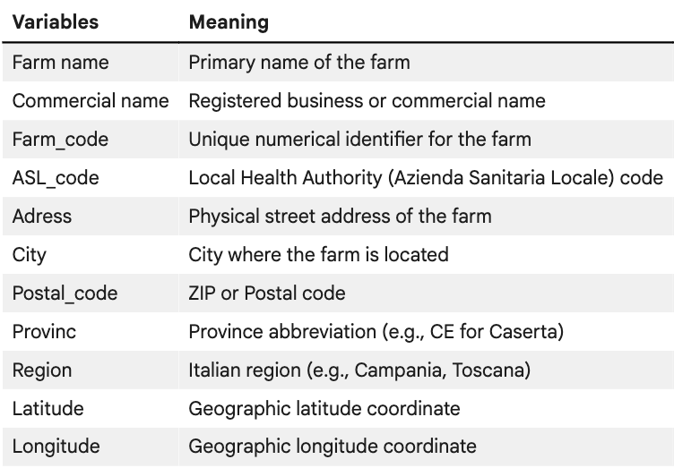
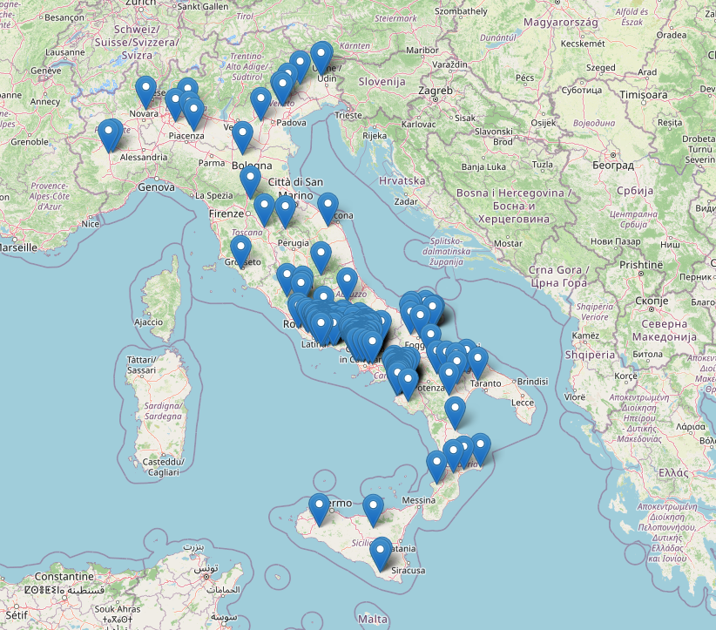
Dataset Overview & Base Variables
Farm Data
Total Number of Data : 329
Null values : 1 in Provinc

Slide 8
Calculated Variables (FeatureEngineering)

Slide 9
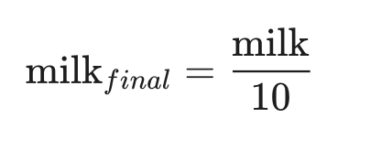
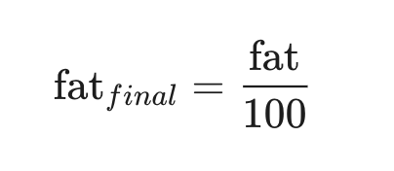
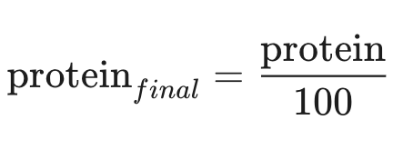
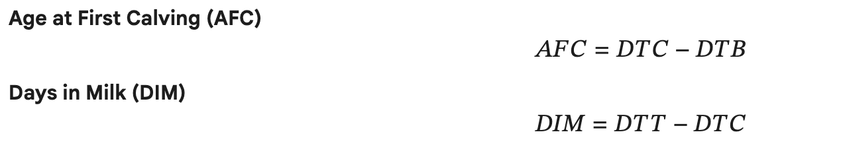
Feature Engineering
Scaled variables
New Variables
Date of Birth
Date of Calving
Date of Test

Slide 10
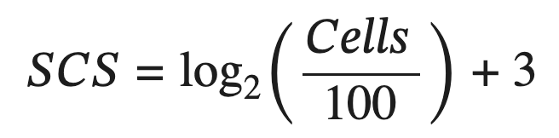
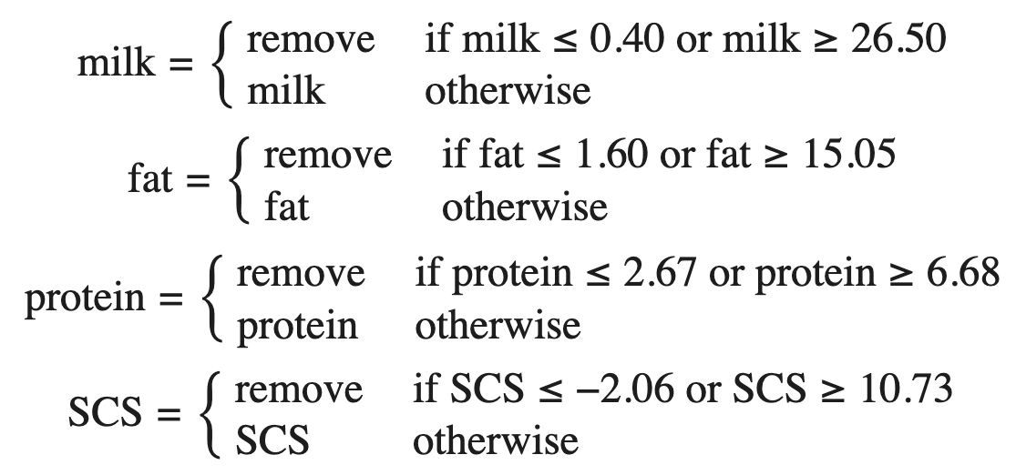
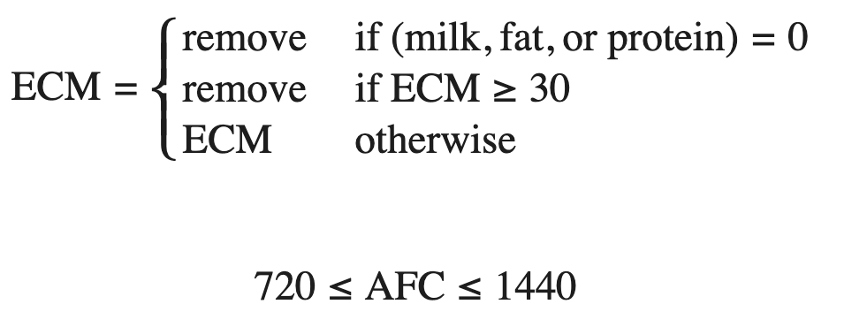
Feature Engineering
New Variables
Component Thresholds

Slide 11
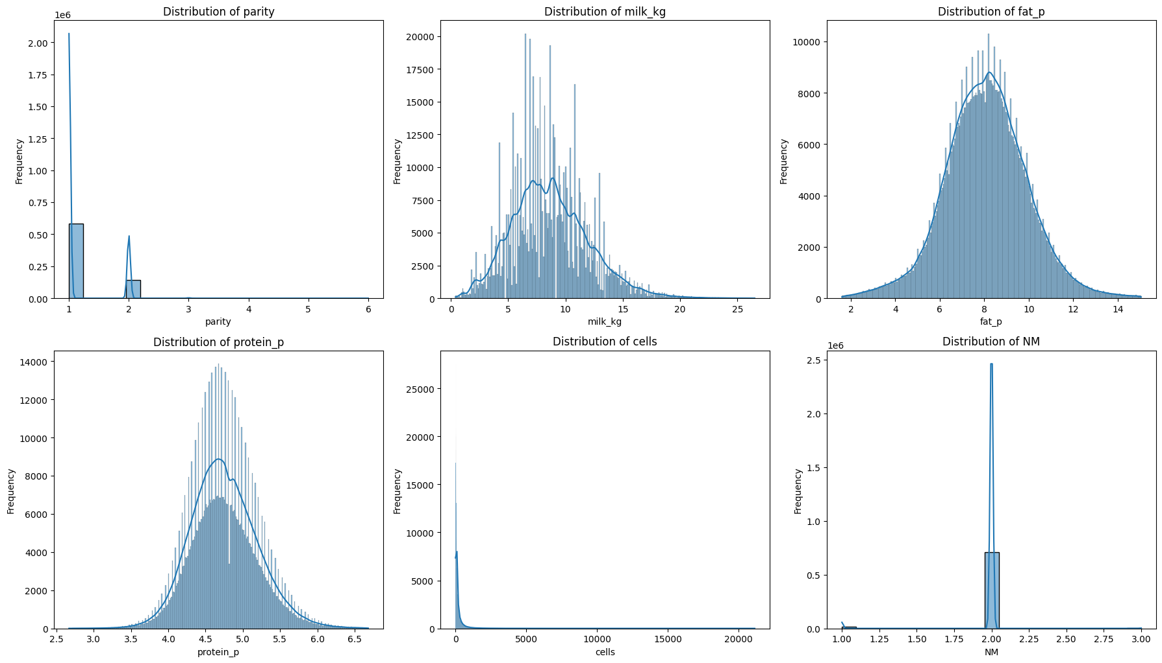
Dataset Overview & Base Variables
Base Data
After Removing outliers

Slide 12
Dataset Overview & Base Variables
Base Data
After Removing outliers

Slide 13
Weather Data

Slide 14
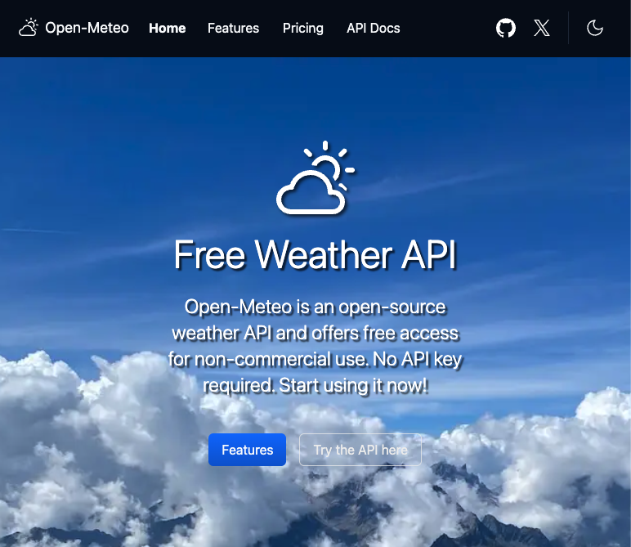
Weather Data
Open-Meteo weather API
Period : Hourly
Start Date : 2013-01-01
End Date : 2025-12-31
Location : 329 individual locations
Variables :
Temperature_2m
relative_humidity_2m
wind_speed_10m

Slide 15
Merged Data

Slide 16
Merged Data
2,593,267 rows
33 columns:
Farm_Code
Animal_ID
dtb dtc dtt parity milk_kg
fat_p protein_p cells NM
ECM
SCS AFC
DIM
temperature_avg temperature_max temperature_min
humidity_avg
humidity_max humidity_min wind_speed_avg
wind_speed_max wind_speed_min THI_1_avg THI_1_min THI_1_max THI_2_avg
THI_2_min THI_2_max WHI_avg WHI_min WHI_max

Slide 17
Predictive Analytics of Climate Stress Impact on the Italian Mediterranean Buffalo
Physiological and Productive Responses
Prof. Luca Barbierato
Prof. Matteo Santinello
Mohammad Sheikh
Department of Control and Computer Engineering
Dipartimento di Automatica e Informatica

