Slide 1

Predictive Analytics of Climate Stress Impact on the Italian Mediterranean Buffalo
Physiological and Productive Responses
Prof. Luca Barbierato
Prof. Matteo Santinello
Mohammad Sheikh
Department of Control and Computer Engineering
Dipartimento di Automatica e Informatica

Slide 2
Milk predictions of buffalo
….
mohammad.sheikh@studenti.polito.it
Predictive Analytics of Climate Stress Impact on the Italian Mediterranean Buffalo

Slide 3
Precision livestock farming (PLF)
Why: increasing demand for animal-derived foods requires enhancement in increasing efficiency of farms and production.
How: PLF represents a valuable strategy to tackle challenges in this area. PLF, uses digital technologies like sensors, IoT, AI, and data analytics to monitor and manage individual animals.
Gap: While PLF technologies have been extensively adopted for pigs, poultry, and dairy cattle, there is a scarcity of research regarding buffalo-specific PLF applications.
G. Neglia, M. Santinello, et al "Precision livestock farming in buffalo species: a sustainable approach for the future," in Revista Científica de la Facultad de Ciencias Veterinarias, 2023, doi: 10.52973/rcfcv-wbc019.
mohammad.sheikh@studenti.polito.it
Predictive Analytics of Climate Stress Impact on the Italian Mediterranean Buffalo

Slide 4
Heat Stress is affecting …
Diseases
Sweating
Blood flow to skin
heart and respiration rate
milk production
feed intake
performance.
Bernabucci, et al. “Metabolic and Hormonal Acclimation to Heat Stress in Domesticated Ruminants.” in Animal 2010, 4, 1167–1183, doi : 10.1017/S175173111000090X
mohammad.sheikh@studenti.polito.it
Predictive Analytics of Climate Stress Impact on the Italian Mediterranean Buffalo

Slide 5
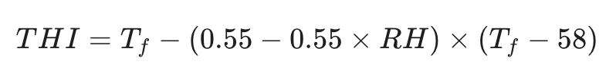
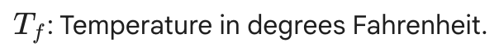
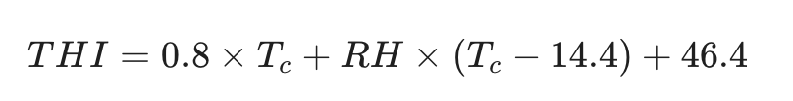
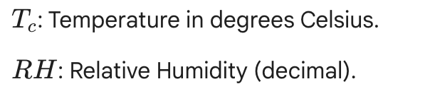
Temperature-Humidity Index (THI)
A temperature-humidity index (THI) is a single value representing the combined effects of air temperature and humidity associated with the level of thermal stress.
Normally THI is Based on Temperature in Fahrenheit.
Bohmanova, J, et al. “Temperature-humidity indices as indicators of milk production losses due to heat stress.” in Journal of Dairy Science, 90(4), 1947–1956. doi: 10.3168/jds.2006-513
mohammad.sheikh@studenti.polito.it
Predictive Analytics of Climate Stress Impact on the Italian Mediterranean Buffalo

Slide 6
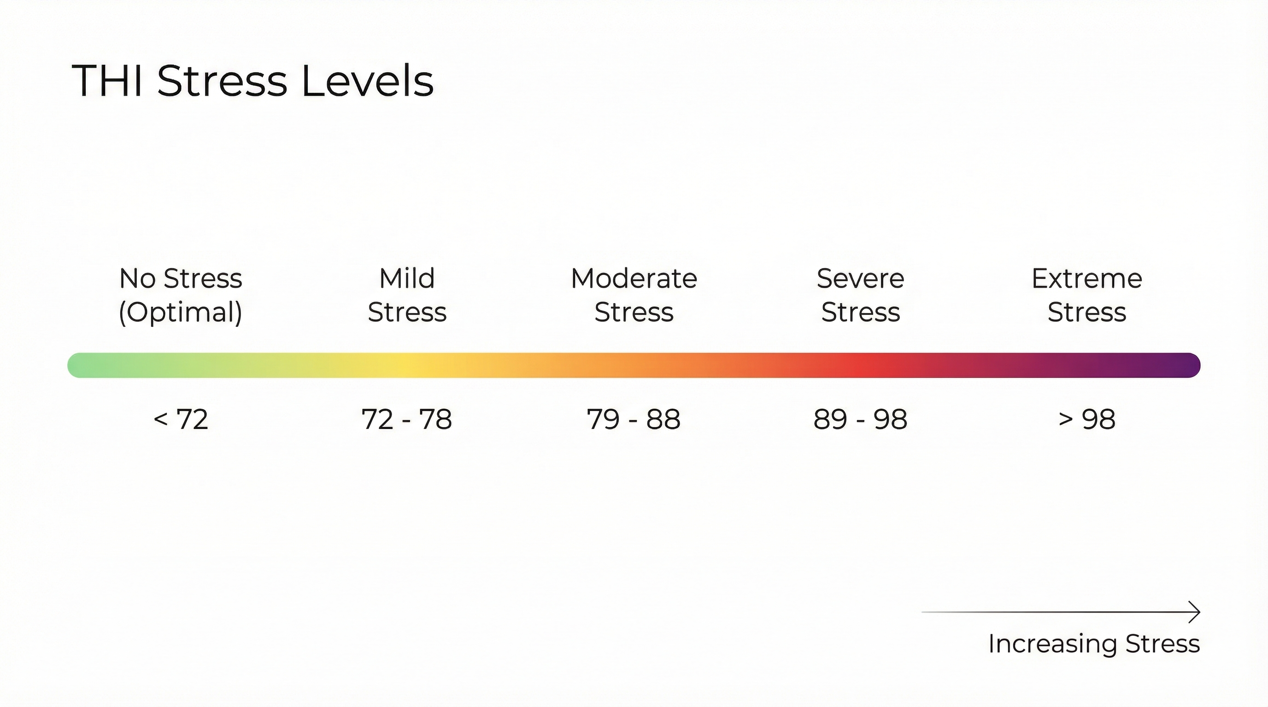
THI refers to be an important KPI in milk production.
V. L. de Araujo et al, "Responses of dairy buffalo to heat stress conditions and mitigation strategies: A review," in Animals, vol. 14, no. 5, Art. no. 731, Feb. 2024, doi: 10.3390/ani13071260
S. Dash, et al, "Effect of heat stress on reproductive performances of dairy cattle and buffaloes: A review," in Veterinary World, vol. 9, no. 3, pp. 235–244, Mar. 2016, doi: 10.14202/vetworld.2016.235-244.

Slide 7
Studies on Milk Prediction
An effective way to incorporate temperature–humidity index to study effect of heat stress on milk yield by an XGBoost machine learning model ,by Hassan, 2025
Development of individual models for predicting cow milk production for real-time monitoring, by Song, 2025
A machine learning framework to predict the next month's daily milk yield, milk composition and milking frequency for cows in a robotic dairy farm, by Ji,2022

Slide 8
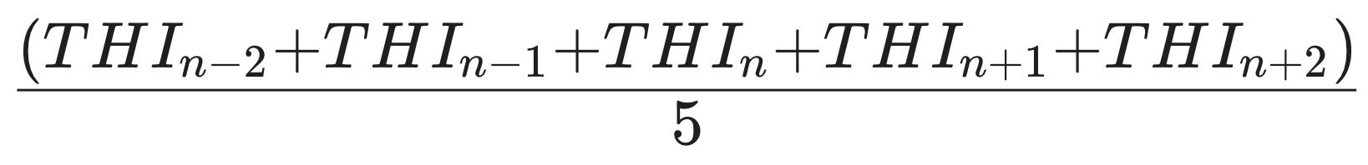
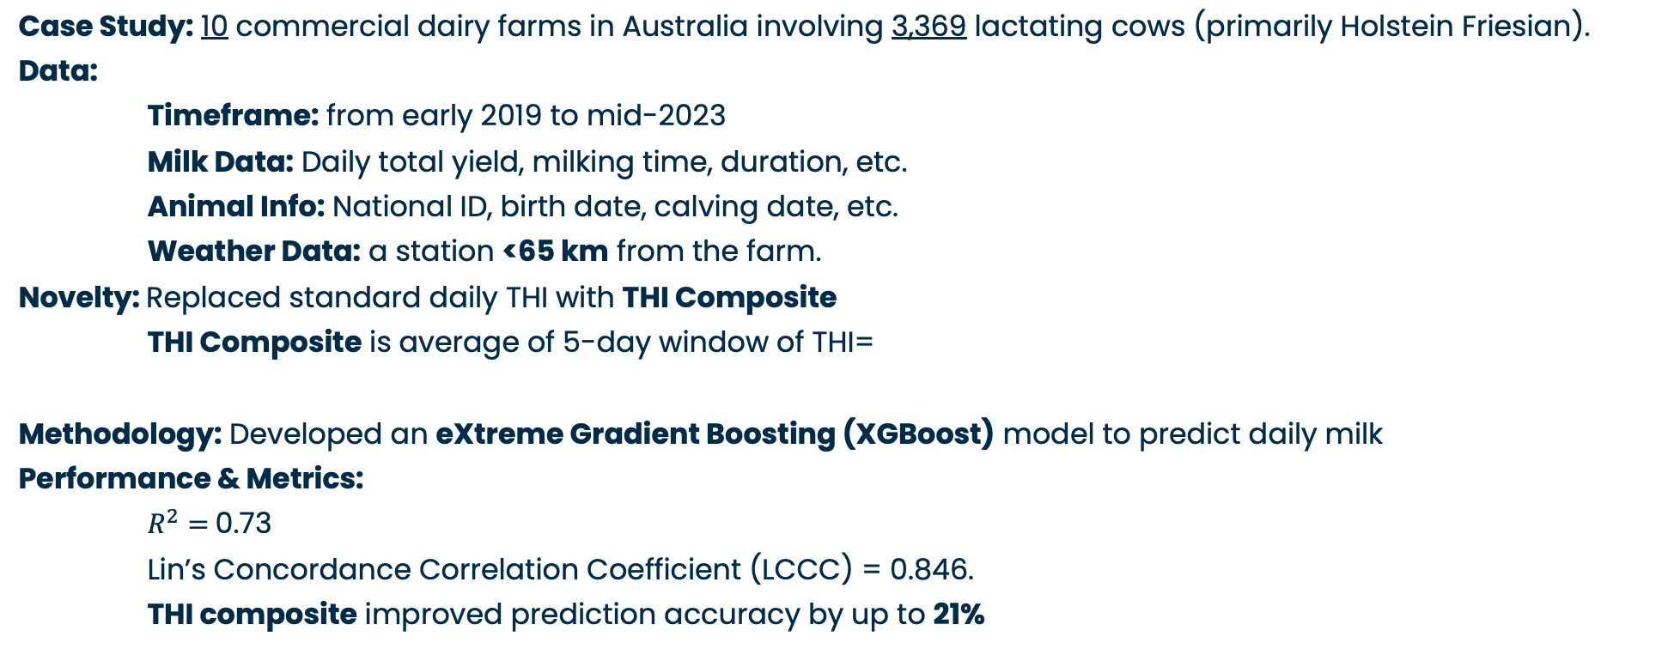
Effect of HS on cow milk yield by Hassan, 2025
Case Study: 10 commercial dairy farms in Australia involving 3,369 lactating cows (primarily Holstein Friesian).
Data:
Timeframe: from early 2019 to mid-2023
Milk Data: Daily total yield, milking time, duration, etc.
Animal Info: National ID, birth date, calving date, etc.
Weather Data: a station <65 km from the farm.
Novelty: Replaced standard daily THI with THI Composite
THI Composite is average of 5-day window of THI=
Methodology: Developed an eXtreme Gradient Boosting (XGBoost) model to predict daily milk
Performance & Metrics:
$R^{2}=$0.73
Lin’s Concordance Correlation Coefficient (LCCC) = 0.846.
THI composite improved prediction accuracy by up to 21%
M. F. Hasan, et al "An effective way to incorporate temperature–humidity index to study effect of heat stress on milk yield by an XGBoost machine learning model," in Journal of Dairy Science, vol. 108, no. 12, 2025, doi: 10.3168/jds.2025-27193.

Slide 9
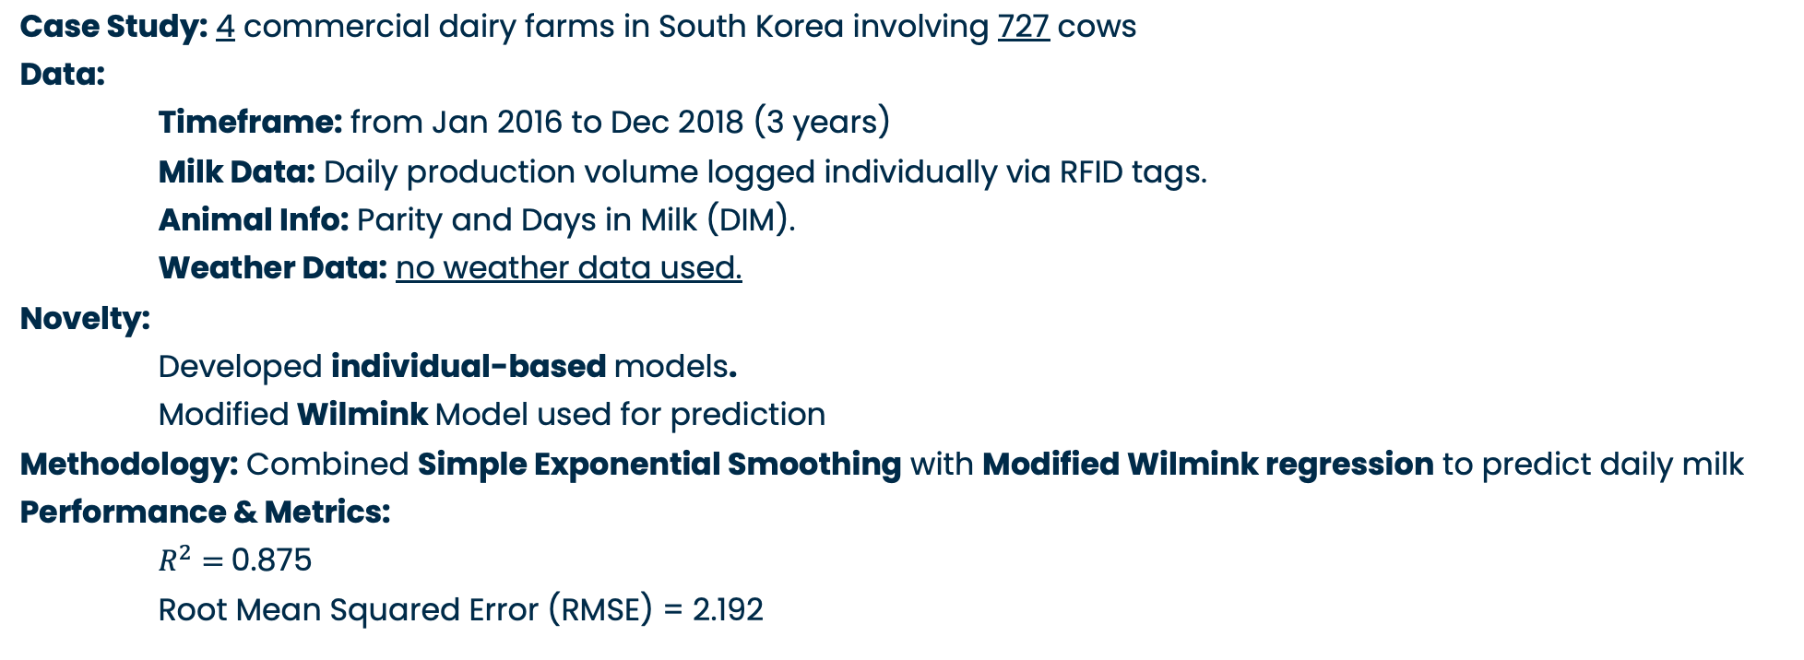
individual models for predicting cow milk production in Korea, by Song,2025
Case Study: 4 commercial dairy farms in South Korea involving 727 cows
Data:
Timeframe: from Jan 2016 to Dec 2018 (3 years)
Milk Data: Daily production volume logged individually via RFID tags.
Animal Info: Parity and Days in Milk (DIM).
Weather Data: no weather data used.
Novelty:
Developed individual-based models.
Modified Wilmink Model used for prediction
Methodology: Combined Simple Exponential Smoothing with Modified Wilmink regression to predict daily milk
Performance & Metrics:
$R^{2}=$0.875
Root Mean Squared Error (RMSE) = 2.192
J.-W. Song, et al "Development of individual models for predicting cow milk production for real-time monitoring," in Computers and Electronics in Agriculture, vol. 228, Art. no. 109698, Jan. 2025, doi: 10.1016/j.compag.2024.109698.

Slide 10
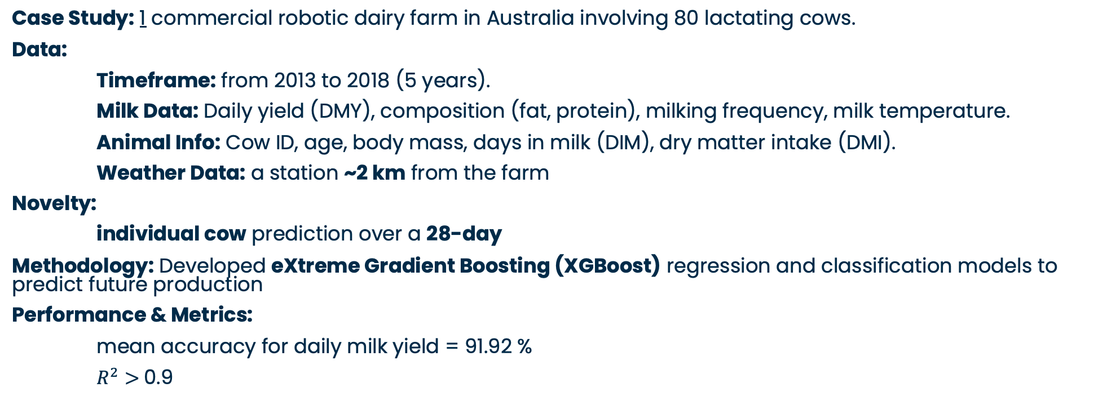
predict the next month's daily cow milk yield in Australia by Ji,2022
Case Study: 1 commercial robotic dairy farm in Australia involving 80 lactating cows.
Data:
Timeframe: from 2013 to 2018 (5 years).
Milk Data: Daily yield (DMY), composition (fat, protein), milking frequency, milk temperature.
Animal Info: Cow ID, age, body mass, days in milk (DIM), dry matter intake (DMI).
Weather Data: a station ~2 km from the farm
Novelty:
individual cow prediction over a 28-day
Methodology: Developed eXtreme Gradient Boosting (XGBoost) regression and classification models to predict future production
Performance & Metrics:
mean accuracy for daily milk yield = 91.92 %
$R^{2}>$0.9
B. Ji et al., "A machine learning framework to predict the next month's daily milk yield, milk composition and milking frequency for cows in a robotic dairy farm," in Biosyst. Eng., vol. 216, pp. 186–197, Apr. 2022, doi: 10.1016/j.biosystemseng.2022.02.013.

Slide 11
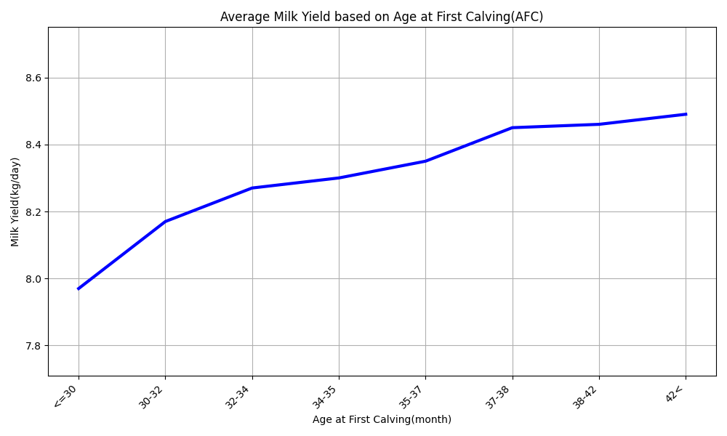
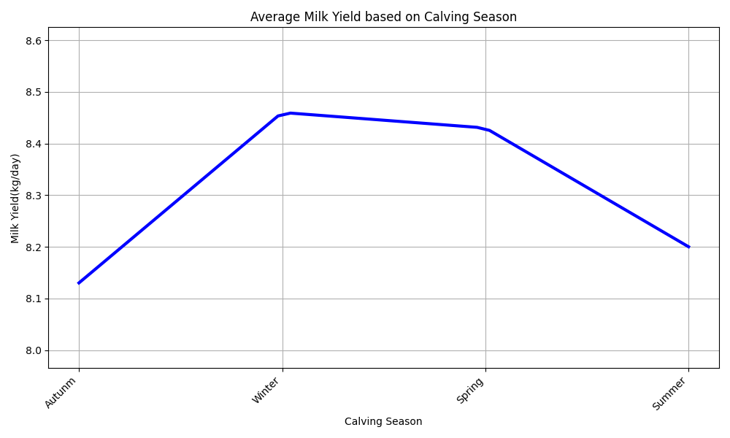
Effect of Calving on Milk Yield
A higher age at first calving is associated with an increased average daily milk yield.
Average daily milk yield is significantly influenced by the calving season, with peak production observed during the winter and spring months.
M. Santinello, G. Neglia, et al., "The role of age at first calving in shaping production and reproductive outcomes in Italian buffaloes," in J. Dairy Sci., vol. 108, no. 7, pp. 7235–7247, Jul. 2025, doi: 10.3168/jds.2025-26369.

Slide 12
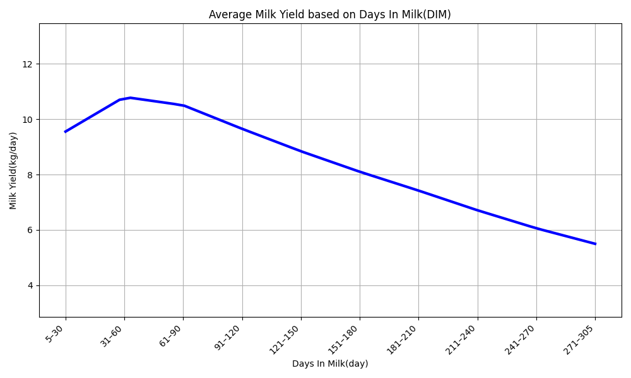
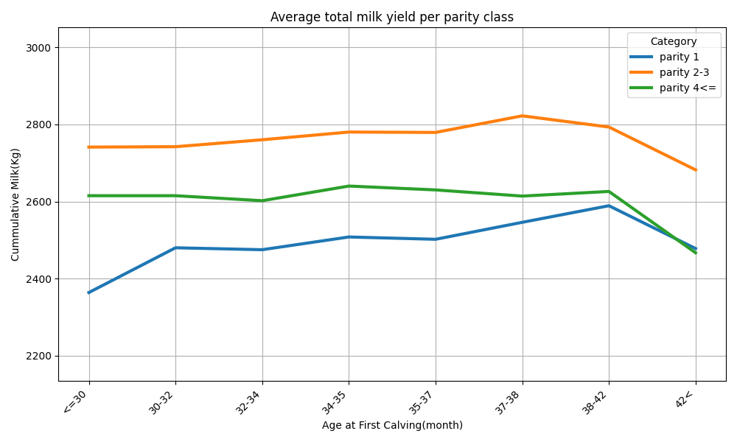
Effect of Days in Milk and Parity on Milk Yield
Daily milk output peaks roughly one to two months after calving and then steadily decreases.
Cumulative milk yield is highest in their second and third parities, regardless of their age at first calving.
M. Santinello, G. Neglia et al., "The cost of being early or late: Biological and economic outcomes of age at first calving in dairy buffaloes,” in J. Dairy Sci., vol. TBC, no. TBC, pp. TBC, 2025, doi: 10.3168/jds.2025-27467.
M. Santinello, G. Neglia, et al., "The role of age at first calving in shaping production and reproductive outcomes in Italian buffaloes," in J. Dairy Sci., vol. 108, no. 7, pp. 7235–7247, Jul. 2025, doi: 10.3168/jds.2025-26369.

Slide 13
Predict Subclinical Mastitis in Italian Buffaloes
: flowchart
Case Study: 6 herds in Southern Italy involving 1,038 Mediterranean buffaloes.
Data:
Timeframe: from August 2019 to February 2021.
Milk Data: Monthly test-day yield, composition (fat, protein, etc.), SCC, DSCC, etc.
Animal Info: Parity, stage of lactation (DIM), calving date.
Weather Data: NASA POWER daily averages (Temp, Humidity, UV, etc.).
Methodology: Compared GLM, SVM, Random Forest, and Neural Network models.
Performance & Metrics:
Best Model: Neural Network (NN) using Animal ID split*.
Accuracy = 76.2%.
Area Under Curve (AUC) = 84.0%.
* To prevent overfitting, two approaches used for splitting data, first splitting by records, second splitting by animal id
G. Neglia et al., "Exploiting machine learning methods with monthly routine milk recording data and climatic information to predict subclinical mastitis in Italian Mediterranean buffaloes," in J. Dairy Sci., vol. 106, no. 3, pp. 1942–1952, Mar. 2023, doi: 10.3168/jds.2022-22292.

Slide 14
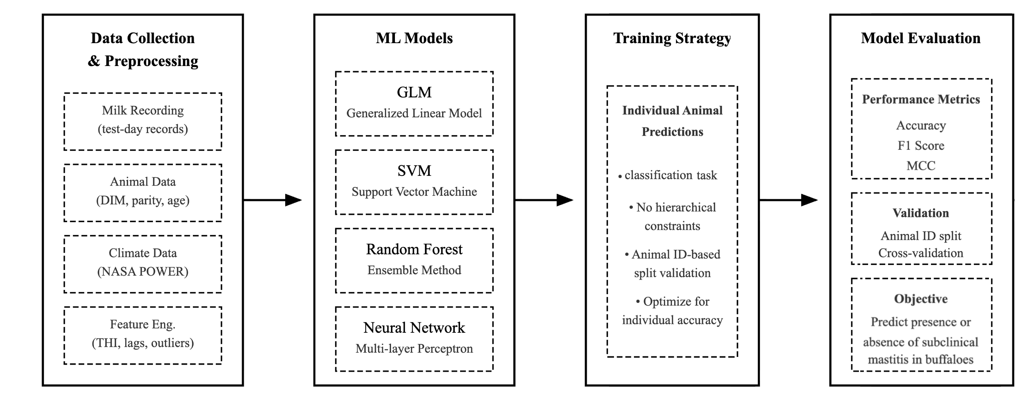
Predict Subclinical Mastitis in Italian Buffaloes
: flowchart
G. Neglia et al., "Exploiting machine learning methods with monthly routine milk recording data and climatic information to predict subclinical mastitis in Italian Mediterranean buffaloes," in J. Dairy Sci., vol. 106, no. 3, pp. 1942–1952, Mar. 2023, doi: 10.3168/jds.2022-22292.

Slide 15
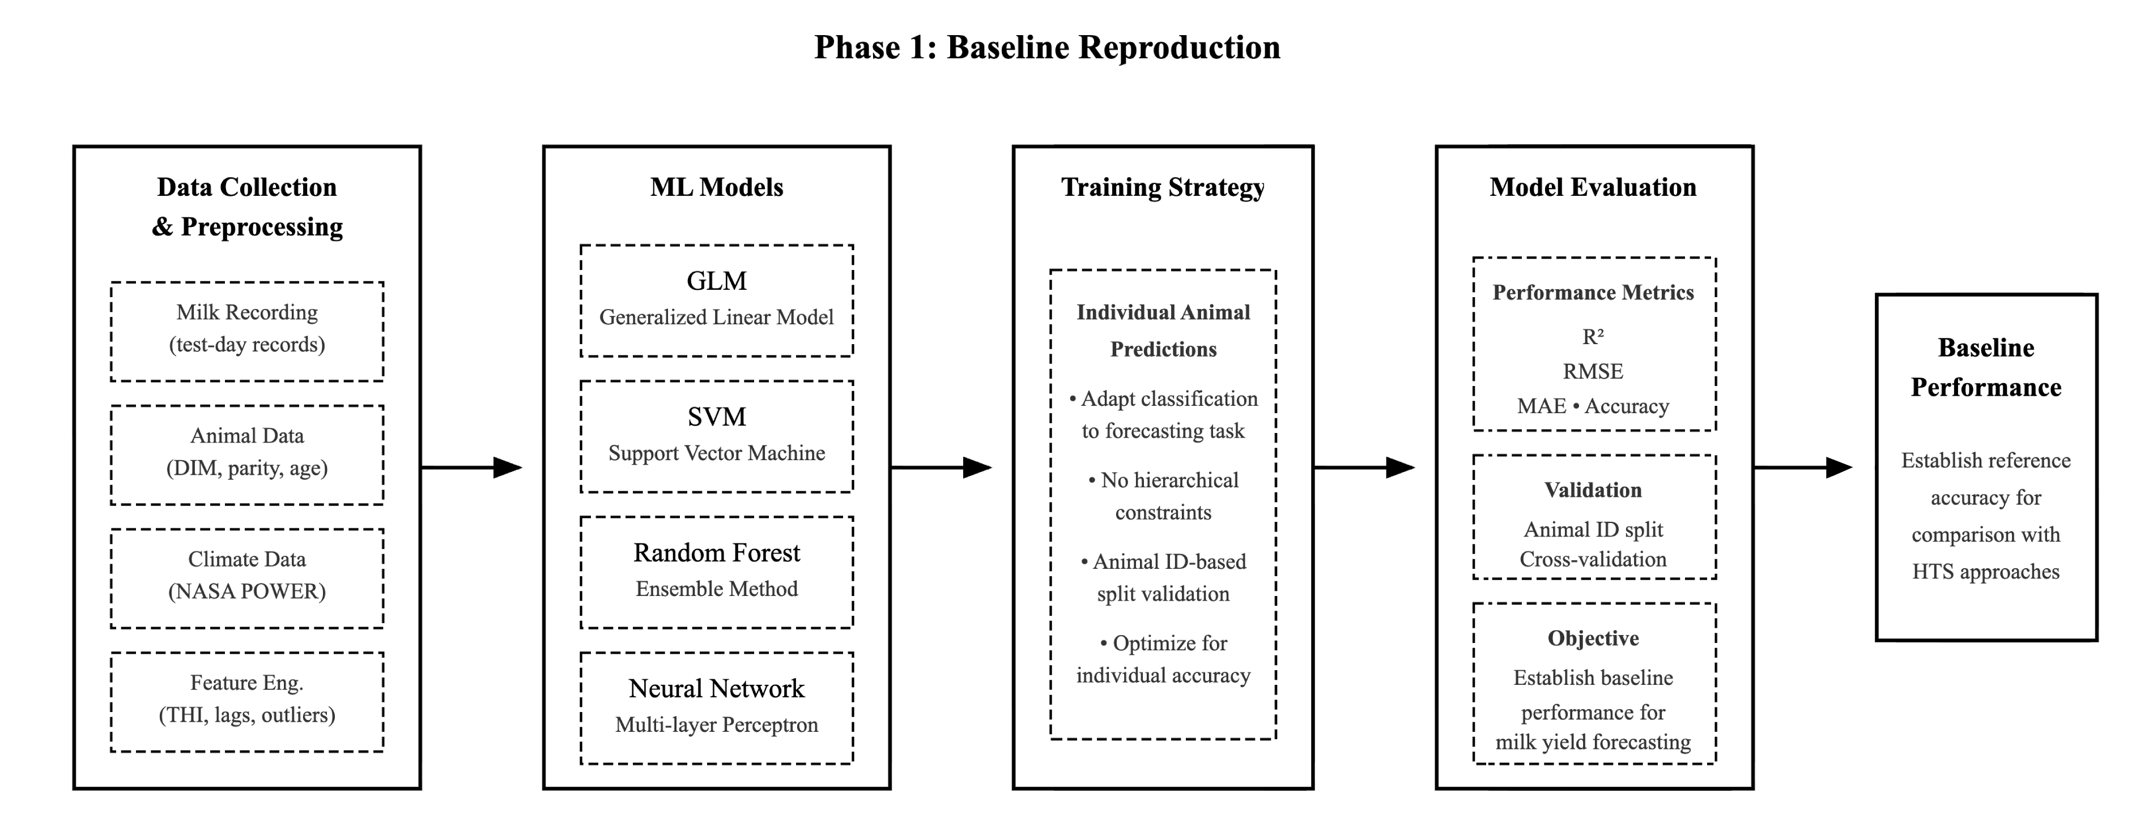
Overview on Project, Phase 1: Baseline Reproduction

Slide 16
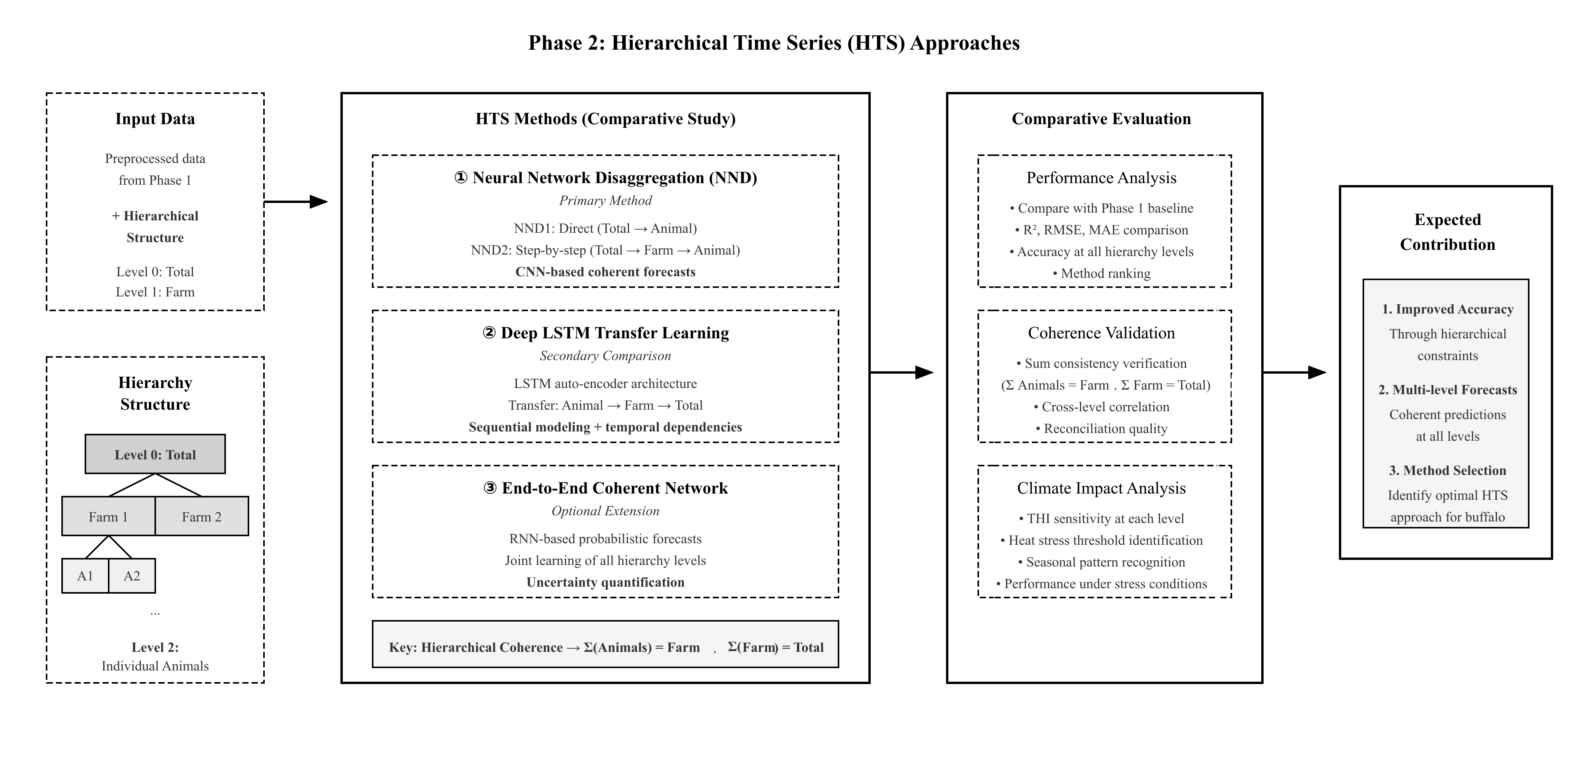
Overview on Project, Phase 2: Hierarchical Timeseries Approach

Slide 17
Literature Review

Slide 18
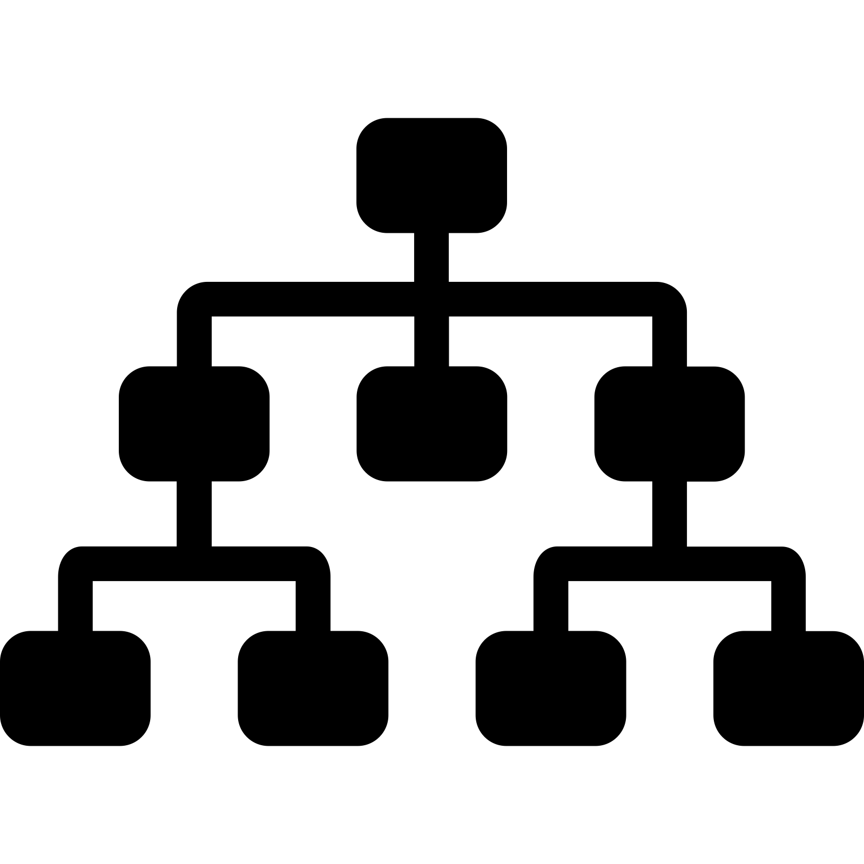
Hierarchy in time series (HTS)
Hierarchical time series, organize time series data in a nested structure where higher-level series aggregate naturally from lower-level series.
Each level represents a meaningful grouping dimension.
Natural Aggregation: Top-level totals equal the sum of all bottom-level series.
Multiple Levels: Data can be viewed at different levels (country → farm → animal level)
Data can be aggregated or disaggregated based on:
Types
Features
geographic division.
R. J. Hyndman and G. Athanasopoulos, Forecasting: Principles and Practice, 3rd ed. Melbourne, Australia: OTexts, 2021. [Online]. Available: https://otexts.com/fpp3/

Slide 19

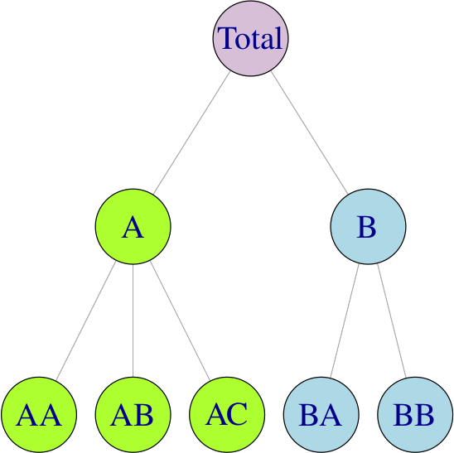
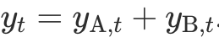


Hierarchy in time series (HTS)
The value of parent is always equals to the sum of the values of its child nodes.
So, if equals The value of j at time t,
then, we have :
Finally, we can say our data
is Coherent.
R. J. Hyndman and G. Athanasopoulos, Forecasting: Principles and Practice, 3rd ed. Melbourne, Australia: OTexts, 2021. [Online]. Available: https://otexts.com/fpp3/

Slide 20
Applications on HTS
Tourism
Forecasting number of tourists going to visit a country divided by region, city, season.
supply chain
Forecasting sales of products based on type, location.
Energy Consumption
Forecasting energy consumption based on region, city, hour.
R. J. Hyndman and G. Athanasopoulos, Forecasting: Principles and Practice, 3rd ed. Melbourne, Australia: OTexts, 2021. [Online]. Available: https://otexts.com/fpp3/
O. Omri, et al., "On the inventory performance of hierarchical forecasting approaches: case of a vaccine supply chain," J. Oper. Res. Soc., Oct. 2025, doi: 10.1080/01605682.2025.2566323.
M. Kim, et al.,"Beginner-friendly review of research on R-based energy forecasting: Insights from text mining," in Electronics, vol. 14, no. 17, Art. no. 3513, Sep. 2025, doi: 10.3390/electronics14173513.

Slide 21
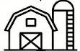

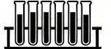
Our Case Representation in HTS
Level 0
TOTAL
Farm Level
Animal Level
Milk Level

Slide 22
Our Case Representation in HTS
Milk Level
Animal_ID | Farm_ID | Date | Age | MILK | DIM | Protein | Fat | SCC
1001 | 102 | 25-01-01 | 4 | 20 Kg | 154 | 10% | 12% | 200K/mm
1004 | 103 | 25-01-01 | 6 | 35 Kg | 114 | 10% | 12% | 200K/mm
1003 | 102 | 25-01-01 | 5 | 15 Kg | 204 | 10% | 12% | 200K/mm
1002 | 103 | 25-01-02 | 7 | 30 Kg | 94 | 10% | 12% | 200K/mm
1003 | 102 | 25-01-02 | 5 | 20 Kg | 204 | 10% | 12% | 200K/mm
1001 | 102 | 25-01-02 | 4 | 25 Kg | 155 | 10% | 12% | 200K/mm
1004 | 103 | 25-01-02 | 4 | 35 Kg | 115 | 10% | 12% | 200K/mm
1002 | 103 | 25-01-01 | 7 | 15 Kg | 93 | 10% | 12% | 200K/mm

Slide 23
Our Case Representation in HTS
Milk Level
Animal_ID | Farm_ID | Date | Age | MILK | DIM | Protein | Fat | SCC
1001 | 102 | 25-01-01 | 4 | 20 Kg | 154 | 10% | 12% | 200K/mm
1004 | 103 | 25-01-01 | 6 | 35 Kg | 114 | 10% | 12% | 200K/mm
1003 | 102 | 25-01-01 | 5 | 15 Kg | 204 | 10% | 12% | 200K/mm
1002 | 103 | 25-01-02 | 7 | 30 Kg | 94 | 10% | 12% | 200K/mm
1003 | 102 | 25-01-02 | 5 | 20 Kg | 204 | 10% | 12% | 200K/mm
1001 | 102 | 25-01-02 | 4 | 25 Kg | 155 | 10% | 12% | 200K/mm
1004 | 103 | 25-01-02 | 4 | 35 Kg | 115 | 10% | 12% | 200K/mm
1002 | 103 | 25-01-01 | 7 | 15 Kg | 93 | 10% | 12% | 200K/mm

Slide 24
Our Case Representation in HTS
Animal Level
Animal_ID | Farm_ID | Date | Age | MILK | DIM | Protein | Fat | SCC
1001 | 102 | 25-01-01 | 4 | 20 Kg | 154 | 10% | 12% | 200K/mm
Animal 1001
1001 | 102 | 25-01-02 | 4 | 25 Kg | 155 | 10% | 12% | 200K/mm
1002 | 103 | 25-01-02 | 7 | 30 Kg | 94 | 10% | 12% | 200K/mm
Animal 1002
1002 | 103 | 25-01-01 | 7 | 15 Kg | 93 | 10% | 12% | 200K/mm
1003 | 102 | 25-01-02 | 5 | 20 Kg | 204 | 10% | 12% | 200K/mm
Animal 1003
1003 | 102 | 25-01-01 | 5 | 15 Kg | 204 | 10% | 12% | 200K/mm
1004 | 103 | 25-01-02 | 4 | 35 Kg | 115 | 10% | 12% | 200K/mm
Animal 1004
1004 | 103 | 25-01-01 | 6 | 35 Kg | 114 | 10% | 12% | 200K/mm

Slide 25
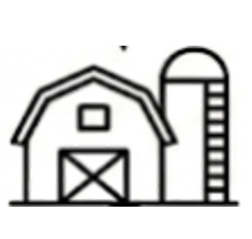
Our Case Representation in HTS
Farm Level
Animal_ID | Farm_ID | Date | Age | MILK | DIM | Protein | Fat | SCC
1001 | 102 | 25-01-01 | 4 | 20 Kg | 154 | 10% | 12% | 200K/mm
1001 | 102 | 25-01-02 | 4 | 25 Kg | 155 | 10% | 12% | 200K/mm
Farm 102
1003 | 102 | 25-01-02 | 5 | 20 Kg | 204 | 10% | 12% | 200K/mm
1003 | 102 | 25-01-01 | 5 | 15 Kg | 204 | 10% | 12% | 200K/mm
1002 | 103 | 25-01-02 | 7 | 30 Kg | 94 | 10% | 12% | 200K/mm
1002 | 103 | 25-01-01 | 7 | 15 Kg | 93 | 10% | 12% | 200K/mm
Farm 103
1004 | 103 | 25-01-02 | 4 | 35 Kg | 115 | 10% | 12% | 200K/mm
1004 | 103 | 25-01-01 | 6 | 35 Kg | 114 | 10% | 12% | 200K/mm

Slide 26
Traditional Approaches of Implementation: Top Down
Forecast
TOTAL
2/3
1/3
3/8
5/8
2/5
3/5
1/3
2/3
2/5
3/5
1/3
2/3
1/2
1/2
R. J. Hyndman et al, "Optimal combination forecasts for hierarchical time series," in Comput. Stat. Data Anal., vol. 55, no. 9, pp. 2579–2589, Sep. 2011, doi: 10.1016/j.csda.2011.03.006.
Notes:
There are 2 related studies one in Korea and another in Australia in recent year used individual model for their prediction.
Also, there is another study that compared global and individual models for timeseries forecasting and the result was LGBM and RNN are out-performed the other models even compared with individual models.

Slide 27
Traditional Approaches of Implementation: Bottom Up
TOTAL
+
+
+
Forecast
R. J. Hyndman et al, "Optimal combination forecasts for hierarchical time series," in Comput. Stat. Data Anal., vol. 55, no. 9, pp. 2579–2589, Sep. 2011, doi: 10.1016/j.csda.2011.03.006.
Notes:
There are 2 related studies one in Korea and another in Australia in recent year used individual model for their prediction.
Also, there is another study that compared global and individual models for timeseries forecasting and the result was LGBM and RNN are out-performed the other models even compared with individual models.

Slide 28
Traditional Approaches of Implementation: Optimal Combination
Forecast
TOTAL
Forecast
Forecast
S. L. Wickramasuriya, et al., "Optimal forecast reconciliation for hierarchical and grouped time series through trace minimization,” in J. Amer. Stat. Assoc., vol. 114, no. 526, pp. 804–819, 2019, doi: 10.1080/01621459.2018.1448825.
Notes:
There are 2 related studies one in Korea and another in Australia in recent year used individual model for their prediction.
Also, there is another study that compared global and individual models for timeseries forecasting and the result was LGBM and RNN are out-performed the other models even compared with individual models.

Slide 29
The Problem in Traditional Approaches
The Problem: When you forecast each level independently, the predictions don't add up correctly.
Farm 102 prediction = 50
Farm 103 prediction = 55
Total prediction = 100
Farm 102 prediction + Farm 103 prediction ≠ Total prediction
TOTAL
102
103
The Solution: Reconciliation is the way to tackle this problem. Reconciliation process of adjusting forecasts across all hierarchical levels to ensure they are mathematically coherent.
MinT : Is one of the methods for reconciliation, minimizes the variance between reconciled values and base forecast error.
S. L. Wickramasuriya, et al., "Optimal forecast reconciliation for hierarchical and grouped time series through trace minimization,” in J. Amer. Stat. Assoc., vol. 114, no. 526, pp. 804–819, 2019, doi: 10.1080/01621459.2018.1448825.
Notes:
There are 2 related studies one in Korea and another in Australia in recent year used individual model for their prediction.
Also, there is another study that compared global and individual models for timeseries forecasting and the result was LGBM and RNN are out-performed the other models even compared with individual models.

Slide 30
Literature Methodology on prediction of HTS

Slide 31
Conditional Hierarchical Forecasting by M. Abolghasemi,
Objective: The goal of this approach is to recognize which hierarchical forecasting (HF) method works best given specific data characteristics.
Methodology:
Offline Phase
Labeling.
Training Classifier.
Online Phase
Predict the best method for new data.
Forecast future with selected method.
M. Abolghasemi, et al, "Model selection in reconciling hierarchical time series," in Mach. Learn., vol. 111, pp. 739–789, Feb. 2022, doi: 10.1007/s10994-021-06126-z.

Slide 32
Conditional Hierarchical Forecasting by M. Abolghasemi,
Methodology:
Offline Phase
Labeling.
Training Classifier.
Online Phase
Predict the best method for new data.
Forecast future with selected method.
The goal of this phase is to train a machine learning model (classifier) to recognize which hierarchical forecasting (HF) method works best given specific data characteristics.
M. Abolghasemi, et al, "Model selection in reconciling hierarchical time series," in Mach. Learn., vol. 111, pp. 739–789, Feb. 2022, doi: 10.1007/s10994-021-06126-z.

Slide 33
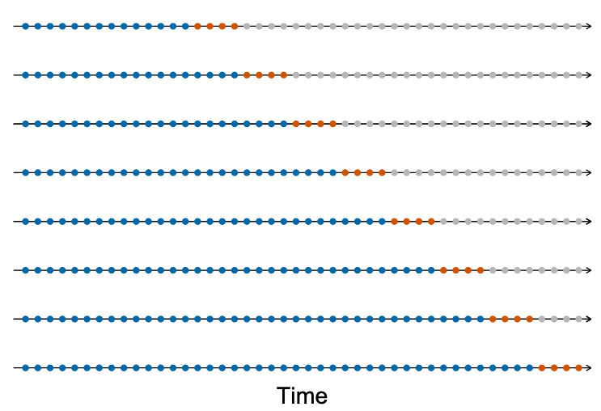
Conditional Hierarchical Forecasting by M. Abolghasemi,
Methodology:
Offline Phase
Labeling.
Training Classifier.
Online Phase
Predict the best method for new data.
Forecast future with selected method.
Rolling Origin
Sample 1
Sample 2
Sample 3
Sample 4
Sample 5
Sample 6
Sample 7
Sample 8
M. Abolghasemi, et al, "Model selection in reconciling hierarchical time series," in Mach. Learn., vol. 111, pp. 739–789, Feb. 2022, doi: 10.1007/s10994-021-06126-z.

Slide 34
Conditional Hierarchical Forecasting by M. Abolghasemi,
Methodology:
Offline Phase
Labeling.
Training Classifier.
Online Phase
Predict the best method for new data.
Forecast future with selected method.
Parallel Paths
1- Feature Extraction
Algorithm extracts features (Trend, entropy, seasonality, etc.) from each Sample and keep it for the next phase.
2- Performance Evaluation
The system generates base forecasts using various standard methods (like Bottom-Up, Top-Down, or Minimum Trace). Then, Calculate the accuracy of each method and identify the Winner as Label for corresponding Sample
Output
Now, we have some new data for training a classifier to recognize which method works best given time series.
M. Abolghasemi, et al, "Model selection in reconciling hierarchical time series," in Mach. Learn., vol. 111, pp. 739–789, Feb. 2022, doi: 10.1007/s10994-021-06126-z.

Slide 35
Conditional Hierarchical Forecasting by M. Abolghasemi,
Methodology:
Offline Phase
Labeling.
Training Classifier.
Online Phase
Predict the best method for new data.
Forecast future with selected method.
Training the Classifier:
The features (inputs) and the most accurate HF method (labels) are combined into a classification training set.
A classification model (such as XGBoost) is trained to learn the relationship between the time series features and the best performing method .
M. Abolghasemi, et al, "Model selection in reconciling hierarchical time series," in Mach. Learn., vol. 111, pp. 739–789, Feb. 2022, doi: 10.1007/s10994-021-06126-z.

Slide 36
Conditional Hierarchical Forecasting by M. Abolghasemi,
Methodology:
Offline Phase
Labeling.
Training Classifier.
Online Phase
Predict the best method for new data.
Forecast future with selected method.
Predict the best method for new data.
As new data comes in, the algorithm computes the same time series features.
Then, model analyzes these features and predicts/selects which HF method is most likely to be the most accurate for the current data .
M. Abolghasemi, et al, "Model selection in reconciling hierarchical time series," in Mach. Learn., vol. 111, pp. 739–789, Feb. 2022, doi: 10.1007/s10994-021-06126-z.

Slide 37
Conditional Hierarchical Forecasting by M. Abolghasemi,
Methodology:
Offline Phase
Labeling.
Training Classifier.
Online Phase
Predict the best method for new data.
Forecast future with selected method.
Final Forecasting
The system produces base forecasts and reconciles them using only the specific HF method selected by the classifier .
M. Abolghasemi, et al, "Model selection in reconciling hierarchical time series," in Mach. Learn., vol. 111, pp. 739–789, Feb. 2022, doi: 10.1007/s10994-021-06126-z.

Slide 38
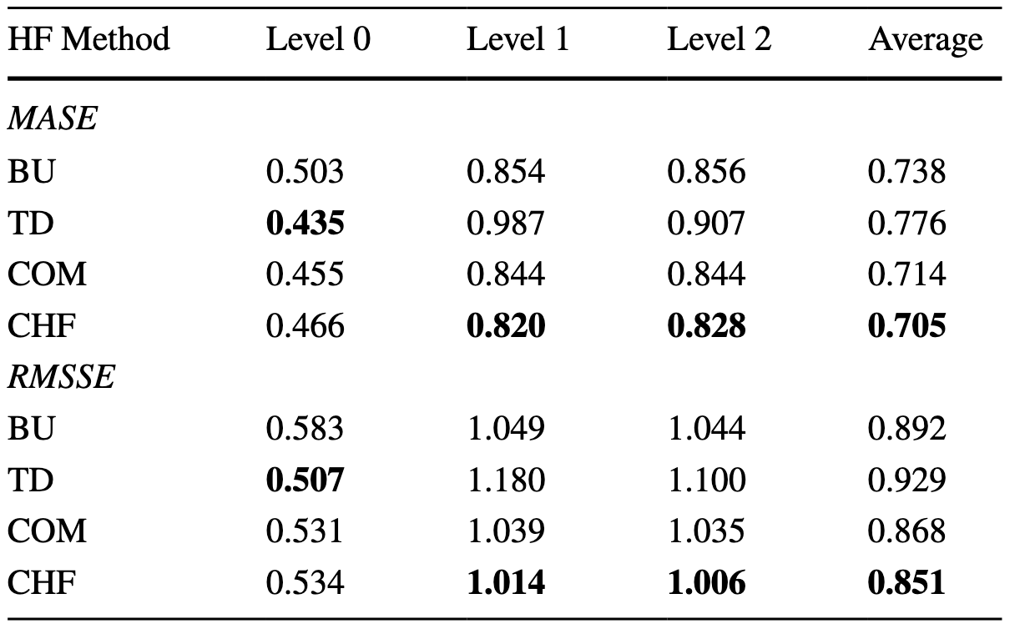
Conditional Hierarchical Forecasting by M. Abolghasemi,
Results
M. Abolghasemi, et al, "Model selection in reconciling hierarchical time series," in Mach. Learn., vol. 111, pp. 739–789, Feb. 2022, doi: 10.1007/s10994-021-06126-z.

Slide 39
Conditional Hierarchical Forecasting by M. Abolghasemi,
Application to Buffalo Milk Prediction
Expected result: Adaptive method selection based on data characteristics (seasonality, DIM patterns, farm-specific trends).
Comparison to Baseline: automatically choosing best reconciliation approach for different time periods/conditions.
New insight: Understanding which forecasting methods work best under different climate stress scenarios.
M. Abolghasemi, et al, "Model selection in reconciling hierarchical time series," in Mach. Learn., vol. 111, pp. 739–789, Feb. 2022, doi: 10.1007/s10994-021-06126-z.

Slide 40
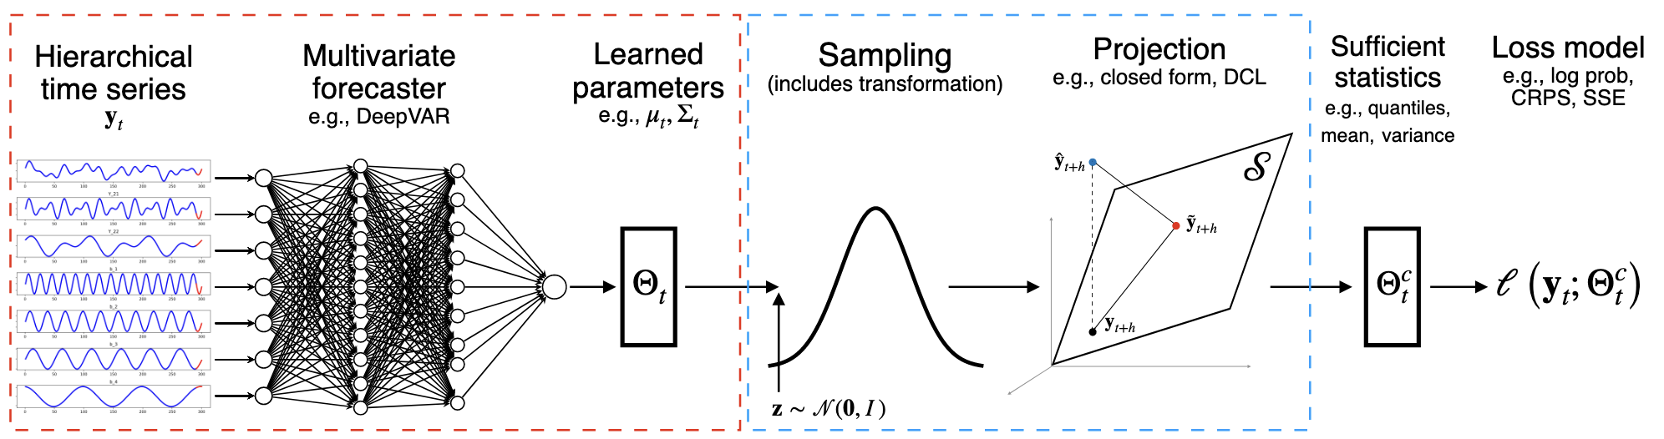
End-to-End Learning of Coherent Probabilistic, by S. Rangapuram
Objective: Learn a single neural network that produces probabilistic forecasts for all levels of a hierarchical time series that are guaranteed to be coherent without any post-processing.
S. Rangapuram, et al., "End-to-end learning of coherent probabilistic forecasts for hierarchical time series," 2021. [Online]. Available: https://www.amazon.science/publications/end-to-end-learning-of-coherent-probabilistic-forecasts-for-hierarchical-time-series

Slide 41
End-to-End Learning of Coherent Probabilistic, by S. Rangapuram
The model uses a recurrent neural network (RNN) to learn from all time series in the hierarchy simultaneously. Then, the model predict the parameters of data probability distribution (mean, variances/covariances for all series)
S. Rangapuram, et al., "End-to-end learning of coherent probabilistic forecasts for hierarchical time series," 2021. [Online]. Available: https://www.amazon.science/publications/end-to-end-learning-of-coherent-probabilistic-forecasts-for-hierarchical-time-series

Slide 42
End-to-End Learning of Coherent Probabilistic, by S. Rangapuram
Then, transforms the data using random noise from normal distribution.
Projection step, where incoherent forecasts become coherent.
S. Rangapuram, et al., "End-to-end learning of coherent probabilistic forecasts for hierarchical time series," 2021. [Online]. Available: https://www.amazon.science/publications/end-to-end-learning-of-coherent-probabilistic-forecasts-for-hierarchical-time-series

Slide 43
End-to-End Learning of Coherent Probabilistic, by S. Rangapuram
Comparing the coherent forecast to the actual observation using statistics and Loss Model.
Then, backpropagate:
Flow back through: Loss ➔ Statistics ➔ Projection ➔ Sampling ➔ Network
Update network weights to make better predictions next time
S. Rangapuram, et al., "End-to-end learning of coherent probabilistic forecasts for hierarchical time series," 2021. [Online]. Available: https://www.amazon.science/publications/end-to-end-learning-of-coherent-probabilistic-forecasts-for-hierarchical-time-series

Slide 44
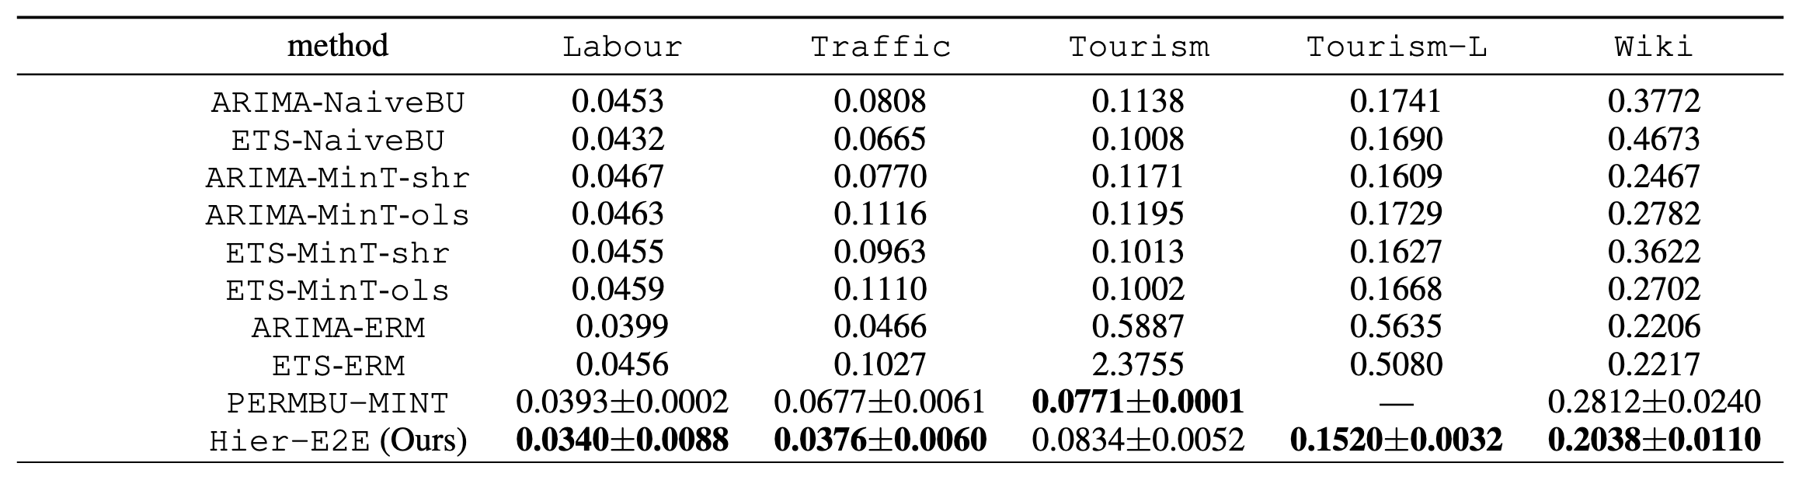
End-to-End Learning of Coherent Probabilistic, by S. Rangapuram
Results: they use the continuous ranked probability score (CRPS) to evaluate the accuracy of their forecast distributions
S. Rangapuram, et al., "End-to-end learning of coherent probabilistic forecasts for hierarchical time series," 2021. [Online]. Available: https://www.amazon.science/publications/end-to-end-learning-of-coherent-probabilistic-forecasts-for-hierarchical-time-series

Slide 45
End-to-End Learning of Coherent Probabilistic, by S. Rangapuram
Application to Buffalo Milk Prediction
Expected result: Coherent probabilistic forecasts across Total→Farm→Animal.
Comparison to Baseline: Uncertainty quantification not present in the baseline approach.
New insight: Confidence intervals for predictions at all hierarchical levels simultaneously.
S. Rangapuram, et al., "End-to-end learning of coherent probabilistic forecasts for hierarchical time series," 2021. [Online]. Available: https://www.amazon.science/publications/end-to-end-learning-of-coherent-probabilistic-forecasts-for-hierarchical-time-series

Slide 46
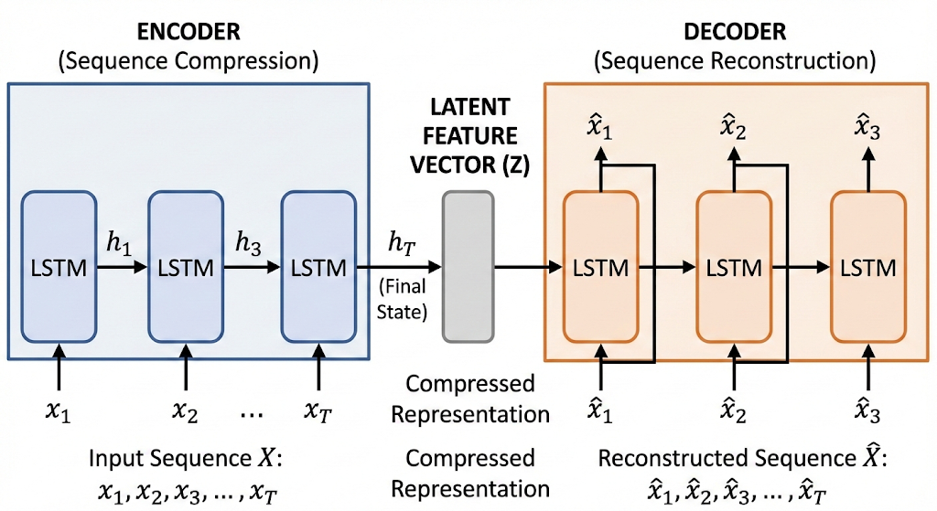
Deep LSTM-Based Transfer Learning Approach, by Sagheer
DLSTM-AE: They developed a Deep Long Short-Term Memory (DLSTM) in an auto-encoder (AE)
Approach:
They are using an Auto Encoder (AE) Architecture contains an encoder that by getting the sequential data as input, try to learn some latent features. And in the decoder part try to generate sequential data from the latent features found in encoder.
For each part of AE they use a LSTM model (Long short-term Memory) that is an RNN model to learn sequent of data.
A. Sagheer, et al., "Deep LSTM-based transfer learning approach for coherent forecasts in hierarchical time series," in Sensors, vol. 21, no. 13, Art. no. 4379, Jun. 2021, doi: 10.3390/s21134379.

Slide 47
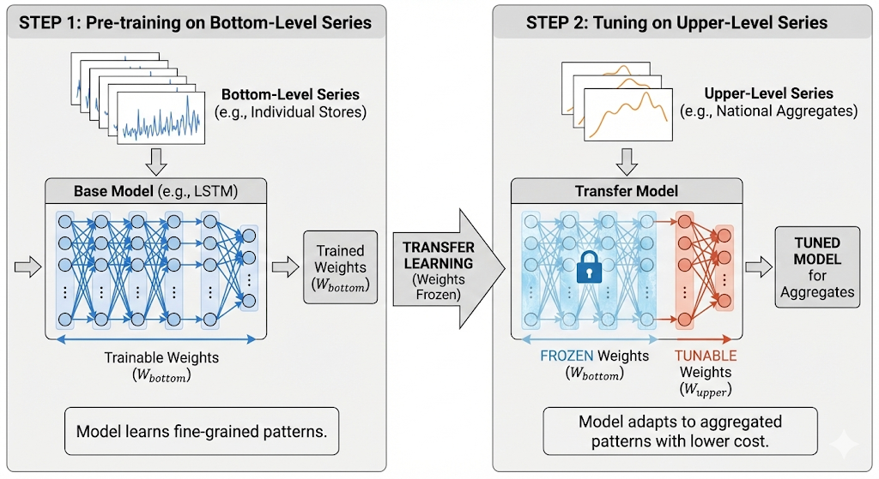
Deep LSTM-Based Transfer Learning Approach, by Sagheer
Transfer Learning:
On the other hand, they are using Transfer learning to reduce the computational cost, first they train the model using just bottom level and then the weights of trained model will be frozen and the model tuned on the upper levels for better forecasts.
A. Sagheer, et al., "Deep LSTM-based transfer learning approach for coherent forecasts in hierarchical time series," in Sensors, vol. 21, no. 13, Art. no. 4379, Jun. 2021, doi: 10.3390/s21134379.

Slide 48
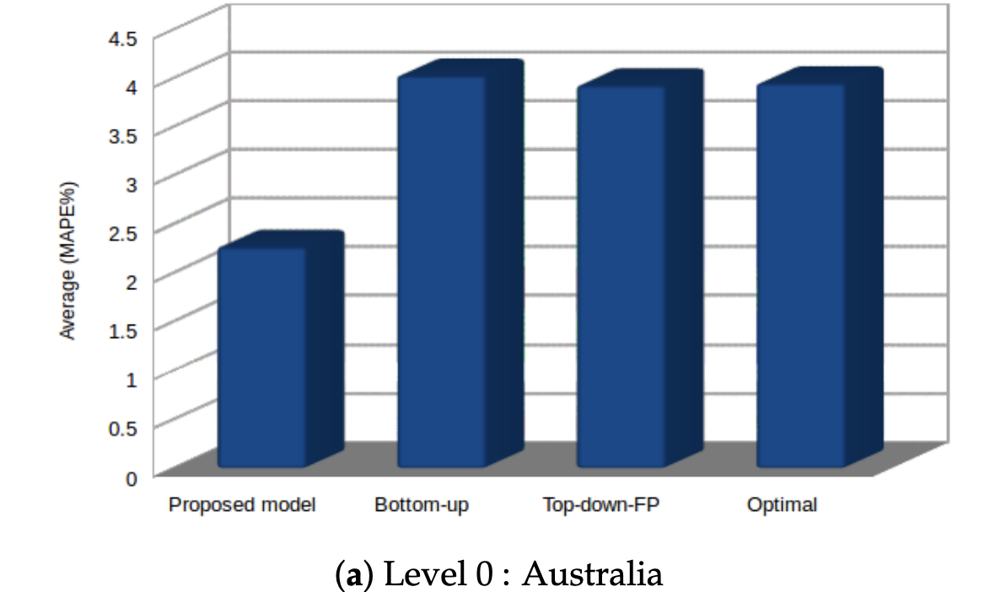
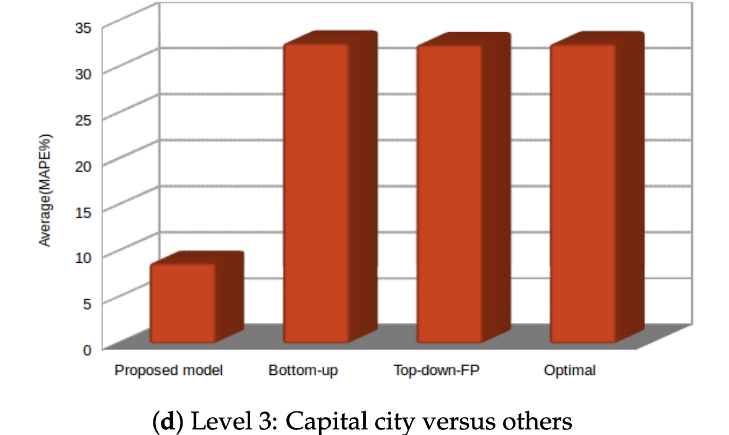
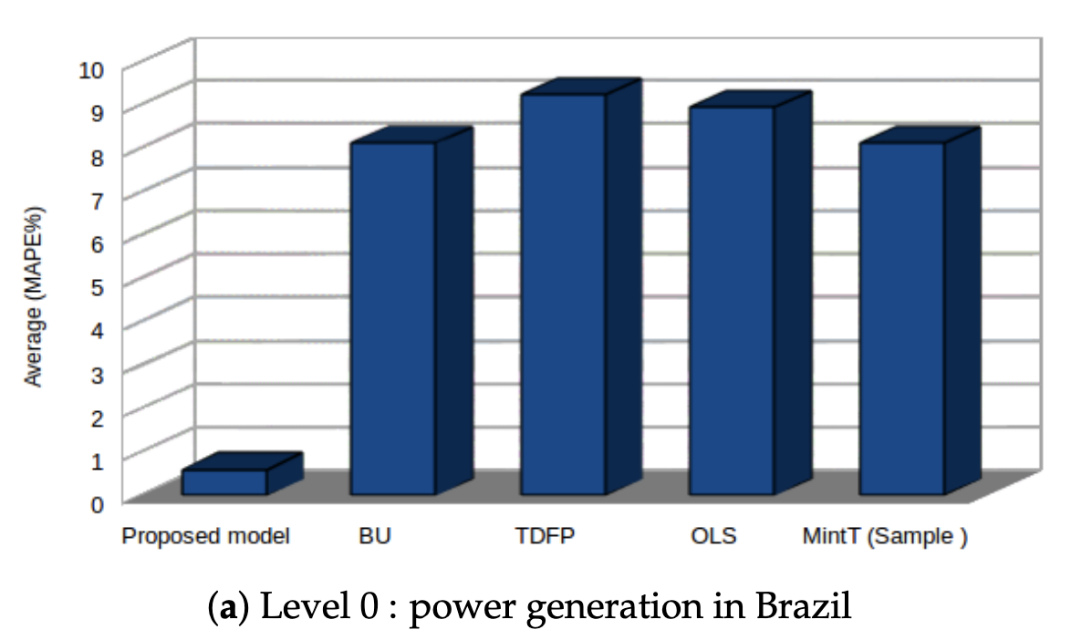
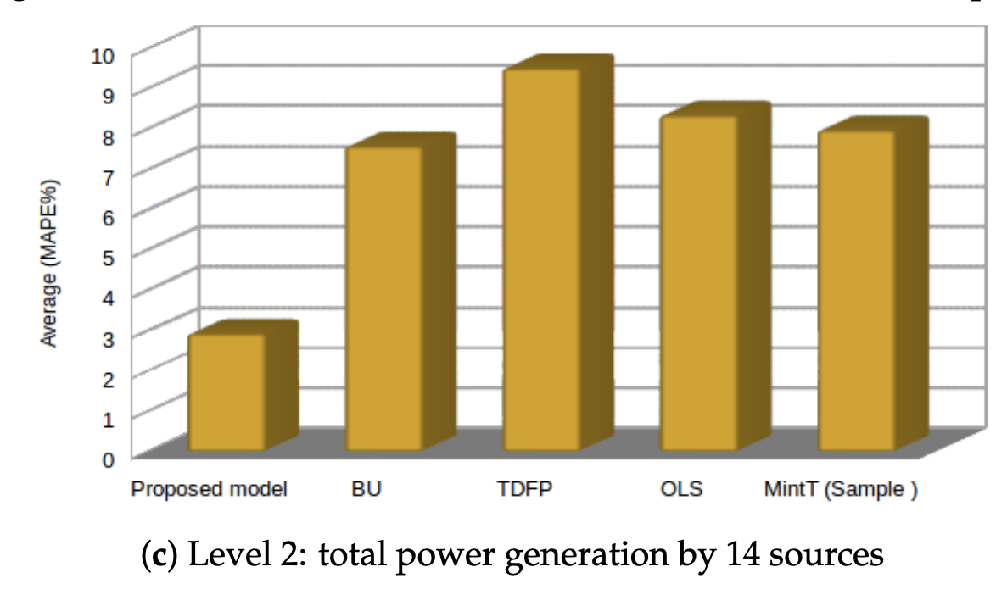
Deep LSTM-Based Transfer Learning Approach, by Sagheer
Results
A. Sagheer, et al., "Deep LSTM-based transfer learning approach for coherent forecasts in hierarchical time series," in Sensors, vol. 21, no. 13, Art. no. 4379, Jun. 2021, doi: 10.3390/s21134379.

Slide 49
Deep LSTM-Based Transfer Learning Approach, by Sagheer
Application to Buffalo Milk Prediction
Expected result: Efficient training by transferring knowledge from individual animals to farm/total levels.
Comparison to Baseline: computational efficiency and temporal sequence modeling (capturing lactation curves).
New insight: Better capture of DIM patterns and sequential dependencies in milk production.
A. Sagheer, et al., "Deep LSTM-based transfer learning approach for coherent forecasts in hierarchical time series," in Sensors, vol. 21, no. 13, Art. no. 4379, Jun. 2021, doi: 10.3390/s21134379.

Slide 50
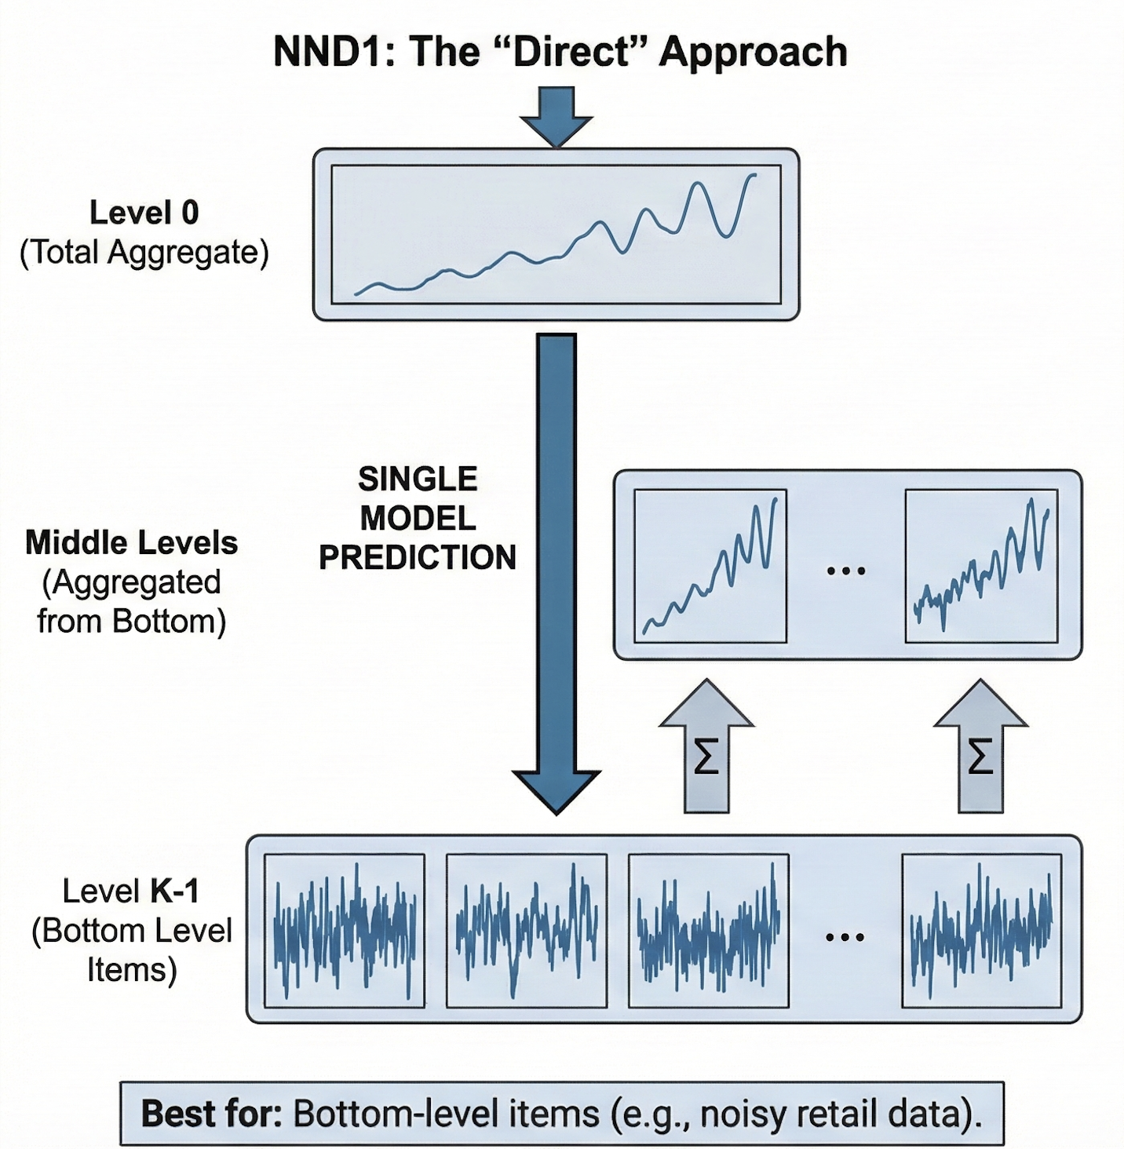
Neural Network Disaggregation (NND), by P. Mancuso
Objective: Uses deep neural networks (specifically CNNs) to directly produce coherent forecasts across hierarchical time series, rather than using traditional post-processing reconciliation methods.
Dataset:
1 - five years Italian grocery store, (3 levels)
2 - electricity demand in Switzerland (2 levels)
3 - Walmart data (M5) (4 levels)
Limitation: a few years of observations for daily time series are needed
They implemented 2 models:
NND1: Direct approach
NND2: Step-by-step approach
P. Mancuso et al.,"A machine learning approach for forecasting hierarchical time series,” in Expert Syst. Appl., vol. 182, Art. no. 115102, Nov. 2021, doi: 10.1016/j.eswa.2021.115102.

Slide 51
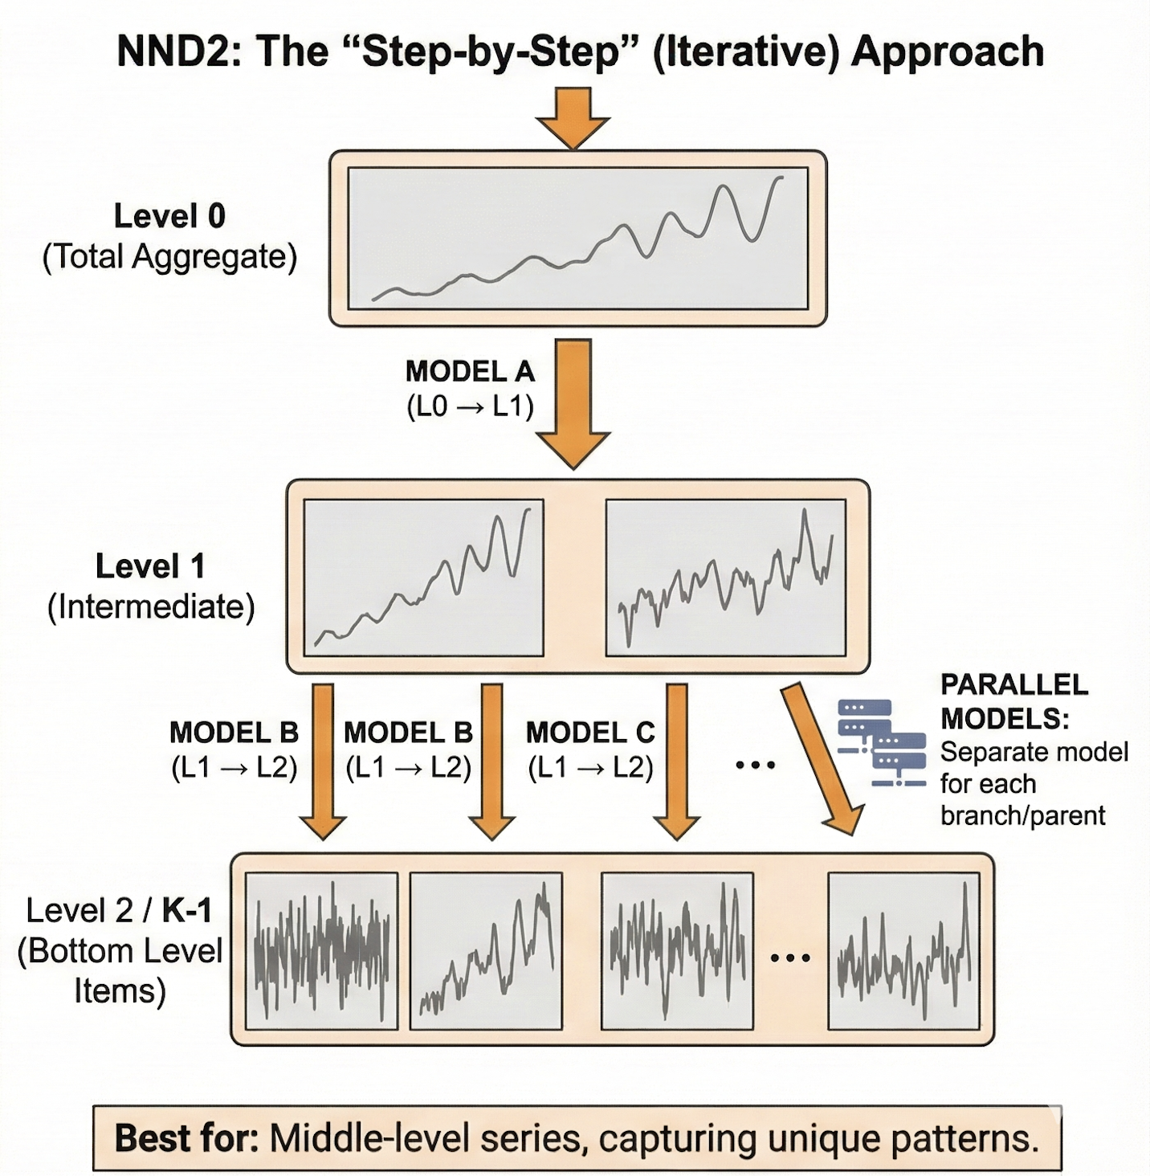
Neural Network Disaggregation (NND), by P. Mancuso
NND1: The "Direct" Approach
The Concept: This method jumps directly from the very top of the hierarchy to the very bottom.
How it works: A single model is trained to look at the total aggregate data (Level 0) and immediately predict the most detailed items at the bottom level (Level K-1).
Final Step: Once the bottom-level items are predicted, you simply sum them back up to fill in the middle levels of the hierarchy.
Best for: This strategy was found to be most effective for the bottom-level items.
P. Mancuso et al.,"A machine learning approach for forecasting hierarchical time series,” in Expert Syst. Appl., vol. 182, Art. no. 115102, Nov. 2021, doi: 10.1016/j.eswa.2021.115102.

Slide 52
Neural Network Disaggregation (NND), by P. Mancuso
NND2: The "Step-by-Step" (Iterative) Approach
The Concept: This method follows the natural structure of the hierarchy level by level.
How it works: Instead of one big jump, separate models are trained for every single level in the hierarchy. For example, the model first predicts Level 1 from Level 0, then Level 2 from Level 1, and so on.
Key Difference: It requires training many models in parallel—one for every parent series that needs to be broken down.
Best for: This strategy is more flexible and captures the unique patterns of middle levels better.
P. Mancuso et al.,"A machine learning approach for forecasting hierarchical time series,” in Expert Syst. Appl., vol. 182, Art. no. 115102, Nov. 2021, doi: 10.1016/j.eswa.2021.115102.

Slide 53
Neural Network Disaggregation (NND), by P. Mancuso
Application to Buffalo Milk Prediction
Expected result: Direct prediction from Total→Individual animals or step-by-step through Farm level.
Comparison to Baseline: hierarchical coherence while maintaining individual animal predictions.
New insight: Guaranteed sum-consistency (farm totals = sum of animal predictions).
P. Mancuso et al.,"A machine learning approach for forecasting hierarchical time series,” in Expert Syst. Appl., vol. 182, Art. no. 115102, Nov. 2021, doi: 10.1016/j.eswa.2021.115102.

Slide 54
Methodology

Slide 55
Preprocessing
Removing Outliers and null values
Time Series Decomposition.
Statical methods like normal distribution.
Integrating climate data.
THI Composite
Avg of 2 days before and after
Lag Features
Captures the effect of past days
Notes:
Ok preprocessing includes some steps, the first step is removing outliers and zero values because of desease or technical issues, I found a paper related to anomaly and outlier detection in cattles that I think it’s very helpful, so they used Time series decomposition and statical approaches like normal distribution for detecting outlier.
Time series decomposition breaks down time series data into components like trends, seasonality, and residuals,
The nest step is integrating climate data, some other studies didn’t use climate data or just utilized climate data from physical station near the farm while we are going to use nasa power API.
Another one is THI compose that Hassan in his paper in 2025 introduced and compared it to the actual THI and got better results,
And finally in all the time series forecastings Lag feature is an essential feature that capture previous effect on the actual values.

Slide 56
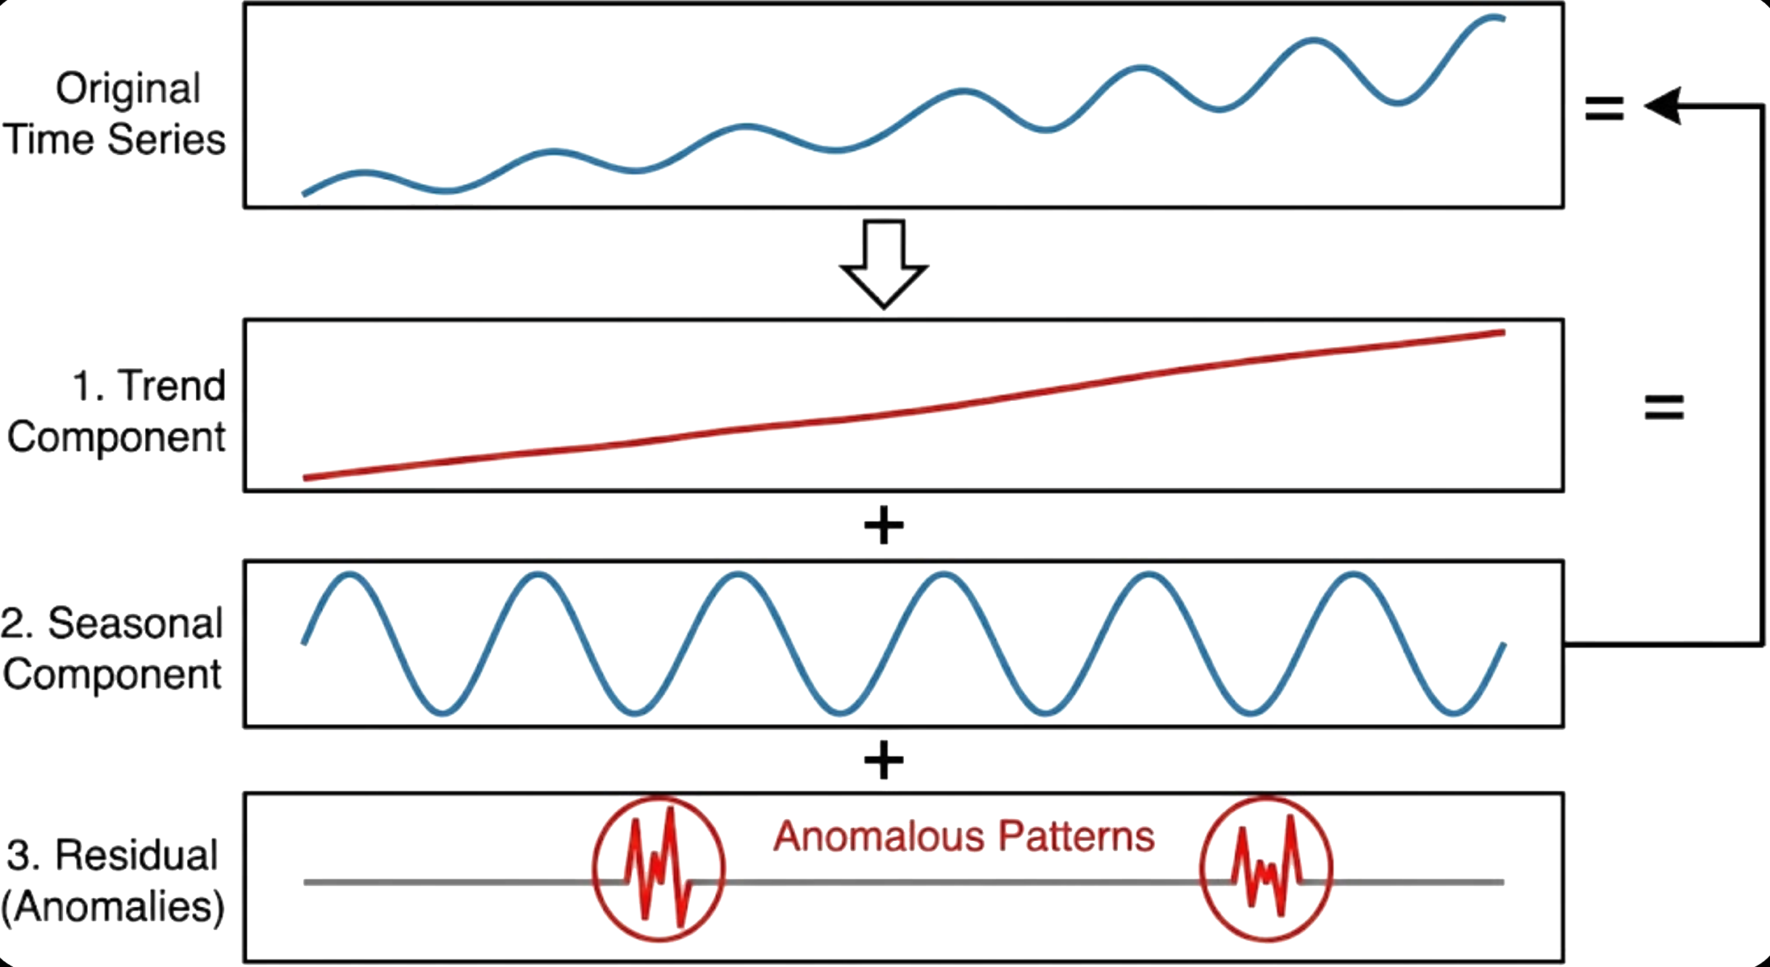
Preprocessing
Removing Outliers and null values
Time Series Decomposition.
Statical methods like normal distribution.
Integrating climate data.
THI Composite
Avg of 2 days before and after
Lag Features
Captures the effect of past days
Time Series Decomposition
Separates the time series into trend, seasonal, and residual components to identify anomalous patterns that deviate significantly from the underlying structure of the data.
J.-M. Jung, et al, "Multi-algorithmic approach for detecting outliers in cattle intake data," in J. Agric. Food Res., vol. 15, Art. no. 101021, Mar. 2024, doi: 10.1016/j.jafr.2024.101021.
Notes:
Ok preprocessing includes some steps, the first step is removing outliers and zero values because of desease or technical issues, I found a paper related to anomaly and outlier detection in cattles that I think it’s very helpful, so they used Time series decomposition and statical approaches like normal distribution for detecting outlier.
Time series decomposition breaks down time series data into components like trends, seasonality, and residuals,
The nest step is integrating climate data, some other studies didn’t use climate data or just utilized climate data from physical station near the farm while we are going to use nasa power API.
Another one is THI compose that Hassan in his paper in 2025 introduced and compared it to the actual THI and got better results,
And finally in all the time series forecastings Lag feature is an essential feature that capture previous effect on the actual values.

Slide 57
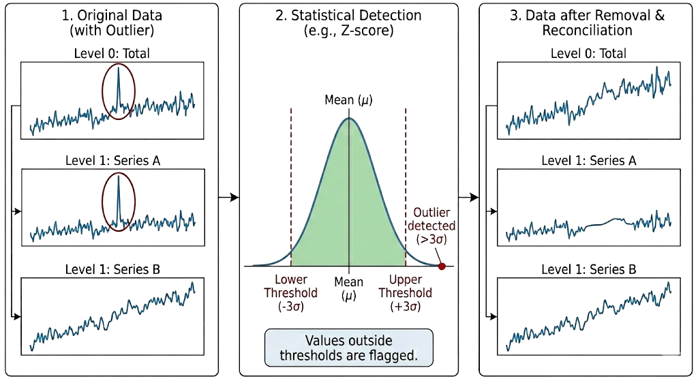
Preprocessing
Removing Outliers and null values
Time Series Decomposition.
Statical methods like normal distribution.
Integrating climate data.
THI Composite
Avg of 2 days before and after
Lag Features
Captures the effect of past days
Statistical methods like normal distribution
statistical techniques such as z-scores, IQR or standard deviation thresholds to detect and remove values that fall outside expected ranges based on distributional assumptions.
J.-M. Jung, et al, "Multi-algorithmic approach for detecting outliers in cattle intake data," in J. Agric. Food Res., vol. 15, Art. no. 101021, Mar. 2024, doi: 10.1016/j.jafr.2024.101021.
Notes:
Ok preprocessing includes some steps, the first step is removing outliers and zero values because of desease or technical issues, I found a paper related to anomaly and outlier detection in cattles that I think it’s very helpful, so they used Time series decomposition and statical approaches like normal distribution for detecting outlier.
Time series decomposition breaks down time series data into components like trends, seasonality, and residuals,
The nest step is integrating climate data, some other studies didn’t use climate data or just utilized climate data from physical station near the farm while we are going to use nasa power API.
Another one is THI compose that Hassan in his paper in 2025 introduced and compared it to the actual THI and got better results,
And finally in all the time series forecastings Lag feature is an essential feature that capture previous effect on the actual values.

Slide 58
Preprocessing
Removing Outliers and null values
Time Series Decomposition.
Statical methods like normal distribution.
Integrating climate data.
THI Composite
Avg of 2 days before and after
Lag Features
Captures the effect of past days
Integrating climate data
Incorporates climate variables (temperature, humidity, THI etc.) from NASA POWER API as inputs.
using satellite-based data instead of physical weather stations for consistent coverage across all hierarchical locations.
G. Neglia, et al., "Exploring the sources of variation of electrical conductivity and total and differential somatic cell count in Italian Mediterranean buffaloes,” in J. Dairy Sci., vol. 107, no. 1, pp. 508–515, Jan. 2024, doi: 10.3168/jds.2023-23629.
Notes:
Ok preprocessing includes some steps, the first step is removing outliers and zero values because of desease or technical issues, I found a paper related to anomaly and outlier detection in cattles that I think it’s very helpful, so they used Time series decomposition and statical approaches like normal distribution for detecting outlier.
Time series decomposition breaks down time series data into components like trends, seasonality, and residuals,
The nest step is integrating climate data, some other studies didn’t use climate data or just utilized climate data from physical station near the farm while we are going to use nasa power API.
Another one is THI compose that Hassan in his paper in 2025 introduced and compared it to the actual THI and got better results,
And finally in all the time series forecastings Lag feature is an essential feature that capture previous effect on the actual values.

Slide 59
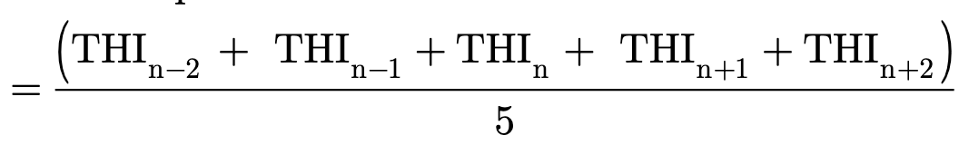

Preprocessing
Removing Outliers and null values
Time Series Decomposition.
Statical methods like normal distribution.
Integrating climate data.
THI Composite
Avg of 2 days before and after
Lag Features
Captures the effect of past days
THI Composite
Creates a Temperature-Humidity Index (THI) feature by averaging climate conditions over a 5-day window (2 days before, current day, and 2 days after), smoothing short-term fluctuations and capturing sustained climate stress periods.
M. F. Hasan, et al.,"An effective way to incorporate temperature-humidity index to study effect of heat stress on milk yield by an XGBoost machine learning model," in J. Dairy Sci., vol. 108, no. 12, pp. 13995–14017, Dec. 2025, doi: 10.3168/jds.2025-27193.
Notes:
Ok preprocessing includes some steps, the first step is removing outliers and zero values because of desease or technical issues, I found a paper related to anomaly and outlier detection in cattles that I think it’s very helpful, so they used Time series decomposition and statical approaches like normal distribution for detecting outlier.
Time series decomposition breaks down time series data into components like trends, seasonality, and residuals,
The nest step is integrating climate data, some other studies didn’t use climate data or just utilized climate data from physical station near the farm while we are going to use nasa power API.
Another one is THI compose that Hassan in his paper in 2025 introduced and compared it to the actual THI and got better results,
And finally in all the time series forecastings Lag feature is an essential feature that capture previous effect on the actual values.

Slide 60
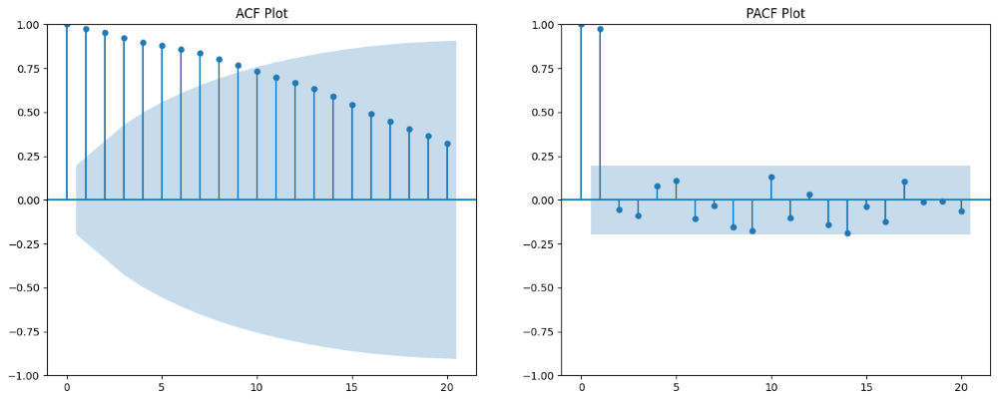
Preprocessing
Removing Outliers and null values
Time Series Decomposition.
Statical methods like normal distribution.
Integrating climate data.
THI Composite
Avg of 2 days before and after
Lag Features
Captures the effect of past days
Lag Features
Generates lagged variables that include historical values from previous time steps as predictors, allowing the model to learn temporal dependencies and autoregressive patterns where past observations influence future outcomes across the hierarchical structure.
G. Neglia, et al., "Exploring the sources of variation of electrical conductivity and total and differential somatic cell count in Italian Mediterranean buffaloes,” in J. Dairy Sci., vol. 107, no. 1, pp. 508–515, Jan. 2024, doi: 10.3168/jds.2023-23629.
Notes:
Ok preprocessing includes some steps, the first step is removing outliers and zero values because of desease or technical issues, I found a paper related to anomaly and outlier detection in cattles that I think it’s very helpful, so they used Time series decomposition and statical approaches like normal distribution for detecting outlier.
Time series decomposition breaks down time series data into components like trends, seasonality, and residuals,
The nest step is integrating climate data, some other studies didn’t use climate data or just utilized climate data from physical station near the farm while we are going to use nasa power API.
Another one is THI compose that Hassan in his paper in 2025 introduced and compared it to the actual THI and got better results,
And finally in all the time series forecastings Lag feature is an essential feature that capture previous effect on the actual values.

Slide 61
Workflow – Two Phase Approach
Use same or new data sources:
test-day records + NASA POWER climate
Notes:
Ok preprocessing includes some steps, the first step is removing outliers and zero values because of desease or technical issues, I found a paper related to anomaly and outlier detection in cattles that I think it’s very helpful, so they used Time series decomposition and statical approaches like normal distribution for detecting outlier.
Time series decomposition breaks down time series data into components like trends, seasonality, and residuals,
The nest step is integrating climate data, some other studies didn’t use climate data or just utilized climate data from physical station near the farm while we are going to use nasa power API.
Another one is THI compose that Hassan in his paper in 2025 introduced and compared it to the actual THI and got better results,
And finally in all the time series forecastings Lag feature is an essential feature that capture previous effect on the actual values.

Slide 62
Workflow – Two Phase Approach
Phase 1
Replicate Neglia & Santinello workflow for milk yield (instead of mastitis)
Use same or new data sources:
test-day records + NASA POWER climate
Notes:
Ok preprocessing includes some steps, the first step is removing outliers and zero values because of desease or technical issues, I found a paper related to anomaly and outlier detection in cattles that I think it’s very helpful, so they used Time series decomposition and statical approaches like normal distribution for detecting outlier.
Time series decomposition breaks down time series data into components like trends, seasonality, and residuals,
The nest step is integrating climate data, some other studies didn’t use climate data or just utilized climate data from physical station near the farm while we are going to use nasa power API.
Another one is THI compose that Hassan in his paper in 2025 introduced and compared it to the actual THI and got better results,
And finally in all the time series forecastings Lag feature is an essential feature that capture previous effect on the actual values.

Slide 63
Workflow – Two Phase Approach
Phase 1
Replicate Neglia & Santinello workflow for milk yield (instead of mastitis)
Apply same models: GLM, SVM, RF, NN
Notes:
Ok preprocessing includes some steps, the first step is removing outliers and zero values because of desease or technical issues, I found a paper related to anomaly and outlier detection in cattles that I think it’s very helpful, so they used Time series decomposition and statical approaches like normal distribution for detecting outlier.
Time series decomposition breaks down time series data into components like trends, seasonality, and residuals,
The nest step is integrating climate data, some other studies didn’t use climate data or just utilized climate data from physical station near the farm while we are going to use nasa power API.
Another one is THI compose that Hassan in his paper in 2025 introduced and compared it to the actual THI and got better results,
And finally in all the time series forecastings Lag feature is an essential feature that capture previous effect on the actual values.

Slide 64
Workflow – Two Phase Approach
Phase 1
Replicate Neglia & Santinello workflow for milk yield (instead of mastitis)
Forecasting Milk Yield for individual animals, without hierarchical stricture.
Notes:
Ok preprocessing includes some steps, the first step is removing outliers and zero values because of desease or technical issues, I found a paper related to anomaly and outlier detection in cattles that I think it’s very helpful, so they used Time series decomposition and statical approaches like normal distribution for detecting outlier.
Time series decomposition breaks down time series data into components like trends, seasonality, and residuals,
The nest step is integrating climate data, some other studies didn’t use climate data or just utilized climate data from physical station near the farm while we are going to use nasa power API.
Another one is THI compose that Hassan in his paper in 2025 introduced and compared it to the actual THI and got better results,
And finally in all the time series forecastings Lag feature is an essential feature that capture previous effect on the actual values.

Slide 65
Workflow – Two Phase Approach
Phase 1
Replicate Neglia & Santinello workflow for milk yield (instead of mastitis)
Validate and establish baseline
performance metrics (R², RMSE, MAE)
Notes:
Ok preprocessing includes some steps, the first step is removing outliers and zero values because of desease or technical issues, I found a paper related to anomaly and outlier detection in cattles that I think it’s very helpful, so they used Time series decomposition and statical approaches like normal distribution for detecting outlier.
Time series decomposition breaks down time series data into components like trends, seasonality, and residuals,
The nest step is integrating climate data, some other studies didn’t use climate data or just utilized climate data from physical station near the farm while we are going to use nasa power API.
Another one is THI compose that Hassan in his paper in 2025 introduced and compared it to the actual THI and got better results,
And finally in all the time series forecastings Lag feature is an essential feature that capture previous effect on the actual values.

Slide 66
Workflow – Two Phase Approach
Notes:
Ok preprocessing includes some steps, the first step is removing outliers and zero values because of desease or technical issues, I found a paper related to anomaly and outlier detection in cattles that I think it’s very helpful, so they used Time series decomposition and statical approaches like normal distribution for detecting outlier.
Time series decomposition breaks down time series data into components like trends, seasonality, and residuals,
The nest step is integrating climate data, some other studies didn’t use climate data or just utilized climate data from physical station near the farm while we are going to use nasa power API.
Another one is THI compose that Hassan in his paper in 2025 introduced and compared it to the actual THI and got better results,
And finally in all the time series forecastings Lag feature is an essential feature that capture previous effect on the actual values.

Slide 67
Workflow – Two Phase Approach
Preprocessing enhancements:
Converting data into Hierarchical structure
THI Composite (5-day window) - from Hassan 2025
Time series decomposition for outlier detection
Lag features for temporal dependencies
Notes:
Ok preprocessing includes some steps, the first step is removing outliers and zero values because of desease or technical issues, I found a paper related to anomaly and outlier detection in cattles that I think it’s very helpful, so they used Time series decomposition and statical approaches like normal distribution for detecting outlier.
Time series decomposition breaks down time series data into components like trends, seasonality, and residuals,
The nest step is integrating climate data, some other studies didn’t use climate data or just utilized climate data from physical station near the farm while we are going to use nasa power API.
Another one is THI compose that Hassan in his paper in 2025 introduced and compared it to the actual THI and got better results,
And finally in all the time series forecastings Lag feature is an essential feature that capture previous effect on the actual values.

Slide 68
Workflow – Two Phase Approach
Models:
Implementing 3 different methods to evaluating which one works better on Buffaloes Milk forecasting
Notes:
Ok preprocessing includes some steps, the first step is removing outliers and zero values because of desease or technical issues, I found a paper related to anomaly and outlier detection in cattles that I think it’s very helpful, so they used Time series decomposition and statical approaches like normal distribution for detecting outlier.
Time series decomposition breaks down time series data into components like trends, seasonality, and residuals,
The nest step is integrating climate data, some other studies didn’t use climate data or just utilized climate data from physical station near the farm while we are going to use nasa power API.
Another one is THI compose that Hassan in his paper in 2025 introduced and compared it to the actual THI and got better results,
And finally in all the time series forecastings Lag feature is an essential feature that capture previous effect on the actual values.

Slide 69
Workflow – Two Phase Approach
Performance:
Analize and compute Performance of each model and compare it with baseline
Notes:
Ok preprocessing includes some steps, the first step is removing outliers and zero values because of desease or technical issues, I found a paper related to anomaly and outlier detection in cattles that I think it’s very helpful, so they used Time series decomposition and statical approaches like normal distribution for detecting outlier.
Time series decomposition breaks down time series data into components like trends, seasonality, and residuals,
The nest step is integrating climate data, some other studies didn’t use climate data or just utilized climate data from physical station near the farm while we are going to use nasa power API.
Another one is THI compose that Hassan in his paper in 2025 introduced and compared it to the actual THI and got better results,
And finally in all the time series forecastings Lag feature is an essential feature that capture previous effect on the actual values.

Slide 70
Workflow – Two Phase Approach
Improve performance of forecasting using HTS methods for Buffaloes milk forecasting
Notes:
Ok preprocessing includes some steps, the first step is removing outliers and zero values because of desease or technical issues, I found a paper related to anomaly and outlier detection in cattles that I think it’s very helpful, so they used Time series decomposition and statical approaches like normal distribution for detecting outlier.
Time series decomposition breaks down time series data into components like trends, seasonality, and residuals,
The nest step is integrating climate data, some other studies didn’t use climate data or just utilized climate data from physical station near the farm while we are going to use nasa power API.
Another one is THI compose that Hassan in his paper in 2025 introduced and compared it to the actual THI and got better results,
And finally in all the time series forecastings Lag feature is an essential feature that capture previous effect on the actual values.

Slide 71
Research Objectives
Main Goal
Develop and evaluate hierarchical forecasting methods for predicting Italian Mediterranean buffalo milk production under climate stress.
Specific Objectives
1. Establish baseline prediction performance using traditional ML methods
2. Implement and compare hierarchical time series forecasting approaches
3. Evaluate the impact of THI composite on prediction accuracy
4. Identify optimal reconciliation methods for buffalo milk forecasting
Notes:
Ok preprocessing includes some steps, the first step is removing outliers and zero values because of desease or technical issues, I found a paper related to anomaly and outlier detection in cattles that I think it’s very helpful, so they used Time series decomposition and statical approaches like normal distribution for detecting outlier.
Time series decomposition breaks down time series data into components like trends, seasonality, and residuals,
The nest step is integrating climate data, some other studies didn’t use climate data or just utilized climate data from physical station near the farm while we are going to use nasa power API.
Another one is THI compose that Hassan in his paper in 2025 introduced and compared it to the actual THI and got better results,
And finally in all the time series forecastings Lag feature is an essential feature that capture previous effect on the actual values.

Slide 72




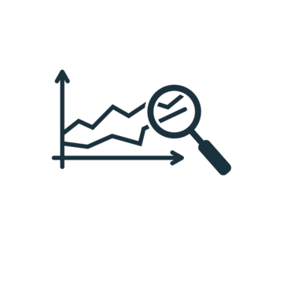
Model Selection for Prediction Task
Individual model for each animal [5,6]:
Not scalable.
Global model for all the animals.
LGBM, XGBoost, RNN works perfectly for global model. [3,7]
Predictive Analytics of Climate Stress Impact on the Italian Mediterranean Buffalo
Notes:
There are 2 related studies one in Korea and another in Australia in recent year used individual model for their prediction.
Also, there is another study that compared global and individual models for timeseries forecasting and the result was LGBM and RNN are out-performed the other models even compared with individual models.

Slide 73
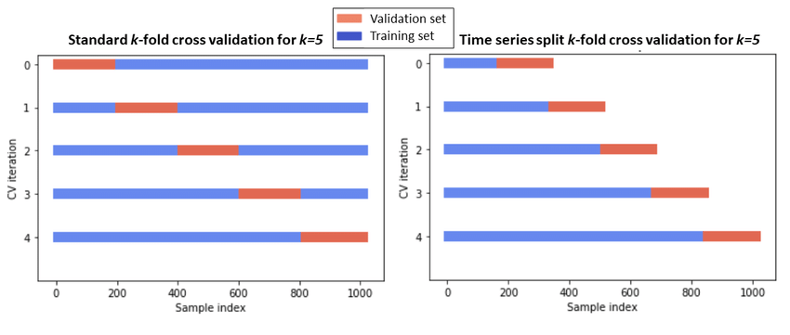
Evaluation and Metrics
Cross-Validation
Global model
We can use both
Individual model
We can use time series cross validation
https://www.researchgate.net/figure/Classical-k-fold-cross-validation-vs-time-series-split-cross-validation_fig1_355889701
Predictive Analytics of Climate Stress Impact on the Italian Mediterranean Buffalo
Notes:
To insure avoiding overfitting we should use a separate and unseen data for evaluate the model.
Cross validation is a way to evaluate our model and to do that we train and test the data for few times on different subset of data.

Slide 74
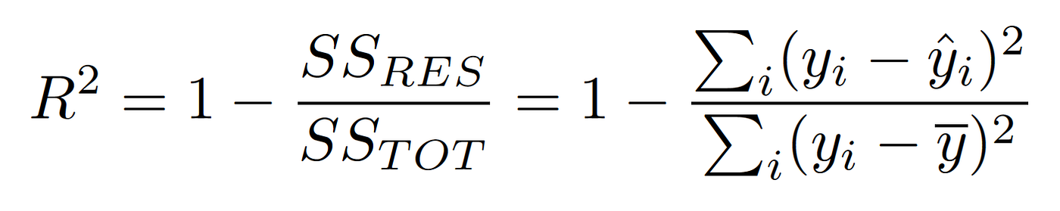
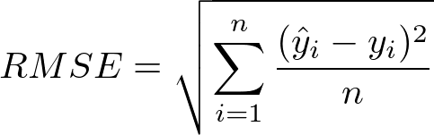
Evaluation and Metrics
R-squared
Root mean squared Error
Predicted Value
Actual Value
Mean of Actual Value
Number of samples
Predictive Analytics of Climate Stress Impact on the Italian Mediterranean Buffalo
Notes:
Here is two common metrics for evaluating performance of regression and forecasting models.

Slide 75
Hierarchical Reconciliation [10]
A model will be trained on the data[XGBoost, ...].
Forecast on the data using current model.
Reconcile the predicted values using statistical approaches:
MinT : minimize the variance between reconciled values and base forecast error.
Predictive Analytics of Climate Stress Impact on the Italian Mediterranean Buffalo

Slide 76
References

Slide 77
References
G. Neglia, M. Santinello, et al "Precision livestock farming in buffalo species: a sustainable approach for the future," in Revista Científica de la Facultad de Ciencias Veterinarias, 2023, doi: 10.52973/rcfcv-wbc019.
Bernabucci, et al. “Metabolic and Hormonal Acclimation to Heat Stress in Domesticated Ruminants.” in Animal 2010, 4, 1167–1183, doi : 10.1017/S175173111000090X
Bohmanova, J, et al. “Temperature-humidity indices as indicators of milk production losses due to heat stress.” in Journal of Dairy Science, 90(4), 1947–1956. doi: 10.3168/jds.2006-513
V. L. de Araujo et al, "Responses of dairy buffalo to heat stress conditions and mitigation strategies: A review," in Animals, vol. 14, no. 5, Art. no. 731, Feb. 2024, doi: 10.3390/ani13071260
S. Dash, et al, "Effect of heat stress on reproductive performances of dairy cattle and buffaloes: A review," in Veterinary World, vol. 9, no. 3, pp. 235–244, Mar. 2016, doi: 10.14202/vetworld.2016.235-244.
M. F. Hasan, et al "An effective way to incorporate temperatureÐhumidity index to study effect of heat stress on milk yield by an XGBoost machine learning model," in Journal of Dairy Science, vol. 108, no. 12, 2025, doi: 10.3168/jds.2025-27193.
J.-W. Song, et al "Development of individual models for predicting cow milk production for real-time monitoring," in Computers and Electronics in Agriculture, vol. 228, Art. no. 109698, Jan. 2025, doi: 10.1016/j.compag.2024.109698.
B. Ji et al., "A machine learning framework to predict the next month's daily milk yield, milk composition and milking frequency for cows in a robotic dairy farm," in Biosyst. Eng., vol. 216, pp. 186Ð197, Apr. 2022, doi: 10.1016/j.biosystemseng.2022.02.013.
M. Santinello, G. Neglia, et al., "The role of age at first calving in shaping production and reproductive outcomes in Italian buffaloes," in J. Dairy Sci., vol. 108, no. 7, pp. 7235–7247, Jul. 2025, doi: 10.3168/jds.2025-26369.
M. Santinello, G. Neglia et al., "The cost of being early or late: Biological and economic outcomes of age at first calving in dairy buffaloes,” in J. Dairy Sci., vol. TBC, no. TBC, pp. TBC, 2025, doi: 10.3168/jds.2025-27467.
G. Neglia et al., "Exploiting machine learning methods with monthly routine milk recording data and climatic information to predict subclinical mastitis in Italian Mediterranean buffaloes," in J. Dairy Sci., vol. 106, no. 3, pp. 1942Ð1952, Mar. 2023, doi: 10.3168/jds.2022-22292.
R. J. Hyndman and G. Athanasopoulos, Forecasting: Principles and Practice, 3rd ed. Melbourne, Australia: OTexts, 2021. [Online]. Available: https://otexts.com/fpp3/
O. Omri, et al., "On the inventory performance of hierarchical forecasting approaches: case of a vaccine supply chain," J. Oper. Res. Soc., Oct. 2025, doi: 10.1080/01605682.2025.2566323.
M. Kim, et al.,"Beginner-friendly review of research on R-based energy forecasting: Insights from text mining," in Electronics, vol. 14, no. 17, Art. no. 3513, Sep. 2025, doi: 10.3390/electronics14173513.
R. J. Hyndman et al, "Optimal combination forecasts for hierarchical time series," in Comput. Stat. Data Anal., vol. 55, no. 9, pp. 2579–2589, Sep. 2011, doi: 10.1016/j.csda.2011.03.006.
S. L. Wickramasuriya, et al., "Optimal forecast reconciliation for hierarchical and grouped time series through trace minimization,” in J. Amer. Stat. Assoc., vol. 114, no. 526, pp. 804–819, 2019, doi: 10.1080/01621459.2018.1448825.
M. Abolghasemi, et al, "Model selection in reconciling hierarchical time series," in Mach. Learn., vol. 111, pp. 739–789, Feb. 2022, doi: 10.1007/s10994-021-06126-z.
S. Rangapuram, et al., "End-to-end learning of coherent probabilistic forecasts for hierarchical time series," 2021. [Online]. Available: https://www.amazon.science/publications/end-to-end-learning-of-coherent-probabilistic-forecasts-for-hierarchical-time-series
A. Sagheer, et al., "Deep LSTM-based transfer learning approach for coherent forecasts in hierarchical time series," in Sensors, vol. 21, no. 13, Art. no. 4379, Jun. 2021, doi: 10.3390/s21134379.
P. Mancuso et al.,"A machine learning approach for forecasting hierarchical time series,” in Expert Syst. Appl., vol. 182, Art. no. 115102, Nov. 2021, doi: 10.1016/j.eswa.2021.115102.
J.-M. Jung, et al, "Multi-algorithmic approach for detecting outliers in cattle intake data," in J. Agric. Food Res., vol. 15, Art. no. 101021, Mar. 2024, doi: 10.1016/j.jafr.2024.101021.
G. Neglia, et al., "Exploring the sources of variation of electrical conductivity and total and differential somatic cell count in Italian Mediterranean buffaloes,” in J. Dairy Sci., vol. 107, no. 1, pp. 508–515, Jan. 2024, doi: 10.3168/jds.2023-23629.

Slide 78
References
[11] - Omri, O., Kafa, N., Babai, M. Z., Jemai, Z. & Rostami-Tabar, B. (2025). On the inventory performance of hierarchical forecasting approaches: case of a vaccine supply chain. Journal of the Operational Research Society. [Ref]
[12] - Kim, M., Kim, H. & Moon, J. (2025). Beginner-Friendly Review of Research on R-Based Energy Forecasting: Insights from Text Mining. [Ref]
Predictive Analytics of Climate Stress Impact on the Italian Mediterranean Buffalo

Slide 79
Predictive Analytics of Climate Stress Impact on the Italian Mediterranean Buffalo
Physiological and Productive Responses
Prof. Luca Barbierato
Prof. Matteo Santinello
Mohammad Sheikh
Department of Control and Computer Engineering
Dipartimento di Automatica e Informatica

