Slide 1

Bangladesh Army University of Science & Technology (BAUST), Saidpur
Department: Computer Science & Engineering
Course Code: CSE2200
Course Title: Software Development Project II
Submitted By :
Submitted To :
Student Name: Sakib Mahmud
ID: 180201106
Batch: 8th
Level: 2 Term: II
Section: B
Date of Submission: 29.11.2020
Teacher Name: MD. Toukir Ahmed
Designation: Lecturer

Slide 2
Proposed Project
Bank management system

Slide 3
Objective
This software lets users create a new account, access all existing account information, make cash deposits and withdrawals and check account through software without the need of going personally to a bank.
This project has been designed in C++ and various actions have different panels. It keeps logs of all the transactions made whether it is withdrawal or deposit of cash. One can create a new account anytime. This gives user the facility to work in one’s own comfort and at a time convenient for them. It is secure and user-friendly.

Slide 4
Apparatus
Software Requirements- Windows 7/10, Codeblocks (IDE)
Language used- C++
Hardware Requirements-
Minimum 2GB space of Hard disk
512 MB of RAM

Slide 5
Existing System
The manual systems that carry out the whole process in a bank are more prone to errors. It takes a vast amount of time to take an action be it the creation of an account or depositing money. It is especially negative when there are time constraints for the customers to get a work done. This makes it a lot inconvenient for the customer as well as it is time consuming. Banks are open only in limited hours in a day and any transaction to be made after those times in cases of emergencies become impossible. This causes a lot of inconvenience.

Slide 6
Proposed System
This system has been designed to overcome all the disadvantages of the traditional banking system. A user has the option of creating an account, cash transactions all at their own discretion. There is a separate module for each and every action and it is really easy to use and secure as well. This software helps save a lot of time, energy and effort that the customers have to go through in carrying out these actions personally.

Slide 7
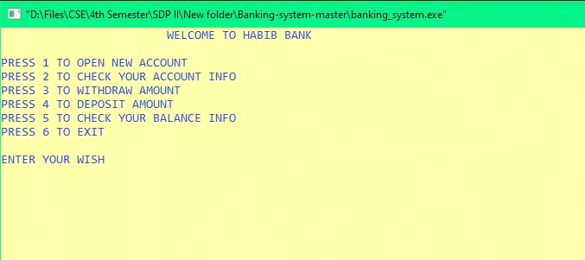
Output of the Program

Slide 8
Modules
New Account Module- This module lets users add a new account by providing desired account number, name, address, mobile number and email address.
2. Check account info module- This module provides account information, balance, withdrawal and deposit information.
3. Withdrawal module- This module has been designed to assist the users in withdrawing money. It takes as input account number, shows current balance and amount have to be withdrawn.
4. Deposit module- This module has been designed to assist the users in depositing money. It takes as input account number, shows current balance and amount have to deposit.
5. Check balance info module- This module provides current balance.

Slide 9
Reason behind the selection of this project
Digital banking is part of the broader context for the move to online banking where banking services are delivered over the internet. The shift from traditional to digital banking has been gradual and remains ongoing, and is constituted by differing degrees of banking service digitization. Digital banking involves high levels of process automation and web-based services. It provides the ability for users to access financial data through desktop, mobile and ATM services. Currently there are 60 scheduled banks in Bangladesh. This project can be very helpful to perform digitalization in banking systems.

Slide 10
Conclusion
Bank management system is a virtualization of transactions in banking system. The banking system are used manual working but when we used online banking system it is totally virtualization process which avoid manual process and converts it in automatic process. If user can make a transaction in bank management system it is available in anywher, change branch location easily. Bank management system is saving the time with accuracy than bank manual system.

Slide 11
GitHub link
https://github.com/smsakib15/Banking-management-system

