Slide 1


Large Scale Machine Learning Methods For Ionospheric Error Mitigation In Global Navigation Satellite Systems
Prepared by: Susana Sanchez
Doctoral Program on Computer and Systems Engineering
Advisor : Raúl Ramos Pollán, Phd
Co-advisor: Fabio González Osorio, Phd
Email: smsanchezn@unal.edu.co
Date: October 27th 2016

Slide 2
Project Objective
ML methods for GBAS applications
To develop a machine learning method to generate an ionospheric threat model for GBAS in equatorial latitudes

Slide 3
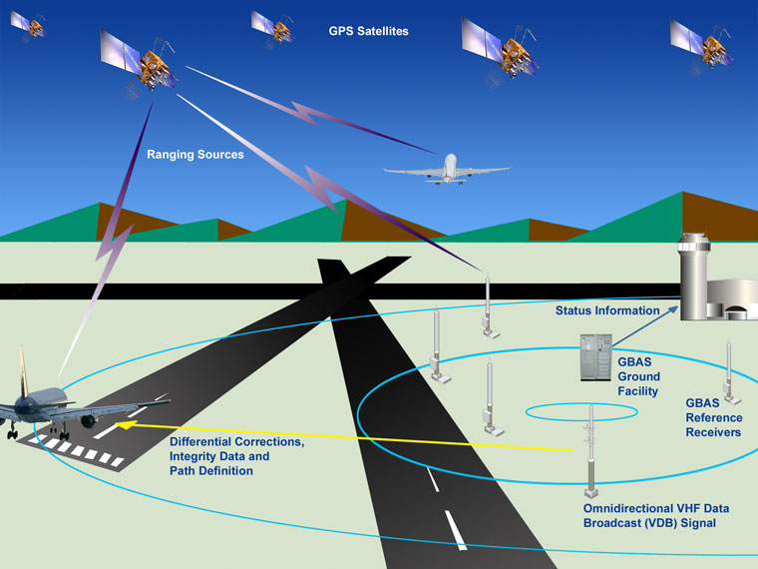
GBAS Architecture

Slide 4
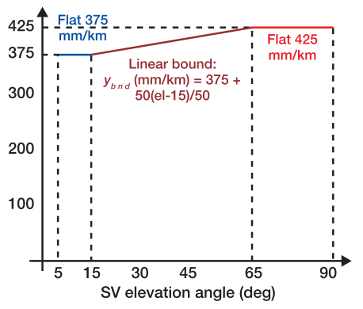
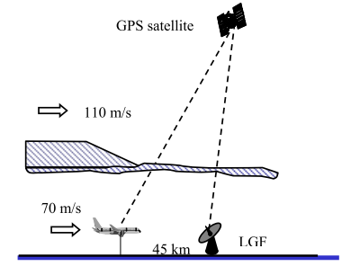
Ionospheric error in GBAS and CONUS Threat Model
GBAS

Slide 5
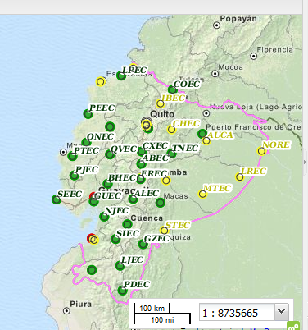
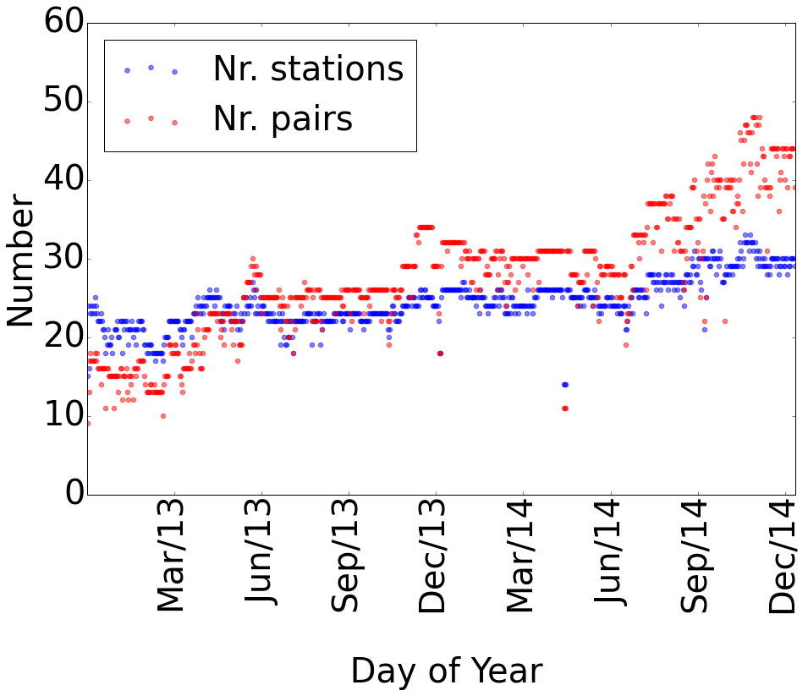
ITM assessment at Ecuador
Two years of automatic data assessment for a total number up to 30 stations
Data Source REGME

Slide 6
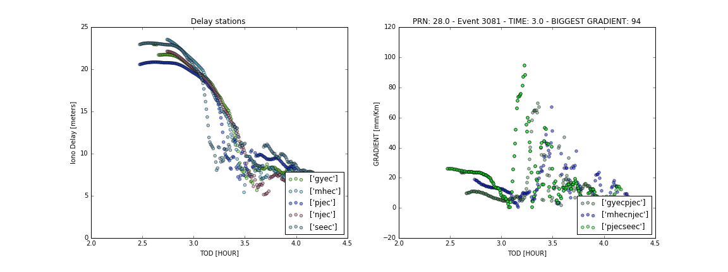
Ecuador Threat Model
Sample event

Slide 7
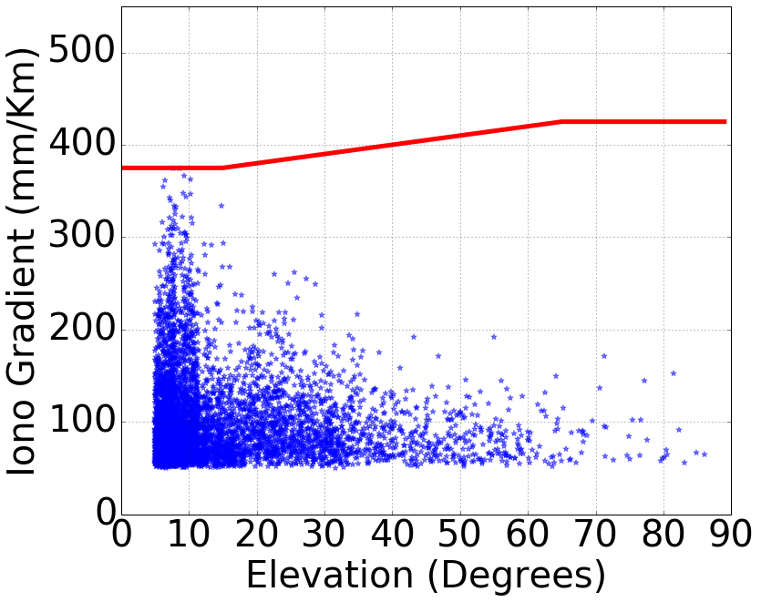
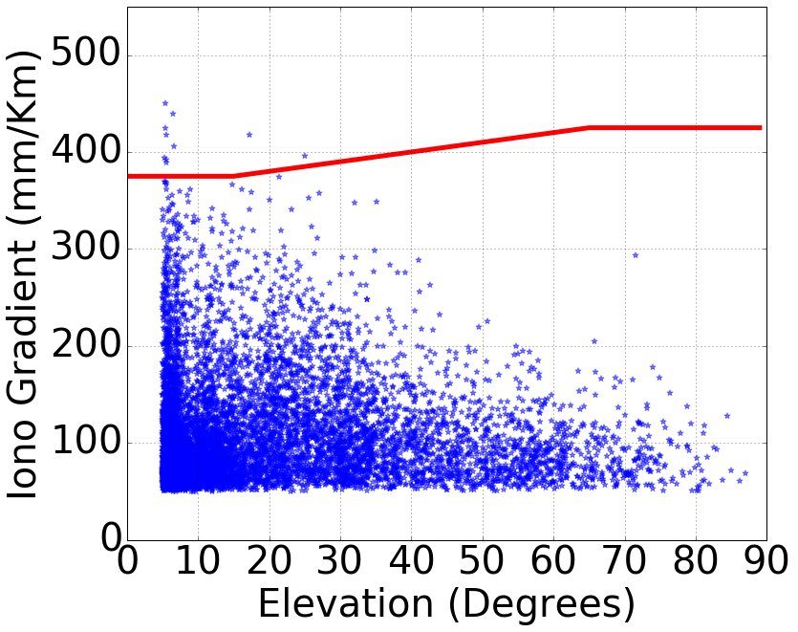
Ecuador Threat Model
Y2013
Y2014

Slide 8
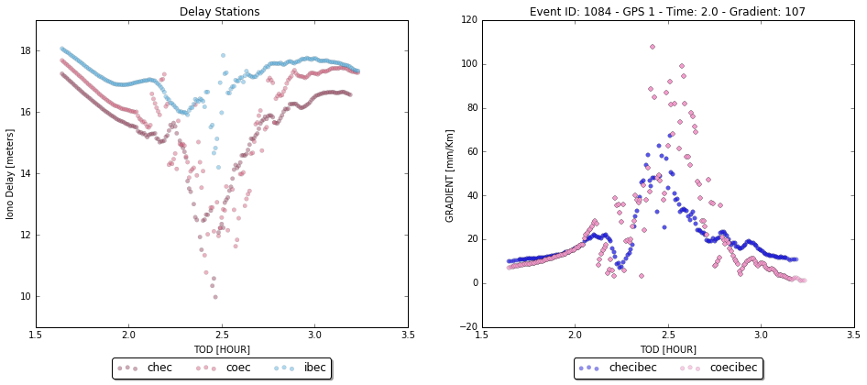
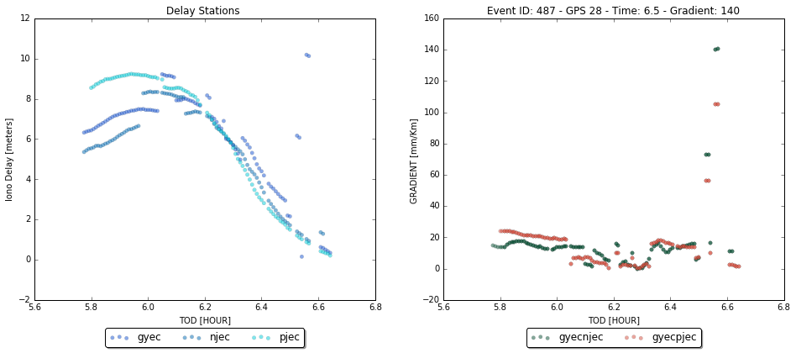
Ecuador Threat Model
True event
False event

Slide 9
Next step: Automated classification of events
First approach: Clustering
Advantages:
No need for manual annotation
K-means for 2013 events with k=5
Each event is represented in an N-dimensional space
5 clusters are defined
Challenges
Proper representation

Slide 10
Class #1 examples

Slide 11
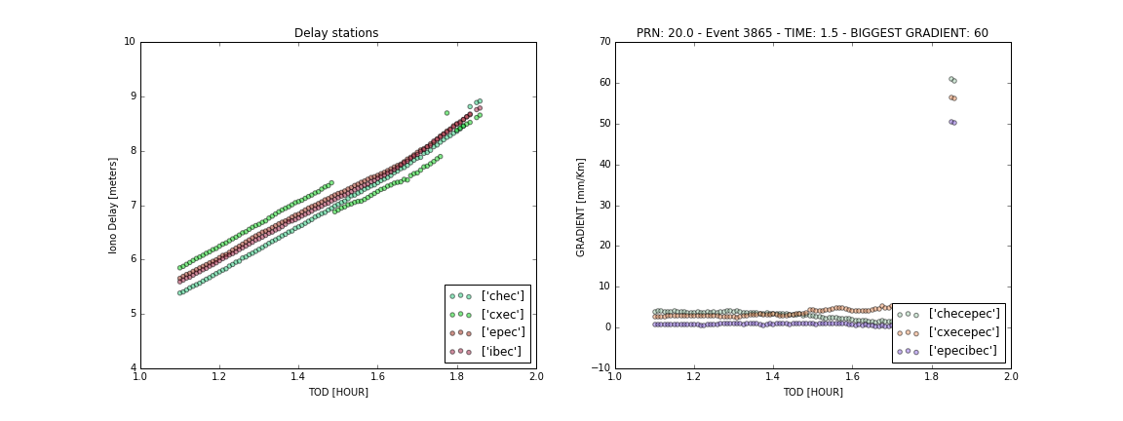
Class #1 examples
Different cases classified in the same category

Slide 12
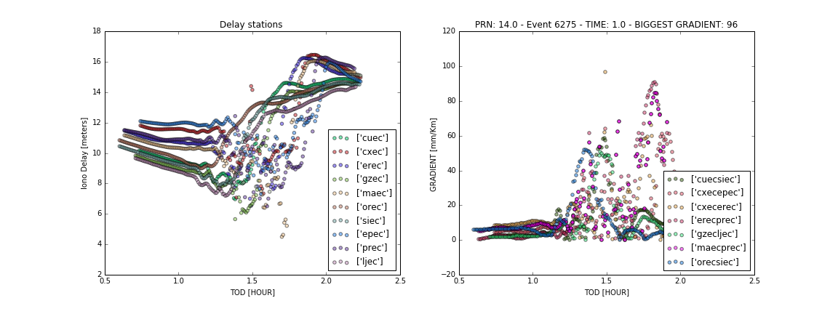
Class #1 examples

Slide 13
New approach: Supervised learning
Manual tagging
True/False events
Models training
Models evaluation
Feature extraction
~1K images

Slide 14
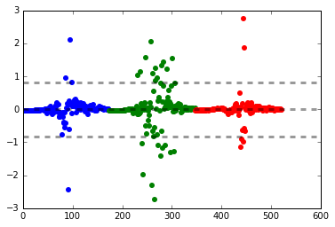
Manual tagging
Delays
Gradients
True event
Delays first difference
Station 1
Station 2
Station 3

Slide 15
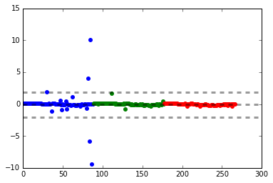
Manual tagging
Delays
Gradients
False event
Delays first difference
Station 1
Station 2
Station 3

Slide 16
Features extraction
Global descriptors
Individual curves descriptors
Aggregated descriptors
Delays
Delays first difference
Delays
Delays first difference

Slide 17
Features extraction
Global descriptors
Number of pairs, number of stations, time of day, time of year, elevation, max gradient

Slide 18
Features extraction
Individual curves descriptors
Per time slot:
Delay descriptors
First difference descriptors
Delays
Delays first difference
Station 1
Station 2
Station 3

Slide 19
Features extraction
Individual curves descriptors
Per time slot:
Delay descriptors
name | description
i_range | Maximum phase delay minus minimum phase delay
n_out_ma | Number of outliers from moving average method
n_out_pf | Number of outliers from polynomial fit method
Delays

Slide 20
Features extraction
Individual curves descriptors
Per time slot:
First difference descriptors
name | description
d_max | Maximum diff value during the time window
d_outliers | Number of diff points out of +/- 2*sigma
d_outliers_bin | Binary indicator for number of diff points out of +/- 2*sigma*
*sigma* is calculated for all the event
Delays first difference
Station 1
Station 2
Station 3

Slide 21
Features extraction
Individual curves descriptors
station_0
station_i
station_m
t0
…
tj
…
t0
…
tj
…
t0
…
tj
v01
…
v0k
…
…
…
vn1
…
vjk
v01
…
v0k
…
…
…
vn1
…
vjk
v01
…
v0k
…
…
…
vn1
…
vjk
Note: Check how to handle different number of stations for each event. Sort by importance? Restrict to top-N stations?

Slide 22
Features extraction
Aggregated descriptors
Aggregation of delay and first difference descriptors for all the stations involved in the event
Delays
Delays first difference
Station 1
Station 2
Station 3

Slide 23
Features extraction
Aggregated descriptors
Delays descriptors aggregation
name | description | f
n | Number of observations per station | sum
n_r | Number of observations per station / L L is the max number of observations | sum
n_low | Number of stations with less than L/2 observations
n_low_r | Number of stations with less than L/2 observations / n_stations
i_outf_ma | Outlier factor from moving average method | std
i_outf_pf | Outlier factor from polynomial fit method | std
i_range | Maximum phase delay minus minimum phase delay | std
Note: Check aggregation rules. Some of them do not make sense

Slide 24
Features extraction
Aggregated descriptors
First difference descriptors aggregation
name | description | f
d_max_diff | Maximum diff value difference between two largest diff values | max - max_2
d_max_std | Maximum diff value | std
d_outliers | Number of diff points out of +/- 2sigma | sum
d_outliers_bin | Binary for diff values out of +/- 2sigma | sum
d_var | diff variance | std
Station 1
Station 2
Station 3

Slide 25
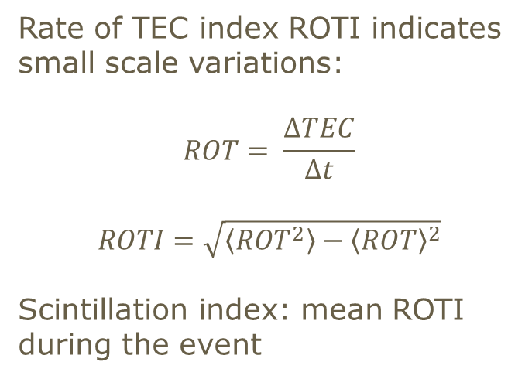
Features extraction
Aggregated descriptors
Scintillation descriptors
Rate of TEC index ROTI indicates small scale variations:
$$ROT= \frac{ΔTEC}{Δt}$$
$$ROTI=\sqrt{\left\langle {ROT}^{2}\right\rangle −{\left\langle ROT\right\rangle }^{2}}$$
Scintillation index: mean ROTI during the event
name | description | f
sroti_max | Max of Scintillation index | max
sroti_mean | Mean of Scintillation index | mean
sroti_std | Standard Deviation of Scintillation index | std

Slide 26
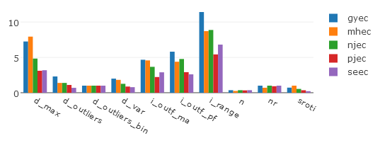
Features extraction
Aggregated descriptors
Similarity between descriptors curves
name | description
sm_mean | Mean similitude between station pairs descriptors
sm_std | Standard deviation of similitude indicator between station pairs descriptors

Slide 27
Features extraction
Global descriptors
Individual curves descriptors
Aggregated descriptors
station_0
station_i
station_m
t0
…
tj
t0
…
tj
t0
…
tj
g0
…
gy
d01
…
d0k
…
…
…
dn1
…
djk
d01
…
d0k
…
…
…
dn1
…
djk
d01
…
d0k
…
…
…
dn1
…
djk
a0
…
az

Slide 28
Features extraction
True event

Slide 29
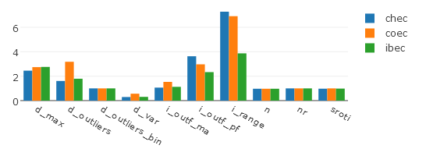
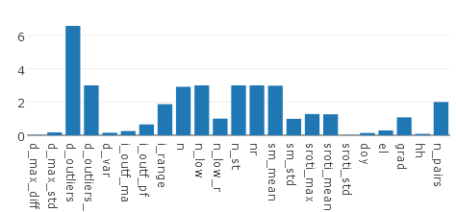
Features extraction
True event

Slide 30
Features extraction
False event

Slide 31
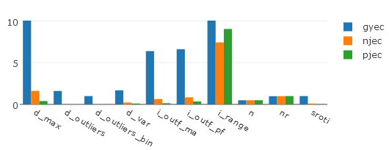
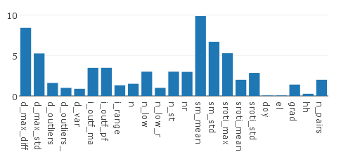
Features extraction
False event

Slide 32
Models
GNB
Gaussian Naive Bayes
RFC
Random Forest Classifier
SVC
Support Vector Classifier
LR
Logistic regression
LSVC Linear SVC
Sweep parameters

Slide 33

Models evaluation
 |  | Real
 |  | True | False
Predicted | True | TP | FP
 | False | FN | TN
False positives rate
$$FPR= \frac{FP}{FP+TN}$$
False negatives rate
$$FNR= \frac{FN}{TP+FN}$$

Slide 34
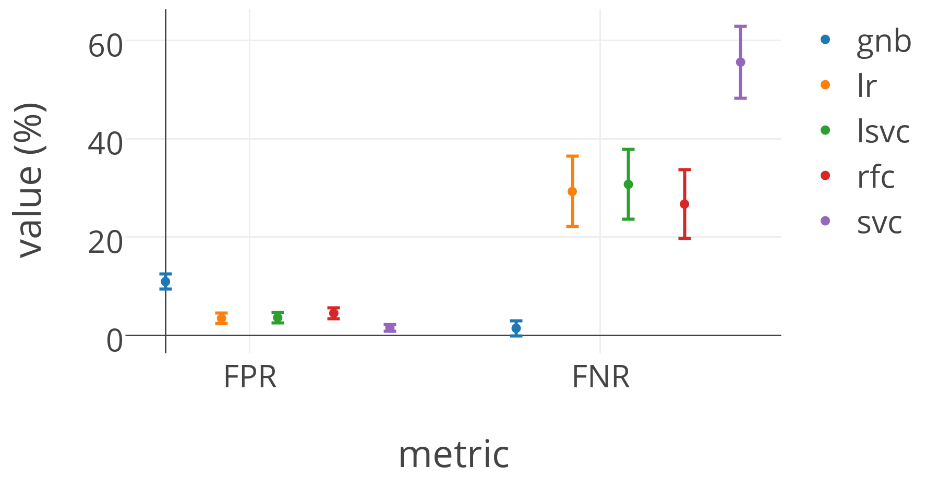
Results: Methods performance without time series descriptors
Model | FPR | FNR
GNB | 10.97 ± 1.52 | 1.49 ± 1.52
LR | 3.5 ± 1.07 | 29.29 ± 7.16
LSVC | 3.64 ± 1.09 | 30.74 ± 7.07
RFC | 4.55 ± 1.11 | 26.73 ± 6.99
SVC | 1.58 ± 0.7 | 55.59 ± 7.33
Average error over 1000 runs for each model

Slide 35
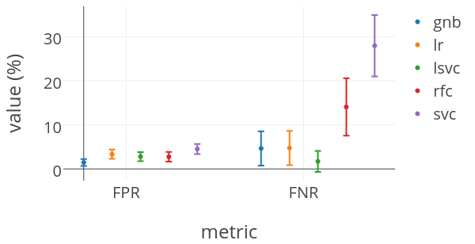
Results: Methods performance with time series descriptors
Model | FPR | FNR
GNB | 1.46 ± 0.8 | 4.65 ± 3.9
LR | 3.33 ± 1.06 | 4.74 ± 3.87
LSVC | 2.79 ± 1.04 | 1.71 ± 2.39
RFC | 2.76 ± 1.1 | 14.07 ± 6.53
SVC | 4.52 ± 1.15 | 27.97 ± 6.96

Slide 36
Results
Feature importance obtained from Random Forest Classifier
descriptor | feat_imp
i_outf_pf | 0.33
i_outf_ma | 0.10
elevation | 0.10
d_max_std | 0.08
d_outliers | 0.07

Slide 37
Concluding remarks
Simple classifiers (with a complex set of features!) provide good results, but still predict False Negatives, which is not desirable
Time series descriptors are important for performance
Next steps
Run different parameters and models
Tag more images (14.000 available)
Introduce more true events in the training dataset

Slide 38
Acknowledgments
This work is financially supported by EU FP7 Marie Curie Initial Training Network MULTI - POS (Multi - technology Positioning Professionals) under grant nr. 316528 and project number 1618 from “Programa Capital Semilla” by Vicerrectoría de Investigación y Extensión at Universidad Industrial de Santander (UIS)
Data processing and analysis was performed at the High Performance and Scientific Computing Centre at UIS (http://www.sc3.uis.edu.co).
Instituto Geografico Militar REGME provided the data required for this study.
Finally, we also acknowledge the support of Pildo Labs, a Barcelona based SME, for the training provided by their staff.

Slide 39
References
Jung, S., & Lee, J. (2012). Long-term ionospheric anomaly monitoring for ground based augmentation systems. Radio Science, 47(February). http://doi.org/10.1029/2012RS005016
Kim, M., Choi, Y., Jun, H.-S., & Lee, J. (2014). GBAS ionospheric threat model assessment for category I operation in the Korean region. GPS Solutions. http://doi.org/10.1007/s10291-014-0404-6
Pedregosa et al., Scikit-learn: Machine Learning in Python, JMLR 12, pp. 2825-2830, 2011.
“Red GNSS de monitoreo continuo del ecuador REGME,” Instituto Geografico Militar, Ecuador, www.igm.gob.ec. Accessed 06.06.2016.
SC3 UIS. Universidad Industrial de Santander (SC3UIS) High Performance and Scientific Computing Centre. http://grid.uis.edu.co and http://sc3.uis.edu.co
Tolman, B., Harris, R. B., Gaussiran, T., Munton, D., Little, J., Mach, R., … Renfro, B. (2004). The GPS Toolkit: Open Source GPS Software. In Proceedings of the 16th International Technical Meeting of the Satellite Division of the Institute of Navigation. Long Beach, California.

Slide 40
New approach: Supervised learning
Manual classification of ~1000 images as False / True Positive
FALSE POSITIVE | 823
TRUE POSITIVE | 131
Total | 954

Slide 41
New approach: Supervised learning
Manual tagging
True/False positives
Models training
GNB
Models evaluation
FPR: False positives rate
SVM
RF
Logistic regression
FNR: False negatives rate
Feature extraction
~1K images
Gradients
Delays

Slide 42
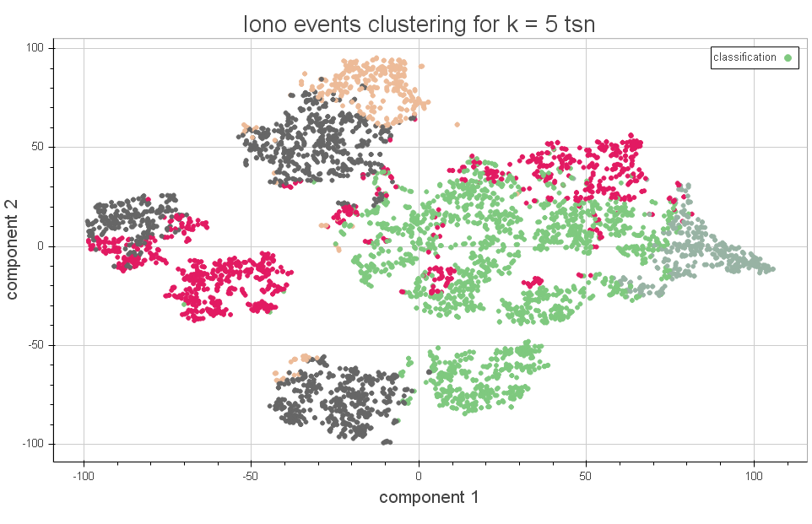
Obtained clusters

