Slide 1

Student Retention Toolkit using R Shiny App
Saint Martin’s University
Kim Van Vleet
Saint Martin’s University
Mary Donahoo
Saint Martin’s University

Slide 2
Student Retention
Student retention rates is one of the most frequently requested data points
Indicator of student success
Work done to improve retention comes from
Internal student success and retention committees
Regional and national conferences
External companies helping institutions

Slide 3
Why is this needed?
Providing student retention requests is occasionally done in ad-hoc manner
Requests for retention data tends to be for similar student attributes
By major or by single attribute
Changes in policies, process, how data is stored can skew results over time

Slide 4
What R Toolkit can do for retention
R Toolkit can routinely provide common student retention graphically and statistically
Uses a systematic, standardized, and documented method for providing retention for student attributes
Demographics: race/ethnicity, gender
Prior to college: SAT/ACT scores, high school GPA, college prep, first generation
Academic: First term GPA, major
Financial: Pell Grant, WA State Need Grant/WA College Grant

Slide 5
Basic concept
Retrieves student dataset from 2004 to near-current year using SQL Server
Dataset is imported into R
Visualizations in R using web-based Shiny app

Slide 6
Main project task list
Task | Description
SQL query/ dataset | Produce date set and create a data dictionary that describes the variable types and a glossary that describes the longitudinal changes in the data
R Studio | Install R and R Studio; using R Studio in cloud
R import guide | Step by step guide to importing the SQL dataset into R
R visualizations | Create separate R scripts for different types of R visualizations; Links to R resources and quick references
Shiny App | Build a Shiny App with a tab set of example visualizations Include instructions on how to make the data available Include a tab for the data dictionary

Slide 7
Security considerations
SQL query output contains student IDs
Use external table that links student ID with pseudo ID
Use algorithm to generate pseudo ID
Apply constant to student ID
Limit access to shiny dashboard
Use active directory

Slide 8
Project deliverables
SQL code for retrieving student data set
Exports into Excel for working with other data
Linking to student survey data
Dataset can be used as stand-alone for use in other analysis software
Data dictionary which defines the variables data types, naming conventions
Glossary which defines how the data has historically changed or if data is office specific
When a variable was first used and when it was last used
SATs, Academic Indexes, majors, first generation
Instructions to install required programs and import dataset

Slide 9
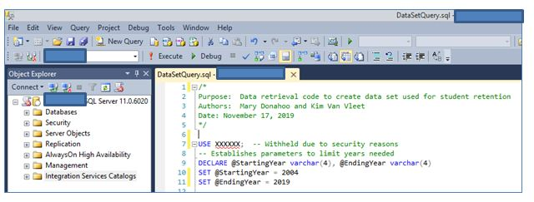
Demonstration
SQL Server

Slide 10
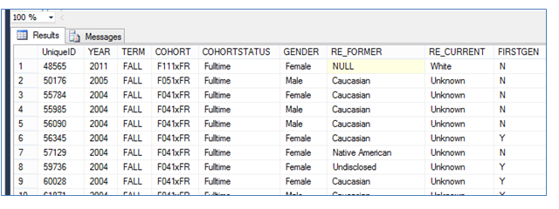
Demonstration
SQL Server

Slide 11
Demonstration
Shiny app dashboard

