Slide 1

Database Management System
SQL
Data Definition Language
Prepared By
Mehak Usmani
Modified By: Sophia Ajaz
Content taken from: © Pearson Education Limited 1995, 2005

Slide 2
Objectives
To Learn
Creating database and its elements using SQL
Data types supported by SQL standard.
How to alter the database design using SQL
How to define integrity constraints using SQL.
How to create and delete views using SQL.
How the DBMS performs operations on views.
Under what conditions views are updatable.
Advantages and disadvantages of views.
Notes:
Chapter Name
September 98

Slide 3
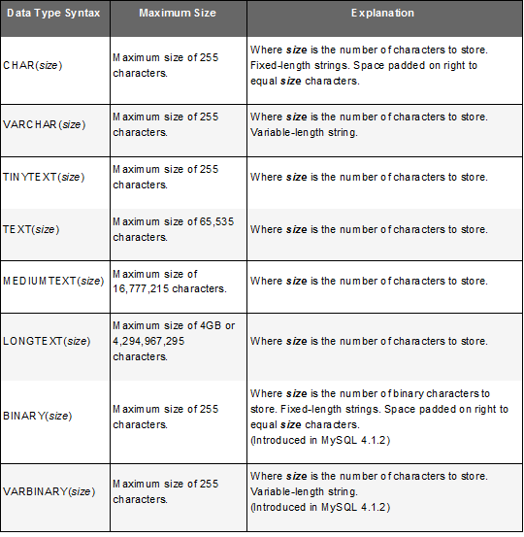
MYSQL Data Types
Notes:
Binary strings (as stored using the BINARY, VARBINARY, and BLOB data types) have a character set and collation named binary. Binary strings are sequences of bytes. For the binary collation, comparison and sorting are based on numeric byte values. The concept of lettercase does not apply to bytes in a binary string. For binary strings, all characters are significant in comparisons, including trailing spaces.
Nonbinary strings (as stored using the CHAR, VARCHAR, and TEXT data types) have a character set and collation other than binary. A non-binary string has a character set and is automatically converted to another character set in different cases. Characters in a non-binary string can be converted from one lettercase to another. Trailing spaces are insignificant in comparisons
Chapter Name
September 98

Slide 4
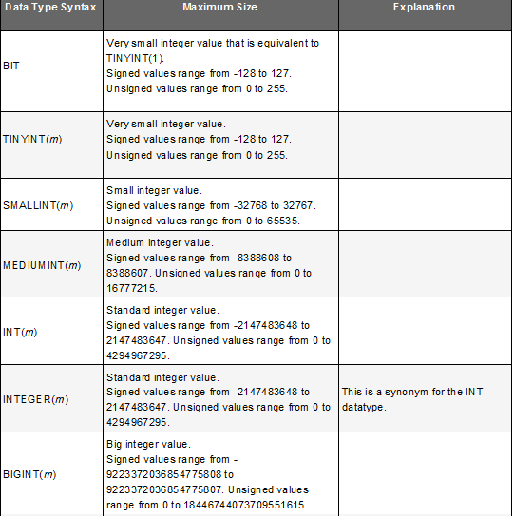
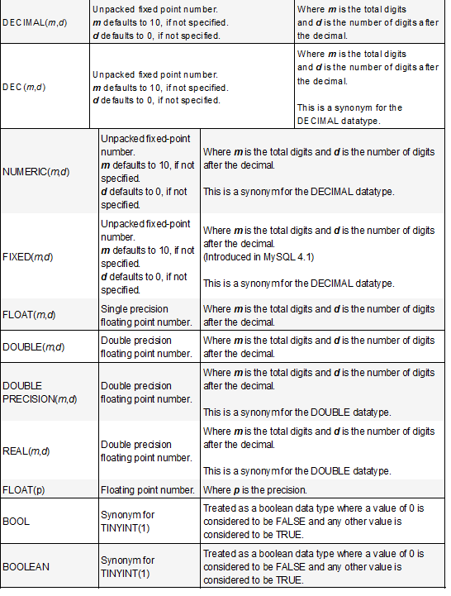
MYSQL Data Types
Notes:
Chapter Name
September 98

Slide 5
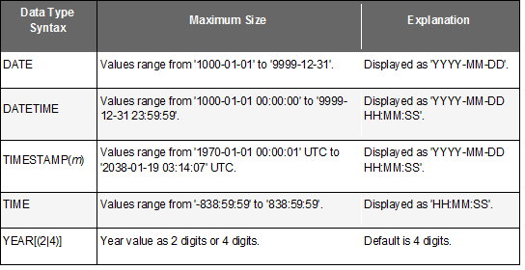
MYSQL Data Types
Notes:
Chapter Name
September 98

Slide 6
Integrity Enhancement Feature
Consider five types of integrity constraints:
  required data
  domain constraints
  entity integrity
  referential integrity
  general constraints.
Notes:
Chapter Name
September 98

Slide 7
IEF - Entity Integrity
Primary key of a table must contain a unique, non-null value for each row.
  PRIMARY KEY(staffNo)
  PRIMARY KEY(clientNo, propertyNo)
Can only have one PRIMARY KEY clause per table. Can still ensure uniqueness for alternate keys using UNIQUE:
  UNIQUE(telNo)
Notes:
Chapter Name
September 98

Slide 8
IEF - Referential Integrity
FK is column or set of columns that links each row in child table containing foreign FK to row of parent table containing matching PK.
Referential integrity means that, if FK contains a value, that value must refer to existing row in parent table.
ISO standard supports definition of FKs with FOREIGN KEY clause in CREATE and ALTER TABLE:
  FOREIGN KEY(branchNo) REFERENCES Branch
Notes:
Chapter Name
September 98

Slide 9
IEF - Referential Integrity
Any INSERT/UPDATE attempting to create FK value in child table without matching value in parent is rejected.
Action taken attempting to update/delete a value in parent table with matching rows in child is dependent on referential action specified using ON UPDATE and ON DELETE sub-clauses:
  CASCADE
  SET NULL
  SET DEFAULT
  NO ACTION
Notes:
Chapter Name
September 98

Slide 10
IEF - Referential Integrity
CASCADE: Delete row from parent and delete matching rows in child, and so on in cascading manner.
SET NULL: Delete row from parent and set FK column(s) in child to NULL. Only valid if FK columns are NOT NULL.
SET DEFAULT: Delete row from parent and set each component of FK in child to specified default. Only valid if DEFAULT specified for FK columns.
NO ACTION: Reject delete from parent. Default.
Notes:
Chapter Name
September 98

Slide 11
IEF - Referential Integrity
FOREIGN KEY (staffNo) REFERENCES Staff
ON DELETE SET NULL
FOREIGN KEY (ownerNo) REFERENCES Owner
ON UPDATE CASCADE
Notes:
Chapter Name
September 98

Slide 12
Data Definition
SQL DDL allows database objects such as schemas, domains, tables, views, and indexes to be created and destroyed.
Main SQL DDL statements are:
  CREATE SCHEMA DROP SCHEMA
  CREATE/ALTER DOMAIN DROP DOMAIN
  CREATE/ALTER TABLE DROP TABLE
  CREATE VIEW DROP VIEW
Many DBMSs also provide:
  CREATE INDEX DROP INDEX
Notes:
Chapter Name
September 98

Slide 13
Data Definition
Relations and other database objects exist in an environment.
Each environment contains one or more catalogs, and each catalog consists of set of schemas.
Schema is named collection of related database objects.
Objects in a schema can be tables, views, domains, assertions, collations, translations, and character sets. All have same owner.
Notes:
Chapter Name
September 98

Slide 14
CREATE SCHEMA
  CREATE SCHEMA [Name]
  DROP SCHEMA Name [RESTRICT | CASCADE ]
With RESTRICT (default), schema must be empty or operation fails.
With CASCADE, operation cascades to drop all objects associated with schema in order defined above. If any of these operations fail, DROP SCHEMA fails.
Notes:
Chapter Name
September 98

Slide 15
CREATE TABLE
CREATE TABLE table_name (
column1 datatype,
column2 datatype,
column3 datatype,
....
);
Notes:
Chapter Name
September 98

Slide 16
CREATE TABLE
Creates a table with one or more columns of the specified dataType.
With NOT NULL, system rejects any attempt to insert a null in the column.
Can specify a DEFAULT value for the column.
Primary keys should always be specified as NOT NULL.
FOREIGN KEY clause specifies FK along with the referential action.
Notes:
Chapter Name
September 98

Slide 17
CREATE TABLE
CREATE TABLE `propertyforrent` (
`propertyNo` varchar(50) NOT NULL,
`street` varchar(50) DEFAULT NULL,
`city` varchar(50) DEFAULT NULL,
`postcode` varchar(50) DEFAULT NULL,
`type` varchar(50) DEFAULT NULL,
`rooms` int(11) DEFAULT NULL,
`rent` int(11) DEFAULT NULL,
`ownerNo` varchar(50) DEFAULT NULL,
`staffNo` varchar(50) DEFAULT NULL,
`branchNo` varchar(50) DEFAULT NULL,
`picture` varchar(40) DEFAULT NULL,
`floorPlan` varchar(40) DEFAULT NULL,
PRIMARY KEY (`propertyNo`),
FOREIGN KEY (staffNo) REFERENCES staff(staffNo)
)
Notes:
Chapter Name
September 98

Slide 18
ALTER TABLE
Add a new column to a table.
Drop a column from a table.
Add a new table constraint.
Drop a table constraint.
Set a default for a column.
Drop a default for a column.
Notes:
Chapter Name
September 98

Slide 19
ALTER TABLE
Change Staff table by removing default of ‘Assistant’ for position column and setting default for gender column to female (‘F’).
  ALTER TABLE Staff
  MODIFY position VARCHAR(50);
  ALTER TABLE Staff
  MODIFY gender VARCHAR(1) DEFAULT 'F';
Notes:
Chapter Name
September 98

Slide 20
ALTER TABLE
Remove column floorPlan from PropertyForRent. Add a new column to Client table.
    ALTER TABLE propertyforrent
    DROP floorPlan
    ALTER TABLE CLIENT
    ADD prefNoRooms INT(3) DEFAULT 2;
Notes:
Chapter Name
September 98

Slide 21
ALTER TABLE
Make staffNo foreign key in propertyforrent.
ALTER TABLE propertyforrent
ADD FOREIGN KEY (staffNo)
REFERENCES staff(staffNo)
To drop FK,
ALTER TABLE propertyforrent
DROP FOREIGN KEY staffNo
Notes:
Chapter Name
September 98

Slide 22
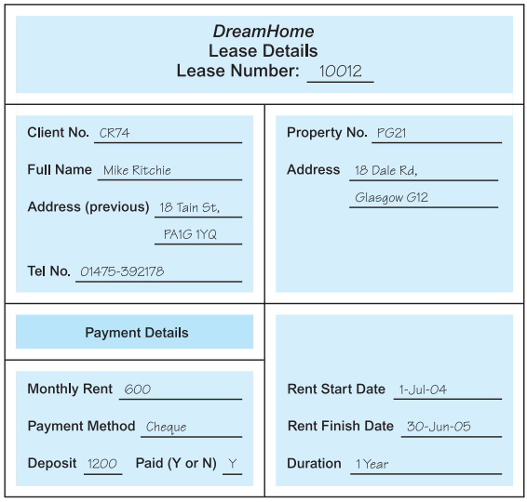
Create Table for Lease Detail
Notes:
Chapter Name
September 98

Slide 23
Create Table for Lease Detail
CREATE TABLE LeaseDetail(
  leaseNo INT(4),
  clientNo VARCHAR(50),
  propertyNo VARCHAR(50),
  monthlyRent INT(10),
  paymentMethod VARCHAR(30) DEFAULT 'Cash',
  Deposit INT(10),
  depositPaid BIT(1) DEFAULT 1,
  rentStartDate DATE,
  rentFinishDate DATE,
  duration VARCHAR(30),
  PRIMARY KEY (leaseNo)
)
Notes:
Chapter Name
September 98

Slide 24
Example: Create Table for Lease Detail
ALTER TABLE LeaseDetail
ADD CONSTRAINT fk_LeaseDetail_client FOREIGN KEY (clientNo) REFERENCES CLIENT(clientNo);
ALTER TABLE LeaseDetail
ADD CONSTRAINT fk_LeaseDetail_property FOREIGN KEY (propertyNo) REFERENCES propertyforrent(propertyNo);
Notes:
Chapter Name
September 98

Slide 25
DROP TABLE
DROP TABLE TableName [RESTRICT | CASCADE]
  e.g. DROP TABLE PropertyForRent;
Removes named table and all rows within it.
With RESTRICT, if any other objects depend for their existence on continued existence of this table, SQL does not allow request.
With CASCADE, SQL drops all dependent objects (and objects dependent on these objects).
Notes:
Chapter Name
September 98

Slide 26
Views
Base Relation
  Named relation corresponding to an entity in conceptual schema, whose tuples are physically stored in database.
View
  The dynamic result of one or more relational operations operating on the base relations to produce another relation. A view is a virtual relation that does not necessarily exist in the database but can be produced upon request by a particular user, at the time of request.

Slide 27
Views
Contents of a view are defined as a query.
A view is a virtual or derived relation: a relation that does not necessarily exist in its own right, but may be dynamically derived from one or more base relations.
Views are dynamic, meaning that changes made to base relations that affect view attributes are immediately reflected in the view.
With view resolution, any operations on view are automatically translated into operations on relations from which it is derived.
With view materialization, the view is stored as a temporary table, which is maintained as the underlying base tables are updated.

Slide 28
Purpose of Views
Provides powerful and flexible security mechanism by hiding parts of database from certain users.
Permits users to access data in a customized way, so that same data can be seen by different users in different ways, at same time.
Can simplify complex operations on base relations.

Slide 29
SQL - CREATE VIEW
CREATE VIEW ViewName [(newColumnName [,])]
AS
SELECT . . .
Can assign a name to each column in view.
If list of column names is specified, it must have same number of items as number of columns produced by subselect.
If omitted, each column takes name of corresponding column in subselect.
Notes:
Chapter Name
September 98

Slide 30
SQL - CREATE VIEW
List must be specified if there is any ambiguity in a column name.
The subselect is known as the defining query.
Need SELECT privilege on all tables referenced in subselect and USAGE privilege on any domains used in referenced columns.
Notes:
Chapter Name
September 98

Slide 31
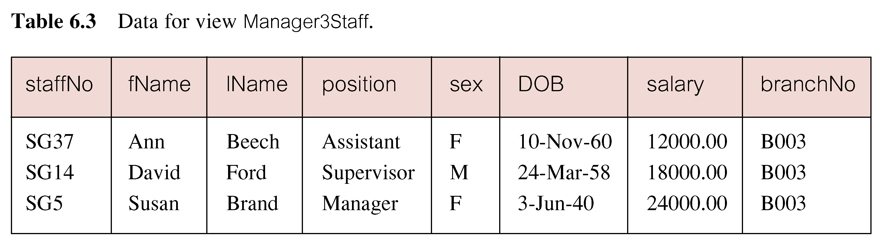
Create Horizontal View
  Create view so that manager at branch B003 can only see details for staff who work in his or her office.
CREATE VIEW vw_branch_B003
  AS SELECT *
  FROM Staff
  WHERE branchNo = ‘B003’;
Notes:
Chapter Name
September 98

Slide 32
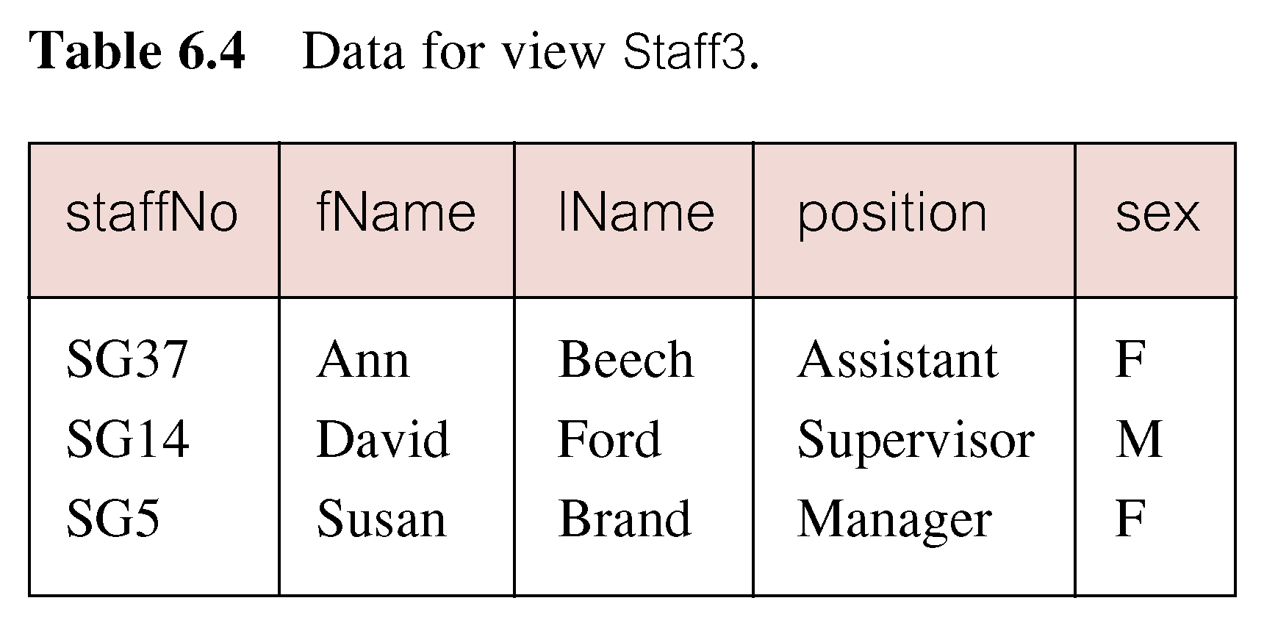
Create Vertical View
Create view of staff details at branch B003 excluding salaries.
CREATE VIEW vw_Staff_B003
  AS
  SELECT staffNo, fName, lName, position, gender
  FROM Staff
  WHERE branchNo = ‘B003’;
Notes:
Vertical views are commonly used where the data stored in a table is used by various
users or groups of users. They provide a private table for these users composed only of the
columns they need.
Chapter Name
September 98

Slide 33
Grouped and Joined Views
Create view of staff who manage properties for rent, including branch number they work at, staff number, and number of properties they manage.
CREATE VIEW vw_StaffPropCnt
(branchNo, staffNo, cnt)
  AS
    SELECT s.branchNo, s.staffNo, COUNT(*)
    FROM Staff s, PropertyForRent p
    WHERE s.staffNo = p.staffNo
    GROUP BY s.branchNo, s.staffNo;
Notes:
Chapter Name
September 98

Slide 34
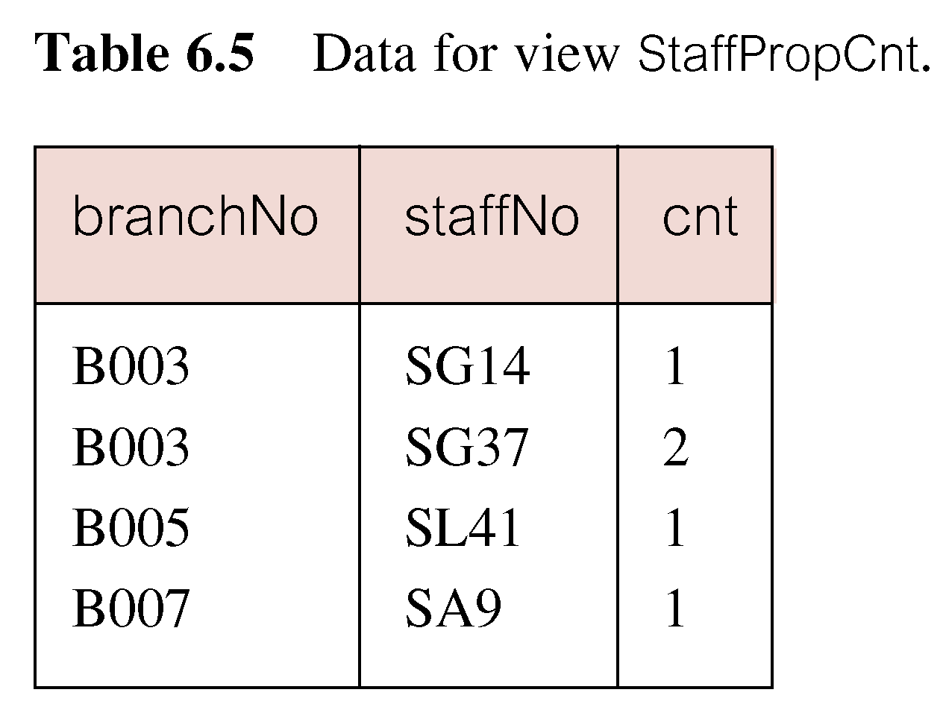
Grouped and Joined Views
SELECT *
FROM vw_StaffPropCnt;
Notes:
Chapter Name
September 98

Slide 35
SQL - DROP VIEW
  DROP VIEW ViewName
Causes definition of view to be deleted from database.
For example:
  DROP VIEW vw_Staff_B003;
Notes:
Chapter Name
September 98

Slide 36
View Resolution
The DBMS stores the definition of the view in the database. When the DBMS encounters a reference to a view, one approach is to look up this definition and translate the request into an equivalent request against the source tables of the view and then perform the equivalent request. This merging process, called view resolution.
Notes:
Chapter Name
September 98

Slide 37
View Resolution
Defining query
User query
Notes:
Chapter Name
September 98

Slide 38
View Resolution
Count number of properties managed by each member at branch B003.
  SELECT staffNo, cnt
  FROM vw_StaffPropCnt
  WHERE branchNo = ‘B003’
  ORDER BY staffNo;
Notes:
Chapter Name
September 98

Slide 39
View Resolution
(a) View column names in SELECT list are translated into their corresponding column names in the defining query:
  SELECT s.staffNo As staffNo, COUNT(*) As cnt
(b) View names in FROM are replaced with corresponding FROM lists of defining query:
  FROM Staff s, PropertyForRent p
Notes:
Chapter Name
September 98

Slide 40
View Resolution
(c) WHERE from user query is combined with WHERE of defining query using AND:
  WHERE s.staffNo = p.staffNo AND branchNo = ‘B003’
(d) GROUP BY and HAVING clauses copied from defining query:
  GROUP BY s.branchNo, s.staffNo
(e) ORDER BY copied from query with view column name translated into defining query column name
  ORDER BY s.staffNo
Notes:
Chapter Name
September 98

Slide 41
View Resolution
(f) Final merged query is now executed to produce the result:
  SELECT s.staffNo AS staffNo, COUNT(*) AS cnt
  FROM Staff s, PropertyForRent p
  WHERE s.staffNo = p.staffNo
  AND branchNo = ‘B003’
  GROUP BY s.branchNo, s.staffNo
  ORDER BY s.staffNo;
Notes:
Chapter Name
September 98

Slide 42
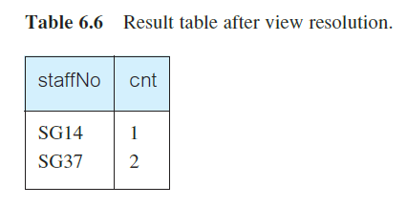
View Resolution

Slide 43
Updating Views
All updates to a base relation should be immediately reflected in all views that reference that base relation.
If view is updated, underlying base relation should reflect change.

Slide 44
Updating Views
There are restrictions on types of modifications that can be made through views:
  Updates are allowed if query involves a single base relation and contains a candidate key of base relation.
  Updates are not allowed involving multiple base relations.
  Updates are not allowed involving aggregation or grouping operations.

Slide 45
View Updatability
All updates to base table reflected in all views that encompass base table.
Similarly, may expect that if view is updated then base table(s) will reflect change.
Notes:
Chapter Name
September 98

Slide 46
View Updatability
However, consider again view StaffPropCnt.
If we tried to insert record showing that at branch B003, SG5 manages 2 properties:
  INSERT INTO StaffPropCnt
  VALUES (‘B003’, ‘SG5’, 2);
Have to insert 2 records into PropertyForRent showing which properties SG5 manages. However, do not know which properties they are; i.e. do not know primary keys!
Notes:
Chapter Name
September 98

Slide 47
View Updatability
If change definition of view and replace count with actual property numbers:
  CREATE VIEW StaffPropList (branchNo, staffNo, propertyNo)
  AS
  SELECT s.branchNo, s.staffNo, p.propertyNo
  FROM Staff s, PropertyForRent p
  WHERE s.staffNo = p.staffNo;
Notes:
Chapter Name
September 98

Slide 48
View Updatability
Now try to insert the record:
  INSERT INTO StaffPropList
  VALUES (‘B003’, ‘SG5’, ‘PG19’);
Still problem, because in PropertyForRent all columns except postcode/staffNo are not allowed nulls.
However, have no way of giving remaining non-null columns values.
Notes:
Chapter Name
September 98

Slide 49
View Updatability
ISO specifies that a view is updatable if and only if:
- DISTINCT is not specified.
- Every element in SELECT list of defining query is a column name and no column appears more than once.
- FROM clause specifies only one table, excluding any views based on a join, union, intersection or difference.
- No nested SELECT referencing outer table.
- No GROUP BY or HAVING clause.
- Also, every row added through view must not violate integrity constraints of base table.
Notes:
Chapter Name
September 98

Slide 50
Updatable View
For view to be updatable, DBMS must be able to trace any row or column back to its row or column in the source table.
Notes:
Chapter Name
September 98

Slide 51
migrating rows - Views
Rows exist in a view because they satisfy WHERE condition of defining query.
If a row changes and no longer satisfies condition, it disappears from the view.
New rows appear within view when insert/update on view cause them to satisfy WHERE condition.
Rows that enter or leave a view are called migrating rows.
Notes:
Chapter Name
September 98

Slide 52
Advantages of Views
Data independence
Concurrency
Improved security
Reduced complexity
Convenience
Customization
Data integrity
Notes:
Chapter Name
September 98

Slide 53
Disadvantages of Views
Update restriction
Structure restriction
Performance
Notes:
Chapter Name
September 98

Slide 54
View Materialization
View resolution mechanism may be slow, particularly if view is accessed frequently.
View materialization stores view as temporary table when view is first queried.
Thereafter, queries based on materialized view can be faster than re-computing view each time.
Difficulty is maintaining the currency of view while base tables(s) are being updated.
Notes:
Chapter Name
September 98

Slide 55
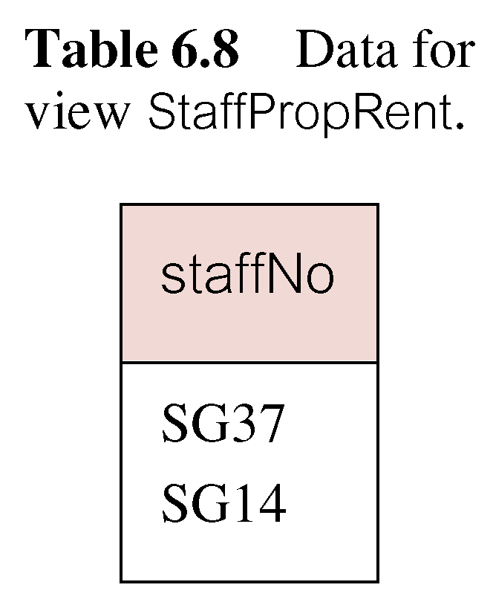
View Maintenance
View maintenance aims to apply only those changes necessary to keep view current.
Consider following view:
  CREATE VIEW StaffPropRent(staffNo)
  AS SELECT DISTINCT staffNo
  FROM PropertyForRent
  WHERE branchNo = ‘B003’ AND
  rent > 400;
Notes:
Chapter Name
September 98

Slide 56
View Materialization
If insert row into PropertyForRent with rent ≤400 then view would be unchanged.
If insert row for property PG24 at branch B003 with staffNo = SG19 and rent = 550, then row would appear in materialized view.
If insert row for property PG54 at branch B003 with staffNo = SG37 and rent = 450, then no new row would need to be added to materialized view.
If delete property PG24, row should be deleted from materialized view.
If delete property PG54, then row for PG37 should not be deleted (because of existing property PG21).
Notes:
Chapter Name
September 98

Slide 57
View Materialization
Materialized Views can be refreshed in different kinds. They can be refreshed:
  never (only once in the beginning, for static data only)
  on demand (for example once a day, for example after nightly load)
  immediately (after each statement, using triggers)
Notes:
Chapter Name
September 98

Slide 58
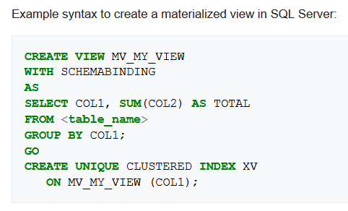
View Materialization
Notes:
Chapter Name
September 98

Slide 59
DCL
Data control language
© Pearson Education Limited 1995, 2005
Notes:
Chapter Name
September 98

Slide 60
Data Control Language - DCL
DCL is short name of Data Control Language which includes commands such as GRANT, and mostly concerned with rights, permissions and other controls of the database system.
GRANT – allow users access privileges to database
REVOKE – withdraw users access privileges given by using the GRANT command
Notes:
Chapter Name
September 98

Slide 61
Access Control
The ‘create user’ statement creates new database accounts. An error occurs if you try to create an account that already exists.
An account when first created has no privileges.
CREATE USER user [auth_option]...
Example
CREATE USER ‘dba’ IDENTIFIED BY 'mypass';
Used to determine which objects user may reference and what operations may be performed on those objects.
Notes:
Chapter Name
September 98

Slide 62
Privileges
Privileges defines the access rights provided to a user on a database object.
There are two types of privileges.
System privileges - This allows the user to CREATE, ALTER, or DROP database objects.
Object privileges - This allows the user to EXECUTE, SELECT, INSERT, UPDATE, or DELETE data from database objects to which the privileges apply.
Notes:
Chapter Name
September 98

Slide 63
Privileges
System Privileges | Description
CREATE object | allows users to create the specified object in their own schema.
CREATE ANY object | allows users to create the specified object in any schema.
The above rules also apply for ALTER and DROP system privileges.
Notes:
Chapter Name
September 98

Slide 64
Privileges
Object Privileges | Description
INSERT | allows users to insert rows into a table.
SELECT | allows users to select data from a database object.
UPDATE | allows user to update data in a table.
EXECUTE | allows user to execute a stored procedure or a function.
Notes:
Chapter Name
September 98

Slide 65
GRANT
  GRANT {PrivilegeList | ALL PRIVILEGES}
  ON ObjectName
  TO {AuthorizationIdList | PUBLIC}
  [WITH GRANT OPTION]
PrivilegeList consists of one or more of above privileges separated by commas.
ALL PRIVILEGES grants all privileges to a user.
Notes:
Chapter Name
September 98

Slide 66
GRANT
PUBLIC allows access to be granted to all present and future authorized users.
ObjectName can be a base table, view, procedure and function.
WITH GRANT OPTION allows privileges to be passed on.
Notes:
Chapter Name
September 98

Slide 67
GRANT
Give Manager full privileges to Staff table.
  GRANT ALL PRIVILEGES
  ON Staff
  TO Manager WITH GRANT OPTION;
Give users Personnel and Director SELECT and UPDATE on column salary of Staff.
  GRANT SELECT, UPDATE (salary)
  ON Staff
  TO Personnel, Director;
Notes:
Chapter Name
September 98

Slide 68
GRANT Specific Privileges to PUBLIC
Give all users SELECT on Branch table.
  GRANT SELECT
  ON Branch
  TO PUBLIC;
Notes:
Chapter Name
September 98

Slide 69
GRANT SYSTEM Privileges
  Grant create table right to dev.
  GRANT CREATE ON dreamHome.* TO dev
  Grant all rights to devlead.
  GRANT ALL PRIVILEGES
  ON dreamHome.* TO devlead
Notes:
Chapter Name
September 98

Slide 70
REVOKE
The REVOKE command removes user access rights or privileges to the database objects.
  REVOKE privilege_name
  ON object_name
  FROM {user_name |PUBLIC |role_name}
  Example:
  REVOKE SELECT ON client FROM manager;
ALL PRIVILEGES refers to all privileges granted to a user by user revoking privileges.
Notes:
Chapter Name
September 98

Slide 71
REVOKE
GRANT OPTION FOR allows privileges passed on via WITH GRANT OPTION of GRANT to be revoked separately from the privileges themselves.
Privileges granted to this user by other users are not affected.
If the user has received SELECT privileges on that table from more than one users, he/she can SELECT from that table until everyone who granted the permission revokes it.
Notes:
Chapter Name
September 98

Slide 72
REVOKE Specific Privileges
Revoke privilege SELECT on Branch table from all users.
  REVOKE SELECT
  ON Branch
  FROM PUBLIC;
Revoke all privileges given to Director on Staff table.
  REVOKE ALL PRIVILEGES
  ON Staff
  FROM Director;
Notes:
Chapter Name
September 98

Slide 73
TCL
Transaction Control Language-
© Pearson Education Limited 1995, 2005
Notes:
Chapter Name
September 98

Slide 74
Transaction Control Language - TCL
TCL is short name of Transaction Control Language which deals with transaction within a database.
START TRANSACTION or BEGIN start a new transaction.
COMMIT commits the current transaction, making its changes permanent.
ROLLBACK rolls back the current transaction, canceling its changes.
SET autocommit disables or enables the default commit mode for the current session.
Notes:
Chapter Name
September 98

Slide 75
Transactions
Transaction is logical unit of work with one or more SQL statements guaranteed to be atomic with respect to recovery.
SQL defines transaction model based on COMMIT and ROLLBACK. InnoDB storage engine of MySQL supports transactions.
By default, MySQL starts the session for each new connection with autocommit enabled, so MySQL does a commit after each SQL statement if that statement did not return an error
Changes made by transaction are not visible to other concurrently executing transactions until transaction completes.
Notes:
Chapter Name
September 98

Slide 76
Commit
SET autocommit=0;
START TRANSACTION;
UPDATE CLIENT SET preType= ‘Flat’ ;
SELECT * FROM CLIENT;
COMMIT;
// Changes made by Update statement will reflect in table for all users and sessions after commit.
Notes:
Chapter Name
September 98

Slide 77
ROLLBACK
SET autocommit=0;
START TRANSACTION;
UPDATE CLIENT SET preType= ‘Flat’ ;
SELECT * FROM CLIENT;
ROLLBACK;
SELECT * FROM CLIENT;
// Changes made by Update statement will not be visible after rollback.
Notes:
Chapter Name
September 98

