Slide 1

Database Management System
SQL
Data Manipulation Language
Prepared By
Mehak Usmani
Modified By: Sophia Ajaz
Content taken from: © Pearson Education Limited 1995, 2005

Slide 2
Objectives
To Learn
Purpose and importance of SQL.
How to retrieve data from database using SELECT and:
  Use compound WHERE conditions.
  Sort query results using ORDER BY.
  Use aggregate functions.
  Group data using GROUP BY and HAVING.
  Use subqueries.

Slide 3
Objectives of SQL
Ideally, database language should allow user to:
  create the database and relation structures;
  perform insertion, modification, deletion of data from relations;
  perform simple and complex queries.
Must perform these tasks with minimal user effort and command structure/syntax must be easy to learn.
It must be portable.

Slide 4
Objectives of SQL
SQL is a transform-oriented language with 2 major components:
  A DDL for defining database structure.
  A DML for retrieving and updating data.
Until SQL:1999, SQL did not contain flow of control commands. These had to be implemented using a programming or job-control language, or interactively by the decisions of user.
Notes:
SQL is an example of a transform-oriented language, or a language designed to use relations to transform inputs into required outputs
Chapter Name
September 98

Slide 5
Objectives of SQL
SQL is relatively easy to learn:
  it is non-procedural - you specify what information you require, rather than how to get it;
  it is essentially free-format.

Slide 6
Objectives of SQL
Consists of standard English words:
1) CREATE TABLE Staff (StaffNo VARCHAR(5),
  LName VARCHAR(15),
  Salary DECIMAL(7,2));
2) INSERT INTO Staff VALUES (‘SG16’, ‘Brown’, 8300);
3) SELECT StaffNo, LName, salary
FROM Staff
WHERE salary > 10000;

Slide 7
Objectives of SQL
Can be used by range of users including DBAs, management, application developers, and other types of end users.
An ISO standard now exists for SQL, making it both the formal and de facto standard language for relational databases.

Slide 8
History of SQL
In 1974, D. Chamberlin (IBM San Jose Laboratory) defined language called ‘Structured English Query Language’ (SEQUEL).
A revised version, SEQUEL/2, was defined in 1976 but name was subsequently changed to SQL for legal reasons.

Slide 9
History of SQL
Still pronounced ‘see-quel’, though official pronunciation is ‘S-Q-L’.
IBM subsequently produced a prototype DBMS called System R, based on SEQUEL/2.
Roots of SQL, however, are in SQUARE (Specifying Queries as Relational Expressions), which predates System R project.

Slide 10
History of SQL
In late 70s, ORACLE appeared and was probably first commercial RDBMS based on SQL.
In 1987, ANSI and ISO published an initial standard for SQL.
In 1989, ISO published an addendum that defined an ‘Integrity Enhancement Feature’.
In 1992, first major revision to ISO standard occurred, referred to as SQL2 or SQL/92.
In 1999, SQL:1999 was released with support for object-oriented data management.
In late 2003, SQL:2003 was released.

Slide 11
Writing SQL Commands
SQL statement consists of reserved words and user-defined words.
Reserved words are a fixed part of SQL and must be spelt exactly as required and cannot be split across lines.
User-defined words are made up by user and represent names of various database objects such as relations, columns, views.

Slide 12
Writing SQL Commands
Most components of an SQL statement are case insensitive, except for literal character data.
More readable with indentation and lineation:
  Each clause should begin on a new line.
  Start of a clause should line up with start of other clauses.
  If clause has several parts, should each appear on a separate line and be indented under start of clause.

Slide 13
Writing SQL Commands
Use extended form of BNF notation:
- Upper-case letters represent reserved words.
- Lower-case letters represent user-defined words.
- | indicates a choice among alternatives.
- Curly braces indicate a required element.
- Square brackets indicate an optional element.
- … indicates optional repetition (0 or more).
Notes:
Backus Naur Form (BNF)
Chapter Name
September 98

Slide 14
Literals
Literals are constants used in SQL statements.
All non-numeric literals must be enclosed in single quotes (e.g. ‘London’).
All numeric literals must not be enclosed in quotes (e.g. 650.00).

Slide 15
Data Manipulation
SELECT – to query data in the database;
INSERT – to insert data into a table;
UPDATE – to update data in a table;
DELETE – to delete data from a table.

Slide 16
SELECT Statement
  SELECT [DISTINCT | ALL]
  {* | [columnExpression [AS newName]] [,...] }
  FROM TableName [alias] [, ...]
  [WHERE condition]
  [GROUP BY columnList] [HAVING condition]
  [ORDER BY columnList]

Slide 17
SELECT Statement
SELECT Specifies which columns are to appear in output.
FROM Specifies table(s) to be used.
WHERE Filters rows.
GROUP BY Forms groups of rows with same column value.
HAVING Filters groups subject to some condition.
ORDER BY Specifies the order of the output.

Slide 18
SELECT Statement
Order of the clauses cannot be changed.
Only SELECT and FROM are mandatory.

Slide 19
All Columns, All Rows
List full details of all staff.
SELECT StaffNo, FName, LName, position,
  gender, DOB, salary, branchNo
  FROM Staff;
Can use * as an abbreviation for ‘all columns’:
  SELECT *
  FROM Staff;

Slide 20
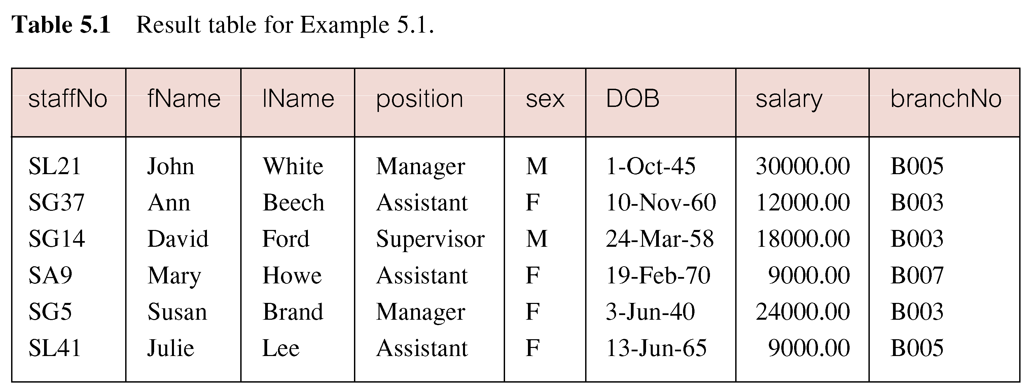
All Columns, All Rows

Slide 21
Specific Columns, All Rows
Produce a list of salaries for all staff, showing only staff number, first and last names, and salary.
  SELECT StaffNo, FName, LName, salary
  FROM Staff;

Slide 22
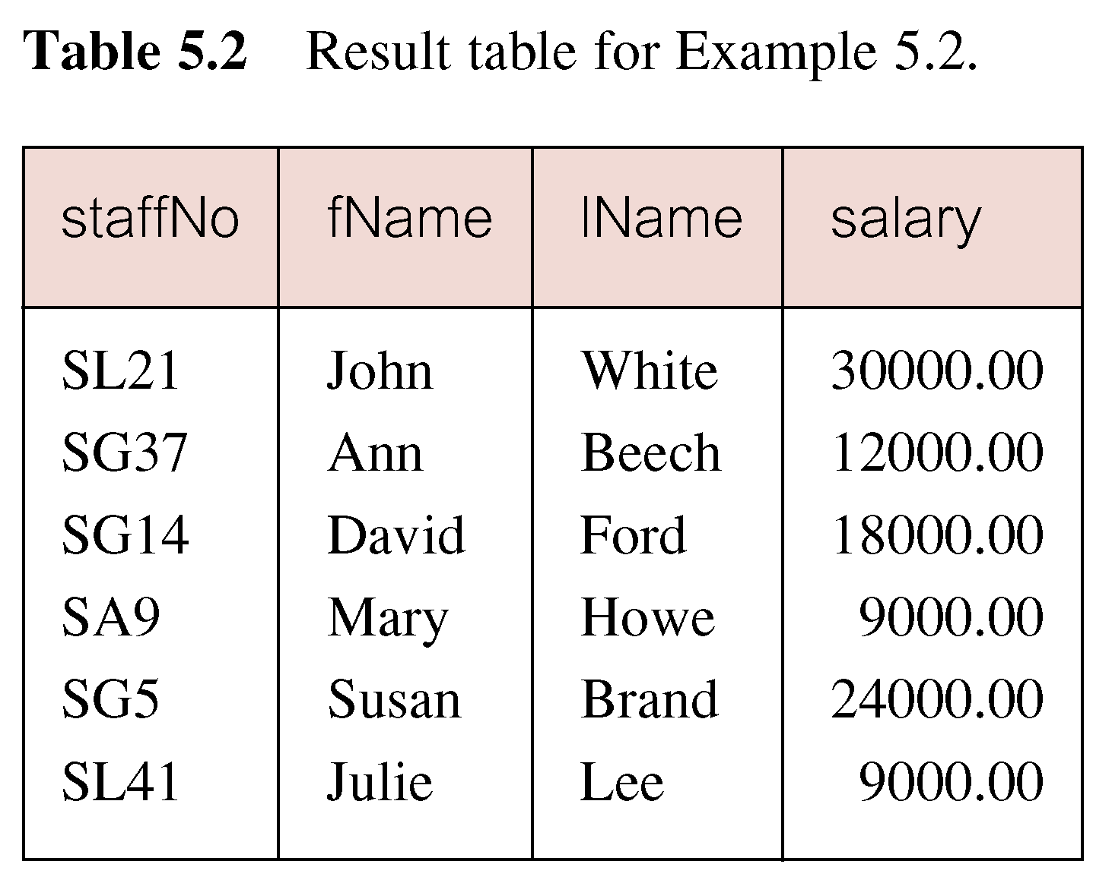
Specific Columns, All Rows

Slide 23
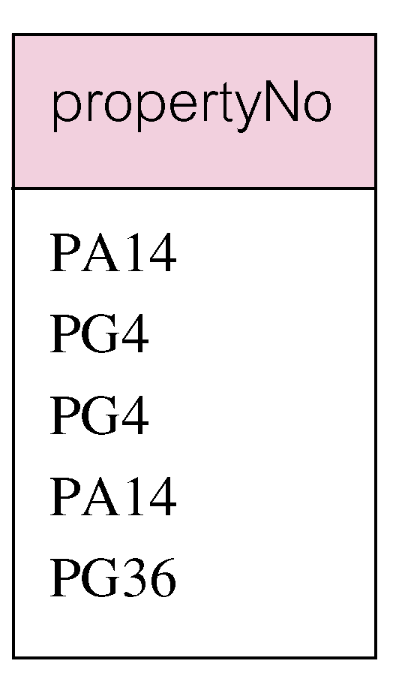
Use of DISTINCT
List the property numbers of all properties that have been viewed.
SELECT PropertyNo
  FROM Viewing;

Slide 24
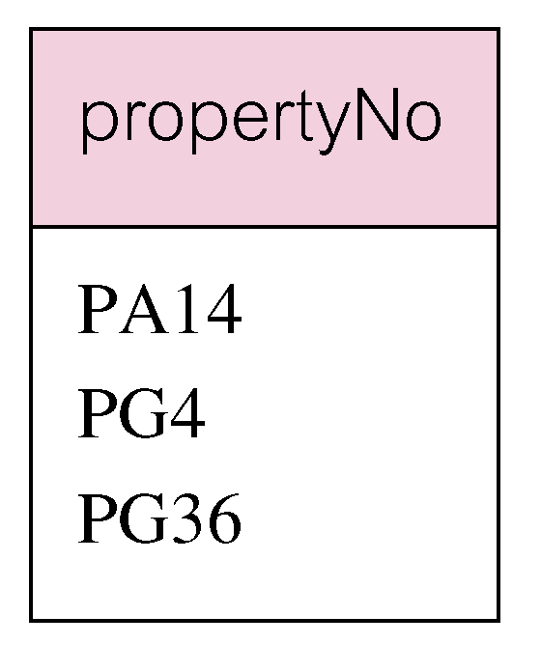
Use of DISTINCT
Use DISTINCT to eliminate duplicates:
SELECT DISTINCT propertyNo
  FROM Viewing;

Slide 25
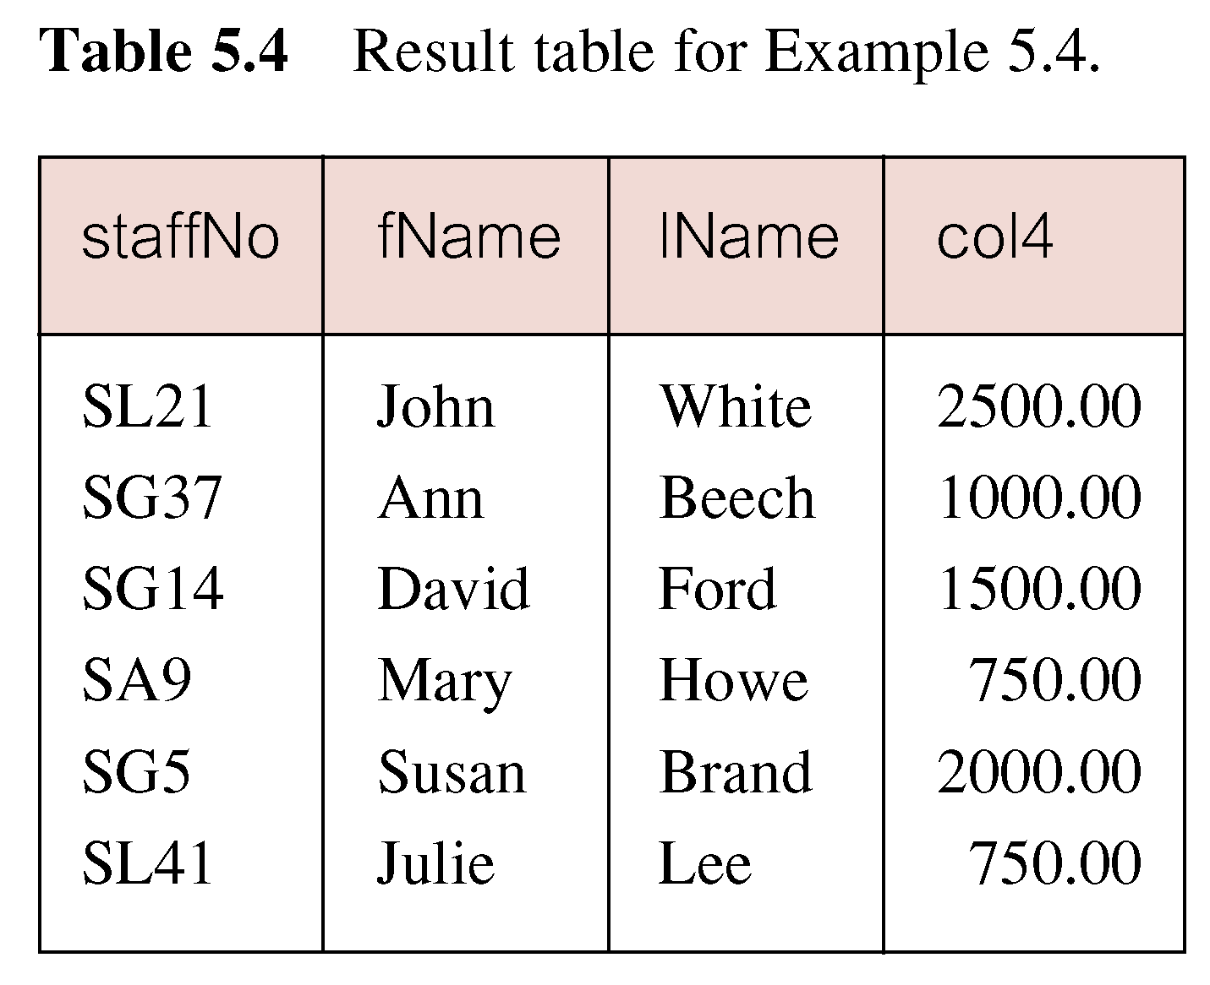
Calculated Fields
Produce list of monthly salaries for all staff, showing staff number, first/last name, and salary.
SELECT StaffNo, FName, LName, salary/12
  FROM Staff;

Slide 26
Calculated Fields
To name column, use AS clause:
SELECT staffNo, fName, lName, salary/12 AS monthlySalary
FROM Staff;

Slide 27
Where clause
Selection: Selects a subset of rows from relation.
Subset of Relation can be obtained using Some Condition (or Using Where Clause)
Expressions in a WHERE clause can use the following types of operators:
    Arithmetic: +, -, *, /, DIV, %
    Comparison: <, <=, =, <> or !=, >=, >, BETWEEN
    Logical: AND, OR, XOR, NOT
    Additional options: IN, IS NULL, LIKE, ()

Slide 28
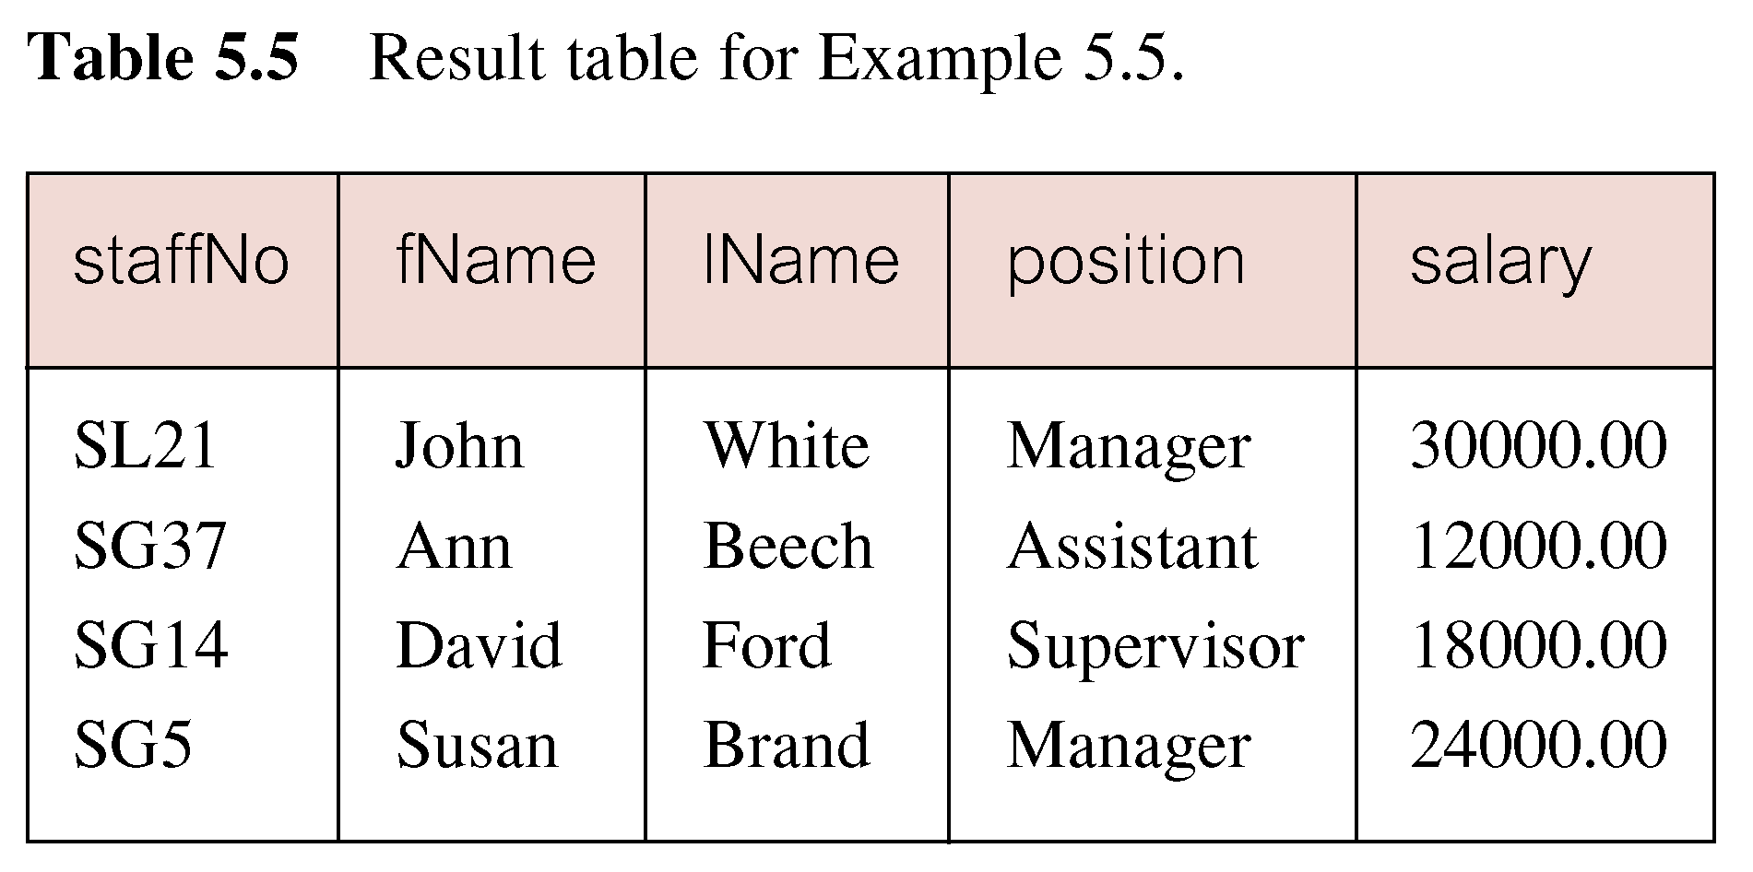
Comparison Search Condition
List all staff with a salary greater than 10,000.
SELECT staffNo, fName, lName, position, salary
  FROM Staff
  WHERE salary > 10000;

Slide 29
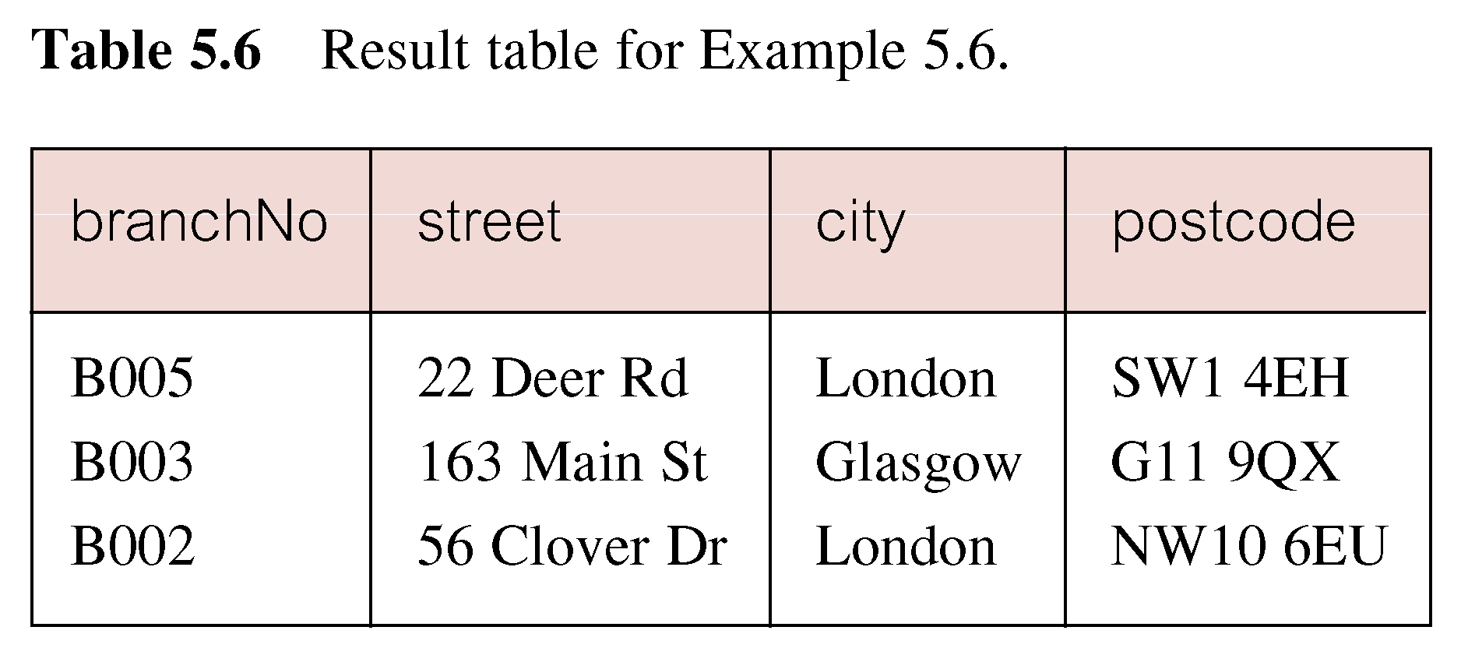
Compound Comparison Search Condition
List addresses of all branch offices in London or Glasgow.
SELECT *
  FROM Branch
  WHERE city = ‘London’ OR city = ‘Glasgow’;

Slide 30
Range Search Condition
List all staff with a salary between 20,000 and 30,000.
SELECT staffNo, fName, lName, position, salary
  FROM Staff
  WHERE salary BETWEEN 20000 AND 30000;
Notes:
BETWEEN test includes the endpoints of range.
Chapter Name
September 98

Slide 31
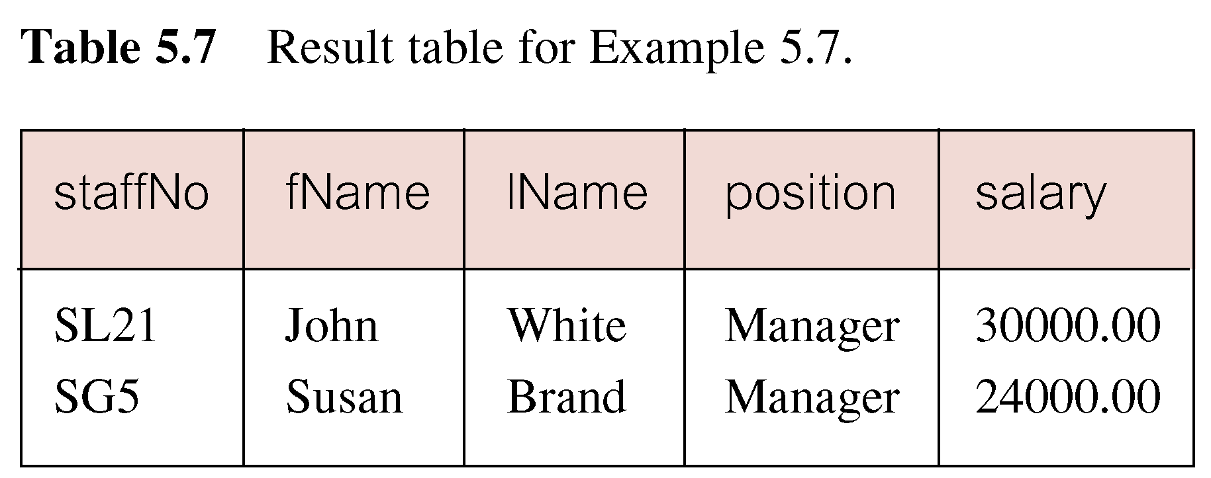
Range Search Condition

Slide 32
Range Search Condition
Can also used with logical NOT.
BETWEEN is inclusive
BETWEEN does not add much to SQL’s expressive power. Could also write:
SELECT staffNo, fName, lName, position, salary
  FROM Staff
  WHERE salary>=20000 AND salary <= 30000;
Useful, though, for a range of values.

Slide 33
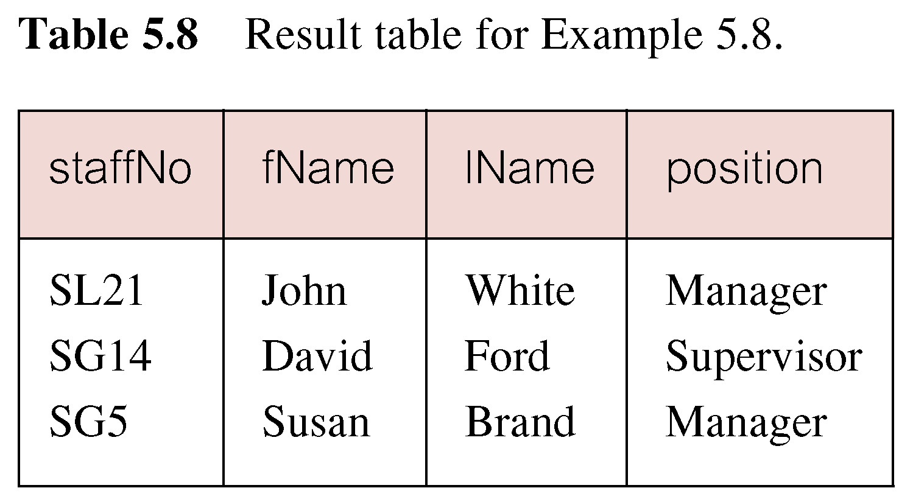
Set Membership
List all managers and supervisors.
  SELECT staffNo, fName, lName, position
  FROM Staff
  WHERE position IN (‘Manager’, ‘Supervisor’);

Slide 34
Set Membership
There is a negated version (NOT IN).
IN does not add much to SQL’s expressive power. Could have expressed this as:
  SELECT staffNo, fName, lName, position
  FROM Staff
  WHERE position=‘Manager’ OR position=‘Supervisor’;
IN is more efficient when set contains many values.

Slide 35
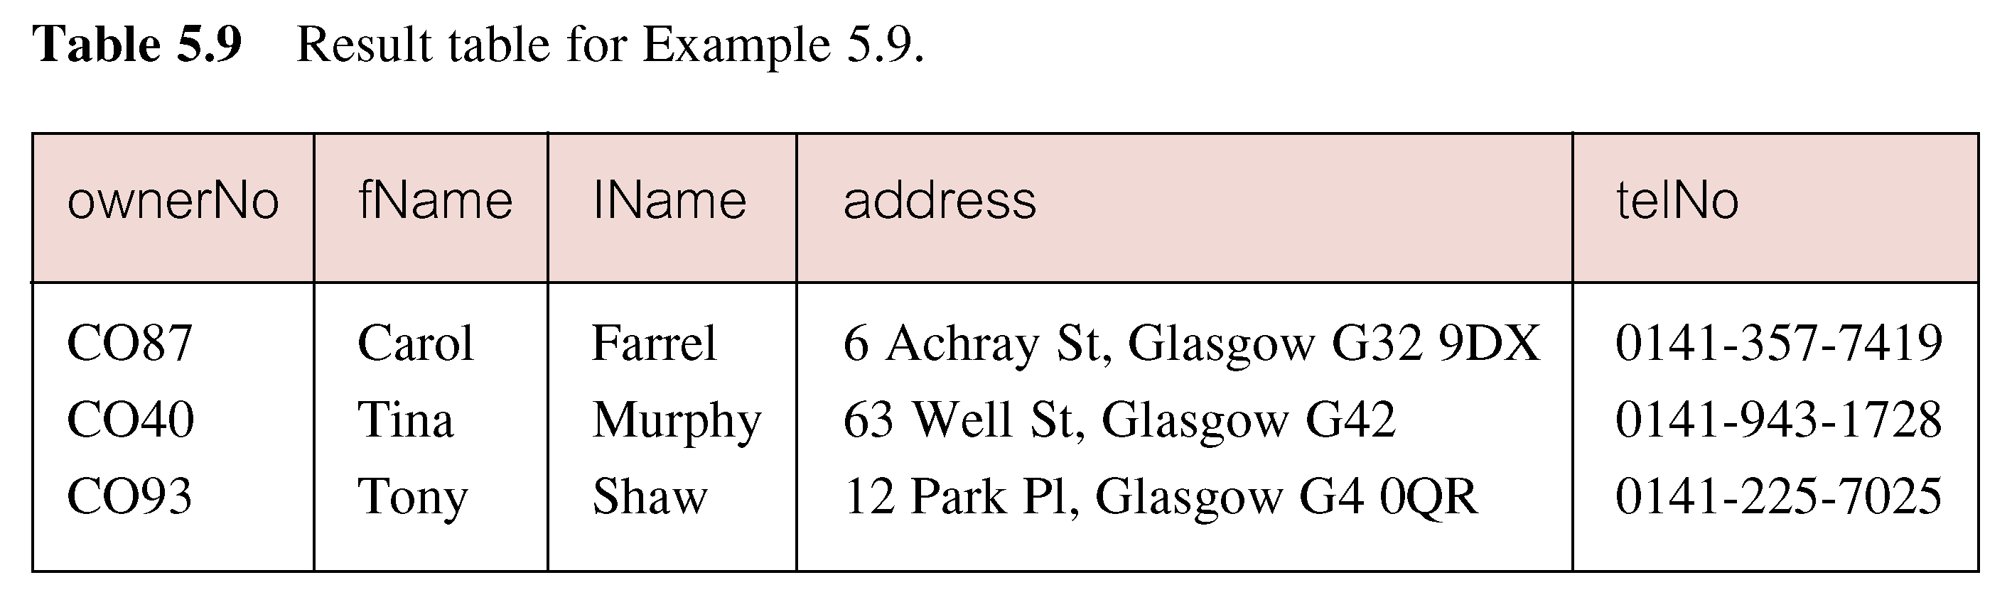
Pattern Matching
Find all owners with the string ‘Glasgow’ in their address.
SELECT staffNo, fName, lName, address
  FROM staff
  WHERE address LIKE ‘%Glasgow%’;

Slide 36
Pattern Matching
SQL has two special pattern matching symbols:
  %: sequence of zero or more characters;
  _ (underscore): any single character.
LIKE ‘%Glasgow%’ means a sequence of characters of any length containing ‘Glasgow’.
Notes:
SELECT staffNo, fName, lName, address
FROM staff
WHERE address LIKE '_3%';
SELECT staffNo, fName, lName, address
FROM staff
WHERE address LIKE '%3_';
Chapter Name
September 98

Slide 37
Pattern Matching
SELECT staffNo, fName, lName, address
FROM staff
WHERE address LIKE '_3%';
Notes:
SELECT staffNo, fName, lName, address
FROM staff
WHERE address LIKE '_3%';
SELECT staffNo, fName, lName, address
FROM staff
WHERE address LIKE '%3_';
Chapter Name
September 98

Slide 38
NULL Search Condition
List details of all viewings on property PG4 where a comment has not been supplied.
There are 2 viewings for property PG4, one with and one without a comment.
Have to test for null explicitly using special keyword IS NULL:
SELECT clientNo, viewDate
  FROM Viewing
  WHERE propertyNo = ‘PG4’ AND
  comment IS NULL;

Slide 39
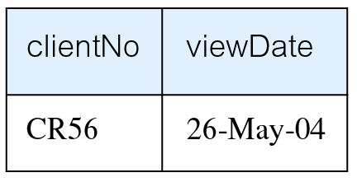
NULL Search Condition
Negated version (IS NOT NULL) can test for non-null values.

Slide 40
Single Column Ordering
List salaries for all staff, arranged in descending order of salary.
SELECT staffNo, fName, lName, salary
  FROM Staff
  ORDER BY salary DESC;

Slide 41
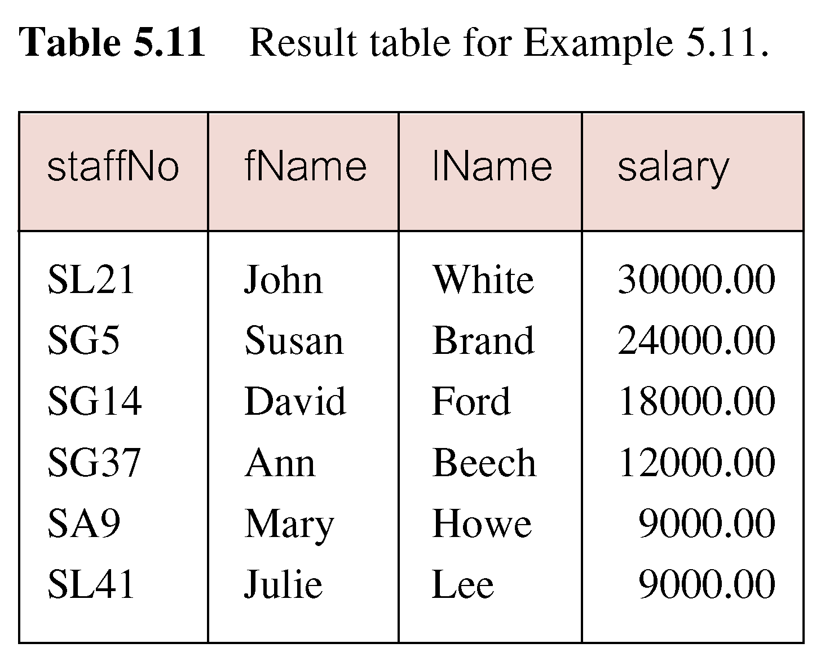
Single Column Ordering

Slide 42
Multiple Column Ordering
Produce list of properties in order of rooms and rent.
SELECT propertyNo, type, rooms, rent
FROM PropertyForRent
ORDER BY rooms, rent;

Slide 43
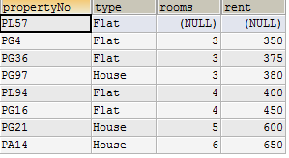
Multiple Column Ordering

Slide 44
Multiple Column Ordering
To arrange in order of rent, specify minor order:
SELECT propertyNo, type, rooms, rent
  FROM PropertyForRent
  ORDER BY type, rent DESC;
If no minor sort key is specified, system arranges these rows in any order it chooses.

Slide 45
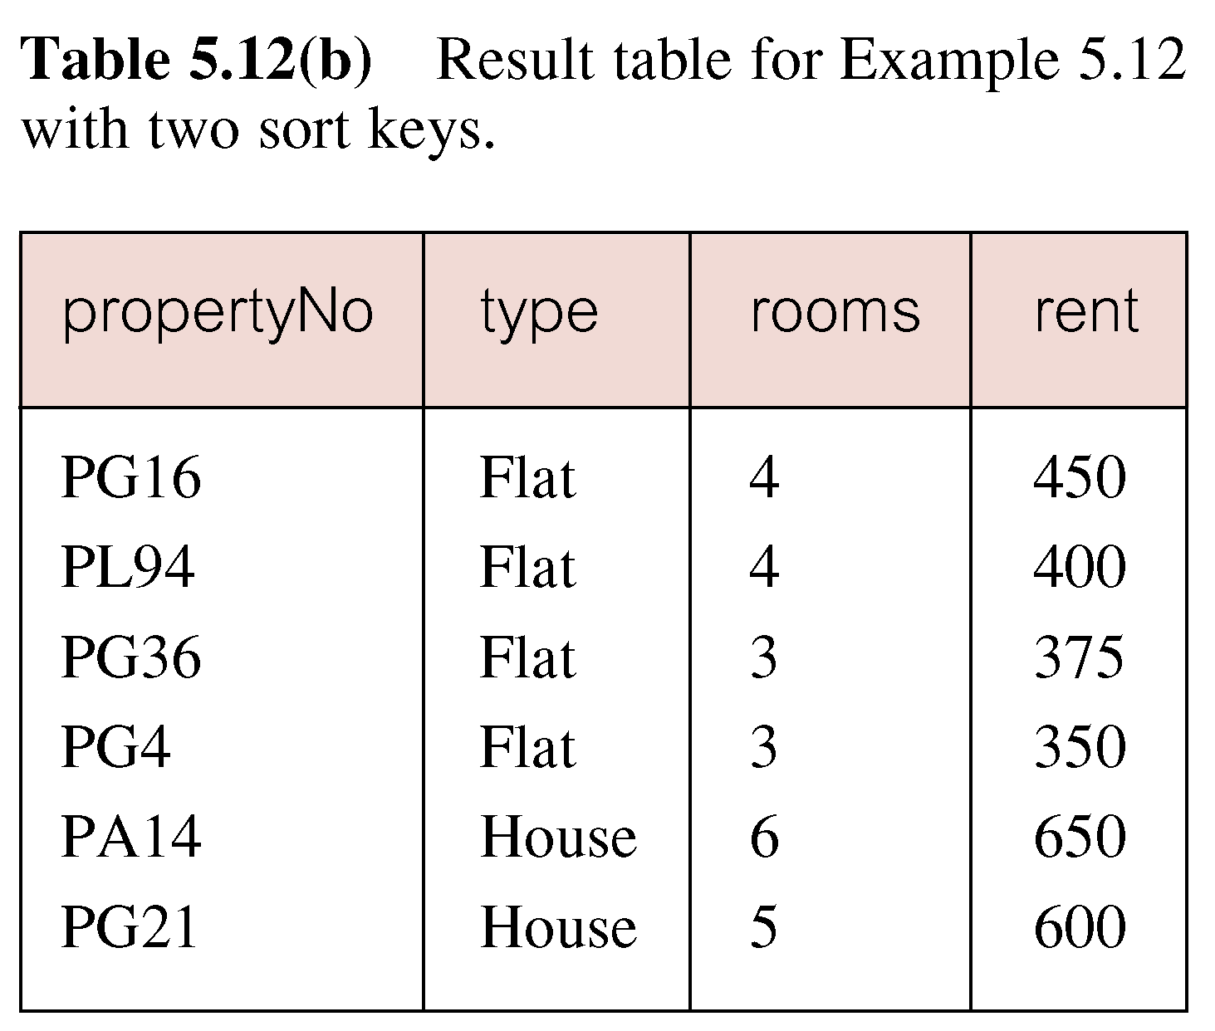
Multiple Column Ordering

Slide 46
Aggregates
ISO standard defines five aggregate functions:
COUNT returns number of values in specified column.
SUM returns sum of values in specified column.
AVG returns average of values in specified column.
MIN returns smallest value in specified column.
MAX returns largest value in specified column.

Slide 47
SELECT Statement - Aggregates
Each operates on a single column of a table and returns a single value.
COUNT, MIN, and MAX apply to numeric and non-numeric fields, but SUM and AVG may be used on numeric fields only.
Apart from COUNT(*), each function eliminates nulls first and operates only on remaining non-null values.

Slide 48
SELECT Statement - Aggregates
COUNT(*) counts all rows of a table, regardless of whether nulls or duplicate values occur.
Can use DISTINCT before column name to eliminate duplicates.
SELECT COUNT(DISTINCT city) FROM branch
DISTINCT has no effect with MIN/MAX, but may have with SUM/AVG.

Slide 49
SELECT Statement - Aggregates
Aggregate functions can be used only in SELECT list and in HAVING clause.
If SELECT list includes an aggregate function and there is no GROUP BY clause, SELECT list cannot reference a column out with an aggregate function. For example, the following is illegal:
SELECT staffNo, COUNT(salary)
  FROM Staff;

Slide 50
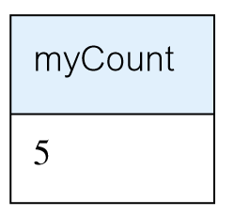
Use of COUNT(*)
How many properties cost more than $350 per month to rent?
SELECT COUNT(*) AS myCount
  FROM PropertyForRent
  WHERE rent > 350;

Slide 51
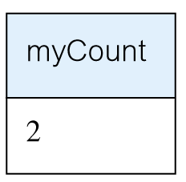
Use of COUNT(DISTINCT)
How many different properties viewed?
SELECT COUNT(DISTINCT propertyNo) AS myCount
  FROM Viewing;

Slide 52
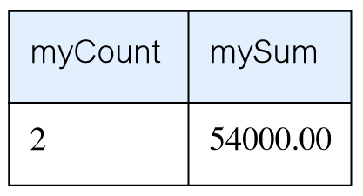
Use of COUNT and SUM
Find number of Managers and sum of their salaries.
SELECT COUNT(staffNo) AS myCount,
  SUM(salary) AS mySum
  FROM Staff
  WHERE position = ‘Manager’;

Slide 53
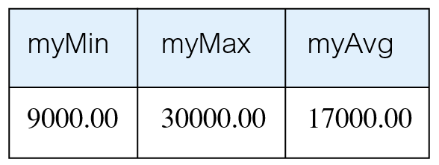
Use of MIN, MAX, AVG
Find minimum, maximum, and average staff salary.
SELECT MIN(salary) AS myMin,
  MAX(salary) AS myMax,
  AVG(salary) AS myAvg
  FROM Staff;

Slide 54
SELECT Statement - Grouping
Use GROUP BY clause to get sub-totals.
SELECT and GROUP BY closely integrated: each item in SELECT list must be single-valued per group, and SELECT clause may only contain:
  column names
  aggregate functions
  constants
  expression involving combinations of the above.

Slide 55
SELECT Statement - Grouping
All column names in SELECT list must appear in GROUP BY clause unless name is used only in an aggregate function.
If WHERE is used with GROUP BY, WHERE is applied first, then groups are formed from remaining rows satisfying predicate.
ISO considers two nulls to be equal for purposes of GROUP BY.

Slide 56
Use of GROUP BY
Find number of staff in each branch and their total salaries.
  SELECT branchNo, COUNT(staffNo) AS myCount,
    SUM(salary) AS mySum
    FROM Staff
    GROUP BY branchNo
    ORDER BY branchNo;

Slide 57
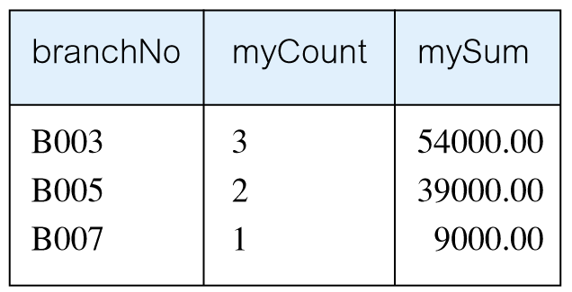
Use of GROUP BY

Slide 58
Grouping Columns
Find number of properties handled by each staff member.
SELECT COUNT(propertyNo), staffNo
FROM propertyforrent
GROUP BY staffNo

Slide 59
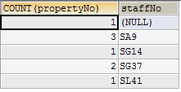
Grouping Columns

Slide 60
Grouping on Multiple Columns
Find total male and female employees on each designation.
SELECT POSITION, gender, COUNT(*)
FROM staff
GROUP BY POSITION, gender

Slide 61
Restricted Groupings – HAVING clause
HAVING clause is designed for use with GROUP BY to restrict groups that appear in final result table.
Similar to WHERE, but WHERE filters individual rows whereas HAVING filters groups.
Column names in HAVING clause must also appear in the GROUP BY list or be contained within an aggregate function.

Slide 62
Use of HAVING
For each branch with more than 1 member of staff, find number of staff in each branch and sum of their salaries.
  SELECT branchNo, COUNT(staffNo) AS myCount,
    SUM(salary) AS mySum
    FROM Staff
    GROUP BY branchNo
    HAVING COUNT(staffNo) > 1
    ORDER BY branchNo;

Slide 63
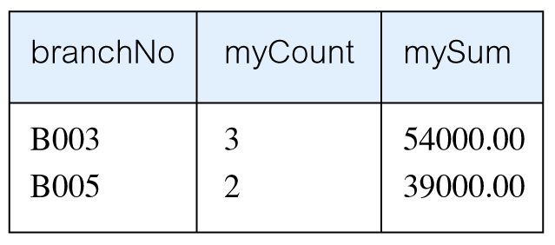
Use of HAVING

Slide 64
Subqueries
Some SQL statements can have a SELECT embedded within them.
A subselect can be used in WHERE and HAVING clauses of an outer SELECT, where it is called a subquery or nested query.
Subselects may also appear in INSERT, UPDATE, and DELETE statements.

Slide 65
Subquery with Equality
List staff who work in branch at ‘163 Main St’.
SELECT staffNo, fName, lName, position
  FROM Staff
  WHERE branchNo =
  (SELECT branchNo
  FROM Branch
  WHERE street = ‘163 Main Street’);

Slide 66
Subquery with Equality
Inner SELECT finds branch number for branch at ‘163 Main St’ (‘B003’).
Outer SELECT then retrieves details of all staff who work at this branch.
Outer SELECT then becomes:
  SELECT staffNo, fName, lName, position
    FROM Staff
    WHERE branchNo = ‘B003’;

Slide 67
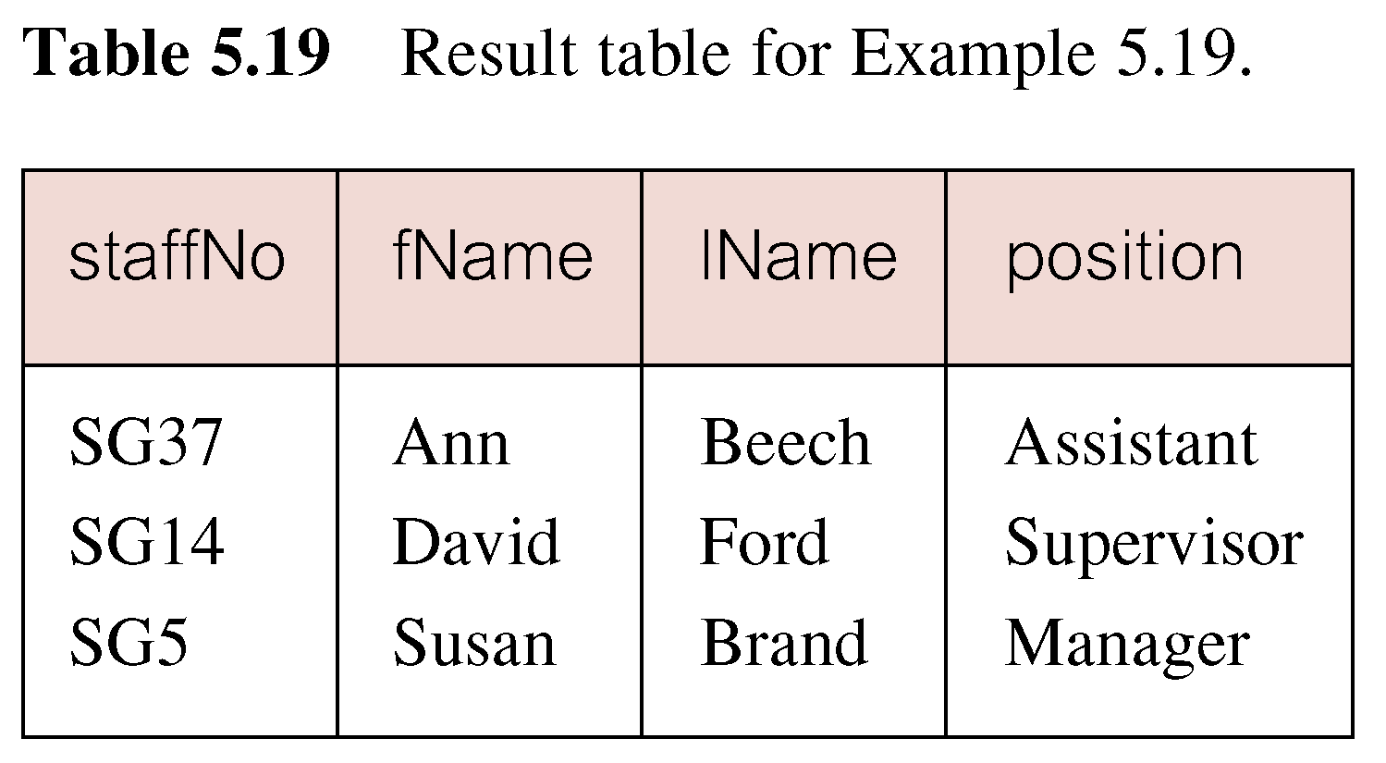
Subquery with Equality

Slide 68
Subquery with Aggregate
List all staff whose salary is greater than the average salary, and show by how much.
  SELECT staffNo, fName, lName, position,
  salary – (SELECT AVG(salary) FROM Staff) As SalDiff
  FROM Staff
  WHERE salary >
    (SELECT AVG(salary)
    FROM Staff);

Slide 69
Subquery with Aggregate
Cannot write ‘WHERE salary > AVG(salary)’
Instead, use subquery to find average salary (17000), and then use outer SELECT to find those staff with salary greater than this:
  SELECT staffNo, fName, lName, position,
  salary – 17000 As SalDiff
  FROM Staff
  WHERE salary > 17000;

Slide 70
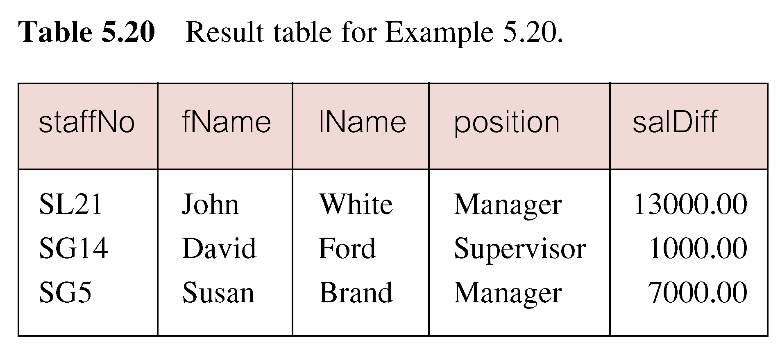
Subquery with Aggregate

Slide 71
Subquery Rules
A subquery must be enclosed in parentheses.
A subquery must be placed on the right side of the comparison operator.
Subqueries cannot manipulate their results internally, therefore ORDER BY clause cannot be added into a subquery. You can use an ORDER BY clause in the main SELECT statement (outer query) which will be the last clause.

Slide 72
Subquery Rules
Use single-row operators with single-row subqueries.
If a subquery (inner query) returns a null value to the outer query, the outer query will not return any rows when using certain comparison operators in a WHERE clause.

Slide 73
Nested subquery: use of IN
List properties handled by staff at ‘163 Main St’.
  SELECT propertyNo, street, city, postcode, type, rooms, rent
  FROM PropertyForRent
  WHERE staffNo IN
    (SELECT staffNo
    FROM Staff
    WHERE branchNo =
    (SELECT branchNo
    FROM Branch
    WHERE street = ‘163 Main Street’));

Slide 74
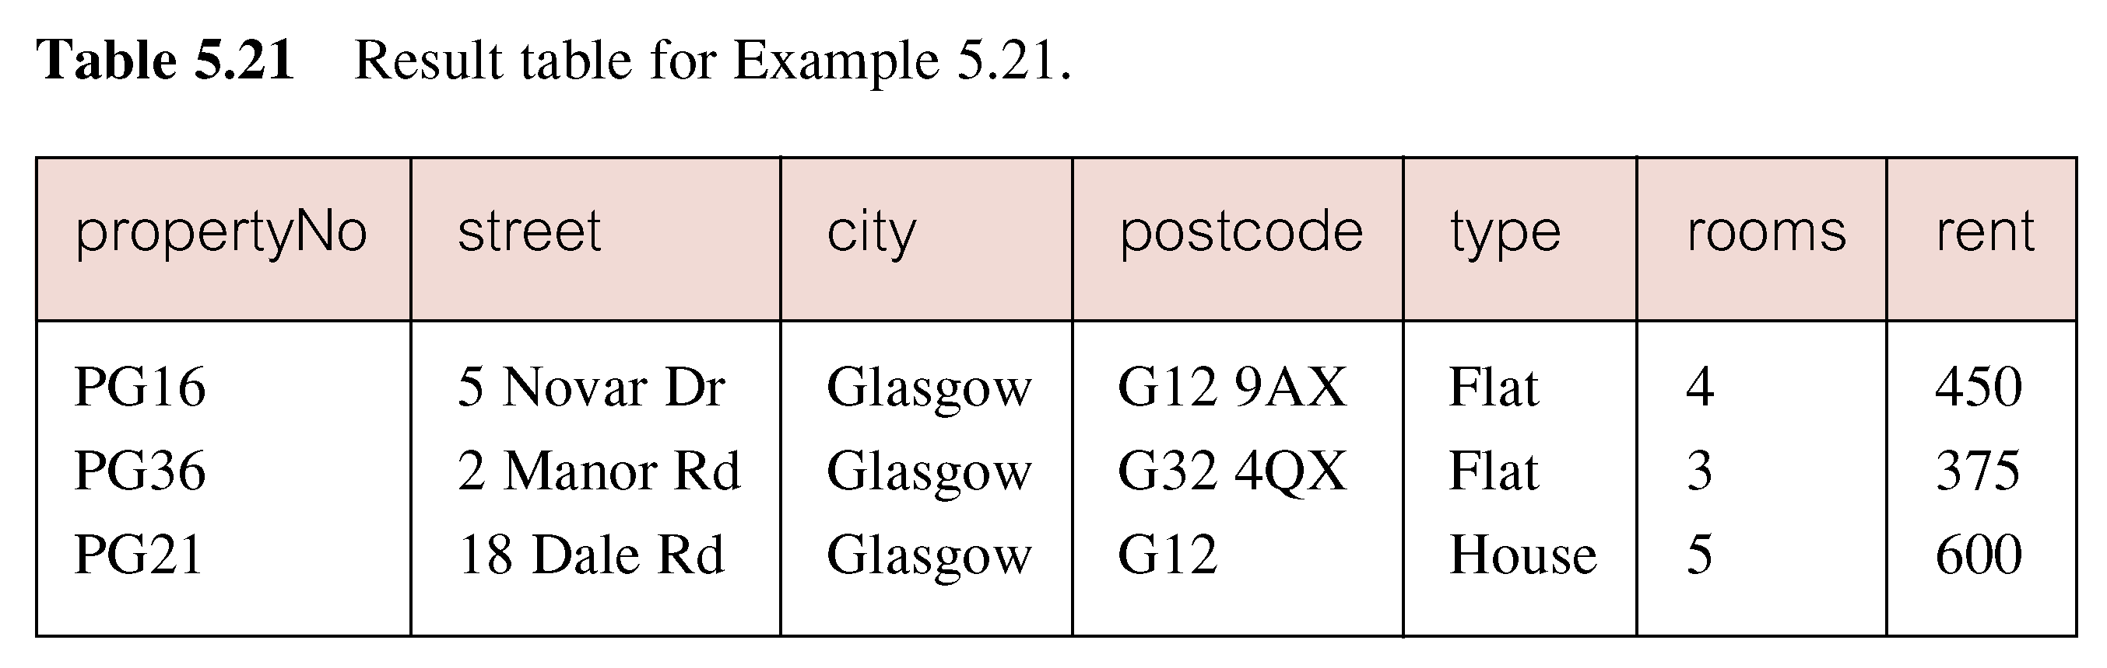
Nested subquery: use of IN

Slide 75
Subqueries with Update & Delete
Subqueries with UPDATE statement
UPDATE table SET column_name = new_value [ WHERE OPERATOR [ VALUE ]
(SELECT COLUMN_NAME FROM TABLE_NAME) [ WHERE) ]
Subqueries with DELETE statement
DELETE FROM TABLE_NAME
[ WHERE OPERATOR [ VALUE ]
(SELECT COLUMN_NAME FROM TABLE_NAME) [ WHERE) ]

Slide 76
ANY AND ALL
ANY and ALL may be used with subqueries that produce a single column of numbers.
With ALL, condition will only be true if it is satisfied by all values produced by subquery.
With ANY, condition will be true if it is satisfied by any values produced by subquery.
If subquery is empty, ALL returns true, ANY returns false.
SOME may be used in place of ANY.

Slide 77
USE OF ANY/SOME
Find staff whose salary is larger than salary of at least one member of staff at branch B003.
SELECT staffNo, fName, lName, position, salary
  FROM Staff
  WHERE salary > ANY
  (SELECT salary
  FROM Staff
  WHERE branchNo = ‘B003’);

Slide 78
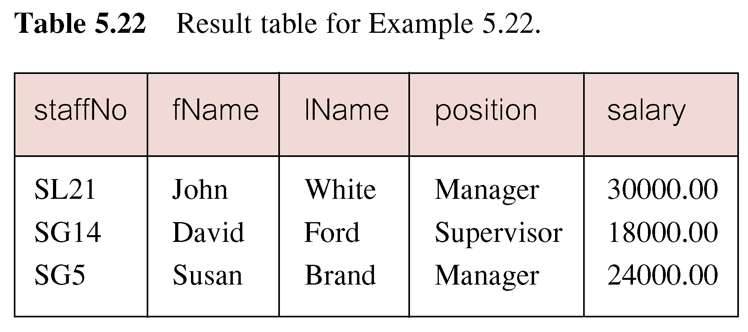
USE OF ANY/SOME
Inner query produces set {12000, 18000, 24000} and outer query selects those staff whose salaries are greater than any of the values in this set.

Slide 79
USE OF ALL
Find staff whose salary is larger than salary of every member of staff at branch B003.
SELECT staffNo, fName, lName, position, salary
  FROM Staff
  WHERE salary > ALL
  (SELECT salary
  FROM Staff
  WHERE branchNo = ‘B003’);

Slide 80
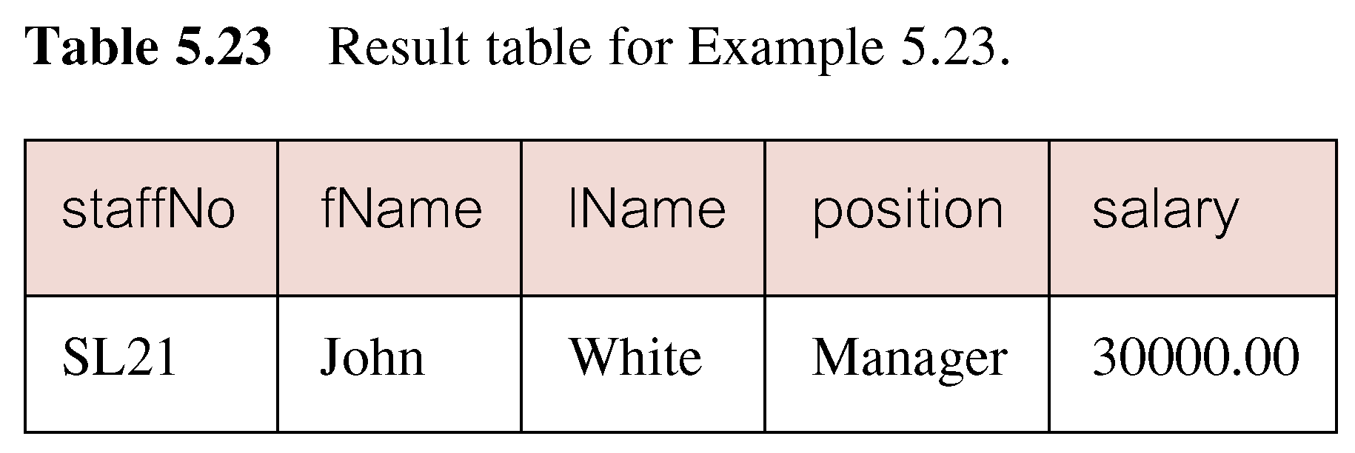
USE OF ALL

