Slide 1

Introduction of Requirement Engineering
Lecture # 01
SEN 354
Engr. Asad Ur Rehman
Senior Lecturer – Iqra University
Certified Business Analysis Professional (CBAP)
Founding Member- Ponder Alliance

Slide 2

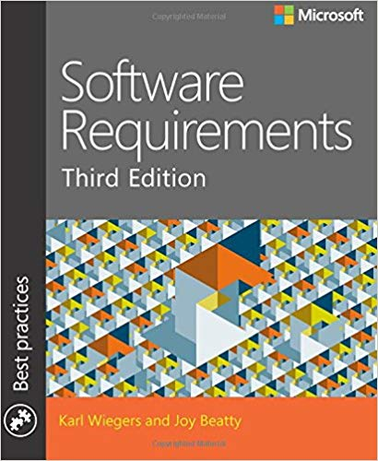

Presentation Credit
Software Requirements
By
Karl wiegers & Joy Beatty
Chapter # 01
Essential Software
Requirements
Karl Wiegers
Joy Beatty

Slide 3
Software Requirement Essential
We will analyze
Requirement Problem
In next few slides

Slide 4


Software Requirement Essential
Requirement Problem Scenario
Maria
“Hello, Phil? This is Maria from HR Dept. We’re having a problem with the personnel system you programmed for us.
An employee just changed her name to Sparkle Starlight, and we can’t get the system to accept the name change. Can you help?”
She married some guy named Starlight?
“No, she didn’t get married, just changed her name,” Maria replied. “That’s the problem. It looks like we can change a name only if someone’s marital status changes.”
I never thought someone might just change her name.
I don’t remember you telling me about this possibility when we talked about the system, Phil said.
Phil

Slide 5
Software Requirement Essential
Requirement Problem Scenario
Maria
“I assumed you knew that people could legally change their name anytime they like,” responded Maria. “We have to straighten this out by Friday or Sparkle won’t be able to cash her paycheck. Can you fix the bug by then?”
It’s not a bug!” Phil retorted. “I never knew you needed this capability. I’m busy on the new performance evaluation system. I can probably fix it by the end of month, but not by Friday. Sorry about that. Next time, tell me these things earlier and please write them down.
“What am I supposed to tell Sparkle?” demanded Maria.
She’ll be upset if she can’t cash her check.”
Phil

Slide 6
Software Requirement Essential
Requirement Problem Scenario
Hey, Maria, it’s not my fault,” Phil protested. “If you’d told me in the first place that you had to be able to change someone’s name at any time, this wouldn’t have happened. You can’t blame me for not reading your mind.
Angry and resigned, Maria snapped, “Yeah, well, this is the kind of thing that makes me hate computers. Call me as soon as you get it fixed, will you?”

Slide 7

Requirement Problem Scenario
Analyze this scenario
write down 2 problems
you can identify

Slide 8
Requirement Problem Scenario
Requirements are NOT documented
Please write down requirements
Not very specific / clear need (assumption)
I assume you knew
Phil – is not HR-experts
I never thought someone . . . Just change her name
Incomplete requirements by HY dept
Legally anyone can change name, at any time
Disagreement – It is not a BUG
Frustration – You can’t blame me

Slide 9
Requirement Problem Scenario
with Phil and Maria, common problem areas are
Informal information gathering
Implied functionality
Miscommunicated assumptions
Poorly specified requirements
Casual change process

Slide 10
Importance of SW Requirements Elicitation

Slide 11
Introduction of Requirement Engineering Importance of Software Requirements Elicitation
Requirement
Elicitation
Requirement
Analysis
Req-Docx
& Agreement
Design
Coding
Testing
Running
software
Should understand Biz-problem
Correct & Complete
Operation &
Maintenance
Automation of Hospital
OPD
IPD
Laboratory
Billing
Pharmacy
Appointment Management
Patient
Record

Slide 12
Introduction of Requirement Engineering Importance of Software Requirements Elicitation
Stakeholders identifies a need or problem then a project is initiate to address that Problem
Team Members
Cost & Time
Benefits/
Value
Project
Problem
Solution
How well the project ultimately addresses that need defines the project’s success or failure.

Slide 13
Introduction of Requirement Engineering Importance of Software Requirements Elicitation
Compliance with Business Objectives: Process of elicitation guarantees that the software development endeavors are in harmony with the company’s objectives.
Comprehending the business context facilitates the development of a solution that adds value for the company.
User Satisfaction: It is easier to create software that fulfills users’ needs when they are involved in the requirements elicitation process.
Higher user pleasure and acceptance of the finished product are the results of this.

Slide 14
Introduction of Requirement Engineering Importance of Software Requirements Elicitation
Time and Money Savings: Having precise and well-defined specifications aids in prevent miscommunication and rework during the development phase.
As a result, there will be cost savings and the project will be completed on time.
Compliance and Regulation Requirements: Requirements elicitation is crucial for projects in regulated industries to guarantee that the software conforms with applicable laws and norms.
In industries like healthcare, finance, and aerospace, this is crucial.
Traceability and Documentation: Throughout the software development process, traceability is based on well-documented requirements.
Traceability helps with testing, validation, and maintenance by ensuring that every part of the software can be linked to a particular requirement.

Slide 15
Traceability and Documentation
Functional Req
Code
Test Cases
Requirements
FS-1.1
FS-1.2
FS-1.3
Cd-11
Cd-11
F-1
Cd-11
Cd-11
Cod-1.1.1
TC-1.1.1
TC-1.1.2
TC-1.1.3
SR-1
SR-2
SR-30
SR-40
Cod-1.2.1
F-2
Cod-1.3.1
FS-2.1
FS-2.2
- -
FS-2.6
Cod-40.1.1
Cd-11
Cd-11
FS-40.1
FS-40.2
- -
FS-40.8
TC-40.1.1
TC-40.1.2
TC-40.1.3
Cod-40.2.1
F-40
Cd-48.3
Cd-48.3
Cod-40.8.3

Slide 16
What is Software Requirements ?

Slide 17
Introduction of Requirement Engineering What is Software Requirements ?
According to IEEE standard, a requirement is defined as follows:
A condition or capability needed by a user to solve a problem or achieve an objective
A condition or capability that must be met or possessed by a system or system component to satisfy a contract, standard, specification or other formally imposed documents
A documented representation of a condition or capability, as in 1 and 2.
Types of Software Requirements
Software Requirements are mainly classified into two types:
Functional requirements
Non-functional requirements

Slide 18
Introduction of Requirement Engineering What is Software Requirements ?
Functional Requirements
Functional Requirements are the requirements that the end user specifically demands as basic features that the system should offer.
It can be a calculation, data manipulation, business process, user interaction, or any other specific functionality that defines what function a system is likely to perform.
All these functionalities need to be necessarily incorporated into the system as a part of the contract.
These are represented or stated in the form of input to be given to the system, the operation performed and the output expected.

Slide 19
Introduction of Requirement Engineering What is Software Requirements ?
Non-Functional Requirements
Nonfunctional requirements, not related to the system functionality, rather define how the system should perform.
The priority or extent to which these factors are implemented varies from one project to other.
Non-Functional requirements deal with issues like:
Portability
Security
Maintainability
Reliability
Scalability
Performance
Reusability

Slide 20
Requirement Engineering Process

Slide 21
Requirement Engineering Process
Requirements
Design
Coding
Testing
Elicitation
Analysis
Specification
Validation

Slide 22
Requirement Engineering Process
Requirement Engg is divided into two parts
Requirement Engineering
Requirement Development
Requirement Management
Req
Elicitation
Req
Analysis
Design
Coding
Testing
SRS
Functional
requirements
Non-Functional
requirements

Slide 23
Requirement Engineering Process
Requirement Engineering
Requirement Development
Requirement Management
Elicitation
Specification
Change Control
Communication
Analysis
Validation
Traceability

Slide 24
Requirements Development
Elicitation
Elicitation encompasses all of the activities involved with discovering requirements, such as interviews, workshops, document analysis, prototyping, and others.
The key actions are:
Identifying the product’s expected user classes and other stakeholders.
Understanding user tasks and goals and the business objectives with which those tasks align.
Learning about the environment in which the new product will be used.
Working with individuals who represent each user class to understand their functionality needs and their quality expectations.

Slide 25
Requirements Development
Analysis
Analyzing requirements involves reaching a richer and more precise understanding of each requirement and representing sets of requirements in multiple ways.
Analyzing the information received from users to distinguish their task goals from
Functional requirements
Quality expectations
Business rules
Suggested solutions and
Other information

Slide 26
Requirements Development
Analysis
Decomposing high-level requirements into an appropriate level of detail
Originating functional requirements from other requirements information
Understanding the relative importance of quality attributes
Allocating requirements to software components defined in the system architecture
Negotiating implementation priorities
Identifying gaps in requirements or unnecessary requirements as they relate to the defined scope

Slide 27
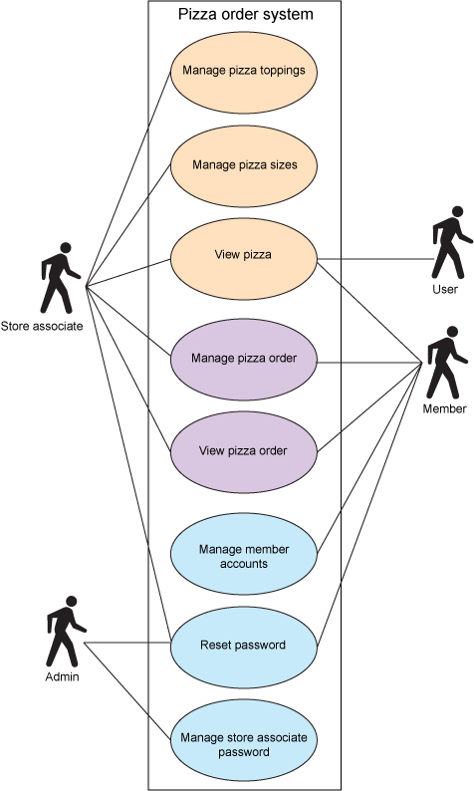
Requirements Development
Pizza
toppings
Analysis - Example
Business Requirement: A pizza vendor, who has operated a traditional pizza delivery service using telephone orders, wants to automate the ordering process by developing an online system.
Manage
Pizza size
View
Pizza
Store
Keeper
Mange pizza order
User Requirement
Select the
Pizza toppings, and size
Number of pizzas
Log in and enter the delivery address.
Specify the time of delivery.
Revise or delete their orders.
View pizza order
Rest
Password
Admin

Slide 28
Requirements Development
Specification
Requirements specification involves representing and storing the collected requirements knowledge in a persistent and well-organized fashion.
The principal activity is:
Translating the collected user needs into written requirements and diagrams
Suitable for . .
Comprehension, Review,
Use by their intended audiences

Slide 29
Requirements Development
Validation
Requirements validation confirms that you have the correct set of requirements information that will enable developers to build a solution that satisfies the business objectives.
The central activities are:
Reviewing the documented requirements to correct any problems before the development group accepts them.
Developing acceptance tests and criteria to confirm that a product based on the requirements would meet customer needs and achieve the business objectives.

Slide 30
Requirements Development
Validation
Iteration is a key to requirements development success.
Plan for multiple cycles of exploring requirements, progressively refining high-level requirements into more precision and detail, and confirming correctness with users.
This takes time and it can be frustrating.
Nonetheless, it’s an intrinsic aspect of dealing with the uncertainty of defining a new software system.

Slide 31
Requirements Management

Slide 32
Requirements Management
Requirements Management
Requirements management activities include the following:
Defining the requirements baseline.
Reviewed and approved set of requirements
often for a specific product release or development iteration
Evaluating the impact of proposed requirements changes and incorporating approved changes into the project in a controlled way.
(Ex MBL_Ploan_SRS-V1.0 next SRS-2.0)
Keeping project plans updated with the requirements as they evolve.
(Ex MBL_PLoan_Sys_Plan-V1.5)
Notes:
Rational DOOR software tool

Slide 33
Requirements Management
Requirements Management
Negotiating new commitments based on the estimated impact of requirements changes.
Defining the relationships and dependencies that exist between requirements.
Tracing individual requirements to their corresponding designs, source code, and tests.
Tracking requirements status and change activity throughout the project.
Notes:
Rational DOOR software tool

Slide 34
Requirements Management
Object of requirements management is not to suffocate change or to make it difficult.
It is to anticipate and accommodate the very real changes that you can always expect so as to minimize their disruptive impact on the project.
Figure 1-5 provides another view of the boundary between requirements development and requirements management.

Slide 35



Requirements Management
Requirement Management Tools

Slide 36
Levels of Software Requirements

Slide 37
Levels of Software Requirements
Why a change
is required ?
1
Business
Requirements
Meezan want to have Islamic Banking application as largest Islamic Bank
2
Stakeholder
Requirements
Bank Islami want to have Islamic Banking application as Profitable Bank from day one
3
Solution Requirements
HBL want to have Islamic Banking application to serve it non-conventional customers
4
Transition Requirements

Slide 38
Levels of Software Requirements
Business requirements: statements of goals, objectives, and outcomes that describe why a change has been initiated.
They can apply to the whole of . . .
. . an enterprise,
. . a business area, or
. . a specific initiative
Example:
Noman wants to have a house in Islamabad as well.
Business wants to transform the way they manage payroll processing.
Current manual process does not satisfy our employees.

Slide 39
Levels of Software Requirements
Stakeholder /user requirements: describe the needs of stakeholders that must be met in order to achieve the business requirements.
They may serve as a bridge between business and solution requirements.
Example:
Noman wants to have enough rooms in that house in Islamabad for all his children
Payroll Dept must reconcile all salary payment made to validate monthly financial results accurately.
As a employee I must receive a Pay-slip which provides salary breakdown details to verify my salary payment.

Slide 40
Levels of Software Requirements
Solution requirements: describe the capabilities and qualities of a solution that meets the stakeholder requirements.
Provide the appropriate level of detail to allow for the development and implementation of the solution.
Solution requirements can be divided into two sub-categories:
Functional requirements: describe the capabilities that a solution must have in terms of the behaviour and information that the solution will manage.
Non-functional requirements or quality of service requirements: do not relate directly to the behaviour of functionality of the solution, but rather describe conditions under which a solution must remain effective or qualities that a solution must have.

Slide 41
Levels of Software Requirements
Functional requirements:
Example:
Each room must have Split-AC in that house in Islamabad.
As a Payroll officer, I must be able to add a new employee record into payroll system.
As an employee, I must be able to print my Pay-slip to keep in record and use it at the time of Income Tax returns.

Slide 42
Levels of Software Requirements
Transition requirements: describe the capabilities that the solution must have and the conditions the solution must meet to facilitate transition from the current state to the future state, but which are not needed once the change is complete.
They are differentiated from other requirements types because they are of a temporary nature. Transition requirements address topics such as data conversion, training, and business continuity.
Example:
Parallel run of both systems for 2 months
Data transfer/conversion methodology
Training for users
Technical training of IT department

Slide 43
Thanks

