Slide 1
AGENTIC AI PROJECT
Northwind
Agentic AI
A multi-agent AI system that answers business questions
using natural language — powered by CrewAI & Gemini
CrewAI
Gemini AI
SQLite
Streamlit
Python

Slide 2
PROBLEM STATEMENT
The Challenge
🔍 Data is locked away
⏱️ Slow decision making
Business data sits in databases that require SQL expertise to access — non-technical users are excluded.
Waiting for analysts to write queries and build reports delays critical business decisions.
📊 No instant insights
🔄 Repetitive manual work
Converting raw data into meaningful charts and explanations requires manual work every time.
The same queries get rewritten repeatedly with no automated pipeline to handle routine analysis.

Slide 3
PROJECT GOALS
What is Set Out to Build
01
02
03
Natural Language Interface
Automated SQL Generation
Reliable Data Execution
Allow users to ask business questions in plain English without writing any SQL.
An AI agent that understands the Northwind schema and writes accurate SQLite queries.
Execute SQL queries directly against a real database and return accurate results.
04
05
06
Intelligent Visualizations
Multi-Agent Architecture
Practical UI
Automatically choose the right chart type and generate business insights from the data.
Demonstrate agentic AI with 3 specialized agents coordinated by CrewAI.
A clean Streamlit dashboard that anyone can use — no technical knowledge required.

Slide 4
Northwind Database Overview
Database features
Key Tables & Their Purpose:
Customers – Stores customer details such as name, contact, and location Orders – Contains order transactions placed by customers Order Details – Line-level data for each order (products, quantity, price) Products – Information about products sold (name, price, stock) Categories – Groups products into categories (e.g., beverages, dairy) Suppliers – Details of suppliers providing products Employees – Employee information managing orders and customers Shippers – Shipping companies responsible for deliveries
The Northwind Database is a sample relational database used to demonstrate business operations of a trading company. It models real-world scenarios like customers, orders, products, and suppliers, making it ideal for learning SQL, analytics, and data modeling.
Key Relationships:
• Customers → Orders (One-to-Many) • Orders → Order Details (One-to-Many) • Products → Order Details (One-to-Many) • Suppliers → Products (One-to-Many) • Categories → Products (One-to-Many)
Use Cases:
• Sales and revenue analysis • Customer segmentation • Inventory tracking • Supply chain analysis

Slide 5
SYSTEM ARCHITECTURE
How the Agents Work Together
👤 User
🖥️ Streamlit
🤖 CrewAI
Natural language
question
▶
Web UI
app.py
▶
Orchestrator
northwind_crew.py
▼
✍️ Agent 1: SQL Writer
⚡ Agent 2: SQL Executor
📊 Agent 3: Visualizer
Translates question
into SQLite query
Runs SQL against
Northwind DB
Builds chart &
generates insight
▶
▶
sql_writer.py
llm_factory.py
db_tool.py
SQLite direct
visualizer.py
matplotlib

Slide 6
TECHNOLOGY STACK
Tools & Frameworks Used
AI & Agents
Data & Backend
CrewAI — multi-agent orchestration
Google Gemini 2.0 Flash Lite — LLM
Groq / Llama 3.1 — alternative LLM
LangChain — LLM integration layer
SQLite — Northwind database
Pandas — data manipulation
SQLAlchemy — DB connection
Python 3.11 — core language
Frontend & UI
Dev Tools
Streamlit — web interface
Matplotlib — chart rendering
Custom CSS — dark theme styling
Session state — query management
VS Code — development IDE
Virtual environment (venv)
python-dotenv — API key management
LiteLLM — model routing

Slide 7
DEVELOPMENT JOURNEY
Steps Followed
1
Project Setup
2
Database Setup
Created folder structure, Python 3.11 venv, installed CrewAI, Streamlit, LangChain
Downloaded Northwind SQLite DB, mapped schema — discovered [Order Details] table naming
3
Agent Design
4
LLM Integration
Built SQL Writer, Executor, Visualizer agents with roles, goals & backstories
Built llm_factory.py supporting Gemini, OpenAI, Groq with single .env switch
5
Tool Building
6
Pipeline Architecture
Created ExecuteSQLTool as CrewAI custom tool with input validation
Wired sequential crew: SQL Writer → Executor → Visualizer with context passing
7
UI Development
8
Debugging & Fixes
Built Streamlit frontend with dark theme CSS, sidebar shortcuts, results layout
Fixed Python 3.9 → 3.11, API keys, table names, rate limits, JSON parsing
9
Testing
10
Optimization
Created test_db.py for offline testing — validated SQL queries without API calls
Separated SQL execution from agent, added retry logic, chart beautification

Slide 8
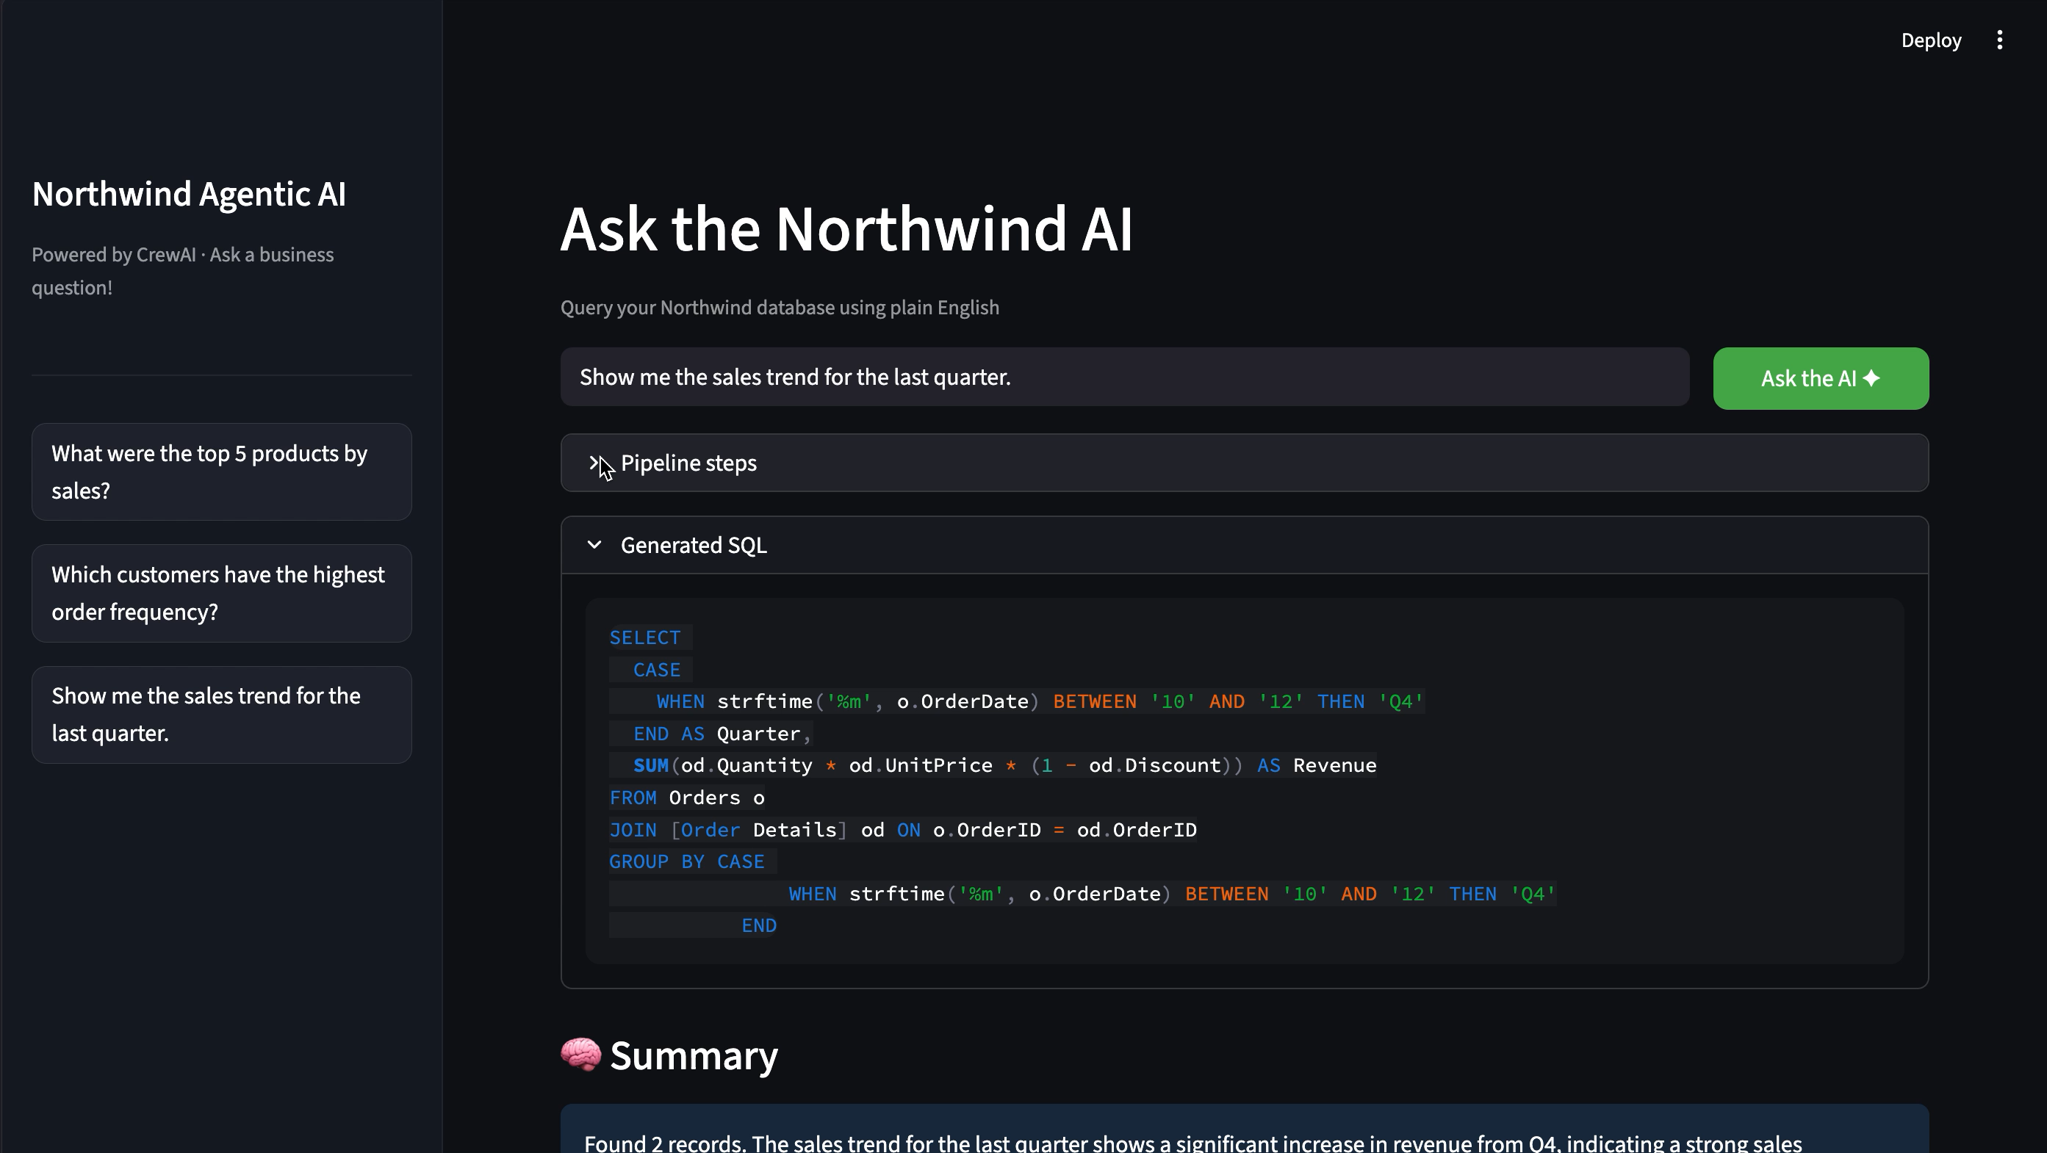
Demo

Slide 9
WHO CAN BENEFIT
Target Users & Use Cases
💼
Business Analysts
🏢
Business Managers
🎓
Students & Learners
Get instant answers to data questions without writing SQL. Spend time on insights, not queries.
Ask questions about sales, customers and performance in plain English during meetings.
Learn SQL by seeing natural language converted to queries in real time. Great for education.
🛒
E-commerce Teams
🔬
Data Scientists
🏗️
AI/ML Developers
Analyse order frequency, product performance and customer behaviour without a data team.
Use as a rapid prototyping tool to validate questions before writing production pipelines.
Study the multi-agent agentic architecture as a reference implementation for their own projects.

Slide 10
FUTURE UPGRADES
Roadmap & Enhancements
Phase 1 — Short Term
Phase 2 — Medium Term
Phase 3 — Long Term
Memory agent — remember previous questions in the session
Query history — save and replay past questions
Export to CSV / Excel directly from the UI
Better error messages with suggested rephrasing
Support for multiple databases beyond Northwind
Voice input — ask questions by speaking
Dashboard mode — pin favourite charts, Interactive charts.
Email reports — schedule weekly summaries
Fine-tuned SQL model on company-specific schema
Role-based access — different users see different data
Predictive analytics — forecast future sales trends
Integration with BI tools like Tableau or Power BI

Slide 11
SUMMARY
What Is Built
3
20+
3
AI Agents
Working Together
Business Questions
Answerable
LLM Providers
Supported
Key Takeaways
✅ Demonstrated a working 3-agent agentic AI pipeline using CrewAI
✅ Natural language → SQL → Data → Chart — fully automated end to end
✅ Flexible LLM support: Gemini, OpenAI, and Groq from a single config file
✅ Built with real-world debugging experience — rate limits, schema issues, tool calling
✅ Foundation ready for production upgrades: memory, multi-DB, voice input

