Slide 1
AGENTIC AI + RAG PROJECT
Northwind
Agentic AI + RAG
Multi-agent AI with RAG, Memory, Evaluation & Guardrails
Powered by CrewAI · ChromaDB · Gemini · Groq · Mistral · Cohere
CrewAI
ChromaDB
RAG
Streamlit
4 LLMs
GitHub

Slide 2
PROBLEM STATEMENT
The Challenge
🔍 Data is locked away
⏱️ Slow decision making
Business data sits in databases that require SQL expertise to access — non-technical users are excluded.
Waiting for analysts to write queries and build reports delays critical business decisions.
📊 No instant insights
🔄 Repetitive manual work
Converting raw data into meaningful charts and explanations requires manual work every time.
The same queries get rewritten repeatedly with no automated pipeline to handle routine analysis.

Slide 3
PROJECT GOALS
What is Set Out to Build
01
02
03
04
Natural Language Interface
RAG SYSTEM
Automated SQL Generation
Reliable Data Execution
Allow users to ask business questions in plain English without writing any SQL.
The system is build where a tables are vectorized and stored into a vector database ‘chromadb’.
The agent understands the schema stored in vector database, use the cosine similarity and write the query
Execute SQL queries directly against a real database and return accurate results.
05
06
07
08
Intelligent Visualizations
Guardrails, memory and evaluation
RAG + Multi-Agent Architecture
Practical UI
Automatically choose the right chart type and generate business insights from the data.
The input and output constraints are used, saved most common queries and compared multiple models
Demonstrate RAG and agentic AI with 3 specialized agents coordinated by CrewAI.
A clean Streamlit dashboard that anyone can use — no technical knowledge required.

Slide 4
Northwind Database Overview
Database features
Key Tables & Their Purpose:
Customers – Stores customer details such as name, contact, and location Orders – Contains order transactions placed by customers Order Details – Line-level data for each order (products, quantity, price) Products – Information about products sold (name, price, stock) Categories – Groups products into categories (e.g., beverages, dairy) Suppliers – Details of suppliers providing products Employees – Employee information managing orders and customers Shippers – Shipping companies responsible for deliveries
The Northwind Database is a sample relational database used to demonstrate business operations of a trading company. It models real-world scenarios like customers, orders, products, and suppliers, making it ideal for learning SQL, analytics, and data modeling.
Key Relationships:
• Customers → Orders (One-to-Many) • Orders → Order Details (One-to-Many) • Products → Order Details (One-to-Many) • Suppliers → Products (One-to-Many) • Categories → Products (One-to-Many)
Use Cases:
• Sales and revenue analysis • Customer segmentation • Inventory tracking • Supply chain analysis

Slide 5
RAG — SCHEMA INDEXING
How Tables Were Stored in ChromaDB
BEFORE — Raw Database (14 tables)
AFTER — ChromaDB Vector Index
Categories
CategoryID, CategoryName, Description, Picture
Table
Vector
Similarity
Customers
CustomerID, CompanyName, ContactName, Country, City
Products
[0.23, 0.87, ...]
0.92
Orders
OrderID, CustomerID, EmployeeID, OrderDate, ShippedDate
Order Details
[0.18, 0.91, ...]
0.88
[Order Details]
OrderID, ProductID, UnitPrice, Quantity, Discount
Orders
[0.31, 0.79, ...]
0.81
→
Products
ProductID, ProductName, CategoryID, UnitPrice, UnitsInStock
Categories
[0.42, 0.65, ...]
0.71
Employees
EmployeeID, FirstName, LastName, Title, HireDate
Customers
[0.11, 0.34, ...]
0.31 ❌
Suppliers
SupplierID, CompanyName, Country
Employees
[0.08, 0.29, ...]
0.28 ❌
Shippers
ShipperID, CompanyName, Phone
+ 6 more tables not shown – total 14 tables
Distance metric: Cosine Similarity

Slide 6
Full ARCHITECTURE
Full Pipeline with RAG + Memory + Evaluation
User Input
Input Guard
Memory Check
RAG Retrieval
SQL Writer
SQL Executor
→
→
→
→
→
Streamlit UI
Sanitise & block
ChromaDB cache
Top 5 tables
Agent 1
Agent 2 (Python)
Streamlit UI
Memory Save
Visualizer
Output Guard
↓
Evaluator
←
←
←
←
Show result
Cache if verified
Agent 3 + chart
Block bad results
Score & detect halluc
ChromaDB (Persistent Vector Store)
• Schema Collection: 14 table vectors (indexed once at startup)
• Distance metric: Cosine similarity · Embedding: DefaultEmbeddingFunction
• Memory Collection: Verified Q&A pairs (grows with use)
• Similarity threshold: 85% for cache hit
64% fewer tokens
< 200ms response
0-100 per query
Input + Output
4 LLMs compared
RAG Coverage
Memory Hit
Eval Score
Guardrails
Models

Slide 7
RAG — RETRIEVAL
How Tables Are Filtered Per Question
ChromaDB Vector Search
Top 5 Retrieved Tables
User Question
▶
Cosine similarity in ~50ms
▶
"top 5 products by sales"
✓ Suppliers (0.67)
✓ Orders (0.81)
✓ Order Details (0.88)
✓ Products (0.92)
✓ Categories (0.71)
Token Usage Comparison — RAG vs No RAG
Tables
Without RAG
With RAG
Token Saving
14 tables
~2,800 tokens
~1,000 tokens
64% saved
50 tables
~10,000 tokens
~1,000 tokens
90% saved
100 tables
~20,000 tokens
~1,000 tokens
95% saved
200 tables
~40,000 tokens
~1,000 tokens
97.5% saved

Slide 8
MEMORY LAYER
ChromaDB Query Cache — How Memory Works
First Time — Question Not in Cache
Question
→
Memory Miss
→
RAG Retrieval
→
SQL Writer
→
Execute SQL
→
Evaluator
→
Visualizer
→
Save to Cache
Full pipeline: ~2-5 seconds · LLM called · Result verified & stored
Second Time — Same/Similar Question (similarity > 85%)
Question
Memory HIT ✓
Re-run SQL
Visualizer
Instant Result
→
→
→
→
Cache hit: ~200ms · No LLM call · Only runs if evaluation previously passed · Similarity threshold: 85%

Slide 9
EVALUATION FRAMEWORK
Metrics & Anti-Hallucination Checks
SQL Quality Score
Hallucination Detection
0-100 composite score
−50 if execution fails
−30 if 0 rows returned
−20 per hallucinated table
Terminal only — never shown to user
Tables used vs tables in DB
Column names vs real schema
SQL aliases excluded (not flagged)
Rate = hallucinated / total tables
Score < 60 → result blocked
RAG Precision@K
Faithfulness Score
Retrieved tables that are relevant
K = 5 (top tables returned)
Measured per question
Coverage ratio: retrieved / total
Narrows 14→5 tables (64% reduction)
Numbers in insight vs actual data
Checks if insight matches rows
0-100% scale
< 50% = flagged as hallucination
Runs after visualizer completes

Slide 10
GUARDRAILS
Input & Output Safety Checks
Input Guardrail (input_guard.py)
Output Guardrail (output_guard.py)
✓ Min length:
5 characters minimum
✓ No hallucinated tables:
SQL must only use real tables
✓ Max length:
500 characters maximum
✓ Data not empty:
Must return at least 1 row
✓ Prompt injection:
Blocks: ignore previous, act as, roleplay
✓ Quality threshold:
Score must be ≥ 50/100
✓ SQL injection:
Blocks: DROP, DELETE, INSERT, UPDATE
✓ Insight sanitised:
Remove SQL keywords from insight
✓ Business intent:
Warning if no business keywords
✓ No SQL in insight:
Strips SELECT/FROM/WHERE from text
✓ Gibberish:
Blocks single-word inputs
✓ Symbol cleanup:
Remove non-standard characters
✓ Sanitisation:
Strips dangerous SQL fragments
✓ Blocked result:
Returns error if any check fails

Slide 11
BENCHMARK RESULTS
4 Models Tested on Same Questions
Model
Quality
Speed
Success
Groq 3.1 8b
100/100
377ms
100%
Mistral 7b
100/100
1046ms
100%
Gemini Lite
50/100
—
50%
Cohere A
100/100
9514ms
100%
🏆 Winner: Groq Llama 3.1 8b
Note: Gemini scored lower due to free tier quota limits — not model quality.
For production: Gemini is recommended for accuracy, Groq for speed.
Fastest at 377ms · 100% success rate · 0% hallucination

Slide 12
TEMPERATURE & DETERMINISM
Will Same Question Give Same SQL?
0.0
0.1
0.2
0.3
0.5+
Fully deterministic
SQL Writer (our setting)
Default factory
Visualizer (our setting)
Very random
Agent Temperature Settings
Agent
Temperature
Behaviour
Why This Value
SQL Writer (Agent 1)
0.1
Almost deterministic
SQL needs to be precise and repeatable
Executor (Agent 2)
0.0
Fully deterministic
No creativity needed — just run the query
Visualizer (Agent 3)
0.3
Slightly creative
Insights benefit from varied language
LLM Factory default
0.2
Balanced
Good for general use across models
Memory Cache makes repeated questions 100% deterministic — same SQL always returned from cache regardless of temperature.

Slide 13
DEPLOYMENT
Published on GitHub & Streamlit Cloud
1
Code pushed to GitHub
2
Streamlit Cloud setup
Full project including README, requirements.txt, folder structure. .env and venv excluded via .gitignore. API keys protected.
Connected GitHub repo to share.streamlit.io. API keys added as Secrets in Streamlit Cloud dashboard (not in code).
3
Secrets configuration
4
RAG auto-indexing
In Streamlit Cloud → App Settings → Secrets: added GOOGLE_API_KEY, GROQ_API_KEY, COHERE_API_KEY, MISTRAL_API_KEY, LLM_PROVIDER.
NorthwindCrew.__init__() detects missing ChromaDB index on first run and rebuilds it automatically. Zero manual setup needed.
5
App live
6
GitHub Actions (planned)
App accessible via public URL. Users can ask business questions in plain English — no SQL knowledge required. Free to use.
CI/CD pipeline to auto-redeploy on every git push. Automated tests run before deployment using test_db.py.

Slide 14
BENCHMARK DETAIL
Question-by-Question Model Comparison
Q1: What were the top 5 products by total sales?
Model
SQL Written
Rows
Time
Score
Hallucinated
Gemini 2.0 Flash
SELECT p.ProductName, SUM(od.Quantity*od.UnitPrice*(1-od.Discount))...
5
5532ms
100/100
None ✓
Groq Llama 3.1 8b
SELECT p.ProductName, SUM(od.Quantity*od.UnitPrice*(1-od.Discount))...
5
381ms
100/100
None ✓
Mistral 7b
SELECT p.ProductName, SUM(od.Quantity*od.UnitPrice*(1-od.Discount))...
5
851ms
100/100
None ✓
Cohere Command A
SELECT p.ProductName, SUM(od.Quantity*od.UnitPrice*(1-od.Discount))...
5
11712ms
100/100
None ✓
Q2: Which customers have the highest order frequency?
Model
Interpretation
Rows
Time
Score
Observation
Gemini 2.0 Flash
—
0
—
0/100
Quota exhausted (not model failure)
Groq Llama 3.1 8b
LIMIT 1 — single top customer
1
372ms
100/100
Strict interpretation of 'highest'
Mistral 7b
No LIMIT — all customers ranked
93
1241ms
100/100
Most thorough, shows full ranking
Cohere Command A
LIMIT 5 — top 5 customers
5
7317ms
100/100
Best for business dashboards

Slide 15
PROJECT COMPLETE
What Was Built & Delivered
3
4
RAG
85%
100%
Live
AI Agents
LLMs Compared
ChromaDB
Cache Threshold
Groq Success
On Streamlit
Key Deliverables
✅ 3-agent CrewAI pipeline: SQL Writer → Executor → Visualizer
✅ RAG with ChromaDB: reduces tokens by 64-97% as tables scale to 100-200
✅ Memory cache: repeated questions answered in <200ms with no LLM call
✅ Evaluation metrics: SQL quality score, hallucination rate, faithfulness, Precision@K
✅ Guardrails: input sanitisation + output validation before showing any result
✅ Benchmark: 4 models compared — Groq fastest, Cohere most business-friendly
✅ Published on GitHub with README, .gitignore, requirements.txt
✅ Deployed on Streamlit Cloud — publicly accessible, zero SQL knowledge needed

Slide 16
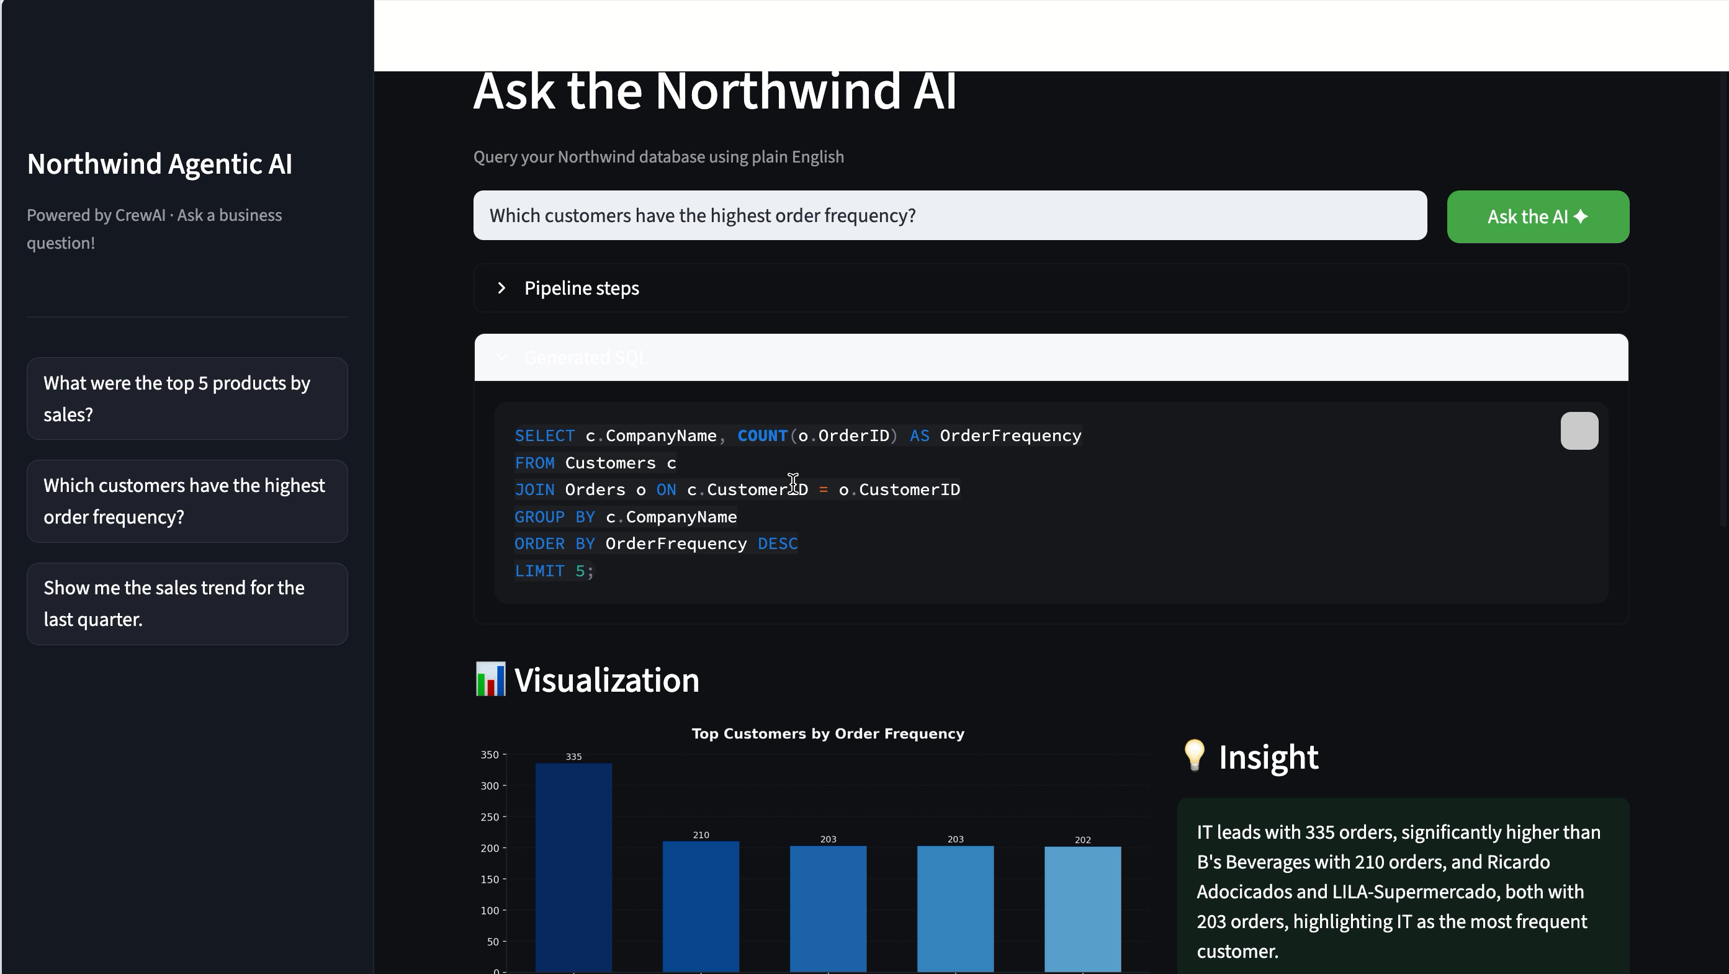
The Execution

Slide 17
WHO CAN BENEFIT
Target Users & Use Cases
💼
Business Analysts
🏢
Business Managers
🎓
Students & Learners
Get instant answers to data questions without writing SQL. Spend time on insights, not queries.
Ask questions about sales, customers and performance in plain English during meetings.
Learn SQL by seeing natural language converted to queries in real time. Great for education.
🛒
E-commerce Teams
🔬
Data Scientists
🏗️
AI/ML Developers
Analyse order frequency, product performance and customer behaviour without a data team.
Use as a rapid prototyping tool to validate questions before writing production pipelines.
Study the multi-agent agentic architecture as a reference implementation for their own projects.

