Slide 1
Advice for Handwritten Maths

Slide 2
Handwritten Maths
While hand-writing solutions has pedagogic value, it is not digitally accessible.
Handwritten material must be uploaded in a different format.
You can use AI to automatically convert handwritten maths into digital maths.
The following short guide shows examples of using Microsoft Copilot and Google Gemini to convert an image of handwritten maths to LaTeX code, which was then pasted in either a tex file or a MathType object.

Slide 3
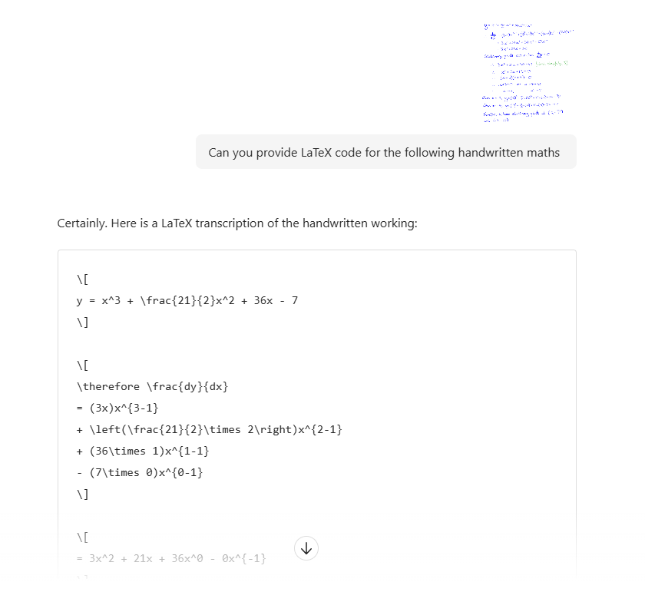
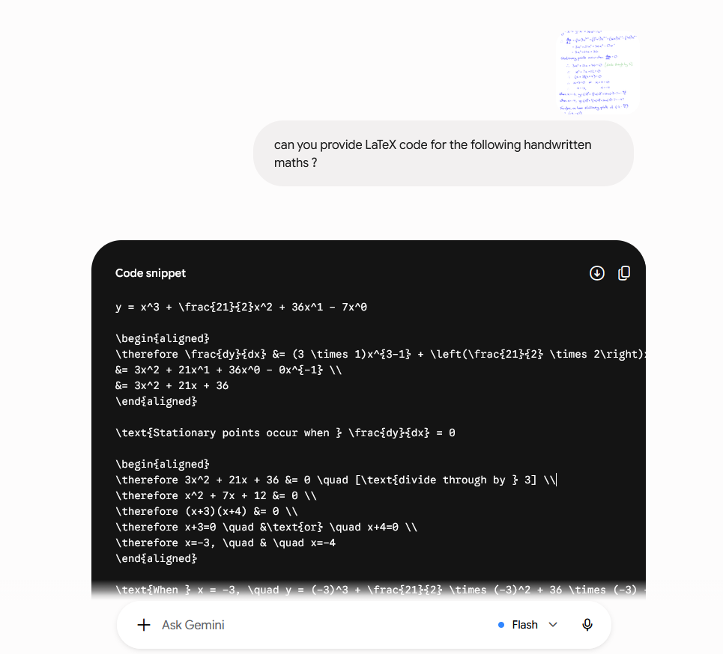
Handwritten Maths
The following prompt was used ‘Can you provide LaTeX code for the following handwritten maths’, together with an image of handwritten piece of maths.
Copilot prompt and answer
Gemini prompt and answer
Notes:
Craig (5 min with LaTeX, 20 total)

Slide 4
Handwritten Maths
The LateX code was pasted into a tex file.
The code produced by Gemini required minor corrections (i.e. adding the missing maths environment commands);
Both codes used the command \therefore which requires the amssymb package

Slide 5
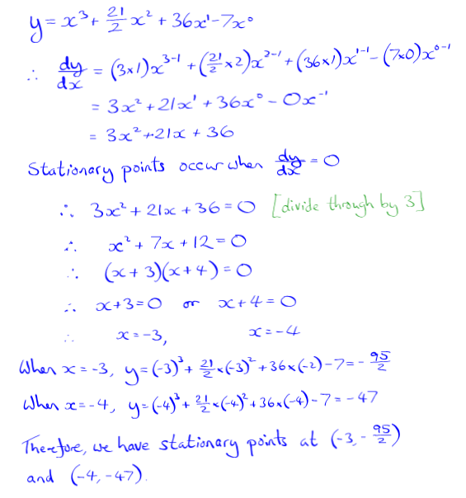
Original handwritten script
Output from Copilot LaTeX code
Output from Gemini LaTeX code

Slide 6
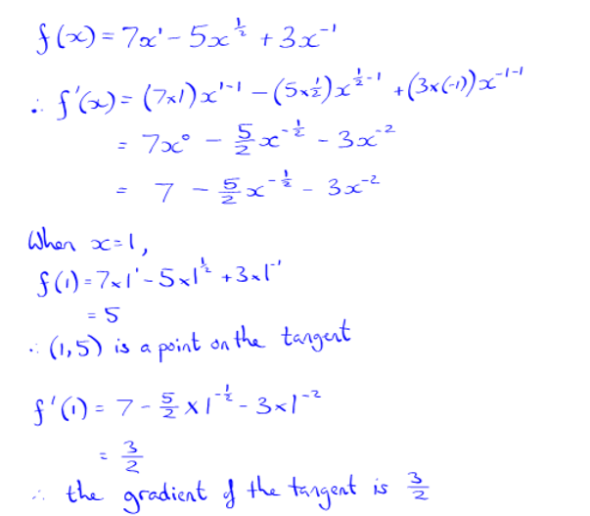
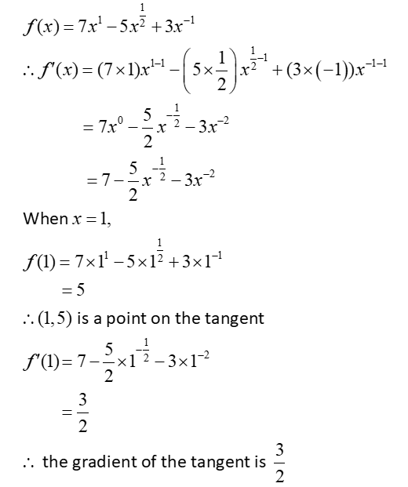
Handwritten Maths
Example of handwritten maths converted to LaTeX code with Gemini, then pasted in a MathType object:

Slide 7
Contact:
E-learning team
University of Aberdeen
elearning@abdn.ac.uk

