Slide 1
Maths in Tables

Slide 2
Tabulated Information
Screen readers read information row by row;
Displaying tabulated information row by row will improve reading and help screen reader users process the information more easily;
This short guide presents three cases where mathematical information was presented in tables in an accessible way.

Slide 3
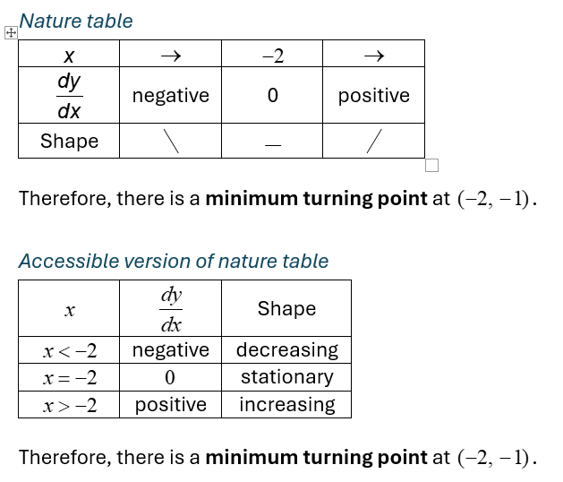
Nature Tables in Calculus
In this example, an accessible version (bottom table) has been added to the traditional nature table for functions (top table).
The accessible table is a transpose of the traditional table, so it displays information row by row.
The accessible table does not use pictograms.

Slide 4
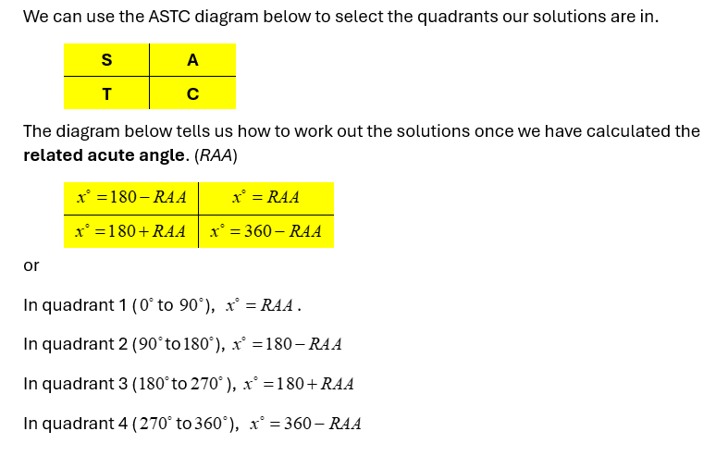
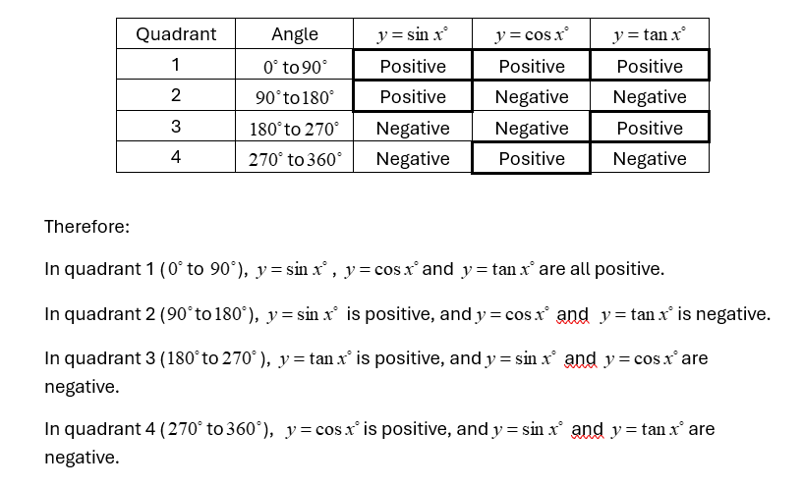
CAST Tables in Trigonometry
In this example, an accessible table was added to the CAST diagram.
Information is read row by row.

Slide 5
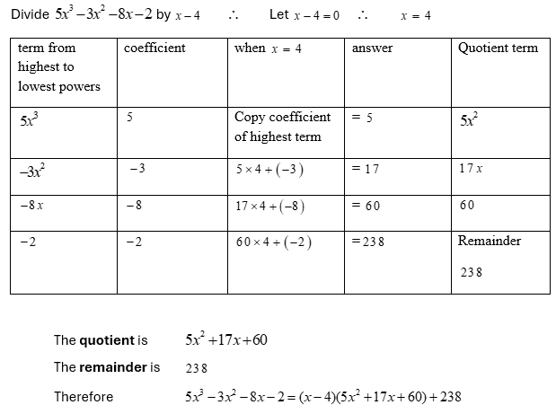
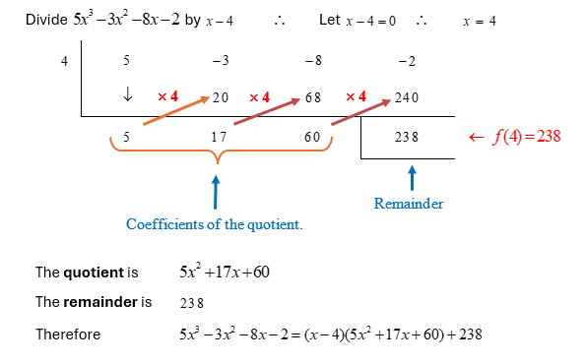
Polynomial Division Table
In this example, polynomial division was presented in table format. Information flows row by row.
Collaboration with Sight Scotland

Slide 6
Contact:
eLearning team
University of Aberdeen
elearning@abdn.ac.uk

