Slide 1
Advice for Word Documents with Maths

Slide 2
Maths in Word Documents
This short guide gives advice to improve accessibility of Word documents containing maths.
It covers:
the structure of documents with lists of exercises and solutions;
the layout of maths content within a solution or demonstration;
Maths editors (such as Word Equation and MathType).

Slide 3
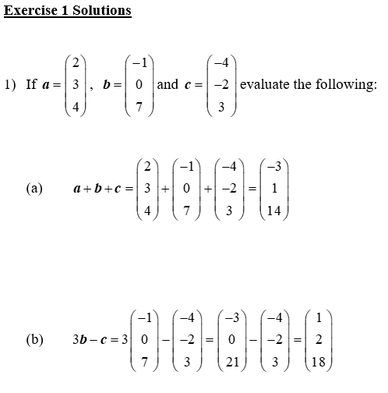
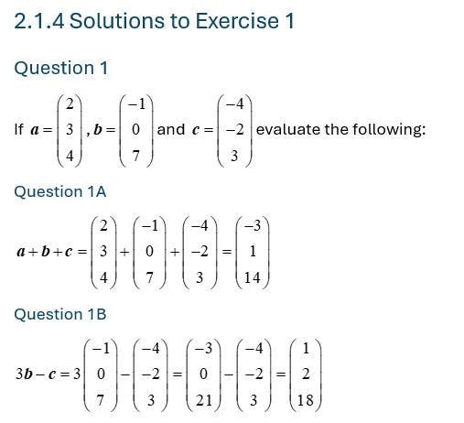
Structuring Maths Content
Structure exercises and solutions sheets: use the built in Microsoft headings for exercise and solution numbering to improve navigation within document.
Example of exercise sheet where exercise names and numbers have been changed to headings:

Slide 4
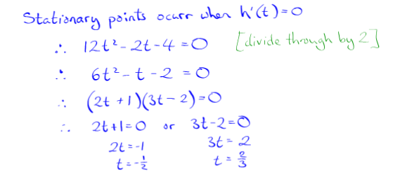
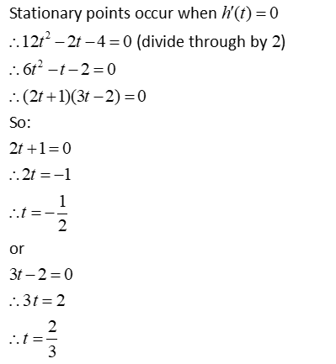
Layout of Maths Content
Structure maths work consistently: screen readers read row by row, so writing solutions solely vertically or horizontally will improve the reading flow.
Example of maths where a two-columns solution was changed to a single column layout:

Slide 5
Using a Maths Editor
ALL THE MATHS should be written within the editor, even if it could be written directly in the document.
Operators and symbols must be used with care (e.g. x, º, .): symbols may look alike but read differently by screen readers.
‘Multistep maths’: when maths steps are interspaced with text, writing everything in as one maths object with the editor improves the reading flow.
*Note: Not all editors allow for text within math entries (e.g. Microsoft editor)
Example of multi-step maths written as a single MathType object.

Slide 6
Contact:
E-learning team
University of Aberdeen
elearning@abdn.ac.uk

