Slide 1
Taggy Web Application
Taggy Email Grabber
Taggy Instant Messenger Plug-in
Taggy Web Service
Taggy Learner
Taggy Matchers
Full Text Search Engine
Relational Database
Attached Files

Slide 2
Taggy Web Application – Ruby on Rails
Taggy Email Grabber
Cron or Scheduled Tasks
Skype Plug-in
Taggy Web Service
Ruby on Rails
Taggy Learner Ruby
Taggy Matchers - Ruby
Full Text Search Engine – Apache Lucene, Solr
Relational Database - MySQL
Attached Files

Slide 3
Taggy Web Application – Ruby on Rails
Taggy Skype Plug-in
Taggy Email Grabber
Cron/Scheduled Tasks
Taggy Rails Web Service
Taggy Learner - Ruby
Taggy Matchers - Ruby
Full Text Search Engine – Apache Lucene, Solr
Relational Database - MySQL
Attached Files

Slide 4
From
To
Time
Subject
Body
Attachments
User Story#1
User Story#2
User Story#3
User Story#4
…
User Story#n
User Story#5
User Story#k
Related
User Stories
Email
CBR Library

Slide 5


User Story#2
Email# n
On User Story# n
User Story#1
Email# 1
On User Story# 1
User Story#3
User Story#n
Email# 3
On User Story# 3

Slide 6
Iterate

Slide 8
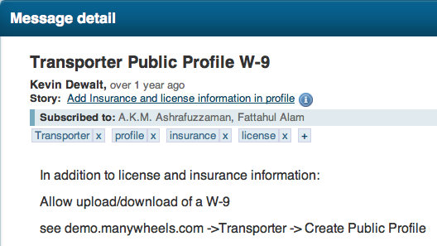

Slide 9
Learn Relative Weights
Evaluate Auto-Tagging Accuracy

Slide 10
@
1
CC:
Developer
Customer
Project Email
2
Email Grabber
CBR System
Compute Local Similarity
Compute Global Similarity
Sort
Pick
4
Auto-Tagger
Filter User Stories
3
9
Database

Slide 11
Instant Message
1
Developer
Customer
Instant Messenger Plug-in
2
Taggy Web Service
3
Database

