Slide 1

Relationship between life expectancy & healthcare spend, pharmaceutical spend, and care models
Capstone Project
Sherilyn Sommerville Colorado State University Global MIS581: Capstone: Business Intelligence and Data Analytics Dr. Orenthio Goodwin 15 May 2022

Slide 2
Healthcare spending
Healthcare related spending reached $4.1 trillion in the United States in 2021 (Centers for Medicare & Medicaid Services, 2021).
In the US healthcare spending is 18.8% of GDP whereas in comparable countries, it is 12% of their respective GDP (Wager, Ortaliza, & Cox, 2022).
23 million people in the US have healthcare debt (Claxton & Rae, 2022)
Notes:
The increasing costs associated with one’s health has created many challenges for Americans including, difficulty in affording any healthcare, preventing people from getting appropriate care or prescriptions, and the accumulation of medical bills. Healthcare related spending reached $4.1 trillion in the United States in 2021 (Centers for Medicare & Medicaid Services, 2021). In the US healthcare spending is 18.8% of GDP whereas in comparable countries, it is 12% of their respective GDP (Wager, Ortaliza, & Cox, 2022). 23 million people in the US have healthcare debt over $250 with around half of those owing more than $2000 (Claxton & Rae, 2022). Does this increased health spending equate to anything significant?

Slide 3
Pharmaceutical price regulation
Prescription costs are 80%-160% higher in the US than other countries (Commission, 2001).
Americans experienced a 15.73% cost increase in prescriptions from 2000-2001 and historically have spent more on “prescription drugs than citizens in other developed countries” (Latham, 2011)
Does the higher associated cost relate to better benefits?
Notes:
The cost of pharmaceutical drugs alone in the United States has long been a topic of discussion within healthcare. Prescription costs are 80%-160% higher in the US than other countries (Commission, 2001). Latham (2011) stated that Americans experienced a 15.73% cost increase in prescriptions from 2000-2001 and historically have spent more on “prescription drugs than citizens in other developed countries”. Crémieux et al., (2004), stated regarding higher drug costs “the cost must be compared with the benefits provided”. If a society is paying more than others for prescription drugs, one would assume they are receiving better medicines to offset the cost.

Slide 4
Care models
Fee-for-service
Providers are paid based on the amount of healthcare services they deliver (Catalyst, 2017).
The US primarily operates on fee-for service
Value-based care
A healthcare delivery model in which providers, including hospitals and physicians, are paid based on patient health outcomes (Catalyst, 2017).
Can be more beneficial for healthcare spending, patient outcomes, physicians, insurance providers, and other healthcare entities
Notes:
The United States has a healthcare focus of disease management whereas other countries have a bigger focus on disease prevention. The United States currently operates on a fee-for service approach “in which providers are paid based on the amount of healthcare services they deliver” (Catalyst, 2017). This means, the more services a physician provides, the more the physician will be paid. Value-based care is “a healthcare delivery model in which providers, including hospitals and physicians, are paid based on patient health outcomes” (Catalyst, 2017). The focus of value-based care is prevention rather than management, the opposite of fee for service. In many value-based care models, physicians are paid based on quality of care and patient outcomes rather than quantity of patient visits. Value-based care has shown to be beneficial for not only patients, but physicians, insurance providers, and other healthcare entities.

Slide 5

Overview of study
The goal of this research project was to analyze and compare healthcare spend, pharmaceutical spend and implementation of a value-based care model to life expectancy of those in the United States vs in other countries.
Notes:
The goal of this research project was to analyze and compare healthcare spend, pharmaceutical spend and implementation of a value-based care model to life expectancy of those in the United States vs in other countries. The objective is to determine how pharmaceutical price regulation and a value-based care model could benefit the United States and ultimately, and if the effects lead to longer life. The outcome of this research project has the potential to increase quality

Slide 6
Research questions
Does healthcare spend have any correlation with higher life expectancy?
Does a value-based care model have any correlation with higher life expectancy?
Does a pharmaceutical spend have any correlation with higher life expectancy?
Notes:
The three research questions looking to be addressed are first, does healthcare spend have any correlation with higher life expectancy? Next, does a value-based care model have any correlation with higher life expectancy? Finally, does a pharmaceutical spend have any correlation with higher life expectancy?

Slide 7
Methods & Methodology
Data was collected from The Organization for Economic Co-operation and Development
Healthcare spend by country, pharmaceutical spend by country, average life expectancy by country & healthcare debt
Care model data was collected from The Economist (2016)
Countries were ranked on their alignment to a value-based care model
High alignment were classified as value-based care while others were listed as a tradition fee for service
Data was cleaned and joined in R then correlational analyses were conducted in SAS
Notes:
Data on Healthcare spend by country, pharmaceutical spend by country, average life expectancy by country & healthcare debt was collected from The Organization for Economic Co-operation and Development.
Care model data was collected from The Economist (2016). Countries were ranked on their alignment to a value-based care model and High alignment were classified as value-based care while others were listed as a tradition fee for service.
Data was cleaned and joined in R then correlational analyses were conducted in SAS

Slide 8
Limitations and ethical considerations
The data was gathered from a single reporting source due to limited access
Lifestyle factors cannot be controlled for, thus, any changes cannot be solely correlated to certain factors
The respect for all personal information collected was be upheld
Informed consent was provided where necessary
Notes:
The data was gathered from a single reporting source due to limited access. Also, Lifestyle factors cannot be controlled for, thus, any changes cannot be solely correlated to specific metrics. All personal information was protected, and any personal identifiers were removed. Informed consent was also provided where necessary

Slide 9

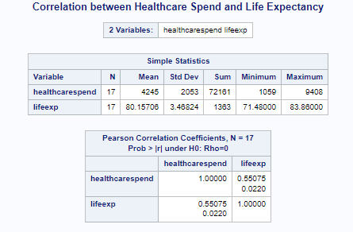


Results
A weak correlation between healthcare spend and life expectancy was reported.
Notes:
The first analysis completed was a correlation between healthcare spend and life expectancy. The correlation coefficient was found to be r = 0.55075 with a p value = 0.0220. Ideally, an r value closer to 1 indicates a strong relationship may exist (Elliott & Woodward, 2016). For this analysis, weak correlation between healthcare spend and life expectancy was discovered. Since the p value <0.05, the null hypothesis can be rejected, and it can be concluded that there is a statistically significant correlation between healthcare spend and life expectancy.

Slide 10
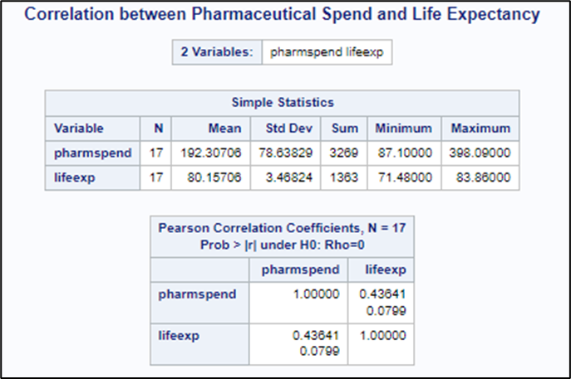
Results
There is no statistically significant correlation between pharmaceutical spend and increased life expectancy
Notes:
The second analysis completed was to determine if there was a correlation between pharmaceutical spending and life expectancy. The correlation coefficient value was found to be r = 0.43641 with a p value = 0.0799. However, since the p value > 0.05, the null hypothesis will not be rejected, and it can be concluded that there is no statistically significant correlation between pharmaceutical spend and increased life expectancy.

Slide 11
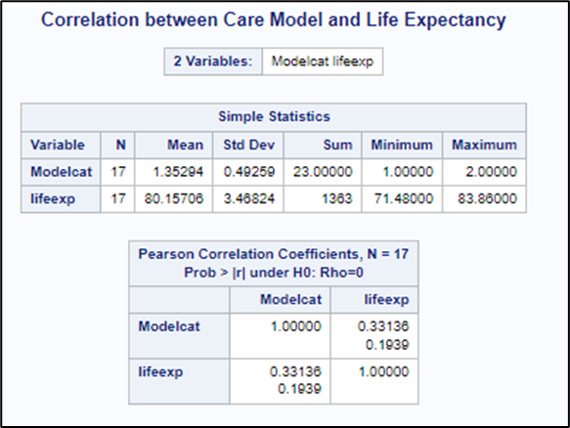
Results
There is no statistically significant correlation between types of care model and life expectancy.
Notes:
The third analysis completed was to determine if there was a correlation between care model and life expectancy. The r value was found to be r = 0.33136 with a p value = 0.1939. Consequently, since the p value is again >0.05, the null hypothesis will not be rejected. It can be concluded that there is no significant correlation between types of care model and life expectancy.

Slide 12
In conclusion & further recommendations
The only significant finding was that there is a weak correlation between increased healthcare spending and life expectancy
No correlations were found between pharmaceutical spend and life expectancy or care model and life expectancy.
Further research should be conducted
Notes:
In conclusion, the only significant finding was that there is a weak correlation between increased healthcare spending and life expectancy. As healthcare spending increased, life expectancy increased as well. Unfortunately, for pharmaceutical spending, no relationship was found with life expectancy. Since no significant relationship was found between the two, it could be concluded that higher pharmaceutical spend does not influence a higher life expectancy. Since a positive or negative relationship was not found between the two variables, this does favor the idea that if the United States implemented a price cap on pharmaceuticals, life expectancy would not change. The final hypothesis was examining a relationship between care model type and life expectancy. Again, no relationship was found to be significant between the two. While only one of the three null hypotheses was disproved, further research within this area should be conducted. Going forward, better tracking of countries type of care model should be addressed while also, data should look at what year a VBC model was implemented. Additionally, some countries have government funded healthcare while others require private insurance. This also could cause changes in healthcare spending. In the future, healthcare funding should also be normalized to account for variations in the data.

Slide 13
References
Catalyst, NEJM. (2017). What is value-based healthcare? NEJM Catalyst. Retrieved March 27, 2022, from https://catalyst.nejm.org/doi/full/10.1056/CAT.17.0558
Centers for Medicare & Medicaid Services. (2021). Press Release National Health Spending in 2020 increases due to impact of COVID-19 pandemic. CMS. Retrieved March 27, 2022, from https://www.cms.gov/newsroom/press-releases/national-health-spending-2020-increases-due-impact-covid-19-pandemic#:~:text=Press%20release-,National%20Health%20Spending%20in%202020%20Increases,Impact%20of%20COVID%2D19%20Pandemic&text=As%20with%20so%20many%20aspects,bringing%20spending%20to%20%244.1%20trillion.
Claxton, G., & Rae, M. (2022). The burden of medical debt in the United States. KFF. Retrieved April 3, 2022, from https://www.kff.org/health-costs/issue-brief/the-burden-of-medical-debt-in-the-united-states/#:~:text=This%20analysis%20of%20government%20data,debt%20owe%20more%20than%20%242%2C000.
Commission, P. (2001). International Pharmaceutical Price Differences. SSRN Electronic Journal. https://doi.org/10.2139/ssrn.277602
Crémieux, P.-Y., Meilleur, M.-C., Ouellette, P., Petit, P., Zelder, M., & Potvin, K. (2004). Public and private pharmaceutical spending as determinants of Health Outcomes in Canada. Health Economics, 14(2), 107–116. https://doi.org/10.1002/hec.922
Dalen, J. E. (2010). We can reduce US health care costs. The American Journal of Medicine, 123(3), 193–194. https://doi.org/10.1016/j.amjmed.2009.12.011
Latham, S. (2011). Pharmaceutical costs. Taylor & Francis. Retrieved March 26, 2022, from https://www.tandfonline.com/doi/abs/10.1080/713832157
OECD (2022), "Data warehouse", OECD.Stat (database), https://doi.org/10.1787/data-00900-en
The Economist. (2016). Value-based healthcare: A global assessment. Economist Intelligence Unit. Retrieved May 1, 2022, from https://www.eiu.com/n/
Wager, E., Ortaliza, J., & Cox, C. (2022). How does health spending in the U.S. compare to other countries? Peterson-KFF Health System Tracker. Retrieved March 27, 2022, from https://www.healthsystemtracker.org/chart-collection/health-spending-u-s-compare-countries-2/#:~:text=Health%20spending%20per%20person%20in,half%20that%20of%20the%20U.S.

