Slide 1
Communicating Sequential Processes
By: Syed Muhammad Saim
#1

Slide 2
Motivation
What is CSP?
Notation of describing patterns of communication by algebraic expressions.
Based on the theory of failures & divergneces
CSP is not
Programming language
#2

Slide 3
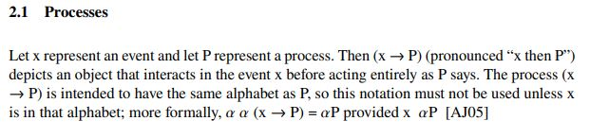

Theoretical Background
ref[8]
#3

Slide 4
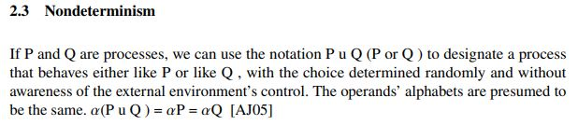
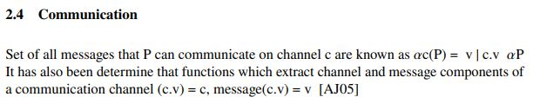
Theoretical Background
ref[8]
#4

Slide 5
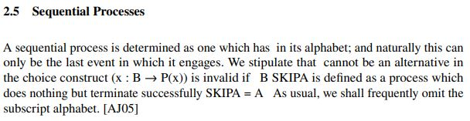
Theoretical Background
ref[8]
#5

Slide 6
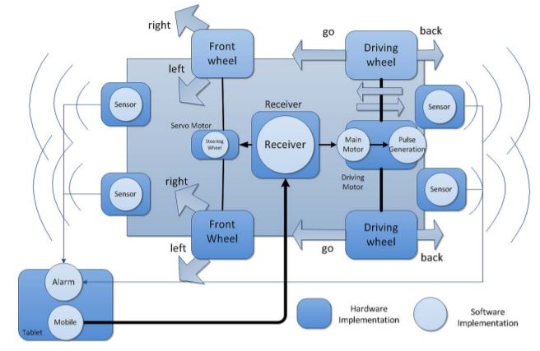
Figure 1. Entire System of RC Car COntrolled by Tablet [7]
#6

Slide 7
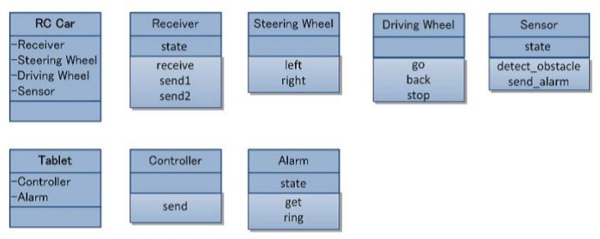
Figure 2. Agent System Model[7]
#7

Slide 8
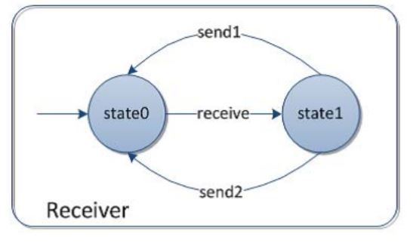
Figure 3. State Transition Model [7]
#8

Slide 9
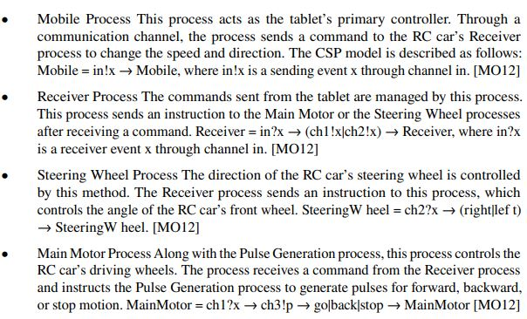
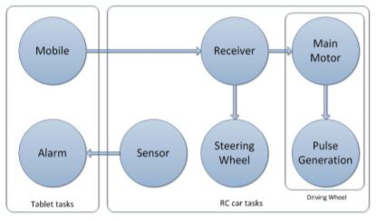
Remote-Controlled Car
Figure 4. CSP of RC Car [7]
#9

Slide 10
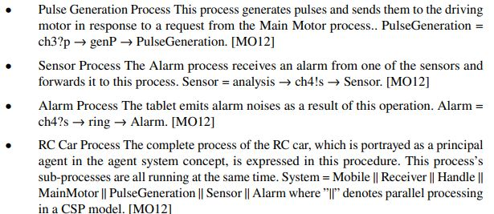
Remote- Controlled Car
ref[7]
#10

Slide 11
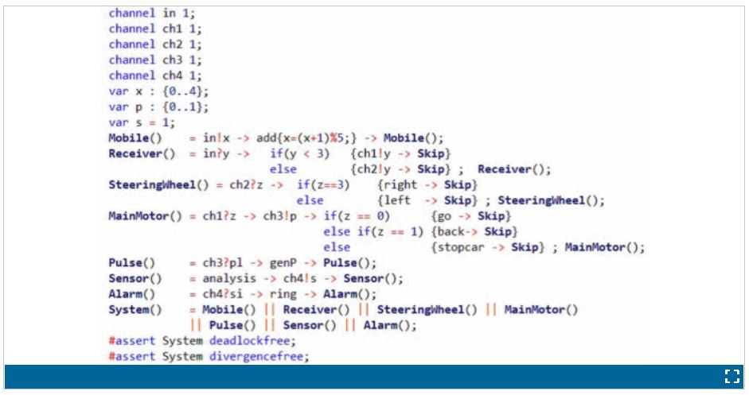
Figure 5. Description of a CSP model in PAT3 [7]

Slide 12
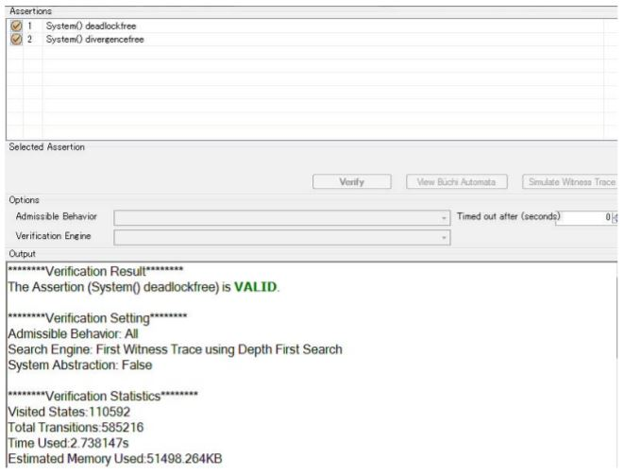
Figure 6. Output Results of deadlock-free verification[7]
#11

Slide 13
Conclusion
#12

Slide 14
Bibliography
Brookes, Stephen D; Hoare, Charles AR; Roscoe, Andrew W: A theory of communicating sequential processes. Journal of the ACM (JACM), 31(3):560–599, 1984.
Chaturvedi, Kanishk; Matheus, Andreas; Nguyen, Son H; Kolbe, Thomas H: Securing spatial data infrastructures in the context of smart cities. In: 2018 International Conference on Cyberworlds (CW). IEEE, pp. 403–408, 2018
Friborg, Rune; Vinter, Brian; Bjørndalen, John: PyCSP - Controlled concurrency. ĲIPM, 1:40–49, 10 2010.
Kinoshita, Satoko; Yun, Sunkil; Kitamura, Noriyasu; Nishimura, Hidekazu: Analysis of a driver and automated driving system interaction using a communicating sequential process. In: 2015 IEEE International Symposium on Systems Engineering (ISSE). IEEE, pp. 272–277, 2015.
Kinoshita, Satoko; Yun, Sunkil; Kitamura, Noriyasu; Nishimura, Hidekazu: Analysis of a driver and automated driving system interaction using a communicating sequential process. In: 2015 IEEE International Symposium on Systems Engineering (ISSE). pp. 272–277, 2015.
Koikkalainen, P; Oja, E: Proc. ICNN’88, Int. Conf. on Neural Networks. 1988.
Mizutani, Ryo; Ohmori, Kenji: A Design and Implementation Method for Embedded Systems Using Communicating Sequential Processes with an Event-Driven and MultiThread Processor. In: 2012 International Conference on Cyberworlds. pp. 221–225, 2012
Abdallah, Ali E; Jones, Cliff B: Communicating Sequential Processes. The First 25 Years:Symposium on the Occasion of 25 Years of CSP, London, UK, July 7-8, 2004. RevisedInvited Papers, volume 3525. Springer Science & Business Media, 2005
#13

Slide 15

Thank You For Your Precious Time
#14

