Slide 1
Controller Area Network (CAN)
ABDULLAH ZAFAR
MUSTAFA TOUQIR
SYED MUHAMMAD SAIM

Slide 2
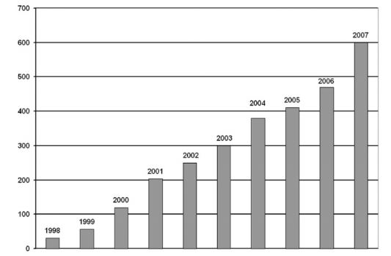
INTRODUCTION
What is Controller Area Network (CAN) ?
Background
CAN Network Technology
Figure 1: Number of million CAN nodes per User

Slide 3
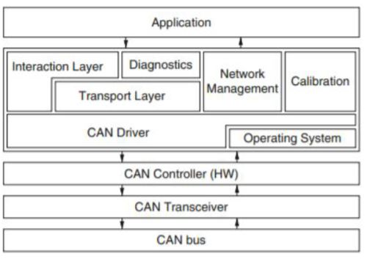
ARCHITECTURE – Main Components
CAN Controller (hardware)
CAN Device Driver
Transport Layer
Interaction Layer
Diagnostic and Network
Management Layers
Calibration Layer
Figure 2: Typical architecture of a CAN-based system

Slide 4
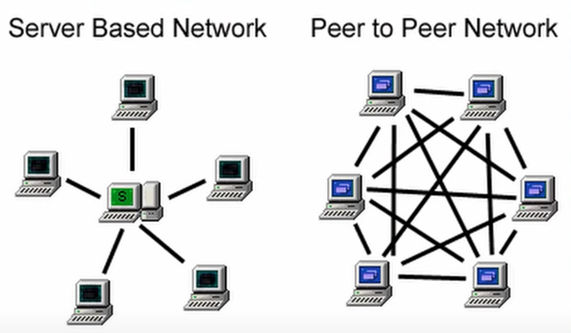
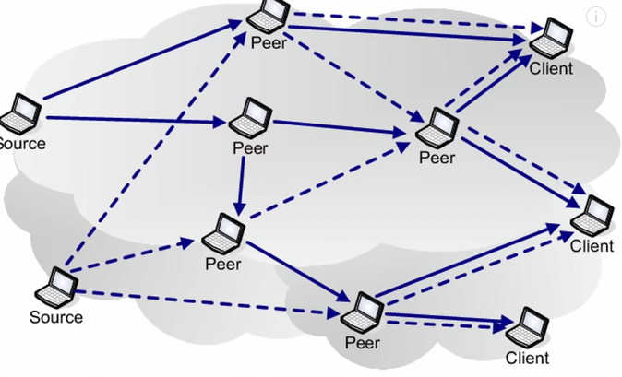
Controller Area Network

Slide 5
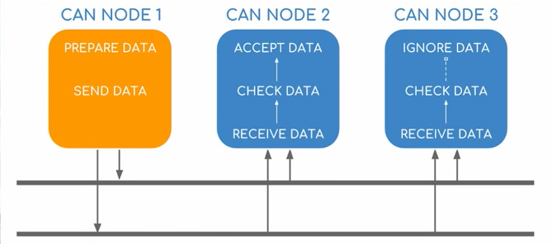
MESSAGE BROADCASTING AND DATA TRANSFER
Transmission and Reception
Peer To Peer Network

Slide 6
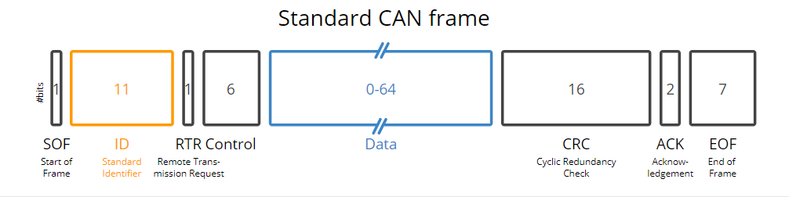
Priority ID system
Two devices or electronics sending the information at the very same time.
Priority ID- How important is the message

Slide 7
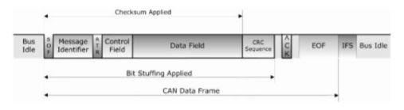
ERROR MANAGEMENT
Bit Monitoring
global error detection
Exact location of the error
Acknowledgment Error
ACK
Figure 6

Slide 8
BENEFITS OF USING CAN BUS
Reduced wiring
Reduced cost
reliability
Improved service
Maintenance features
Error management
Low cost implementation
World wide acceptance
Functioning in extreme electrical
environments and high degree of real time

Slide 9
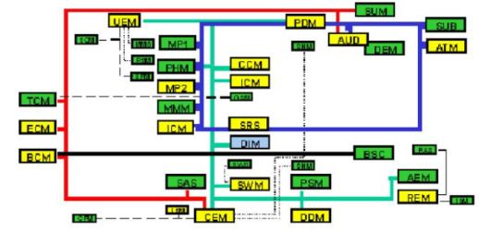
APPLICATIONS
Figure 3: Distributed control architecture for the Volvo XC90

Slide 10
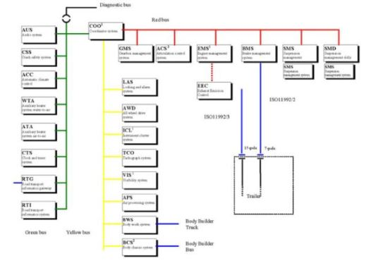
APPLICATION
Figure 4: Distributed control architecture for a Scania Truck

Slide 11
DRAWBACKS
CAN Bus has to deal with an increased amount of electronic devices in automobile
Event triggered CAN has built up itself as a de facto standard
problematic to asynchronous external events which are not know in advance
TTCAN
by ISO 11848-4

Slide 12
CONCLUSION

Slide 13
APPENDIX
Figure 1 : Number of million CAN nodes per User
Figure 2 : Typical architecture of a CAN-based system
Figure 3 : Distributed control architecture for the Volvo XC90
Figure 4 : Distributed control architecture for a Scania Truck
Figure 5 : Control architecture for SMART – 1 spacecraft
Figure 6 : Number of million CAN nodes per User
Figure 7 : CAN Bus Arbitration

Slide 14
BIBLIOGRAPHY
[1] A Albert, R Strasser, and A Trachtler. Migration from can to ttcan fora distributed control system. InProceedings of 9th international CAN inAutomation Conference, volume 5, pages 9–16, 2003.
[2] Jean-Luc Bechennec, Mikael Briday, S ́ebastien Faucou, and Yvon Trin-quet. Trampoline an open source implementation of the osek/vdx rtosspecification. In2006 IEEE Conference on Emerging Technologies andFactory Automation, pages 62–69. IEEE, 2006.
[3] Marco Di Natale, Haibo Zeng, Paolo Giusto, and Arkadeb Ghosal.Understanding and using the controller area network communicationprotocol: theory and practice. Springer Science & Business Media, 2012.
[4] Karl Henrik Johansson, Martin T ̈orngren, and Lars Nielsen. Vehicleapplications of controller area network. InHandbook of networked andembedded control systems, pages 741–765. Springer, 2005.
[5] Wilfried Voss.A comprehensible guide to controller area network.Copperhill Media, 2008
https://www.csselectronics.com/screen/page/simple-intro-to-can-bus/language/en(pictures)

Slide 15
YOUR QUESTIONS

