Slide 1
Internship at STAR ELECTRONICS GmbH & Co. KG
by Syed Muhammad Saim

Slide 2
Contents
Introduction of the Company
Softwares
Hardwares
Tools Used
Jenkins
Tortoise SVN
Intel Quartus Prime
Ranorex
Training - Automotive Bus Systems and Communication Protocols
FlexConfig RBS
Scalable service-Oriented MiddlewarE over IP (SOME/IP)
Controller Area Network (CAN)
Controller Area Network Flexible Data-Rate (CAN-FD)
FlexRay
TASK 1: Gateway Testing
Motivation
CAPL GUI
My Contribution 1
My Contribution 2
My Contribution 3
TASK 2: Black-Box Testing - Field Programmable Gate Arrays (FPGA)
Motivation
Flashing
Complex Programmable Logic Device (CPLD)
FlexTinys
Cables
My Contributions
TASK 3: Regression Testing
Motivation
Test Setup
My Contributions
My Internship Evaluation
Academic Relevance
Skills Learned
Pros and Cons of the Internship
Bibliography

Slide 3
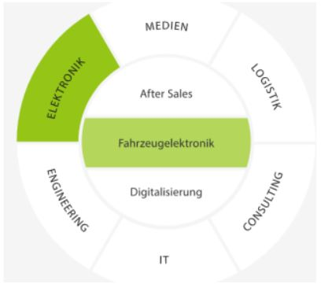
Introduction Of The Company
headquarter in Böblingen
Situated worldwide
STAR Electronics is part of STAR Cooperation
specialist in automotive electronics
Consulting services for complex concepts
provides right hardware and software
Figure 1: Field Of Activity Of STAR GmbH & Co. KG

Slide 4
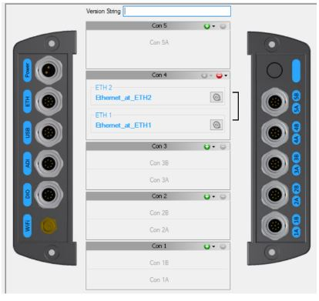
Introduction of the Company
Software
used together with FlexDevices and FlexCards
supports all kind of bus communication protocols
Figure 2: Flex Config RBS Software

Slide 5
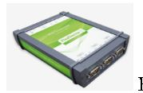
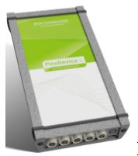
Introduction of the Company
2. Hardwares
FlexDevice S
versatile bus control unit
One FlexTiny and 3 connectors for wires
FlexDevice L
5 FlexTinys and 5 connectors for wires
1 ARM Cortex A9 Dual Core Processor
1GB DDR3 RAM
FlexDevice L²
5 FlexTinys and 5 connectors for wires
2 ARM Cortex A9 Dual Core Processor
2 GB DDR3 RAM
Figure 3: FlexDevice S
Figure 4: FlexDevice L
Figure 5: FlexDevice L²

Slide 6
Contents
Training - Automotive Bus Systems and Communication Protocols
FlexConfig RBS
Scalable service-Oriented MiddlewarE over IP (SOME/IP)
Controller Area Network (CAN)
Controller Area Network Flexible Data-Rate (CAN-FD)
FlexRay
TASK 1: Gateway Testing
Motivation
CAPL GUI
My Contribution 1
My Contribution 2
My Contribution 3
TASK 2: Black-Box Testing - Field Programmable Gate Arrays (FPGA)
Motivation
Flashing
Complex Programmable Logic Device (CPLD)
FlexTinys
Cables
My Contributions
TASK 3: Regression Testing
Motivation
Test Setup
My Contributions
My Internship Evaluation
Academic Relevance
Skills Learned
Pros and Cons of the Internship
Bibliography

Slide 7
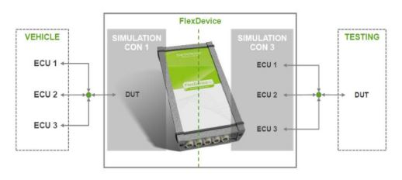
TRAINING - Automotive Bus Systems And Communication Protocols
FLEXCONFIG RBS
Residual Bus Simulation
Transparent Gateway
FlexConfig Gateway
Bus Complementation
Manipulation
Filter
Visualization
Figure 6: Transparent Gateway Structure [1].

Slide 8
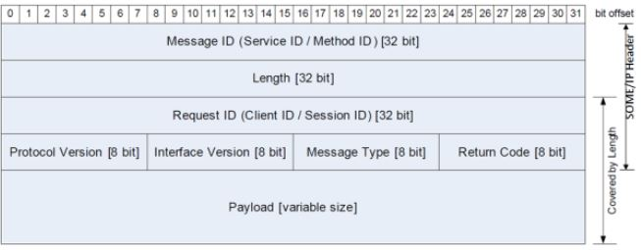
TRAINING - Automotive Bus Systems And Communication Protocols
2. Scalable service-Oriented MiddlewarE over IP (SOME/IP)
service based (not signal based)
Methods
Events
Fields
notifier
getter
setter
Figure 7: SOME/IP [2].

Slide 9
TRAINING - Automotive Bus Systems And Communication Protocols
3. Controller Area Network (CAN)
Message oriented, multi-master, serial asynchronous communication bus
Used for dependable data exchange between ECUs
Applications:
Automobiles
Building Automation
Elevators
Lightning control system
Drawbacks
Overhead bits
Use of two wires
Latency time

Slide 10
TRAINING - Automotive Bus Systems And Communication Protocols
4. Controller Area Network Flexible Data-Rate (CAN-FD)
Upgraded version of CAN
Five times more data rates than CAN
Data Length increased to 64 bytes from 8 bytes

Slide 11
TRAINING - Automotive Bus Systems And Communication Protocols
5. FlexRay
Transfer data rate at 10 megabits/second
Can also be used where CAN is already employed
Topologies include point-to-point links, passive stars, linear passive buses, active star networks, cascaded active stars, hybrid topologies, dual channel topologies.

Slide 12
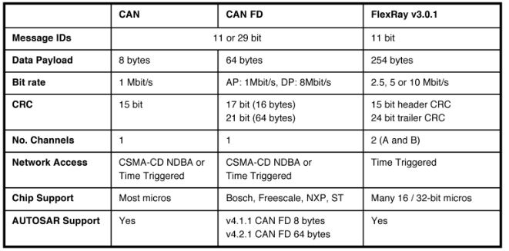
Figure 8: CAN, CAN-FD, FlexRay Comparison [3].

Slide 13
Contents
TASK 1: Gateway Testing
Motivation
CAPL GUI
My Contribution 1
My Contribution 2
My Contribution 3
TASK 2: Black-Box Testing - Field Programmable Gate Arrays (FPGA)
Motivation
Flashing
Complex Programmable Logic Device (CPLD)
FlexTinys
Cables
My Contributions
TASK 3: Regression Testing
Motivation
Test Setup
My Contributions
My Internship Evaluation
Academic Relevance
Skills Learned
Pros and Cons of the Internship
Bibliography

Slide 14
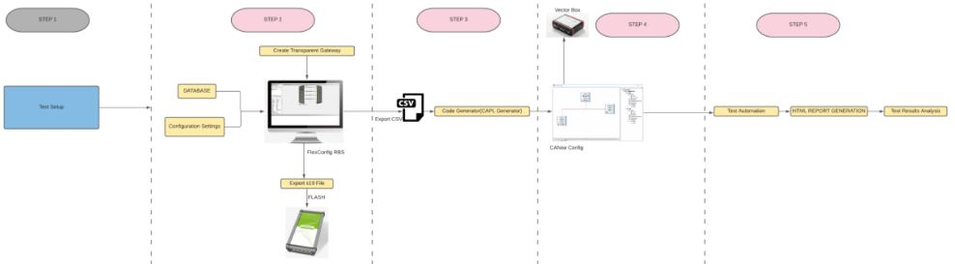
TASK 1: Gateway Testing
Motivation
Figure 9: Gateway Testing Workflow

Slide 15
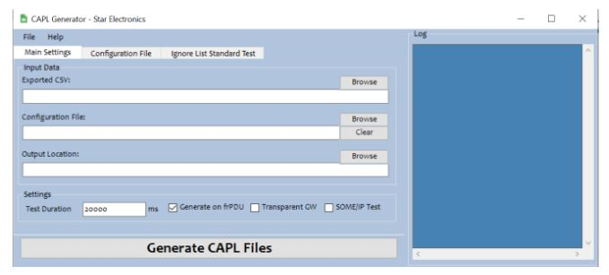
TASK 1: Gateway Testing
2. Communication Access Programming Language (CAPL) Generator GUI
Figure 10: CAPL Generator Software.

Slide 16
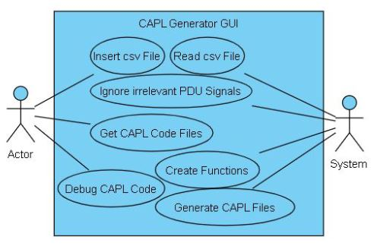
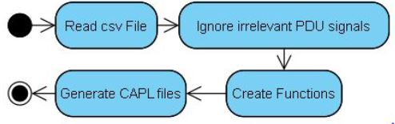
TASK 1: Gateway Testing
2. Communication Access Programming Language Generator (CAPL) Generator GUI
Figure 12: CAPL Generator Activity Diagram
Figure 11: CAPL Generator Use-Case Diagram

Slide 17
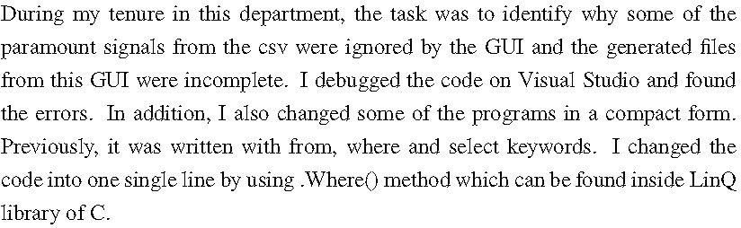
TASK 1: Gateway Testing
My Contribution 1:

Slide 18
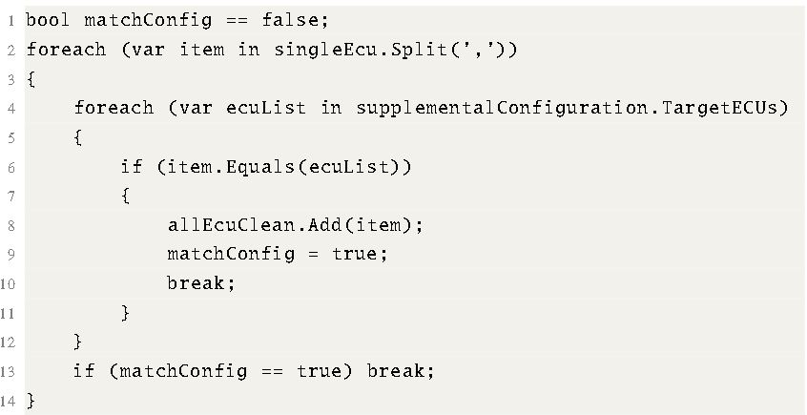
TASK 1: Gateway Testing
My Contribution 2:

Slide 19
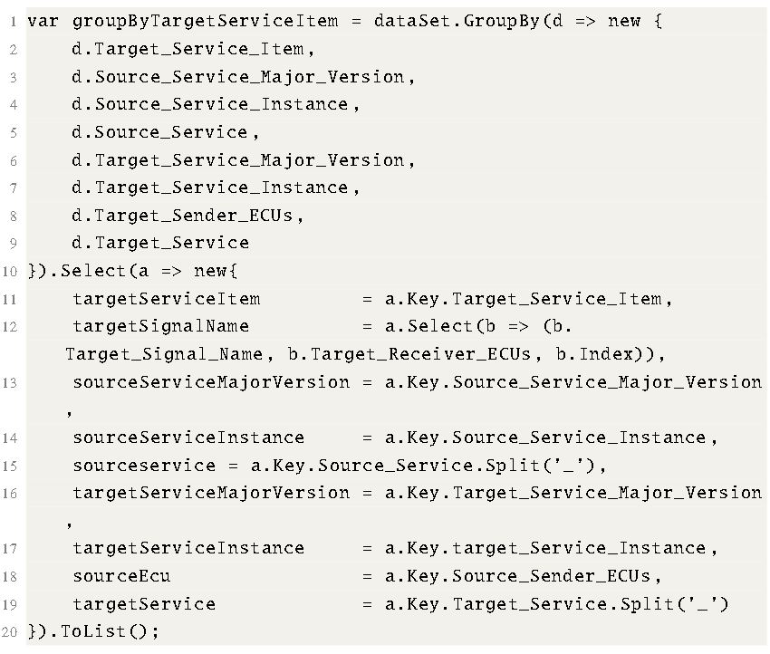
TASK 1: Gateway Testing
My Contribution 3:
used GroupBy Method with lambda

Slide 20
Contents
TASK 2: Black-Box Testing - Field Programmable Gate Arrays (FPGA)
Motivation
Flashing
Complex Programmable Logic Device (CPLD)
FlexTinys
Cables
My Contributions
TASK 3: Regression Testing
Motivation
Test Setup
My Contributions
My Internship Evaluation
Academic Relevance
Skills Learned
Pros and Cons of the Internship
Bibliography

Slide 21
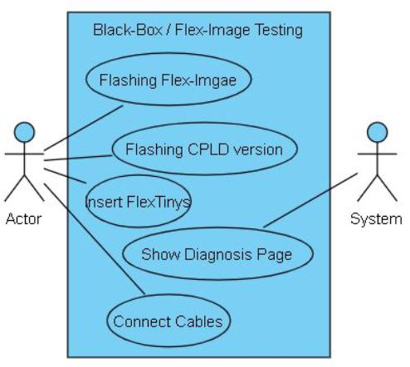
TASK 2: Black-Box Testing - Field Programmable Gate Arrays (FPGA)
Motivation
focused only on functionality
detailed understanding is not necessary
Figure 13: FPGA-Image Testing Use-Case Diagram

Slide 22
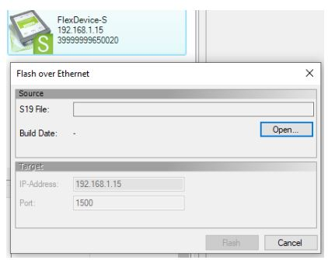
TASK 2: Black-Box Testing - Field Programmable Gate Arrays (FPGA)
2. Flashing
flashing FPGA-Image
installed on Flex Device
project binary file (.s19)
Figure 14: Flashing

Slide 23
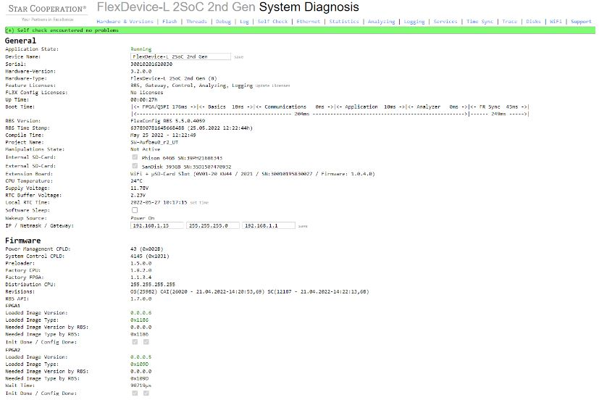
TASK 2: Black-Box Testing - Field Programmable Gate Arrays (FPGA)
2. Flashing
shows informationof deivce.
Figure 15: Diagnosis Page

Slide 24
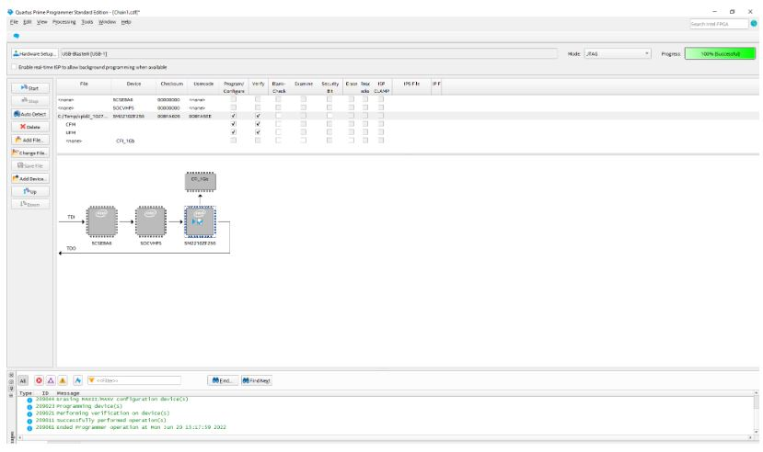
TASK 2: Black-Box Testing - Field Programmable Gate Arrays (FPGA)
3. Complex Programmable Logic Device (CPLD)
2 main versions
with the help of Joint Test Ation Group (JTAG)
Figure 16: Intel Quartus Prime with connected Hardwares

Slide 25
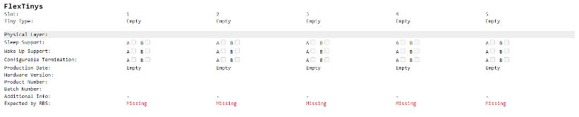
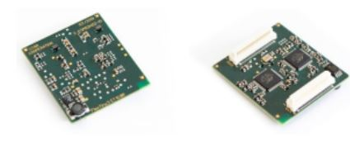
TASK 2: Black-Box Testing - Field Programmable Gate Arrays (FPGA)
3. FlexTinys
small system on chip boards
plugged inside the FlexDeives and FlexCards
Figure 17: FlexTinys Information
Figure 18: FlexTinys [4].

Slide 26
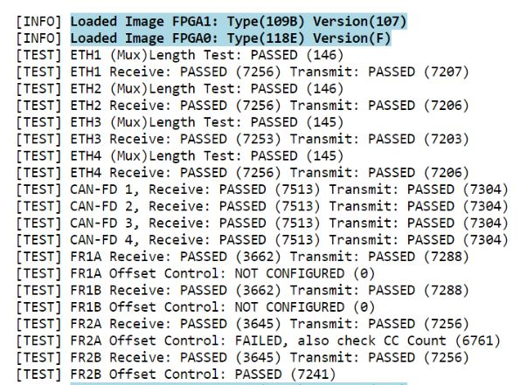
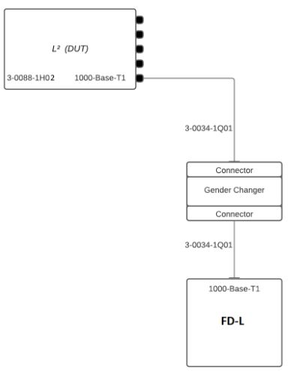
TASK 2: Black-Box Testing - Field Programmable Gate Arrays (FPGA)
4.Cables
special cables
Figure 19: Cables
Figure 20: Project Results

Slide 27
TASK 2: Black-Box Testing - Field Programmable Gate Arrays (FPGA)
5. My Contributions
updated the concerned department after checking
tested number of FPGA Images

Slide 28
Contents
TASK 3: Regression Testing
Motivation
Test Setup
My Contributions
My Internship Evaluation
Academic Relevance
Skills Learned
Pros and Cons of the Internship
Bibliography

Slide 29
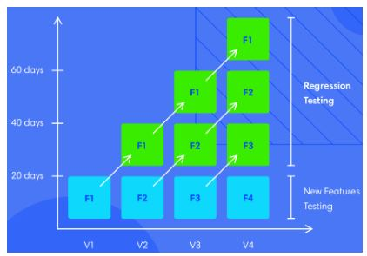
TASK 3 - Regression Testing
Motivation
test an application after any change
Figure 21: Regression Testing Workflow [5].

Slide 30
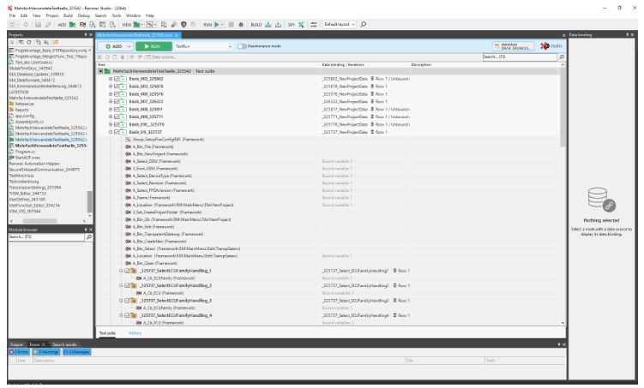
TASK 3 - Regression Testing
2. Test Setup
Testsuites
Smart Folders
Recoridings
Actions
Events
Figure 22: Ranorex Software with added Testsuites

Slide 31
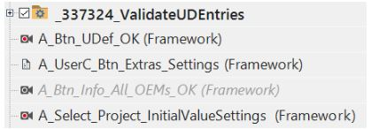
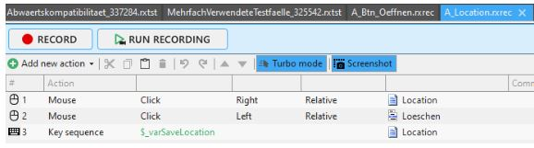
TASK 3 - Regression Testing
3. My Contributions
Figure 23: Disabling Button
Figure 24: Actions and Events

Slide 32
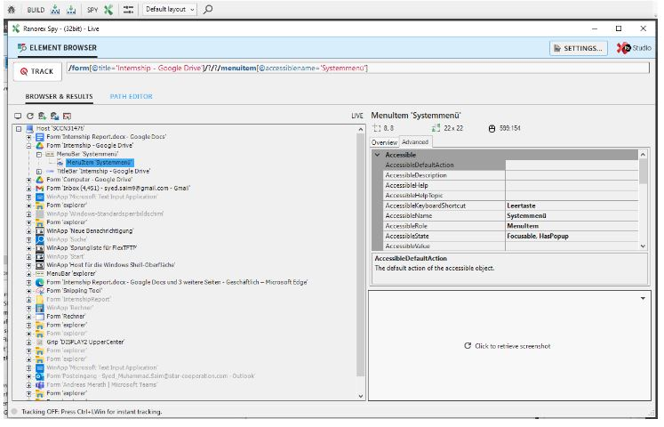
TASK 3 - Regression Testing
3. My Contributions
essential element of Ranorex Software
Figure 25: Ranorex Spy

Slide 33
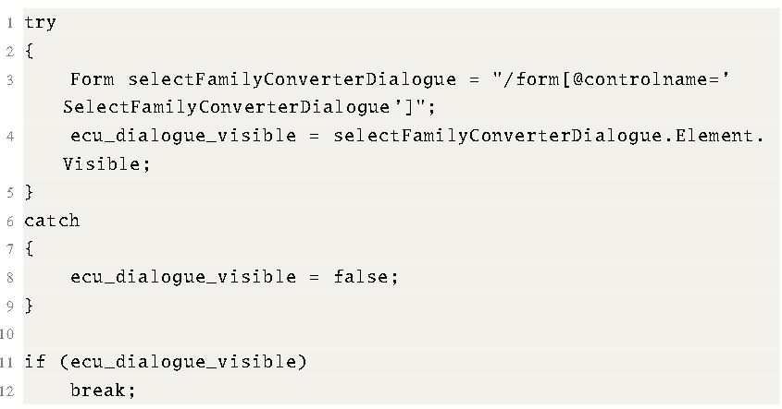
TASK 3 - Regression Testing
3. My Contributions

Slide 34
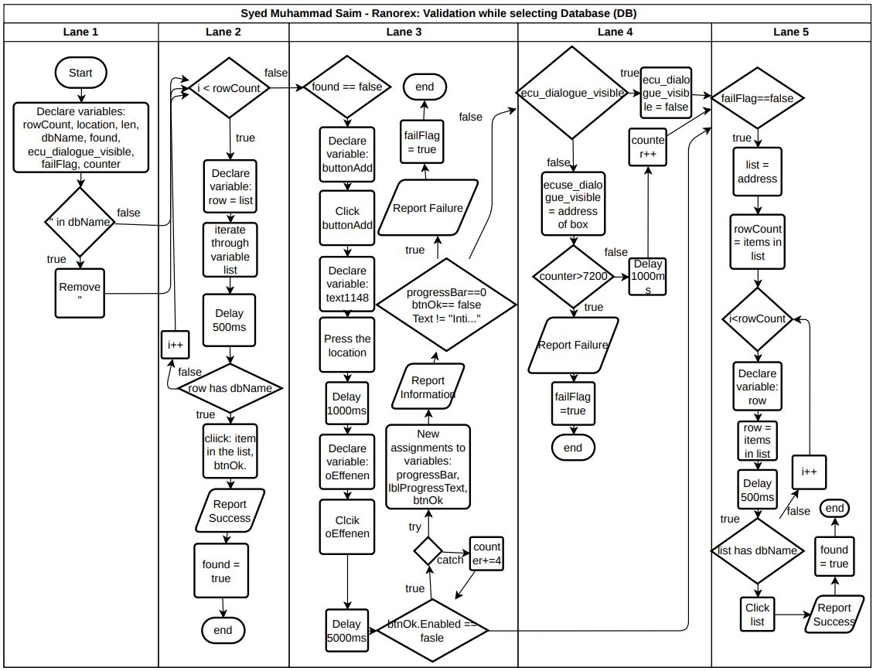
Figure 26: FlowChart Diagram for written code

Slide 35
Contents
My Internship Evaluation
Academic Relevance
Skills Learned
Pros and Cons of the Internship
Bibliography

Slide 36
My Internship Evaluation
Academic Relevance

Slide 37
My Internship Evaluation
2. Skills Learned

Slide 38
My Internship Evaluation
3. Pros and Cons of Internship

Slide 39
Contents
Bibliography

Slide 40
Bibliography
STAR Electronics GmbH Co. KG. Flexconfig rbs software documentation. 66(3):254–272, 2016.
STAR Electronics GmbH Co. KG. Scalable service-oriented middleware over ip (some/ip) documentation. 69(11):13450–13466, 2016.
STAR Electronics GmbH Co. KG. Flexray. star-cooperation.de, 3(2):125–138, 2016.
STAR electronics GmbH Co. KG. Flextinys documentation. IEEE transactions on industrial electronics, 54(4):1824–1842, 2016.
kira K Onoma, Wei-Tek Tsai, Mustafa Poonawala, and Hiroshi Suganuma. Regression testing in an industrial environment. Communications of the ACM, 41(5):81–86, 1998.

