Slide 1

Medical Cyber-Physical System
Presesnter: Syed Muhammad Saim
Figure1

Slide 2


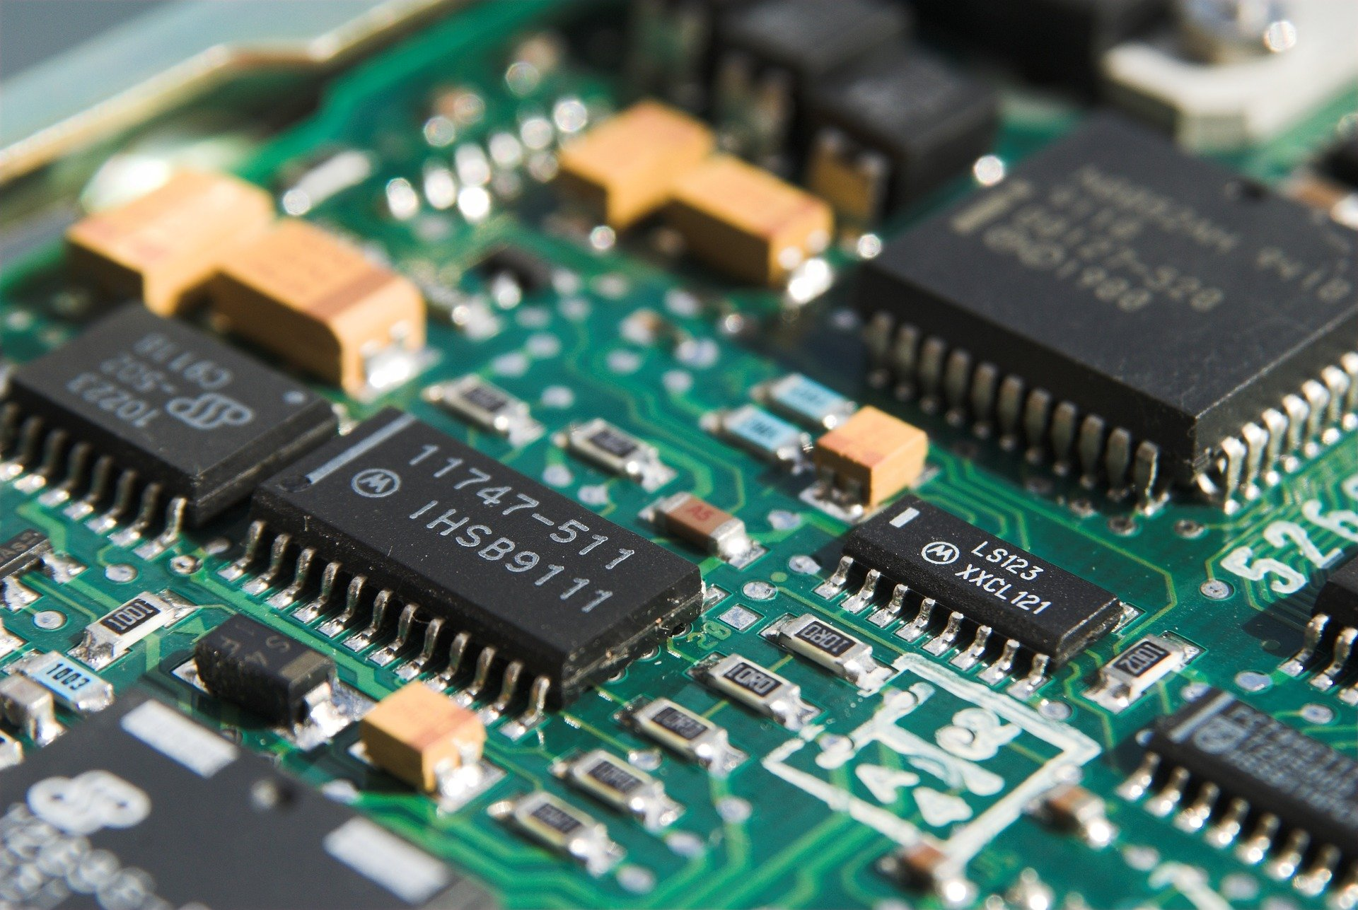
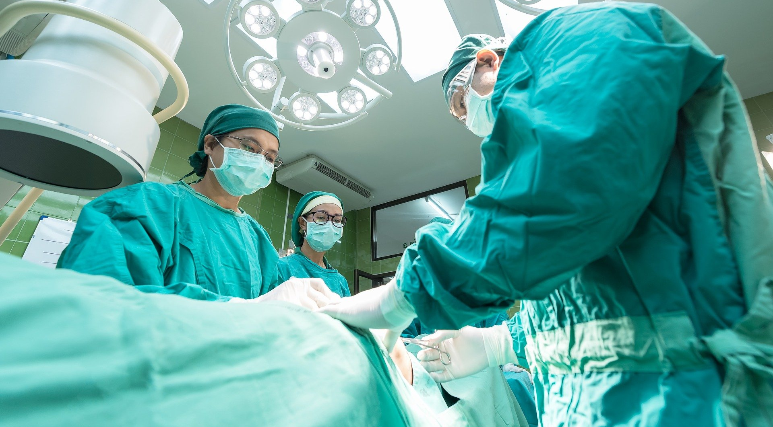
Introduction
What is Cyber-Physical System?
Unification of physical processes and cyber world
Need of CPS in healthcare
Poor medical care quality
Current enhancements
Security and reliability, sensing capabilities
Linked with other Cyber-Physical Systems
CPSS,NCS,etc
Protection of Data
Malicious attacks
Figure1,2,3,4,5

Slide 3
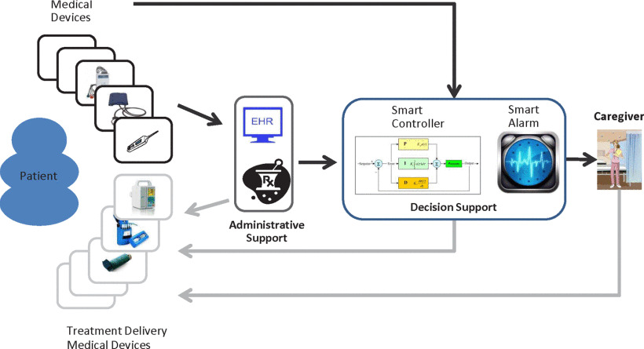
Technicalities
Conventional
Thought of as closed loops
MCPS is introduced
Smart Alarm Systems
Decision Support Entity
Other Developments
Software, Interoperability, Context Awareness, Autonomy, Certifiability
Sec incident response and Digital Forensics
Figure6

Slide 4
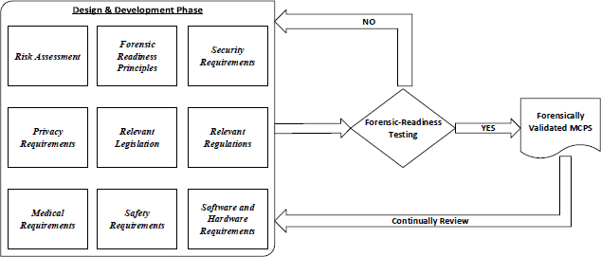
Forensic Frame Work
Forensic readiness Principle
Define circumstances, Determine sources, Evidences, Policies
Security Requirements
Privacy Requirements
Medical Requirement
E.g infusion pump to provide insulin
Safety Requirements
Software and Hardware requirements
Figure7

Slide 5
Future Medical Devices
MCPS can be thought of as IoT
Engineering and science-based design and progress are supported by implementation technologies and platforms
New ways to advancing end-to-end, development, and principled tools
Medical information is synthesized, and medical systems progress towards CPS
Innovative services

Slide 6
Conclusion

Slide 7

Summary
Introduction
Technicalities
Forensic Frame-Work
Future Medical Devices

Slide 8
References
https://pixabay.com/photos/internet-cyber-network-finger-3484137/ - Figure1
https://pixabay.com/photos/surgery-hospital-1807541/ - Figure2
https://pixabay.com/photos/cyber-security-network-internet-2377718/ - Figure3
https://pixabay.com/vectors/anatomy-biology-brain-thought-mind-1751201/ - Figure4
https://pixabay.com/photos/cyber-security-online-computer-2296269/ - Figure5
Grispos G., Glisson W. B., Choo K. R. July (2017) Medical Cyber Physical Systems Development, Philadelphia PA USA :IEEE Retrieved - Figure6
Insup Lee, Oleg Sokolsky, Sanjian Chen, John Hatcliff, Eunkyoung Jee, BaekGyu Kim, Andrew King, Margaret Mullen-Fortino, Soojin Park, Alexander Roederer, and Krishna Venkatasubramanian, "Challenges and Research Directions in Medical Cyber-Physical Systems", Proceedings of the IEEE 100(1), 75-90. January 2012.– figure 7

Slide 9

Thank You For Your Precious Time

