Slide 1

Access Control List (Basic)
Safwan Muntasir (Sufi) Networking Enthusiast

Slide 2
Introduction
In the early days of computer networking, when the internet was in its infancy, security was not a significant concern. Networks were small and tightly controlled. However, as networks grew in size and complexity, the need for security measures became apparent. ACLs (Access Control List) were first introduced in the Multics operating system in 1965. Multics was a groundbreaking OS that introduced many concepts that are still used today, including ACLs. ACLs were originally used to control to files and directories, but they have since been extended to other types of resources and now a common feature of most OS and network devices. They are used to protect resources from unauthorized access and to enforce security policies.
Why do we need ACLs?
Prevent unauthorized users from accessing our files and directories.
Prevent unauthorized users from accessing our networks and applications.
Prevent unauthorized users from making changes to our systems.
Ensure that only authorized users can perform certain actions, such as deleting files or creating new users.
ACLs can also be used to define traffic to Network Address Translate (NAT), encrypt or filter non-IP protocols such as AppleTalk or IPX.
ACLs are used in troubleshooting network issues and implementing QoS (Quality of Services) policies.

Slide 3
Key Features
ACL is a set of rules defined for controlling network traffic and reducing network attacks. ACLs are used to filter traffic based on the set of rules defined for the incoming or outgoing of the network. ACL set of rules matches source IP, destination IP address, IP protocol, ports.
ACLs use first-match logic. That means, the set of rules defined are matched serial wise (sequential order). Matching stars with the first line, then 2nd , then 3rd and so on.
The packets are matched only until it matches one rule. Once a rule is matched then no further comparison takes place and that rule will be performed.
There is an implicit denial at the end of every ACL, if no condition or rule matches then the packet will be discarded.
Each rules or lines are called ACE (Access Control Entries) or ACL statements. A group of ACEs or rules referred as ACL.

Slide 4
Types
There are two basic types of ACLs-
Filesystem ACLs: These work as filters, managing access to directories or files. A filesystem ACL gives the operating system instructions as to the users that are allowed to access the system, as well as the privileges they are entitled to once they are inside.
Networking ACLs: Manage network access by providing instructions to network switches and routers that specify the types of traffic that are allowed to interface with the network. These ACLs also specify user permissions once inside the network. The network administrator predefines the networking ACL rules. In this way, they function similar to a firewall.
ACLs can also be categorized by the way they identify traffic. These two are widely used ACL types-
Standard ACLs: Standard ACLs are the simpler type of ACL. It can only filter traffic based on the source IP Address (Network, Host or Subnet).
Extended ACLs: Extended ACLs can filter traffic based on a wider range of criteria, including source IP addresses, destination IP addresses, port numbers, protocol type and ICMP message type.
ACLs can also be classified by where they are applied-
Interface ACLs ii) Router ACLs iii) Firewall ACLs

Slide 5

Types
In addition to these two main types of ACLs, there are also a number of other types of ACLs-
Reflexive ACLs: A type of extended ACL that can be used to filter traffic generated by the router itself. In other words, these are used to permit inbound traffic in response to outbound traffic.
Dynamic ACLs: A type of ACL that can be updated dynamically based on information from other sources, such as routing protocols or security devices. They are often used in conjunction with authentication mechanisms such as RADIUS or TACACS+ to control user access.
Numbered ACLs: A type of ACL that is identified by a numeric value.
Named ACLs: A type of ACL that can be given a descriptive name. This can make it easier to manage and maintain ACLs, specially in large network.
According to direction, ACL can be divided into two types-
Inbound: Any packet coming to the router, before the router makes its forwarding (routing) decisions.
Outbound: Any packet going out of the router, after the router makes its forwarding decisions and has determined the exit interface.
***Only one inbound and one outbound ACL can be defined in an interface.
IN
OUT
OUT
Fa0/1
IN
Fa0/0

Slide 6
Wild Card Mask
A wildcard mask is a bitmask used to specify range of IP addresses. It tells the IOS which portion of the bits to match or ignore. A wildcard mask is a 32-bit bitmask, similar to a subnet mask, but it works in the opposite way.
Decimal 0 – The router must compare this octet as normal.
Decimal 255 – The router ignores this octet, considering it to already match.
To match a specific but in an IP address, the corresponding bit in the wildcard mask must be zero.
To ignore a specific bit in an IP address, the corresponding bit in the wildcard mask must be one.
Notice the ACL equivalents-
The source/wildcard of 0.0.0.0/255.255.255.255 means any (host).
The source/wildcard of 10.1.1.2/0.0.0.0 is the same as host 10.1.1.2.
Wildcard mask is also used for network summarization. Network summarization or route aggregation is the act of taking two or more IP networks and using a single IP network to represent them all.

Slide 7
Wild Card Mask
Subnet Mask | CIDR | Wildcard Mask
0.0.0.0 | /0 | 255.255.255.255
255.0.0.0 | /8 | 0.255.255.255
255.255.0.0 | /16 | 0.0.255.255
255.255.255.0 | /24 | 0.0.0.255
255.255.255.128 | /25 | 0.0.0.127
255.255.255.192 | /26 | 0.0.0.63
255.255.255.224 | /27 | 0.0.0.31
255.255.255.240 | /28 | 0.0.0.15
255.255.255.248 | /29 | 0.0.0.7
255.255.255.252 | /30 | 0.0.0.3
255.255.255.254 | /31 | 0.0.0.1
255.255.255.255 | /32 | 0.0.0.0

Slide 8
Standard ACLs
Can be named of numbered. Range of Standard ACL number is (1-99) or (1300-1999).
ACL must be applied on the transit router and interface.
Standard ACLs should be placed near to the destination of the packets (not always).
Standard ACLs can only filter traffic based on the source IP Address (Network, Host or Subnet).
There is an implicit denial at the end of every ACL, if no condition or rule matches then the packet will be discarded.
Commands for numbered standard ACLs- ‘Router(config)# access-list <acl no> <permit/deny> <source address> <source wildcard mask>’ ‘Router(config)# access-list <acl no> <permit/deny> any’
Commands for numbered standard ACL on single host- ‘Router(config)# access-list <acl no> <permit/deny> <source host address>’ ‘Router(config)# access-list <acl no> <permit/deny> host <source host address>’ ‘Router(config)# access-list <acl no> <permit/deny> <source host address> 0.0.0.0’
After creating ACLs, it is time to apply the ACLs on the right interface and direction using following commands- ‘Router(config)# interface <interface name>’ ‘Router(config-if)# ip access-group <acl no> <in/out>’

Slide 9



Standard ACLs
Se0/1/0
Se0/1/0
Se0/1/0
Se0/1/1
Se0/1/0
1. Host 192.168.1.100 cannot ping hosts and servers of 192.168.2.0 network
2. Server 192.168.3.200 cannot ping hosts and servers of 192.168.2.0 network
3. Other host/network can ping independently
10.0.1.1/29
10.0.1.2/29
10.0.1.9/29
10.0.1.10/29
Gig0/0/0
192.168.1.1/24
Gig0/0/0
192.168.2.1/24
Gig0/0/0
192.168.3.1/24
Fa0/1
Fa0/1
Fa0/1
Fa0/2
Fa0/3
Fa0/2
Fa0/3
Fa0/2
Fa0/3
PC-1
Server-1
PC-2
Server-2
PC-3
Server-3
192.168.1.100
192.168.1.200
192.168.2.100
192.168.2.200
192.168.3.100
192.168.3.200

Slide 10
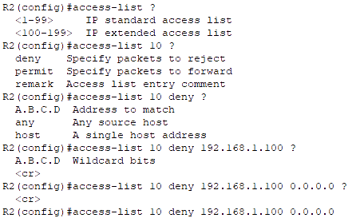
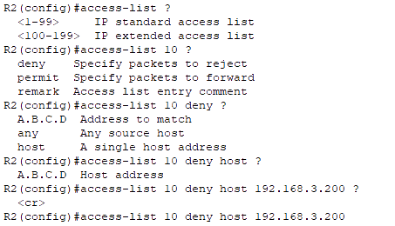
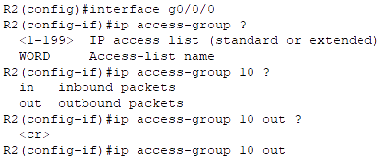
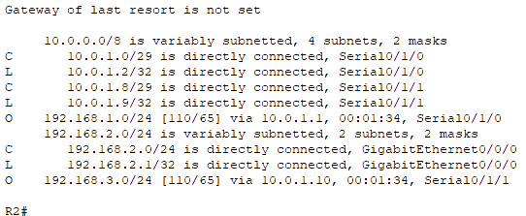
Standard ACLs
1. Host 192.168.1.100 cannot ping hosts and servers of 192.168.2.0 network
2. Server 192.168.3.200 cannot ping hosts and servers of 192.168.2.0 network
3. Other host/network can ping independently
There is OSPF route from each network to every other network.
1
2
3

Slide 11
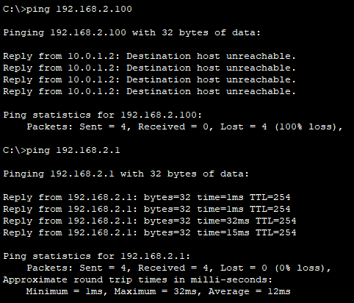
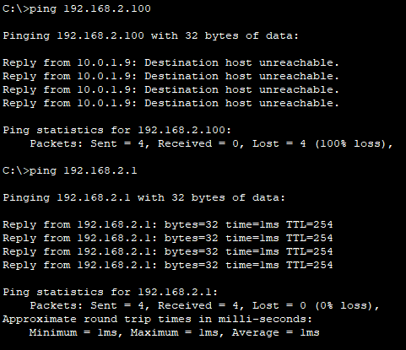
Standard ACLs
From PC-1 192.168.1.100
From Server-3 192.168.3.200

Slide 12


Standard ACLs
Named ACLs are case-sensitive. Commands for named standard ACLs- ‘Router(config)# ip access-list <standard/extended> <acl name> ‘Router(config-std-nacl)# <permit/deny> <source address> <source wildcard mask>’ ‘Router(config-std-nacl)# <permit/deny> any’
Commands for named standard ACL on single host- ‘Router(config-std-nacl)# <permit/deny> <source host address>’ ‘Router(config-std-nacl)# <permit/deny> host <source host address>’ ‘Router(config-std-nacl)# <permit/deny> <source host address> 0.0.0.0’
After creating ACLs, it is time to apply the ACLs on the right interface and direction using following commands- ‘Router(config)# interface <interface name>’ ‘Router(config-if)# ip access-group <acl name> <in/out>’

Slide 13
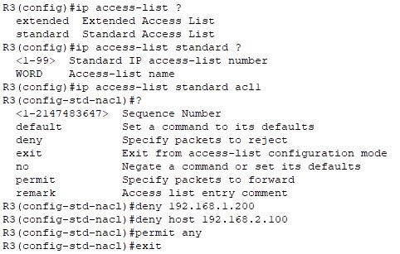
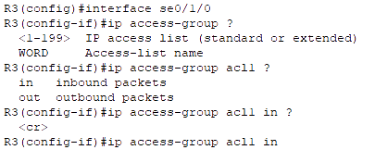


Standard ACLs
1. Server 192.168.1.200 cannot ping 192.168.3.0 network
2. Host 192.168.2.100 cannot ping 192.168.3.0 network
3. Other host/network can ping independently
There is OSPF route from each network to every other network.

Slide 14
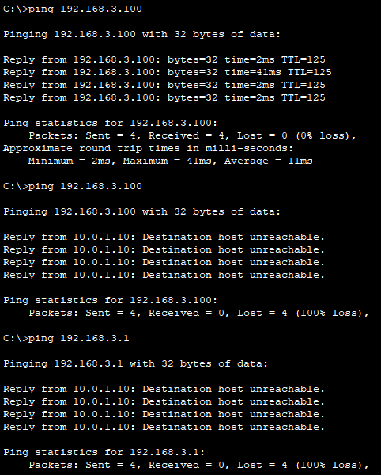
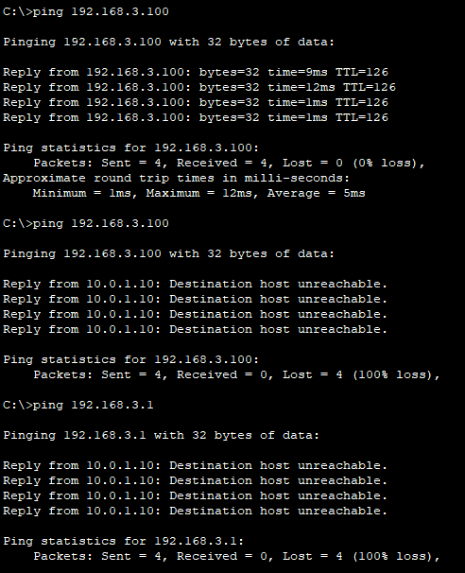
Standard ACLs
From Server-1 192.168.1.200
From Host-2 192.168.2.100

Slide 15
Protocols
TCP/IP
Other Protocols
Services | ACL Keyword | Port Numbers
FTP Data | ‘ftp-data’ | 20
FTP Control | ‘ftp’ | 21
SSH | - | 22
Telnet | ‘telnet’ | 23
SMTP | ‘smtp’ | 25
DNS | ‘domain’ | 53
DHCP Server | ‘bootps’ | 67
DHCP Client | ‘bootpc’ | 68
TFTP | ‘tftp’ | 69
HTTP | ‘www’ | 80
POP3 | ‘pop3’ | 110
SNMP | ‘snmp’ | 161
SSL | - | 443
Syslog | - | 514
TCP
UDP
ICMP
GRE
OSPF
EIGRP
AHP
ESP
HTTP (80)
Telnet (23)
SSH (22)
FTP (20, 21)
SMTP (25)
DNS (53)
POP3 (110)
SSL (443)
DNS (53)
DHCP (67, 68)
TFTP (69)
SNMP (161)
Syslog (514)
Ping
Tracert
***GRE – Generic Routing Encapsulation Tunneling
***AHP – Authentication Header Protocol
***ESP – Encapsulation Security Payload
***SSL – Secure Sockets Layer

Slide 16
Extended ACLs
Can be named of numbered. Range of Extended ACL number is (100-199) or (2000-2699).
Extended ACLs should be placed near to the source of the packets to save some bandwidth (not always).
Extended ACLs can filter traffic based on the source IP (Network, Host or Subnet), destination IP, port no, protocols and services.
There is an implicit denial at the end of every ACL, if no condition or rule matches then the packet will be discarded.
Extended ACL operators are used to match TCP and UDP Port Numbers. Operators are optional to use, not mandatory.
Commands for numbered extended ACLs- ‘Router(config)# access-list <acl no> <permit/deny> <protocol> <source> <wcm> <destination> <wcm> <operator> <service/port>’ ‘Router(config)# access-list <acl no> <permit/deny> <ip> any any’
Commands for numbered extended ACL on single host- ‘Router(config)# access-list <acl no> <permit/deny> <protocol> <source>…..’ ‘Router(config)# access-list <acl no> <permit/deny> <protocol> host <source>…..’ ‘Router(config)# access-list <acl no> <permit/deny> <protocol> <source> 0.0.0.0 …..’
Apply the ACLs on the right interface and direction using following commands- ‘Router(config)# interface <interface name>’ ‘Router(config-if)# ip access-group <acl no> <in/out>’
Most used ACL Operators:
‘eq’ – Equal To
‘neq’ – Not Equal To
‘lt’ – Less Than
‘gt’ – Greater Than
‘range’ – Range of Port Number

Slide 17
Extended ACLs
Se0/1/0
Se0/1/0
Se0/1/0
Se0/1/1
Se0/1/0
1. Host 192.168.1.100 cannot ping hosts of 192.168.2.0 network
2. Network 192.168.3.200 cannot access web servers of 192.168.2.0 network
3. Other host/network can reach independently
10.0.1.1/29
10.0.1.2/29
10.0.1.9/29
10.0.1.10/29
Gig0/0/0
192.168.1.1/24
Gig0/0/0
192.168.2.1/24
Gig0/0/0
192.168.3.1/24
Fa0/1
Fa0/1
Fa0/1
Fa0/2
Fa0/3
Fa0/2
Fa0/3
Fa0/2
Fa0/3
PC-1
Server-1
PC-2
Server-2
PC-3
Server-3
192.168.1.100
192.168.1.200
192.168.2.100
192.168.2.200
192.168.3.100
192.168.3.200

Slide 18
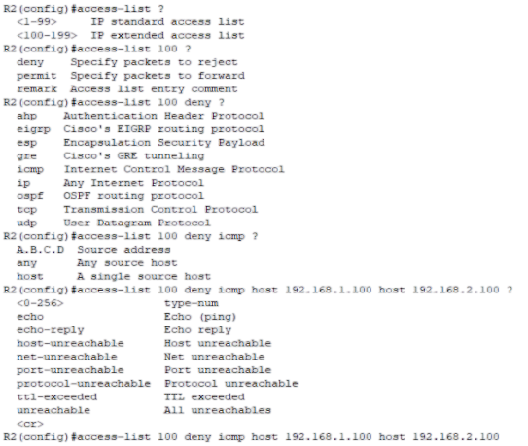
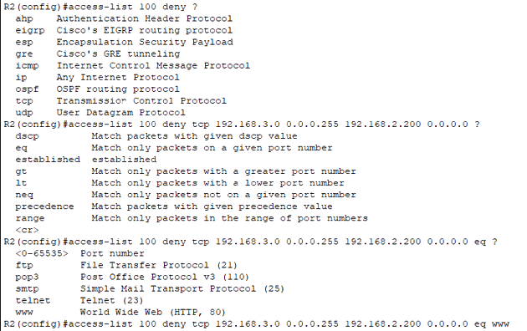
Extended ACLs
1. Host 192.168.1.100 cannot ping hosts of 192.168.2.0 network
2. Network 192.168.3.200 cannot access web http of 192.168.2.0 network
3. Other host/network can reach independently
1
2

Slide 19
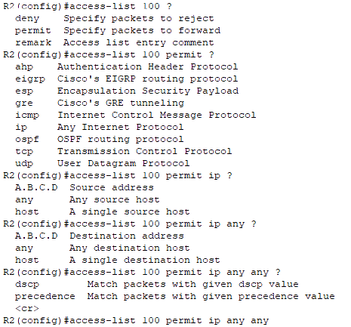
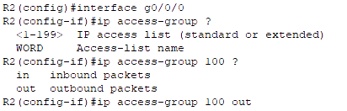


Extended ACLs
3
***Extended ACLs could be applied in Router R1 and R3 also, not on Router R2 to save Bandwidth.

Slide 20
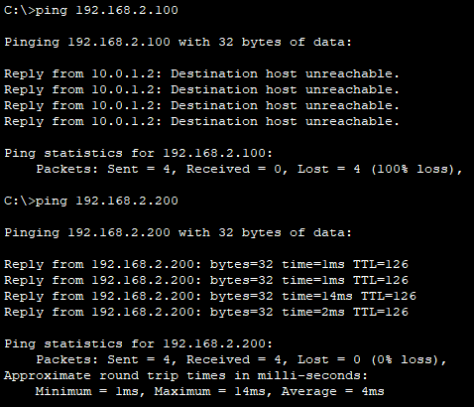
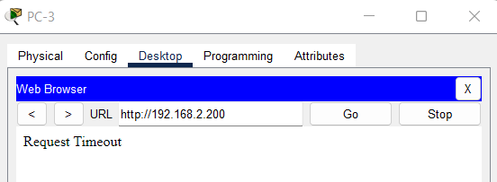
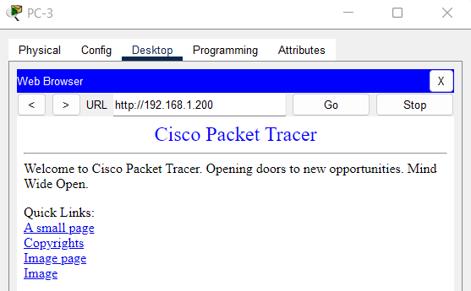
Extended ACLs
From PC-1 192.168.1.100
From Server-3 192.168.3.200

Slide 21
Extended ACLs
Named ACLs are case-sensitive. Commands for named extended ACLs- ‘Router(config)# ip access-list <extended> <acl name> ‘Router(config-ext-nacl)# <permit/deny> <protocol> <source> <wcm> <destination> <wcm> <operator> <service/port>’ ‘Router(config-ext-nacl)# <permit/deny> <ip> any any’
Commands for named extended ACL on single host- ‘Router(config-ext-acl)# access-list <permit/deny> <protocol> <source> <wcm> <destination> <wcm> <operator> <service/port>’ ‘Router(config-ext-acl)# access-list <permit/deny> <protocol> host <source> <wcm> <destination> <wcm> <operator> <service/port>’ ‘Router(config-ext-acl)# access-list <permit/deny> <protocol> <source> 0.0.0.0 <destination> <wcm> <operator> <service/port>’
After creating ACLs, it is time to apply the ACLs on the right interface and direction using following commands- ‘Router(config)# interface <interface name>’ ‘Router(config-if)# ip access-group <acl name> <in/out>’

Slide 22
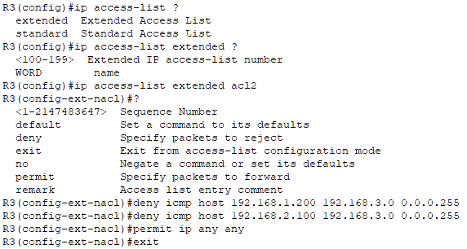
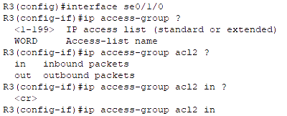


Extended ACLs
1. Server 192.168.1.200 cannot ping 192.168.3.0 network
2. Host 192.168.2.100 cannot ping 192.168.3.0 network
3. Other host/network can ping independently
There is OSPF route from each network to every other network.

Slide 23
Extended ACLs
From Server-1 192.168.1.200
From Host-2 192.168.2.100

Slide 24
ACLs Editing
In old version of IOS, numbered ACLs (Standard or Extended) could not be edited. To simply delete a line from the ACL, the user had to delete the entire ACL and then reconfigure it.
By default, new ACL statements will be added in the last in sequence. If we wanted to add line in between, we had to copy entire ACL into a notepad, re-arrange the ACEs, and the after deleting old ACL we had to create a new ACL with updated sequenced ACEs.
However, the ability to edit numbered ACLs was introduced in Cisco IOS version 12.3(2)T, released in 2006. So, all modern versions of Cisco IOS support editing numbered ACLs.
To verify the version of Cisco IOS running, use the command- ‘Router# show version’
It is recommended to use Named ACLs instead of numbered ACLs. Because Named ACLs are more flexible and easier to remember and manage than numbered ACLs. They can be applied to multiple interfaces and they can be used in firewall policies and routing protocols where numbered ACLs have limitations using in firewalls. Named ACLs can be edited in all the existing Cisco IOS versions.
Commands for Inserting an ACE in an existing ACL- ‘Router(config)# ip access-list <standard/extended> <acl name>’ ‘Router(config-std-nacl)# <sequence number> <permit/deny> <source>’
Commands for Deleting an ACE in an existing ACL- ‘Router(config)# ip access-list <standard/extended> <acl name>’ ‘Router(config-std-nacl)# no <sequence number>’

Slide 25
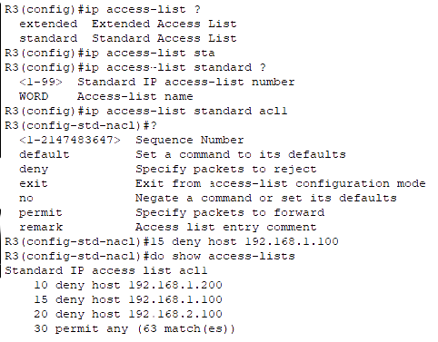

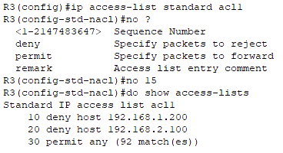
ACLs Editing

Slide 26
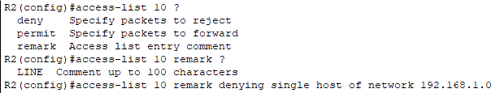

ACLs Editing
Commands for Remarking the ACEs in an existing named ACL- ‘Router(config)# ip access-list <standard/extended> <acl name>’ ‘Router(config-std-nacl)# <remark> <remarking-string>’
Commands for Remarking the ACEs in an existing numbered ACL- ‘Router(config)# access-list <acl no> remark <remarking-string>’

Slide 27



Thank You
Feel free to reach out to me for any suggestions or feedback via LinkedIn or Mail
www.github.com/smsufi
www.linkedin.com/in/smsufi
safwanm.cse@gmail.com

Slide 28
References
https://en.wikipedia.org/wiki/Access-control_list
https://www.cisco.com/c/en/us/support/docs/security/ios-firewall/23602-confaccesslists.html#anc0
https://www.geeksforgeeks.org/access-lists-acl/
https://www.youtube.com/watch?v=ZmcFK_qJRqE&list=PLJqb_j53o7BhgMyY_SlaHDCZtjaQlDYEs
https://www.cbtnuggets.com/blog/technology/networking/networking-basics-what-are-wildcard-masks-and-how-do-they-work
https://www.techtarget.com/searchnetworking/definition/access-control-list-ACL#:~:text=Access%20control%20lists%20are%20used%20for%20controlling%20permissions%20to%20a,devices%20that%20users%20access%20directly.
https://learningnetwork.cisco.com/s/question/0D53i00000KsokACAR/editing-numbered-named-acls
https://learningnetwork.cisco.com/s/question/0D53i00000Kt6wXCAR/difference-between-numbered-acl-and-named-acl
https://techhub.hpe.com/eginfolib/networking/docs/switches/RA/15-18/5998-8151_ra_2620_asg/content/ch10s10.html

