Slide 1

First Hop Redundancy Protocol (Basic)
Safwan Muntasir (Sufi) Networking Enthusiast

Slide 2
Introduction
The First Hop Redundancy Protocol (FHRP) was developed by Cisco in the early 1990s. Hot Standby Router Protocol (HSRP) was designed to provide redundancy for Cisco Routers, but it became popular with other vendors as well. In 1997, the Internet Engineering Task Force (IETF) published a draft standard for a new FHRP protocol called Virtual Router Redundancy Protocol (VRRP). VRRP was designed to be an open standard FHRP protocol that could be used by routers from different vendors. VRRP was eventually finalized and published as an IETF standard in 2002. The VRRP protocol was defined in RFC 2338 in 1998 and later updated in RFC 5798.In early 2000s, another FHRP protocol named Gateway Load Balancing Protocol (GLBP) was developed by Cisco and introduced some limitations of HSRP and VRRP. It was designed to offer not only redundancy but also load balancing of traffic across multiple routers.
The history of the different versions of FHRP protocols is as follows:
HSRP -
VRRP -
GLBP -
Version 1: Released in 1992.
Version 2: Released in 1995 with support for multiple standby routers and load balancing.
Version 1: Released in 1998 as a draft standard.
Version 2: Released in 2002 as an IETF standard.
Version 3: Released in 2012 with support for IPv^6 and other new features.
Version 1: Released in 2001 as a draft standard.
Version 2: Released in 2004 as an Cisco Proprietary Protocol.

Slide 3
First Hop Redundancy Protocol (FHRP)
FHRP is a computer networking protocol that is designed to protect the default gateway used on a subnetwork by allowing two or mote routers to provide backup for that address; in the event of failure of an active router, the backup router will take over the address, usually within a few seconds.
Virtual IP Address (VIP) – configured on all of the routers in the FHRP group.
Virtual MAC Address (VMA) – configured on the active router.
Priority - each router in the FHRP group is assigned a priority. The router with the highest priority becomes the active router, and the others become standby routers. In case of tie breaker, the router with highest IP address will become the active router. If the active router fails, the standby router with the next highest priority takes over.
Periodical Hello Message is sent to the active router by the standby routers. If the active router fails to respond for a certain period of time, one of the standby routers will become the new active router and it updates its ARP cache so that the VMA is mapped to its own MAC Address.
Transparent Protocol – end hosts do not need to be aware of the FHRP group or the VIP. They simply configure the VIP as their default gateway. This makes FHRP idea for use in enterprise networks, where it can provide a high level of redundancy and available without requiring any changes to end hosts.
Preemption – is the ability of a standby router with a higher priority to become the active router if it becomes available again. Preemption is generally disabled by default in FHRP protocols.

Slide 4




First Hop Redundancy Protocol (FHRP)
FHRP is a valuable tool for improving the reliability and high availability of networks. By providing redundancy for the default gateway, FHRP can help to ensure that networks remain operational even if one of the routers in the network fails.
There are three main types of FHRP Protocols –
Hot Standby Router Protocol (HSRP) – is a Cisco Proprietary Protocol that was the first FHRP protocol to be developed.
Virtual Router Redundancy Protocol (VRRP) – is an Open Standard FHRP Protocol that is supported by a wide range of vendors.
Gateway Load Balancing Protocol (GLBP) – is an Cisco Proprietary Protocol that can be used to Load Balancing traffic across multiple routers.
10.0.0.1
100.1.1.1
10.0.0.0/24
10.0.0.100
Internet
FHRP VIP: 10.0.0.3
8.8.8.8
10.0.0.2
200.1.1.1
10.0.0.200

Slide 5
Hot Standby Router Protocol (HSRP)
Cisco Proprietary (RFC2281).
Multicast group IP address in HSRPv1 is 224.0.0.2 and in HSRPv2 is 224.0.0.102.
Group Virtual Mac Address in HSRPv1 is 0000.0C07.ACXX and in HSRPv2 is 0000.0C9F.FXXX for IPv6 (Group id in XX/XXX positions).
Group number range in HSRPv1 is 0 to 255 and in HSRPv2 is 0 to 4095.
IPv6 is supported in HSRPv2.
Millisecond timer values are advertised and learned in HSRPv2.
Send and receive multicast UDP Hello Packets in every 3 seconds and Hold Time is 10 seconds by default.
Uses UDP port 1985.
One active router election based on highest priority and highest IP address in tiebreaker, one standby router and rest are listening routers.
Priority is 100 of every router in HSRP by default (range 0 to 255).
Not-preemptive by default.
Supports plain text and MD5 authentication.
The following conditions have to be same in every router in HSRP-
Group Number
Virtual IP Address
Subnet Mask
Virtual MAC Address
Hello & Hold Timer
Preemption Settings
Version
Authentication (if used)

Slide 6
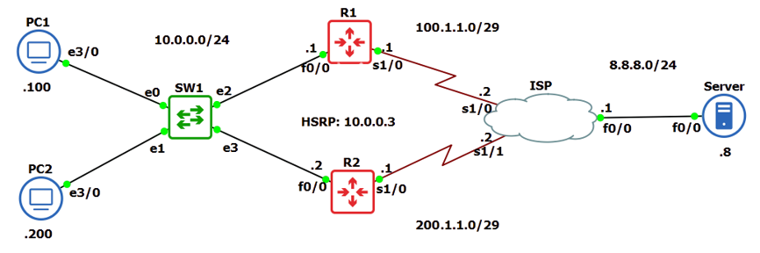
Hot Standby Router Protocol (HSRP)
***This lab/topology was created in GNS3 2.2.43
***Routers/ISP Cloud: Cisco Catalyst 7200 Series Router
***Switch: GNS3 Default Ethernet Switch
***PCs/Server: Cisco Catalyst 3600 Series Router

Slide 7
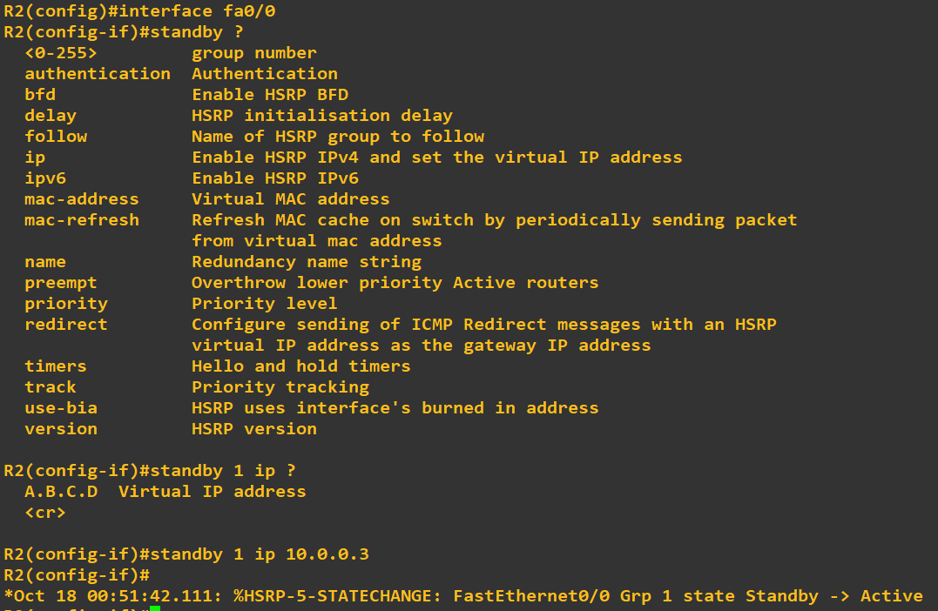
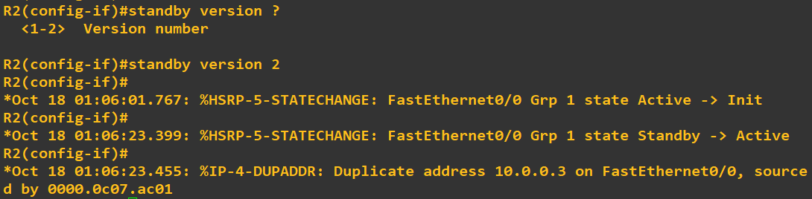
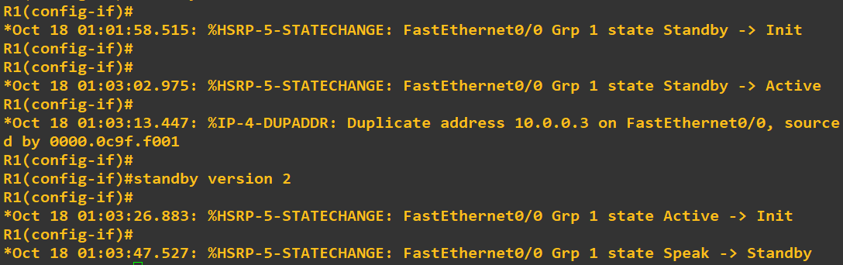
Hot Standby Router Protocol (HSRP)
Commands for HSRP in Cisco Routers- ‘RTR(config)# interface <interface name>’ ‘RTR(config-if)# standby <group id> ip <virtual IP address>’
Commands for changing HSRP version- ‘RTR(config-if)# standby version <1/2> Default version is 1.

Slide 8
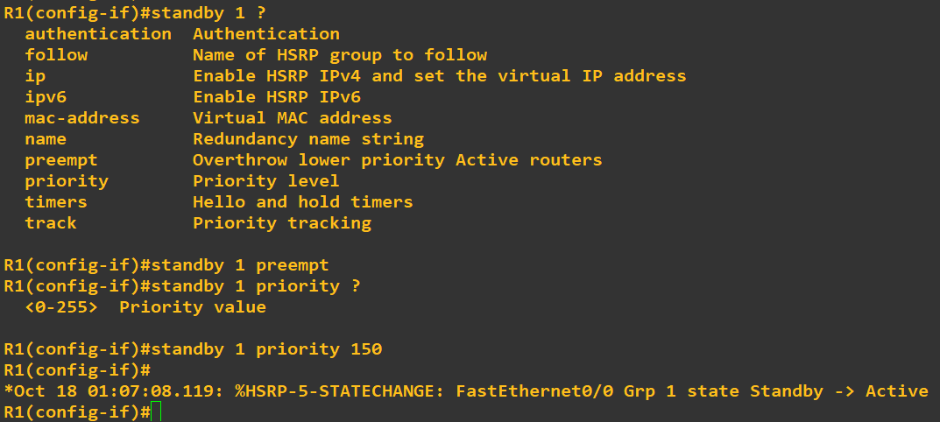
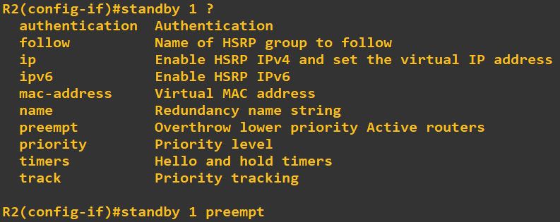
Hot Standby Router Protocol (HSRP)
Commands to enable preemption- ‘RTR(config-if)# standby <group id> preempt’
Commands to change priority of the router- ‘RTR(config-if)# standby <group id> priority <0-255>’

Slide 9
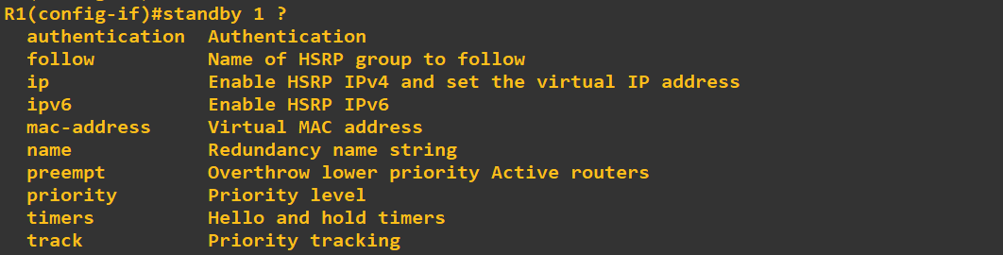
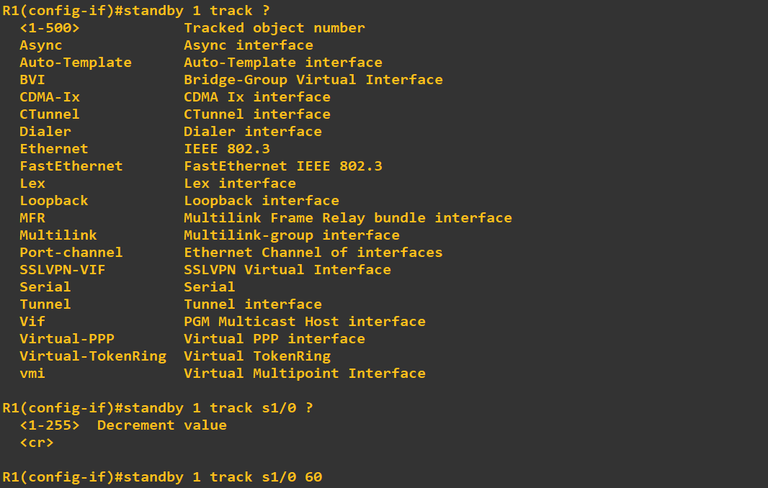
Hot Standby Router Protocol (HSRP)
Commands to track interfaces in HSRP- ‘RTR(config-if)# standby <group id> track <interface name> <priority decrement value>’
Why will we use track?
For example, if our ISP-end interface goes down in the active router, the standby router cannot identify the problem and it will still be in standby mood because the hello packets will ensure all the connectivity in the LAN network is okay and running. Therefore, packets will be lost.
If we use this feature, the active router will automatically track the ISP-end interface. By any chance if the ISP-end interface goes down, the router will immediately decrease its priority value and go to standby mood because of the preemption feature and no data will be lost.

Slide 10
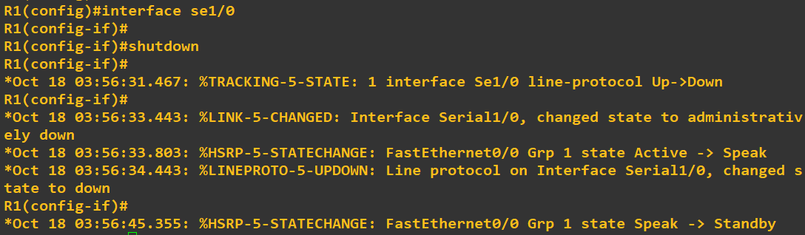
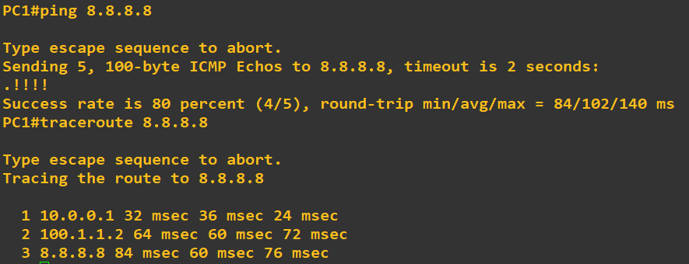
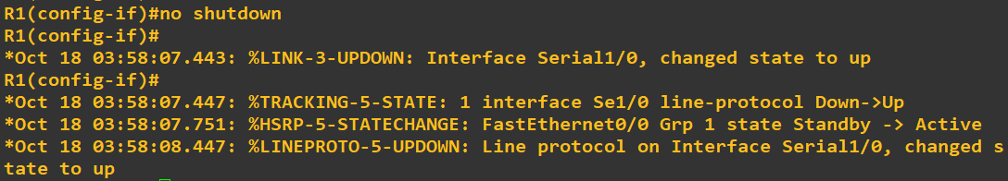
Hot Standby Router Protocol (HSRP)
When the ISP-end interface goes down-
Ping test from PC1-
When the ISP-end interface comes up-
Commands to show HSRP interface status- ‘RTR# show running-config interface <interface name>’
Commands to show HSRP status- ‘RTR# show standby’
Commands to show HSRP status in brief- ‘RTR# show standby brief’

Slide 11
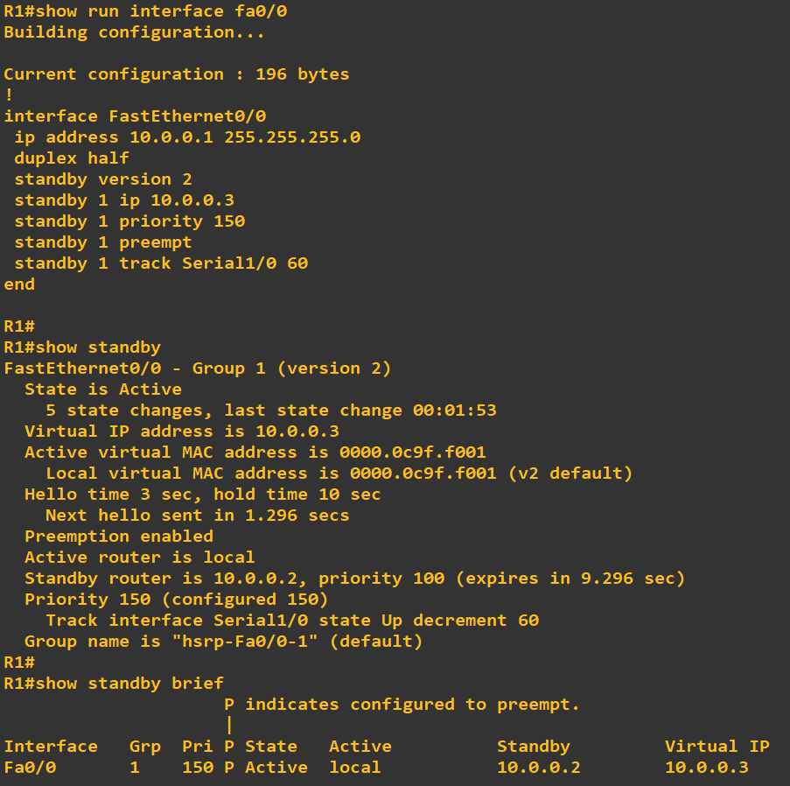
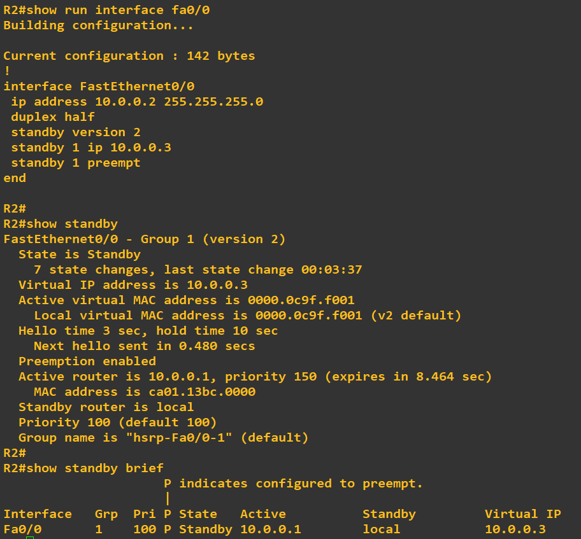
Hot Standby Router Protocol (HSRP)

Slide 12
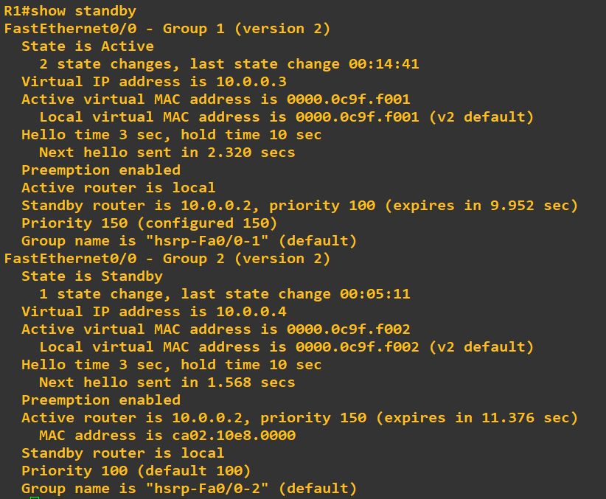
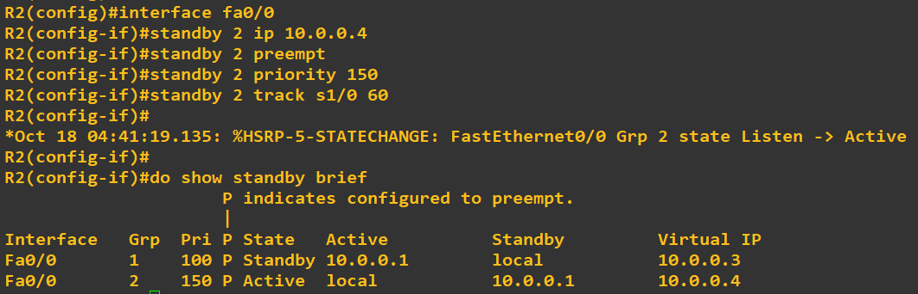
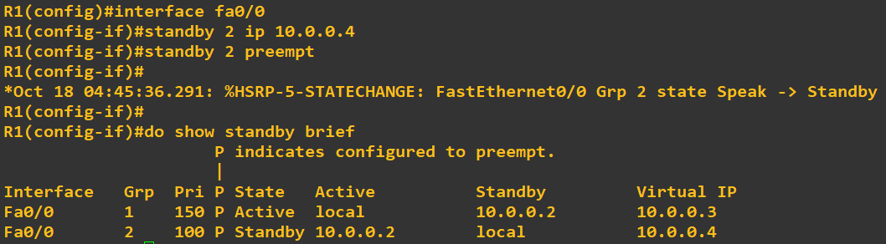
Hot Standby Router Protocol (HSRP)
HSRP does not support load-balancing. But we can make the router to support load sharing by adding multiple groups. The secret technique is, create another HSRP group. In the second group make the active router as standby and the standby router as active router.
Try it on yourself before watching the following commands!

Slide 13
Virtual Router Redundancy Protocol (VRRP)
IEEE Standard Protocol (RFC3768).
Multicast group IPv4 address in VRRP is 224.0.0.18 and IPv6 is FF02:0:0:0:0:0:0:12 (or FF02::12).
Group Virtual Mac Address in VRRP is 0000.5E00.01XX for IPv4 and in VRRPv3 is 0000.5E00.02XX for IPv6 (Group id in XX positions).
Group number range in VRRPv1 and VRRPv2 is 0 to 255 and in VRRPv3 is 0 to 4095.
IPv6 is supported in VRRPv3.
Millisecond timer values are advertised and learned in VRRPv3.
Send and receive multicast UDP Hello Packets in every 1 second and Hold Time is 3 seconds by default.
Uses UDP port 112.
One Master Router election based on Highest Priority and Highest IP address in tiebreaker, the rest are Backup Routers.
Priority can be set from 1 to 254, priority 255 is reserved for the master router (range 1 to 255).
Preemptive by default in VRRPv2 and VRRPv3.
Simple and MD5 authentication is supported in VRRPv2 only.
Interface IP can be used as Virtual IP in VRRP.
The following conditions have to be same in every router in VRRP-
Group Number
Virtual IP Address
Subnet Mask
Virtual MAC Address
Hello & Hold Timer
Preemption Settings
Version
Authentication (if used)

Slide 14
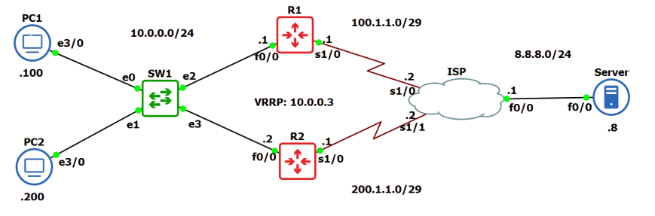
Virtual Router Redundancy Protocol (VRRP)
***This lab/topology was created in GNS3 2.2.43
***Routers/ISP Cloud: Cisco Catalyst 7200 Series Router
***Switch: GNS3 Default Ethernet Switch
***PCs/Server: Cisco Catalyst 3600 Series Router

Slide 15
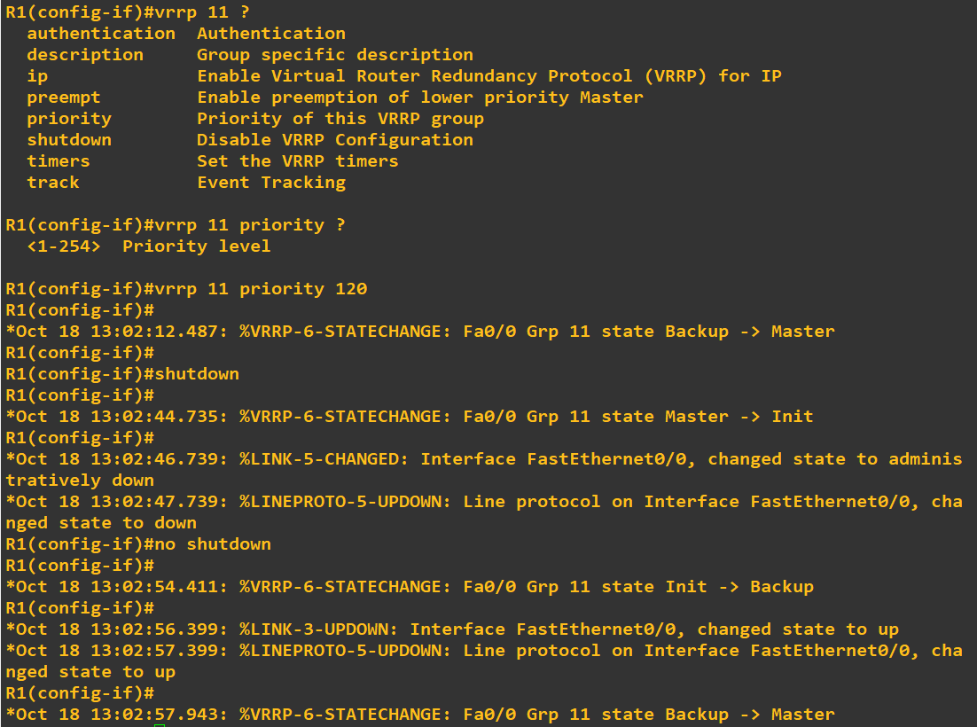
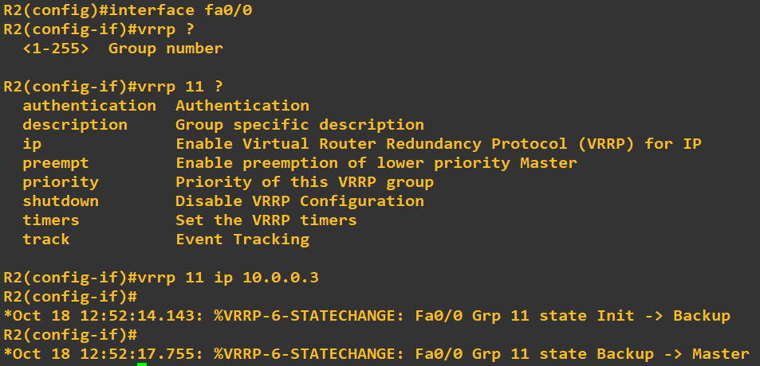
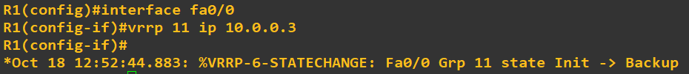
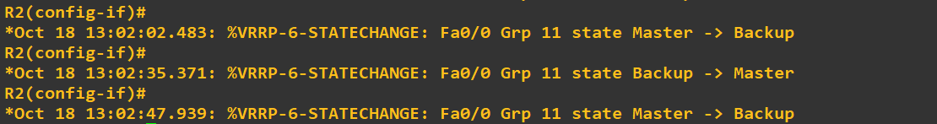
Virtual Router Redundancy Protocol (VRRP)
Commands for VRRP in Cisco Routers- ‘RTR(config)# interface <interface name>’ ‘RTR(config-if)# vrrp <group id> ip <virtual IP address>’
Commands to change priority of the router- ‘RTR(config-if)# vrrp <group id> priority <1-254>’

Slide 16
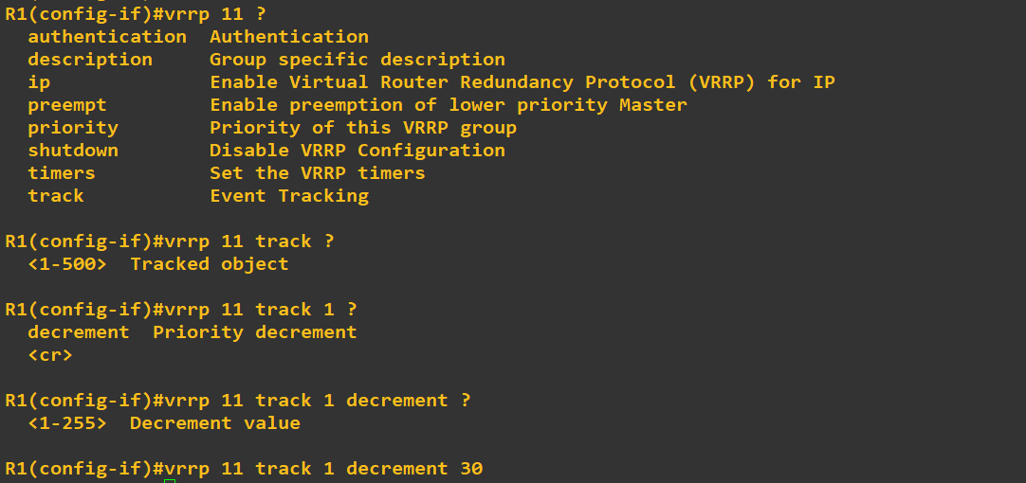
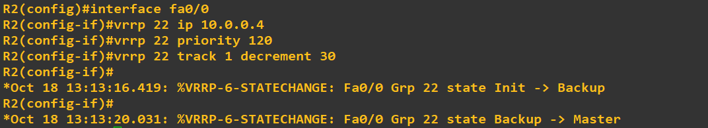
Virtual Router Redundancy Protocol (VRRP)
Commands to track interfaces in VRRP- ‘RTR(config-if)# vrrp <group id> track <tracked object no> decrement <priority decrement value>’
VRRP does not support load-balancing. But we can make the router to support load sharing by adding multiple groups. The secret technique is, create another VRRP group. In the second group make the master router as backup and the backup router as master router.
Try it on yourself before watching the following commands!
Commands to show VRRP interface status- ‘RTR# show running-config interface <interface name>’
Commands to show VRRP status- ‘RTR# show vrrp’
Commands to show VRRP status in brief- ‘RTR# show vrrp brief’

Slide 17
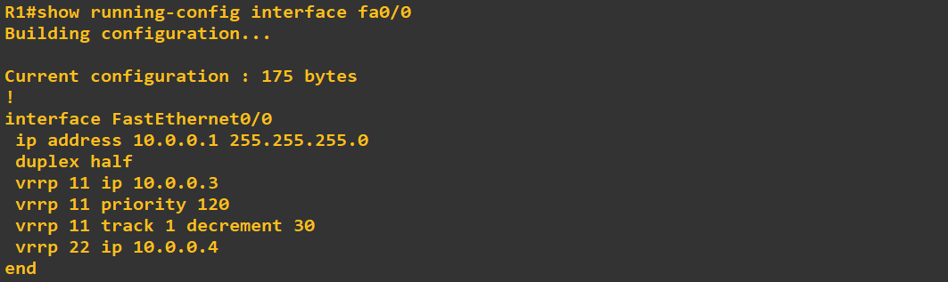
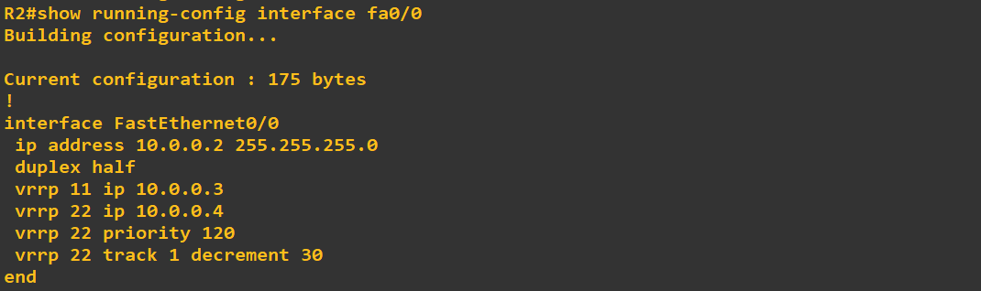
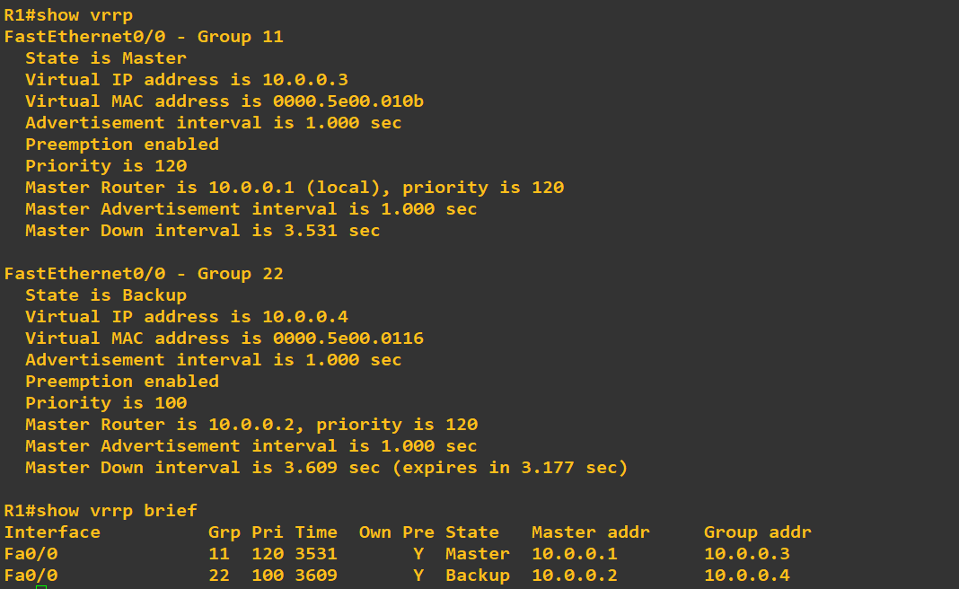
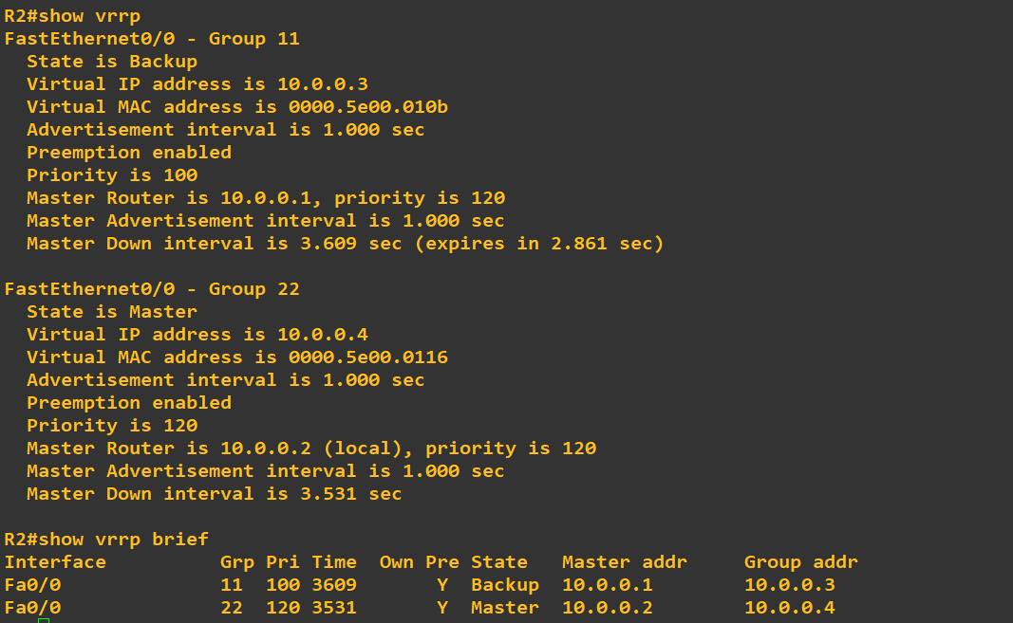
Virtual Router Redundancy Protocol (VRRP)

Slide 18
Gateway Load Balancing Protocol (GLBP)
Cisco Proprietary.
Multicast group IPv4 address in GLBP is 224.0.0.102 and IPv6 address is FF02::6:1.
Group Virtual Mac Address in GLBP is 0007.B400.XXYY (Group id in XX position and AVF router id in YY position).
Group number range in GLBPv1 is 0 to 255 and in GLBPv2 is 0 to 1023.
IPv6 is supported in GLBPv2.
Send and receive multicast UDP Hello Packets in every 3 second and Hold Time is 10 seconds by default.
Uses UDP port 3222.
One router is elected as the AVG (Active Virtual Gateway), based on Highest Priority] and Highest IP address in tiebreaker, which performs load balancing duties, up to Four routers are AVFs (Active Virtual Forwarders), which assist in load balancing in GLBP, and up to 1024 Virtual Routers can exist in GLBP.
A router becoming AVF or not depends on Weighted Values of the routers. Having weighted value 0, that router will not become AVR.
Provides automatic failover in case the AVG becomes unavailable.
AVG assign the virtual MAC address to AVF routers.
Customizable load-balancing algorithms, including round-robin and weighted load balancing.
Non-preemptive by default in GLBP.
Simple and MD5 authentication is supported in GLBPv2.

Slide 19
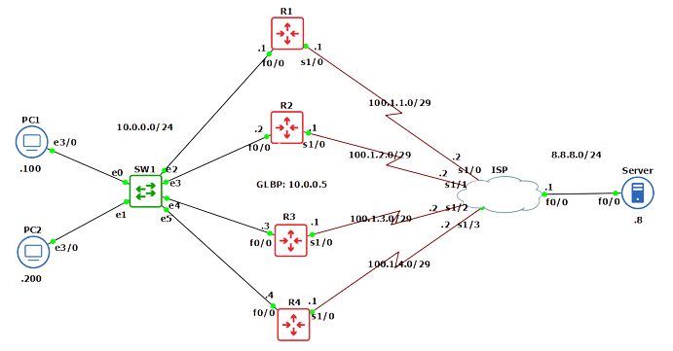
Gateway Load Balancing Protocol (GLBP)
***This lab/topology was created in GNS3 2.2.43
***Routers/ISP Cloud: Cisco Catalyst 7200 Series Router
***Switch: GNS3 Default Ethernet Switch
***PCs/Server: Cisco Catalyst 3600 Series Router

Slide 20
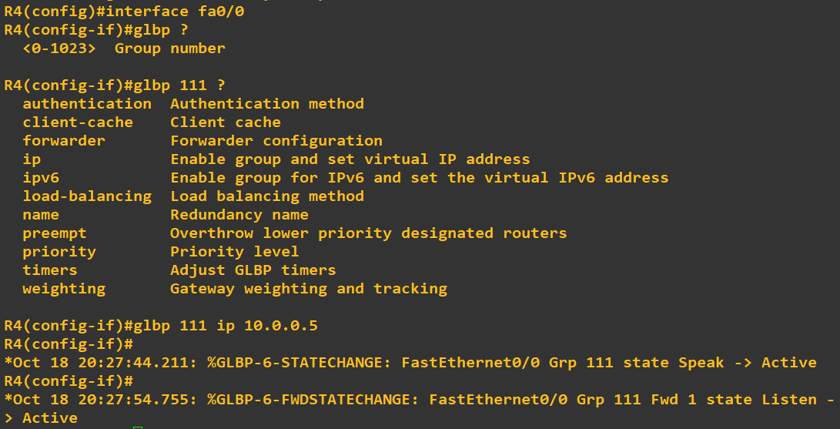
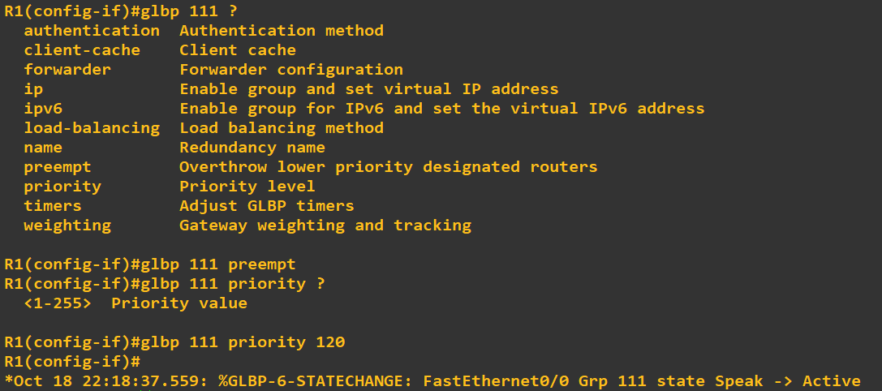
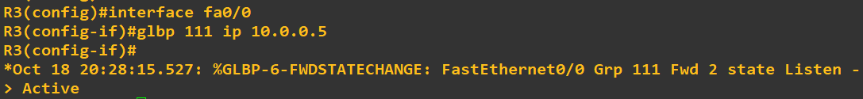
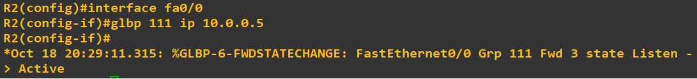
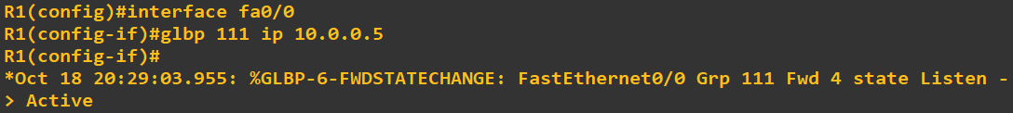
Gateway Load Balancing Protocol (GLBP)
Commands for GLBP in Cisco Routers- ‘RTR(config)# interface <interface name>’ ‘RTR(config-if)# glbp <group id> ip <virtual IP address>’
Commands to change priority of the router- ‘RTR(config-if)# glbp <group id> priority <1-255>’

Slide 21
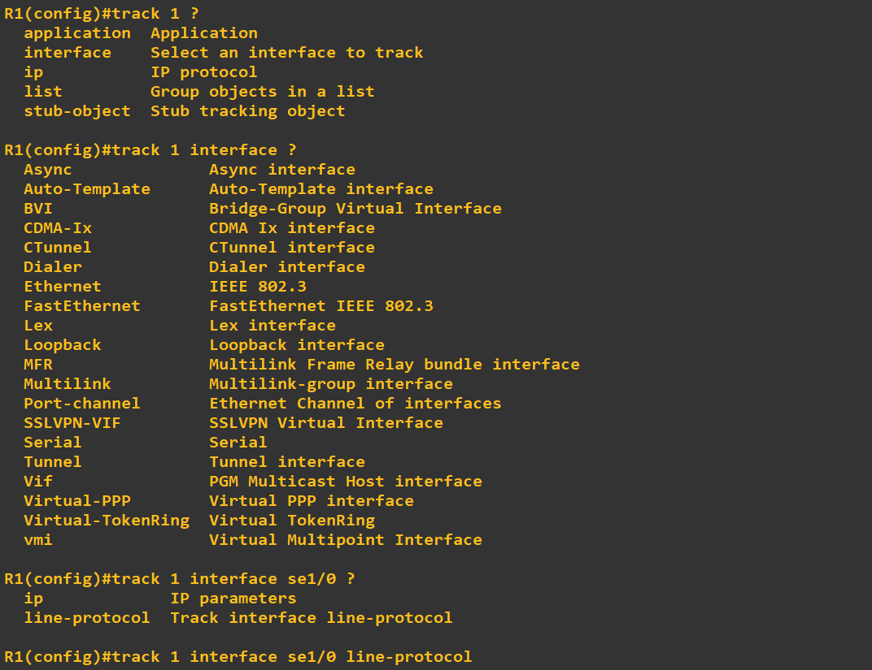
Gateway Load Balancing Protocol (GLBP)
Commands for creating Track object in routers- ‘RTR(config)# track <track object no> interface <interface no> line-protocol’
Track is a feature of GLBP that allows you to monitor the status of an interface or other object and dynamically adjust the GLBP group's weighting based on the results of the tracking. This can be used to improve the performance and reliability of the GLBP group.
The priority value is used to determine which device in a GLBP group will become the active router. The device with the highest priority will become the active router.
The weight value is used to determine how traffic will be distributed across the devices in a GLBP group. The default weight value is 100. The router having weight value 0 will not forward traffic, but if that router is AVG. it will control the AVF routers.

Slide 22
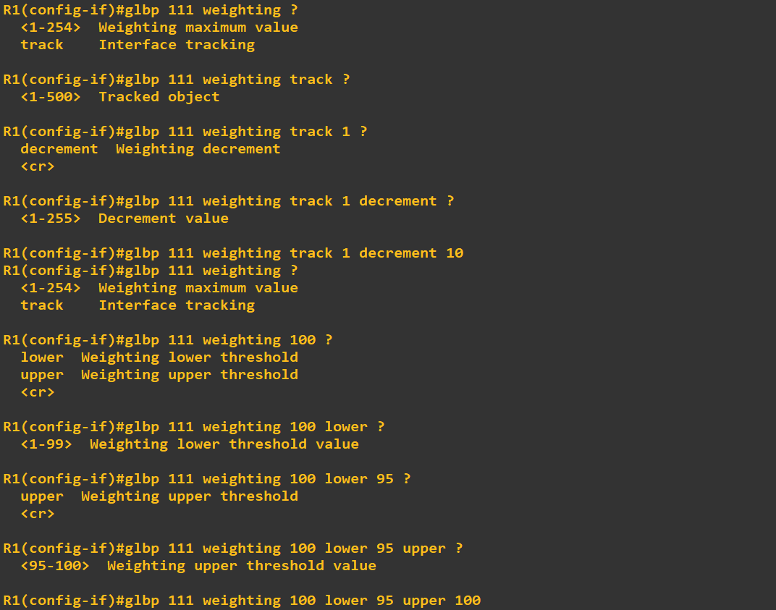
Gateway Load Balancing Protocol (GLBP)
Commands for creating configuring track and weight value on the routers- ‘RTR(config)# interface <interface name>’ ‘RTR(config-if)# glbp <group no> weighting track <track object no> decrement <decrement weighting value>’ ‘RTR(config-if)# glbp <group no> weighting <max value> lower <lower threshold> upper <upper threshold>’
There are two ways to track. The shortcut way is if the tracked interface goes down, immediately weighted value of that router will become zero. Therefore, it will not forward traffic as long as the interface comes up. Default decrement value is 10.
Another way is creating a weighting threshold value. If the weighted value is less than the threshold, the router will not forward traffic. When the interface will come up, the weighted value will be greater than the threshold value and the router will resume forwarding traffic.

Slide 23
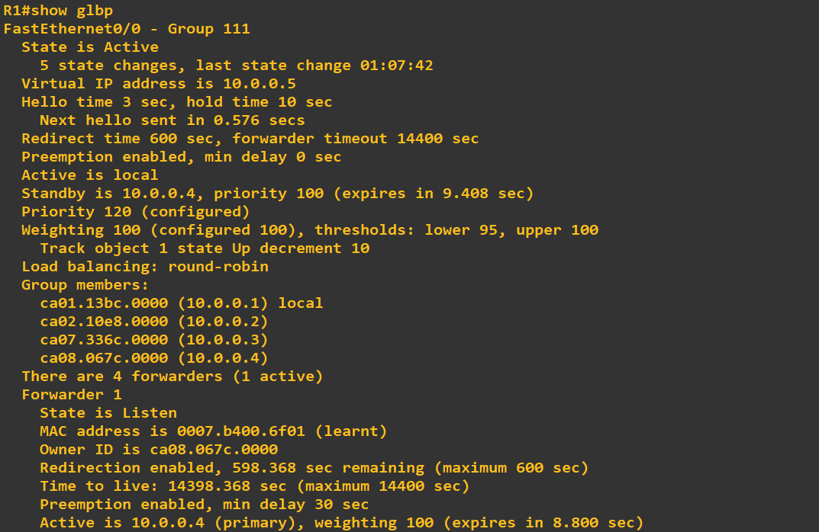
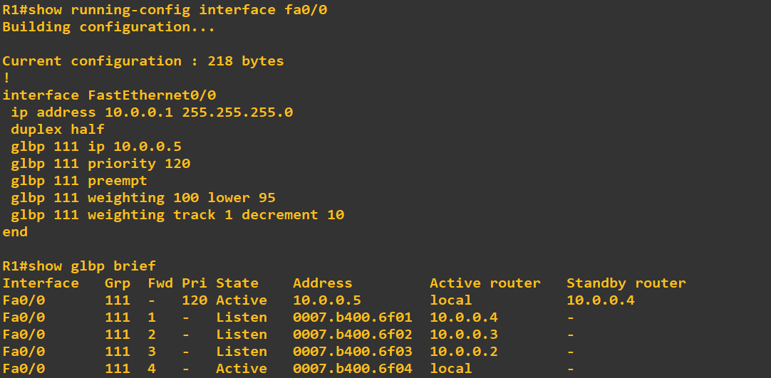
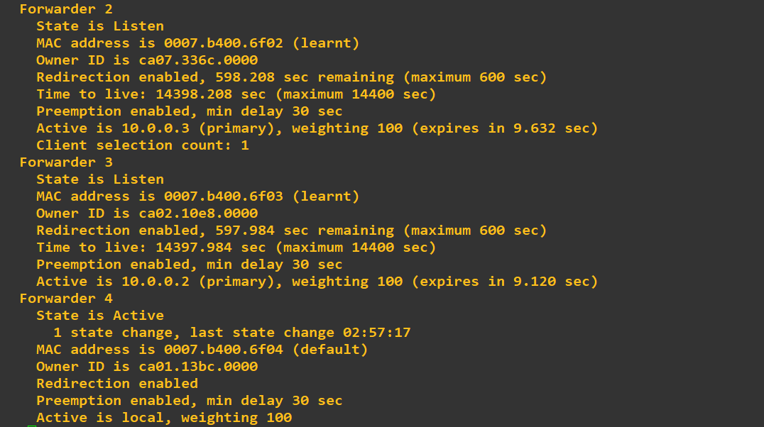
Gateway Load Balancing Protocol (GLBP)
Commands to show GLBP interface status- ‘RTR# show running-config interface <interface name>’
Commands to show GLBP status- ‘RTR# show glbp’
Commands to show VRRP status in brief- ‘RTR# show glbp brief’
Details of the Active AVG router-

Slide 24
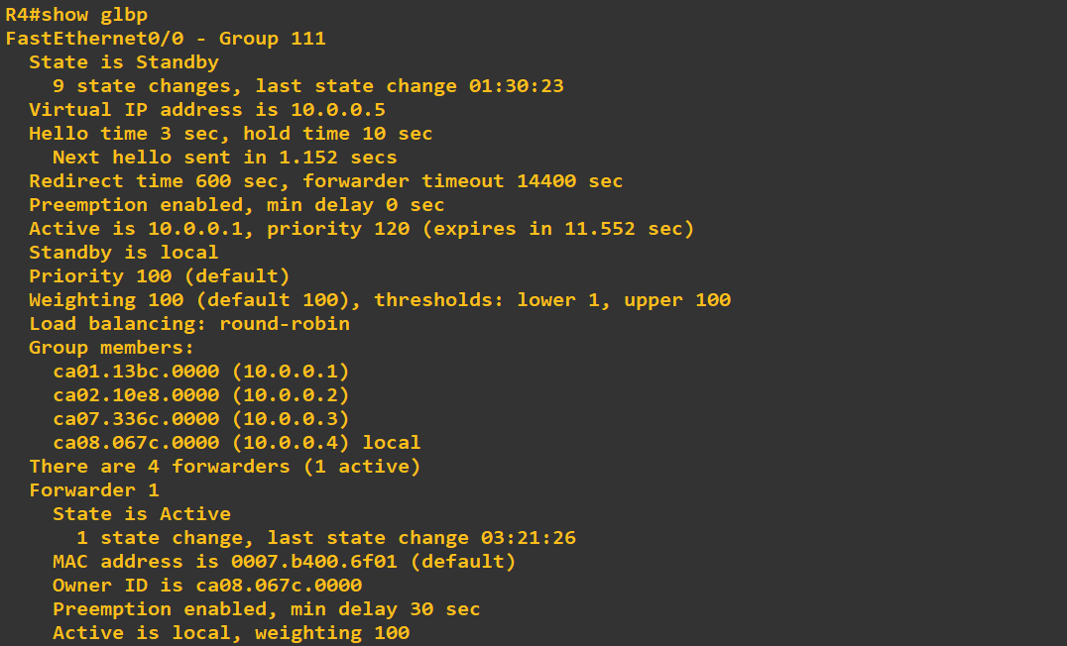
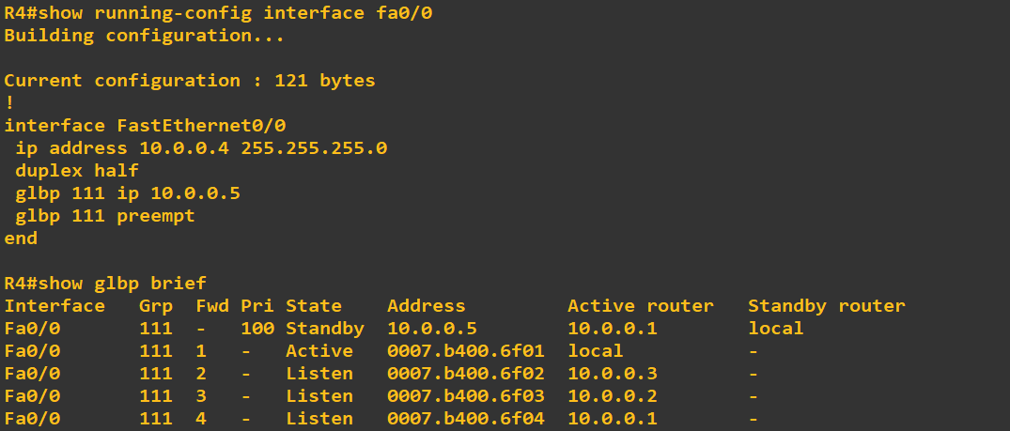
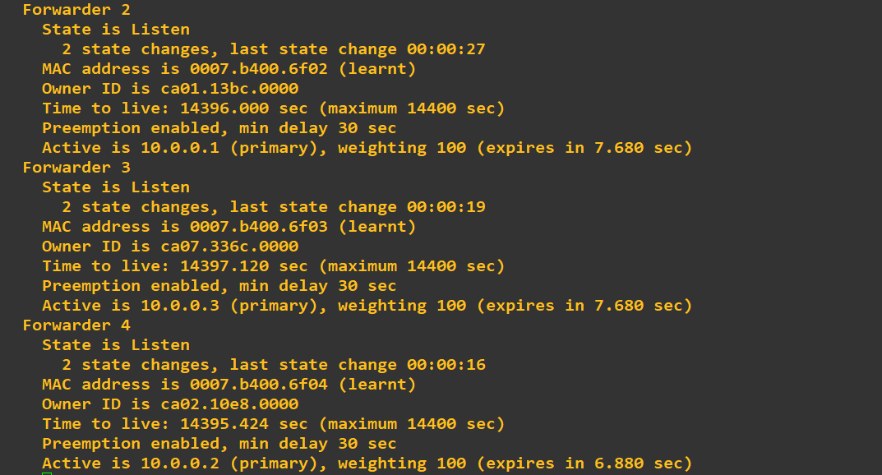
Gateway Load Balancing Protocol (GLBP)
Details of the Standby AVF router-

Slide 25
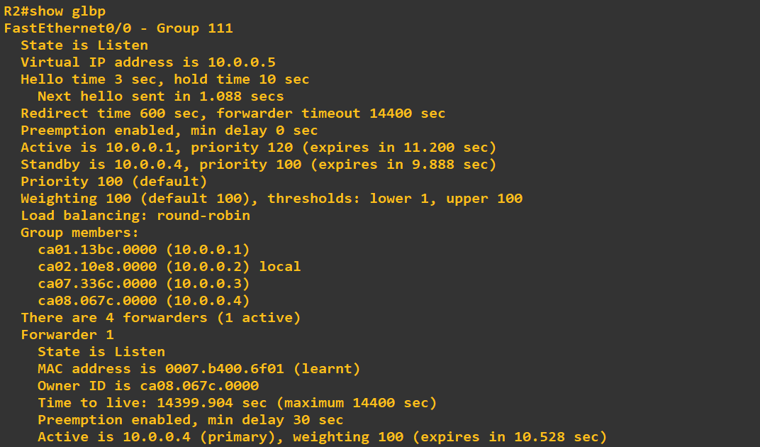
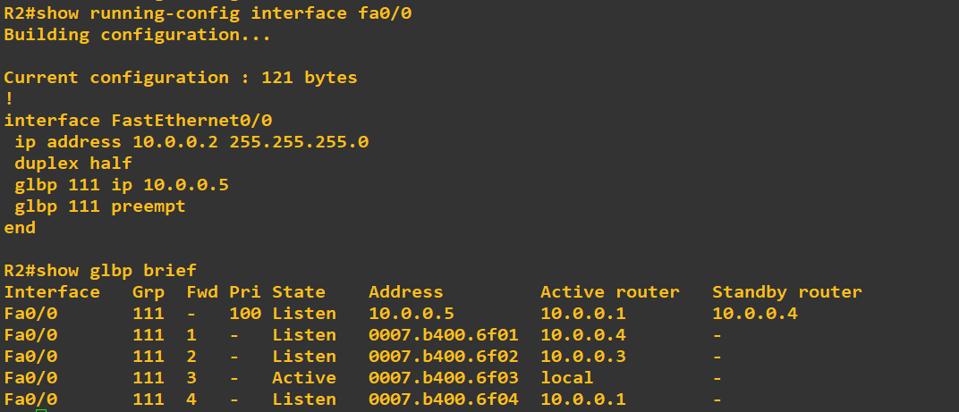
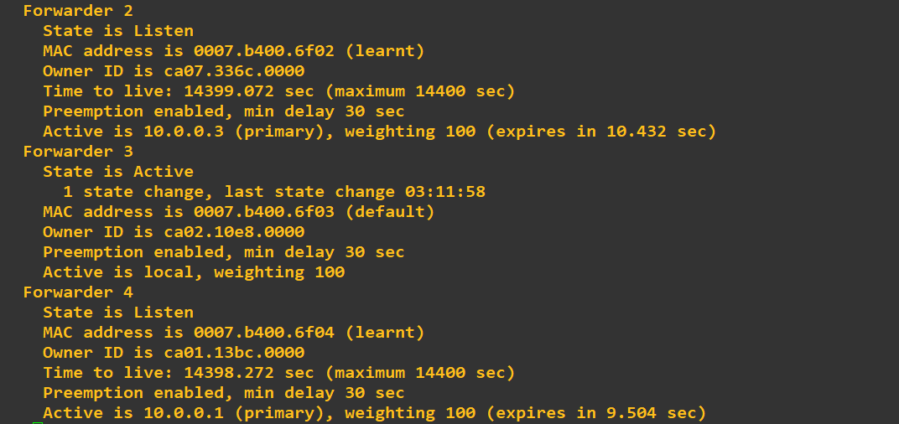
Gateway Load Balancing Protocol (GLBP)
Details of an Listening AVF router-

Slide 26



Thank You
Feel free to reach out to me for any suggestions or feedback via LinkedIn or Mail
www.github.com/smsufi
www.linkedin.com/in/smsufi
safwanm.cse@gmail.com

