Slide 1

Network Address Translation (Basic)
Safwan Muntasir (Sufi) Networking Enthusiast

Slide 2
Before starting this study material, in case if you didn’t check, it is recommended to go through the study material named “ACL Basic”

Slide 3
Introduction
Network Address Translation (NAT) was first proposed in 1992 by Phil Karn and Kathleen Greene. It was first implemented in the Cisco PIX Firewall in 1994. NAT quickly became a popular way to conserve IPv4 addresses, and is now used in most routers and firewalls.
NAT is a method of mapping an IP address space into another by modifying network address information in the IP header of packets while they are in transit across a traffic routing device. The technique was originally used to bypass the need to assign a new address to every host when a network was moved, or when the upstream Internet Service provider was replaced, but could not route the network’s address space.
Why do we need NAT?
To conserve IPv4 addresses: The Ipv4 address space is limited, and NAT allows us to use multiple devices behind a single public IP address. This is specially important for home networks, where we may have devices connected to the internet, such as computers, smartphones, tablets, etc. NAT ensures that none of the IP networks are reused.
To improve security: NAT can help to improve security by hiding the private IP addresses of devices on the network. This makes it more difficult for attackers to target specific devices.
To control traffic: NAT can be used to control traffic that enters and leaves the network. This can be used to block unwanted traffic and to improve performance.

Slide 4
IPv4 Address Shortage Solutions
To overcome IPv4 address shortage, two solutions are applied-
1. Short Term Solutions: By using IPv4 addresses.
Private addressing. (RFC 1918)
Network Address Translation (NAT)
Subnetting and Classless Interdomain Routing (CIDR)
2. Long Tern Solutions: By using IPv6 addresses.
Increase the size of the IP address to 128 bits.
Assigning unique address ranges to every organization connected to the Internet.
Public and Private IPv4 Address
Public IPv4 Address:
Used on public network (Internet)
Recognized on Internet
Globally unique and Registered address
Given by the service provider (from IANA)
Pay to service provider (or IANA)
Private IPv4 Address:
Used with the LAN or within the organization
Given by the administrator
Unique within the network or organization
Not recognized on Internet
Free / Unregistered IP

Slide 5



What is NAT?
NAT, defined in RFC 3022, is a process in which one or more local IP address is translated into one or more Global IP address and vice versa in order to provide Internet access to the local hosts. Also, it does the translation of port numbers i.e. masks the port number of the host with another port number, in the packet that will be routed to the destination. It then makes the corresponding entries of IP address and port number in the NAT table. NAT generally operates on a routers, firewalls and servers.
Private
NAT
Internet
Source
Destination
Source
Destination
192.168.1.1 8.8.8.8 ……….
200.1.1.1 8.8.8.8 ……….
Source
Destination
Source
Destination
8.8.8.8 192.168.1.1 ……….
8.8.8.8 200.1.1.1 ……….

Slide 6
Types
There are three main types of NAT-
Static NAT: Static NAT maps a single private IP address to a single public IP address. This is typically used for servers that need to be accessible from the public Internet. This is one-to-one mapping provides a consistent and permanent mapping.
Dynamic NAT: Dynamic NAT maps a pool of private IP addresses to a pool of public IP addresses. This is typically used for clients that need to access the public Internet, but do not need to be directly accessible from the public Internet. The mapping is temporary and based on the first-come, first-served principle.
NAT Overload: Also known as Port Address Translation (PAT). PAT is a type of dynamic NAT that uses a single public IP address to represent multiple private IP addresses. This is done by using different port numbers to distinguish between the different private IP addresses. PAT is the most common type of NAT used today. This is one-to-many mapping.
Private
NAT
Internet
Source
Destination
Source
Destination
192.168.1.1 8.8.8.8 ……….
200.1.1.1 8.8.8.8 ……….
Inside Local
Outside Local
Inside Global
Outside Global

Slide 7
Static NAT
One-to-one mapping. Maps a single private IP address to a single public IP address.
A consistent and permanent mapping.
Not suitable for network where a large number of host exist.
Commands for selecting inside/outside interface- ‘Router(config)# interface <interface name>’ ‘Router(config-if)# ip nat <inside/outside>’
Commands for static nat- ‘Router(config)# ip nat <inside> source <static> <inside local ip address> <inside global ip address>’
192.168.1.101 -> 100.0.0.1
192.168.1.102 -> 100.0.0.2
192.168.1.103 -> 100.0.0.3
192.168.1.101
Private
NAT
Internet
G0/0/0
Se0/1/0
Se0/1/0
G0/0/0
192.168.1.102
1.1.1.1/29
192.168.1.1
1.1.1.2/29
Router
Router
Google RTR
8.8.8.8
192.168.1.103

Slide 8
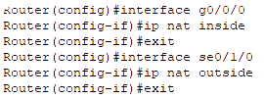
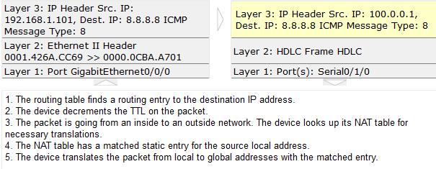
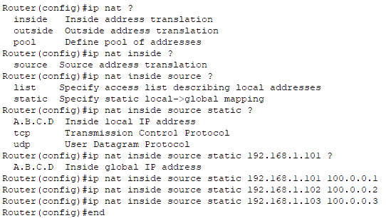
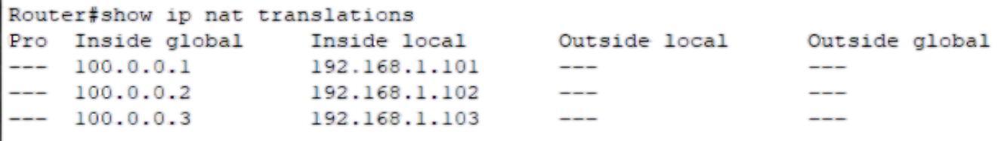
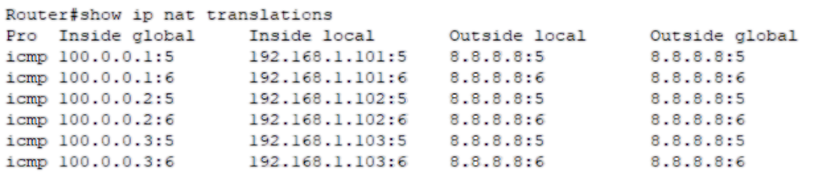
Static NAT

Slide 9
Dynamic NAT
One-to-one mapping done automatically. Maps a pool of private IP addresses to a pool of public IP addresses.
The mapping is temporary and based on the first-come, first-served principle.
This is typically used for clients that need to access the public Internet, but do not need to be directly accessible from the public Internet.
If all the pooled IP addresses are in use, the router simply discard the packet.
Commands for selecting inside/outside interface- ‘Router(config)# interface <interface name>’ ‘Router(config-if)# ip nat <inside/outside>’
Commands for defining private addresses via standard access-lists- ‘Router(config)# access-list <acl no> <permit/deny> <source ip> <source wcm>’
Commands for defining private addresses via extended access-lists- ‘Router(config)# access-list <acl no> <permit/deny> <protocol> <source ip> <wcm> <dest. Ip> <wcm> <operator> <port/service>’
Commands for creating nat pool for converted public addresses- ‘Router(config)# ip nat pool <pool name> <starting public ip> <ending public ip> netmask <subnet mask>’
Commands for dynamic nat- ‘Router(config)# ip nat <inside> source <list> <acl no> pool <pool name>’

Slide 10
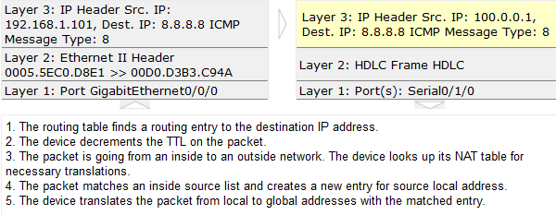
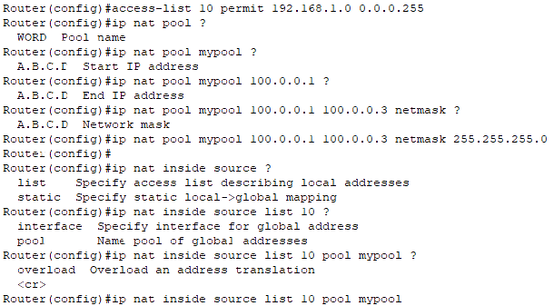
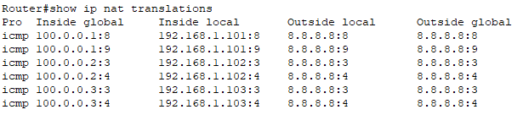
Dynamic NAT

Slide 11
NAT Overload
Also known as Port Address Translation (PAT).
Maps a pool of private IP addresses to a single public IP address but different port numbers.
The port numbers used in PAT are typically in the rage of 0124 to 65535. These are assigned uniquely and randomly.
As PAT uses only one public ip for translation, so the starting and ending ip address will be the same.
Commands for selecting inside/outside interface- ‘Router(config)# interface <interface name>’ ‘Router(config-if)# ip nat <inside/outside>’
Commands for defining private addresses via standard access-lists- ‘Router(config)# access-list <acl no> <permit/deny> <source ip> <source wcm>’
Commands for defining private addresses via extended access-lists- ‘Router(config)# access-list <acl no> <permit/deny> <protocol> <source ip> <wcm> <dest. Ip> <wcm> <operator> <port/service>’
Commands for creating nat pool for converted public addresses- ‘Router(config)# ip nat pool <pool name> <starting public ip> <ending public ip> netmask <subnet mask>’
Commands for nat overload/pat- ‘Router(config)# ip nat <inside> source <list> <acl no> pool <pool name> overload’

Slide 12
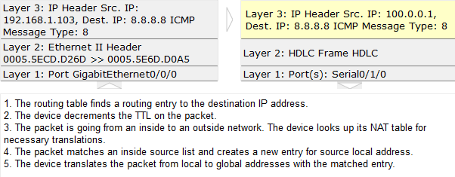
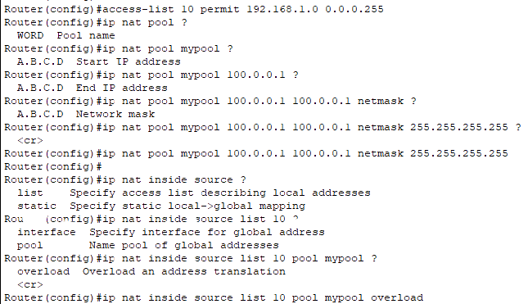
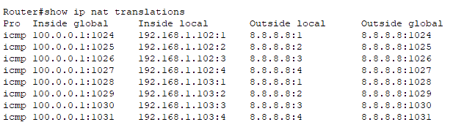
NAT Overload

Slide 13



Thank You
Feel free to reach out to me for any suggestions or feedback via LinkedIn or Mail
www.github.com/smsufi
www.linkedin.com/in/smsufi
safwanm.cse@gmail.com

Slide 14
References
https://en.wikipedia.org/wiki/Network_address_translation
https://www.techtarget.com/searchnetworking/definition/Network-Address-Translation-NAT#:~:text=A%20Network%20Address%20Translation%20(NAT,IP%20addresses%20an%20organization%20needs.
https://www.geeksforgeeks.org/network-address-translation-nat/
https://www.comptia.org/content/guides/what-is-network-address-translation
https://www.youtube.com/@SIKANDARshaik/playlists

