Slide 1

Virtual Local Area Network (Basic)
Safwan Muntasir (Sufi) Networking Enthusiast

Slide 2
Contents
No | Topic | Page
01 | Introduction | 03
02 | Broadcast Domain | 04
03 | VLAN Basic | 05
04 | VLAN Types | 06-07
05 | VLAN Ranges | 08
06 | Switchport Modes | 09
07 | Basic Configuration | 10-14
08 | Inter-VLAN Routing | 15
09 | Router-On-A-Stick (ROAS) | 16-19
10 | Layer-3 Switch Inter-VLAN Routing | 20-21
11 | IEEE 802.1Q | 22
12 | Native VLAN | 23-27
13 | Dynamic Trunking Protocol (DTP) | 28-31
14 | VLAN Trunking Protocol (VTP) | 32-34

Slide 3
Introduction
Back to Contents
VLANs are a fundamental technology in modern networking, allowing administrators to logically divide a physical network into multiple, isolated broadcast domains. Devices in different VLANs cannot communicate with each other directly, unless they are routed through a router or switch. Virtual local area networks (VLANs) were first conceived in the late 1980s by W. David Sincoskie, a computer engineer at Bellcore. Sincoskie was looking for a way to improve the performance and security of Ethernet networks, which were becoming increasingly congested as more devices were connected to them. Sincoskie's early work on VLANs was implemented using a bridging protocol called GARP (Generic Attribute Registration Protocol). GARP allowed switches to communicate with each other and dynamically assign devices to VLANs.
In 1998, the IEEE 802.1Q standard was published, which defined a standard way to implement VLANs in Ethernet networks. The 802.1Q standard added a new header to Ethernet frames that allows switches to identify the VLAN that a frame belongs to. Today, VLANs are an essential part of many enterprise networks. They are used to improve performance, security, and manageability. VLANs are also being used in new and innovative ways, such as in cloud computing and software-defined networking.
Inter-Switch Link (ISL) is a cisco proprietary VLAN trunking protocol developed by Cisco Systems in the 1990s. ISL played a significant role in the early days of Virtual Local Area Networks (VLANs) before the IEEE 802.1Q standard became widely adopted.

Slide 4

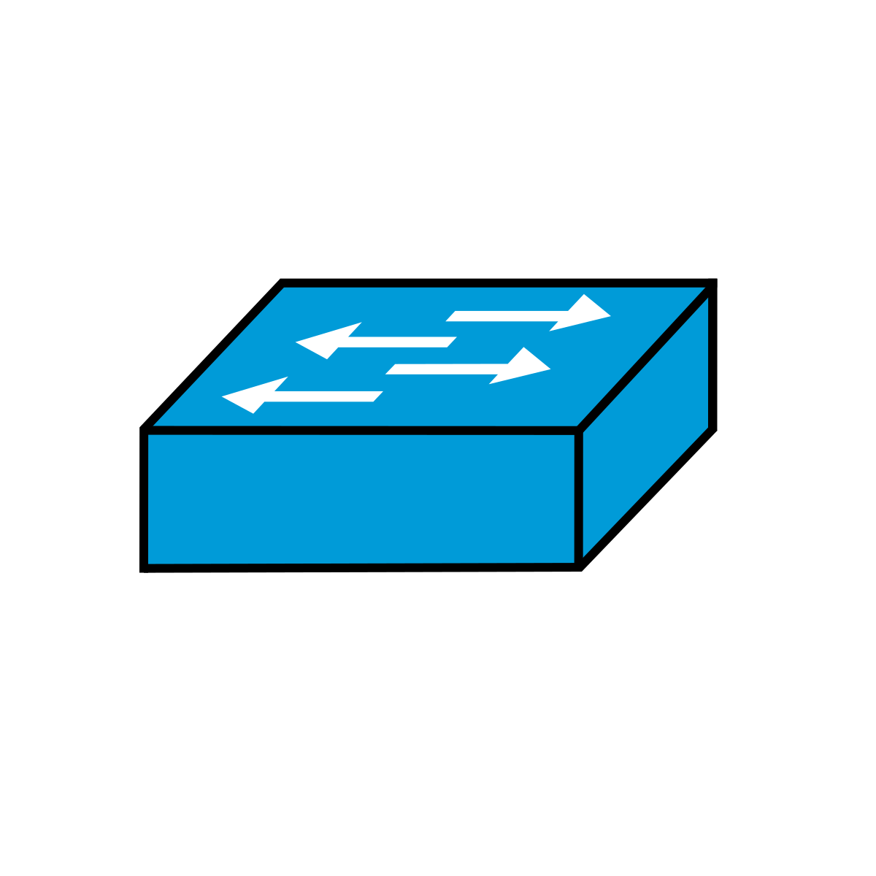

Broadcast Domain
Back to Contents
LAN: A Local Area Network (LAN) is a single broadcast domain, including all devices in that broadcast domain. In another word, LAN is a single network where various end devices communicates through MAC Address (Layer 2) without any routing (Layer 3).
Broadcast Domain: A broadcast domain is the group of devices which will receive a broadcast frame (destination MAC FFFF.FFFF.FFFF) sent by any one of the members.
Switches broadcast ethernet frames if they haven’t learned the destination MAC address.
Switches flood broadcast traffic on all their interfaces, except the one they received the broadcast on.
Size of the broadcast domain depends on number of devices connected in LAN/VLAN.
Routers do not forward broadcast traffic, they break broadcast domains. But VLANs on switches also break the broadcast domain.
No Broadcast

Slide 5
VLAN Basics
Back to Contents
VLAN: VLAN is a logical grouping of devices on a network that are treated as if they were on a separate physical network, even though they may be connected to the same switch or router.
VLANs are configured on switches on a per-interface basis and it logically separate end hosts at layer 2.
Reduces broadcast domain in a LAN.
Switches do not forward traffic directly between hosts in different VLANs.
VLANs limit the number of broadcast, better performance and enhance network security.
Improves the network performance and reduces network congestion.
Every interfaces in a switch maintain a MAC-Address-Table to forward frames in Layer 2 communication. This table has four columns-
VLAN: VLAN ID if used.
MAC-Address: Connected or received end host’s MAC addresses.
Type: Static or Dynamic
Port: Port on which the destination device is connected.
***Every Interfaces in Switch/Router has a Network Interface Card (NIC) and a unique MAC Address.
***End host cannot understand VLAN information. Connected interfaces of the switch belongs to specific VLANs.

Slide 6
VLAN Types
Back to Contents
There are mainly five types of VLAN-
Default VLAN: It is the VLAN that is by default exist. In different vendor switches like Cisco, HP, Huawei, etc, the default VLAN is typically 1. At the initial boot up of the switch, all the ports become a member of the default VLAN (one broadcast domain). VLAN 1 has all the features of any VLAN, except it cannot be renamed or deleted. It is commonly used for traffic that has not been explicitly tagged with a VLAN ID.
Data VLAN: It is the most common type of VLAN, also known as a user VLAN. The link connected to end devices like PC is assigned to a data VLAN. It is designed only for user-generated data such as regular network traffic. Data VLANs can help to improve network performance and security by isolating different groups of traffic from each other.
Voice VLAN: Voice VLANs are used to carry voice over IP (VoIP) traffic, also known as Auxiliary VLAN (AUX VLAN). Voice VLAN enables access ports to carry IP voice traffic from an IP Phone. VoIP traffic is time-sensitive, so it is important to isolate it from other types of traffic to avoid performance problems. Voice VLANs can also help to improve the quality of VoIP calls by reducing jitter and latency. IP Phones used the same UTP cables to connect to ethernet switch. PCs will be in a data VLAN and IP Phones will be in the Voice VLAN.

Slide 7
VLAN Types
Back to Contents
Management VLAN: Management VLANs are used to group together devices that need to be managed, such as switches, routers, and firewalls including remote administration, device monitoring and configuring management by using protocols such as telnet, SSH, SNMP, syslog etc. Normally the Management VLAN is VLAN 1, but it can be any VLAN. It is recommended to use separate VLAN for management traffic. Management VLANs can help to improve security by isolating management traffic from other types of traffic.
Native VLAN: The native VLAN is often used in IEEE 802.1Q trunk links. It is a special type of trunk VLAN. Native VLANs are used to carry untagged traffic on a trunk link. Untagged traffic is traffic that does not belong to any specific VLAN. Native VLANs are typically configured as VLAN 1.

Slide 8
VLAN Ranges
Back to Contents
The IEEE 802.1Q standard specifies a range of 0 to 4095 VLAN IDs (total 4096 VLANs). These VLANs are organized into several ranges-
VLANs | Type | Usage
0, 4095 | Reserved | For system use only, cannot be seen or used
1 | Default/Normal | Can be used but cannot be deleted
2-1001 | Normal | For Ethernet VLANs. Can be created, used and deleted.
1002-1005 | Reserved/Normal | Defaults for FDDI and Token Ring. Should not be used and cannot be deleted
1006-4094 | Extended | For Ethernet VLANs. Can be created, used and deleted

Slide 9
Switchport Modes
Back to Contents
There are mainly two switchport modes-
Access Mode: Configured to carry traffic for a single VLAN. The switch removes the VLAN tag from all frames received on the port and forwards the frames to the switch's MAC address table. In access mode, the switch port is configured to connect end-user devices like computers, printers, and IP phones. The port belongs to a single VLAN, and all traffic on the port is untagged and associated with that VLAN. That’s why it’s called an access port, it gives the end hosts access to the network.
Trunk Mode: Configured to carry traffic for multiple VLANs. The switch preserves the VLAN tag on all frames received on the port and forwards the frames to the appropriate switchport or router interface based on the VLAN tag. Trunk ports are essential for inter-switch communication, as they can carry tagged frames representing different VLANs. The most common standard for VLAN tagging is IEEE 802.1Q. There is another VLAN tagging protocol named Inter-Switch Link (ISL) which is a Cisco Proprietary. ISL doesn’t support native VLANs. That’s why it is not used in today’s networks.

Slide 10
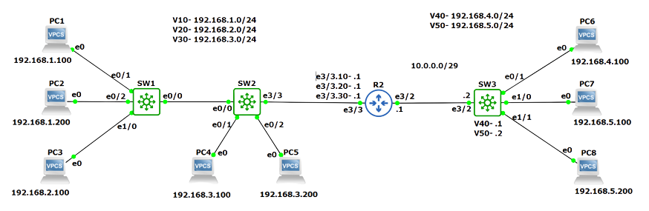
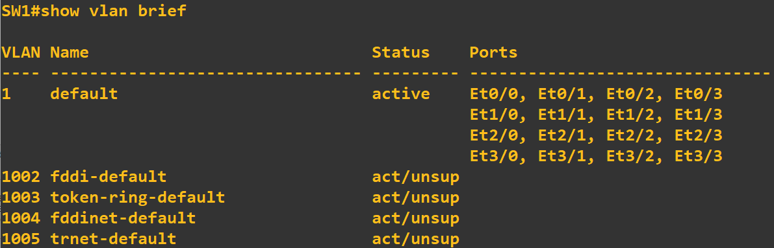
Basic Configuration
Back to Contents
***This lab/topology was created in GNS3 2.2.43
***Routers: Cisco Catalyst 7200 Series Router
***Switches: i86bi Linux L3 Cisco IOS Version 15.1
***PCs: GNS3 Default VPCS
By default all the interface of a switch belongs to Default VLAN 1. Use this command to check- ‘SW# show vlan brief’

Slide 11
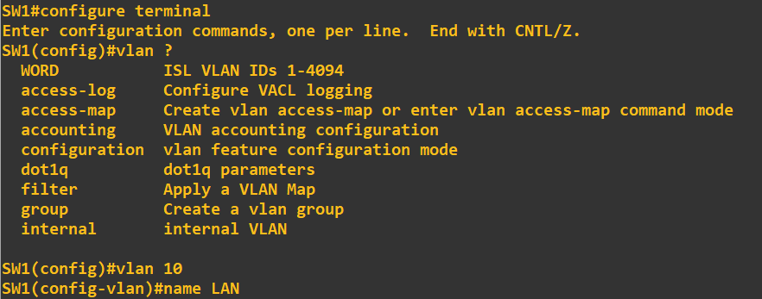
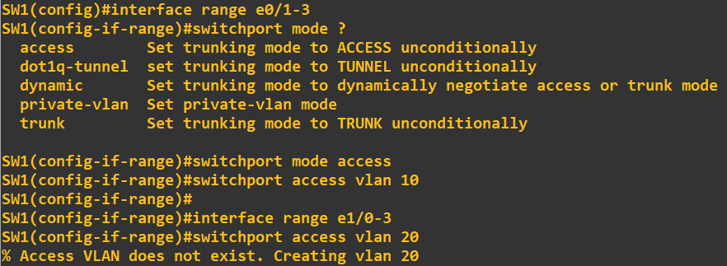
Basic Configuration
Back to Contents
Create VLAN using following commands- ‘SW# configure terminal’ ‘SW(config)# vlan <VLAN ID>’ ‘SW(config-vlan)# name <VLAN name>’
Configuring switchport mode in interfaces connected to end devices- ‘SW(config)# interface range <interface ID range>’ ‘SW(config-if-range)# switchport mode <access>’ ‘SW9config-if-range)# switchport access vlan <VLAN ID>’ If VLAN is not created, it will be created automatically after configuring switchport access to that VLAN.

Slide 12
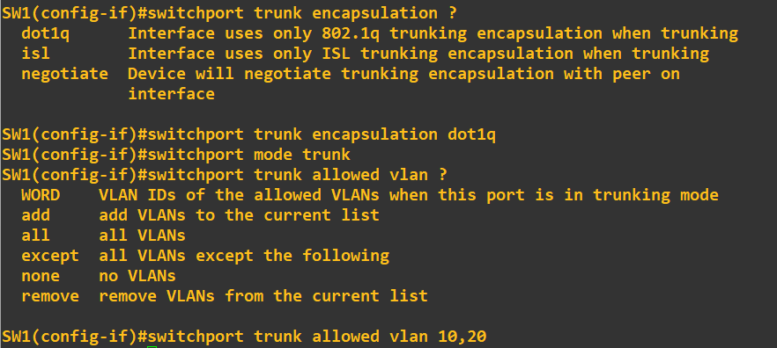
Basic Configuration
Back to Contents
Configuring switchport mode in the up-links- ‘SW(config)# switchport interface <interface ID>’ ‘SW(config-if)# switchport trunk encapsulation <dot1q>’ ‘SW(config-if)# switchport mode <trunk>’ ‘SW(config-if)# switchport trunk allowed vlan <VLAN IDs>’
Encapsulation is the process of adding a header and trailer to a frame in order to prepare it for transmission over a network. The encapsulation header contains information about the frame, such as the source and destination MAC addresses, the VLAN ID (if VLANs are being used), and the type of traffic. The encapsulation trailer contains information about the end of the frame, such as a checksum.
Layer 2 switches do not need to encapsulate frames because they are only transmitting frames within the same network segment. Layer 2 switches use the MAC address tables to forward frames to the correct destination devices.
I have used Multilayer switches in the topology, that’s why I have used ‘switchport trunk encapsulation dot1q’ command before configuring switchport mode to trunk. We will learn about encapsulation in details in later slides In Sha Allah. Just remember for now, in case of Layer 2 switches like C2960, this command is not needed.

Slide 13
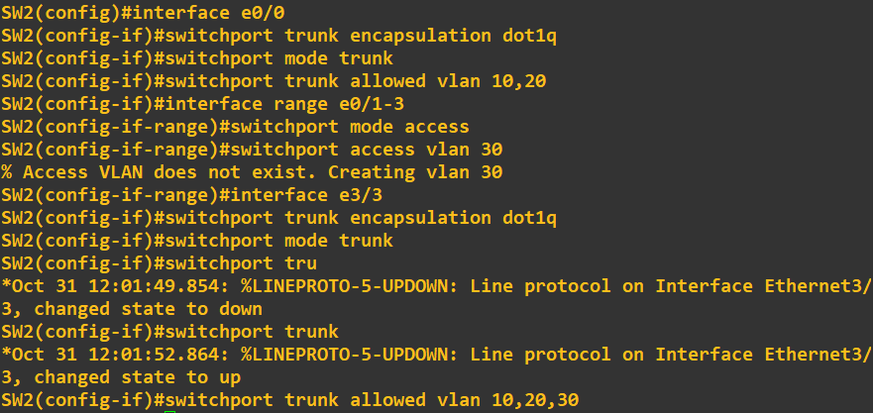





Basic Configuration
Back to Contents
Configuration on Switch 2-
Configuration on PCs-

Slide 14
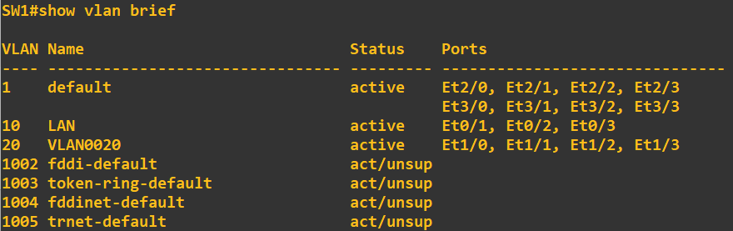
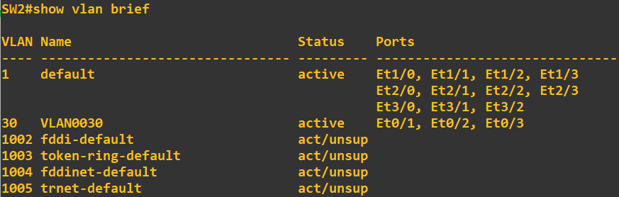
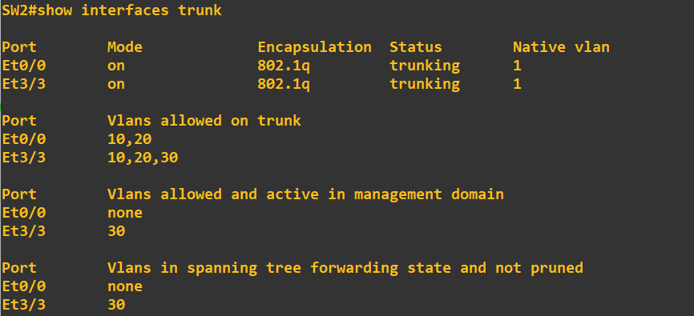
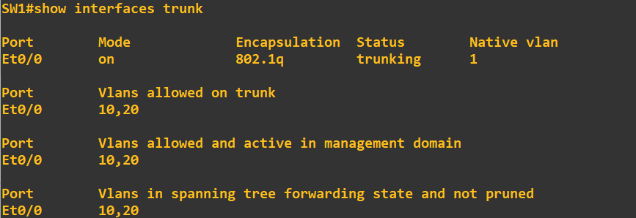
Basic Configuration
Back to Contents
SW1 VLAN information-
SW2 VLAN information-
To check trunk information, use this command- ‘SW# show interfaces trunk’
SW1 trunk information-
SW2 trunk information-

Slide 15
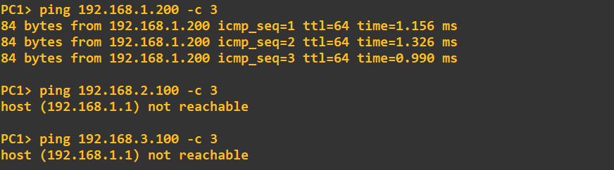
Inter-VLAN Routing
Back to Contents
VLANs have been created. PCs from same VLAN can ping each other, but cannot ping end devices in different VLAN. Inter-VLAN Routing must be enabled to ping/reach end devices on other VLANs. Gateway of VLAN 10, 20 and 30 will be on SW2. SW2 is a Layer 3 or Multilayer Switch.
There are two ways to enable Inter-VLAN Routing-
Router-On-A-Stick (ROAS): Router-on-a-Stick is a common method for inter-VLAN routing using a single physical router interface connected to a switch. This router interface serves as a gateway for multiple VLANs using sub-interfaces, each configured with a unique IP address and VLAN ID. The router tags incoming frames with the appropriate VLAN tag, routes the packets, and untags them before sending them back to the switch.
Layer-3 Switch: A Layer 3 switch is a multi-layer switch capable of routing traffic between networks. It combines Layer 2 and Layer 3 functionality, allowing for routing without the need for an external router. VLANs are configured on the Layer 3 switch, and IP addresses are assigned to each VLAN interface. The switch can route traffic between VLANs directly, eliminating the need for external routing devices.

Slide 16
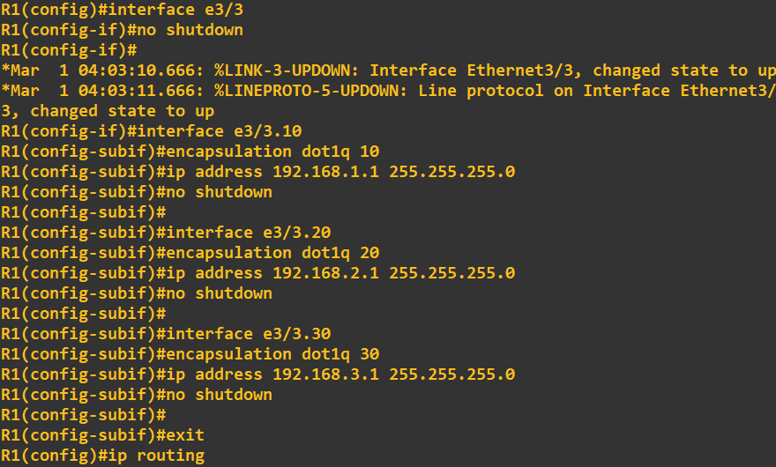
Router-On-A-Stick (ROAS)
Back to Contents
Gateway of VLAN 10, 20 and 30 is on the router. So, we have to configure Router-On-A-Stick to route between VLANs.
To enable Inter-VLAN Routing on a router- ‘RTR(config)# ip routing’
Sub-interface commands in routers- ‘RTR(config)# interface <interface no>.<sub-int no>’ ‘RTR(config)# encapsulation dot1q <VLAN ID>’ ‘RTR(config)# ip address <network ip> <subnet mask>’ ‘RTR(config)# no shutdown’
***Always remember, physical interface must be on up state. If physical interface become down, sub-interfaces will also become down state.

Slide 17
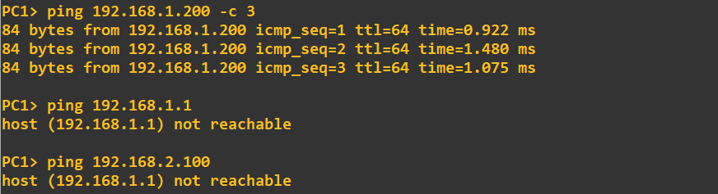
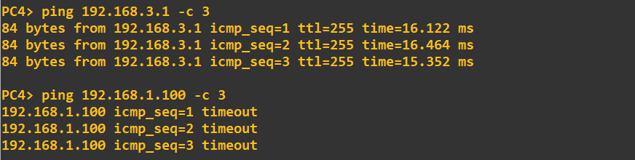

Router-On-A-Stick (ROAS)
Back to Contents
We have done Inter-VLAN Routing, still VLAN 10 and 20 cannot ping their gateway, though PCs from VLAN 30 can ping its gateway. Can you tell why??
If you can remember our configuration till now, we have not created VLAN 10 and 20 on SW2. Packets from PCs n VLAN 10 and 20 are coming from SW1 to SW2, but SW2 doesn’t recognize these VLANs. So, they don’t know where to forward the packets and discards them.
Always remember, in every transit switch, transit VLANs must be created, or else those switch will discard the packets.
Now, VLAN 10, 20 and 30 has been created in SW2, but SW doesn’t have to know about VLAN 30 although PCs from these VLAN can ping each other. WHY?? Think of yourself!

Slide 18
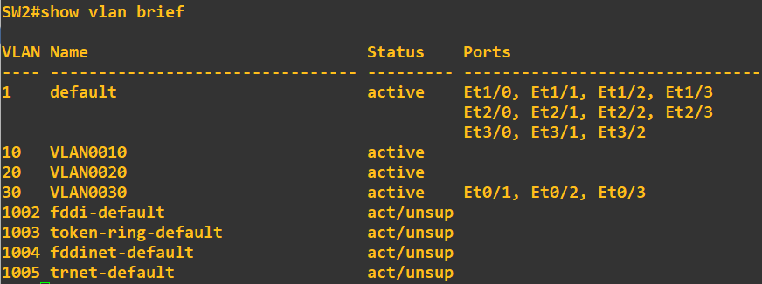
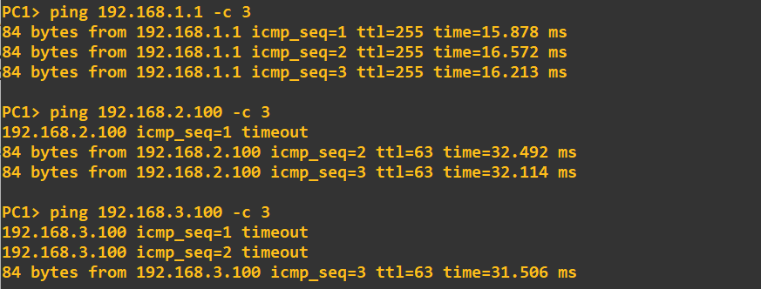
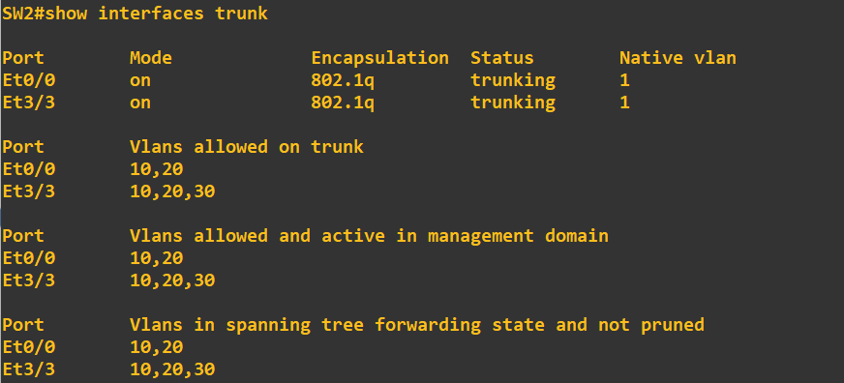
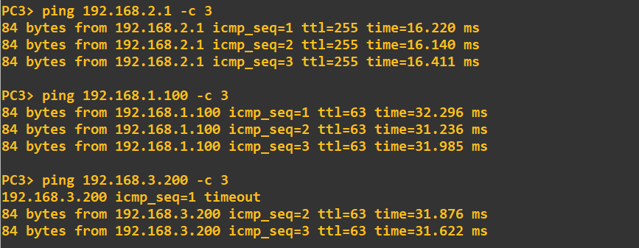
Router-On-A-Stick (ROAS)
Back to Contents
SW2 VLAN information-
Now PCs from every VLANs can ping each other. First ping is lost because of ARP requests to know the MAC addresses.
SW2 trunk information-

Slide 19
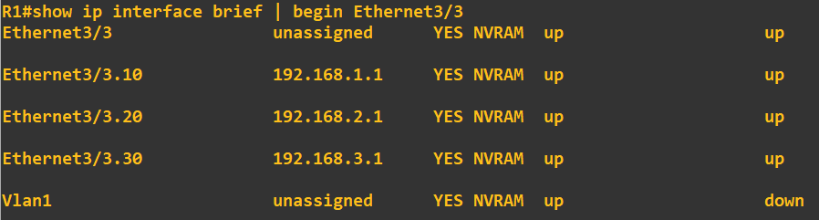
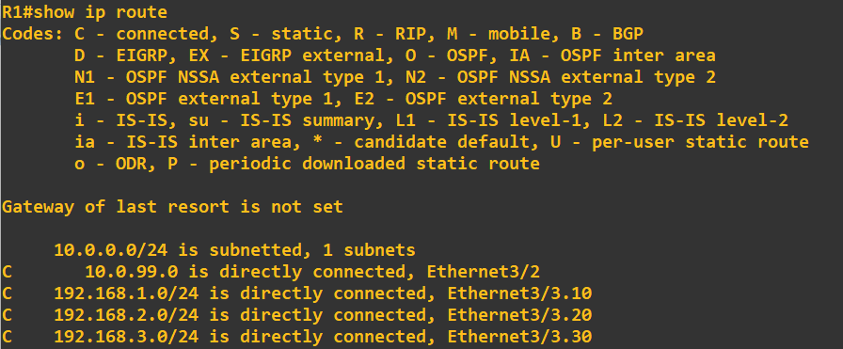
Router-On-A-Stick (ROAS)
Back to Contents
Interfaces and sub-interfaces of R1-
Route table of R1

Slide 20
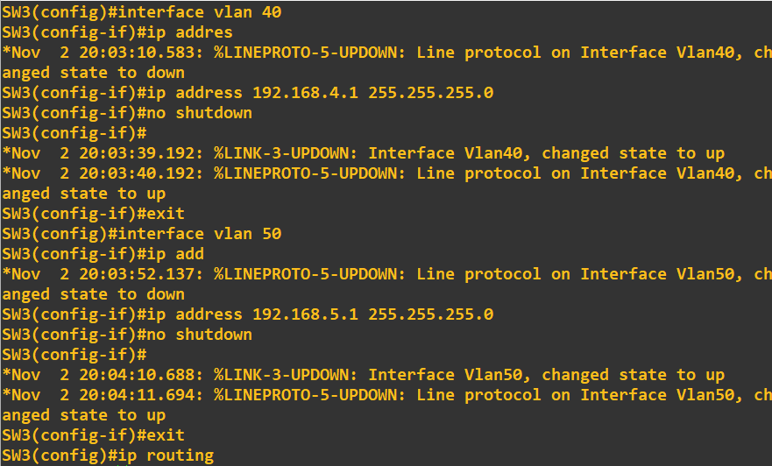
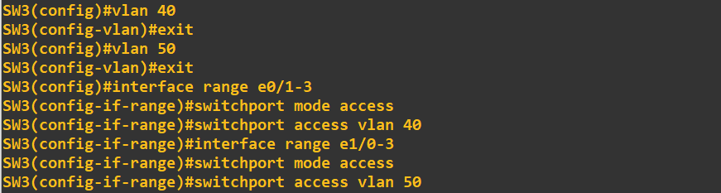
Layer-3 Switch Inter-VLAN Routing
Back to Contents
Gateway of VLAN 40 and 50 is on the Multilayer SW3. After creating VLAN 40 and 50 we have to create VLAN interfaces and assign gateway address of these VLANs. Then SW3 will be able to route Inter-VLANs by enabling ip routing in the switch.
Assigning ip addresses in the VLAN interfaces- ‘SW(config)# interface vlan <VLAN ID>’ ‘SW(config-if)# ip address <IP Address> <subnet mask>’

Slide 21
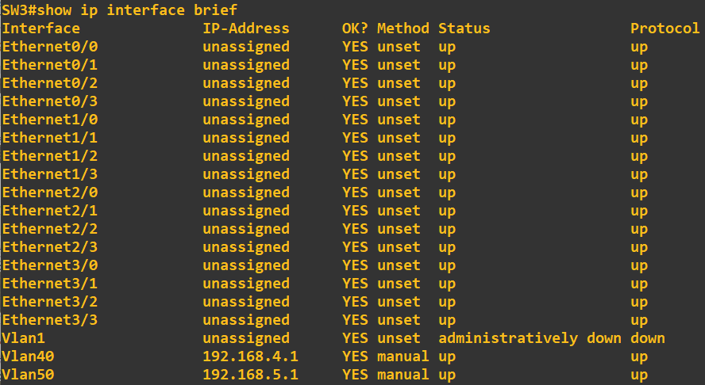
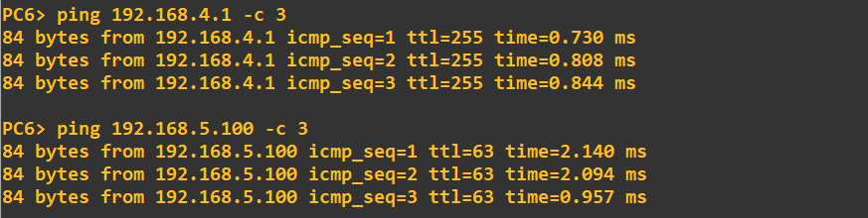
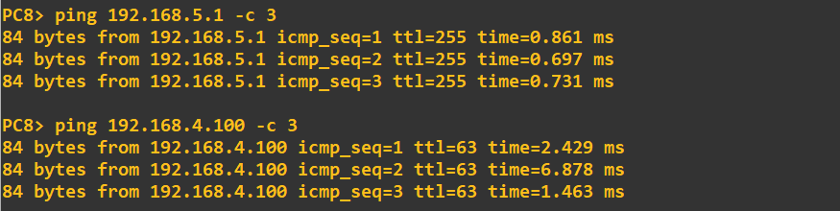
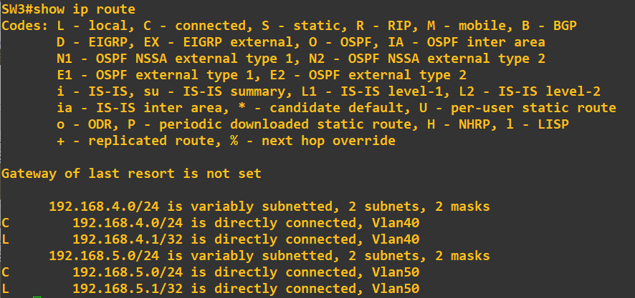
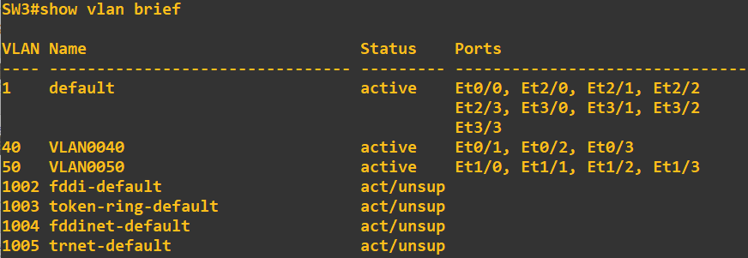
Layer-3 Switch Inter-VLAN Routing
Back to Contents
Now every end devices will be able to ping other VLANs end devices.

Slide 22
IEEE 802.1Q
Back to Contents
Switches will ‘tag’ all frames that they send over a trunk link. This allows the receiving switch to know which VLAN the frame belongs to.
Trunk ports are tagged ports.
Access ports are untagged ports.
The 802.1Q tag is inserted between the source and type/length fields of the Ethernet frame. The tag is 4 bytes (32 bits) in length.
The tag consists of two main fields-
Tag Protocol Identifier (TPID)
Tag Control Information (TCI)
All the fields are discussed below:
Preamble | SFD | Destination | Source | 802.1Q | Type | Data | FCS
TPID: Always set to a value of 0x8100. This indicates that the frame is 802.1Q tagged. ‘0x’ defines hexadecimal value.
PCP: Priority Code Point- used for Class of Service (CoS), which prioritizes important traffic in congested networks.
DEI: Drop Eligible Indicator- used to indicate frames that can be dropped if the network is congested.
VID: VLAN ID- identifies the VLAN the frame belongs to. It is 12 bits in length = 4096 total VLANs (2^12), range 0 to 4095.
16 bits | 3 bits | 1 bit | 12 bits
TPID | TCI
 | PCP | DEI | VID

Slide 23
Native VLAN
Back to Contents
802.1Q has a feature called the native VLAN, ISL does not have this feature.
A native VLAN is a special VLAN that is used to carry untagged traffic on a trunk port. Untagged traffic is traffic that does not belong to any specific VLAN.
Native VLANs are typically configured as VLAN 1 by default on all trunk ports, however this can be manually configured on each trunk port.
The switch does not add an 802.1Q tag to frames in the native VLAN. When a switch receives an untagged frame on a trunk port, it assumes the frame belongs to the native VLAN.
It is very important that the native VLAN matches.
For security purposes, it is best to change the native VLAN to an unused VLAN.
There are two methods of configuring the native VLAN on a router-
Using the command ‘encapsulation dot1q <VLAN ID> native’ on the router sub-interface.
Configure the IP address for the native VLAN on the router’s physical interface, no encapsulation command is necessary.

Slide 24
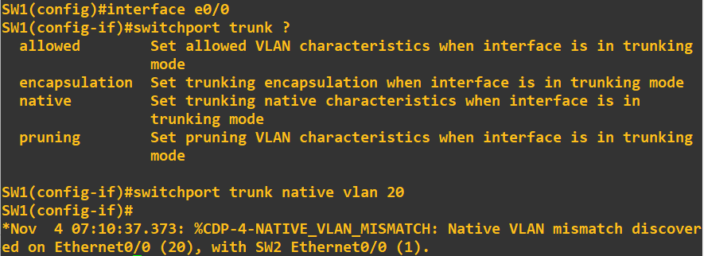
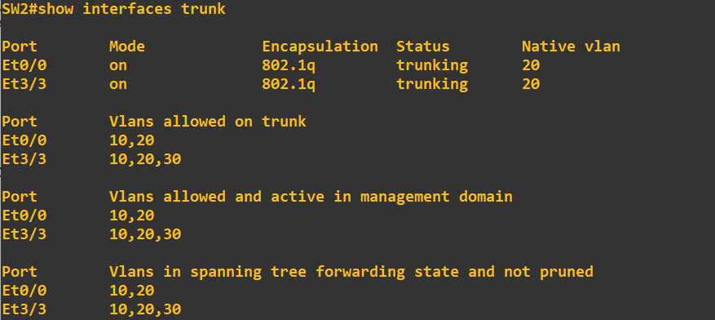
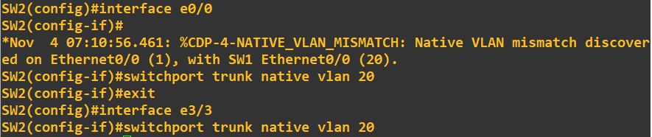
Native VLAN
Back to Contents
Commands for configuring Native VLAN on trunk ports- ‘SW(config)# interface <interface no>’ ‘SW(config-if)# switchport trunk encapsulation dot1q’ ‘SW(config-if)# switchport mode trunk’ ‘SW(config-if)# switchport trunk allowed vlan <VLAN IDs>’ ‘SW(config-if)# switchport trunk native vlan <native VLAN ID>’
Trunk information of SW2 after configuring native VLAN-
We are making VLAN 20 as native VLAN in the topology. Configuring SW1 and SW2-

Slide 25
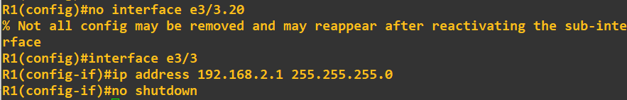
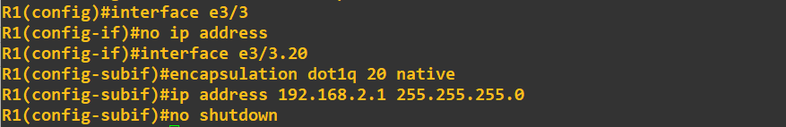
Native VLAN
Back to Contents
Commands for configuring ROAS for native vlan- ‘RTR(config)# interface <interface no>’ ‘RTR(config-if)# ip address <gateway ip of native VLAN>’
OR, ‘RTR(config)# interface <interface no>’ ‘RTR(config-if)# encapsulation dot1q <native VLAN ID> native’

Slide 26
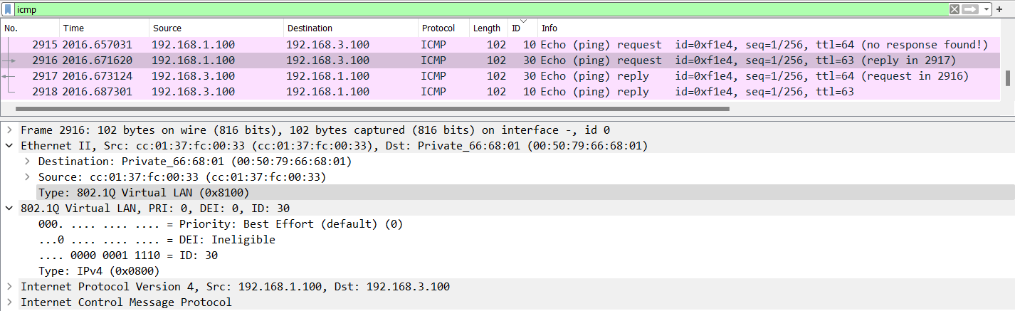
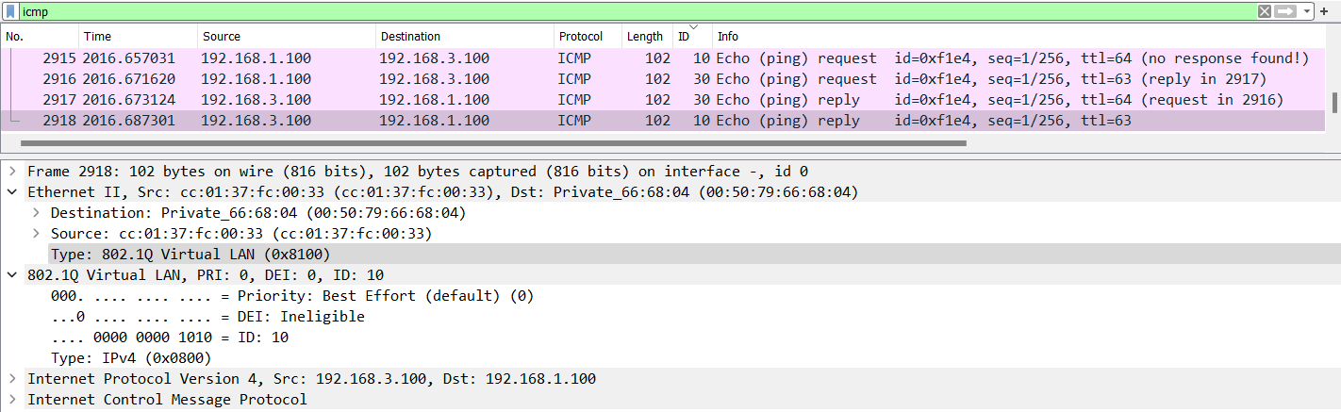
Native VLAN
Back to Contents
ICMP packet captured in Wireshark of PC1 from VLAN 10 pinging PC4 from VLAN 30
Focus on 802.1Q tag fields

Slide 27
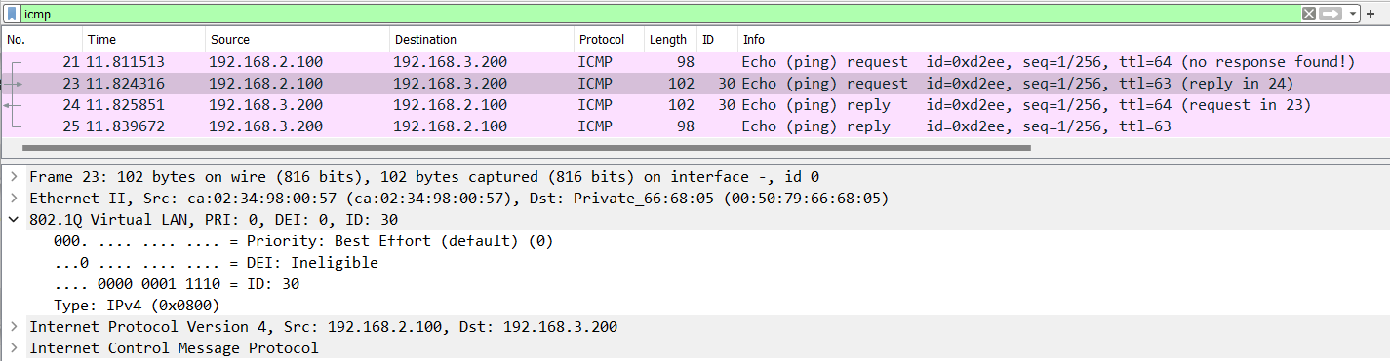
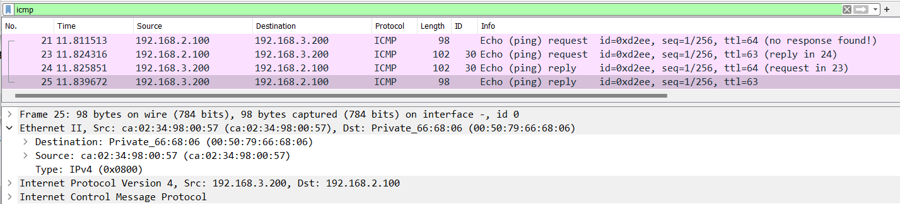
Native VLAN
Back to Contents
ICMP packet captured in Wireshark of PC3 from Native VLAN 20 pinging PC5 from VLAN 30
Focus on 802.1Q tag fields

Slide 28
DTP (Dynamic Trunking Protocol)
Back to Contents
Dynamic Trunking Protocol (DTP) is a Cisco proprietary protocol that allows switches to negotiate trunking between each other. DTP is used to automatically configure trunk ports on switches. DTP works by exchanging messages between switches to determine the trunking mode of each port. The DTP messages contain information about the following:
The desired trunking mode (trunk or access)
The supported trunking encapsulation types (IEEE 802.1q or ISL)
When two switches receive DTP messages from each other, they will negotiate the trunking mode and encapsulation type. If the switches cannot agree on a trunking mode or encapsulation type, the ports will be configured as access ports. DTP is enabled by default on all Cisco switch interfaces.
There are two modes of DTP-
Auto: A switchport in dynamic auto mode will not actively try to form a trunk with other Cisco switches, however it will form a trunk if the switch connected to it is actively trying to form a trunk. It will form a trunk with a switchport in trunk/dynamic desirable modes.
Desirable: A switchport in dynamic desirable mode will actively try to form a trunk with other Cisco switches. It will form a trunk if connected to another switchport in trunk/dynamic desirable/dynamic auto modes.

Slide 29
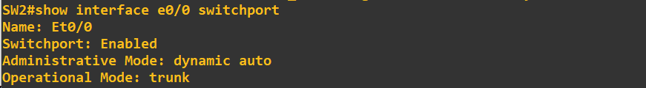
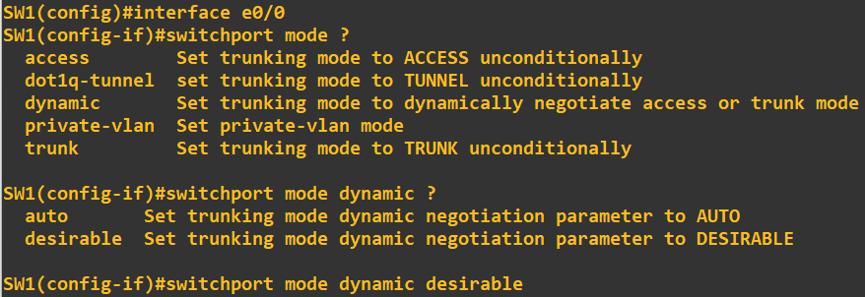
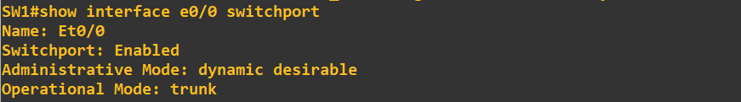
DTP (Dynamic Trunking Protocol)
Back to Contents
Commands of DTP in switches- ‘SW(config)# interface <interface no>’ ‘SW(config-if)# switchport mode dynamic <auto/desirable>’
Commands to check DTP switchport mode- ‘SW# show interface <interface no> switchport’
Configuring DTP mode of SW1 to desirable-
Configuring DTP mode of SW2 to auto-
There are also ‘dynamic access’ ports, in which a server automatically assigns the VLAN depending on the MAC address of the connected device.
‘static access’ means as access port that belongs to a single VLAN that doesn’t change (unless we configure a different VLAN).
What happens if a manually configured TRUNK is connected to a manually configured ACCESS port?
Since both are manually configured, they are forced to operate mismatched in trunk and access modes. This configuration does not work and will result in an error.

Slide 30
DTP (Dynamic Trunking Protocol)
Back to Contents
The following chart summarizes the resulting operational mode given different administrative modes-
SW1 Administrative Mode | SW2 Administrative Mode | Operational Mode
Trunk | Trunk | Trunk
Access | Access | Access
Trunk | Access | X
Dynamic Desirable | Trunk | Trunk
Dynamic Desirable | Dynamic Desirable | Trunk
Dynamic Desirable | Dynamic Auto | Trunk
Dynamic Desirable | Access | Access
Dynamic Auto | Trunk | Trunk
Dynamic Auto | Dynamic Desirable | Trunk
Dynamic Auto | Dynamic Auto | X
Dynamic Auto | Access | Access
DTP will not form a trunk with a router, end devices like PC, etc.
On older switches, switchport mode dynamic desirable is the default administrative mode.
On newer switches, switchport mode dynamic auto is the default administrative mode.
DTP negotiation on an interface can be disabled with the command- ‘switchport nonegotiate’

Slide 31
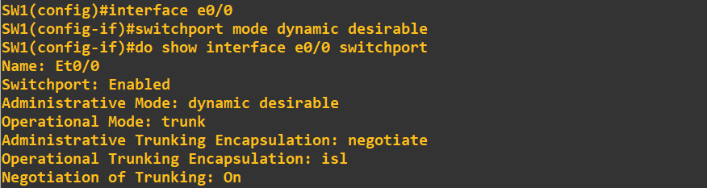
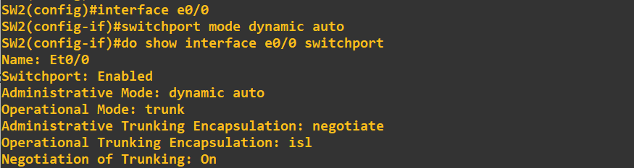
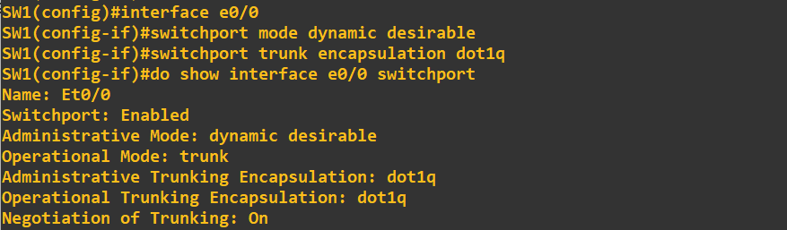
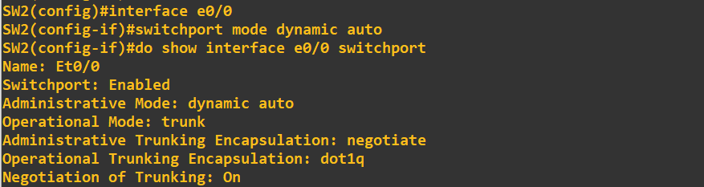
DTP (Dynamic Trunking Protocol)
Back to Contents
Switches that support both 802.1Q and ISL trunk encapsulations ca use DTP to negotiate the encapsulation they use.
This negotiation is enabled by default. Command to enable switchport trunk encapsulation mode- ‘SW(config)# interface <interface no>’ ‘SW(config-if)# switchport trunk encapsulation <dot1q/isl/negotiate>’
ISL is favored over 802.1Q, so if both switches support ISL, it will be selected in auto negotiation-
If one switch is configured as 802.1Q, the other switch will also select 802.1Q in auto negotiation-

Slide 32
VTP (VLAN Trunking Protocol)
Back to Contents
VLAN Trunking Protocol (VTP) is a Cisco proprietary protocol that propagates the definition of Virtual Local Area Networks (VLANs) on the whole local area network.
It allows network administrators to configure, update, and maintain VLAN information consistently across multiple Cisco switches, making network management more efficient.
VTP carries VLAN information to all switches in a VTP domain.
VTP advertisements can be sent over 802.1Q, and ISL trunks.
It is designed for large networks with many VLANs, so that we don’t have to configure each VLAN on every switch.
There are three VTP versions- 1, 2 and 3.
VTPv1 and VTPv2 do not support the extended VLAN range (1006-4094). Only VTPv3 supports them.
There are three VTP modes- VTP server, VTP client and VTP transparent.
Cisco switches operate in VTP server mode by default.
If a switch with no VTP domain (Null) receives a VTP advertisement with a VTP domain name, it will automatically join that VTP domain.
If a switch receives a VTP advertisement in the same VTP domain with a higher revision number, it will update it’s VLAN database to match.
***One danger of VTP: It we connect an old switch with a higher revision number to our network (and the VTP domain name matches), all switches in the domain will sync their VLAN database to that switch. That’s why it is recommended to turn off VTP in switches and manually add corresponding VLANs on the switches.

Slide 33
VTP (VLAN Trunking Protocol)
Back to Contents
There are three VTP modes-
VTP Server: Can add/modify/delete VLANs. Store the VLAN database in non-volatile RAN (NVRAM). Will increase the revision number everytime a VLAN is added/modified/deleted. Will advertise the latest version of the VLAN database on trunk interfaces, and the VTP clients will synchronize their VLAN database to it. VTP servers also functions as VTP clients. Therefore, a VTP server will synchronize to another VTP server with a higher revision number.
VTP Client: Cannot add/modify/delete VLANs. Do not store the VLAN database in NVRAM (in VTPv3, they do). Will synchronize their VLAN database to the server with the highest revision number in their VTP domain. Will advertise their VLAN database, and forward VTP advertisements to other clients over trunk ports.
VTP Transparent: A VTP transparent switch is a switch that does not participate in VTP. VTP transparent switches send VTP advertisements to other switches but do not learn about VLANs from VTP advertisements. They act as "pass-through" switches, forwarding VTP advertisements but not processing them. They maintain their own VLAN database in NVRAM. They can add/modify/delete VLANs, but won’t be advertised to other switches.
How to reset VTP on a switch-
Changing the CTP domain to an unused domain will reset the revision number to 0.
Changing the VTP mode to transparent will also reset the revision number to 0.

Slide 34
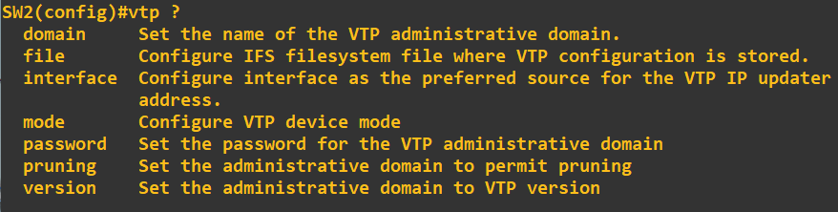
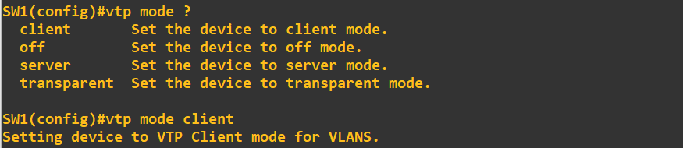
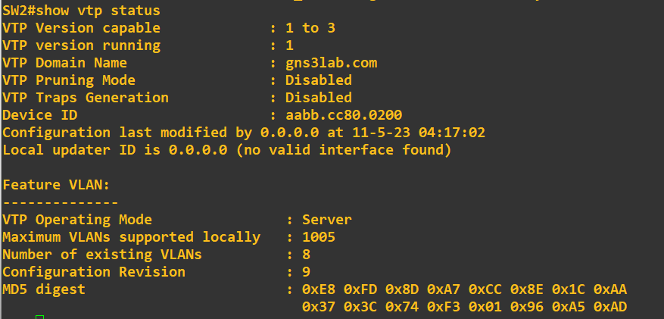
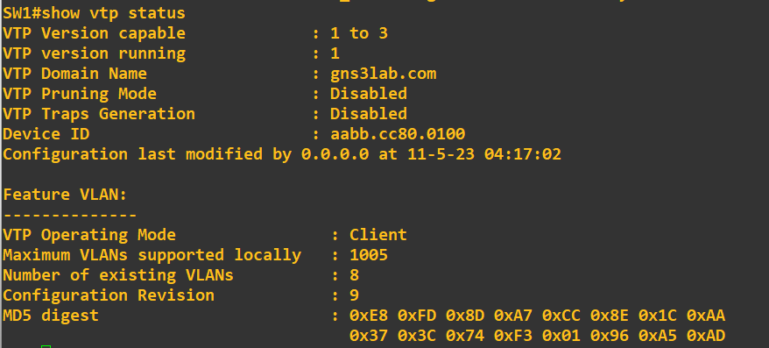
VTP (VLAN Trunking Protocol)
Back to Contents
Command to check VTP status- ‘SW# show vtp status’
Command to set VTP modes- ‘SW(config)# vtp mode <client/off/server/transparent>’
Command to create VTP domain- ‘SW(config)# vtp domain <VTP domain name>’
Command to change VTP versions- ‘SW(config)# vtp version <1/2/3>’

Slide 35



Thank You
Feel free to reach out to me for any suggestions or feedback via LinkedIn or Mail
www.github.com/smsufi
www.linkedin.com/in/smsufi
safwanm.cse@gmail.com

