Slide 1

Rent-Buddy
Group No: 03
Presented By-
Safwan Muntasir
Mashfiq Rahman
Abdullah Al Mohaimen
Arifur Rahman Jawad
Safwan Muntasir ID: 180104084 Mashfiq Rahman ID: 180104087
Arifur Rahman Jawad ID: 180104097 Abdullah Al Mohaimen ID: 180104098
03-Oct-2021
Rent-Buddy

Slide 2
Introduction
We tried to develop a website on vehicle renting system which gives an online platform to rent out vehicles in tourist zones for the ease of travel. Rent-buddy is a place where a customer can choose vehicles of their choice for renting for specific time.
In that way, they will have the freedom of travelling in tourist zone without being bothered about transportation syndicates and as well as save money. Currently targeted Cox’s Bazar as it is the most visited tourist spot of Bangladesh and has the most expensive transportation charges and syndicates. We tried our best to build a syndicate free and cheap vehicle renting system for tourist and also give earning facilities for local people by taking their vehicles for rent services.
We tried to build the website based application to run on all devices for ease of use for everyone.
03-Oct-2021
Rent-Buddy
2

Slide 3
Project Summary
Rent Buddy is an website on vehicle renting system which gives an online platform to rent out vehicles in tourist zone.
Customer can choose vehicles of their choice for renting for specific time.
For now, we are targeting our service for Cox’s Bazar only as it is the most visited tourist spot of Bangladesh and has the most expensive transportation charges and syndicates.
Application based to run on all devices for ease of use for everyone without going to the hassle of downloading any app.
Users will go through both online and offline verification before receiving the service.
03-Oct-2021
Rent-Buddy
3

Slide 4
Project Requirements
Technical Requirements
Browsers - Google Chrome, Firefox
HTML, CSS, Bootstrap & Angular
C#, MySQL Database
Other Requirements
Microsoft Visual Studio, Microsoft SQL Server Studio and Other
Computer System
Operating System
03-Oct-2021
Rent-Buddy
4

Slide 5
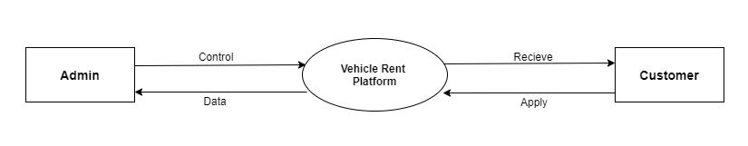
Level 0 Diagram (Context Level Diagram)
03-Oct-2021
Rent-Buddy
5

Slide 6
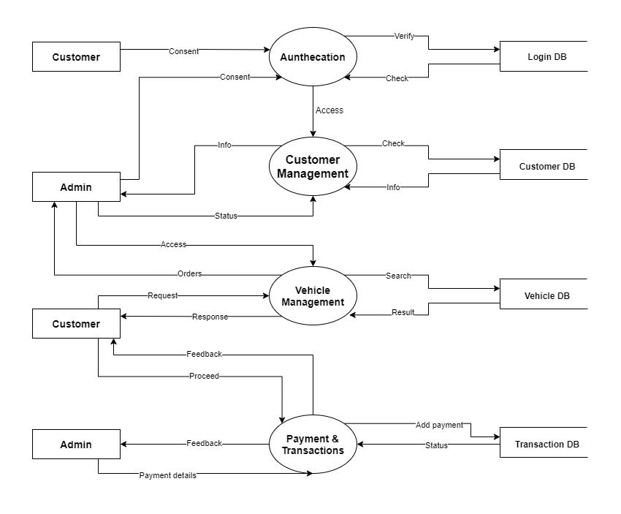
Level 1 Diagram
03-Oct-2021
Rent-Buddy
6

Slide 7
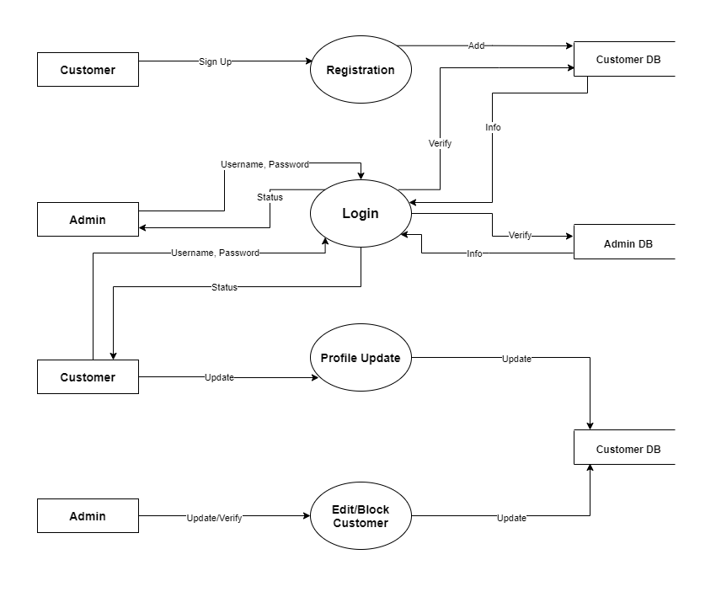
Level 2 Diagram
03-Oct-2021
Rent-Buddy
7

Slide 8
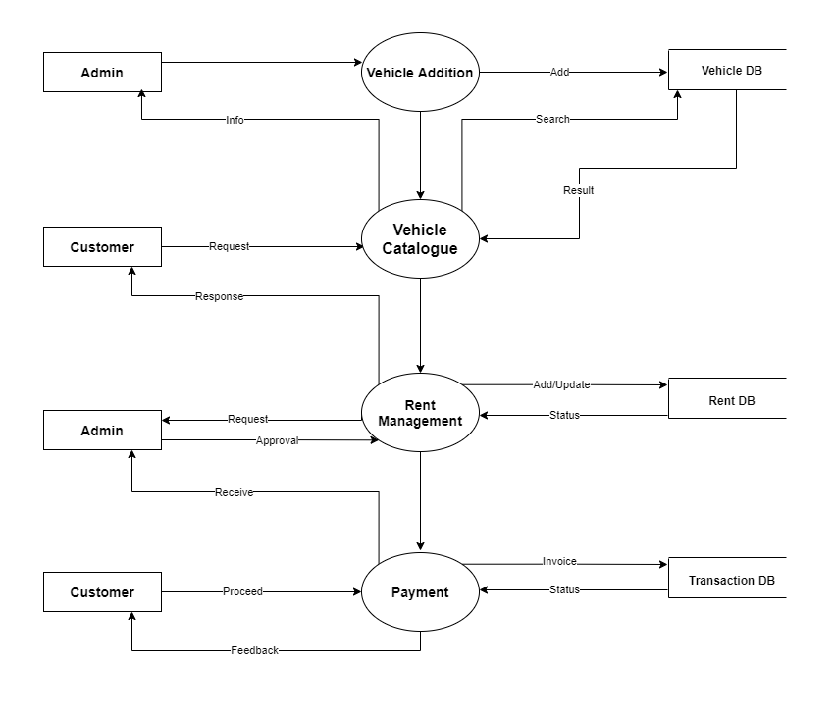
Level 2 Diagram (Contd.)
03-Oct-2021
Rent-Buddy
8

Slide 9
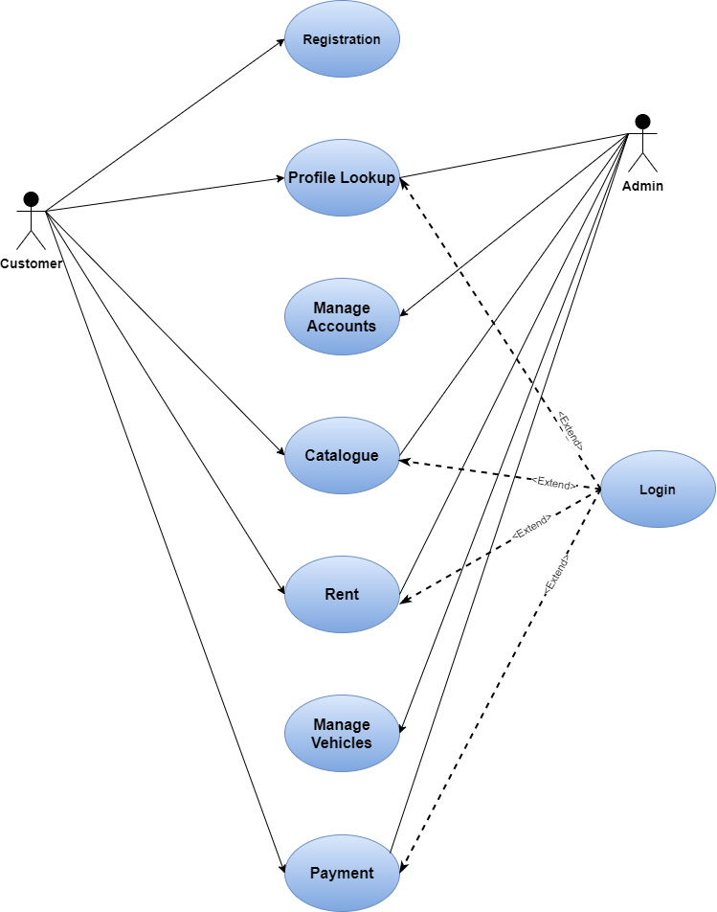
Use Case Diagram
Actors:
Admin
Customer
Use Cases:
Registration
Login
Profile Lookup
Manage Accounts
Catalogue
Rent
Manage Vehicles
Payment
03-Oct-2021
Rent-Buddy
9

Slide 10
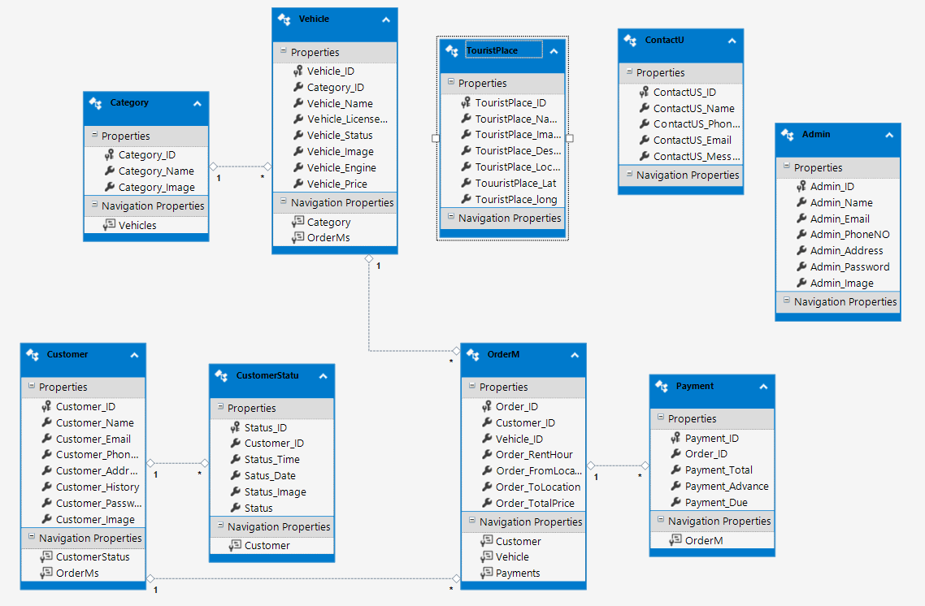
Entity Relationship Diagram
03-Oct-2021
Rent-Buddy
10

Slide 11
Future Plan
We want to implement a live chat system for admin and customers.
Implement mobile app for user’s ease.
An interface for drivers also.
Integrated bkash, nagad and other gateway payment systems.
Implementation of a rating system.
Suggestion system using deep learning.
03-Oct-2021
Rent-Buddy
11

Slide 12
Project Demonstration
Now Safwan Muntasir will demonstrate our project.
03-Oct-2021
Rent-Buddy
10

Slide 13
THANK YOU
THANK YOU

