Slide 1

iSafe-Plug
Group No: 04
Safwan Muntasir ID: 180104084 Mashfiq Rahman ID: 180104087
Arifur Rahman Jawad ID: 180104097 Abdullah Al Mohaimen ID: 180104098
07-Oct-2021
iSafe-Plug

Slide 2
Objective
Smart multiplug
Safer for everyone
Easy to use in daily life
Controlled by Bluetooth
Timer set for avoiding extra damage
Avoid wasting of electricity
Avoid unwanted accidents
07-Oct-2021
iSafe-Plug
2

Slide 3
Social Values
Increasing tech accessories
Device overcharging
Bluetooth controlled and setting timer
Gas leaks, water damage solution
07-Oct-2021
iSafe-Plug
3

Slide 4
Required Components
• Arduino Uno
• Bluetooth Module (HC-06)
• Gas sensor (MC Q2)
• Relay Module
• Power points board
• Lamp(as AC ports)
• Wires
• Buzzer
• Resistors
• Rectifier diode (1N4007)
• NPN Transistor (2N2222)
• Logic toggle/state
• LEDs
• Water Sensor(Rain Sensor)
• AC Current Supply(Alternator)
07-Oct-2021
iSafe-Plug
4

Slide 5
Working Procedure
The basic components that react to the input are as follows:
1. Bluetooth Module
• it controls the multiplug via creating connection between the devices.
2. Gas Sensor
• To detect gas/fume
3. Water sensor
• To detect water
07-Oct-2021
iSafe-Plug
5

Slide 6
Working Procedure(Cont.)
4. Relay Module
• To turn on AC connections of the plug
5. Arduino
• Controls everything of the plug
6. Buzzer
• Alarm rings for the consequence of unwanted event
07-Oct-2021
iSafe-Plug
6

Slide 7
Estimated Budget
Equipment | Quantity | Budget(Tk)
Arduino Uno | 1 | 450
Bluetooth Module (HC-06) | 1 | 350
Gas Sensor (MC Q2) | 1 | 120
Relay Module | 2 | 250
AC Port Board | 2 | 300
Buzzer | 1 | 15
Resistor | As required | 20
LEDs | 1 | 10
Rain Sensor | 1 | 250
Wires | As required | 100
Breadboard | 1 | 100
Total |  | 1965
07-Oct-2021
iSafe-Plug
7

Slide 8
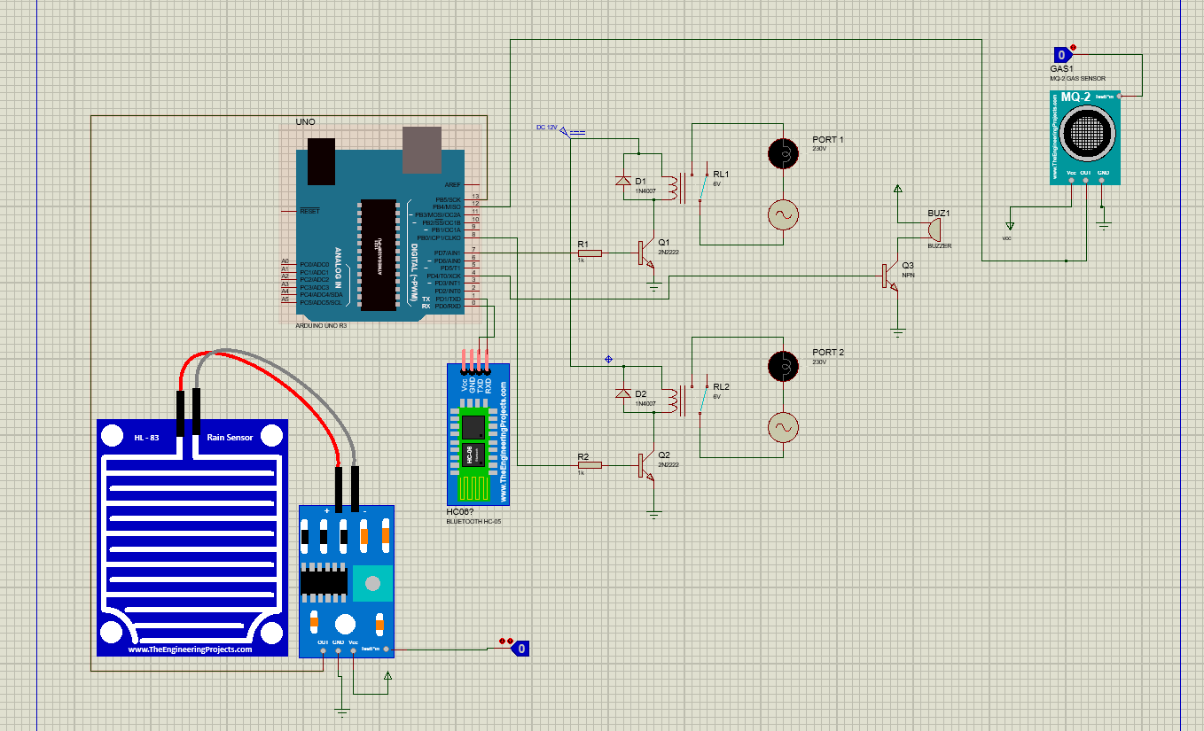
Circuit Diagram
07-Oct-2021
iSafe-Plug
8

Slide 9
Future Plan
We want to make it wifi based in order to control from anywhere.
Adding more smart features like motion detector for turning on lamp or fan based on temperature.
Adding integrated hidden security camera and microphone.
07-Oct-2021
iSafe-Plug
9

Slide 10
Conclusion
In this project, the various types of sensors used plays vital rule for the safety purpose of its built. Its prime objective is to safeguard and secure charging or connection of devices to avoid accidents. It can overcome the vital thread our everyday life faces. Over charging or electrical problems are not small issues to fool around , so this project holds a whole new importance for the society.
07-Oct-2021
iSafe-Plug
10

Slide 11
THANK YOU
THANK YOU

