Slide 1
Memory
Some Tips on How To Use It!
Useful for learning
Useful for presentations & public speaking
Fun!
Notes:
Not an expert!
First became aware of ‘memory techniques’ from Hannibal
Does anybody know any memory techniques?

Slide 2
Contents
What we will do
Some background about memory
Principles of memory technqiues
Explanation of some different techniques
Put it into practice
The Goal
To give you some tools for remembering, and maybe expand your horizons

Slide 3

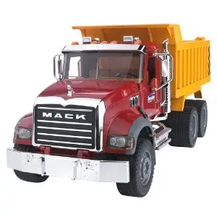

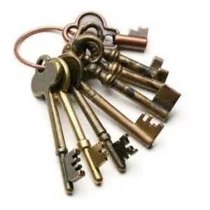

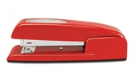
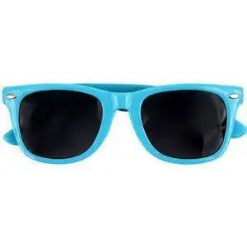
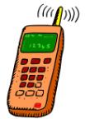
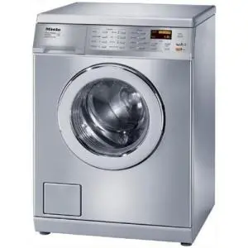
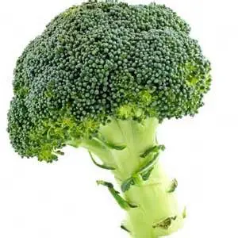
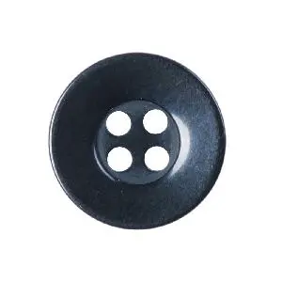
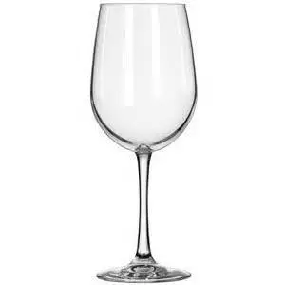
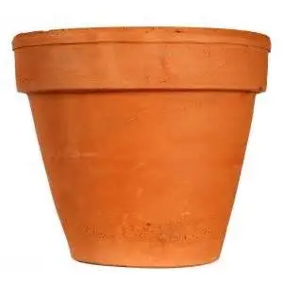

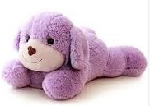
First – An exercise

Slide 4
Good News!
Your memory is more powerful than you think
Two things that we should be taught at school:
How to learn
How to remember
Your memory is like a muscle – you can train it
There are techniques for remembering
Notes:
Many people despair about their memory – I don’t have a good one.
A bit like walking – you are no good at the start!
Use it or lose it – brain training staves off dementia

Slide 5
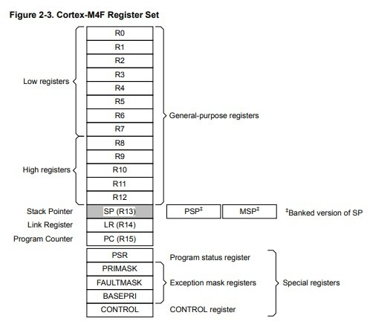
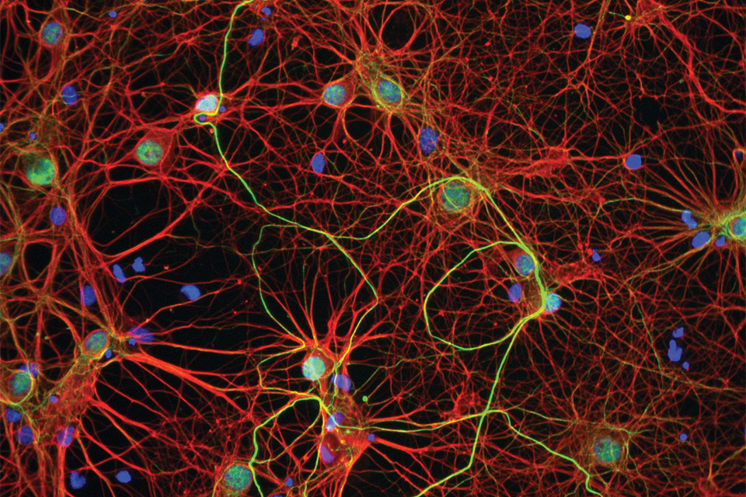
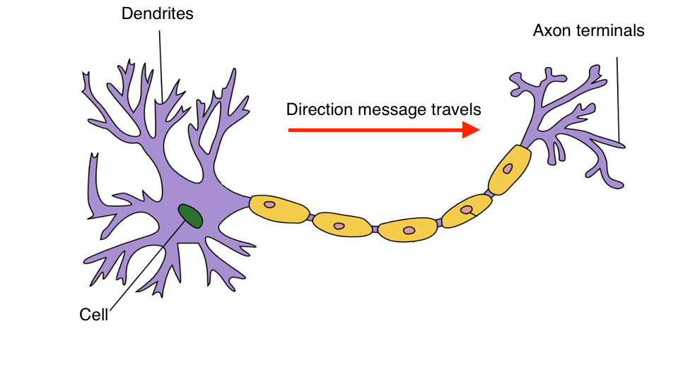
About Memory
Computer memory
Sequential
Very robust
Human memory
Transistors vs neurons
Notes:
Computer memory – address based
Human memory – content based

Slide 6
About Memory
100 billion neurons in your head
Up to 10,000 connections between neurons
Estimated 100 Trillion(!) synapses in your brain
There is a lot of capacity there!
How do you use it?
Working memory 5 +/- 3 ‘bits’ of information
Notes:
use 20% of brain is rubbish

Slide 7
You Can Exercise Your Memory!
Hannibal
Memory Palace (Matteo Ricci)
Simonides
Tony Buzan – books about memory
Dominic O’Brien – world champion
Derren Brown memorizing cards

Slide 8
Techniques
Mnemonic – “memory device” (knuckles for months, Mother visits every Monday, JSUN)
Story
Journey (loci)
Roman Room
Link
Pegs – sounds & shapes, alphabet
Body
Major System
Dominic System
Memory Palace

Slide 9
Principles 1
Framework that you either know or can figure out
Framework gives you ‘hooks’
Hang memories on to hooks by linking an image to the hook
Use tactics to make images more memorable

Slide 10
Principles 2
Synesthesia / sensuality | sight, sound, touch, taste, smell
Movement | running, jumping, vibrating, rolling
Association | “it reminds me of...”
Sexuality | this always sticks in the memory
Humour | silly things stand out
Imagination | be creative
Numbers | sequences & order
Symbolism | link abstract pattern with the memory
Colour | can use multiple colours
Order | sequences (as in peg system)
Positivity | we remember +ve, don’t remember -ve
Exaggeration | very big / small, over the top

Slide 11
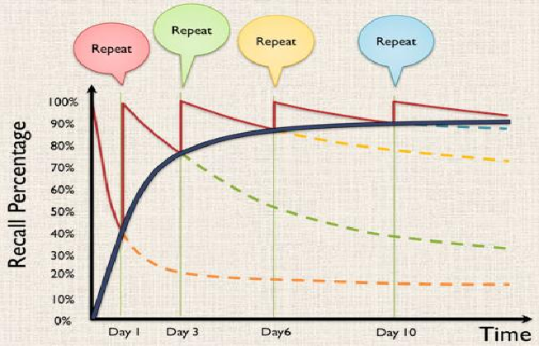
Making Memories Stick
Spaced Repetition

Slide 12
Remembering random items
Link Method (item 1, item 2, item 3, …)
Create an image that involves item 1 & item 2
Create an image that involves item 2 & item 3
…
For example: duck, scissors, hat, wheel:
A duck using it’s feet to hold some scissors, to give another duck a hair cut
A hat that must be placed very carefully on the head, as it is made of lot’s of pairs of scissors
A car with sombrero hats instead of wheels
...

Slide 13



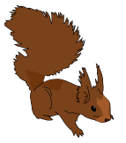



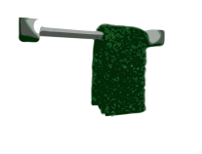
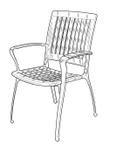
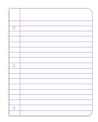


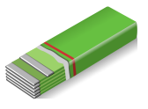


Exercise 2

Slide 14
Remembering a list of items
Link method
Number shapes:
Soldier
Swan
boobs
Yacht
Snake
Cherry
Walking stick
lady
Balloon
Bat & ball
Number sounds:
Bun
Shoe
Tree
Door
(bee)Hive
Sticks
Heaven
Gate
Wine
Pen

Slide 15
Putting Things On Your Body
Head
Left hand
Right Hand
Left Foot
Right Foot
Around your neck
Around your waist

Slide 16
Roman Room
Image your house (or any house that you know well)
Each room has a number of features
Each feature can be a hook
e.g. living room: sofa, lamp, TV, comfy chair kitchen: table, stove, fridge, work surface, … bedroom: bed, mirror, cupboards, drawers, ...

Slide 17
Story
Commonly mentioned as ‘the memory technique’
Create a story that contains the elements that you want to remember (using the memory principals)
Doesn’t really come with a ‘framwork of hooks’ – you have to remember the story!

Slide 18
Mnemonics
A creative way of linking things
Daylight savings | Spring forward, Fall back
Days in a month | 30 days have September, April, June, and November, all the rest have 31, except February, with 28 days clear and 29 each leap year.
Screwdriver | Righty tighty, lefty loosey
Taxonomy | Do Kids Prefer Cheese Over Fried Green Spinach
Spell Diarrhoea | Dining In A Rolls Royce Having Over Eaten Again
Digits of pi | How I wish I could calculate pi
Silent vowels | When two vowels go walking the first does the talking
Order of i & e | I before E, except after C

Slide 19
Journey
Imagine a route that you know well
e.g. from your house to the shops
Place items to remember at interesting points along the journey
When you want to recall, take the journey

Slide 20
Exercise 3
Milk
Bread
Beer
Deodorant
Crisps
Lottery ticket
Flowers
Butter
Honey
Flour
Tomatoes
Apples
Beans
Bleach
String

Slide 21
Major System
Very robust framework
Converts numbers into words, and vice versa
0
1
2
3
4
5
6
7
8
9

Slide 22
Remembering vast amounts – Major System 2
0 | 10 | 20 | 30 | 40
nothing | Fire | Water | Wind | Earth
1 | Bun
2 | Shoe
3 | Tree
4 | Door
5 | (bee)hive
6 | Ricks (& Mortys!)
7 | Heaven
8 | Gate
9 | Wine
10 | Pen

Slide 23
Dominic System
Link method

Slide 24
Memory Palace
Description of a memory palace….

Slide 25
Remembering Names
As soon as you find out the persons name, try to use it multiple times: ”Hi John, nice to meet you”, instead of “Nice to meet you”.
Try to make a link to their name if you can – e.g. Mike → Microphone, Dan → trying to hold back a river
Give them a nickname (in your mind!)
Link them to someone else you know with the same name, or to a celebrity
Create a framework. David is always a Star, Kate is always a princess
If you forget…
Just ask them! You probably won’t forget after that!
or ask someone else

