Slide 1
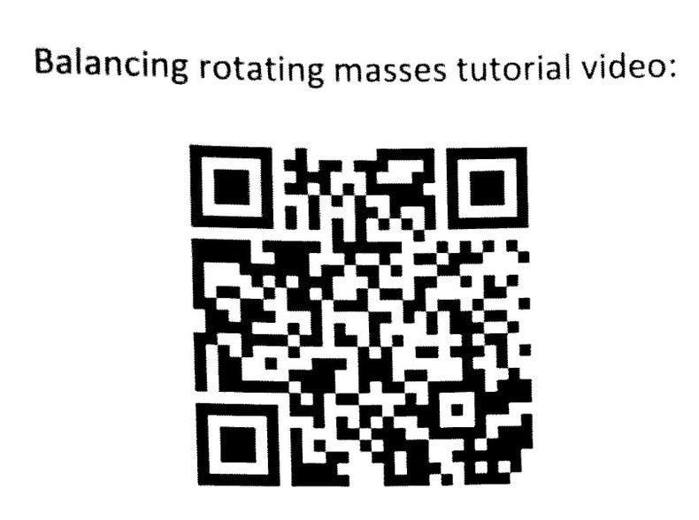
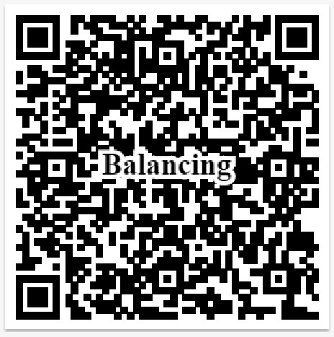
What is this project about?
https://www.youtube.com/watch?v=a8r1d5lX5M0&feature=emb_title
You may take a quick look the actual equipment in our lab.
https://smartmatertech.weebly.com/static-and-dynamic-balancing.html

Slide 2
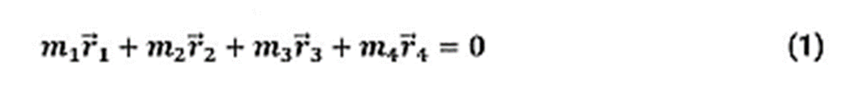
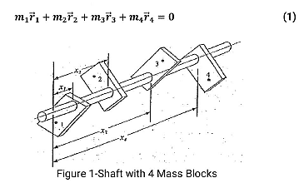
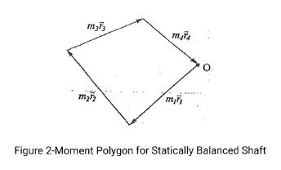

Slide 3

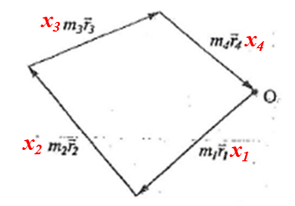

ω²( )

Slide 4
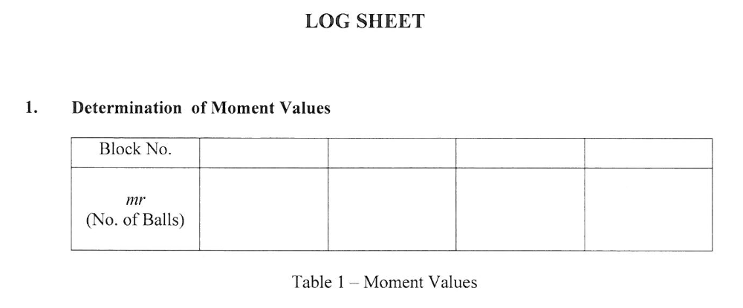
Four (mr)s will be provided

Slide 5
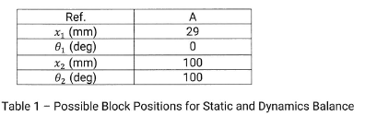
m₃r₃
m₄r₄
θ₃
θ₄

Slide 6
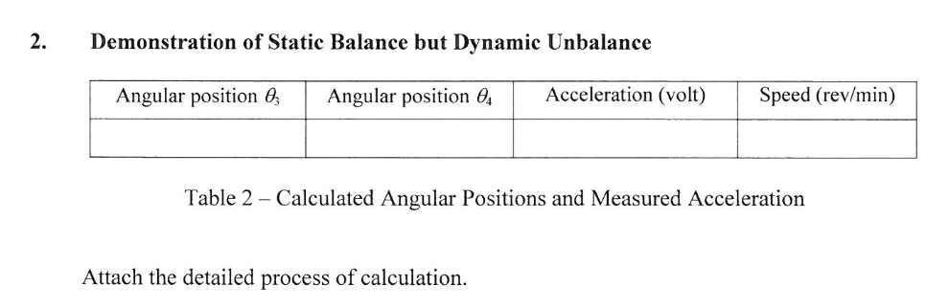
Graphic method

Slide 7
x₃m₃r₃
x₄m₄r₄
θ₃₌
θ₄₌
x₂m₂r₂
θ₁₌₀
x₁m₁r₁
θ₂₌₁₀₀

Slide 8
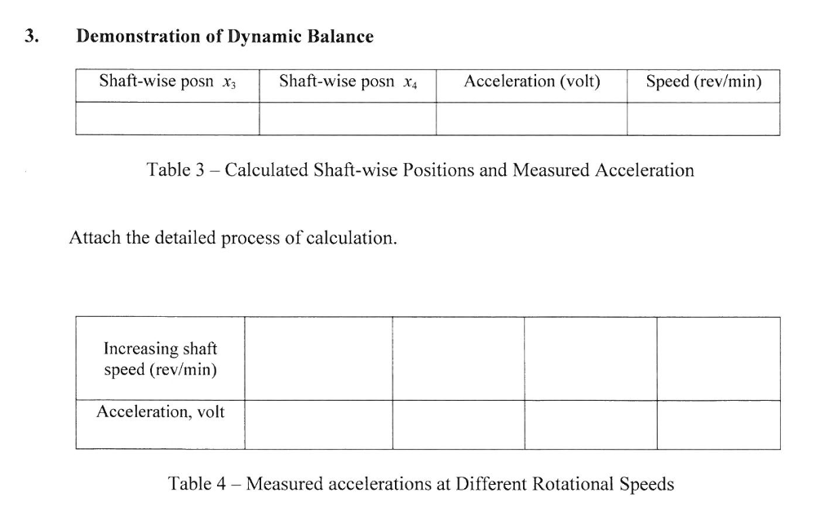
Graphic method

Slide 9
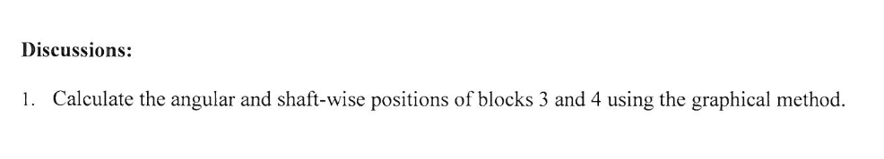

Slide 10
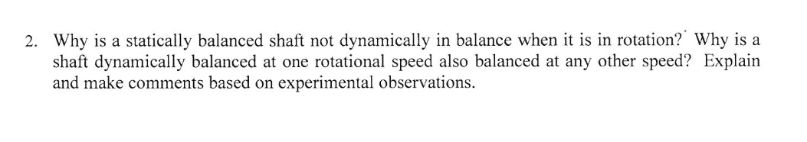
3.......pls answer

