Slide 4
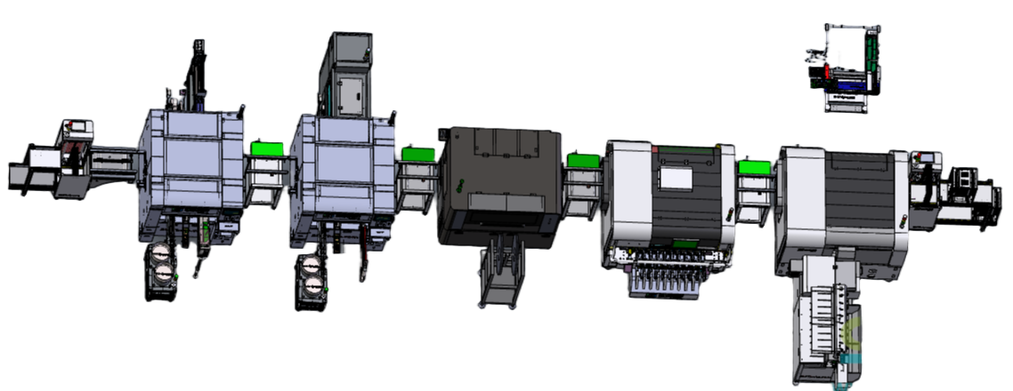
Your Trusted Partner for SMT & THT Solutions
Founded in Shenzhen in 2011, Southern Machinery specializes in designing and manufacturing advanced SMT/THT machinery for PCB assembly automation. Our precision-engineered equipment delivers cost-effective, high-efficiency solutions for both high-speed mass production and delicate small-batch manufacturing, ensuring durability and user-friendly operation.
Leveraging Shenzhen’s electronics manufacturing expertise, we provide not just top-tier machinery but also industry-leading knowledge and best practices to global clients.
Explore our solutions at www.smthelp.com, follow our innovations on:
- [LinkedIn Company Page](https://www.linkedin.com/company/smtmachine)
- [LinkedIn Profile](https://cn.linkedin.com/in/smtsupplier)
- [Twitter](https://twitter.com/smtspecialist)
- [Facebook](https://www.facebook.com/autoinsertion)
- [YouTube Channel](https://www.youtube.com/c/Smthelping)
- Browse our machine catalog at (https://file.autoinsertion.com)
- Find machine photos at (https://ph.smthelp.com)
Shaping the Future of Electronics Manufacturing.

