Slide 1






April 2025
User Guide Code Active Learning
Clara Guilhaumon,
PhD Director: Francisco Chinesta
PhD Supervisors: Nicolas Hascoët and Marc Lavarde
PIMM, Arts et Métiers Institute of Technology, Paris, France UPR EBINNOV, Ecole de Biologie Industrielle, Cergy, France

Slide 2
Content
Introduction
Prerequire
Code structure
Context
Active Learning
Our Method
Illustration
Groups Option
Input Selection
Output Selection
API Main Function
Example Request
Code Output
Contribuiting
Scientific Contribution - Publications
Notes:
Pour cela on va commencer par un tour de l’état de l’art sur sur les données

Slide 3
Introduction
Welcome to the user guide for Active Learning for High Dimensional Regression Code.
This code is designed to help you to select efficiently samples to create your training database for a regression model in high dimensions. It allows users to apply an active learning methodology that build the training data base iteratively along side with the model. The samples are selected with a criterion based on the Fisher Information and for an s-PGD regression model.

Slide 4
Prerequise
Before you can use this code, you need to have the following installed on your system:
Python version: [e.g., Python 3.9.7 or higher]
Required libraries:
numpy, pandas, pyDOE2, scipy including scipy.interpolate and scipy.stats, scikit-optimize and swifter
All can be found within the requirement.txt file
To install the dependencies from this file, simply run: pip install -r requirements.txt
Notes:
Pour donner un peu de contexte

Slide 5
Code Structure
/ActiveLearning_HighDimensional_Regression_Code
│
│
├── src/ # Source code files
│ ├── main.py # Main script to run the code
│ ├── model.py # Model-related functionality
│ └── utils.py # Utility functions
│
├── requirements.txt # List of dependencies
└── User_guide_activelearning.pptx # This file
Notes:
Pour donner un peu de contexte

Slide 6
Context
This guide addresses regression problems where the goal is to predict a continuous one-dimensional output Y from input features X₁, ..., Xₙ using machine learning. Training a model requires labelled samples (input-output pairs), but collecting labels (Y) can be costly. While more data generally improves performance, efficient sample selection is essential.
Thus, we introduce here an active learning strategy that automatically selects the most informative samples to label, enabling the construction of an optimized training set with minimal cost.
Notes:
Pour donner un peu de contexte

Slide 7




Active Learning
Active Learning is an iterative process where the database is build alongside with the model. It lays on the assumption that if at each step the most informative/interresting sample is added to the training data base of the model then the global performances of the model will increase faster.
General Active Learning Framework
INITIALIZATION
RUN
FINAL MODEL
Training data base :
Small DOE
Phase 1: Training
Learner = trained model on
Phase 2: Prediction
Prediction on
→ y_{pred} + info criterion
Phase 3: Adding point
Adding best point to
Model trained on few points with good global performances
$$X_{training} y_{training}$$
$$X_{pool}$$
$$X_{training} y_{training}$$
$$X_{training} y_{training}$$
Pool :
$$X_{pool}$$
Notes:
Pour donner un peu de contexte

Slide 8
Our Method
Initialization Phase
The process begins by creating a D-dimensional uniform grid of candidate samples ("pool") to explore the input space. An initial training dataset is then generated using a space-filling design, such as a Halton or Hammersley sequence, to ensure broad coverage of the parameter space, and an initial main surrogate model is trained on this data. Additionally, a separate dataset is prepared to train a criterion model, which evaluates the informativeness of candidate samples.
Iterative Training and Selection
In each iteration, the criterion model identifies the most valuable samples from the pool, i.e. those expected to maximize learning efficiency. These sample are added to the main training set. Both the surrogate model and the criterion model are updated with the newly labeled data, refining their predictions and improving the selection process in subsequent iterations.
This loop continues until the desired number of iterations is reached.
Notes:
Pour donner un peu de contexte

Slide 9
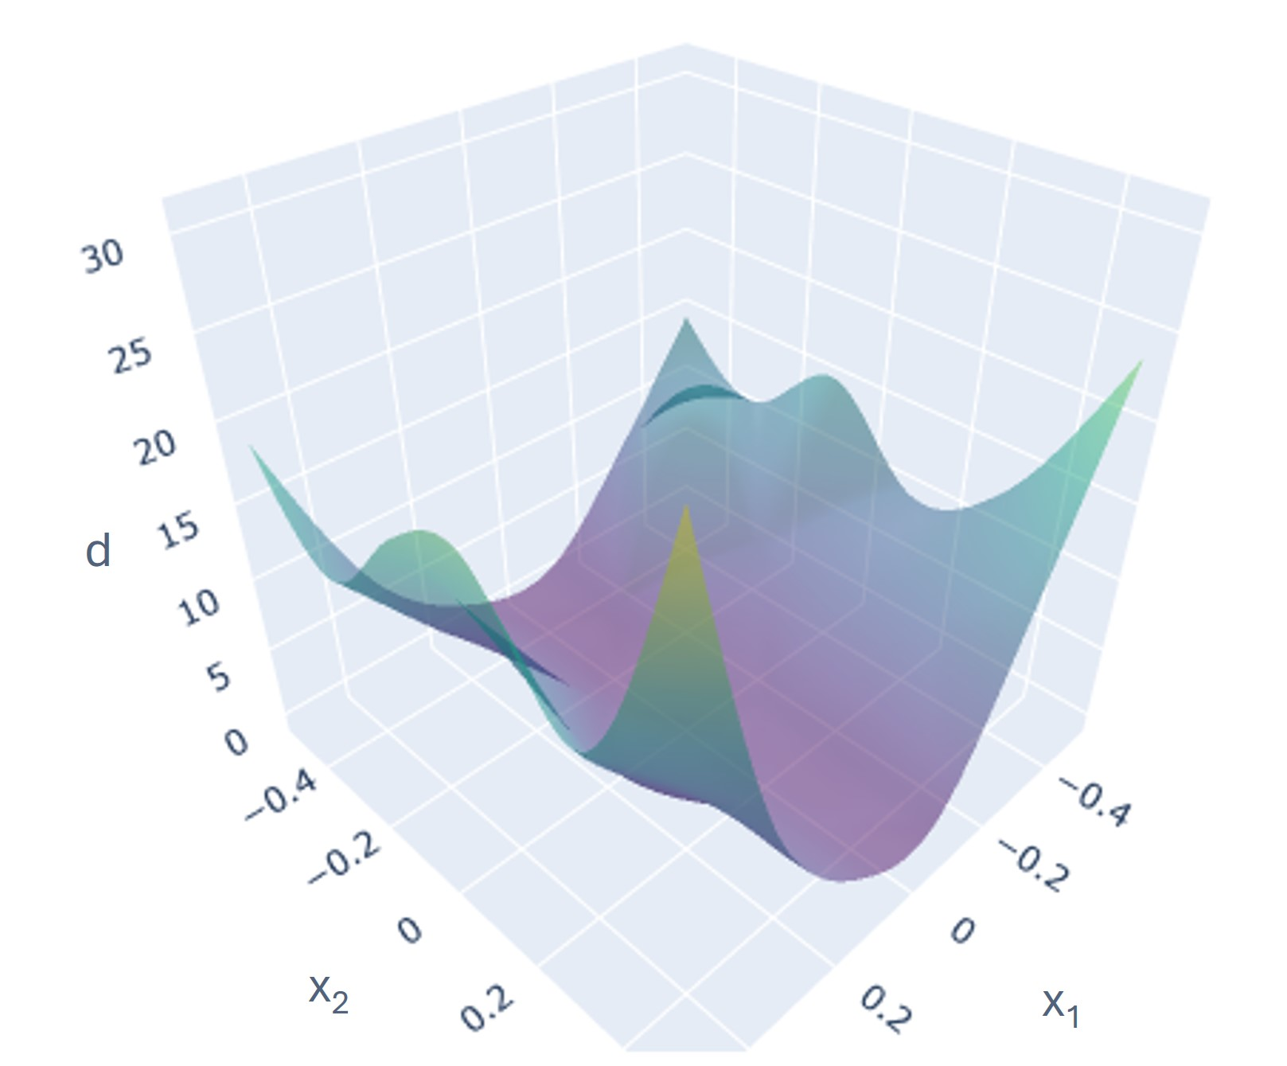
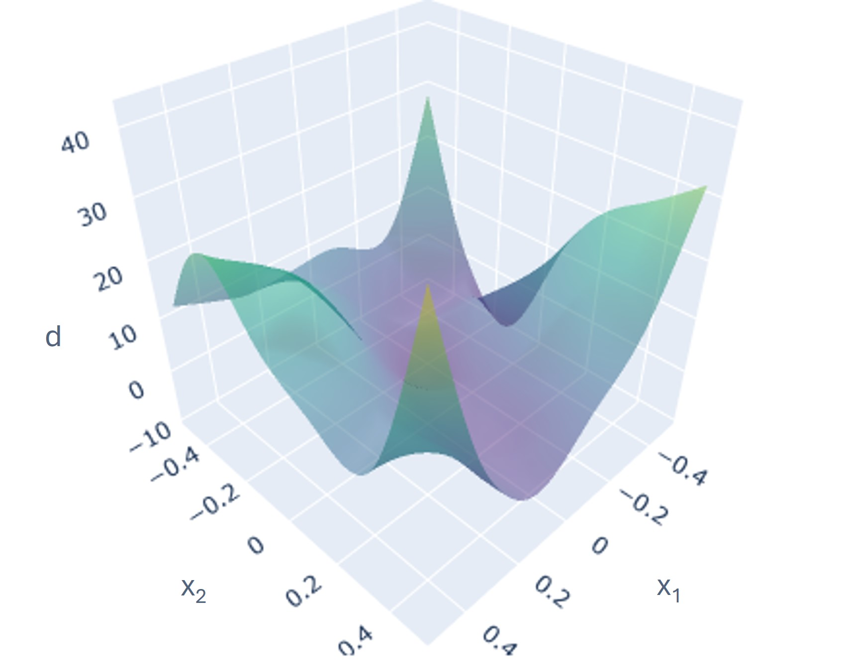

Illustration
The process starts with an Halton or Hammersly Design
A function of the criterion $d(x_{1},x_{2})$ is defined
A surrogate of the criterion is made from a big LHS
The maximum value is selected and the sample is added as training
x₂
x₁
x₂
x₁

Slide 10
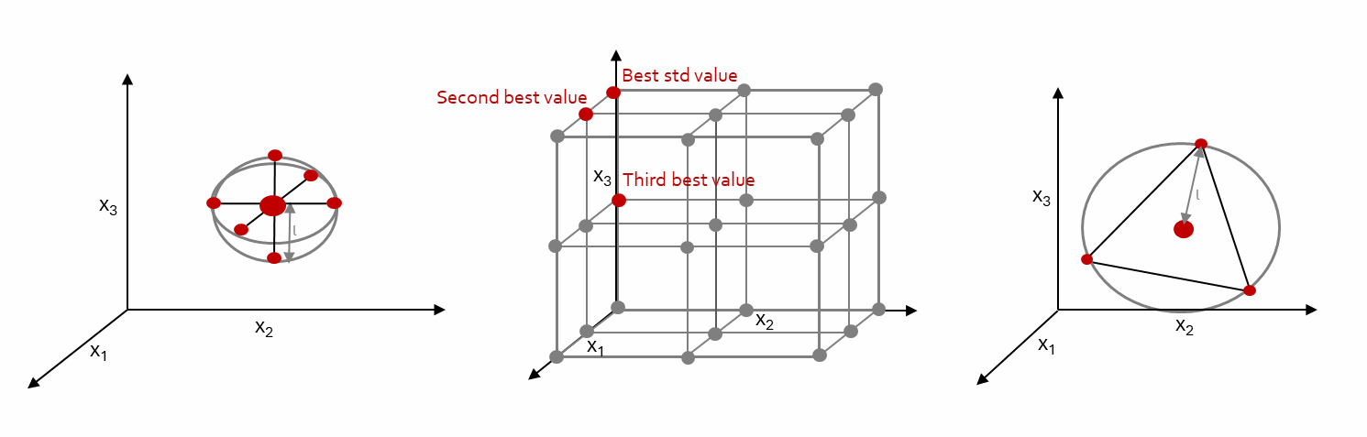
Groups Option
The samples can be added one by one to the database thus the sample from the pool with the highest criterion value is selected and added. But adding group of samples at each step can be considered (especially for experimental data where the iterative aspect may be restrictive).
Two options for groups can be considered:
Cross Method
Simplex Method
Both give good results. The choice should be made according to the cost as the Cross Method implies to add D*2+1 samples and the Simplex Method D+1 samples.

Slide 11
Inputs Selection
Main Function Parameters
spgd_params (dict): Configuration parameters for the SPGD model, including the number of basis functions (nFun), number of modes (nModes), and number of active dimensions (activeDim). The active dimension should be settled equal to input_dim.
initial_sample_size (int): Number of initial training samples. Should be settled at least once input_dim but not too much according to the computational cost.
num_queries (int): Number of active learning steps.
criterion_sample_size (int): Number of samples used to train the criterion model. Should be settled to be smaller than the grid size (grid_subdivision^input_dim) but enough to have a correct model of the criterion.
input_dim (int): Dimensionality of the input space.
grid_subdivision (int): Grid resolution for generating the pool of samples. Should be settle to have a grid refined enough but not to big to compute.
Notes:
Pour donner un peu de contexte

Slide 12
Inputs Selection
Main Function Parameters
selection_strategy (str): Selection strategy used to select query points. Valid options are 'one', 'cross', and 'simplex’.
'one' -> add a single sample with the best criterion,
'cross' -> add a group of (2*D + 1) samples in a cross shape,
'simplex' -> add a group of (D + 1) sampless forming a simplex.
The choice should be made according to the cost as the ‘cross’ implies to generate lot of samples the ‘simplex’ an intermediate amount.
sampling_method (str): Sampling method for generating the initial training dataset. Valid options are 'halton' and 'hammersly’. Both perform similarly and can be chosen.
Notes:
Pour donner un peu de contexte

Slide 13
Output Selection
Function Parameters
The utils.py file contains a key function that generates numerical outputs based on the problem's requirements. Currently, this function serves as a placeholder with two possible implementations: either a 5-dimensional polynomial function for demonstration purposes, or a commented-out stub for interfacing with external crash simulation software.
To adapt this for practical use, users must modify the function with their own output function or computational model. The modified implementation must preserve the expected return structure, typically an array or scalar value, while producing results that accurately represent the target system's behavior.
Notes:
Pour donner un peu de contexte

Slide 14
API Main Function
Main Function Details : active_learning()
This function implements the core of the active learning process, performing the following steps:
Creates a D-dimensional uniform grid of points ("pool") as candidate data points.
Generates an initial training dataset using either a Halton or Hammersley sequence, and trains an initial surrogate model (learner_model).
Generates a dataset to train a model of the criterion (criterion_model).
Iteratively selects new points to add to the training set using the criterion model and updates both models.
Evaluates the performance of the surrogate model using R² scores.
Steps:
Configuration and User Input:
Parameters such as the number of basis functions, modes, active dimensions, and others are entered by the user.
Initial Training Set:
The script generates the initial training set using either Halton or Hammersley sequences and adds them to the pool grid.
Surrogate Model and Criterion Model:
The surrogate model is initialized and trained using the training data.
A criterion model is trained based on the initial training set and is used to select new points for training.
Active Learning Loop:
The script iteratively queries new points from the pool based on the criterion model and updates both the surrogate and criterion models.
R² scores are computed after each query to assess the performance of the surrogate model.
Output:
The R² scores at each step are written to a CSV file (results.csv).
Notes:
Pour donner un peu de contexte

Slide 15
Example Request
Enter number of basis functions (e.g., 6): 6
Enter number of modes (e.g., 1): 1
Enter number of active dimensions (e.g., 5): 5
Enter number of initial training samples (e.g., 20): 20
Enter number of active learning steps (e.g., 20): 20
Enter number of samples to train criterion sub-model (e.g., 5000): 5000
Enter dimensionality of the input space (e.g., 5): 5
Enter number of grid subdivisions per dimension (e.g., 15): 15
Enter selection strategy ('one', 'cross' or 'simplex’): one
Choose initialization method ('halton' or 'hammersly'): halton
Notes:
Pour donner un peu de contexte

Slide 16
Code Output
The output of the active learning process will be a CSV file (results.csv) containing R² scores at each active learning step, which reflects the performance of the surrogate model. This can be modified to export any performance value you want, the training data base at each step or the final trained model.
Example Output (results.csv): R2_scores
26, 0.3398026509818336
27, 0.4750155352920788
28, 0.4140424852261031
29, 0.43570701479027079
30, 0.5126325894649711
31, 0.52360390803747635
32, 0.6719027620884938
33, 0.6740119281859347
34, 0.6744063340410916
35, 0.6746721364322958
36, 0.6753737878319062
37, 0.6756706684227425
38, 0.6765939538911804
39, 0.6803178873798588
40, 0.684667683834036
41, 0.6861519220569036
42, 0.6865072728198927
43, 0.6871602953652234
44, 0.6877636566490258
45, 0.6885779549550161
Notes:
Pour donner un peu de contexte

Slide 17

Contributing
We welcome contributions to Active Learning for High Dimensional Regression Code !
Please find the file at: https://github.com/smtr91/ActiveLearning_HighDimensional_Regression_Code
To contribute:
Fork the repository
Create a new branch (git checkout -b feature/your-feature)
Make your changes, Commit your changes (git commit -am 'Add new feature’)
Push to your forked repository (git push origin feature/your-feature)
Create a pull request from your fork to the main repository.
Notes:
Pour donner un peu de contexte

Slide 18
Thanks for your utilisation
Any questions ?
Clara Guilhaumon,
Art et Metiers, PIMM Laboratory, Paris
School of Industrial Biology (EBI), Cergy
clara.guilhaumon@ensam.eu

Slide 19
Scientific contributions - Publications
For more details on the Active Learning for High Dimensional Regression methodologies used in the code.
Publications
C. Guilhaumon, N. Hascoet, F. Chinesta, M. Lavarde, F. Daim. Data Augmentation for Regression Machine Learning Problems in High Dimensions. Computation, 2023. Article with explanations on the high dimensional active learning criterion used and the methodology.
C. Guilhaumon, N. Hascoet, F. Chinesta, M. Lavarde, F. Daim. Optimized Active Learning Methodology for High Dimensional Regression Problems. JAIR, 2025. Article with explanations on the choice of the initialisation (halton and hammersly) and scenario (use of the surrogate of a criterion) giving rise to an optimised version of active learning for high dimensional regression problem methodolgy.

