Slide 1



dashboard
View in Power BI
Last data refresh:
5/3/2022 3:53:25 PM UTC
Downloaded at:
5/3/2022 3:54:19 PM UTC

Slide 2
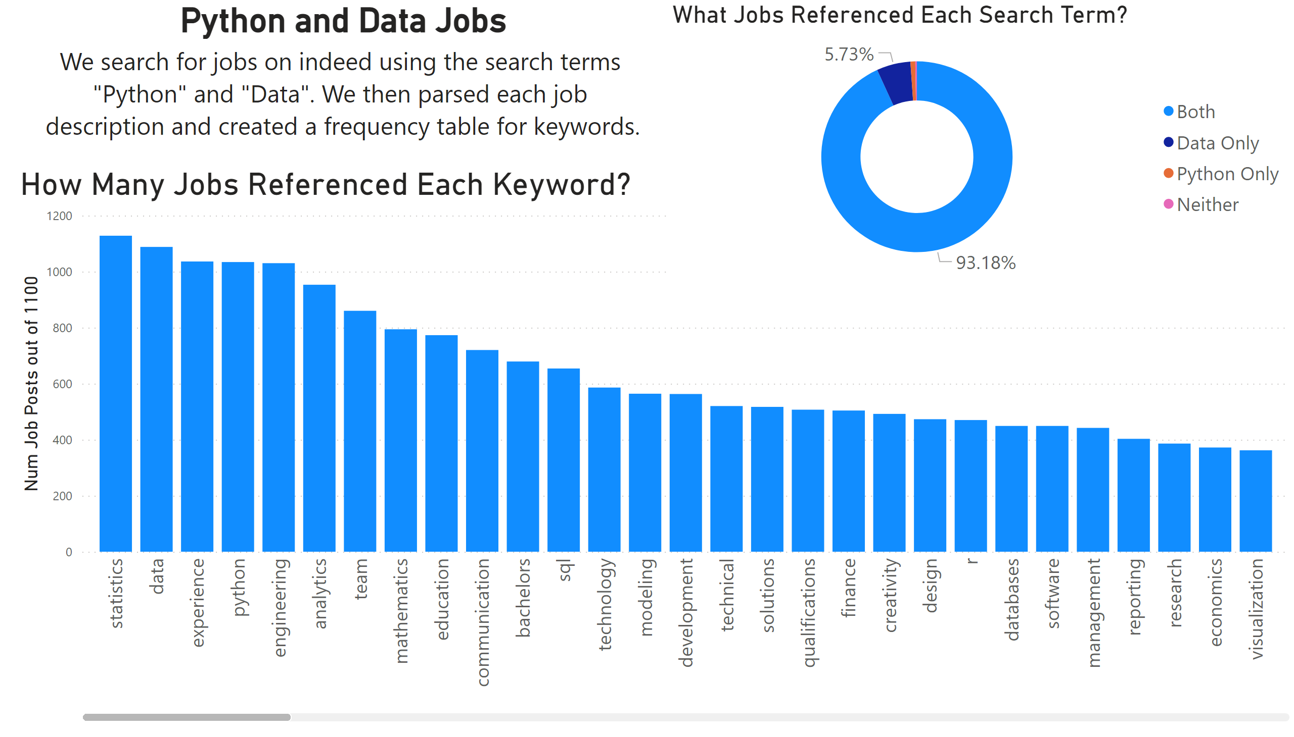
Front Page
Notes:
How Many Jobs Referenced Each Keyword?
No alt text provided
Python and Data Jobs
No alt text provided
What Jobs Referenced Each Search Term?
No alt text provided

Slide 3
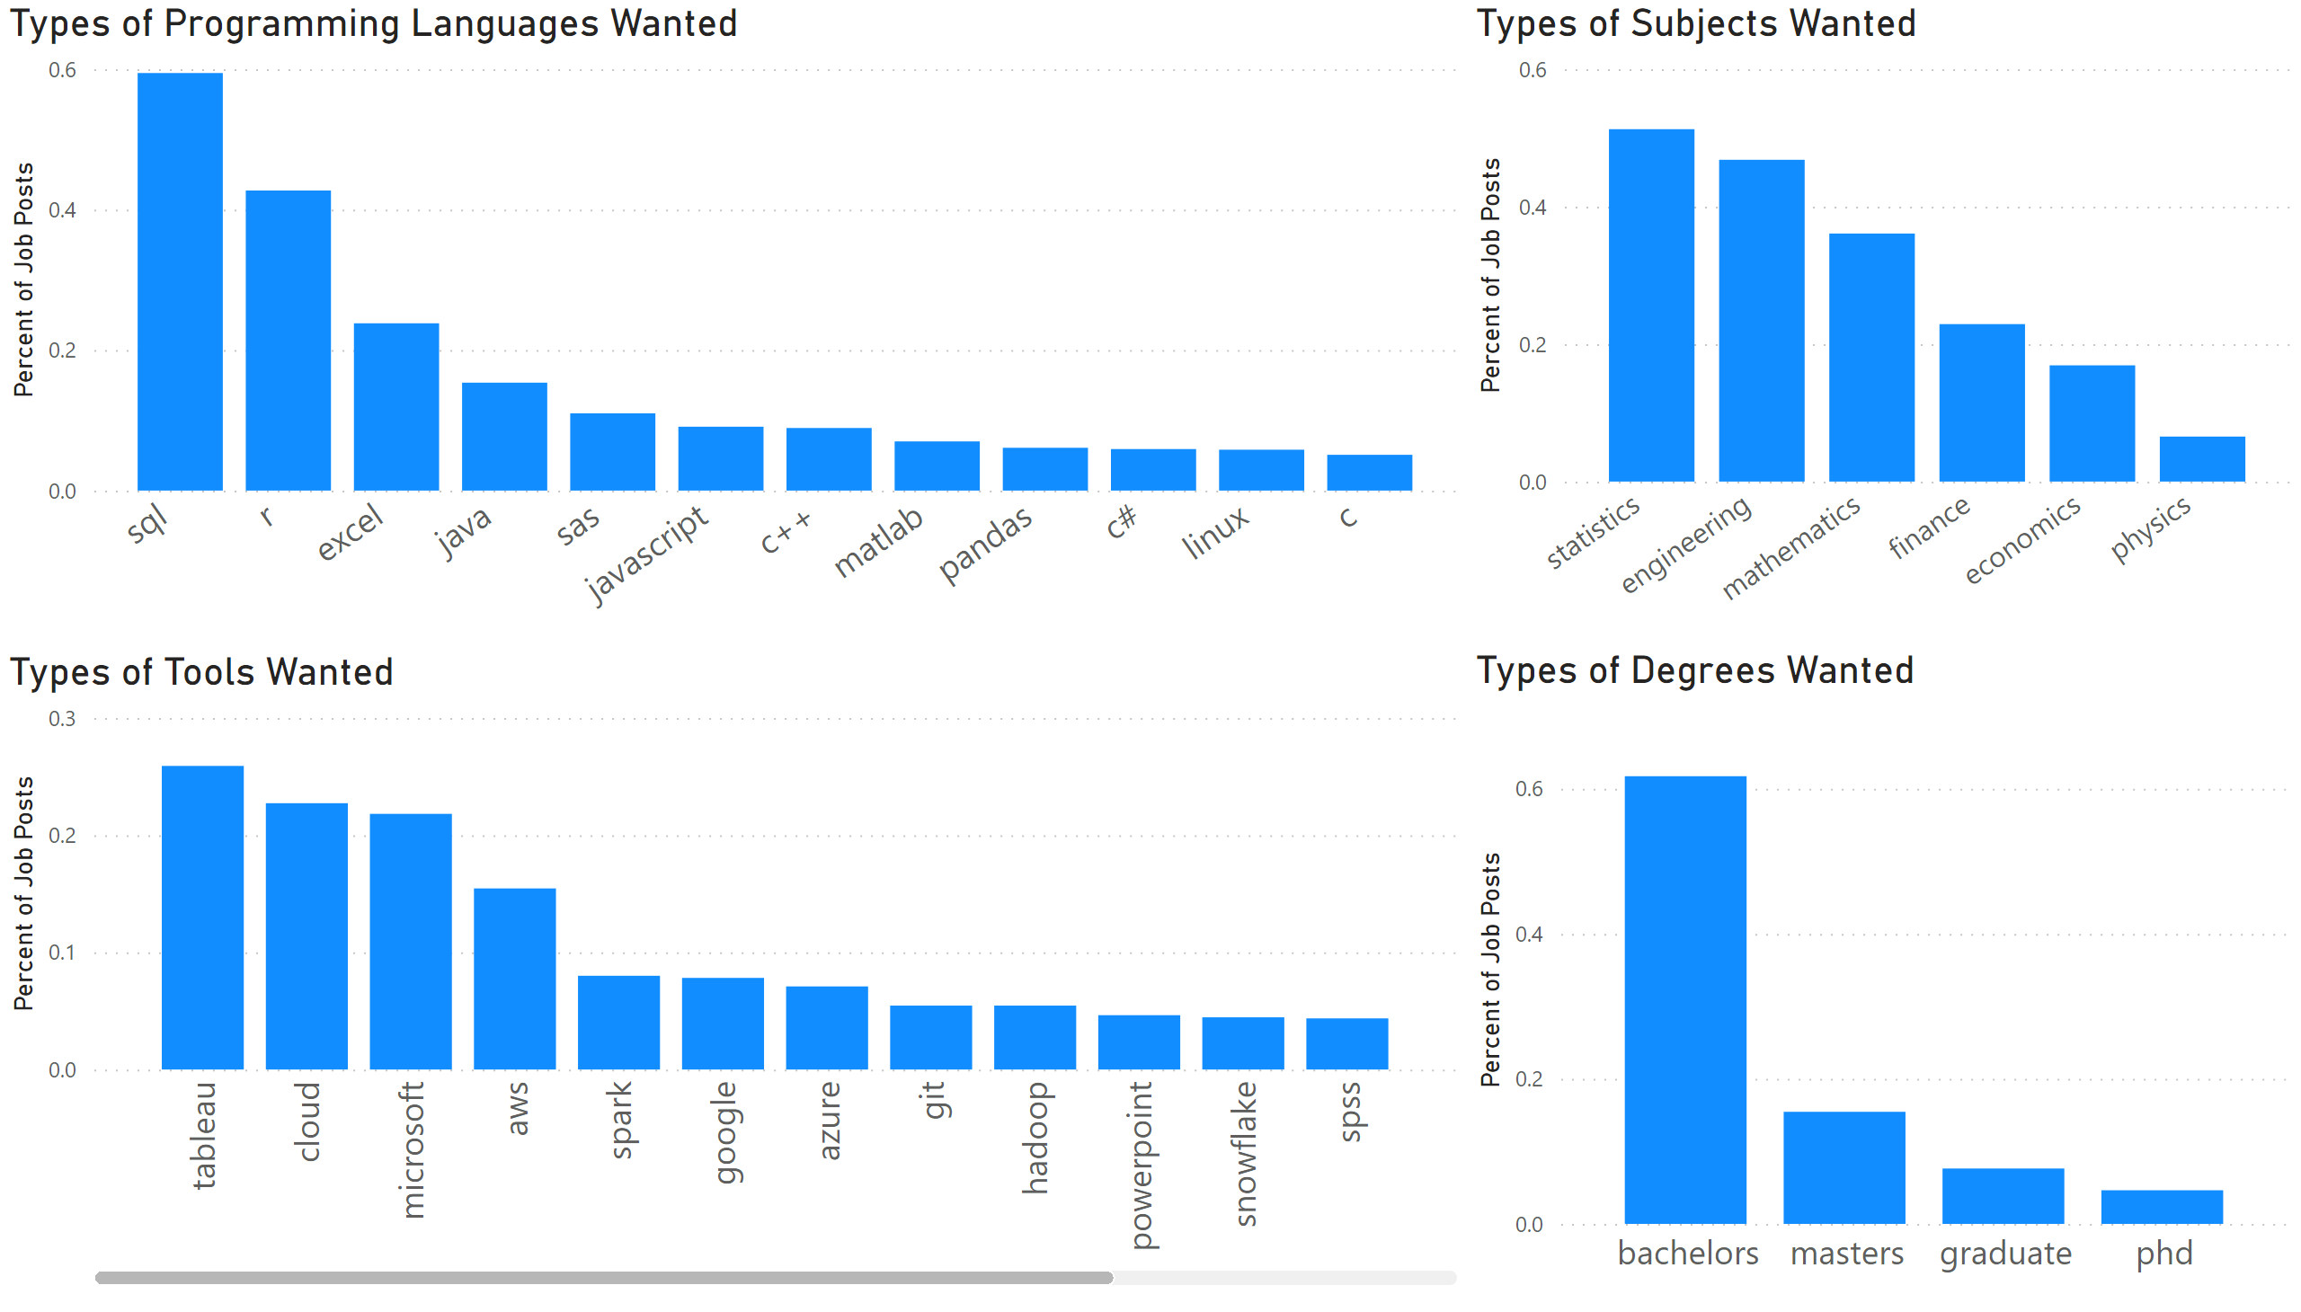
Experience
Notes:
Types of Degrees Wanted
No alt text provided
Types of Subjects Wanted
No alt text provided
Types of Programming Languages Wanted
No alt text provided
Types of Tools Wanted
No alt text provided

Slide 4
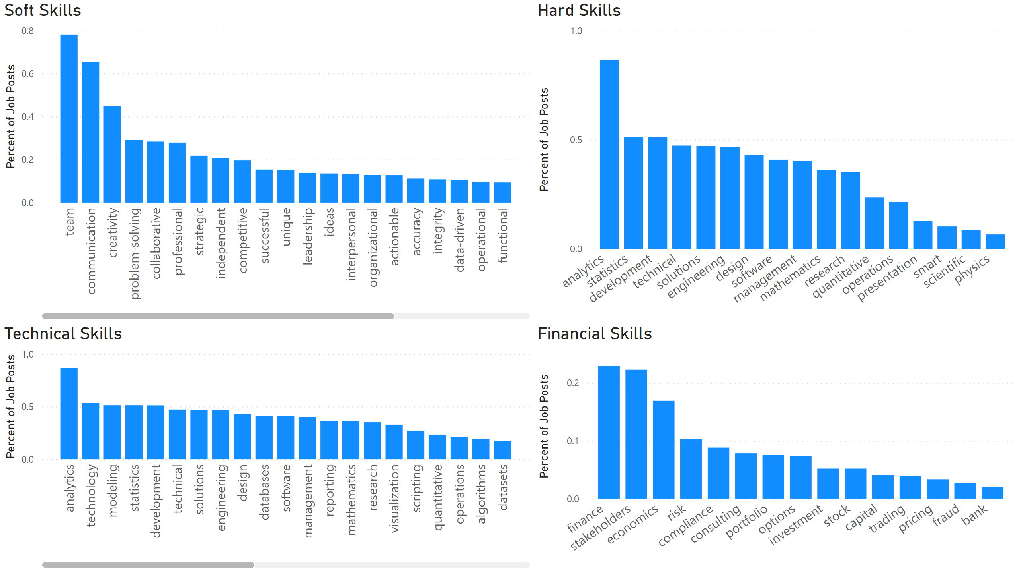
Skills
Notes:
Soft Skills
No alt text provided
Hard Skills
No alt text provided
Technical Skills
No alt text provided
Financial Skills
No alt text provided

Slide 5
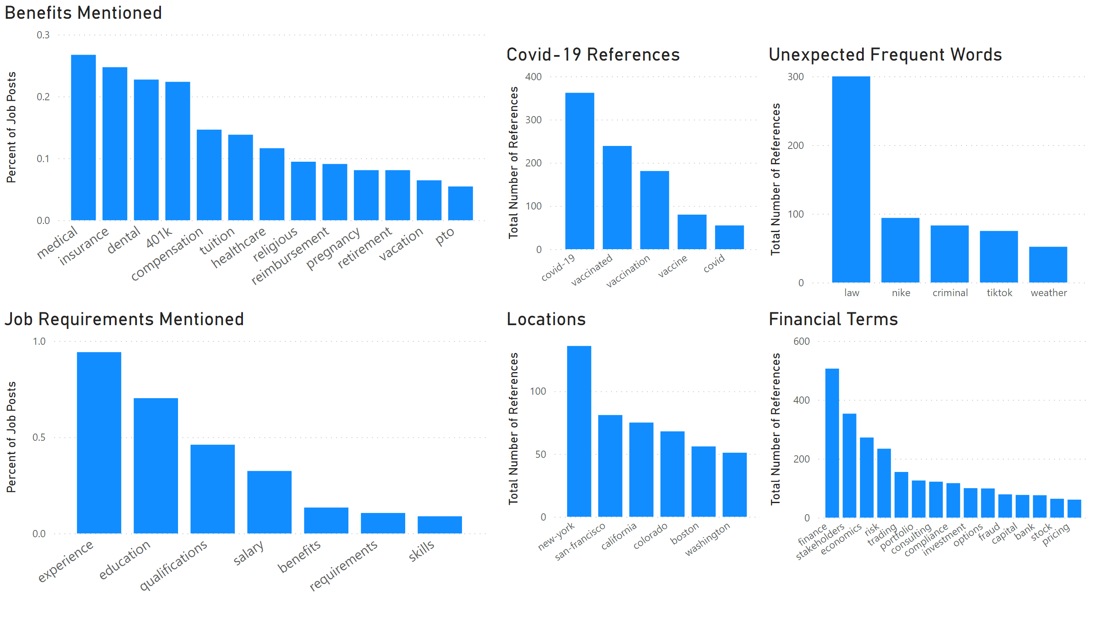
Job Desc
Notes:
Benefits Mentioned
No alt text provided
Job Requirements Mentioned
No alt text provided
Covid-19 References
No alt text provided
Unexpected Frequent Words
No alt text provided
Locations
No alt text provided
Financial Terms
No alt text provided

