Slide 1
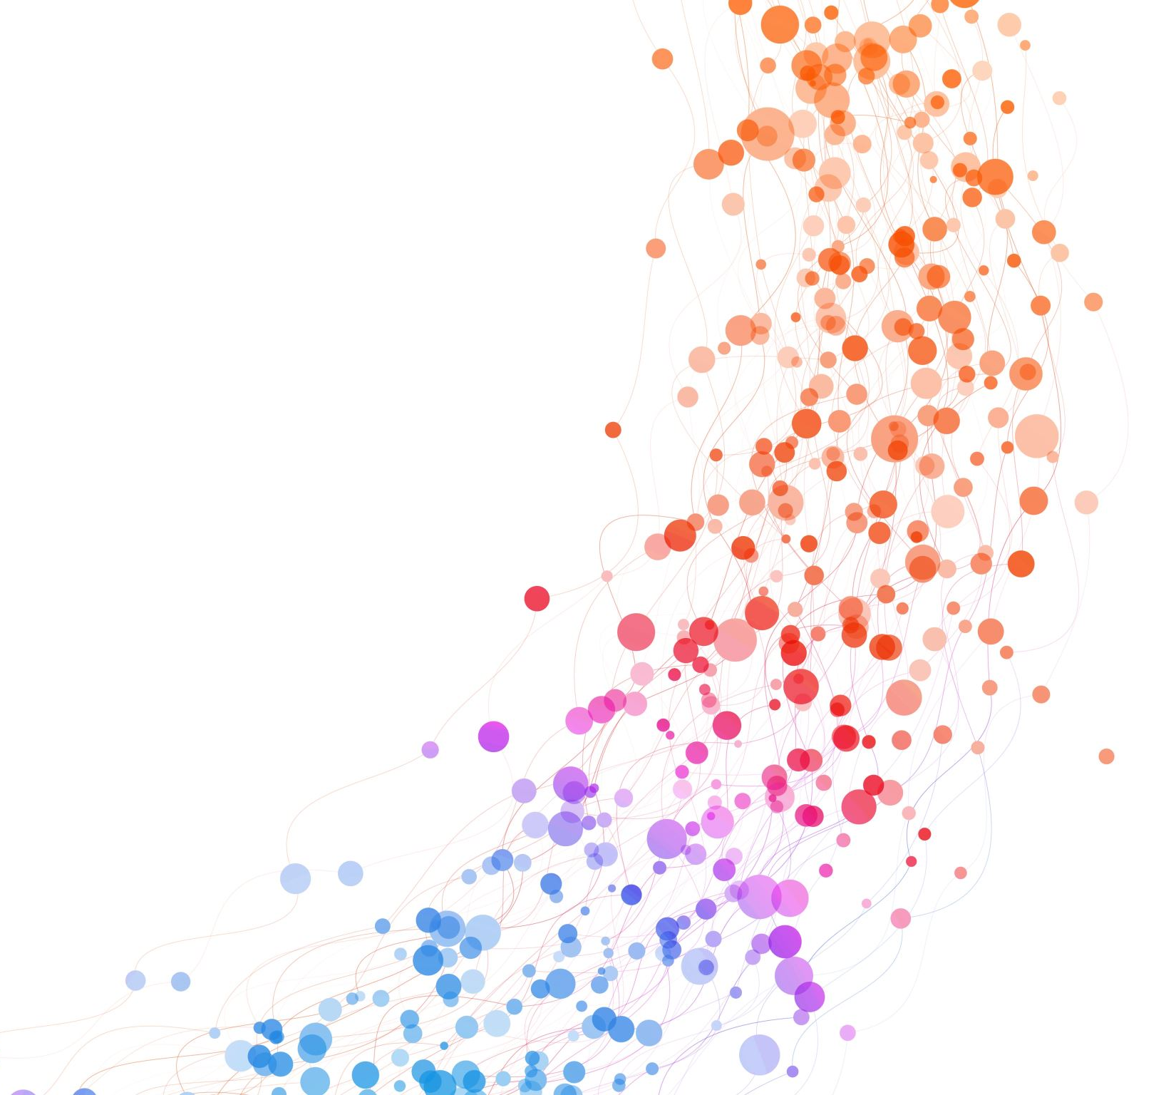

Engagement Results
Kyle Evans
DDS Analytics

Slide 2
The Client (You)
Frito-Lay (PepsiCo)
55,000 employees
30+ manufacturing facilities
29 snack brands

Slide 3
The Why
Can we predict attrition using business data?
Entry-level – up to 50% of Salary + Benefits
Technical/Leader – up to 250% of Salary + Benefits
Source: https://tinyurl.com/j34re8pu

Slide 4
Metrics
2 models
KNN
Naïve Bayes
Minimum 60% Specificity and Sensitivity

Slide 5
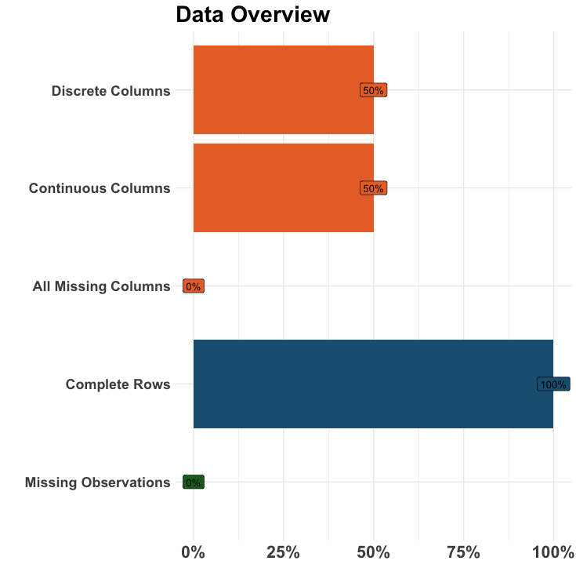
The Data
870 rows
36 columns
18 categorical
18 continuous
Zero missing data

Slide 6
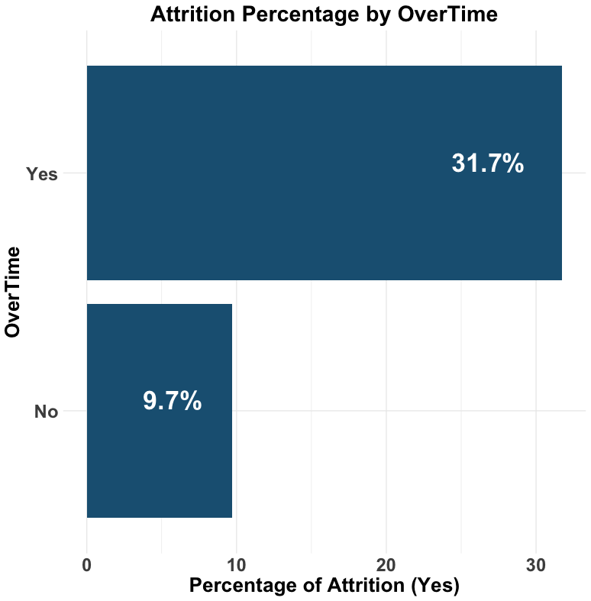
Predictor Candidate #1 Overtime
p-value < .00001, ChiSquared test

Slide 7
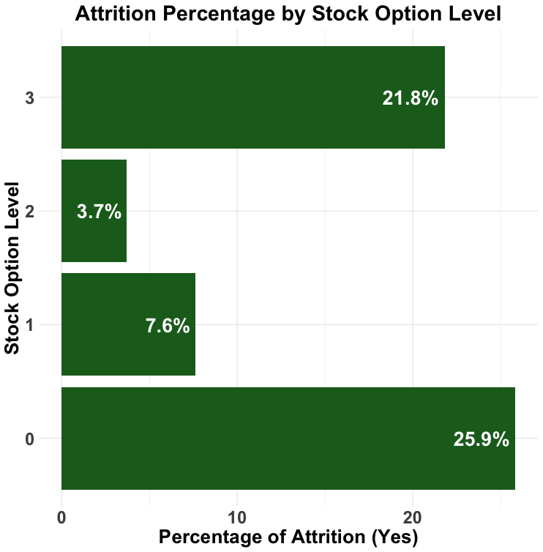
Predictor Candidate #2 Stock Option Level
p-value < .00001, ChiSquared test

Slide 8
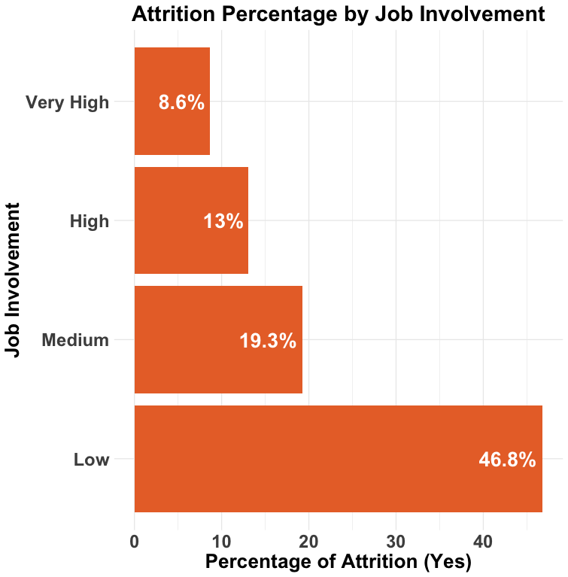
Predictor Candidate #3 Job Involvement
p-value < .00001, ChiSquared test

Slide 9
Predictors Summary
Overtime
Job Role
Age
Job Satisification
Job Involvement
Job Level
Marital Status
Stock Option Level
Work Life Balance
Department
Years With Current Manager
Monthly Income

Slide 10
Model Candidate #1 Max Accuracy Naïve Bayes
Features
Department
Job Involvement
Job Level
Over Time
Work Life Balance
Details
Sample - Up
Laplace - 5
Positive Class - Yes
Stock Option Level
Years with Current Manager
Kernel - True
Adjust - 1
Metric | Value
Accuracy | .81
Sensitivity | .77
Specificity | .82
ROC | .82

Slide 11
Model Candidate #2 Max Sensitivity Naïve Bayes
Features
Details
UP
Laplace 3
Positive Class - Yes
Age
Job Involvement
Job Role
Job Satisfaction
Monthly Income
Over Time
Stock Option Level
Work Life Balance
Kernel
Adjust 3
Metric | Value
Accuracy | .76
Sensitivity | .83
Specificity | .75
ROC | .82

Slide 12
Next Steps
Deployment
Refinement
Enhancements

Slide 13
Kyle Evans
DDS Analytics
kyleevans@smu.edu

