Slide 1
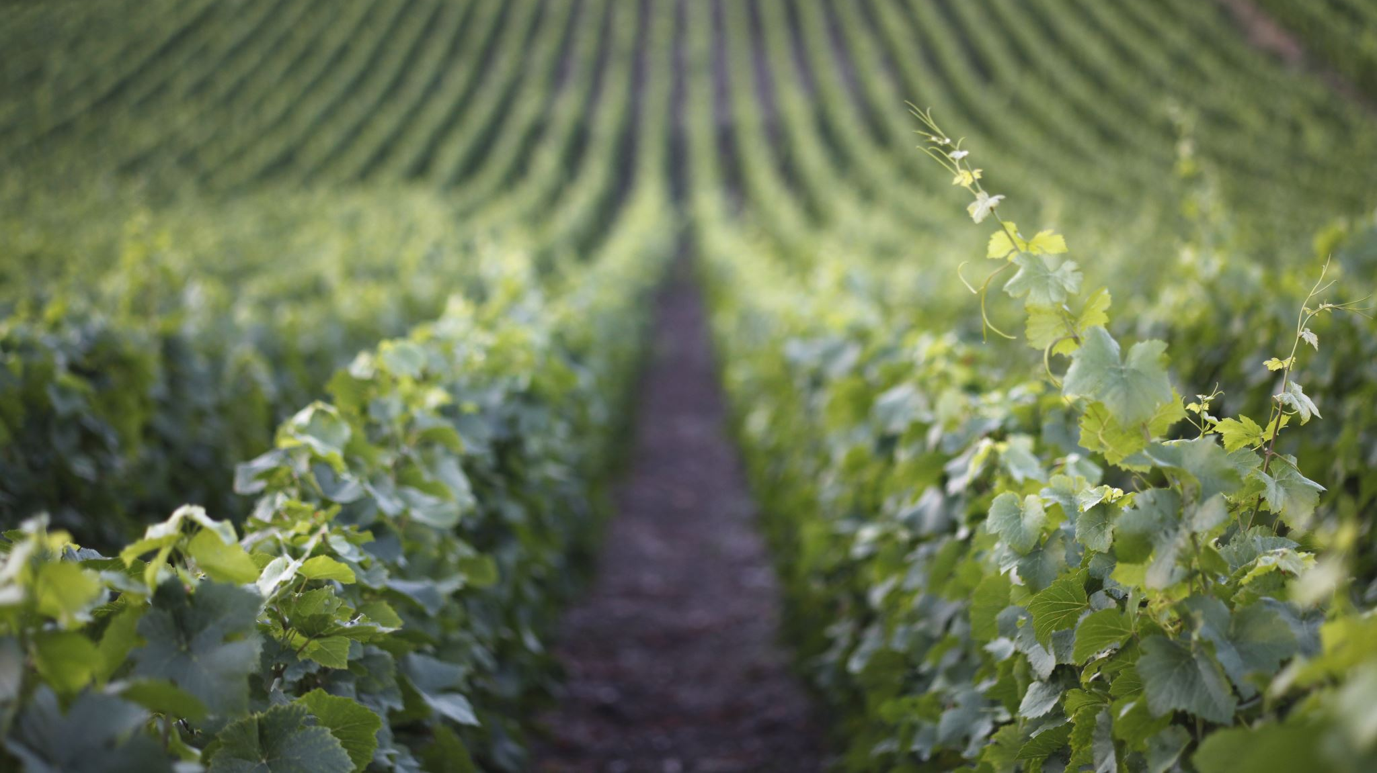
Robert Renzoni Vineyards
Wine Quality Engagement
DDS Analytics

Slide 2


The Team
Kyle Evans
Ekam Brar

Slide 3
Objectives
Identify key drivers of wine quality
Deliver a predictive model to forecast wine quality

Slide 4
Data
5463 observations
15 columns + Feature Engineering
1 identifier
2 categorical
11 continuous
Missing
Wine Type
152 observations / 2.78%
Quality
0 - 10 theoretical
3 - 9 observed
Imputed with KNN

Slide 5
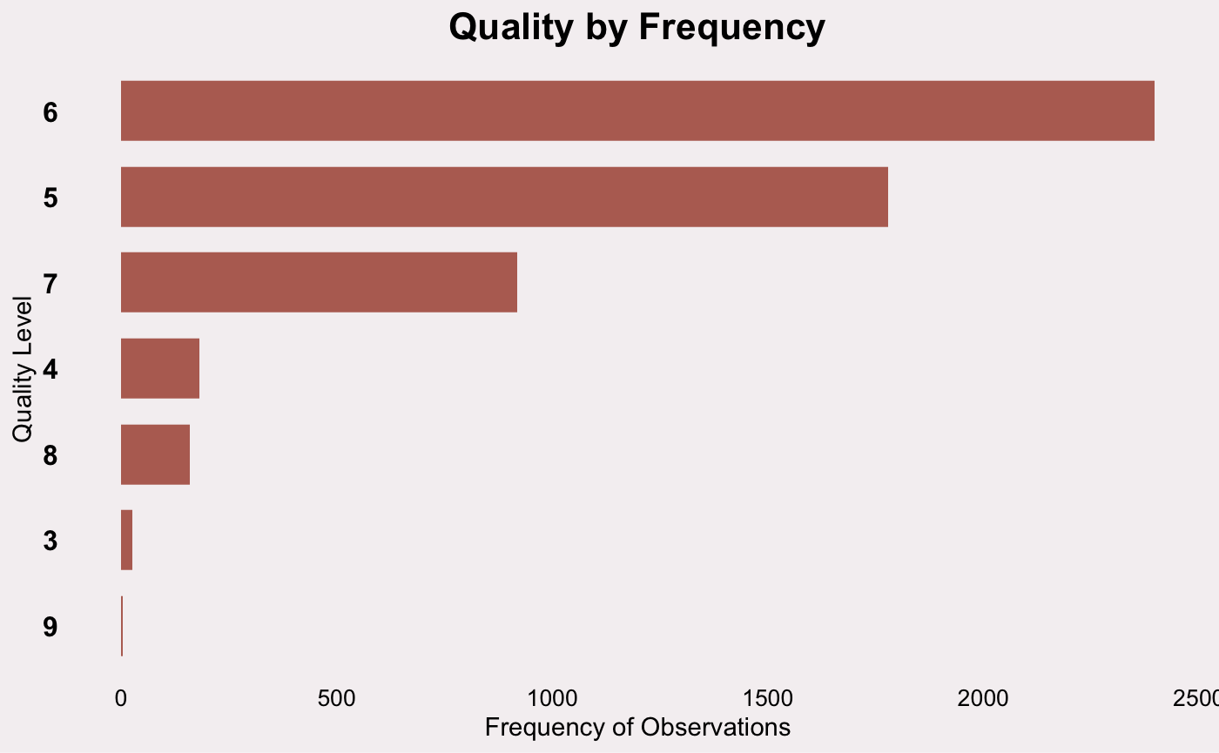
Insights

Slide 6
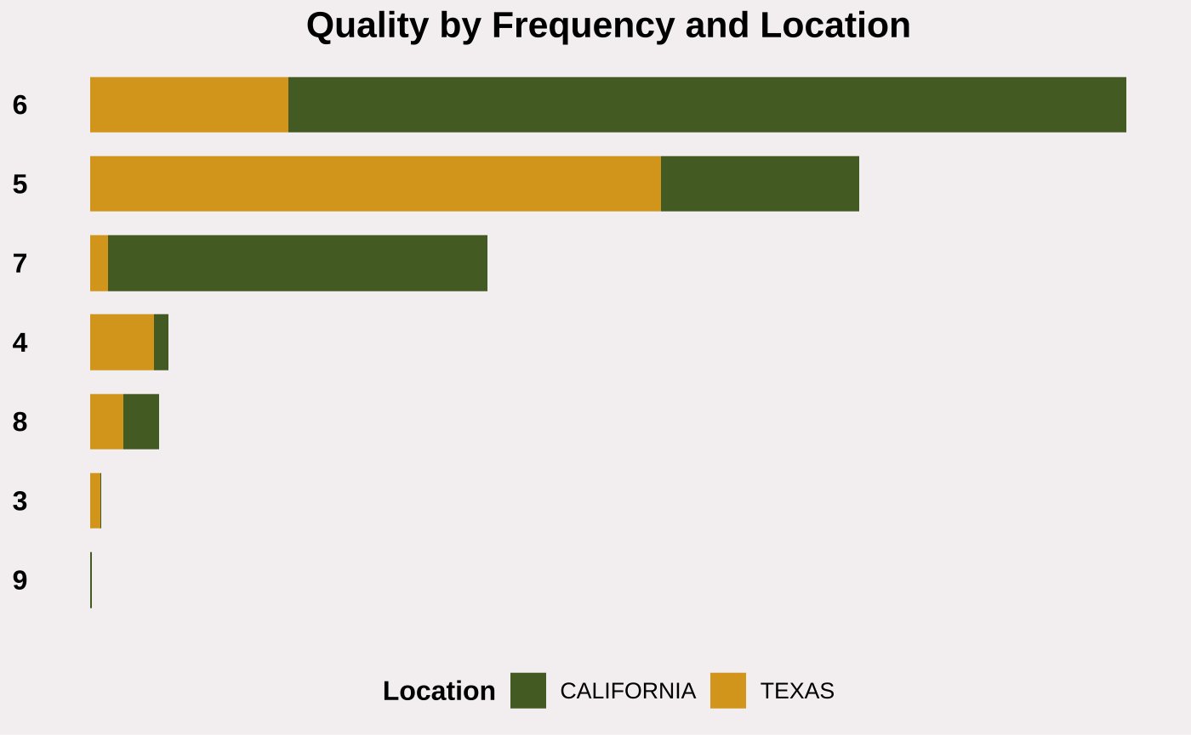
Insights

Slide 7
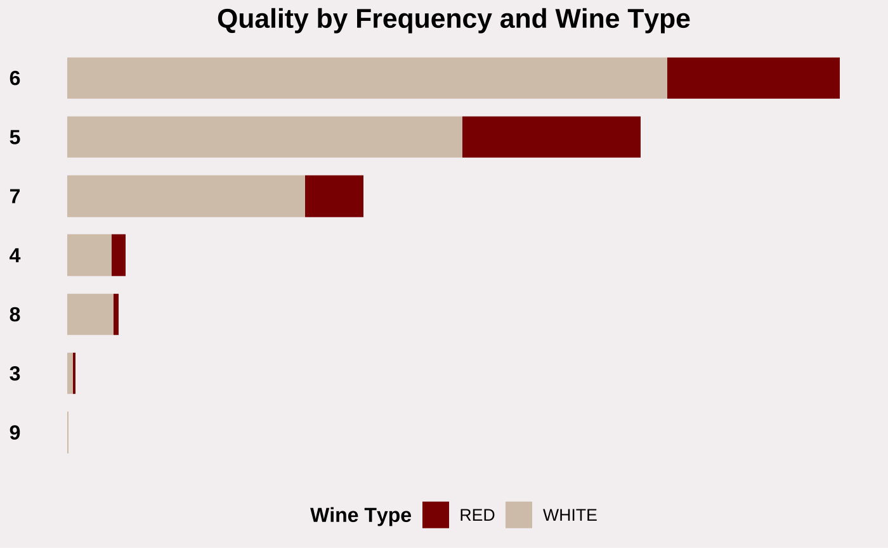
Insights

Slide 8
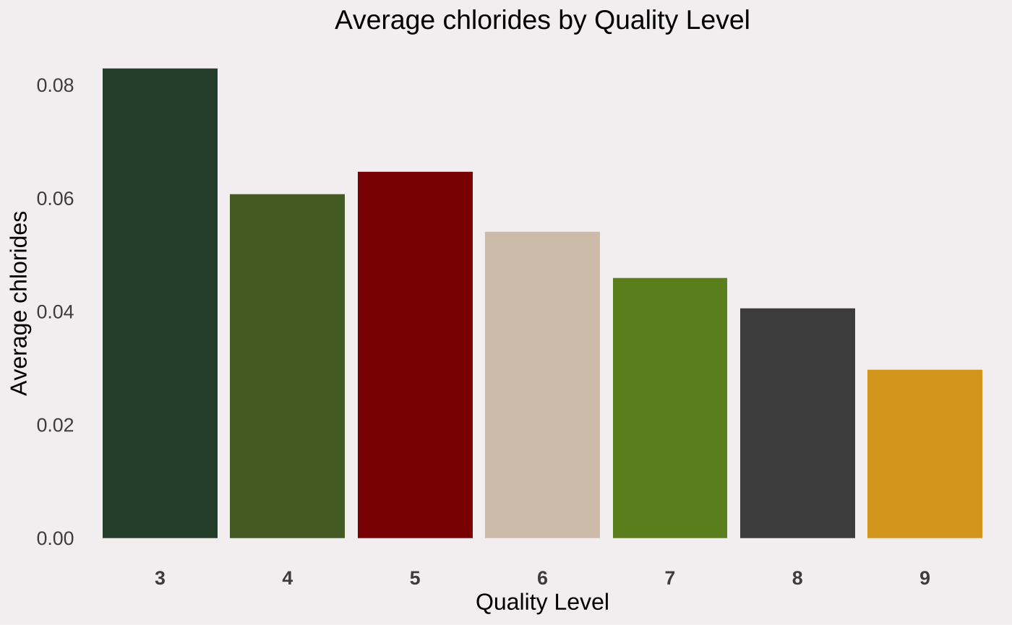
Insights

Slide 9
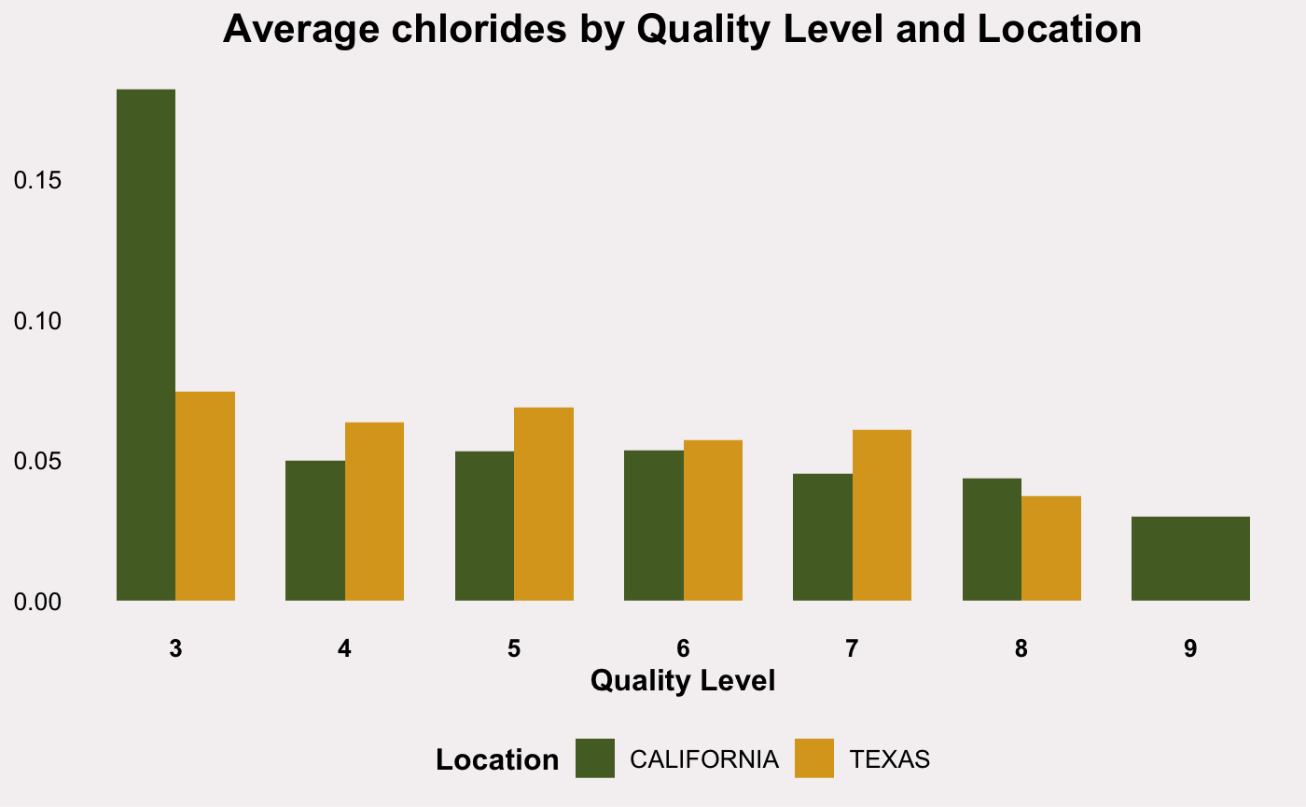
Insights

Slide 10
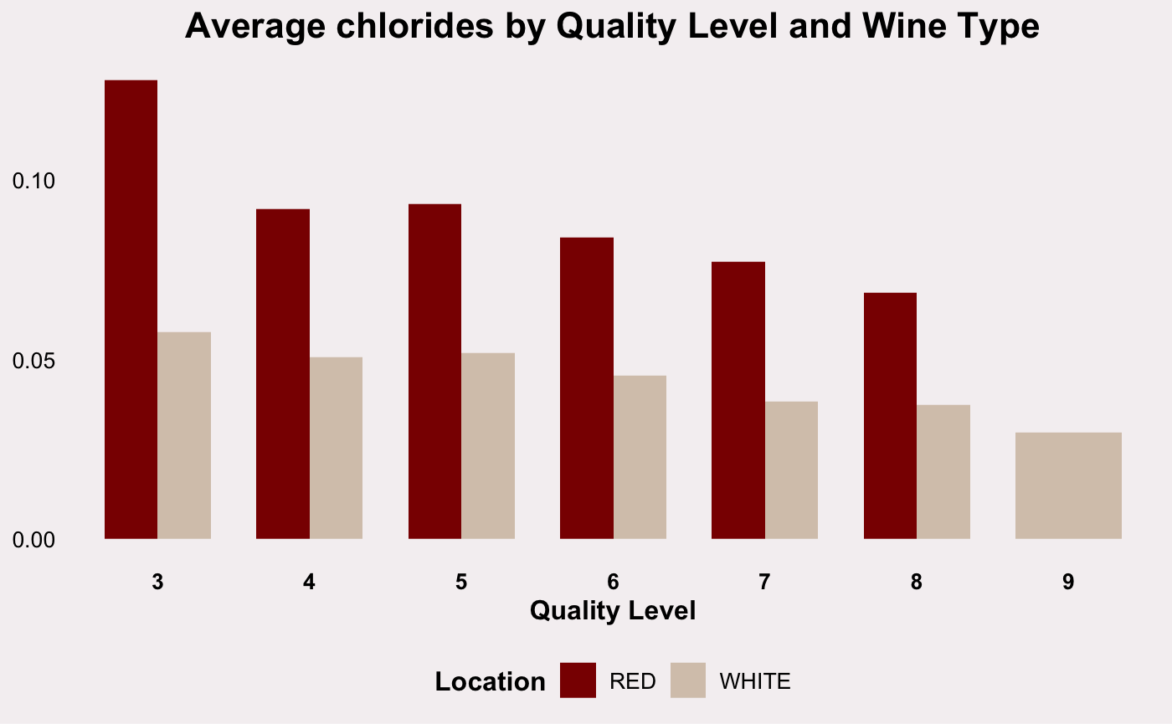
Insights

Slide 11
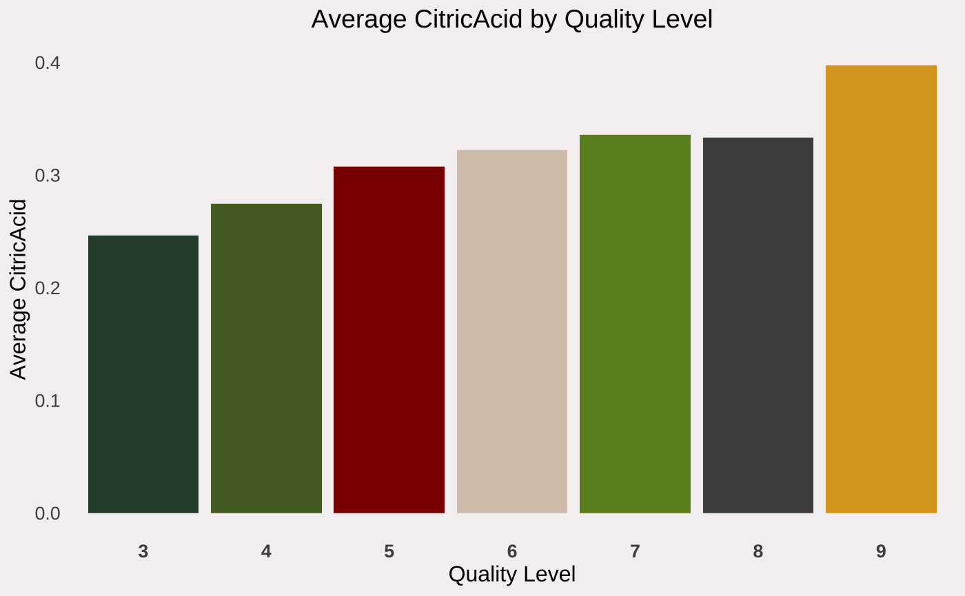
Insights

Slide 12
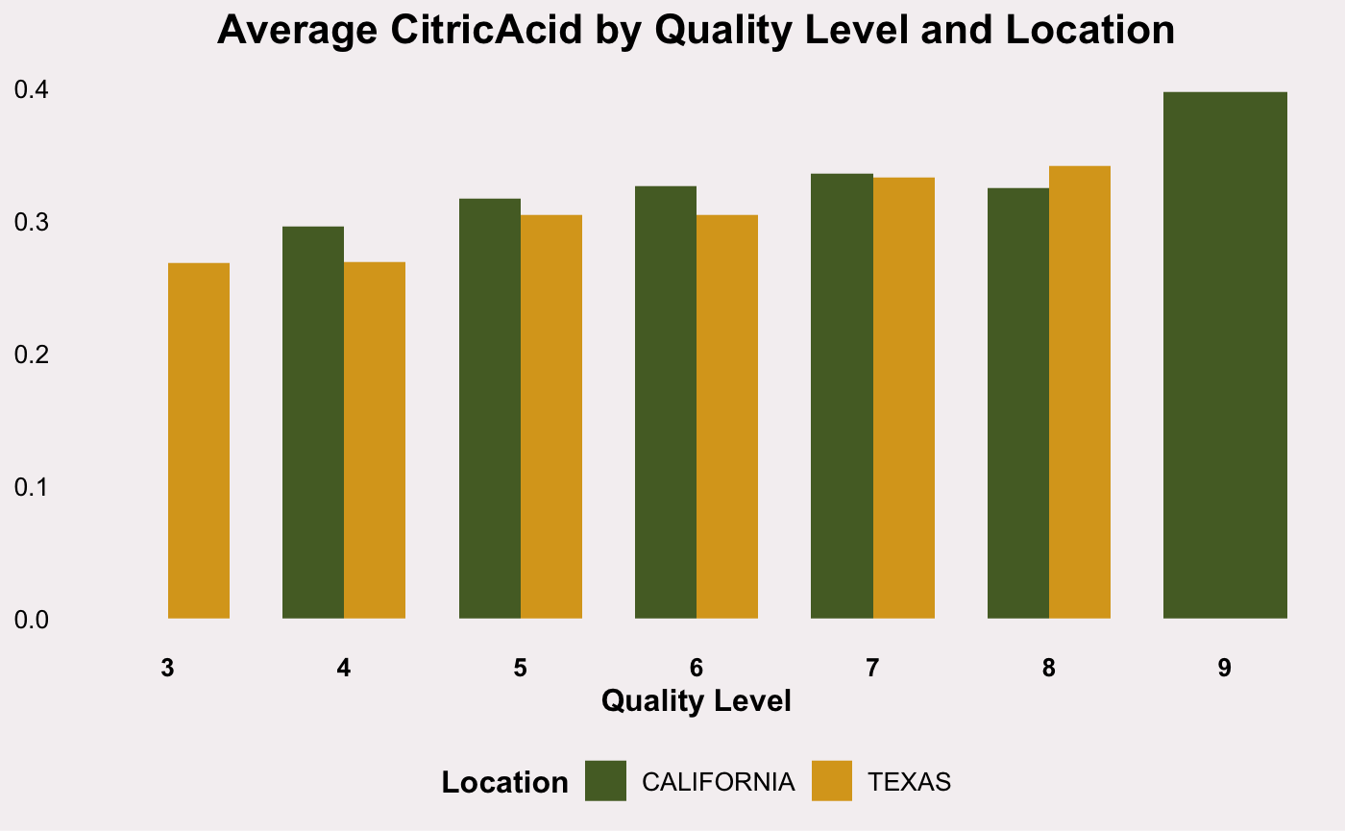
Insights

Slide 13
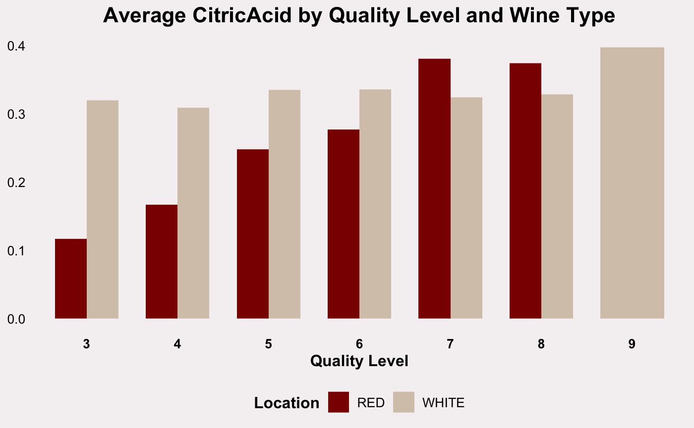
Insights

Slide 14
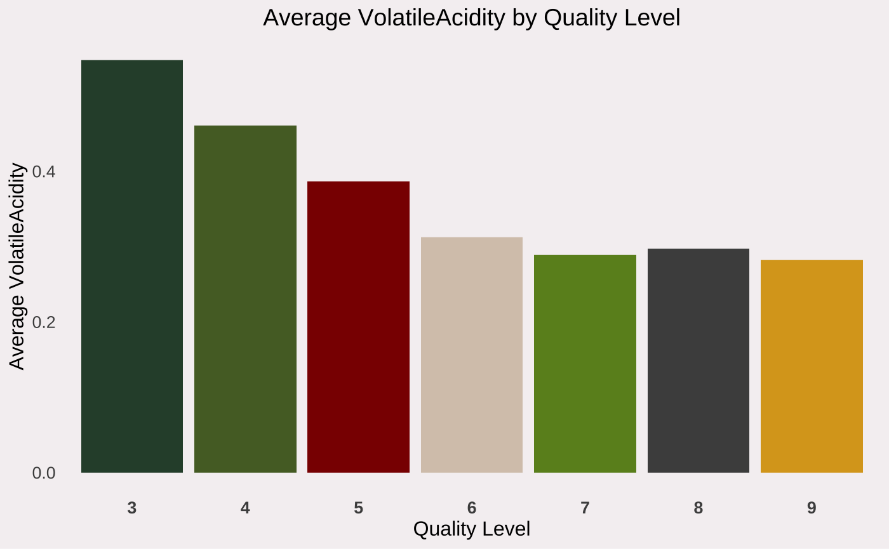
Insights

Slide 15
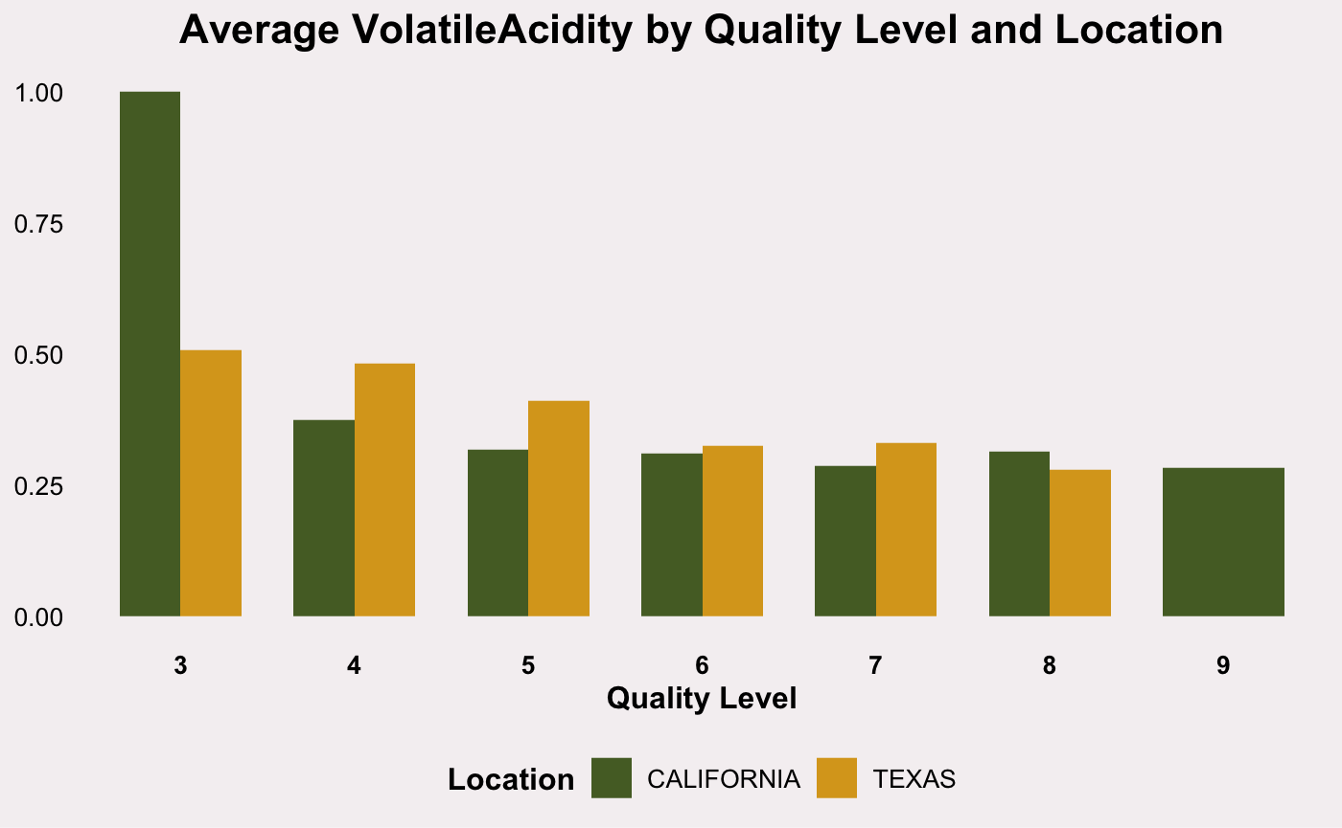
Insights

Slide 16
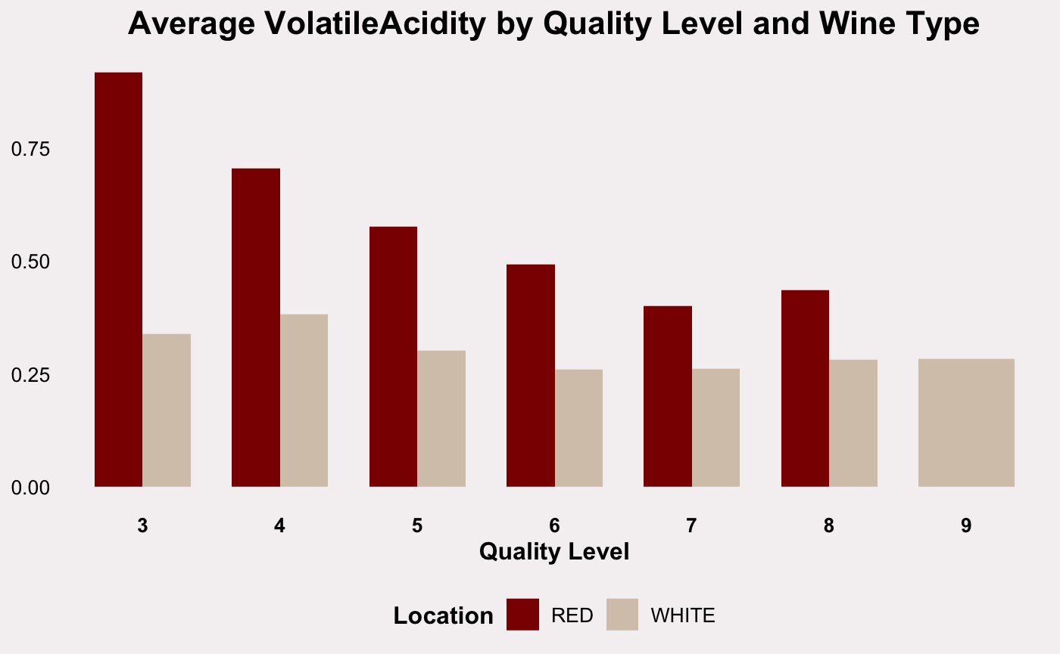
Insights

Slide 17
Predicting
Linear Regression Model
Uses all data points
MAE: .444
Logistic Regression Model
Uses all data points
BEST MAE: .398

Slide 18
Thank you!
Kyle Evans
Ekam Brar
kyleevans@smu.edu
ebrar@mail.smu.edu

