Slide 1

Finsocial
Get financially smart with Finsocial
Notes:
As we are constantly overloaded with financial information. There is an uprising in influencers who’s popularity is based on their financial wisdom. That’s where our product Finsocial comes into play, “getting social with your money”

Slide 2




AUDIENCE DEMOGRAPHICS
AGE
INFORMATION
INTERESTS
Get news/information on current affairs through social media
86%
Youth in Singapore
A Snapshot of our Singaporean youth - National Youth Survey 2016 Nation Youth Council
(CNA - The Big Read: Dangers lurk in youth's chase for social media 'likes'), 1 dot is an hour a week
Notes:
Our target audience is the youth in Singapore, from our research 86% of youths rely on social media to get their news.
Since most youth’s are getting information from social media it is important to understand why they are doing so.
We believe it is so as social media is much more attractive compared to traditional media whereby it has a lot more interaction with the viewers, spending on average 12 hrs a week.
Coupled with video content platforms such as Youtube have youths spending approx 10 hrs a week on youtube. Therefore we can see that the youths are are heavily invested in these platforms.

Slide 3


WHAT PLATFORMS ARE WE GOING TO USE?
YOUTUBE
Tik Tok
Twitter
INSTAGRAM
Collated verified nano-influencers who focus on finance
Linked data from different social media platforms to construct related finance news
Dynamically display feed through embed codes
Notes:
The four platforms we believe that are essential in getting youths,
First we will identify and verify financial influencers and gather data from these social media platforms. Of which will construct a graph of related financial news from the data points.
Lastly Finsocial will dynamically display the feed for them.

Slide 4

STRATEGY
STEP 3
Data is piped to MongoDB as the data lake for all data from the social media platforms
STEP 1
Identify verified nano-influencers whose focus are on financial issues
STEP 5
Information is displayed dynamically with embed code hence providing interactivity
STEP 2
Data ingress through cron jobs on AWS Lambda which scraps 4 social media platforms
STEP 4
Data from the different social media platforms are linked to form a substantial story line
Notes:
This is an indepth strategy for how we go about storing the data.
First we identfiy nano-influencers on all 4 social media platforms of which data will be ingested through cron jobs within our AWS lambda scripts.
The data is then piped to our MongoDB which will act as a data lake to process the data. To process, we will link the data from the different social media platforms to create a substantial story to curate a financial storyline for the youths.
Lastly the information will be displayed through embed code to allow the youths to directly interact with the social media platforms

Slide 5


Data Ingress
Data ingress @ 6am daily
Lambda
Data piped
Pull verified nano-influencers
Notes:
This is the high level overview of how the data is ingress, the lambda script will scrape the 4 social media platforms daily at 6am to pull new data from the content creators to be piped back to MongoDB

Slide 6
Relevant Financial News
Twitter is used as the master node as data is mainly text based which allows better searches on YouTube Search API after filtering using nltk
Using YouTube Search API, we pull the top 3 most relevant videos based on views related to the tweet from a list of 20 videos
Another layer of search is done based on the most viewed YouTube video from the previous layer of search done. Lastly, we take the top 3 most viewed YouTube Video from this group of 5
Notes:
Here is an example of our graph works.
Twitter is used as our master node as it is mainly text based. Using nltk we are able to remove stop words and extract the important context of the tweet. Of then we will use the Youtube search API to get 20 videos based on the context and take the top 3 videos based on views.
Another layer of search is done to on the highest viewed video of the previous layer to check for more videos. It will then be added to the current 3 videos which will result in 5 videos where we will take the top 3 most viewed videos. This will allow us to obtain a more contextual storyline.

Slide 7
Social Media Embedded Widgets
Added Credibility
Widgets posts are verified, and ensure that users are engaging the right influencers.
Increased Engagement
Widgets can increase the time visitors spend on the website
Reduced Bounce Rate
By offering them more content to engage with, which, in turn, reduces how frequently visitors leave our site
Notes:
Social media embedded widgets,
Finsocial is not only about data, although it is important to youths to learn, we want to showcase entertaining content and improve their overall learning experience.
We tap on the social media embedded widgets to add credibility to our data via verified post. The widgets promotes a better engagement with the user as they are able to interact with a
familiar user interface that they use everyday. Lastly, each individual widget is able to provide more content for the user to consume, without having to redirect them to a different platform.
This reduces bounce rate and retains the users exploring our site.

Slide 8
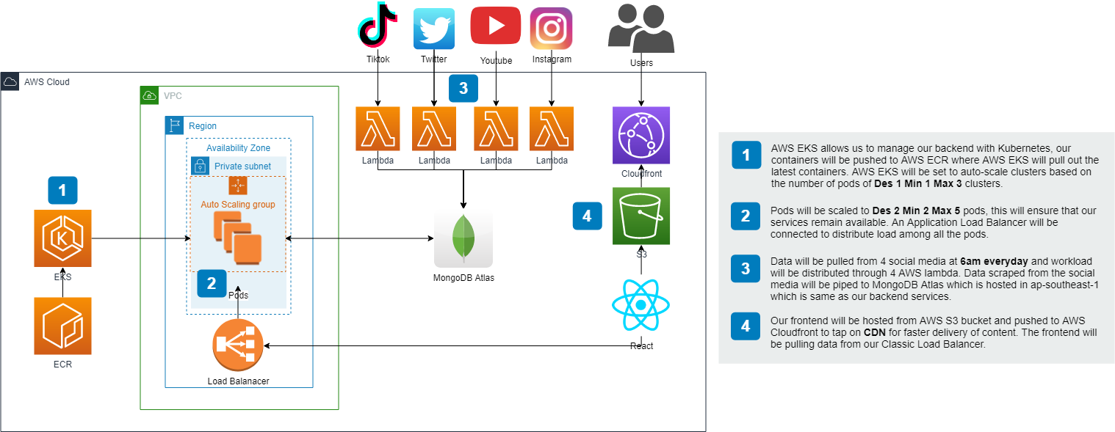
Solution Architecture
Notes:
Here is our solution architecture, where we will focus on 4 aspects.
1 we are tapping on AWS EKS to manage our kubernetes cluster which pulls containers from AWS ECR.
2 The pods are auto scaled with des 2 min 2 max 5 and clusters are auto scaled with des 1 min 1 max 3 with an application load balancer to manage the load
3 Data is ingress at 6am everyday and workload is distributed among 4 AWS lambda which piped data to MongoDB
4 Our frontend is hosted on AWS S3 which is exposed to end-users through AWS Cloudfront to provide CDN for faster delivery of content

Slide 9



Summary
Designed For Youth
Data pulled from social media rather than financial sites
Tapped On Nano-Influencers
Continuous up-to-date information on the financial markets
Relevant News Linkage
Assemble a network graph of relevant news based on news from Financial Times
Reliable and Scalable Infrastructure
Utilize kubernetes to construct the infrastructure to ensure uptime and scalability
Interactive Interface
Interface designed to attract and retain youth attention

Slide 10






OUR TEAM
NICOLAS
WEE
ARIX
PHUA
nicolaswee
nicolaswee
nicolasmarcwee
arixpsy
arixpsy
arixpsy.codes

