Slide 1

Ellipsis Tech Series Hackathon 2020
Presented by:
Going global with GS Atlas | Team
Singa Sushi
Isaac Lee Yi De | Zeph Ng | Shao Shxuan

Slide 2
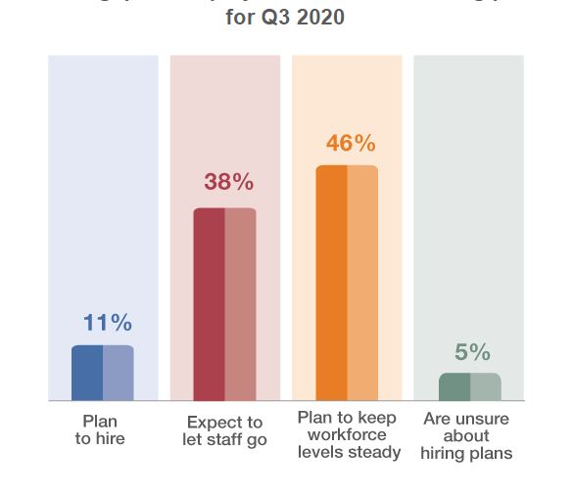
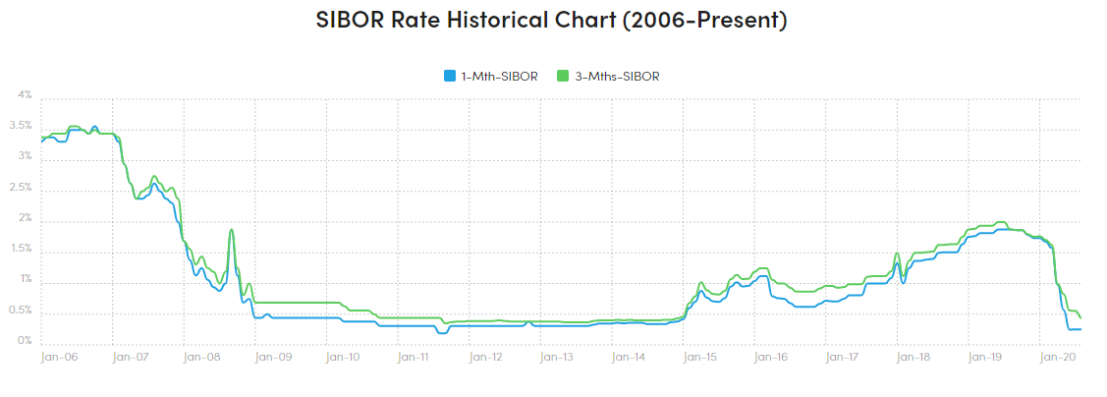
Singaporean youths are stuck in an investing bubble
Access to information or expertise about foreign REITs often require financial advisors
Major barrier is the lack of understanding/misunderstanding
“Invest in what you know” mentality but its hard to learn more
Limited growth potential in local investments
Small market, slowing productivity
Lack of geographical diversity in portfolio
Leaving us vulnerable to geographical idiosyncratic risks
Growth Drivers for REITs
Economic Growth
Job Market
Demographics
Occupancy Rates and Rents
Mortgage Rates
Interest Rates
Our Team
The Opportunity
Tech Stack
The Business Case
Solution Demo
Solution Workflow
Solution Scope
Problem Specification
Beyond a product
Timeline to Victory
Notes:
https://marketrealist.com/2015/08/factors-drive-reit-earnings/
https://manpowergroup.com.sg/

Slide 3


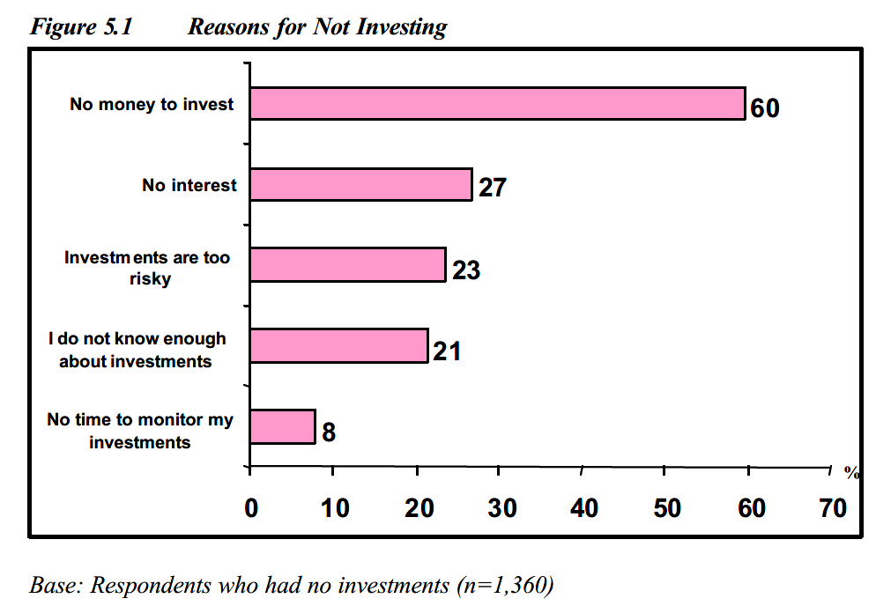


Why aren’t youths investing more?
Understanding their wants and the gaps for our target audience
27%
Just aren’t
interested
“Majority of youths would be lucky to have anything between $500 - $1000(SGD) monthly available for investments”
- DollarsAndSense, 2020
“Millennials and Gen Z feel more comfortable being self-directed and do not see value in traditional financial advice.”
- Swell Investing Survey 2018
- MAS, Financial Literacy Survey, 2005
Our 3 Main Objectives
It Has To Be Affordable
Give Them Control
Make It Fun
Our Team
The Opportunity
Tech Stack
The Business Case
Solution Demo
Solution Workflow
Solution Scope
Problem Specification
Beyond a product
Timeline to Victory

Slide 4



Solving the gaps by building an intuitive and fun platform to explore funds
Making understanding funds so much easier
Problem Statement #4: Financial Services and Products today lack innovation to address the experiential youth lifestyle
Live demo
Atlas
Interactive
Intuitive
Insightful
Our Team
The Opportunity
Tech Stack
The Business Case
Solution Demo
Solution Workflow
Solution Scope
Problem Specification
Beyond a product
Timeline to Victory

Slide 5
Understanding our scope and solution
How does this solve our problem and achieve our objectives?
Why Property
Funds?
Familiarity and Traceability
Exposure linked to place of business
Familiar to Singaporean Investors
Safer bets and a relatively more predictable market
News sentiment correlates with REITs fund prices
Untapped Data Dimension
Can be switched to Sovereign Bond Funds, Agriculture, etc
Cluster analysis, Geospatial Autocorrelations, etc
Intuitive and dynamic information
Great foundation to build on (Online simulations, etc)
Why Geospatial
Data?
Our Team
The Opportunity
Tech Stack
The Business Case
Solution Demo
Solution Workflow
Solution Scope
Problem Specification
Beyond a product
Timeline to Victory

Slide 6





Proposed Framework
How could Atlas fit into Goldman Sachs’ larger eco-system?
Bloomberg News/ News source API
Services
Singa Sushi
Registration through Marcus
Data Processing & ML/Geospatial Models
Atlas
Dashboard
Funds & News Data
Storage
Goldman Sachs/ Bloomberg Funds
Data API
Connected Service
Front-End Service
Goldman Sachs
Trading/Broker
Services
Back-End Service
Our Team
The Opportunity
Tech Stack
The Business Case
Solution Demo
Solution Workflow
Solution Scope
Problem Specification
Beyond a product
Timeline to Victory

Slide 7


Current Framework
Building a prototype that is light weight and easily adaptable
Web scrapper on news sites
Singa Sushi
Standalone Login/
Registration
Data Processing & ML/Geospatial Models
Atlas
Dashboard
Funds & News Data
Storage
European Mutual Funds and ETF
Dataset
User customized
fund selection
Connected Service
Front-End Service
Back-End Service
Our Team
The Opportunity
Tech Stack
The Business Case
Solution Demo
Solution Workflow
Solution Scope
Problem Specification
Beyond a product
Timeline to Victory
Notes:
Unable to deploy due to dependency issues not loading into environments. Solution for running locally found on github

Slide 8
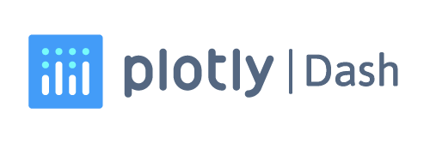








Tech Stack
How does Atlas fit into Goldman Sachs’ larger eco-system?
Front-End
Back-End
External Mock Apps
:
Framework
:
Hosting
API Testing
Web Scrapper
:
Database
:
Local Host
Framework
API
Languages
:
Languages
Database
:
Sentiment Analysis
Geospatial Processing
NLTK Vader
Front-End Service
Back-End Service
Attempted deployment on both platforms. However,
failed due to Geopandas dependencies
External Mock Apps
Our Team
The Opportunity
Tech Stack
The Business Case
Solution Demo
Solution Workflow
Solution Scope
Problem Specification
Beyond a product
Timeline to Victory
Notes:
User Account Web Service – Flask App

Slide 9




What are the key benefits of the solution
Making sense of the business behind the platform
Dynamic User Experience
Encourage Involvement in Investing
For Youths
Value-add to other business functions
Platform Play
For
Goldman Sachs
Our Team
The Opportunity
Tech Stack
The Business Case
Solution Demo
Solution Workflow
Solution Scope
Problem Specification
Beyond a product
Timeline to Victory

Slide 10



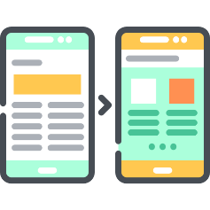
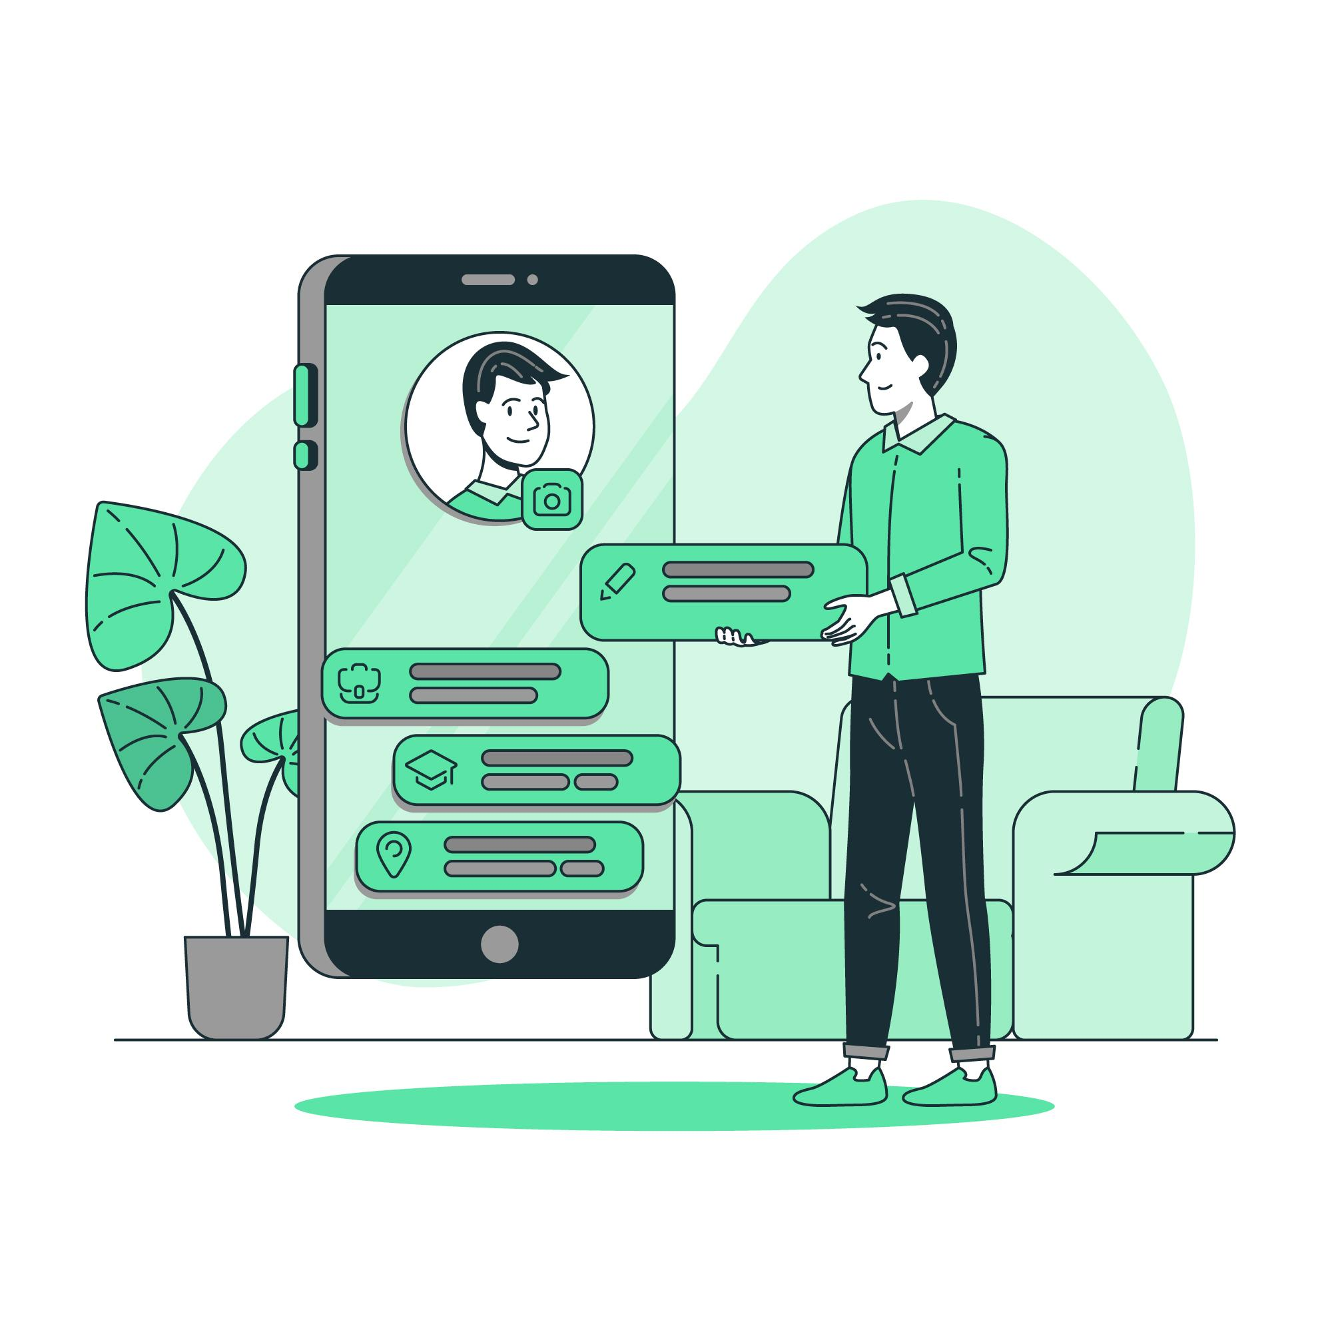







The product vision – reimagine the way we view financial data
Huge potential for both Goldman Sachs and partners with clear milestones in the coming years
2021
Phase 1
\
Integration into Marcus and Goldman Sachs API environments
Atlas 1.0
Initial Dashboard Launch with select Funds tracked
Integration of live-trading functions with ETFs through broker services
1st Year Assessment of design and rework of UI/UX accordingly
2024
Phase 2
2022
Integrate modularity in User interface
Addition of different types of funds and ability to change tracked metrics
Launch of simulations tab for paying users
Atlas 2.0
Develop environmental/global economic event simulations
2025
Phase 3
Beyond 2025
Atlas 3.0
Full Integration into Goldman Sachs’ trading services
Integration into wealth management and Robo-advisory services
Provide a simulation sandbox to allow users to create their simulations and their own funds
A wild journey ahead
Our Team
The Opportunity
Tech Stack
The Business Case
Solution Demo
Solution Workflow
Solution Scope
Problem Specification
Beyond a product
Timeline to Victory

Slide 11





Simulations as our key leverage for customer acquisition
Exploring new ways to educate and engage potential investors in a dynamic world
Atlas Dashboard
Scenario Games
Experience simulated financial education
Hyper-personalized
financial recommendations
Increased purchase of financial products
Atlas
Decision & behavioural data
Our Team
The Opportunity
Tech Stack
The Business Case
Solution Demo
Solution Workflow
Solution Scope
Problem Specification
Beyond a product
Timeline to Victory

Slide 12

We make investing engaging
Reworking the way we view funds to provide greater transparency and reachability
Invest confidently with visual cues
Explore a new dimension of geo-spatial relationships
Provide Greater Transparency
Enable Greater Accessibility
Provide Greater Discoverability of Funds
Active Engagement and Insight
Our Team
The Opportunity
Tech Stack
The Business Case
Solution Demo
Solution Workflow
Solution Scope
Problem Specification
Beyond a product
Timeline to Victory

Slide 13
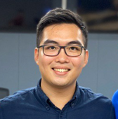

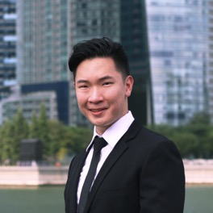
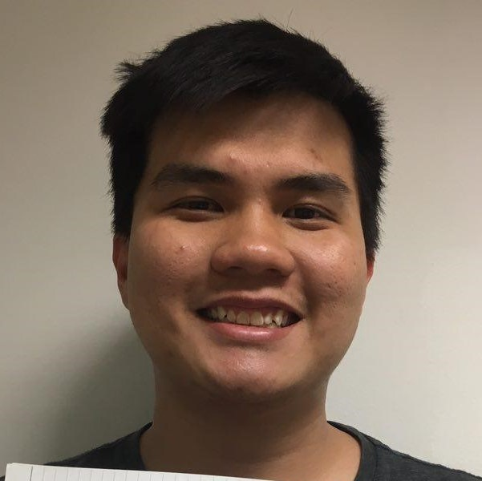
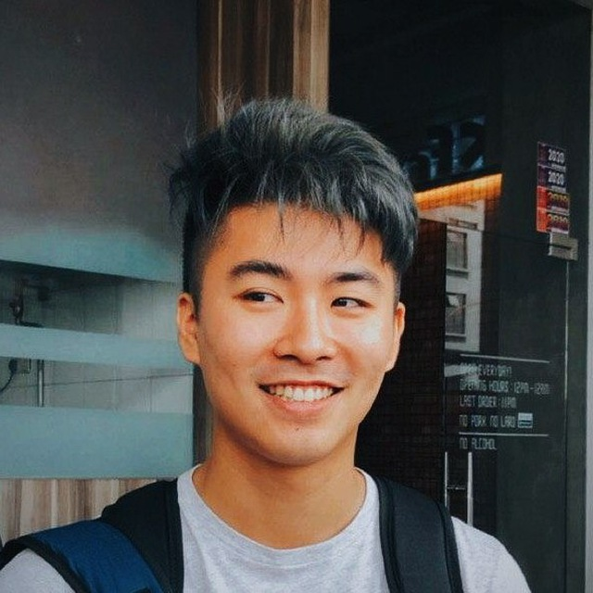
Meet the SingaSushi Team
Passionate FinTech Enthusiasts
Isaac Lee Yi De
Zeph Ng
Shao Shxuan
Business Product Owner
Solutions Designer &
Back-End Developer
Front-End Developer
Data Science Intern – Deloitte CRISP,
Investments Intern – Grab Ventures,
Management Intern – KPMG DV
• Hackathon veteran specializing in new business conceptualization and product management
• Ex-President of the SMU FinTech Club
Competencies:
• Geospatial/NLP Data Science
• Digital Consulting
• Venture Capital Management
• New Ventures / Entrepreneurship
• Product Management
Software Development Consultant - KPMG,
President - SMU FinTech Club
• Mobile and Web developer for financial applications
• Specialized in open-sourced data scrapping, web crawling and text messaging applications
Competencies:
• Mobile and Web Development
• API Development
• Full-Stack Developer
• IoT Developer
Legal Tech – Rajah & Tan Technologies,
Vice-President – SMU WhiteHat Society,
Software Engineer – Credid.io
• Specialist in Web development for e-learning, legal-tech and contract management webapps.
• Cyber-Security as a focus fo rdesign and implementation of web services
Competencies:
• Front-end Design & Development
• Cyber-Security
• Youth Branding
• Web & Mobile Services
Our Team
The Opportunity
Tech Stack
The Business Case
Solution Demo
Solution Workflow
Solution Scope
Problem Specification
Beyond a product
Timeline to Victory

