Slide 1


TIMNEM
MAKE MONEY MAKING EASIER
Financial Sensemaking in a Digital Era

Slide 2

PROBLEM STATEMENT
Youths, characterized by their general lack of understanding towards financial markets and instruments, are consistently overwhelmed by the bulk of financial data available. These individuals have little to no idea as to how they can gauge the financial performance of the firms, even if robust data were available.

Slide 3



DRAWBACKS OF EXISTING SOLUTIONS
Why are existing solutions not user-friendly?
WHERE TO START?
ACCESSIBILITY
TECHNICALITIES
Lack of Direction in Financial & Technical Analysis
Better Solutions are Exclusive due to Paywalls
Users are unable to Comprehend Financial Jargons

Slide 4





OUR SOLUTION
The Unique Selling Proposition that we have to offer
INTEPRETER
DYNAMIC
Calculates & compares key financial ratios across industries and different periods in real time
A web application that explains
important financial ratios
VISUALISATION
COMPLEMENTARY
Historical data charts and side-by-side tables improve user-friendliness
Complementary tool used on top of existing solutions to allow users to quickly make sense of financial data

Slide 5
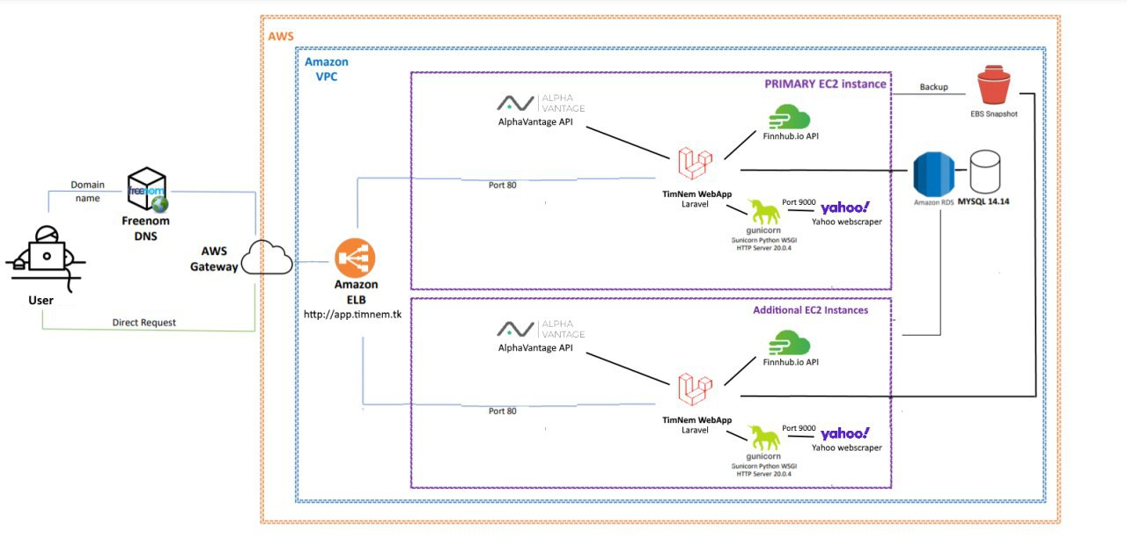
ARCHITECTURE

Slide 6



SCALABILITY
Scalability of our Proposal in the Technical Aspect
SCALING
WEB SCRAPING
DATABASE
AWS ELB & EC2 Instances for Seamless Workload Based Scaling
Flask & Gunicorn to serve our Real-Time Web-Scraper. Gunicorn can scale using workers and start seamlessly
RDS to Serve our Database Needs

Slide 7


SCALABILITY
Scalability of our Proposal in the Business Aspect
5 Company API Call Limit due to free API limitations
Paid API can Bypass Both the Limitations
Short-Term Stock Data due to free API limitations

