Slide 1
Python code
Tools for writing
consistent and reliable

Slide 2
Today we’ll talk about …
Writing consistent Python code.
Tools for enforcing code consistency.
Type hints and mypy.
Writing consistent docstrings.
… will not talk about unit testing.

Slide 3

Motivation
Make your programming life easier.
Inefficient workflow, wasted time on individual coding quirks.
Simple tools can help you become a better programmer.
Which tools make sense in a data science context?

Slide 4
Inconsistency is the hobgoblin of little minds.
PEP 8: Style Guide for Python Code

Slide 5
WHY should you care about coding style?
The mental health of your future self.
The mental health of your coworkers.
Spend less time on formatting, more on logic.

Slide 6
Pep 8 - the official style guide
Python Enhancement Proposal.
PEP 8 formalises a recommended programming style.
PEP 8 covers:
Naming styles and conventions.
Whitespace, maximum line lengths, indentations, trailing commas, and much more.

Slide 7
example: Naming styles
Type | Example
Function/method | function, my_function
Variable | variable, my_variable
Class | Class, MyClass
Constant | CONSTANT, MY_CONSTANT
Module | module.py, my_module.py
Package | package, mypackage

Slide 8
Please, please, please read pep 8

Slide 9
Enforcing consistency
Memorise PEP 8? Ain’t nobody got time for dat.
Use linters!
Linters check your code for logical errors and compliance with PEP 8.
Most IDEs already use linting tools.

Slide 10
Popular python linters
pylint
Very powerful.
User-unfriendly defaults.
flake8
Wrapper around pyflakes, pycodestyle and mccabe.
User-friendly defaults.

Slide 11
Flake8
pyflakes checks your source files for errors. Does not complain about style.
pycodestyle (formerly pep8) checks PEP 8 compliance.
mccabe checks the complexity of your code (switched off by default).
Notes:
Mccabe uses a software metric called the McCabe complexity, aka. Cyclomatic complexity, which measures the number of paths that execution can take through a piece of software (e.g. if-statements). If the complexity exceeds som agreed-upon limit, the program should be split into smaller modules.

Slide 12
example: Using flake8
Run flake8 on code_with_lint.py through command line interface.
Clone repository* to play with this example.
https://github.com/smu095/presentations/tree/master/python101

Slide 13
Flake8 output
{filename}:{line}:{column}:{error code} {message}
W***/E*** are PEP 8 warnings (pycodestyle).
F*** are syntax errors (pyflakes).
C9** are complexity errors (mccabe).
Customisable, error messages can be ignored.

Slide 14
Autoformatting code
Linters check your code, doesn’t fix it.
Autoformatters enforce consistency by refactoring your code.
Idea: Avoid formatting arguments in code review, focus on logic.

Slide 15
Black - the uncompromising code formatter
black is an opinionated autoformatter that enforces a superset of PEP 8.
Produces smallest diffs possible to make code review faster.
Some stylistic deviations from PEP 8, e.g.
maximum line length is 88 characters.
all single quotes replaced by double quotes.

Slide 16
example: Using black
Run black on unformatted_code.py through command line interface.
Clone repository* to play with this example.
https://github.com/smu095/presentations/tree/master/python101

Slide 17
So far we have talked about…
Community guidelines for coding style.
Linters that check your code for errors.
Autoformatters that refactor your code so you don’t have to.
There is a third linting tool, which relies on type hints.

Slide 18
Static vs. Dynamic typing
Statically typed languages:
Variables bound to type.
Dynamically typed languages:
Variables not bound to type.
Variables are allowed to change type.
Types are correctly inferred at runtime.

Slide 19
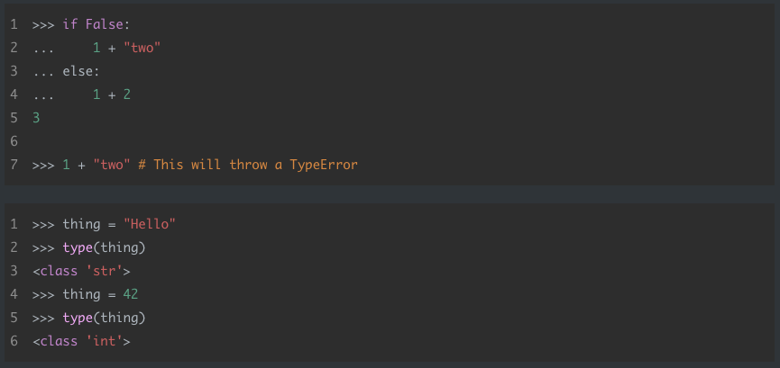
example: Dynamic typing in python

Slide 20
Static type checking with mypy
mypy performs static type checking, i.e. code doesn’t need to run to catch type errors.
Needs your help, in the form of type annotations.
Introduced in PEP 484, also called type hints.
Completely optional, types are suggested but not enforced.

Slide 21
Function annotation
def ceiling(number): rounded = … return rounded
def ceiling(number: float) -> int: rounded = … return rounded

Slide 22
example: Using type hints
Run mypy on type_hinting_example.py through command line interface.
Run mypy on variable_hints.py through command line interface.
Clone repository* to play with this example.
https://github.com/smu095/presentations/tree/master/python101

Slide 23
Should we use type hinting?
Adds little value in short, throw-away scripts.
Potential for a lot of value in bigger, collaborative projects.

Slide 24
Type hinting yes-men
More understandable, helps document code.
More maintainable, easier to refactor.
More reliable, catches bugs early.

Slide 25
Type hinting nay-sayers
Requires time and effort.
Introduces some overhead.
Introduces un-Pythonic verbosity.
Only available in Python 3.5+*.
Use assert statements instead.
* Works in earlier versions too, but with different syntax.

Slide 26
Type hinting takeaways
Mildy controversial.
Completely optional, Python will remain dynamically typed.
More and more projects use type hinting and mypy, worth familiarising yourself with.
Use your best judgement!

Slide 28
docstrings
Problem: Terribly documented code, took forever to figure out how it worked.
PEP 257 formalises a style guide for docstrings.
Docstrings come in different formats.
Up to you, but stay consistent within your project.

Slide 29
A minimal function docstring
Every docstring should at the very least contain:
A one-liner summarising the function.
A description of the parameters.
A description of the return value.
Surround by triple quotes, place immediately after function declaration.

Slide 30
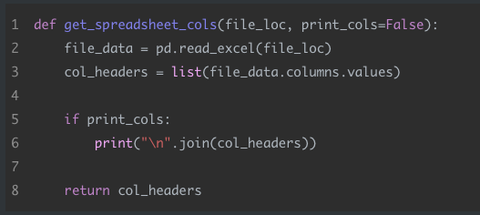
Example: undocumented function

Slide 31
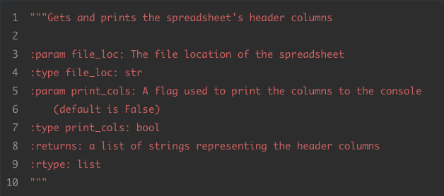
Example: reStructured text (RST)

Slide 32
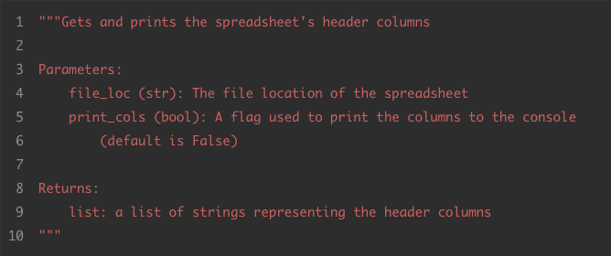
Example: google docstrings

Slide 33
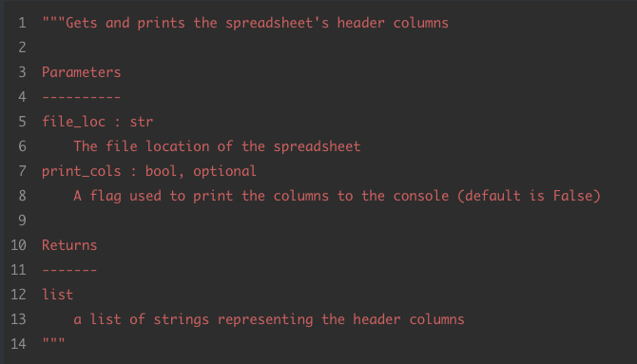
Example: numpy/SciPy docstrings

Slide 34
Including EXAMPLES
The numpy docstring format strongly encourages examples in docstrings.
Examples use the docstring module to parse docstrings for runnable examples of code.
Idea: Make sure examples are running as shown, not intended as tests.

Slide 35
Building documentation
reStructuredText, Google and Numpy docstrings are widely used.
Can produce well-formatted reference guides using tools like sphinx and autodoc.

Slide 36
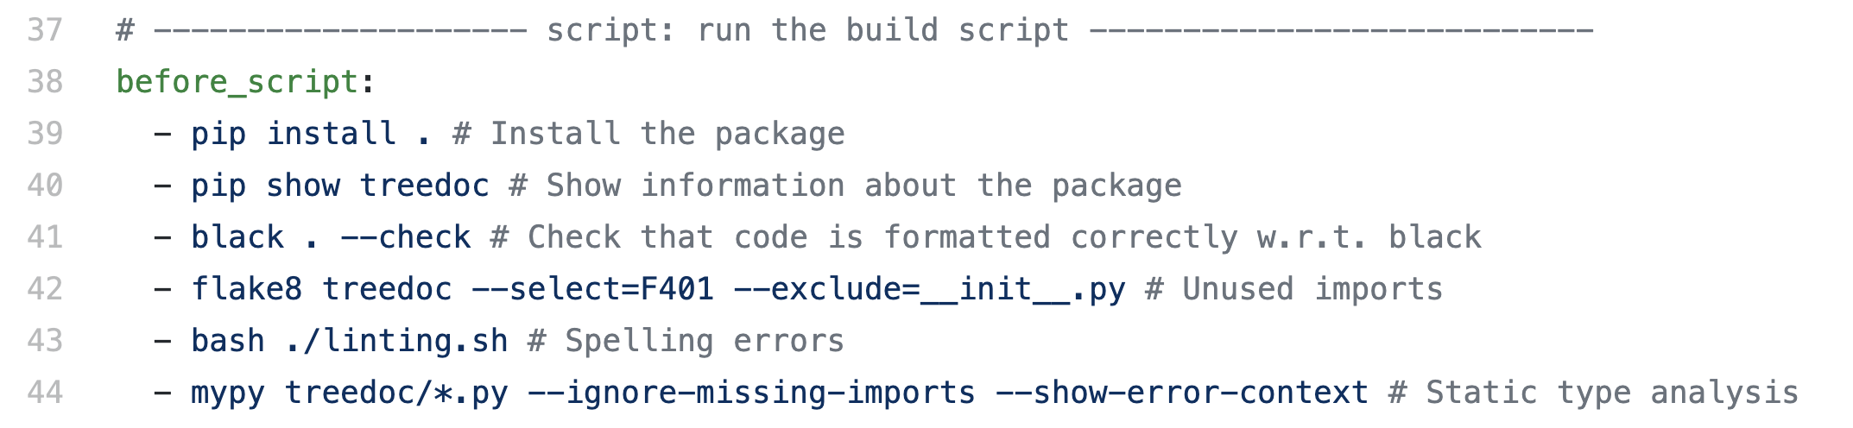
Practical use of linting tools
Typically used in continuous integration pipeline.

Slide 37
Summary (FRIENDLY VERSION)
Read PEP 8.
Follow the community’s recommended style guide.
Use linting and autoformatting tools when appropriate.
Probably a good idea to familiarise yourself with type hints.
Make a habit of writing good docstrings.

Slide 38
Summary (dictator VERSION)
Agree on an autoformatter and use it religiously.
Set master protection on repository.
All merge commits proposed via feature branches.
Set up CI to fail build if any errors are flagged by linters.
All pull requests must be reviewed prior to merge.
Squash merge exclusively.

Slide 39
The end

