Slide 1
Python code
Tools for writing consistent

Slide 2

Motivation
Make our programming lives easier.
Inefficient workflow, wasted time on individual coding quirks.
Simple tools can help you become a better programmer.
Which tools make sense in a data science context?
Notes:
Picture of me in previous job
Had to reproduce an experiment using someone else’s code base
Fortunately there are very simple tools that can help you become a better programmer, and in this presentation I will give a high-level overview of some of the most popular.
Also want to stimulate a discussion about which tools make sense in data science

Slide 3
Today we’ll talk about …
Writing consistent Python code.
Tools for enforcing code consistency.
Type hints and mypy.
Writing consistent docstrings.

Slide 4
Inconsistency is the hobgoblin of little minds.
PEP 8: Style Guide for Python Code

Slide 5
WHY should you care about coding style?
The mental health of your future self.
The mental health of your coworkers.
Spend less time on formatting, more on logic.

Slide 6
Pep 8 - the official style guide
Python Enhancement Proposal.
PEP 8 formalises a recommended programming style.
PEP 8 covers:
Naming styles and conventions.
Whitespace, maximum line lengths, indentations, trailing commas, and much more.
Notes:
PEP is an abbreviation of … and serve as a development logs.

Slide 7
example: Naming styles
Type | Example
Function/method | function, my_function
Variable | variable, my_variable
Class | Class, MyClass
Constant | CONSTANT, MY_CONSTANT
Module | module.py, my_module.py
Package | package, mypackage
Notes:
End with: Ask (those who code) how many have read
1.) some of PEP
2.) all of PEP 8.
React accordingly

Slide 8
Please, please, please read pep 8

Slide 9
Enforcing consistency
Memorise PEP 8? Ain’t nobody got time for dat.
Use linters!
Linters check your code for logical errors and compliance with PEP 8.
pylint and flake8 are two commonly used linters.
Most IDEs already use linting tools.
Notes:
PEP 8 establishes community guidelines for coding style.
Good news: Most IDEs come equipped with linters, so you’re probably already using them.
However, if you’re like I was before I became interested in these tools, you probably just see a bunch of annoying (and sometime confusing) error messages. So let’s try to clear things up a bit.

Slide 10
Popular python linters
pylint
Very powerful.
User-unfriendly defaults.
flake8
Wrapper around pyflakes, pycodestyle and mccabe.
User-friendly defaults.
Notes:
Pylint is considered by some to be unreasonably strict with regards to PEP 8, which will flood your IDE with warnings.

Slide 11
Flake8
pyflakes checks your source files for errors. Does not complain about style.
pycodestyle (formerly pep8) checks PEP 8 compliance.
mccabe checks the complexity of your code (switched off by default).
Notes:
Pyflakes will complain about unused variables or imports, for example.
Mccabe: how does it do this, you might wonder? McCabe complexity, aka. Cyclomatic complexity, which measures the number of paths that execution can take through a piece of software (e.g. if-statements). If the complexity exceeds som agreed-upon limit, the program should be split into smaller modules.

Slide 12
example: Using flake8
Run flake8 on code_with_lint.py through command line interface.
Clone repository* to play with this example.
https://github.com/smu095/presentations/tree/master/python101

Slide 13
Flake8 output
{filename}:{line}:{column}:{error code} {message}
W***/E*** are PEP 8 warnings (pycodestyle).
F*** are syntax errors (pyflakes).
C9** are complexity errors (mccabe).
Customisable, error messages can be ignored.

Slide 14
Autoformatting code
A linter checks your code, doesn’t fix it.
Autoformatters enforce consistency by refactoring your code according to some rules.
Idea: Avoid formatting arguments in code review, focus on logic.
Notes:
If Karl and I disagree on a specific subset of PEP 8 recommendations, the autoformatter makes the choice for us.

Slide 15
Black - the uncompromising code formatter
black is an opinionated autoformatter that enforces a superset of PEP 8.
Produces smallest diffs possible to make code review faster.
Some stylistic deviations from PEP 8, e.g.
maximum line length is 88 characters.
all single quotes replaced by double quotes.
Notes:
Small diffs: E.g. by always dementing closing brackets and adding a trailing comma in lists. If an element is added or moved, the diff is always just one line.
Deviations done mostly for aesthetic reasons.

Slide 16
example: Using black
Run black on unformatted_code.py through command line interface.
Clone repository* to play with this example.
https://github.com/smu095/presentations/tree/master/python101

Slide 17
So far we have talked about…
Community guidelines for coding style.
Linters that check your code for errors.
Autoformatters that refactor your code so you don’t have to.
There is a third linting tool, which relies on type hints.

Slide 18
Static vs. Dynamic typing
In statically typed languages variables are bound to type.
In dynamically typed languages:
Variables not bound to type.
Variables are allowed to change type.
Types are correctly inferred at runtime.
Notes:
E.g. in Java you declare that a variable is an integer, and it can never be any other type, so you can’t assign a string to that variable.

Slide 19
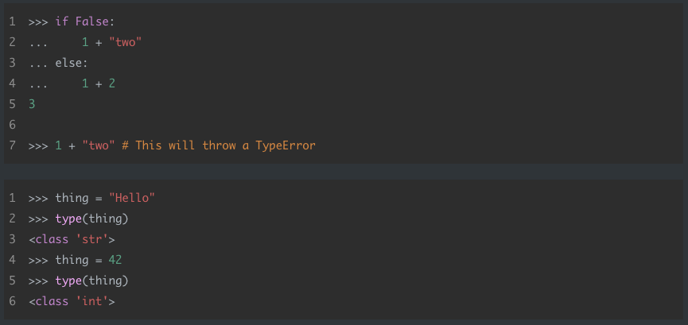
example: Dynamic typing in python

Slide 20
Static type checking with mypy
mypy performs static type checking, i.e. code doesn’t need to run to catch type errors.
Needs your help, in the form of type annotations.
Introduced in PEP 484, also called type hints.
Completely optional, types are suggested but not enforced.

Slide 21
Function annotation
def ceiling(number): rounded = … return rounded
def ceiling(number: float) -> int: rounded = … return rounded
Notes:
One of the most useful applications of type hinting is when writing functions.
If you accidentally pass a string to the ceiling-function somewhere in your script, you typically won’t notice until it crashes at runtime.
So let’s introduce the type hinting syntax and augment this function.
The argument is followed by a colon and the expected argument type.
The output is denoted by this arrow symbol, followed by the expected output type.
Let me show you a concrete example.

Slide 22
example: Using type hints
Run mypy on type_hinting_example.py through command line interface.
Run mypy on variable_hints.py through command line interface.
Clone repository* to play with this example.
https://github.com/smu095/presentations/tree/master/python101

Slide 23
Type hinting yes-men
More understandable, helps document code.
More maintainable, easier to refactor.
More reliable, catches bugs early.

Slide 24
Type hinting nay-sayers
Requires time and effort.
Introduces some overhead.
Introduces un-Pythonic verbosity.
Only available in Python 3.5+*.
Use assert statements instead.
* Works in earlier versions too, but with different syntax.

Slide 25
Should we use type hinting?
Adds little value in short, throw-away scripts.
Potential for a lot of value in bigger, collaborative projects.

Slide 26
Type hinting takeaways
Mildy controversial.
Completely optional, Python will remain dynamically typed.
More and more projects use type hinting and mypy, worth familiarising yourself with.
Use your best judgement!

Slide 27
Notes:
Let’s return to this picture of me working on reproducing that experiment I talked about earlier.

Slide 28
docstrings
Problem: Terribly documented code, took forever to figure out how it worked.
PEP 257 formalises a style guide for docstrings.
Docstrings come in different formats.
Up to you, but stay consistent within your project.
Notes:
In Python, doctoring can come in different formats.

Slide 29
A minimal function docstring
Every docstring should at the very least contain:
A one-liner summarising the function.
A description of the parameters.
A description of the return value.
Surround by triple quotes, place immediately after function declaration.
Notes:
Before we go into the different styles, let’s take a look at what a minimal doctoring should contain.

Slide 30
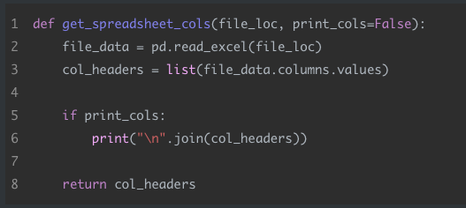
Example: undocumented function
Notes:
Developers have done good job of aptly naming the function, arguments and variables, not to hard to figure out what’s going on. Still, I have to parse the function to get the gist of it. Had the developer’s been sloppy in their naming choices, this would have been much harder and a doctoring almost be completely necessary.
Let’s look at three different doctoring formats that could be applied to this function.

Slide 31
Building documentation
reStructuredText, Google and Numpy docstrings are widely used.
Can produce well-formatted reference guides using tools like sphinx and autodoc.

Slide 32
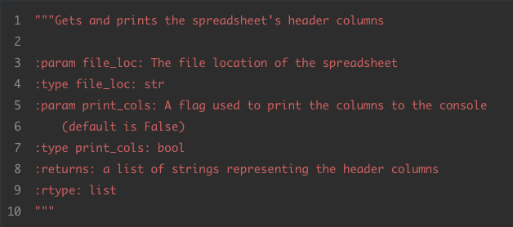
Example: reStructured text (RST)
Notes:
Used by Python’s documentation generation system Sphinx. However, not very human-friendly when in scripts. Other formats have been created that address this issue.

Slide 33
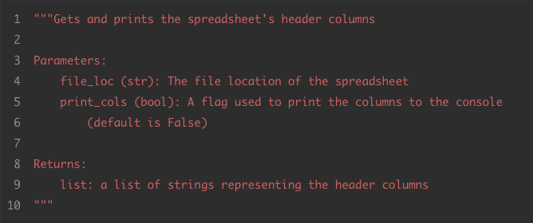
Example: google docstrings

Slide 34
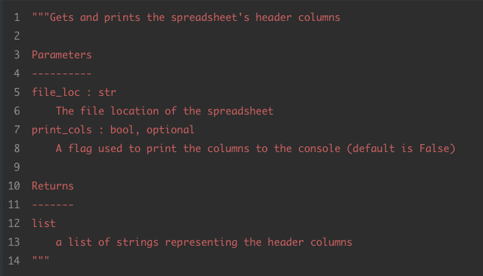
Example: numpy/SciPy docstrings
Notes:
Some IDEs have support for automatically generating a template for different types of doctoring formats, which remove all the boiler plate.

Slide 35
Including EXAMPLES
The numpy docstring format strongly encourages including working examples in docstrings.
Uses the docstring module to parse docstrings for runnable examples of code.
Idea: Make sure examples are running as shown, not intended as tests.
Notes:
Detail about the Numpy doctoring format is that it strongly encourages…

Slide 36
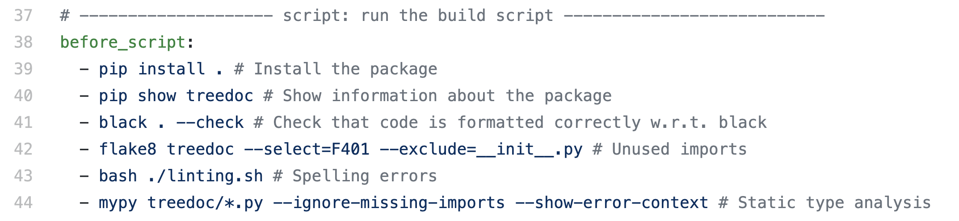
Practical use of linting tools
Typically used in continuous integration pipeline.

Slide 37
Summary (FRIENDLY VERSION)
Read PEP 8.
Follow the community’s recommended style guide.
Use linting and autoformatting tools when appropriate.
Probably a good idea to familiarise yourself with type hints.
Make a habit of writing good docstrings.

Slide 38
Summary (dictator VERSION)
Agree on an autoformatter and use it religiously.
Set master protection on repository.
All merge commits proposed via feature branches.
Set up CI to fail build if any errors are flagged by linters.

Slide 39
The end

