Slide 1
Breweries case study
Heindel adu, gabriel gonzales, amy markum

Slide 2
Breweries case study
Provide an overview of current market
Presence of breweries by state
Identify current saturation and market opportunities
Which states offer opportunities for market entry
Identify beer trends per market
What ABV is preferred in each state
Which states prefer more bitter beer

Slide 3
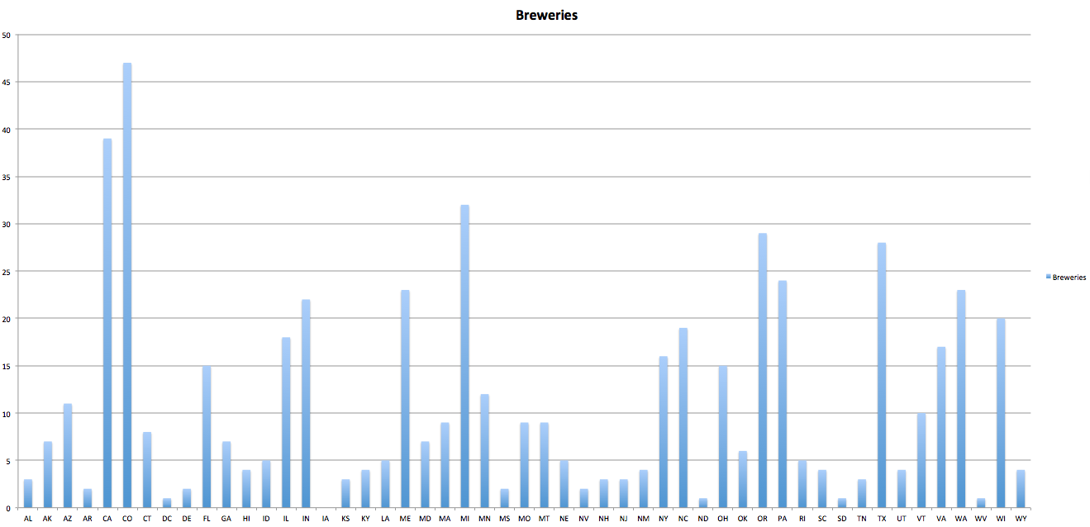
Breweries per state
Saturation & market opportunities

Slide 4
States with highest/lowest ABV & IBU rates
Highest ABV (.128)
Upslope Brewing Co, Boulder Co
Lee Hill Series Vol 5
(Quadrupel)
Lowest ABV (.001)
Uncommon Brewers, Santa Cruz CA
Scotty K
(Low alcohol beer)
Highest IBU Value (138)
Astoria Brewing Co, Astoria OR
Bitter Bitch Imperial IPA
(American Double / Imperial IPA)
Lowest IBU Value (4)
Anderson Valley Brewing Co, Boonville CA
Summer Solstice (Cream Ale) 2009/2011

Slide 5
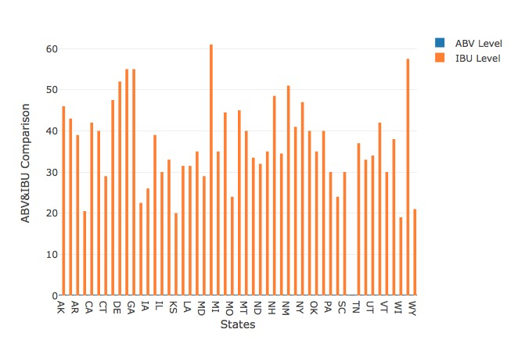
Direct comparison is difficult because scale is very different for the two types of data

Slide 6
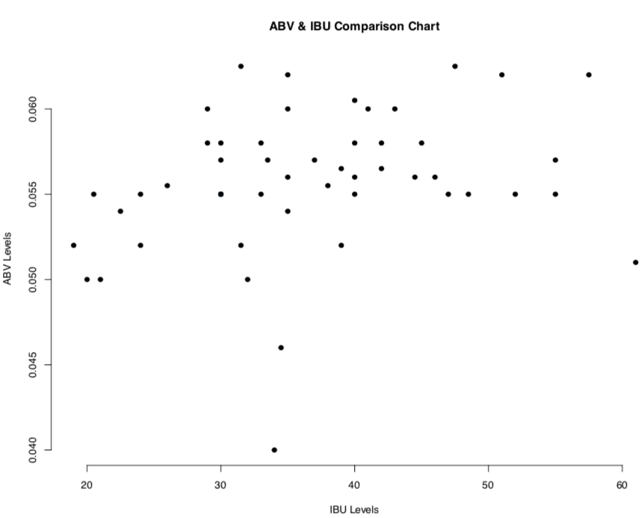
ABV & IBU breakout & comparison
Overall Median ABV = 0.056
Range = 0.001 – 0.128
Overall Median IBU = 35
Range = 4 – 138

Slide 7
ABV and IBU Relationship
Traditionally, there is a correlation between the bitterness (IBU) of a beer and its alcohol content (ABV). The malts used in beer are the counterpart to bitterness. So, if a beer has a lot of malts (probably higher ABV), then it can balance out a higher level of IBUs.
It can be viewed like this; more malt = higher ABV = greater ability to balance bitterness. This is a very simplified view that won’t apply to every beer but it’s a good place to start.

Slide 8
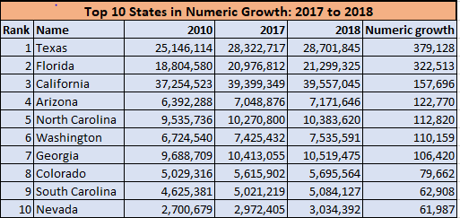
Potential Market Opportunities
Potential Markets lie in states such as AZ, FL, GA, SC and NV. Each state has ≤ 15 breweries.
Honorable Mention: Arkansas.
According to the Brewers Association, craft brewing had a $476 million economic impact on the state in 2017.
Brewers Association Data: https://www.brewersassociation.org/statistics/economic-impact-data/
Census data from the U.S. Census Bureau. https://www.census.gov/newsroom/press-releases/2018/estimates-national-state.html

Slide 9
conclusion
Provided an overview of current market and identified current market saturation and entry opportunities
Identified beer trends per market
SUGGESTIONS:
Additional research comparing current brewery locations against populations
Review of pertinent legislation and licensing restrictions

