Slide 1
Project Guidelines
DDSAnalytics is planning to leverage data science for talent management. The executive leadership has identified predicting employee turnover as its first application of data science for talent management. Before the business green lights the project, they have tasked your data science team to conduct an analysis of existing employee data.
You should identify (at least) the top three factors that contribute to turnover.
The business is also interested in learning about any job role specific trends that may exist in the data set (e.g., “Data Scientists have the highest job satisfaction”).

Slide 2
Summary Statistics
Age | Monthly Income | Education | Performance Rating | Job Satisfaction | Number of Companies Worked | Work Life Balance
Min. :18.00 | Min. : 1009 | Min. :1.000 | Min. :3.000 | Min. :1.000 | Min. :0.000 | Min. :1.000
1st Qu.:30.00 | 1st Qu.: 2911 | 1st Qu.:2.000 | 1st Qu.:3.000 | 1st Qu.:2.000 | 1st Qu.:1.000 | 1st Qu.:2.000
Median :36.00 | Median : 4919 | Median :3.000 | Median :3.000 | Median :3.000 | Median :2.000 | Median :3.000
Mean :36.92 | Mean : 6503 | Mean :2.913 | Mean :3.154 | Mean :2.729 | Mean :2.693 | Mean :2.761
3rd Qu.:43.00 | 3rd Qu.: 8379 | 3rd Qu.:4.000 | 3rd Qu.:3.000 | 3rd Qu.:4.000 | 3rd Qu.:4.000 | 3rd Qu.:3.000
Max. :60.00 | Max. :19999 | Max. :5.000 | Max. :4.000 | Max. :4.000 | Max. :9.000 | Max. :4.000

Slide 3
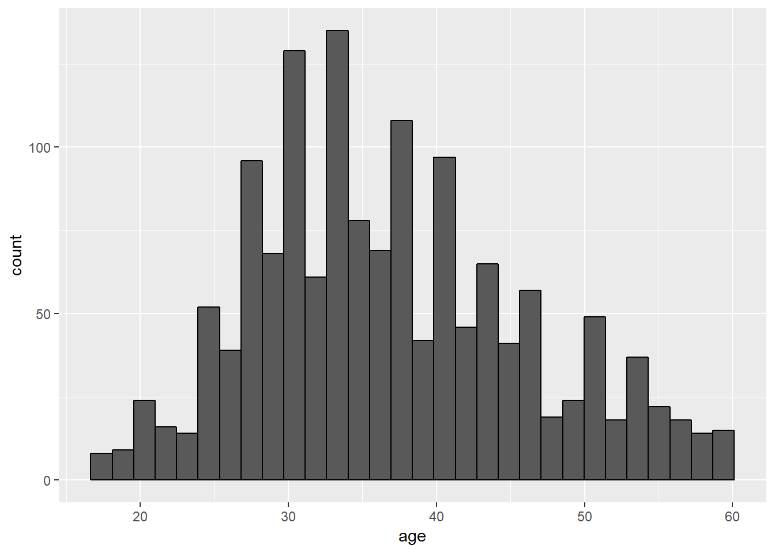
Age in the Workplace

Slide 4
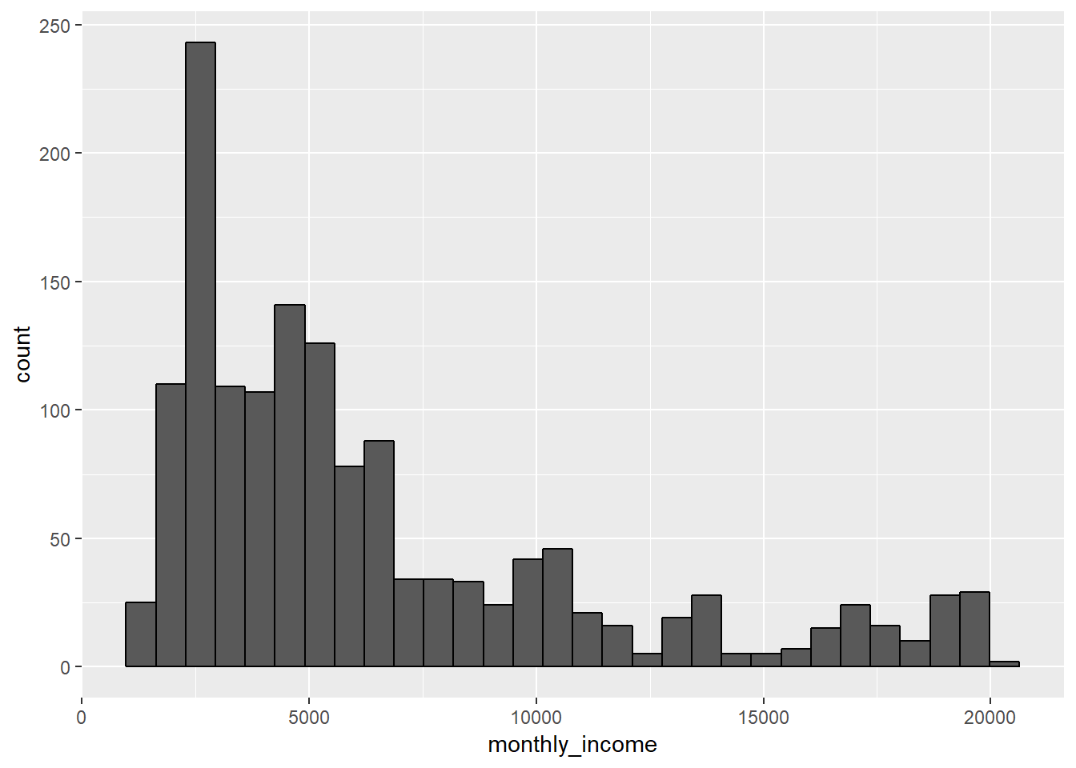
Income of Employees

Slide 5
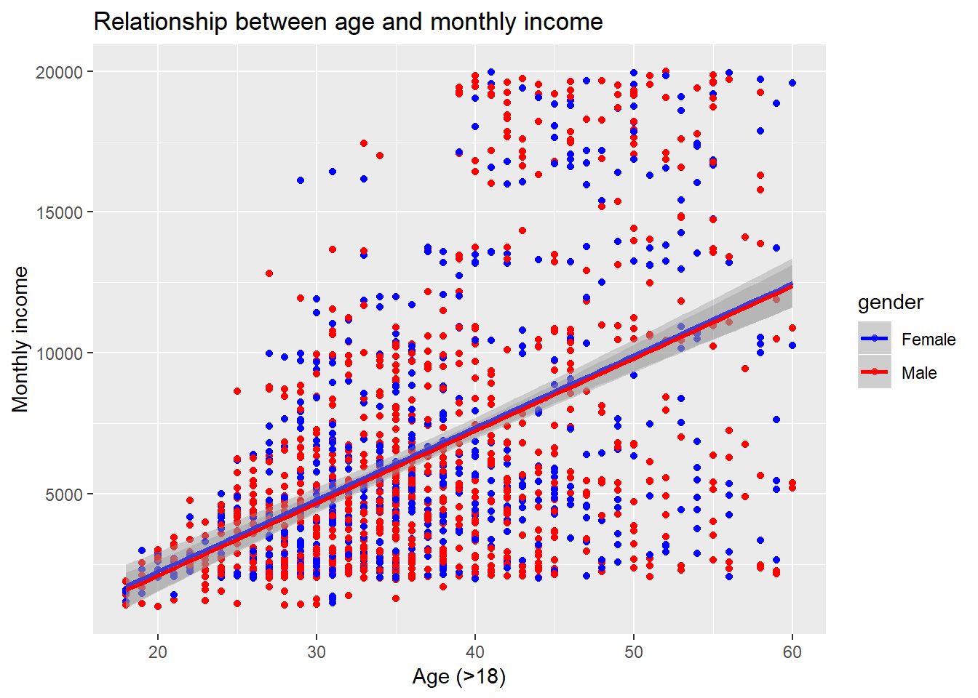

Slide 6

Indicators of Life Satisfaction
 | Estimate | Std. Error | t value | Pr(>|t|)
(Intercept) | 8.2065175 | 0.2961577 | 27.709963 | 0.0000000
age | 0.0138749 | 0.0074587 | 1.860228 | 0.0630541
employee_number | -0.0001671 | 0.0000812 | -2.057894 | 0.0397774
genderMale | 0.1430717 | 0.0998467 | 1.432913 | 0.1520965
hourly_rate | -0.0063841 | 0.0024048 | -2.654759 | 0.0080227
over_timeYes | 0.3346806 | 0.1086668 | 3.079879 | 0.0021095
total_working_years | -0.0159800 | 0.0106838 | -1.495725 | 0.1349413
years_at_company | 0.0230156 | 0.0143622 | 1.602505 | 0.1092602
Life Satisfaction is a combination of job satisfaction, environment satisfaction, relationship satisfaction

Slide 7
Gender, Education, Occupation
Gender
Female | 588
Male | 882
Education
1 | 170
2 | 282
3 | 572
4 | 398
5 | 48
Occupation
Healthcare Representative | 131
Human Resources | 52
Laboratory Technician | 259
Manager | 102
Manufacturing Director | 145
Research Director | 80
Research Scientist | 292
Sales Executive | 326
Sales Representative | 83

Slide 8
Management Positions Low Attrition Rate…
Healthcare Representative | 131
Human Resources | 52
Laboratory Technician | 259
Manager | 102
Manufacturing Director | 145
Research Director | 80
Research Scientist | 292
Sales Executive | 326
Sales Representative | 83
Manager | 102
Manufacturing Director | 145
Research Director | 80
Attrition ?
No | 310
Yes | 17

Slide 9
Let’s look at Non-Management Positions
Healthcare Representative | 131
Human Resources | 52
Laboratory Technician | 259
Manager | 102
Manufacturing Director | 145
Research Director | 80
Research Scientist | 292
Sales Executive | 326
Sales Representative | 83
Healthcare Representative | 131
Human Resources | 52
Laboratory Technician | 259
Research Scientist | 292
Sales Executive | 326
Sales Representative | 83
Attrition ?
No | 923
Yes | 220

Slide 10
Indicators of Attrition (Non-Management)
 | Estimate | Std. Error | z value | Pr(>|z|)
(Intercept) | 2.4546611 | 1.2579661 | 1.9512936 | 0.0510221
Age | -0.0364905 | 0.0143138 | -2.5493199 | 0.0107933
business_travelTravel_Frequently | 2.1809362 | 0.4455487 | 4.8949448 | 0.0000010
business_travelTravel_Rarely | 1.1322092 | 0.4078707 | 2.7759022 | 0.0055049
daily_rate | -0.0003473 | 0.0002376 | -1.4618012 | 0.1437957
distance_from_home | 0.0525711 | 0.0116762 | 4.5024174 | 0.0000067
education_fieldLife Sciences | -0.7526950 | 0.8276149 | -0.9094749 | 0.3630995
education_fieldMarketing | -0.5138872 | 0.8779787 | -0.5853071 | 0.5583412
education_fieldMedical | -0.9045149 | 0.8264456 | -1.0944639 | 0.2737516
education_fieldOther | -0.7586900 | 0.8868155 | -0.8555218 | 0.3922624
education_fieldTechnical Degree | 0.1782905 | 0.8476513 | 0.2103348 | 0.8334064
environment_satisfaction | -0.4506928 | 0.0892362 | -5.0505592 | 0.0000004
genderMale | 0.3979462 | 0.1997898 | 1.9918245 | 0.0463903
job_involvement | -0.5380517 | 0.1321696 | -4.0709186 | 0.0000468
job_roleHuman Resources | 1.4265512 | 0.6903097 | 2.0665379 | 0.0387777
job_roleLaboratory Technician | 1.5001670 | 0.4503858 | 3.3308491 | 0.0008658
job_roleResearch Scientist | 0.5301772 | 0.4575116 | 1.1588277 | 0.2465264
job_roleSales Executive | 1.1090742 | 0.4585444 | 2.4186843 | 0.0155768
job_roleSales Representative | 2.0306898 | 0.5255304 | 3.8640767 | 0.0001115
job_satisfaction | -0.4598033 | 0.0881611 | -5.2154890 | 0.0000002
marital_statusMarried | 0.2602160 | 0.2749518 | 0.9464061 | 0.3439415
marital_statusSingle | 1.4535908 | 0.2806692 | 5.1790176 | 0.0000002
num_companies_worked | 0.2298522 | 0.0429208 | 5.3552626 | 0.0000001
over_timeYes | 2.1428049 | 0.2143208 | 9.9981209 | 0.0000000
relationship_satisfaction | -0.2626179 | 0.0883886 | -2.9711747 | 0.0029666
total_working_years | -0.0775926 | 0.0308920 | -2.5117393 | 0.0120138
training_times_last_year | -0.1785569 | 0.0786633 | -2.2698894 | 0.0232143
work_life_balance | -0.4426958 | 0.1336424 | -3.3125387 | 0.0009245
years_at_company | 0.0900221 | 0.0499906 | 1.8007807 | 0.0717374
years_in_current_role | -0.1647293 | 0.0522888 | -3.1503714 | 0.0016306
years_since_last_promotion | 0.2384219 | 0.0496727 | 4.7998544 | 0.0000016
years_with_curr_manager | -0.1667260 | 0.0543606 | -3.0670352 | 0.0021619

