Slide 1






FULL-STACK WEB APPLICATION
QUICKCOURT
FIND YOUR COURT.
FIND YOUR PEOPLE.
THE PROBLEM
QuickCourt is a platform that enables sports enthusiasts to book local sports facilities such as badminton courts, turf grounds, tennis tables and other sports venues, while also allowing them to create or join matches with people in their area.
The goal is to provide an end-to-end experience that makes discovering facilities, booking accurately, and connecting with other players simple and reliable.
RUSHI · HELLY · KRISHNA
BOX CRICKET / 01
QUICKCOURT / 2026
SPORTS · BOOKING · COMMUNITY
01 / 08

Slide 2





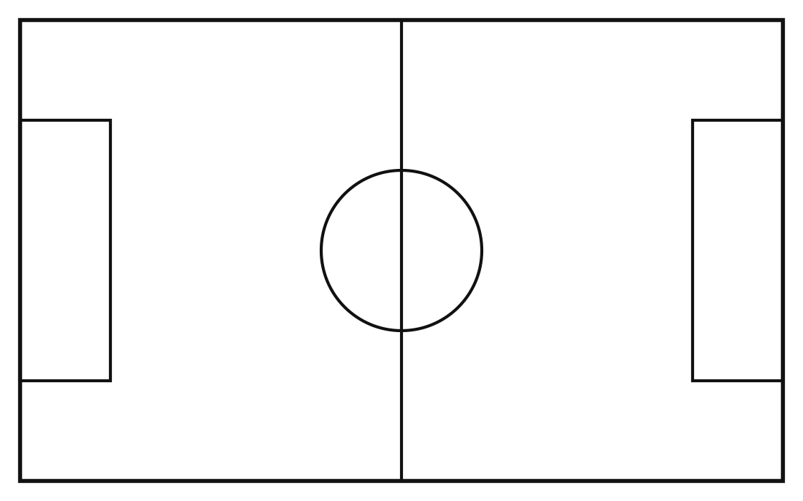



CORE CAPABILITIES
THE QUICKCOURT SOLUTION
01
02
03
DISCOVER
BOOK
CONNECT
Find nearby turf grounds, badminton courts, and sports facilities instantly using smart filters.
Secure real-time slots with accurate server-validated availability and pricing.
Create or join local matches, find players, and build a thriving sports community.
THREE ROLES, ONE PLATFORM
PLAYER
FACILITY OWNER
ADMIN
QUICKCOURT / 2026
DISCOVER · BOOK · PLAY
02 / 08

Slide 3





TECHNICAL FOUNDATION
BUILT FOR SPEED & SIMPLICITY
PLAYER / OWNER / ADMIN
MVP STACK
The MVP stack is designed for rapid iteration, leveraging standard web technologies and minimal infrastructure overhead.
FRONTEND — VANILLA JS SPA
REST API
One index.html — vanilla JS SPA, hash router, no build step
Node.js + Express 5 REST API
SQLite database, seeded automatically
Server-side lock prevents double booking
Simulated payment gateway
NODE.JS + EXPRESS 5
SQLITE DATABASE
FAST, RELIABLE, AND FUNCTIONAL.
QUICKCOURT / 2026
ARCHITECTURE
03 / 08

Slide 4
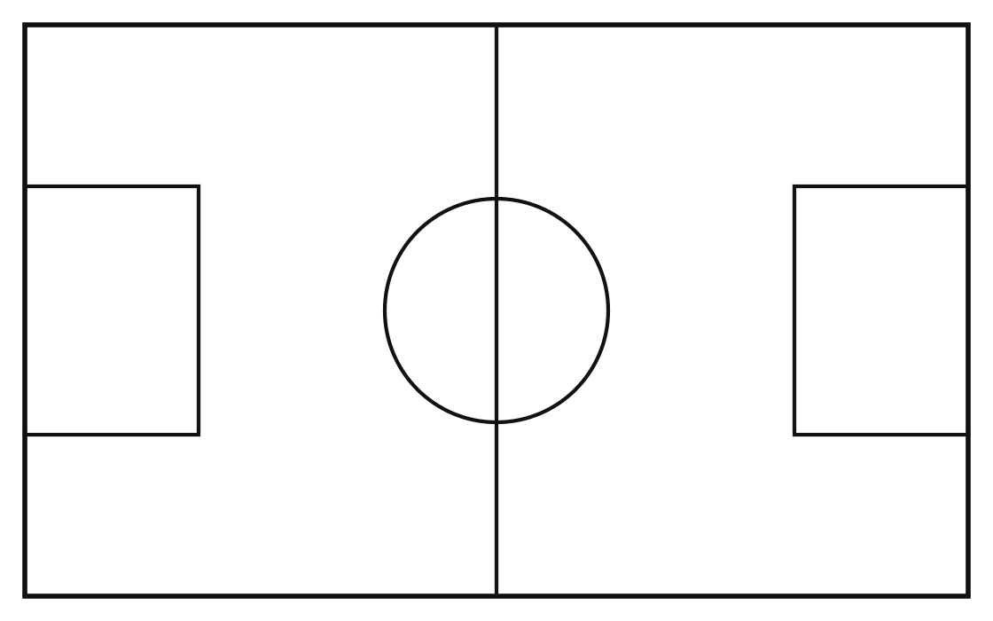

FEASIBILITY & VIABILITY
THE GAME PLAN
01
02
03
04
TECHNICAL
OPERATIONAL
BUSINESS
SCALABILITY
Proven, minimal stack (Express + SQLite) keeps build risk low.
Single-server deploy; no external services to manage for MVP.
Low infra cost; commission-ready booking flow from day one.
Clear upgrade path from SQLite to production-grade services.
MVP → VALIDATE → SCALE
QUICKCOURT / 2026
STRATEGY
04 / 08

Slide 5



MORE THAN A BOOKING PLATFORM
QUICKCOURT CONNECTS PLACES, PLAYERS AND PLAY.
FOR PLAYERS
FOR FACILITY OWNERS
FOR THE SPORTS COMMUNITY
FIND FASTER
MANAGE EVERYTHING
MORE ACCESS
Discover nearby venues using filters.
Manage courts and block slots.
Make facilities easier to discover.
BOOK WITH CONFIDENCE
UNDERSTAND DEMAND
MORE PARTICIPATION
Availability checked by server.
View bookings, revenue, occupancy.
Help people find matches.
FIND YOUR PEOPLE
REDUCE MANUAL WORK
MORE UTILIZATION
Create and join matches.
Auto-generate availability.
Manage bookings efficiently.
MORE PLAY. LESS SEARCHING.
QUICKCOURT / 2026
PLAYERS · OWNERS · COMMUNITY
05 / 08

Slide 6


END-TO-END EXPERIENCE
FROM "I WANT TO PLAY" TO "GAME ON."
01
02
03
04
05
DISCOVER
CHOOSE
BOOK
CONNECT
RETURN
Choose sport → search venues → filter
Open venue → check pricing → select slot
Server checks → reserve 10 min → confirm
Find match → create or join → meet players
Complete game → review venue → book again
NO DOUBLE BOOKING · AUTO AVAILABILITY · SERVER-SIDE PRICE · ROLE-BASED ACCESS
QUICKCOURT / 2026
THE JOURNEY
06 / 08

Slide 7
RESEARCH SOURCES
WE STUDIED HOW PEOPLE ALREADY BOOK & PLAY
PLATFORM
WHAT WE OBSERVED
RELEVANCE TO QUICKCOURT
PLAYO
Sports venue discovery, venue booking, joining games and finding players.
Validates the combined venue-booking + player-community model.
HUDLE
Sports venue discovery, activity selection, location-based venue browsing and slot booking.
Useful reference for venue/activity selection and booking flows.
KHELOMORE
Sports venue booking, finding games, hosting games and finding players.
Demonstrates the value of combining venue discovery with game/community participation.
THE MARKET ALREADY PROVES THE NEED FOR DIGITAL SPORTS DISCOVERY.
QUICKCOURT'S FOCUS: A simple end-to-end experience for discovery → booking → matchmaking.
Research references accessed September 2026
QUICKCOURT / 2026
RESEARCH
07 / 08

Slide 8


QUICKCOURT
FIND YOUR COURT. FIND YOUR PEOPLE.
THANK YOU.
LET'S GET THE GAME STARTED.
RUSHI · HELLY · KRISHNA
QUICKCOURT / 2026
THE GAME IS JUST GETTING STARTED
08 / 08

