Slide 1
Project: Hare and Tortoise Competition
Race between hare and tortoise
Learn vector, class, and object

Slide 2
Hare and Tortoise Competition
Hare and Tortoise move in a pattern recorded in vector of integers. Simulate the competition between them.
This project has the following classes:
Hare: record the current position of a hare and how it moves.
Tortoise: similar to hare
Road: describe a road object in competition
Competition: how hare, tortoise, and road work together to simulate the competition process
RunCompetition: test the competition class

Slide 3
Hare and Tortoise competition
A competition involves a hare, a tortoise and a road. Once a road is given, its last block is known.
The road can be slippery, so competitors can fall backward (but not further left to block 0, image we put a road blocker cone at block 0. Similarly, competitors cannot go beyond the last block.)
Assume that blocks start from 0.
In each round, each competitor takes its turn to move, until at least one of them reaches the last block. Report result.

Slide 4
Movement of tortoise
Fast plod (3 blocks forward) 50%
Slip (6 blocks backward) 20%
Slow plod (1 block forward) 30%
How to represent this movement pattern?
Generate a random number in [1, 10]
1 2 3 4 5 6 7 8 9 10
If the number is in [1, 5], then fast plod;
if the number is in [6, 7], then slip;
if the number is in [8, 10], then slow plod.

Slide 5
Movement of tortoise in vector
Fast plod (3 blocks forward) 50%
Slip (6 blocks backward) 20%
Slow plod (1 block forward) 30%
represent movement pattern in vector
Generate a random number in [0, 9]
0 1 2 3 4 5 6 7 8 9
If the number is in [0, 4], then fast plod;
if the number is in [5, 6], then slip;
if the number is in [7, 9], then slow plod.
0 1 2 3 4 5 6 7 8 9 (index)
3 | 3 | 3 | 3 | 3 | -6 | -6 | 1 | 1 | 1

Slide 6
Movement of tortoise in vector
Generate a random number in [0, 9]
0 1 2 3 4 5 6 7 8 9
If the number is in [0, 4], then move 3 blocks;
if the number is in [5, 6], then move -6 blocks;
if the number is in [7, 9], then move 1 block.
0 1 2 3 4 5 6 7 8 9 (index)
Suppose that the tortoise's current position is 25, suppose random number 4 is generated, where element at index 4 represents moving forward 3 blocks, so current position is changed to 25 + 3 = 28.
3 | 3 | 3 | 3 | 3 | -6 | -6 | 1 | 1 | 1

Slide 7
Movement of hare in vector
Sleep (no move at all) 20%
Big hop (9 blocks forward) 20%
Big slip (12 blocks backward) 10%
Small hop (1 block forward) 30%
Small slip (2 blocks backward) 20%
represent movement pattern in vector
0 1 2 3 4 5 6 7 8 9 (index)
0 | 0 | 9 | 9 | -12 | 1 | 1 | 1 | -2 | -2

Slide 8
Represent Move Patterns
Suppose the move patterns of an animal is represented by a vector {1, 2, 2, 3, -2}?
What does this mean?
1 out 5 times, ie, 20%, move 1 step forward
2 out 5 times, ie, 40%, move 2 steps forward
1 out of 5 times, ie, 20%, move 3 steps forward
1 out of 5 times, ie, 20%, move 2 steps backward

Slide 9








How to move

Slide 10

Step to move is like a choice in a spin wheel

Slide 11
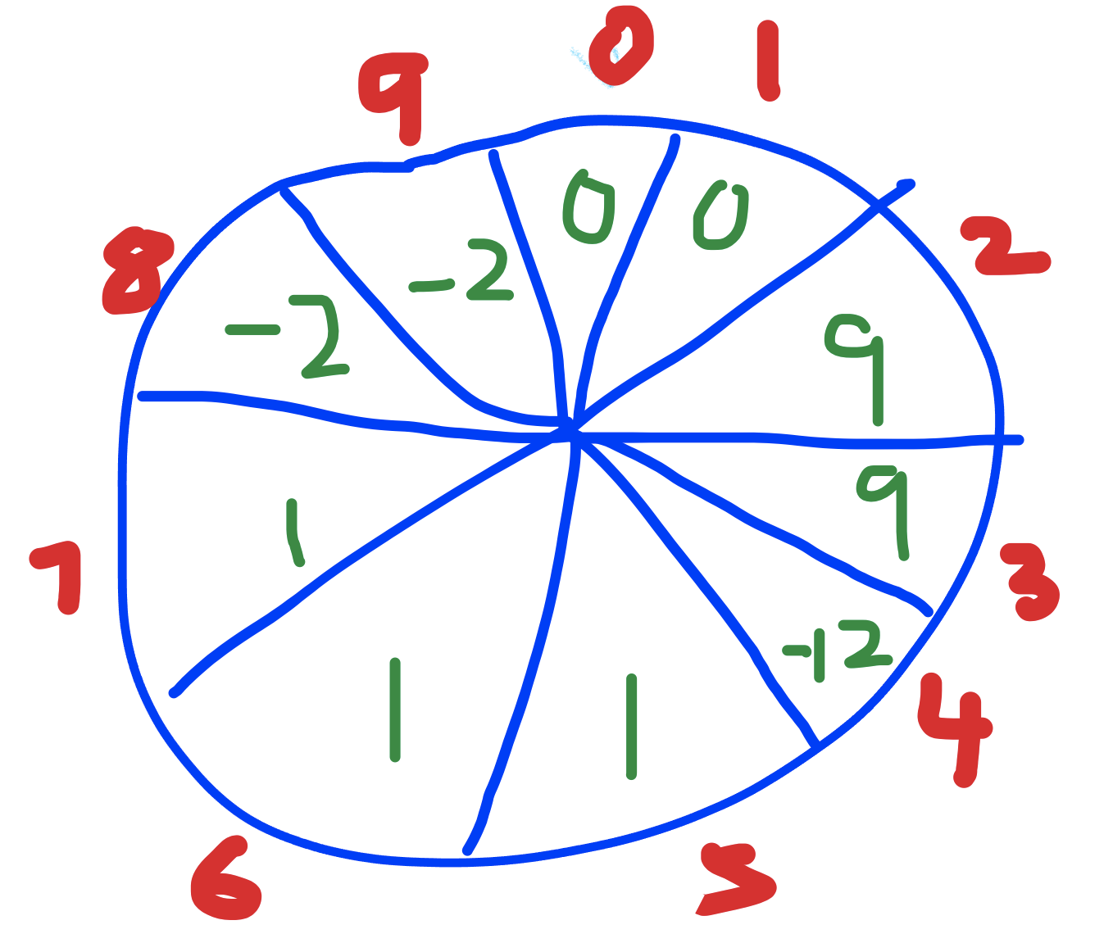
How to move
Generate a random index in [0, size_of_patterns-1].
The step to move is ...
What is the position after the move?

Slide 12
Hare class: Data members and operations
Data members are attributes of hare, that is, what are common properties for a hare?
Can we talk current position of hare?
Can we talk move pattern of a hare?
Can we talk road length of a hare?

Slide 13
Hare class: Data members
Data members are attributes of hare, that is, what are common properties for a hare?
What type to represent current position of hare?
What type to represent move pattern of hare?

Slide 14
Class Hare
#ifndef Hare_H
#define Hare_H
#include <vector>
class Hare {
//TODO
};
#endif

Slide 15
Data Members of Hare
private:
std::vector<int> patterns;
int position;

Slide 16
Constructors and methods of Hare
public:
Hare();
//a typical hare that sleeps 20% of the time,
//move 9 squares to the right 20% of the time,
//move 12 squares to the left 10% of the time,
//move 1 square to the right 30% of the time,
//move 2 squares to the left 20% of the time.
Hare(std::vector<int> patterns, int position);
Hare(int* arr, int size, int position);

Slide 17
Methods of Hare
void move();
int getPosition() const;
void setPosition(int position);

Slide 18
Class Hare
//TODO: define default constructor.
//1. Default constructor initializes position to be 0,
//and move patterns to reflect the following data.
//a typical hare that sleeps 20% of the time,
//move 9 squares to the right 20% of the time,
//move 12 squares to the left 10% of the time,
//move 1 square to the right 30% of the time,
//move 2 squares to the left 20% of the time.

Slide 19
Non-default constructors of Hare: II
//TODO: given move pattern together and given //position, use give parameter to initialize //corresponding data members.
Hare(std::vector<int> patterns, int position) {
…
}
Hare(int* arr, int size, int position) {
…
}

Slide 20
move method of Hare: III
//Move the hare by generating a random number
//in [0, size of vector patterns),
//then move the animal according to its move pattern.
//The position will be further validated once the animal //participates in a competition and knows road length.
//Competitor call fall of roads (suppose we have pads
//at both ends of the road.
void Hare::move() {
//Your code goes here.
}
Hints:
No need to use if-else statement.
Use index of vector instead.

Slide 21
getPosition method of Hare: IV
int Hare::getPosition() const {
//Your code goes here.
}

Slide 22
setPosition method of Hare: IV
//Position generated by move() might be out of //boundary of the road (slip pass the leftmost block
//or slop past the rightmost block of the road),
//reset the position to an appropriate number.
void Hare::setPosition(int newPosition) {
//Your code goes here.
}

Slide 23
Class Tortoise
//TODO: define constructors.
//1. Default constructor initializes position to be 0,
//and move patterns to reflect the following data.
//50% of the time, tortoise moves forward 3 blocks.
//20% of the time, tortoise moves 6 blocks backward.
//30% of the time, tortoise moves 1 block forward.
Other code will be similar to that of Hare class.

Slide 24
Road
Road can be thought as adjacent blocks (squares) of mud, when an animal step on a block, the animal will leave a mark.
A hare leaves letter ‘H’, while a tortoise leaves letter ‘T’. An untouched block is represented by a space.
Use a vector of char to represent a road. It remains to find operations for this data member.

Slide 25
Class Road
What are data members?
What are operations on data members?
How to define constructor?
//Default constructor to create a road with 70 blocks,
//each block is initialized with a space char.
//A non-default constructor to create a road with //proper length. A parameter representing length is provided.

Slide 26
Class road: III
//Get the length of the road.
int Road::length(){
//Your code goes here.
}
//Put ch into (index)th element of data member blocks.
void Road::mark(int index, char ch){
//Your code goes here.
}

Slide 27
Class road: IV
//print out the contents of road
void display() const;

Slide 28
Class Competition
Data members
Constructors
Destructor
Operations

Slide 29
Class Competition - II
void Competiton::play() {
//find out last block of the road.
int lastBlock = …;
int round = 1; //Record time to start race.

Slide 30
Class Competition - III
as long as neither hare nor tortoise reaches the last block
move hare
move tortoise
adjust hare’s position if it is too left or too right.
adjust tortoise’s position if it is too left or too right.
Mark road blocks where hare and tor reach.
Print out round, then print road as a string.
Clear the corresponding block of the road to prepare for the next round.

Slide 31
Class Competition -- III
//Once at least one of hare and tortoise //reaches the last block, report the result.
if both animals reaches the endline
print out “It is a tie.”
else if hare reaches the endline
print out “Yuck. Hare wins.”
else print out “Yay!!! Tortoise wins.”
} //end of method start

Slide 32
Client of Competition – string things up
int main() {
Competition race;
race.start();
//Create a object of Competition
//using non-default constructor.
//Call start method from this object.
return 0;
}

Slide 33
Sample output for a road of 10 blocks
1: T
Ouch, tortoise bites hare.
2: H T
3: H T
4: T
Ouch, tortoise bites hare.
5: T H
6: T H
7: H T
8: H T
9: H T
Tortoise wins. Yay!!!

Slide 34
Sample output for a road of 10 blocks
1: H T
2: H T
3: HT
4: T H
5: T H
6: T H
7: T H
Hare wins. Yuck.

Slide 35
Sample output of a road of 10 blocks
1: H T
2: T H
3: T
Ouch, tortoise bites hare.
4: H T
5: H T
6: TH
7: TH
8: T H
9: HT
10: T H
11: T H
12: T H
13: T
Ouch, tortoise bites hare.
14: HT
15: T
Ouch, tortoise bites hare.
It is a tie.

Slide 36
Summary
In this project, we learn how to simulate or model problems.
We define class and create objects to call on appropriate methods.
We use vectors to represent the moving pattern of animals, and we use a vector as data member of a road.

