Slide 1
CommonAccord.org
Wei Shen and Regina

Slide 2
Table of Contents
01
02
04
05
Mission Vision
Motivation vs Drawbacks
Route Map/Formulae
03
Overview, Contributors, Goals
Advantage and pitfalls
4-Pronged Approach
End Goal
GitHub Excursion
Commentary
06
An ecosystem of happy players
Templates, Packages, Languages
Learning points Q&A

Slide 3
Who is CommonAccord
#1. Who
#2. What
#3. How
An initiative
Create global codes of legal transacting
Codify & Automate legal documents (contracts/permits/documents)
#4. Places of the World
#5. Unify
#6. Partners
World Commerce & Contracting
MIT Connection Science
Caisse Des Depots Groupe
Lab Chaiin
Each jurisdiction, in every language
1 “global” code for international dealings and coordination
Notes:
A: Who are they and What do they do?
B: (#1 Who, #2What, #3How,#Places,#5Unify)
A: ambitious effort that cannot be a solo effort. (#6Partners) + 2-3 lines of these partners

Slide 4
Integration
100%
Definitely
Connected system
Features
Via templates managed like software on GitHub or elsewhere
Commented
Rated
Annotated like legal codes
Must have
Flexible
Adaptable (“forked”)
Integrated (“merged”)
Audit-friendly
Notes:
A: So now we know the end is all about integrated end product beyond a 100% connected system…
B: Yes and for obvious reasons, it must have flexibility + lawyer /user friendly features since it would not be reasonable to expect every lawyer can code.

Slide 5
Table of Contents
01
02
04
05
Mission Vision
Motivation vs Drawbacks
Route Map/Formulae
03
Overview, Contributors, Goals
Advantage and pitfalls
4-Pronged Approach
End Goal
GitHub Excursion
Commentary
06
An ecosystem of happy players
Templates, Packages, Languages
Learning points Q&A

Slide 6
—CommonAccord.Org (Call for Global Codification of Legal Documents)
“Codification promotes clarity and stability.
It allows the accumulation of knowledge about an issue in the form of commentary, precedents and familiarity. In economic terms, the reuse of known text allows “network benefits” and “learning benefits.” ”
Notes:
A

Slide 7
Drawbacks
Requires a strong initiator to organize the codification effort
Committee participation (limiting voices)
Cannot deal with too many variations
Sticky (stuck updates + improvements in pipelines
Notes:
B: Certainly there are also drawbacks. Like #1, #2
A: #3, #4

Slide 8
Formulae
Notes:
B: This sounds like a moving equation; is there some helpful formulae?

Slide 9
Table of Contents
01
02
04
05
Mission Vision
Motivation vs Drawbacks
Route Map/Formulae
03
Overview, Contributors, Goals
Advantage and pitfalls
4-Pronged Approach
End Goal
GitHub Excursion
Commentary
06
An ecosystem of happy players
Templates, Packages, Languages
Learning points Q&A

Slide 10
Call currently many proof-of-concept materials, software and many document models at www.commonaccord.org
Contribution
Software: Python codes exist.
Need codes + integration to handle all languages (R2L + non-alphab)
Tech specs to i) ︎support s/w + soln uses ii) legal template standards
Legal materials
Expand inventory / convert into codes [GitHub/ assisted]
Curation
Public interest of templates agst
Fraudulent / low-quality soln
Concentration of interest groups
Coordination
Global interoperability for wide domains & jurisdictions
Business, insurance, fin regulation, public health
Organizations, trade groups, NGOs
Governance
“Open” to avoid control by any faction
”Simple” to support participation, authorship and adoption
“Fair” to highlight trade-offs/contentions
Notes:
A: Yes. There is! –sort of.. There is call on their website. (Contribution)
B: (Curation, Coordination, Governance)

Slide 11
Table of Contents
01
02
04
05
Mission Vision
Motivation vs Drawbacks
Route Map/Formulae
03
Overview, Contributors, Goals
Advantage and pitfalls
4-Pronged Approach
End Goal
GitHub Excursion
Commentary
06
An ecosystem of happy players
Templates, Packages, Languages
Learning points Q&A

Slide 12
An ecosystems of happy players
Notes:
B: Title

Slide 13
Achieve legal standard templates + customization + enforceability
2
4
1
3
Participants sync their files with partners in
Git
Blockchain
agreed methods (emails)
Similar to conventional legal doc in word-processing by lawyers
Files are
private,
controllable by them
shared and handled
as intended
Every participant has their own files stating legal r/s + transaction history with each partner
Notes:
B: #1, #2
A: #3, #4

Slide 14
Table of Contents
01
02
04
05
Mission Vision
Motivation vs Drawbacks
Route Map/Formulae
03
Overview, Contributors, Goals
Advantage and pitfalls
4-Pronged Approach
End Goal
GitHub Excursion
Commentary
06
An ecosystem of happy players
Templates, Packages, Languages
Learning points Q&A

Slide 15
GitHub: Excursion
Case Examples Template (yc combinator & NDA)
Founder
Packages & Languages
Notes:
B: Over at the GitHub, number of repos, 1 member, earliest, latest
A: Languages, topics like SMUCCLAW,

Slide 16
Table of Contents
01
02
04
05
Mission Vision
Motivation vs Drawbacks
Route Map/Formulae
03
Overview, Contributors, Goals
Advantage and pitfalls
4-Pronged Approach
End Goal
GitHub Excursion
Commentary
06
An ecosystem of happy players
Templates, Packages, Languages
Learning points Q&A

Slide 17

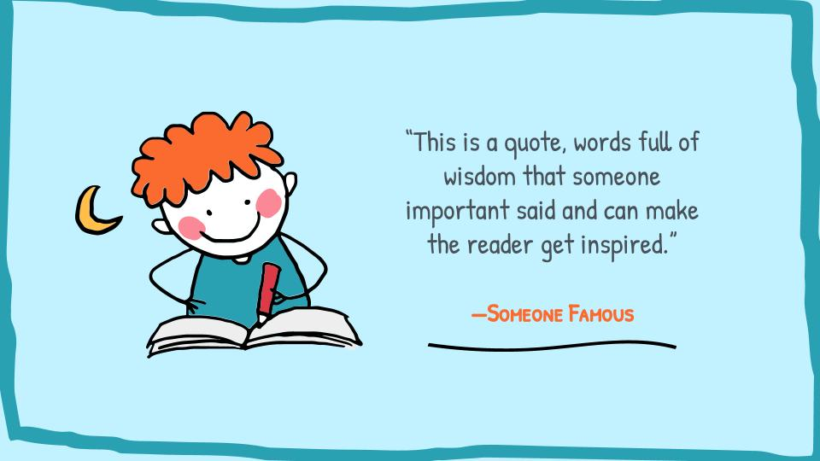

Commentary & Demo
https://youtu.be/7VAwpMTSaCA
Notes:
Interview & Demo

Slide 18
Learning Points
E = Existing R= Required
Label | Example
E | Strong Industry support: Relevant use cases
R | Easy to use, essential & scalable product
E | Infrastructure and tools route map
R - E | Awareness and Education
Notes:
A-B-A-B

Slide 19
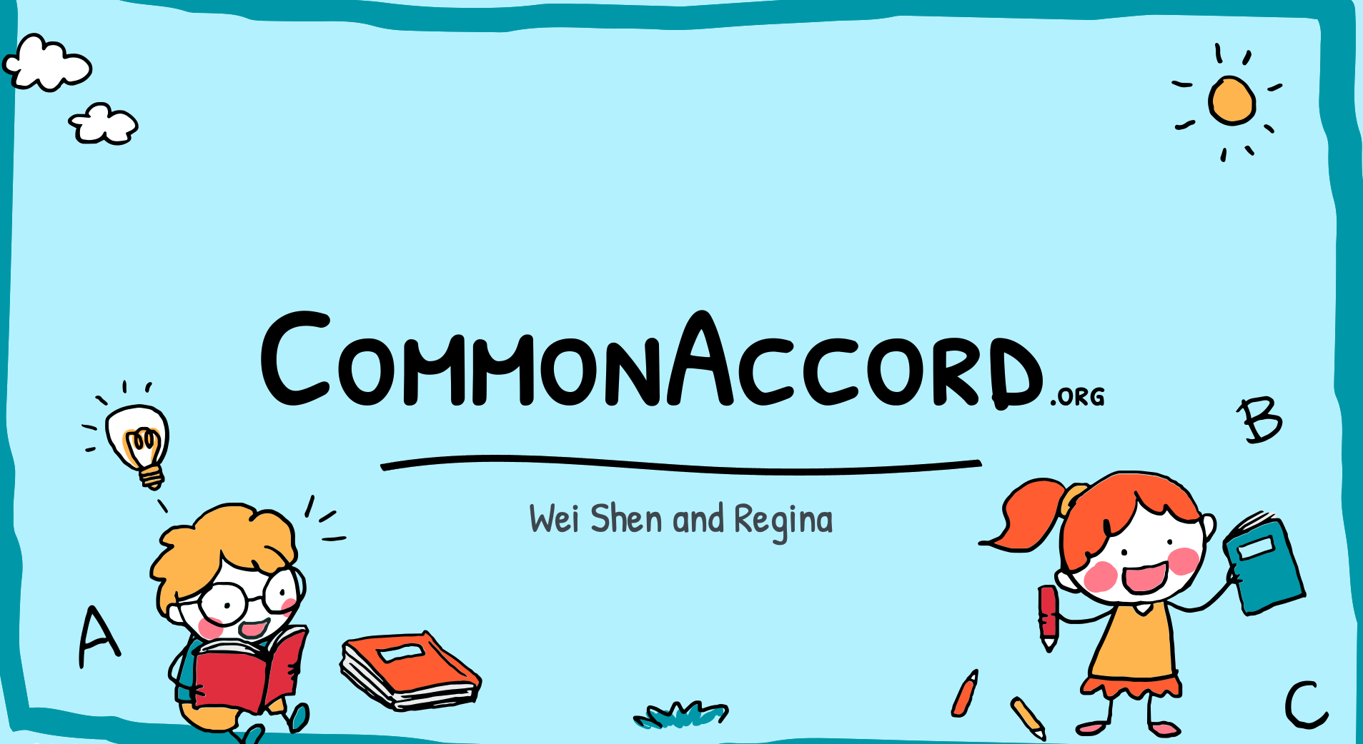
That’s all folks

