Slide 1
Performance Engineering for AI Systems
Guojie Luo

Slide 2
Benchmarking & Performance Metrics
Profiling & Roofline Analysis
Auto-Tuning & KernelGen
End-to-End Optimization
Lab: Performance Analysis in Practice

Slide 3
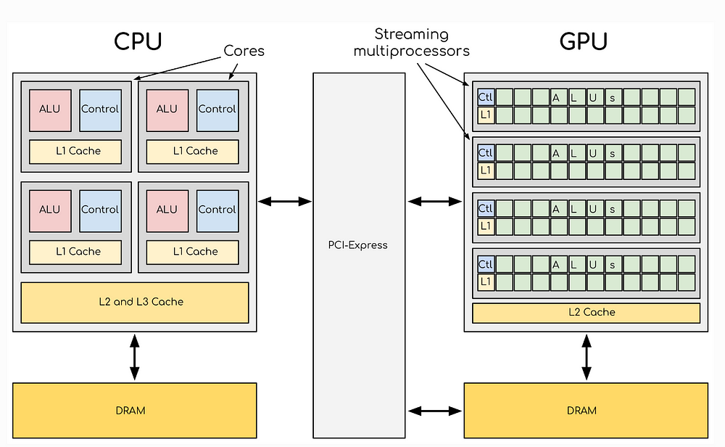
Why Do We Need Performance Metrics?
In High-Performance Computing (HPC) and system optimization,
we need to quantify program and hardware performance — different metrics reveal bottlenecks at different levels
Common Performance Metrics
FLOPS
Bandwidth
Compute Capacity
Bandwidth
Latency
Utilization
Latency
Resource Utilization
Roofline Model
Performance Ceiling Model
Image source: Medium - CPU vs GPU Architecture
Notes:
为什么需要性能指标？在HPC和系统优化中，我们必须定量地分析程序和硬件的性能——不同的指标揭示不同层次的瓶颈。本讲介绍五类核心指标：FLOPS衡量计算能力，带宽衡量数据吞吐，延迟衡量单次访问时间，利用率衡量资源使用效率，Roofline Model则是综合分析瓶颈类型的可视化工具。

Slide 4
Classification of Performance Metrics
Compute Capacity
Data Access Capability
Compute Bound
Memory Bound
FLOPS
Bandwidth
Measures the number of floating-point operations a processor can execute per second — the core metric for compute-intensive task performance.
Represents the amount of data transferable per unit time, determining throughput capacity for data-intensive applications.
Utilization
Latency
Reflects the actual usage efficiency of hardware resources, helping identify whether compute units are fully utilized.
Represents the time required to complete one data access, directly affecting program responsiveness and real-time performance.
Roofline Model used to analyze both bottleneck types, helping determine whether a program is compute-bound or memory-bound
Notes:
性能指标可以按瓶颈类型分为两大类。第一类是计算能力相关：FLOPS衡量每秒浮点运算次数，是计算密集型任务的核心指标；利用率反映硬件资源的实际使用效率。第二类是数据访问能力相关：带宽决定数据密集型应用的吞吐上限；延迟衡量单次数据访问的时间代价。Roofline Model则综合两类瓶颈，判断程序究竟是计算瓶颈还是访存瓶颈，从而指导优化方向。

Slide 5
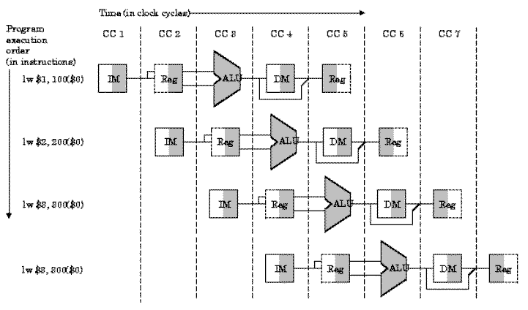
What is FLOPS ?
FLOPS = Floating Point Operations Per Second
Assumed CPU Specs
Clock Frequency
FLOPs per Cycle
3 GHz
8 FLOP
Theoretical Performance Calculation
FLOPS = Frequency × FLOPs per Cycle
= 3×10⁹ × 8
= 24 GFLOPS
Note: This is the theoretical peak; actual performance is typically lower
Image source: University of Florida - CPU Pipeline
Notes:
我们来看一个FLOPS计算示例。假设CPU主频3 GHz，每个时钟周期可执行8个浮点操作，则理论峰值性能等于频率乘以每周期FLOP数，即3×10的9次方乘以8，等于24 GFLOPS。需要强调：这是理论峰值，实际性能通常远低于此，因为流水线停顿、访存延迟等因素会拉低实际算力。
理论FLOPS与实际FLOPS之间往往存在显著差距。理论峰值完全由硬件规格决定，基于核心数、主频和每周期指令数计算得出。而实际FLOPS受多种因素影响，通常远低于理论峰值。主要影响因素有四个：Cache miss导致访存停顿；分支预测失败导致流水线冲刷；指令依赖限制并行度；以及内存带宽不足造成数据供给跟不上计算速度。优化的目标就是尽量填满这个差距。

Slide 6
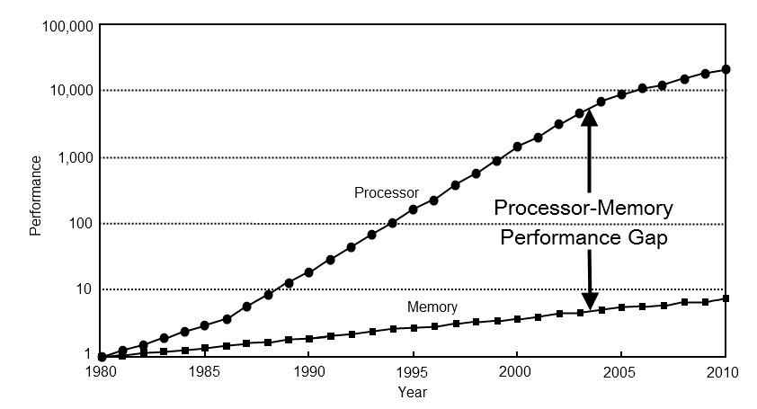
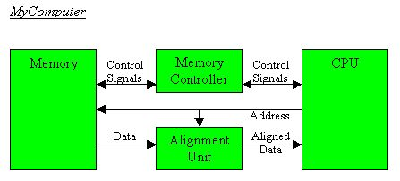
Bandwidth
Bandwidth
Represents the amount of data transferable per unit time
Common Units
MB/s
Megabytes/second
GB/s
Gigabytes/second
TB/s
Terabytes/second
Use Cases
Memory Bandwidth
Disk Bandwidth
Network Bandwidth
Image source: ForrestTheWoods - Memory Bandwidth,
University of Pittsburgh - Memory Controller
Notes:
带宽（Bandwidth）表示单位时间内可传输的数据量，决定了数据密集型应用的吞吐上限。常用单位是MB/s、GB/s和TB/s。带宽有三种典型场景：内存带宽，即CPU/GPU访问主存的速度；磁盘带宽，决定I/O吞吐；网络带宽，影响分布式训练中的通信效率。在AI训练场景中，GPU显存带宽是最常关注的瓶颈之一。

Slide 7
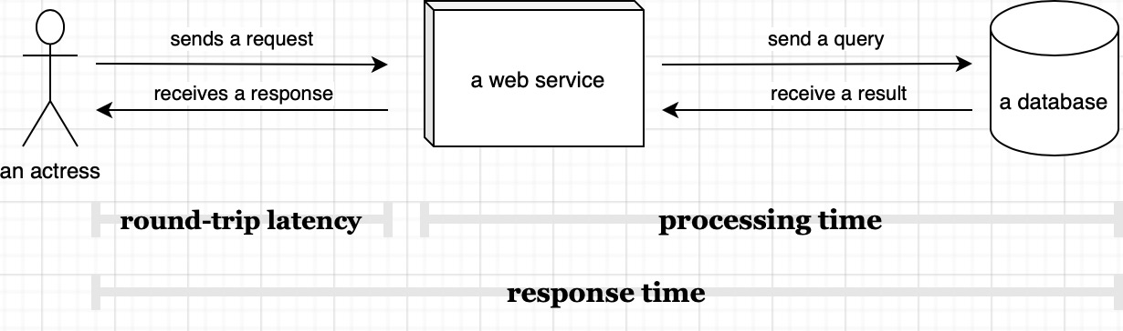
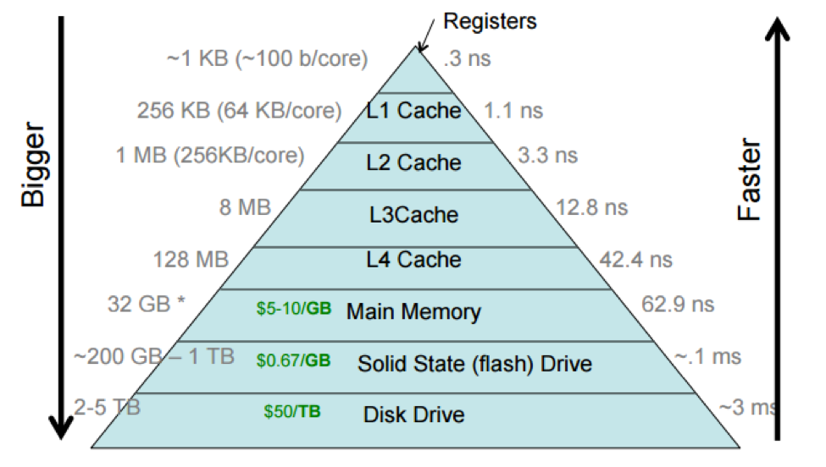
What is Latency?
Latency
Represents the time required to complete one operation
Typical Scenarios
Memory Access Latency
Image source: Scalable Developer - Latency Timeline
Network Latency
Disk Access Latency
Common Units
ns
μs
ms
Nanosecond
Microsecond
Millisecond
10⁻⁹ second
10⁻⁶ second
10⁻³ second
Image source: Brown University - Memory Hierarchy
Notes:
延迟（Latency）表示完成一次操作所需的时间，关注的是单次请求的响应速度。典型场景包括：内存访问延迟、网络延迟、磁盘访问延迟。常用单位有三个：ns纳秒，即10的负9次方秒；μs微秒，10的负6次方秒；ms毫秒，10的负3次方秒。延迟与带宽的核心区别在于：延迟描述单次操作有多快，带宽描述持续处理数据的吞吐能力。

Slide 8
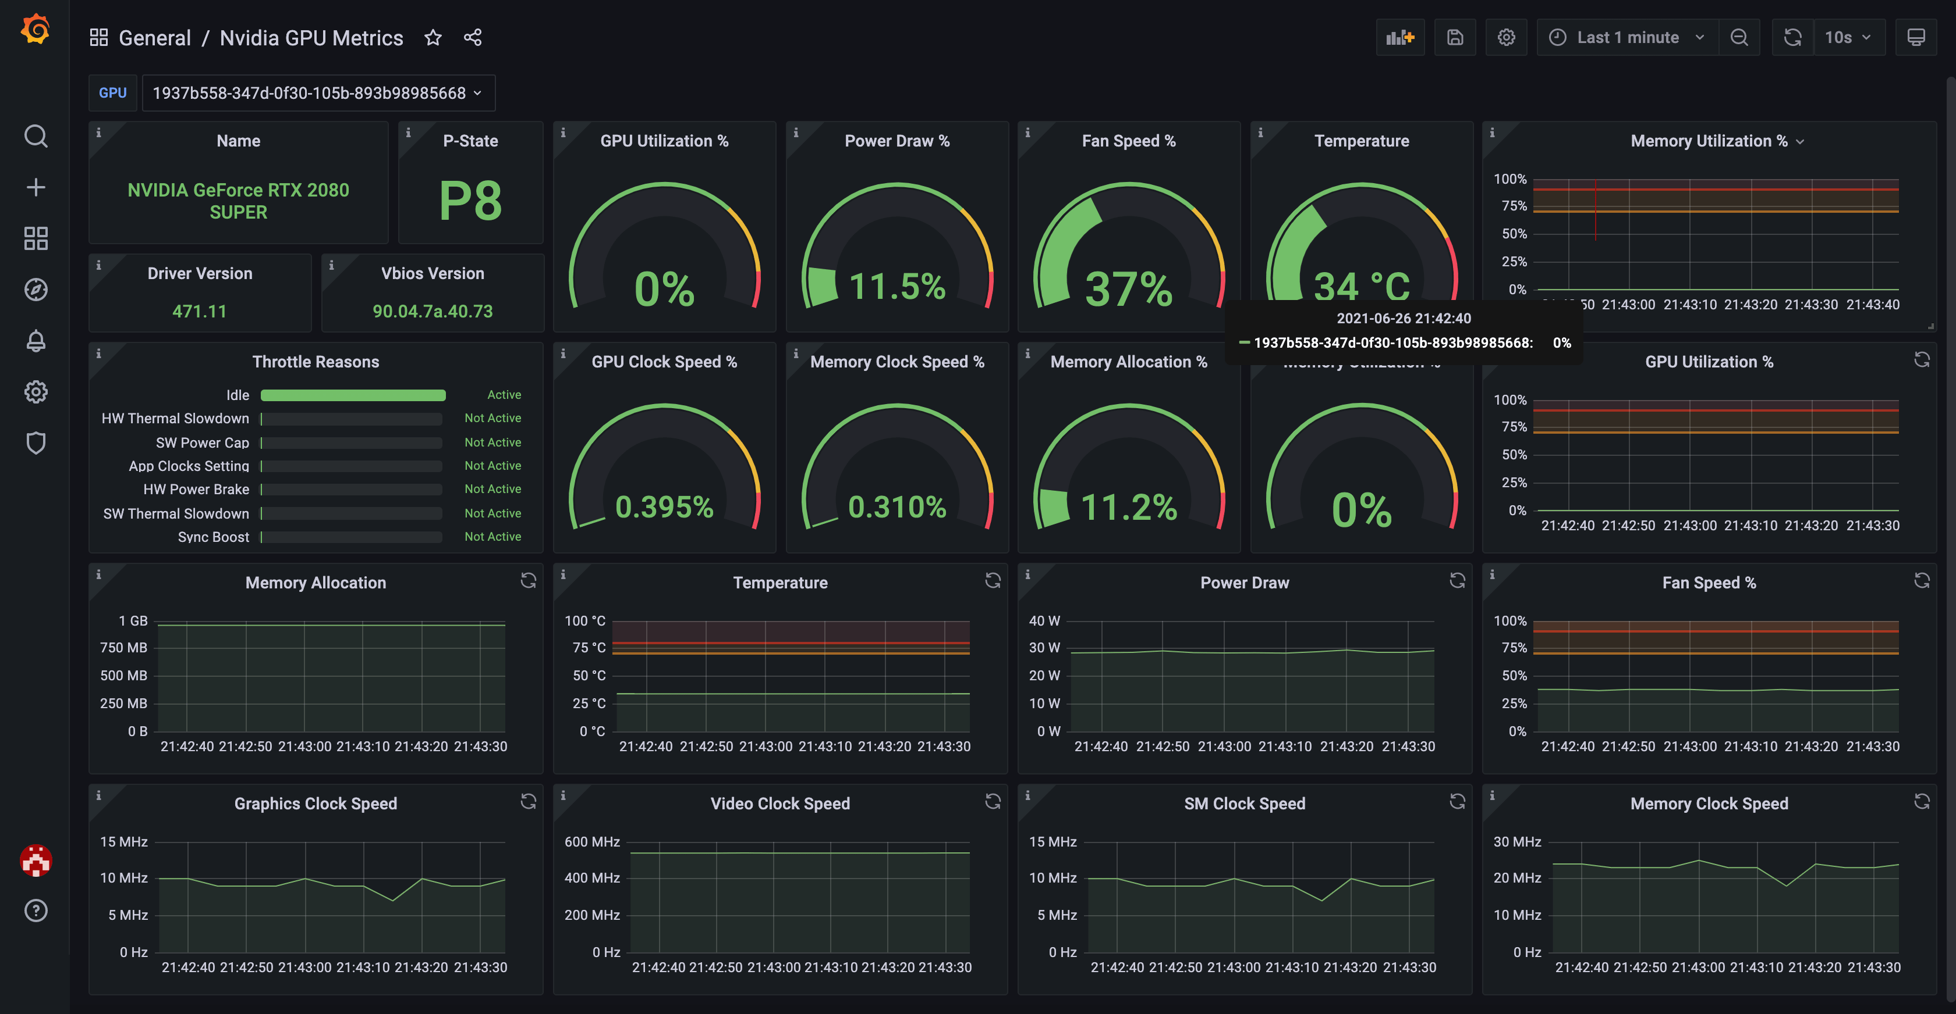
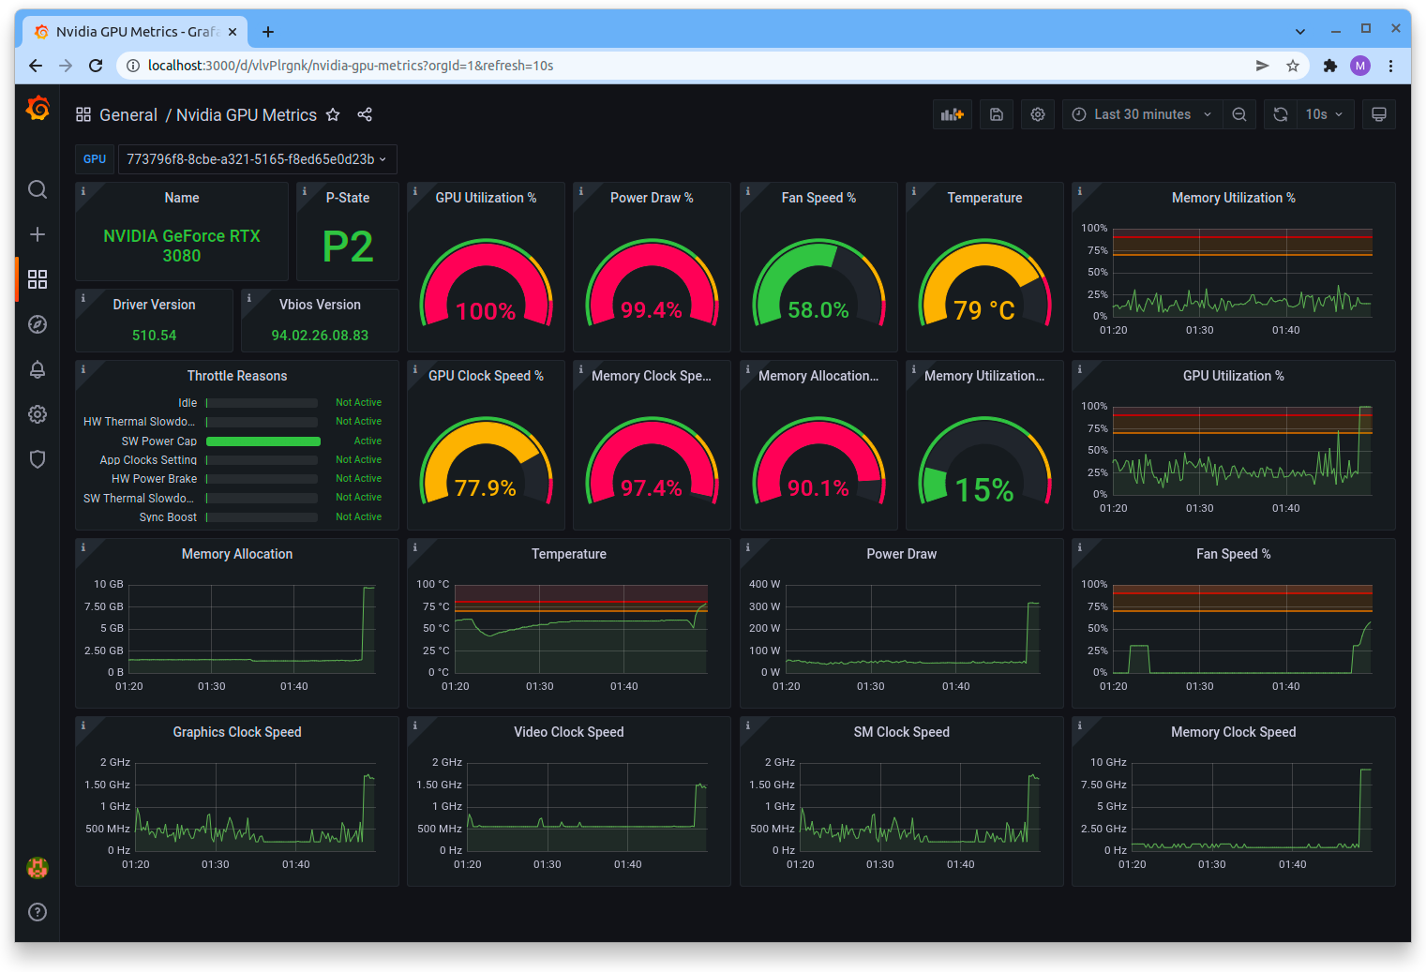
Utilization
Actual usage level of hardware resources
Utilization
Even with powerful hardware
if utilization is low → performance will still be poor
Formula
Utilization = Actual Performance / Theoretical Peak
Image source: Grafana - GPU Metrics Dashboard
Typically expressed as a percentage
Calculation Example
GPU Theoretical Performance
10 TFLOPS
Actual Program Performance
5 TFLOPS
Utilization
50%
Image source: Lambda Labs - GPU Monitoring Tools
Notes:
利用率（Utilization）衡量硬件资源的实际使用效率，公式是：利用率等于实际性能除以理论峰值，通常以百分比表示。举例：GPU理论峰值10 TFLOPS，程序实际跑出5 TFLOPS，则利用率为50%。利用率是衡量优化效果的直接指标——同样的硬件，利用率从30%提升到80%，意味着性能提升了接近3倍，而无需更换任何硬件。

Slide 9

MLPerf – Industry Standard for ML Performance
What is MLPerf?
An industry-standard benchmark suite for machine learning performance
Two main suites: MLPerf Training and MLPerf Inference
Over 3,500 individual results from 100+ system configurations (as of 2021)
Performance spans 5 orders of magnitude – from tiny embedded devices to cloud-scale datacenters
Why MLPerf matters?
Provides fair, reproducible comparison across hardware and software
Drives performance improvements – 1.3× speedup in 16-chip results between v0.5 and v0.6 despite higher quality targets
Growing adoption: 3 submitters (40+ results) → 14 submitters (500+ results) in early rounds
Key design principles:
Closed Division: Fixed model for apples-to-apples hardware comparison
Open Division: Any model allowed to encourage innovation
Time-to-train as the primary metric for training (vs. throughput)
Semantic-level benchmarks: Submitters reimplement models for their hardware
Notes:
性能指标可以按瓶颈类型分为两大类。第一类是计算能力相关：FLOPS衡量每秒浮点运算次数，是计算密集型任务的核心指标；利用率反映硬件资源的实际使用效率。第二类是数据访问能力相关：带宽决定数据密集型应用的吞吐上限；延迟衡量单次数据访问的时间代价。Roofline Model则综合两类瓶颈，判断程序究竟是计算瓶颈还是访存瓶颈，从而指导优化方向。

Slide 10
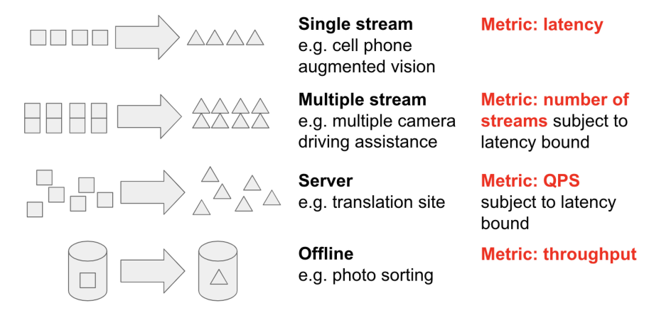
MLPerf Inference – Scenarios & Metrics
Quality targets:
  Most tasks: within 1% of FP32 reference accuracy
  Medical imaging / recommendation: within 0.1% (real-world stringency)
Performance varies drastically across scenarios:
  Server vs Offline throughput ratio: up to 0.55× (GNMT), ~0.8× on average
  Systems optimized for throughput may perform poorly under latency constraints
Reddi, V. J., Cheng, C., Kanter, D., Mattson, P., Schmuelling, G., & Wu, C.-J. (2021). The vision behind MLPerf: Understanding AI inference performance. IEEE Micro, *41*(3), 10–18
Notes:
性能指标可以按瓶颈类型分为两大类。第一类是计算能力相关：FLOPS衡量每秒浮点运算次数，是计算密集型任务的核心指标；利用率反映硬件资源的实际使用效率。第二类是数据访问能力相关：带宽决定数据密集型应用的吞吐上限；延迟衡量单次数据访问的时间代价。Roofline Model则综合两类瓶颈，判断程序究竟是计算瓶颈还是访存瓶颈，从而指导优化方向。

Slide 11
Benchmarking & Performance Metrics
Profiling & Roofline Analysis
Auto-Tuning & KernelGen
End-to-End Optimization
Lab: Performance Analysis in Practice

Slide 12
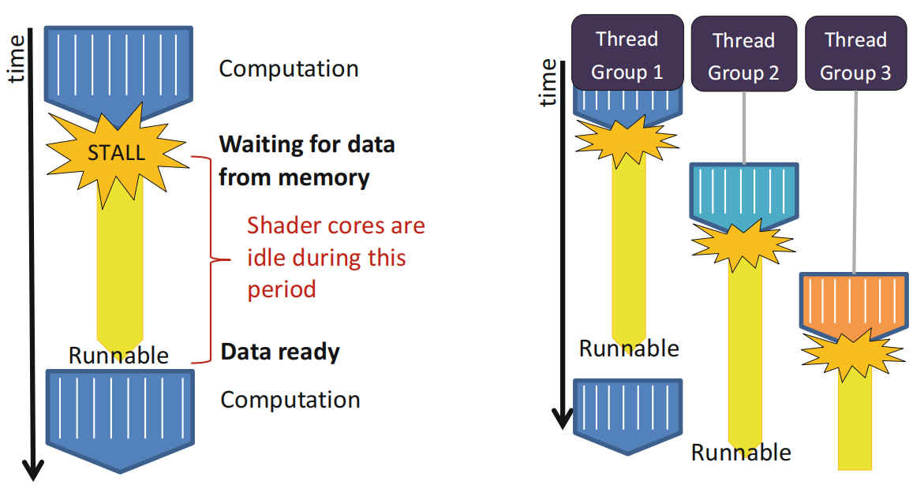
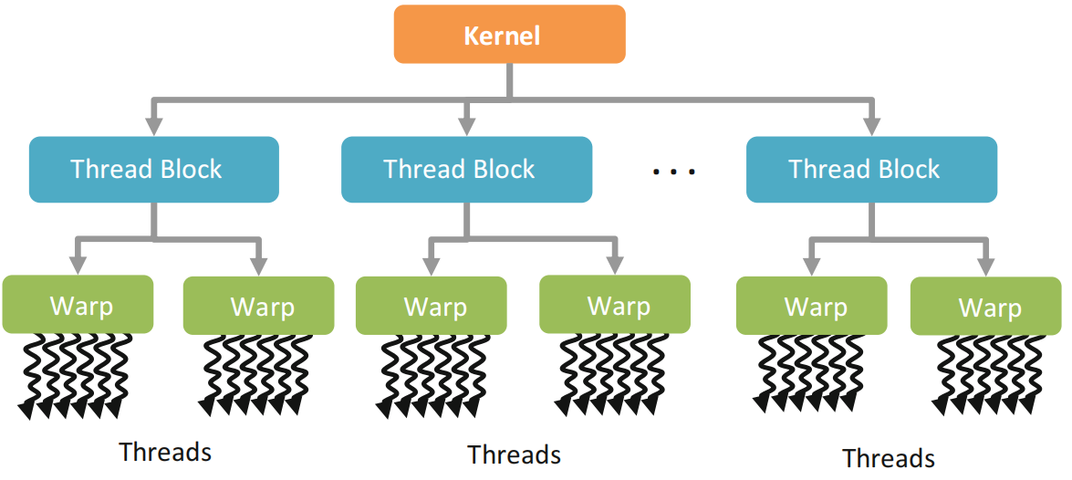
Profiling answers: Where is the time spent inside the kernel?
Execution model under GPU Architecture
  GPU execution without/with batched thread groups
  Single-instruction multiple threads (SIMT)
  Hierachical thread execution model

Slide 13
Occupancy – Keeping the GPU Busy
Occupancy = Active Warps / Maximum Warps per SM
Three limiting factors:Registers:
  Each SM has limited registers (e.g., 16384)
  Shared Memory: Limited capacity per SM
  Thread Block Size: Hardware limit (NVIDIA: 1024, BI-V150: 4096)
Example: Consider a GPU with 16384 registers per SM running a kernel that requires 35 registers per thread
  Each SM can execute at most 468 threads
  This affects the choice of block size
    A block size of 512 is not possible
    Only 1 block of 256 threads is allowed at a time, even though 212 more threads could be running
    3 blockss of 128 threads are allowed, providing 384 threads to be scheduled, etc.

Slide 14
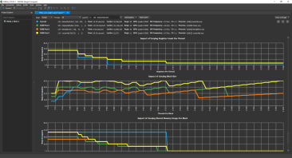
Occupancy – Limiting Factors
The minimum of these three factors is what limits the active number of threads (or occupancy) of a compute unit
The interactions between the factors are complex
  The limiting factor may have either thread or wavefront granularity
  Changing work group size may affect register or shared memory usage
  Reducing any factor (such as register usage) slightly may have allow another work group to be active
The Nsight occupancy calculator from NVIDIA plots these factors visually allowing the tradeoffs to be visualized

Slide 15
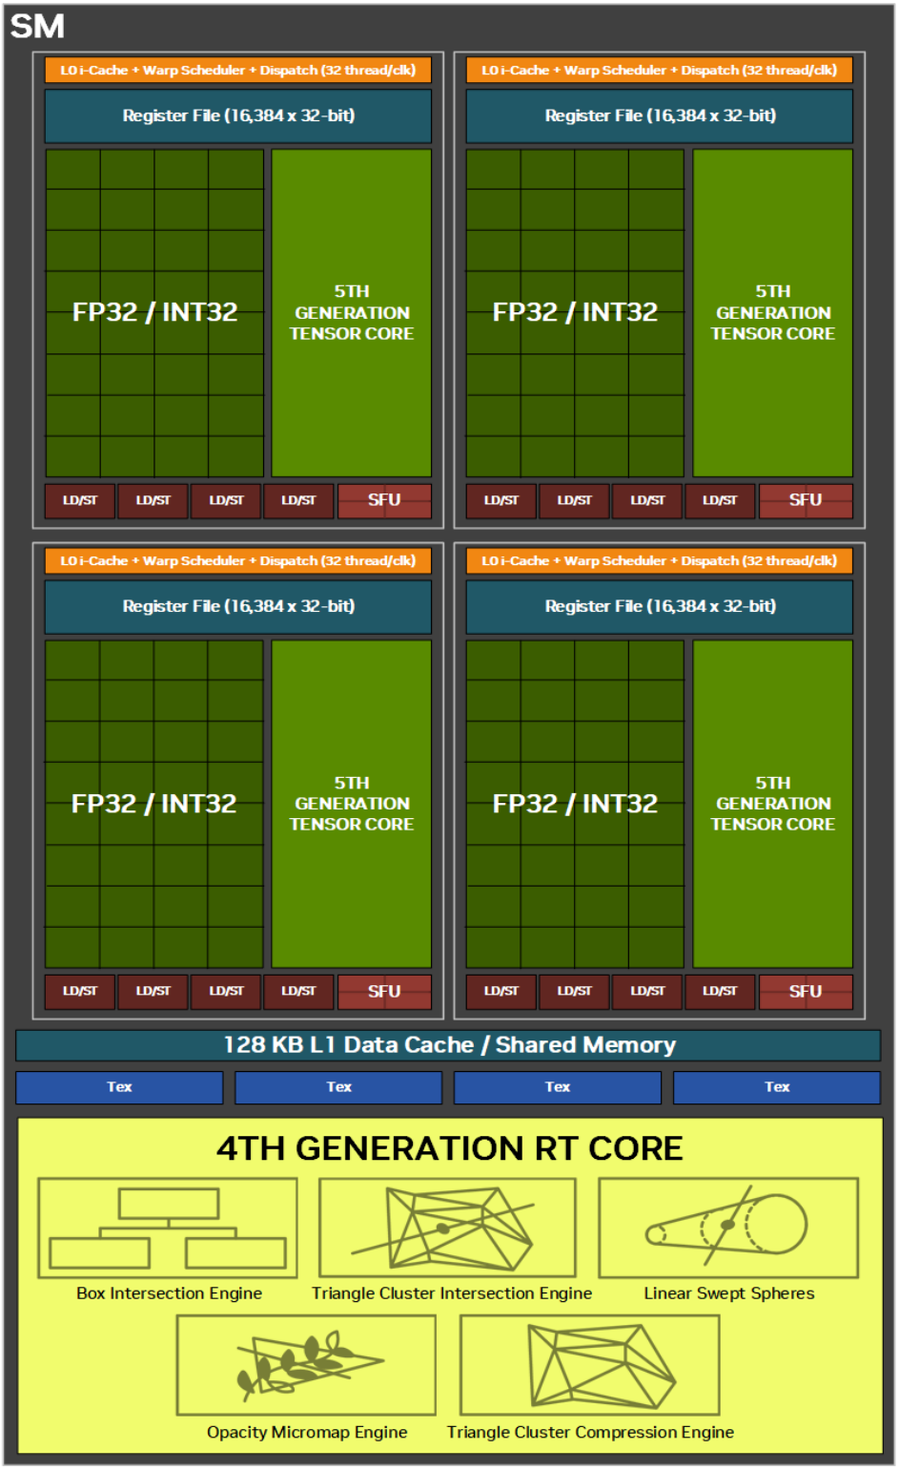
Occupancy: Tradeoffs
Shared memory and registers are persistent within SM when other warps execute
  Allows for lower overhead context switch
The number of active warps that can be supported per SM is limited
  Decided by the shared memory per block and register usage per thread
The number of active warps possible on an SM can be expressed using a metric called utilization
Larger numbers of active warps allow for better latency hiding on both NV and AMD hardware

Slide 16
Profiling Tools on BI-V150 (Days Platform)
ixSMI: System-level monitoring
ixsmi
View GPU status (temp, power, memory)
ixsmi dmon
Real-time device monitoring
ixsmi pmon
Process monitoring
ixSYS: System-wide trace capture
ixsys -t cuda,nvtx -o output.trace ./program
Captures CUDA API calls
kernel execution
Web-based visualization UI
ixKN: Kernel-level performance analysis
ixkn-cli --set default ./program
Sections
  Instruction
  LaunchStats
  Occupancy
  WarpStateStats,
  Memory

Slide 17
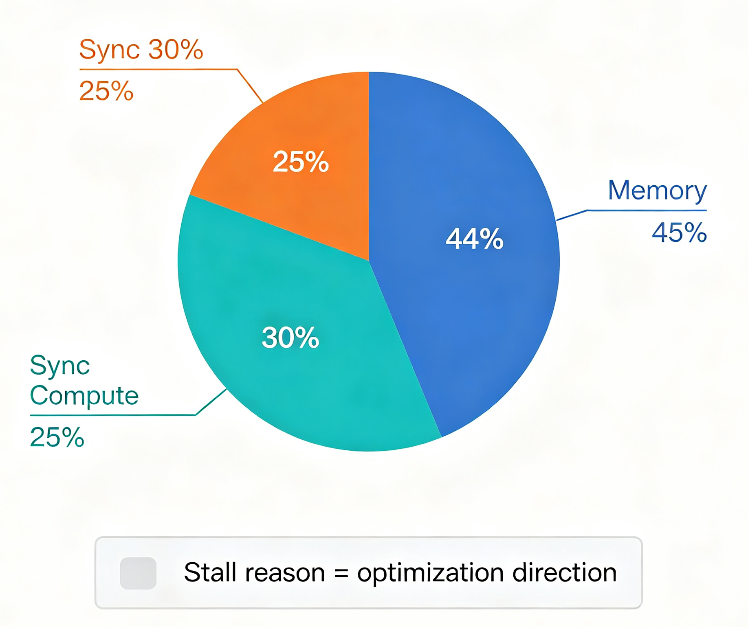
ixKN – A Deep Dive into Kernel Performance
WarpStateStats example
Section | What It Tells You
LaunchStats | Grid/Block config, resource usage
Occupancy | Active warps vs. maximum, utilization rate
WarpStateStats | Why warps are stalling (memory, sync, compute)
Instruction | Instruction mix and execution counts
Memory | Shared memory bank conflicts, cache hit rates

Slide 18
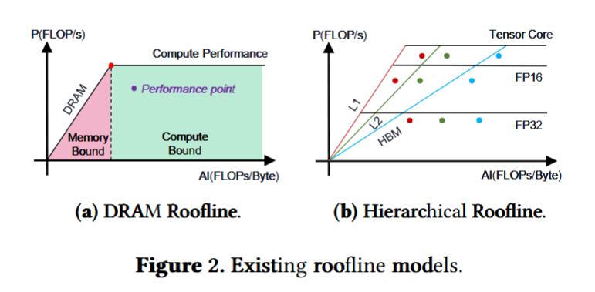
The Roofline Model – Visualizing Performance Limits
A visual performance analysis model that answers:
  Is my program compute-bound or memory-bound?
  How far am I from the hardware limit?
The core insight: Performance is limited by two constraints:
  Compute ceiling (horizontal line): P ≤ π (peak FLOP/s)
  Bandwidth slope (diagonal line): P ≤ β × I (bandwidth × arithmetic intensity)
Ridge point: Intersection of horizontal and diagonal lines divides the space into two regions:
  Left of ridge → Memory-bound (performance limited by bandwidth)
  Right of ridge → Compute-bound (performance limited by arithmetic)

Slide 19
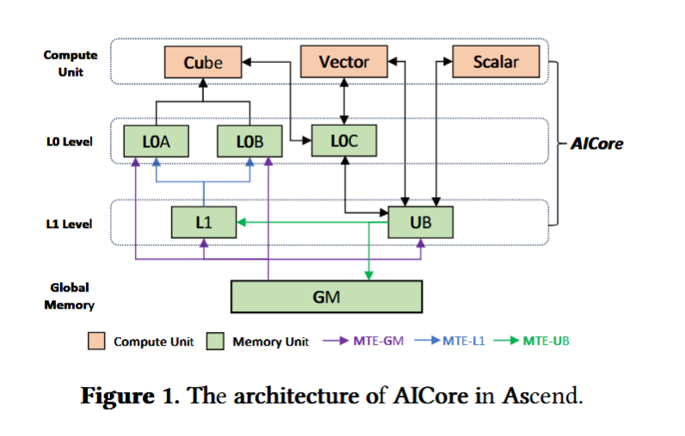
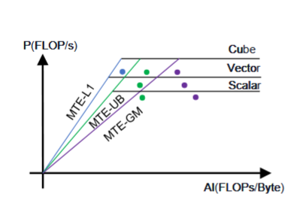
Beyond DRAM – Hierarchical & Component-Based Roofline
Hierarchical Roofline:
  CPUs/GPUs have multi-level caches (L1, L2, DRAM)
  Any layer can be a bottleneck → build bandwidth ceilings for each layer
  Also supports multiple precision/compute units (FP32, FP16, Tensor Core)
Challenge: Roofline on DSAs (Ascend):
  Ascend has unique compute units and memory transfers
  Naive approach: build rooflines for every precision-transfer combination
  For Ascend: 180 combinations → visualization complexity explodes!
Component-Based Roofline Model:
  Proposed in ASPLOS 2025 paper "Squeezing Operator Performance Potential for the Ascend Architecture"
  Core idea: Abstract components to capture operator performance → identify bottleneck components
  Instead of 180 combinations → focus on component-level bottlenecks
  Results: 1.07× to 2.15× end-to-end speedups across 11 real-world tasks

Slide 20
Benchmarking & Performance Metrics
Profiling & Roofline Analysis
Auto-Tuning & KernelGen
End-to-End Optimization
Lab: Performance Analysis in Practice

Slide 21
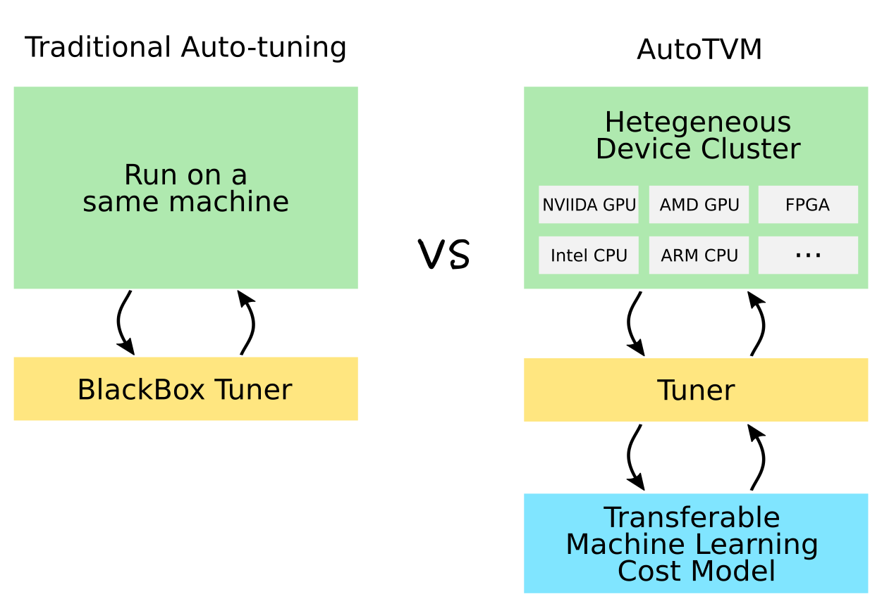
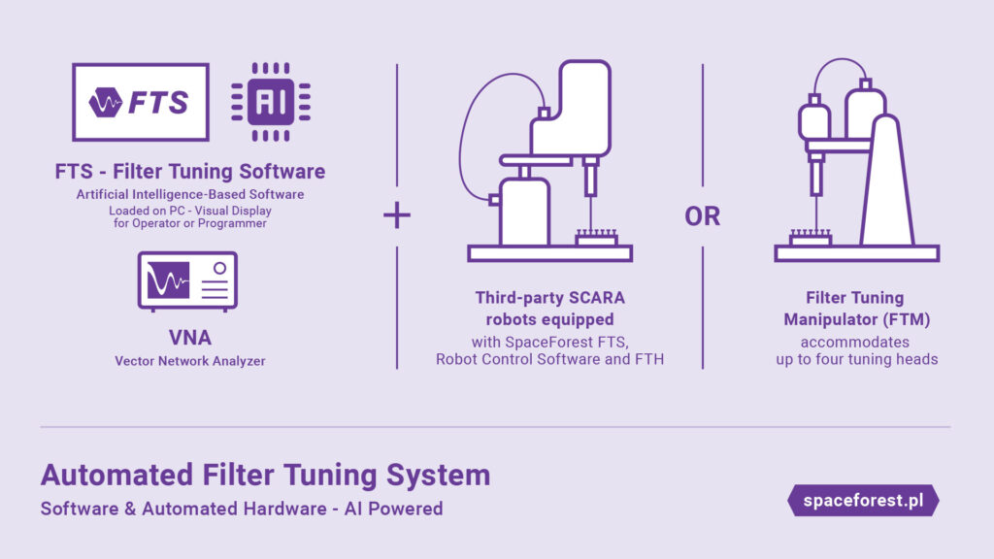
Automatic Tuning
Automatic Tuning Algorithm and Underlying Implementation
  From Template Search to AI-Driven Operator Tuning

Slide 22
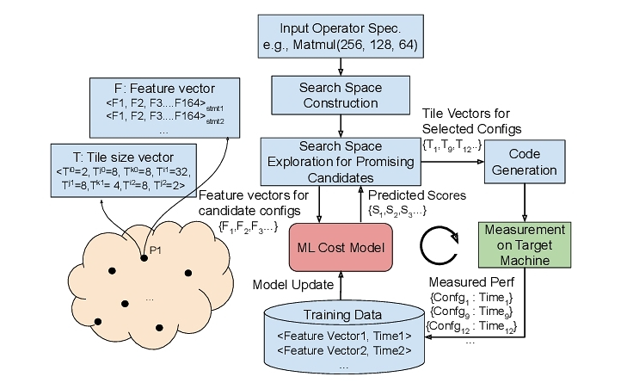

What is Kernel Auto-tuning?
Automation of Code Generation:
  Input: Mathematical calculation expressions (e.g., tensor multiplication, convolution).
  Output: Low-level code optimized for specific hardware (e.g., CUDA, LLVM IR).
Common Tuning Dimensions (Schedule Primitives):
  Tiling: Improves cache hit rate.
  Unrolling: Reduces branch overhead.
  Vectorization: Utilizes SIMD instructions (e.g., AVX, TensorCore).
  Binding: Block/Thread mapping in the GPU.
Notes:
Kernel Auto-tuning（内核自动调优）的核心机制在于代码生成（Code Generation）与调度原语（Schedule Primitives）的自动化组合。在深度学习编译器中，计算的数学定义（算法逻辑）与计算的具体执行方式（调度执行）被解耦。自动调优系统通过向底层的抽象语法树（AST）或中间表示（IR）中注入调度指令，来控制代码的硬件映射。常见的调优维度涵盖了计算与存储架构的各个层面：循环分块（Tiling）用于将巨大的张量切割以适配容量有限但速度极快的各级缓存；循环展开（Unroll）旨在通过增加代码体积来消除循环控制开销并提升指令级并行度；而线程绑定（Thread Binding）与张量化（Tensorization）则是将特定的计算轴精确映射到GPU的线程束（Warp）或专用的矩阵乘法累加单元（如Tensor Cores）上 。

Slide 23
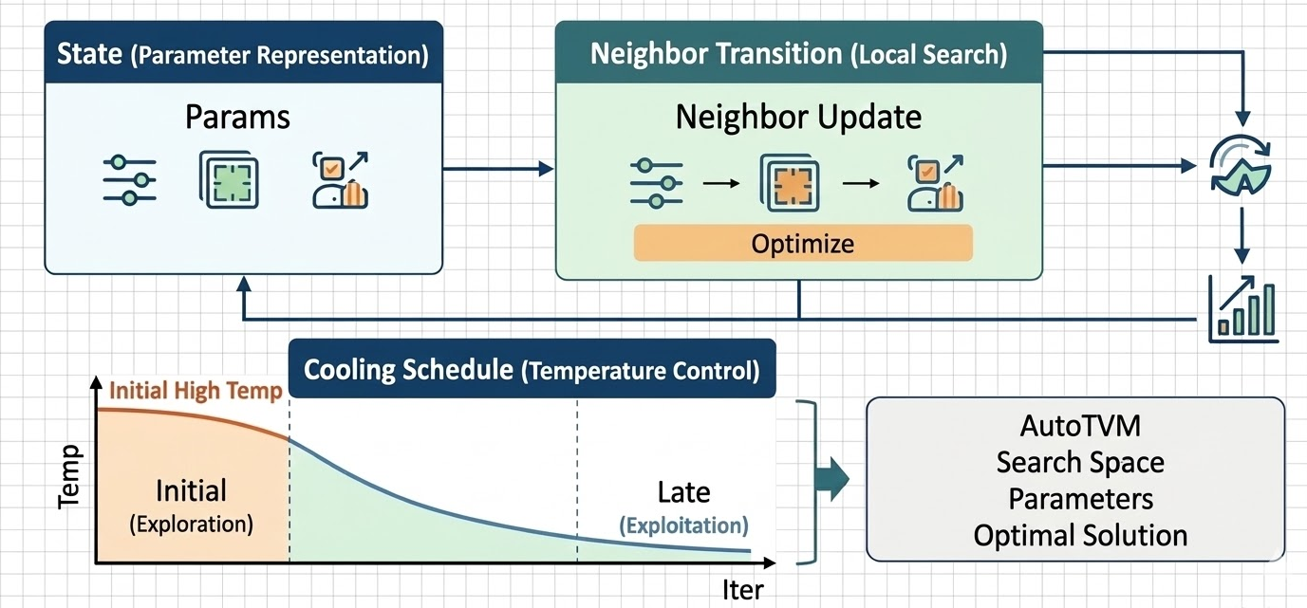
Application of Simulated Annealing
State Representation: The current set of template parameters
Neighbor Transition: Fine-tuning one of the parameters
Cooling Schedule:
  Initial High Temperature: High probability of accepting poor solutions (large-scale exploration).
  Later Low Temperature: Almost only accepting good solutions (local convergence exploration).
Early versions of AutoTVM widely used simulated annealing to find optimal parameters in the candidate space.
Notes:
Page 12: 3. 模拟退火在算子调优中的应用
状态表示 (State)：当前的一组模板参数（如 BlockSize=128, TileSize=4）。
邻域跳转 (Neighbor Transition)：微调其中一个参数（如将 BlockSize 变成 256）。
温度控制 (Cooling Schedule)：
初始高温：概率很高地接受差解（大范围探索 Exploration）。
后期低温：几乎只接受好解（局部收敛 Exploitation）。
AutoTVM 早期版本即广泛采用模拟退火在候选空间中寻找最优参数。
概率与突变的艺术：模拟退火算法在调优中的应用
无论搜索空间是由模板限定还是由草图生成，算子参数的优化表面都具有高度的非凸性（Non-convexity）。该空间充满了不规则的离散约束（如参数必须是硬件线程束的整数倍）和深浅不一的局部极小值。传统的梯度下降或贪婪爬山算法在这样的地形中极易陷入局部最优而停滞不前 。为应对这一挑战，模拟退火（Simulated Annealing, SA）成为了自动调优早期最核心的探索算法。
模拟退火算法的原理源自对冶金学中固体物理退火过程的隐喻。在物理退火中，材料被加热至高温状态，原子获得极大的动能，脱离原有的晶格排列；随后通过严格控制的缓慢冷却，原子在逐渐降低的温度下寻找能量最低的稳定晶体结构 。将这一原理映射到算子调优中，“系统能量”等价于代价模型（如XGBoost）预测的内核执行时间，“原子状态”则对应于特定的一组调优参数配置 。
模拟退火之所以能够跳出局部最优，关键在于其特有的概率接受机制——Metropolis-Hastings准则。在每一次迭代中，算法在当前配置的邻域内随机产生一个新的候选配置。若新配置的预测执行时间更短（能量下降），算法则无条件接受。然而，如果新配置导致性能恶化（能量上升），算法并不会立即将其抛弃，而是根据当前的系统“温度”参数 $T$ 和能量的恶化程度 $\Delta E$，以一定的概率 $P$ 接受这个次优解。该概率通常定义为 $P = \exp(-\Delta E / T)$ 。
温度参数 $T$ 在这里扮演了平衡“探索（Exploration）”与“利用（Exploitation）”的绝对核心。在算法初期的高温阶段，$T$ 的值极大，使得接受劣质解的概率很高，这赋予了算法极强的空间跨越能力，使其能够在整个参数空间中广泛游走，避免被早期的局部陷阱捕获。随着算法迭代，冷却计划（Cooling Schedule）开始生效，温度逐渐下降。常见的冷却曲线包括线性降温、对数降温以及工业界最常用的指数降温（例如 $T_{n+1} = \alpha T_n$，其中 $\alpha$ 通常域在0.8至0.99之间） 。在冷却后期的低温阶段，接受次优解的概率几乎降为零，算法退化为局部贪婪搜索，致力于在当前发现的优秀区域内进行最精细的参数微调 。在AutoTVM中，由于XGBoost的推理速度极快，模拟退火算法被用于在极短时间内对数以万计的特征向量进行高效预筛选，从而挑出最值得投入硬件实测的高质量样本 。

Slide 24
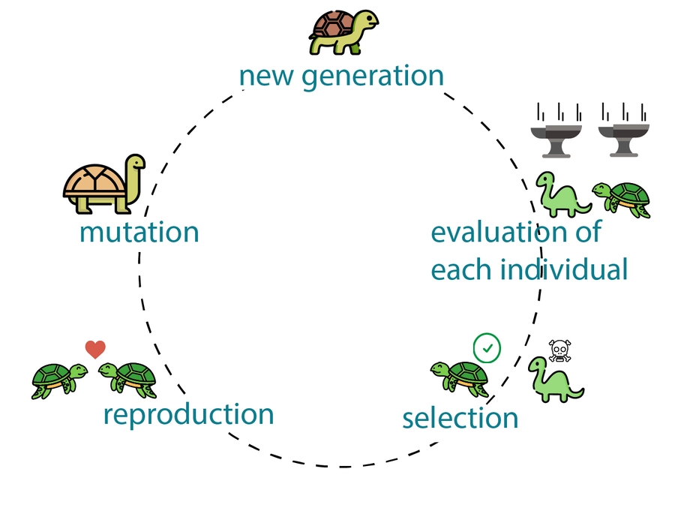
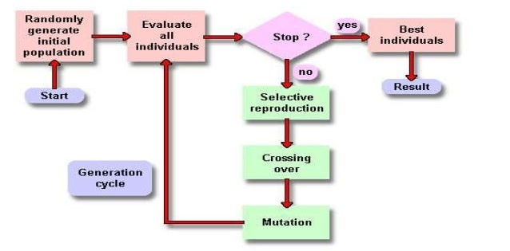
Advanced Exploration Algorithm: Genetic Algorithm
Inspiration: Darwin's theory of evolution, "survival of the fittest."
Core Algorithm Steps:
  Population: Randomly generate a batch of initial configurations.
  Fitness Evaluation: Evaluate performance using a cost model.
  Crossover: Swap some parameters between two superior configurations to produce offspring.
  Mutation: Randomly change some parameters (introducing new genes to prevent premature convergence).
  Selection: Eliminate poorly performing configurations and retain the better ones for the next generation.
Notes:
并行探索的进化力量：遗传算法在离散空间中的升维打击
尽管模拟退火在约束较强的模板空间中表现尚可，但在面对Ansor引入的巨大且拓扑异构的无模板搜索空间时，单链马尔可夫演进的退火算法逐渐显露出搜索视野狭窄、难以跨越巨大结构断层的劣势 。为了在更加离散且不规则的算子参数空间中实施“升维打击”，现代调优框架引入了更为强大的群体智能启发式方法——遗传算法（Genetic Algorithm, GA）。
遗传算法直接从达尔文的生物进化与自然选择理论中汲取核心思想，其最显著的优势在于多点并行探索（Multi-point Parallel Exploration）。它不再追踪单一的配置点，而是同时维护一个由大量候选程序组成的种群（Population） 。在调优语境下，每一个具体的张量程序配置（例如特定维度的Tiling因子、Unroll设定等）被抽象为个体（Individual），其参数组合被编码为“染色体”或“基因序列”。个体的适应度（Fitness）同样由底层代价模型给出的吞吐量预测值来决定 。
遗传算法的执行逻辑由四个严密嵌套的算子构成：种群初始化、选择、交叉与变异。首先，系统通过随机采样以及引入历史评测中的高分程序，生成具备高度多样性的初始种群。进入进化世代后，**选择（Selection）**算子（如锦标赛选择或轮盘赌算法）依据适应度分布，赋予性能优异的程序更高的繁衍权重，确保了优势算子结构的延续 。
**交叉（Crossover）**是遗传算法在复杂空间中合成创新解的核心引擎。被选中的父代程序会交换其内部的基因片段。在处理张量程序的调度时，由于粗暴的参数互换会破坏循环的语义合法性，系统（如Ansor）创造性地将算子生成的“重写历史步骤（Rewriting Steps）”定义为基因。通过智能地合并不同高性能个体的重写步骤，算法能够完美地将一个程序中优秀的内存布局与另一个程序中极致的并行展开策略融为一体，生成超越前代的超级后代 。
为了对抗种群同质化并防止算法过早收敛于局部极值，**变异（Mutation）**算子以较低概率在子代群体中注入随机扰动（例如随机突变某个循环的分割因子大小） 。此外，诸如自适应参数控制（Adaptive Parameter Tuning）的进阶技术也被引入，当算法检测到连续多个世代无性能提升时，会自动放大变异率或调整交叉概率，从而强制种群跳出当前的优化陷阱 。这种基于演化规律的多点并发机制，在处理包含严密数学约束（如内存大小限制、并行度整除要求）的离散算子空间时，展现出了远超退火算法的鲁棒性与天花板上限 。

Slide 25
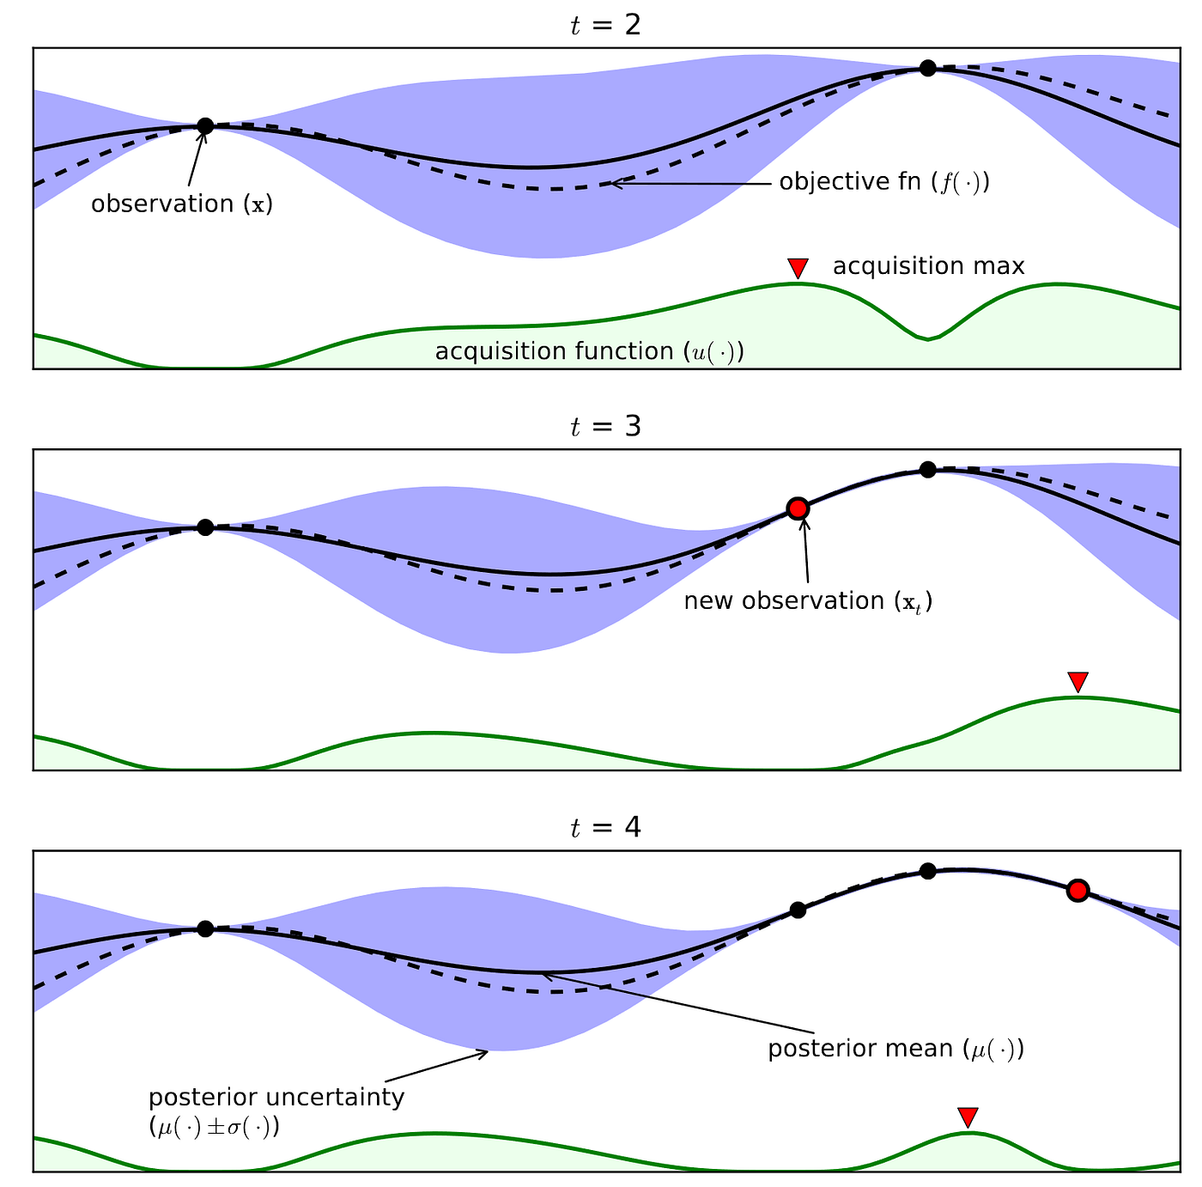
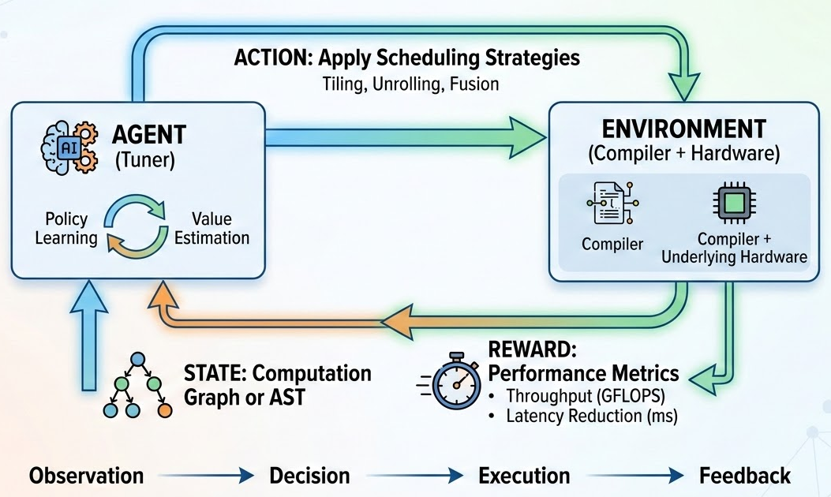
Advanced Techniques
Bayesian
Suitable Scenarios: Optimization of black-box functions where a single evaluation is extremely costly
Core Components
  Surrogate Model: Typically uses a Gaussian process
  Acquisition Function: Often uses EI (Expected Improvement).
Reinforcement Learning
Tuning from a Reinforcement Learning Perspective (MDP - Markov Decision Process)
Notes:
而强化学习（RL） 则为算子调优带来了另一种更具连贯性的序贯决策视角。RL抛弃了对静态配置的单点评估，转而将调度序列的生成过程直接建模为马尔可夫决策过程（MDP） 。在这个由 $<S, A, T, R, \gamma>$ 构成的五元组中，智能体（即自动调优器）不断与环境（编译器基础设施与硬件）进行交互 。
具体而言，状态（State, S） 被定义为算子当前的抽象语法树（AST）、部分构建的计算图或是底层特征向量 。动作（Action, A） 对应于调度器可以执行的一步具体程序变换，例如“在K轴上执行系数为32的Tiling”或“应用向量化” 。随着动作的逐个应用，程序状态发生转移。当一系列调度指令最终构成一个可编译的Kernel下发到真实硬件后，硬件返回的执行延迟或吞吐量便构成了极其关键的奖励函数（Reward Function, R） 。
由于程序的性能具有非附加性和稀疏性——单独的Tiling可能导致性能下降，但结合内存提升（Memory Promotion）后可能带来百倍的加速，强化学习（如PPO算法或Actor-Critic架构）天然适合捕捉这种动作之间的长期组合依赖关系 。智能体通过不断试错并获取延迟反馈，利用梯度上升算法优化自身的策略网络，最终不仅能学会“针对单一算子选取最优参数”，更能抽象出“如何像人类编译专家一样去思考和优化一类算子”的元知识 。

Slide 26
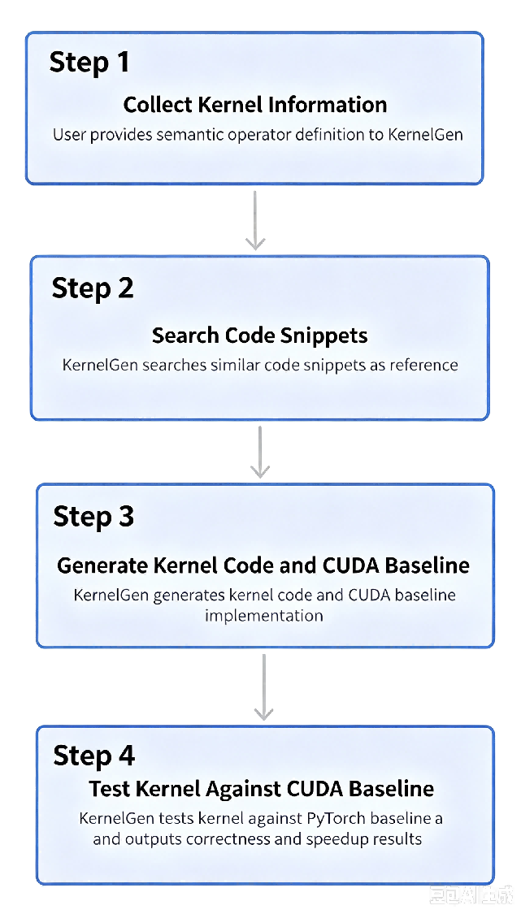



KernelGen background && workflow
KernelGen core objectives
Utilizing AI technology to automatically generate GPU kernel code, achieving ultimate performance optimization for target hardware and resolving the challenges of manual programming.
The industry faces challenges
The GPU programming model is complex, with large differences between architectures, lacking general optimization strategies, and having extremely high thresholds for parallel computing scheduling and memory management.
Core value of the project
Significantly lowering the threshold for GPU application development, unleashing the potential of hardware computing power, and improving the execution efficiency of computing tasks as well as resource utilization.

Slide 27
Benchmarking & Performance Metrics
Profiling & Roofline Analysis
Auto-Tuning & KernelGen
End-to-End Optimization
Lab: Performance Analysis in Practice

Slide 28
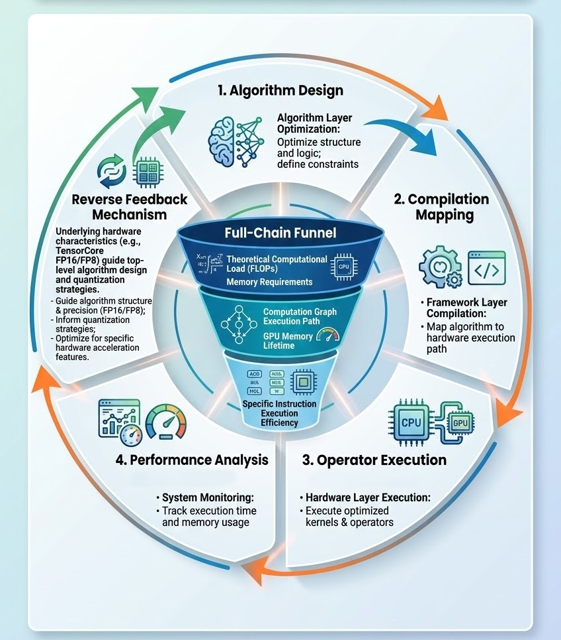
What is end-to-end collaborative optimization?
Limitations of local optimization:
  Amdahl's Law
Full-chain funnel model:
  Top layer (algorithm layer): theoretical computational load (FLOPs) and memory requirements.
  Middle layer (compilation/framework layer): execution path of the computation graph and the lifetime of GPU memory.
  Bottom layer (operator/hardware layer): execution efficiency of specific instructions.
Reverse feedback mechanism
  The characteristics of the underlying hardware (such as TensorCore's dedicated FP16/FP8) in turn guide the design and quantization strategy of the top-level algorithm.
Notes:
什么是端到端协同优化？
端到端协同优化可以抽象为一个“漏斗模型”。在漏斗的顶部，算法设计决定了计算图的拓扑结构和算术强度。通过算法层面的结构优化（如引入混合专家模型 MoE 或优化注意力机制），可以从源头上降低计算复杂度或显存压力 。进入编译器层后，计算图会被进一步精简和重组，算子融合（Operator Fusion）等策略将多个零散的数学运算合并为单一的硬件调用，从而减少昂贵的数据搬运开销 。漏斗的底部则是算子实现层，通过对手写 Kernel 的极致调优，利用硬件特定的指令集（如张量核心 Tensor Core 或向量单元）实现峰值吞吐 。
这种协同不仅是正向的，更包含关键的逆向反馈机制。底层硬件的存储层次结构（如 HBM 带宽、片上 SRAM 大小）会反过来制约算子的分块（Tiling）策略，并最终影响算法层对块大小（Block Size）或量化精度的选择 。FlagOS 社区倡导的“模型-系统-芯片”三层开放技术生态，正是基于这一设计理念，旨在实现“一次开发，跨芯迁移”的高效工作流，打破不同芯片软件栈之间的生态隔阂 。

Slide 29
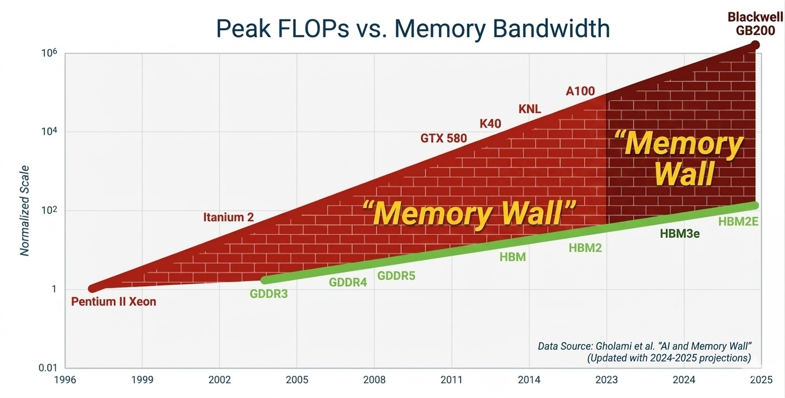
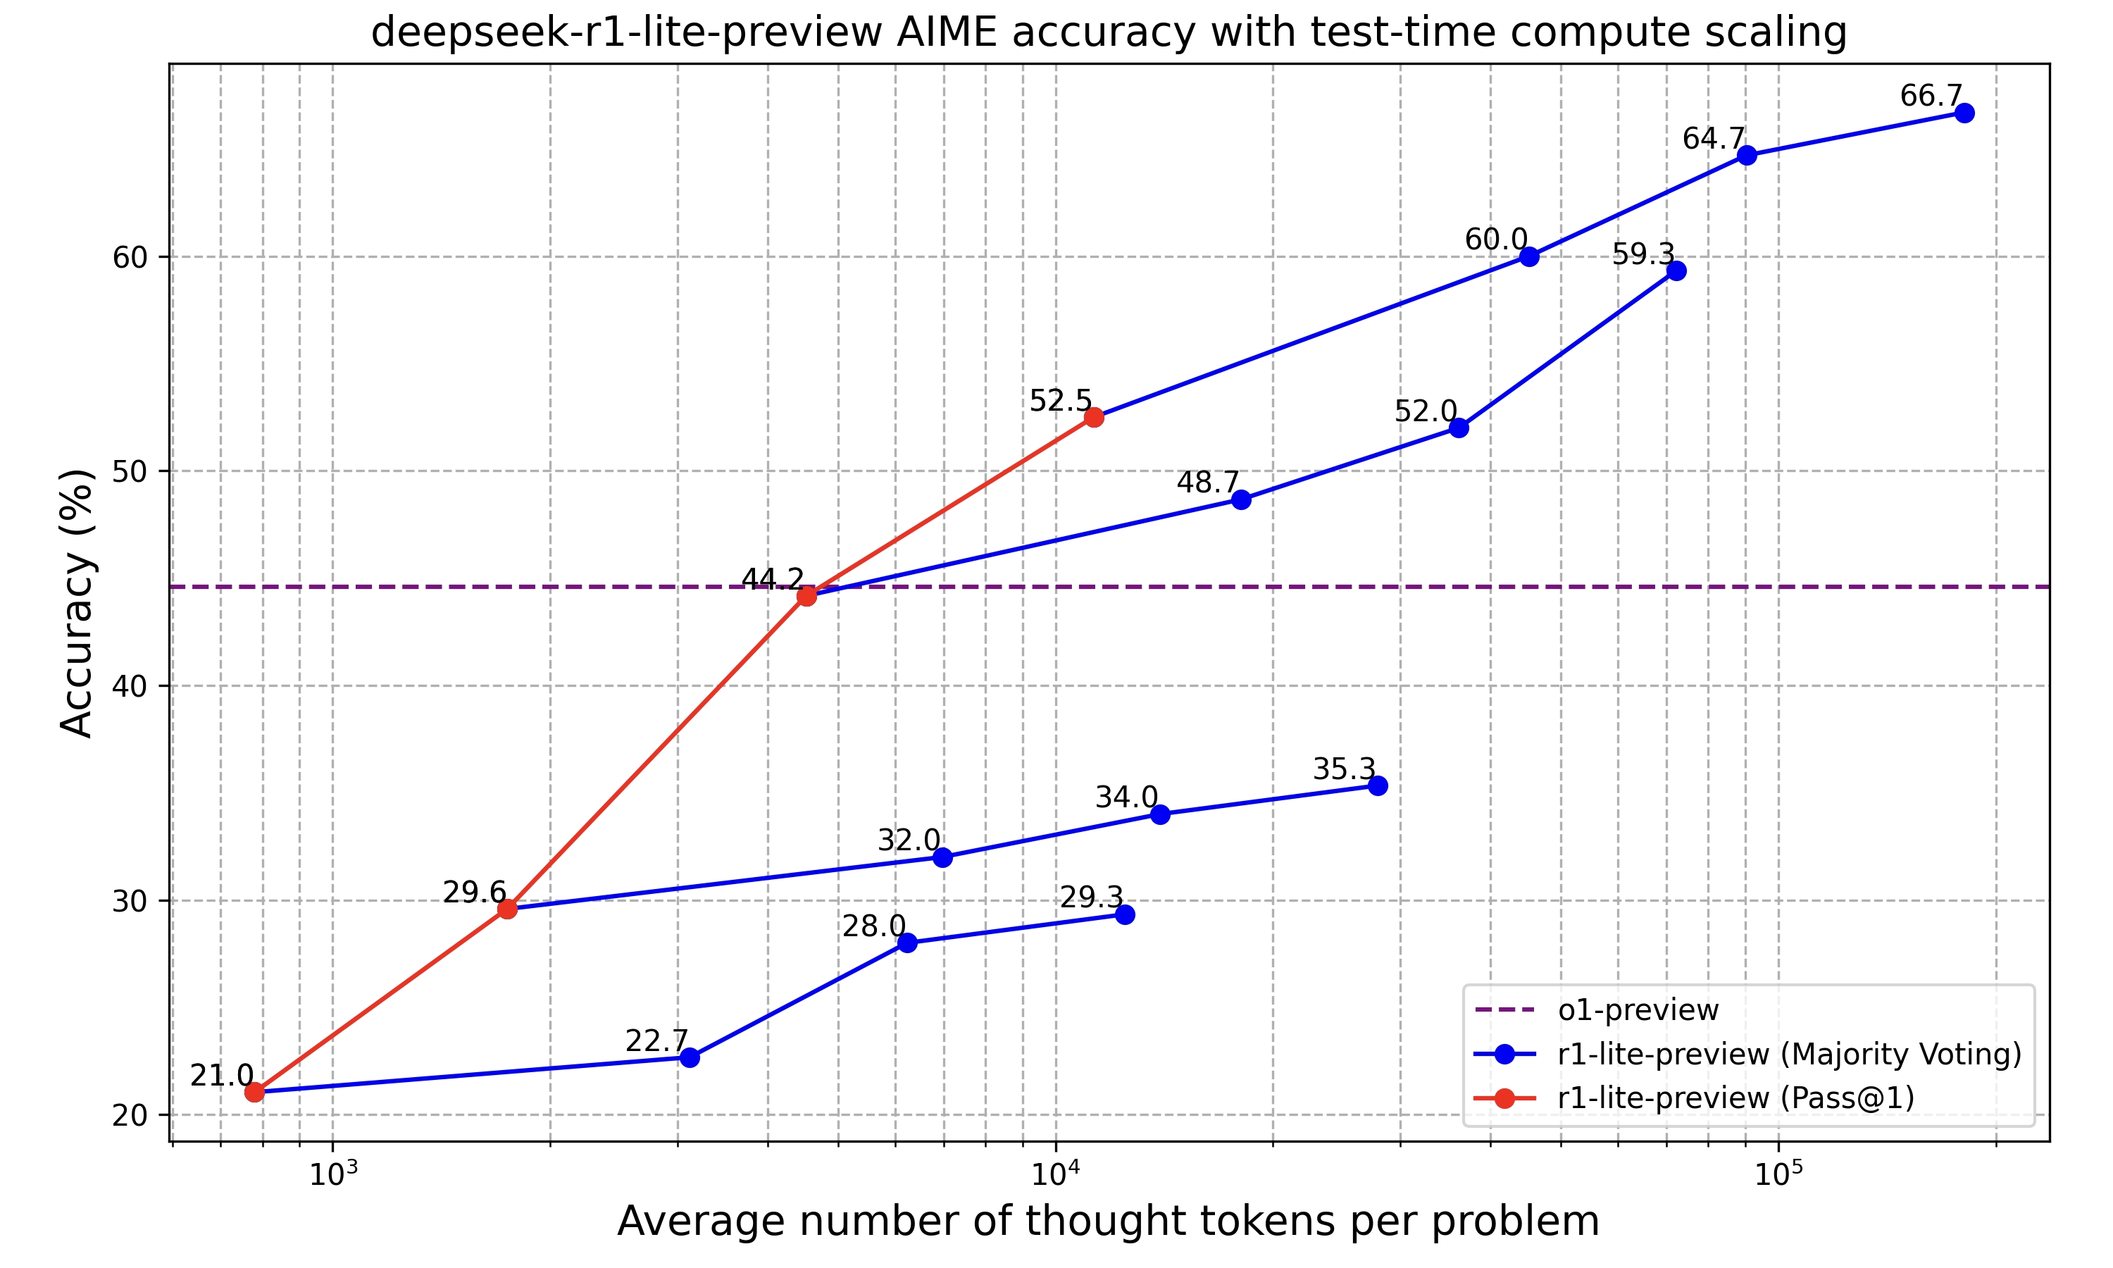
The "Double Walls" of Large Model Inference
Memory Wall:
  The decoding phase of LLM inference is primarily limited by memory access bandwidth.
  The massive key-value cache consumes a significant amount of GPU memory, limiting concurrent batch size.
Compute Wall:
  During the prefill phase, when handling long contexts, the computational cost of the attention mechanism increases quadratically with sequence length (compute-bound).
Notes:
大模型推理面临的“内存墙”与“计算墙”
当前大模型推理主要面临双重物理制约：内存墙（Memory Wall）与计算墙（Compute Wall）。内存墙是指由于内存带宽增长速度远滞后于处理器算力增长速度，导致模型在解码阶段（Decoding Phase）大部分时间处于等待数据读取的状态 。在处理长上下文或大规模批处理时，频繁访问外部存储器（如 DRAM 或 HBM）不仅增加了延迟，更显著拉高了系统功耗 。

Slide 30
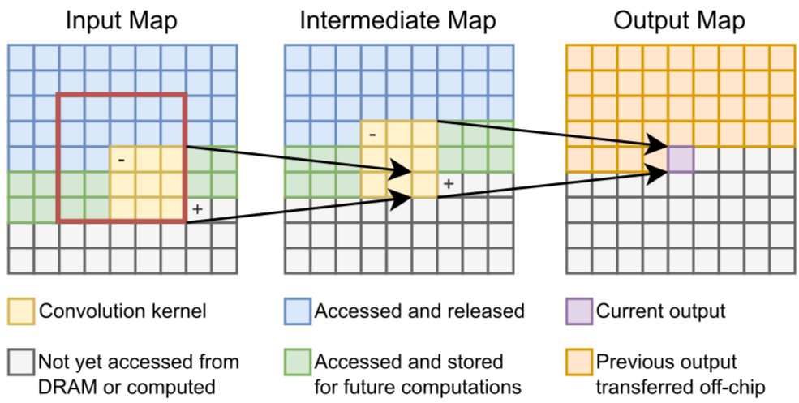
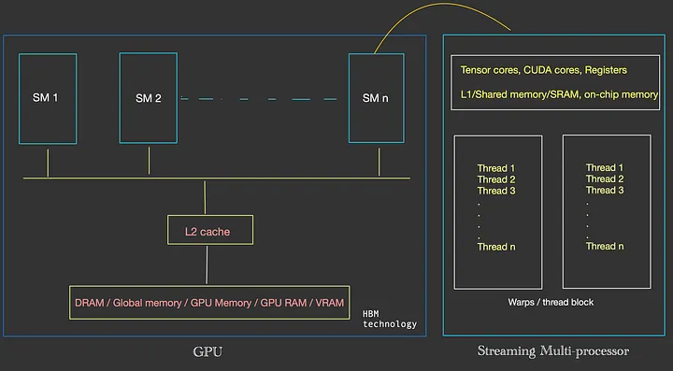
Compiler-Level Optimization Strategies
Graph Optimization:
  Operator Fusion: Merging multiple small operators (e.g., MatMul + Bias + ReLU) into a large kernel.
  Benefits: Avoids repeated read/write operations to GPU memory (DRAM -> SRAM -> DRAM) for intermediate results; instead, it's completed directly in registers or shared memory, significantly improving bandwidth utilization.
  Constant Folding & Dead Code Elimination
Notes:
第二层：编译器级优化策略
编译器层是算法逻辑向机器码转化的关键节点。其任务是在不改变算法语义的前提下，最大限度地减少冗余操作和非必要的内存读写。
计算图级优化：算子融合与代码消除
计算图优化专注于宏观算术逻辑的重组。算子融合（Operator Fusion）是最核心的技术之一，它将相邻的 Pointwise 操作（如 Add, Mul, Sigmoid）或 Reduce 操作合并为一个单 Kernel 执行。这种融合避免了将中间结果写回主存的昂贵代价，将数据保留在寄存器或 L1/L2 缓存中，极大提升了访存密集型（Memory-bound）任务的执行速度 。
此外，常量折叠（Constant Folding）在编译阶段预先计算静态子图，死代码消除（Dead Code Elimination）则移除不影响最终输出的冗余计算分支。FlagTree 作为一个统一的 AI 芯片编译器框架，能够针对多种后端（如 NVIDIA, Huawei Ascend, Moore Threads 等）生成高度优化的中间表示（FLIR），并结合“flagtree_hints”引导硬件特有的内存管理策略 。

Slide 31
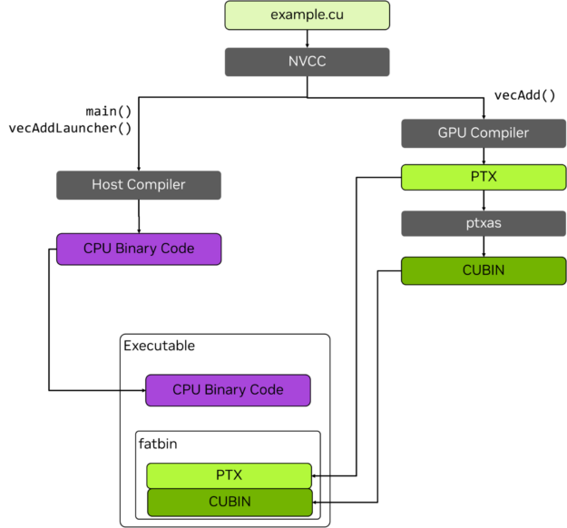
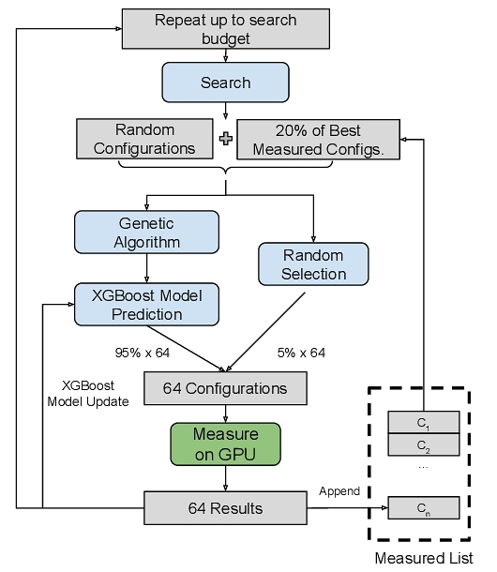
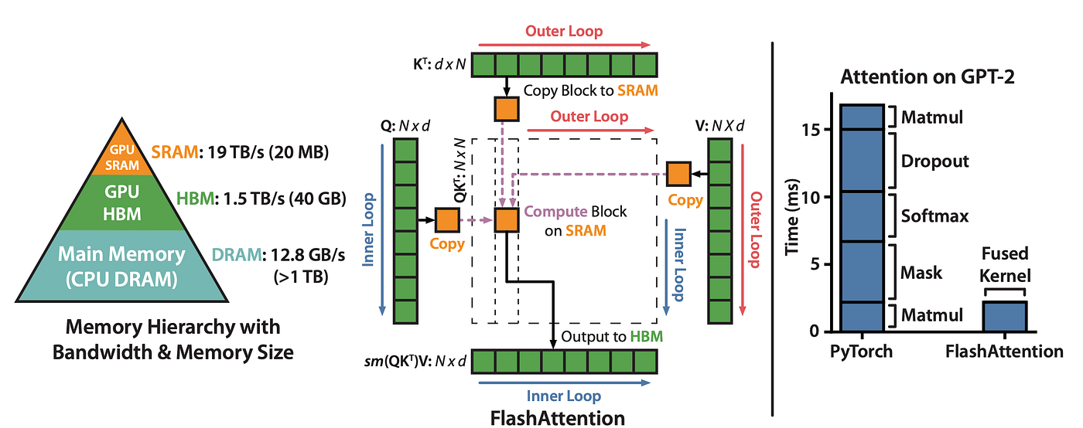
Operator Implementation
Following up on the Automatic Tuning:
  The optimal schedule found by AutoTVM or heuristic algorithms is compiled into the final hardware instructions.
Core Optimization Techniques:
  FlashAttention and its variants: Avoiding instantiating the complete Attention matrix into GPU memory through Tiling and Recomputation.
  Extreme Assembly-Level Optimization: Squeezing out the last 5% of performance using PTX or a handwritten kernel tailored to a specific domestic chip microarchitecture.
Notes:
算子实现与硬件微结构优化
当优化进入算子实现层，竞争的焦点转变为对硬件指令集和存储层次结构的极致利用。
算子级手写与调优：Kernel 集成全链路
虽然自动化编译技术在快速迭代，但针对大模型中的热点算子（如 LayerNorm, Softmax, RMSNorm），手写高性能 Kernel 仍不可或缺。利用 OpenAI 推出的 Triton 语言，开发者可以编写具有高度可读性且性能媲美原生 CUDA 的算子代码 。在端到端链路中，这些调优好的 Kernel 需要通过标准化的 API 集成到上层推理框架中。
FlagGems 作为高性能通用算子库，提供了大量经过深度调优的 Triton 实现。其核心价值在于“后端中立”的内核集合，能够根据运行时的硬件后端自动派发最优实现 。例如，在复杂的反向传播场景中，FlagGems 提供的 gather_backward 等算子极大缓解了训练过程中的性能瓶颈 。

Slide 32
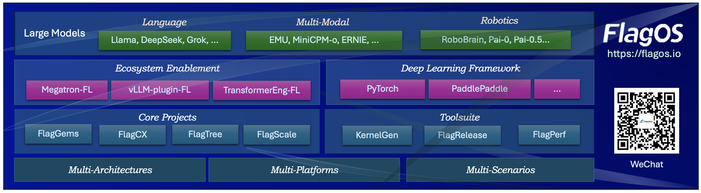
The FlagOS Ecosystem
What FlagOS does
    Unified heterogeneous computing open-source software stack
    "Write once, run on any hardware"
    Supports NVIDIA, Days, Hygon, Huawei, Moore Threads
Component | Function
FlagGems | High-performance operator library (based on Triton)
FlagScale | Distributed training/inference framework
FlagTree | Multi-AI-chip backend Triton compiler
FlagCX | Cross-chip communication library
Notes:
FlagGems 算子库的设计理念及其作用
FlagGems 的设计理念主要围绕“无缝替换”和“高效运行时”展开。它通过覆盖重写 PyTorch 的 ATen 算子，使得模型开发者无需修改底层代码，仅通过一行 flag_gems.enable() 即可切换到高性能 Triton 算子库 。
为了解决 Triton 运行时由于复杂的装饰器（如 Autotuner）带来的 CPU 端侧开销，FlagGems 创新性地引入了 LibEntry 机制。该机制通过独立维护的缓存绕过多层调用，将算子执行的 CPU 耗时降低了约 70%，确保了在处理小规模算子时也能达到与原生 ATen 相当的效率 。此外，FlagGems 支持自动化的 Pointwise 代码生成，能够灵活处理非连续张量和多种输入类型，大幅提升了算子开发的覆盖面和通用性 。

Slide 33
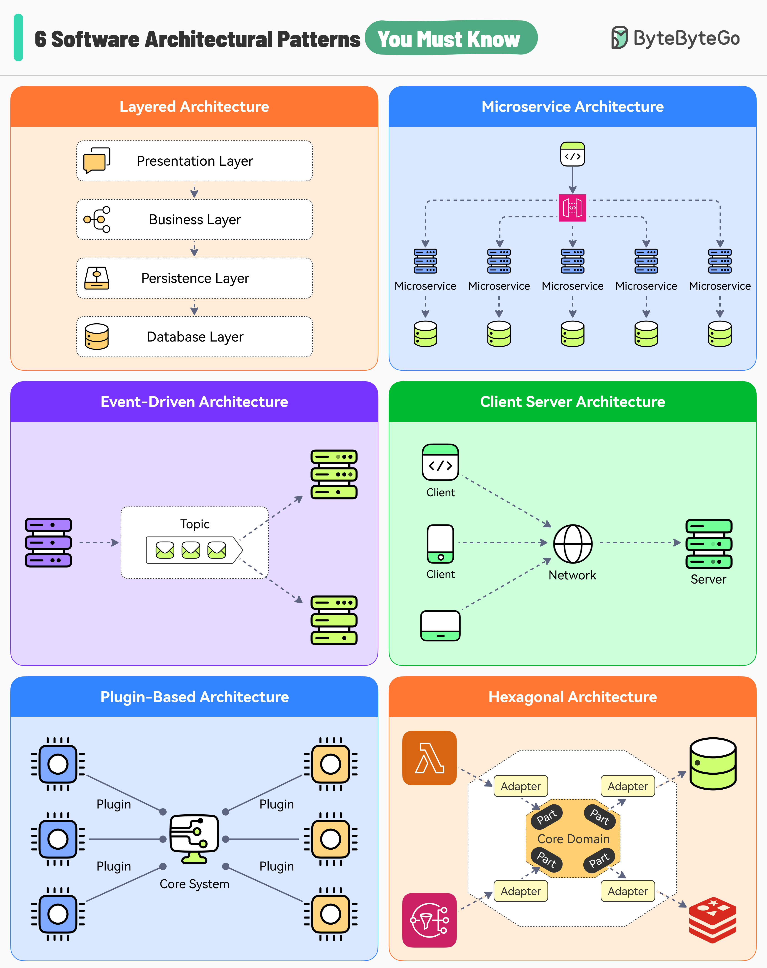
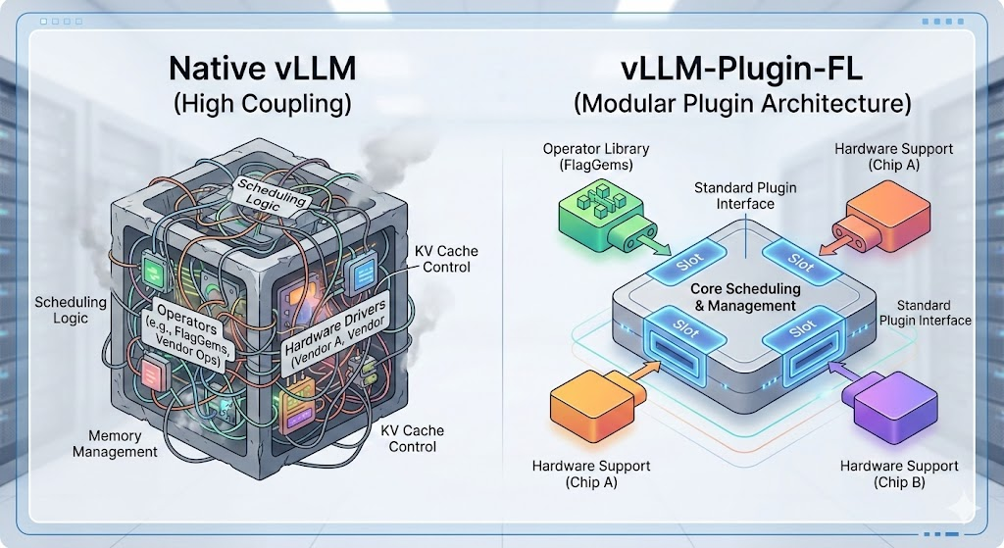
vLLM-Plugin-FL Design Philosophy
vLLM-Plugin-FL's Plugin-Based Design:
  Decoupling: Separating core scheduling logic from underlying hardware execution/operator libraries.
  Hot-Swapping: Facilitating quick integration with self-developed optimization libraries such as FlagGems.
Notes:
核心组件拆解：vLLM-Plugin-FL 设计初衷
原生 vLLM 的痛点：
对国产化及异构算力生态支持不够灵活。
代码耦合度高，定制化深度优化（特别是针对特定调度策略或新算子库）侵入性强。
vLLM-Plugin-FL 的插件化设计：
解耦：将核心调度逻辑与底层硬件执行/算子库分离。
热插拔：方便快速接入 FlagGems 等自研优化库。
核心组件拆解：vLLM-Plugin-FL 加速策略
在端到端推理优化中，vLLM-Plugin-FL 是联结上层服务框架与底层高性能算子的关键枢纽。
vLLM 原生瓶颈与 Plugin-FL 的插件化初衷
原生的 vLLM 框架虽然在调度层面表现卓越，但在面对多样化的国产芯片时，其对 CUDA 的强依赖成为了生态扩张的瓶颈。vLLM-Plugin-FL 的初衷是基于 FlagOS 的统一后端，为 vLLM 提供一个非侵入式的多芯片支持层 。通过该插件，同样的 vllm serve 命令可以在 NVIDIA、平头哥（Pingtouge-Zhenwu）、昇腾（Ascend）、寒武纪（Cambricon）等多种芯片上运行，而无需修改核心代码 。

Slide 34
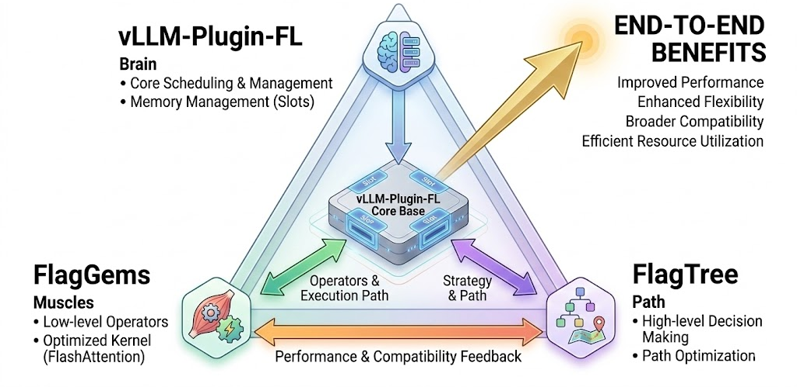
vLLM-Plugin-FL + FlagGems + FlagTree
The Iron Triangle Collaboration Mechanism:
  vLLM-Plugin-FL: Acts as the brain, responsible for efficient request scheduling, memory management (KV Cache), and computation graph distribution.
  FlagGems: Acts as the muscles, providing highly optimized underlying kernels (such as FlashAttention and various fusion operators).
  FlagTree: Provides higher-level optimization of decision trees or execution paths
End-to-End Benefits: Achieves "out-of-the-box" high performance across multiple platforms.
Notes:
深度整合：vLLM-Plugin-FL + FlagGems + FlagTree
这三个组件构成了 FlagOS 智算底座的“铁三角”，实现了从算子级到系统级的全面打通。
组件协同机制：从算子到系统的闭环
协同机制可以描述为以下流程：vLLM 负责全局的请求调度与批处理逻辑；当计算图执行到具体的算子（如 RMSNorm 或 Linear）时，vLLM-Plugin-FL 通过派发机制调用 FlagGems 提供的预编译 Kernel 。如果面临全新的、未经调优的算子需求，FlagTree 编译器则负责即时（JIT）生成适配目标芯片的代码 。这种分层协作确保了系统既有预置算子的高性能，又有应对模型快速迭代的灵活性 。

Slide 35
Benchmarking & Performance Metrics
Profiling & Roofline Analysis
Auto-Tuning & KernelGen
End-to-End Optimization
Lab: Performance Analysis in Practice

Slide 36
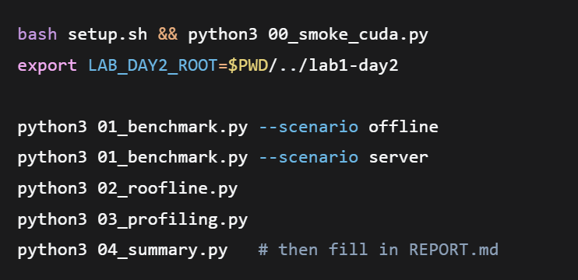
Module 5: Performance Evaluation & Optimization Practice
How to Run This Lab
Lab 1 introduced how to write and tune a GEMM kernel.
This module teaches you how to prove whether your changes actually help — scientifically, and layer by layer.
Repository
  Student repo: gitee.com/yihan-long/day2-lab5
  Target platform: BI-V150 / FlagOS; SUT = Day2 GEMM (or the in-repo equivalent)

Slide 37
Three Experiments – What Question Does Each One Answer?
Step | What We Do | What We Measure / Look At | The Question It Answers
①Benchmark | Run GEMM repeatedly through LoadGen (Offline / Server) | Median/P99 latency, throughput, effective TFLOP/s; compare torch / baseline / autotuned | How fast is it? How large is the gap?
② Roofline | Plot the benchmark results against hardware peak values | Arithmetic intensity (I), ridge point, position relative to the ceiling | Is the bottleneck compute or memory?
③ Profiling | Observe the same workload with ixsmi / ixsys / ixkn | Utilization, trace timeline, kernel-level evidence | Where exactly is it stalling? Does it agree with the Roofline diagnosis?
D

Slide 38
Thank you!
D

