Slide 1
Efficient Skyline Maintenance for Streaming Data with Partially-Ordered Domains
Yuan Fang
Institute for Infocomm Research
Chee-Yong Chan
National University of Singapore
DASFAA10 @ Tsukuba, Japan
2 April 2010

Slide 2
Outline
Introduction
STARS
STARS⁺
SkyGrid
Experiments
Conclusion

Slide 3
Outline
Introduction
  Concept
  Problem settings
STARS
STARS⁺
SkyGrid
Experiments
Conclusion

Slide 4
Definitions
A tuple X dominates Y iff for a set of relevant attributes A:
  (1) X is better than or equal to Y in every attribute in A; and
  (2) X is better than Y in at least one attribute in A.
The skyline consists of:
  all tuples not dominated by any other tuple.

Slide 5
Hotel example
Tourist looking for a hotel
  Cheap
  Close to the city
Relevant attributes
  Price
  Distance
A hotel X dominates Y iff:
  (1) X.price ≤ Y.price; and
  (2) X.distance ≤ Y.distance; and
  (3) at least one of (1) and (2) is strict.

Slide 6
Hotel example
Hotel | Price ($) | Distance to city (km)
A | 200 | 3
B | 150 | 2
C | 200 | 2
D | 250 | 1
E | 100 | 7
F | 100 | 5
G | 150 | 5
H | 250 | 4
Price
250
200
150
100
50
·D
·H
·C
·A
·B
·G
·F
·E
0 1 2 3 4 5 6 7
Distance

Slide 7
Data domain
Total-order
  A linear ordering of every value
  E.g., price, grade
Partial-order
  Lack a total linear ordering
  Values can be comparable and incomparable
  Good for hierarchies, preferences, intervals
  E.g., user prefers yellow to red and blue to red, but there is no preference between yellow and blue.

Slide 8
Query context
Offline
  For disk-resident data (relatively static)
  Answer query on demand
Online
  For streaming data (fast-changing)
  Infeasible to answer the query from scratch
  Maintain a skyline continuously

Slide 9
Problem settings
Data domain: partially-ordered
Query context: streaming
  Count-based sliding window model
  Maintain a buffer of size N
  New tuple inserted into buffer
  Oldest tuple deleted from buffer
Baseline: Streaming Arrangment Skyline (STARS)
Contributions
  STARS⁺
  SkyGrid

Slide 10
Outline
Introduction
STARS
STARS⁺
SkyGrid
Experiments
Conclusion

Slide 11
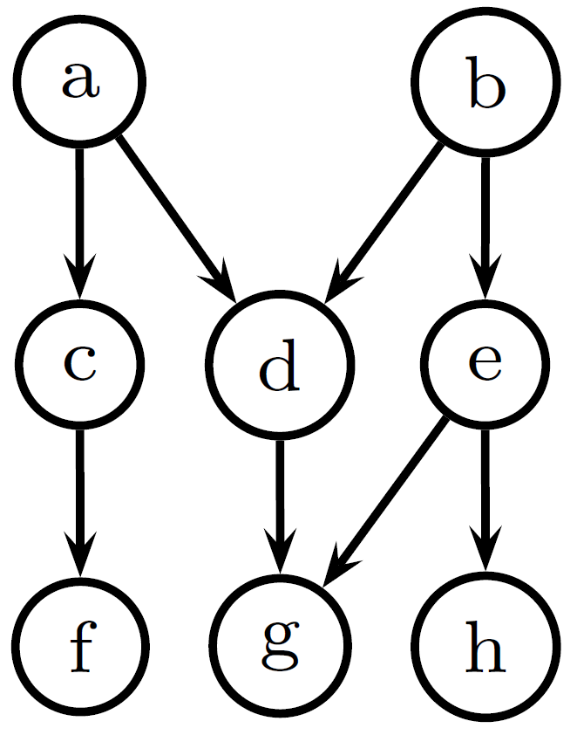
Domain representation
Directed acyclic graph (DAG)
Vertex – values
Edge – relationship
  a dominates d
  d dominates g
  d, e incomparable

Slide 12
Domain transformation
Values → topological sorting orders
A topological sort of a DAG is:
  A linear ordering of all the vertices
  For any directed edge, source vertex is always listed before the destination vertex
  Denote vertex v’s position by r(v)
If r(v) ≥ r(v’), v cannot dominate v’
  Inverse is not true
Example: a, b, c, …, h
  r(c) > r(a)
  c does not dominate a

Slide 13
SkyBuffer
Discard irrelevant tuples from buffer
Given t’ and t, if:
  (1) t’ is younger than t, and
  (2) t’ dominates t.
t can never get promoted to the skyline
t is irrelevant
SkyBuffer: the relevant part of the buffer

Slide 14
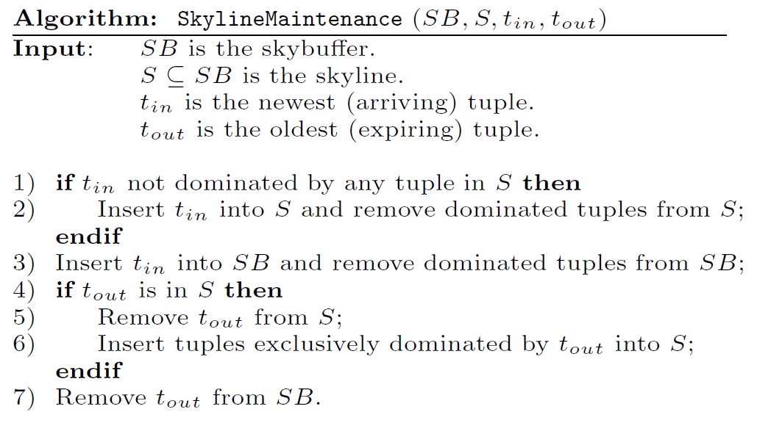
Skyline maintenance

Slide 15
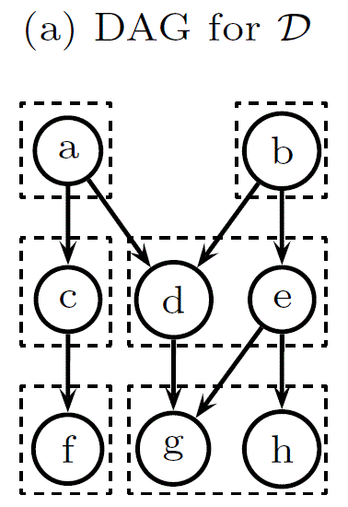
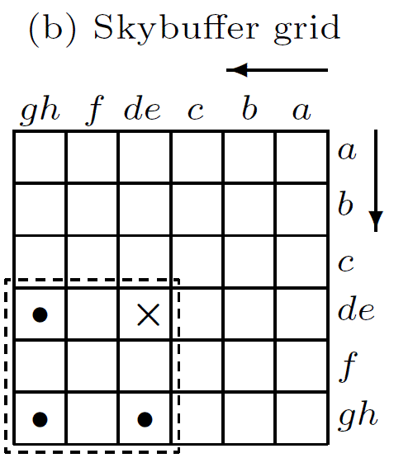
Buffer organization
Main query: to find tuples dominated by a query tuple
Multi-dimensional grid
Value grouping for scalability
Focused search

Slide 16
Skyline organization
Main query: to check whether any tuple dominates a query tuple
Each tuple mapped to a line
y = r(a) ∙ x – r(b),
where a, b are two arbitrarily attributes
Skyline: a geometric arrangement
  Only need to check lines intersecting with the query line on the positive half of the x-axis
  Doubly-Connected-Edge-List (DCEL)

Slide 17
Progressive query of skyline tuples
Y
l₁, l₂, l₃: skyline tuples
l₃
l₂
l₁
X
l_{Q}: query tuple

Slide 18
Outline
Introduction
STARS
STARS⁺
  Dominating Tuple
  Empty Cell
  Minmax
SkyGrid
Experiments
Conclusion

Slide 19
STARS⁺
An improved STARS
Drawbacks of STARS
  Expensive exclusive dominance checking
  Sparse buffer grid
  Inefficient geometric arrangement
    Arbitrary tuple-line mapping
    Unknown pruning power
    Quadratic space complexity

Slide 20
Exclusive dominance checking
Required for every tuple in the buffer dominated by an expiring skyline tuple
Each checking requires a query to skyline
Many such queries in a single update when a skyline tuple expires

Slide 21
Dominating Tuple optimization
Eager approach
  When a tuple comes in, find all dominating skyline tuples
Lazy approach
  Defer computation until needed
Semi-eager approach
  Only remember one dominating tuple
  Virtually no extra computation
  “Dominating Tuple” optimization

Slide 22
Complexity analysis
Time complexity for a given buffer tuple
s: size of the skyline.
Assume independent attribute values.
Assume exclusive dominance checking is required for every expiring skyline.
 | Lazy | Eager | Semi-eager
Exclusive dominance checking | O(s) | O(1) | O(ln(s))
Pre-computation overhead | O(1) | O(s) | O(1)

Slide 23
Sparse buffer grid
Most of the tuples in the buffer are irrelevant
Only SkyBuffer affects skyline
The buffer grid is very sparse
  Assume independent attribute values
  SkyBuffer size: O(ln^{d}N)
  Density: ρ= O(ln^{d}N/g^{d})
  E.g., ρ = 0.022
  when N = 10⁵, d = 4, g = 30
  Most of the cells are empty
d: # of dimensions
g: # of buckets/dim
N: buffer size

Slide 24
Empty Cell optimization
Maintain d − 1 additional structures (index grids)
  Keep track of # of tuples in the grid regions.
  Each index grid C_{i} (1 ≤ i ≤ d−1) is i-dimensional
  C_{i} maintains # of tuples in the regions identified by first i dimentions
During Focused search
  Candidate cells are examined by enumerating the cell coordinates
  Early termination of the enumeration if an empty region is detected

Slide 25
Problems in geometric arrangement
d > 2 is common in real life
Arbitrary attribute selection in line mapping
  Performance gap can exceed 20%
  No heuristic to optimize this selection
Only utilize two attributes for mapping
  Intuitively, using more attributes is likely to provide better pruning power

Slide 26
Minmax optimization
Consider a d-tuple t = (a₁, … , a_{d})
Minmax maps t to the line
y = C ∙ x − D, where
C = max(r(t.a₁), … , r(t.a_{d})),
D = min(r(t.a₁), … , r(t.a_{d}))
Proven correctness for pruning lines
An intuitively better heuristic
  Utilize all attributes
  Two extreme values may help prune more

Slide 27
Outline
Introduction
STARS
STARS⁺
SkyGrid
Experiments
Conclusion

Slide 28
Why geometric arrangement
Pruning ratio
  Assume independent attribute values
  Suppose no “progressiveness”
  Proven to be less than ½
Space complexity
  Quadratic space O(s²)

Slide 29
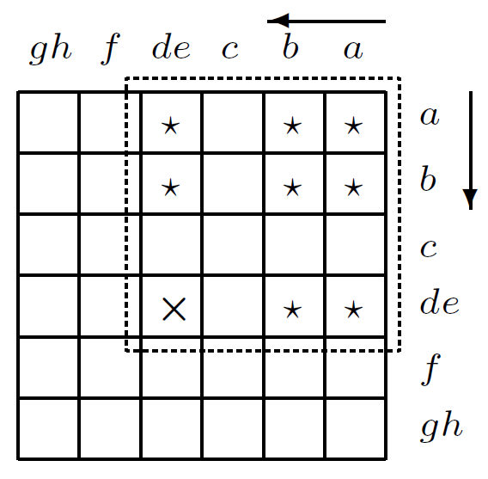
SkyGrid
Eliminate geometric arrangement
SkyGrid: everything in one place
  Both SkyBuffer and skyline in the same grid
  Distinguish skyline with a status bit
  Utilize two sets of index grids for Empty Cell optimization
Allows focused search
  On the other direction

Slide 30
Benefits of SkyGrid
Potentially higher pruning ratio
No extra space required for skyline
  Except for the linear requirement of status bit
Simplified skyline maintenance
  No manipulation of geometric arrangment (O(s))
  Only update a status bit (O(1))

Slide 31
Outline
Introduction
STARS
STARS⁺
SkyGrid
Experiments
Conclusion

Slide 32
Experiments
Purposes
  Effectiveness of STARS⁺ optimizations
  Pruning ratio of SkyGrid
  Amortized update time
Synthetic datasets
  Distributions: indep, corr, anti
  Dimensionality: d = 2, 3, 4
  Buffer size: N = 10K ~ 1000K

Slide 33
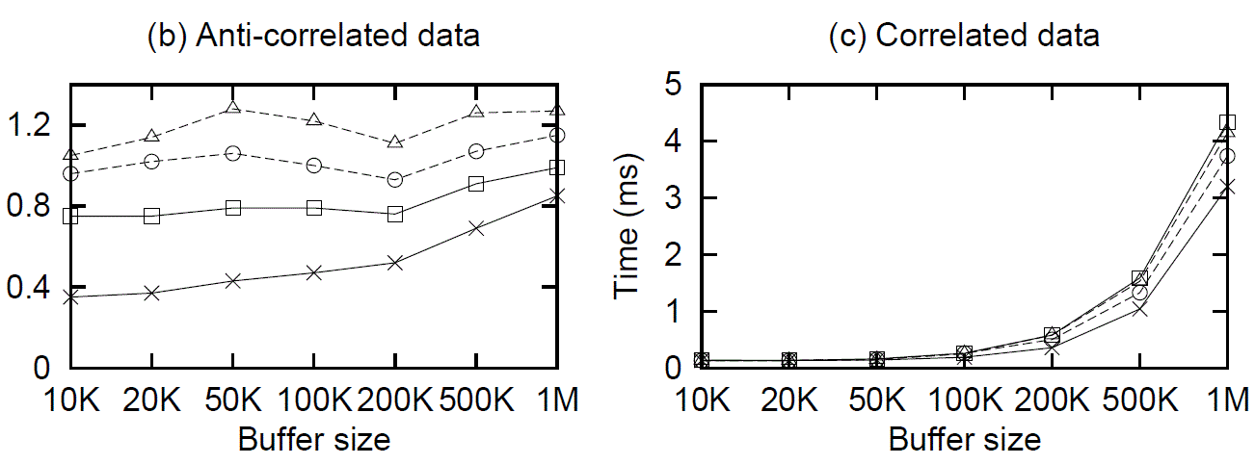
Amortized update time
STARS-Best, STARS-worst, STARS⁺, SkyGrid
With two orthogonal optimizations in all (DT/EC)

Slide 34
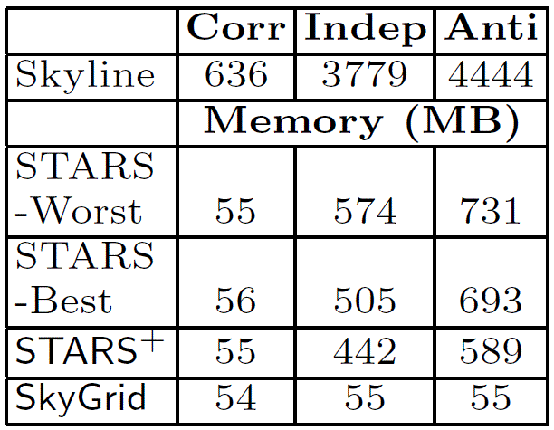
Space requirement
Buffer size = 100K
SkyGrid uses the least memory

Slide 35
Outline
Introduction
STARS
STARS⁺
SkyGrid
Experiments
Conclusion

Slide 36
Conclusion
Two new approaches for streaming data on partially-ordered domains
  STARS⁺
  SkyGrid
Both outperforms STARS
The surprising result: SkyGrid, being the simplest, is the best approach.

Slide 37
Questions?

Slide 38
References
S. Börzsönyi, D. Kossmann, and K. Stocker. The skyline operator. In ICDE, pages 421–430, 2001.
C.-Y. Chan, P.-K. Eng, and K.-L. Tan. Stratified computation of skylines with partially-ordered domains. In SIGMOD, pages 203–214, 2005.
C.-Y. Chan, H. V. Jagadish, K.-L. Tan, A. K. H. Tung, and Z. Zhang. Finding k-dominant skylines in high dimensional space. In SIGMOD, pages 503–514, 2006.
Y. Fang, C.-Y. Chan. Efficient Skyline Maintenance for Streaming Data with Partially-Ordered Domains. In DASFAA, pages 322-336, 2010.
D. Kossmann, F. Ramsak, and S. Rost. Shooting stars in the sky: an online algorithm for skyline queries. In VLDB, pages 275–286, 2002.
K. C. Lee, B. Zheng, H. Li, and W.-C. Lee. Approaching the skyline in Z order. In VLDB, pages 279–290, 2007.
X. Lin, Y. Yuan, W. Wang, and H. Lu. Stabbing the sky: Efficient skyline computation over sliding windows. In ICDE, pages 502–513, 2005.
D. Papadias, Y. Tao, G. Fu, and B. Seeger. An optimal and progressive algorithm for skyline queries. In SIGMOD, pages 467–478, 2003.
D. Sacharidis, S. Papadopoulos, and D. Papadias. Topologically-sorted skyline for partially-ordered domains. In ICDE, 2009.
N. Sarkas, G. Das, N. Koudas, and A. K. Tung. Categorical skylines for streaming data. In SIGMOD, pages 239–250, 2008.
K.-L. Tan, P.-K. Eng, and B. C. Ooi. Efficient progressive skyline computation. In VLDB, pages 301–310, 2001.
Y. Tao and D. Papadias. Maintaining sliding window skylines on data streams. IEEE TKDE, 18(3):377–391, 2006.

Slide 39
Data distribution
Standard in the literature
Independent (indep)
  Attribute values follow a uniform distribution
Correlated (corr)
  Good in one attribute → also good in other attributes
Anti-correlated (anti)
  Good in one attribute → bad in at least one other attribute

Slide 40
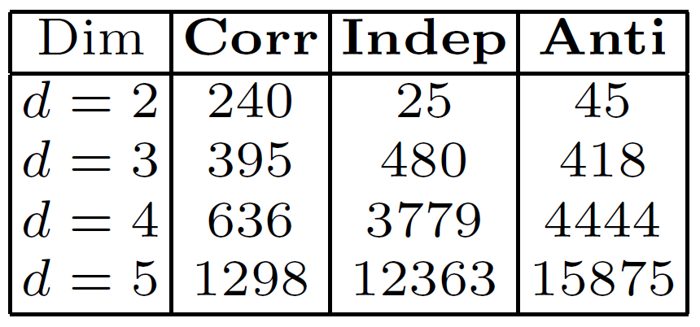
Effects of d
Skyline is too large when d is large
No-longer interesting
0.045 %
0.42 %
4.4 %
16 %
Buffer size: 100K

Slide 41
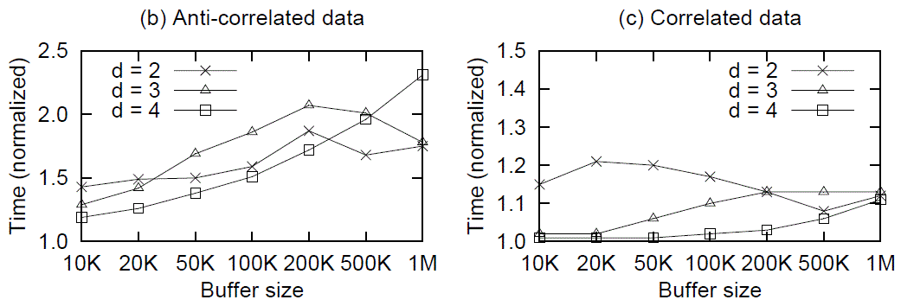
Dominating Tuple optimization
With only Dominating Tuple optimization
Average time per query to skyline (amortized)
Normalized w.r.t. optimized run time
Upto 2.3 times faster

Slide 42
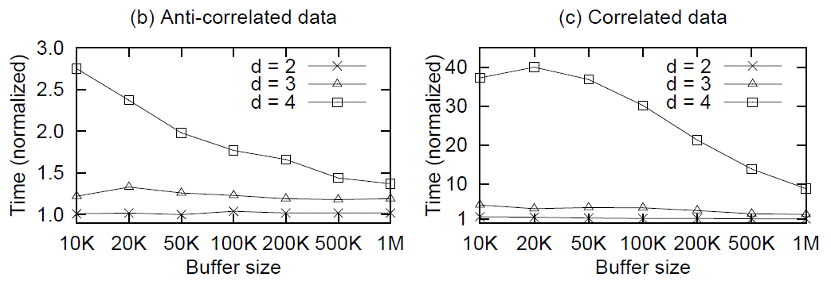
Empty Cell optimization
With only Empty Cell optimization
Average time per query to buffer (amortized)
Normalized w.r.t. optimized run time
Upto 40 times faster

Slide 43
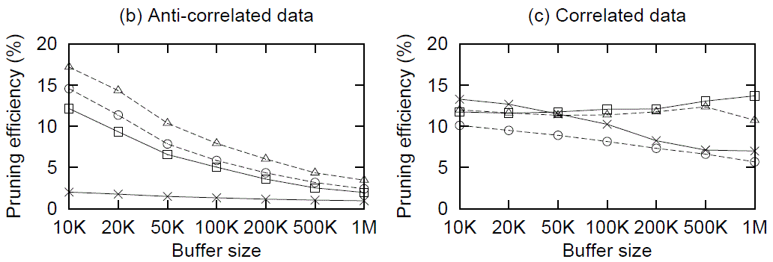
Pruning ratio
Pruning ratio of STARS, minmax and SkyGrid
SkyGrid much better pruning ratio
  Except for correlated data
  Other benefits make it still worth

