Slide 1



RoundTripRank Graph-based Proximity with Importance and Speciﬁcity
Yuan Fang Univ. of Illinois at Urbana-Champaign
Kevin C.-C. Chang Univ. of Illinois at Urbana-Champaign
Hady W. Lauw Singapore Management University
ICDE 2013 @ Brisbane, Australia
April 10, 2013
arise.adsc.com.sg

Slide 2

Graph-based proximity has many applications with different ranking needs
Citation graph
Query log graph
“pear”
paper 3
?
?
“apple”
VLDB
?
“apple inc”
“xml”
author 1
paper 1
“data”
Social network
?
ICDE
“spatio”
“temporal”
paper 2
author 2

Slide 3
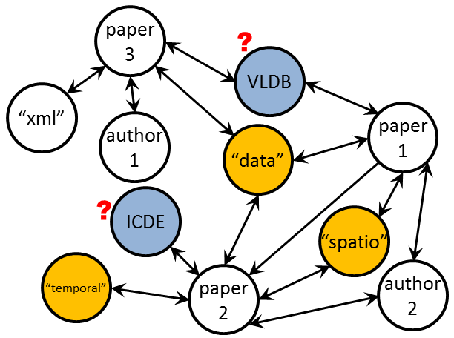
Although various applications involve different needs, ranking by existing graph proximity is limited
Query
“spatio”, “temporal”, “data”
Matching venues by P-PageRank
SIGMOD | Intl Conference
VLDB | Intl Conference
ICDE | Intl Conference
Looks reasonable?
What’s missing?
favor very popular or important venues
only categorically related as data topics
“schema”, “matching”?
Notes:
Very popular/important venues
But too general: only categorically related, not specifically tailored to the query
Ranked high on any data-centric topic

Slide 4
Other venues are needed for different purposes
Query
“spatio”, “temporal”, “data”
More specific venues?
quick background study
Spatio-Temporal Databases | Springer Book
Spatio-Temporal Data Mining | Intl Workshop
Temporal Aspects in Information Systems | Working Conference
report preliminary results
A balanced mixture of venues?
important
VLDB | Intl Conference
Spatio-Temporal Databases | Springer Book
ACM SIGSPATIAL/GIS | Intl Conference
specific
balanced

Slide 5
Specificity has been traditionally ignored
Semantics
 | Closeness
Common neighbor | Jaccard coefﬁcient [Jaccard1901] AdamicAdar [Adamic2003]
Hitting time | Escape probability [Koren2006, Tong2007] SimRank [Jeh2002]
Reachability
Ad-hoc | Katz [Katz1953]
Importance
P-PageRank [Page1999] ObjectRank [Balmin2004] PopRank [Nie2005]
Specificity
InvObjectRank Inverse global ObjectRank Inverse node degree [Hristidis2008]
Methodology
Notes:
1. Lack of a finer sense
E.g., SimRank, AdamicAdar, escape probability
2. Most well-established sense
Eg. PPR and its variants
Aka importance or authoritativeness
3. Specificity has been traditionally ignored. Only emerge recently
Pioneered by Hristidis (2008)
Various heuristic forms
4. Dual sensed proximity: Mostly ad-hoc combination
Lack of unifying model
Fixed trade-off

Slide 6
Applications require varying degrees of trade-off between importance and specificity
Observation 1 Most Tasks Require Both Importance and Specificity.
Overly important: maybe too broad, unaware of details
Finding a Reviewer
Overly specific: maybe a student, lack authoritativeness
Observation 2 The Desirable Trade-off Varies from Task to Task.
(to submit best work) important conferences ++
Choosing a Venue
Purpose?
(to build background) specific book chapters ++
Notes:
Observation 1 example
Sourcing for an expert reviewer
A important but broad expert may miss some developments
A specific student researcher may lack authoritativeness
Observation 2 example
looking for a venue
To build background on a topic, specificity weighs more
To submit one’s best work, importance weighs more

Slide 7
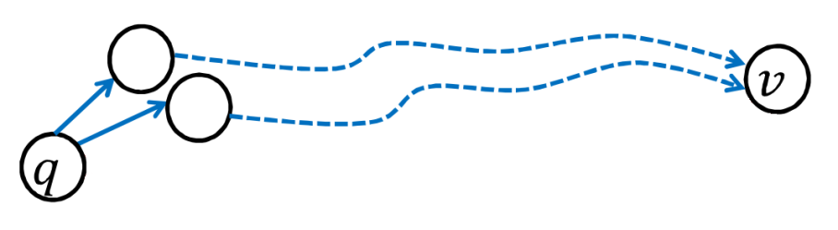
Addressing the two observations is challenging
Challenge 1: How do we unify importance & specificity into a single proximity measure?
Generalize random walk based importance to integrate specificity.
Challenge 2: How do we generalize our unified model to accommodate flexible trade-offs?
more importance
more specificity
Challenge 3: How do we efficiently compute the proximity measure?
Real-time search is indispensable.

Slide 8
Challenge 1 How do we unify importance & specificity into a single proximity measure?

Slide 9

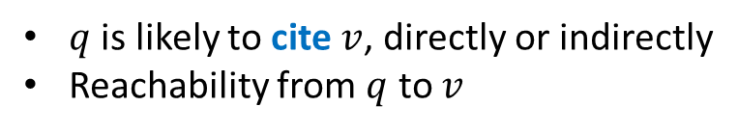

Let’s first review reachability-based importance for generalization to specificity
paper 1
cites
paper
2
paper 1
published in
ICDE
accepts
“citations” or “endorsements”
If node $v$ is important to query $q$…
$q$ is likely to cite $v$, directly or indirectly
Reachability from $q$ to $v$
Notes:
How do we interpret importance?
Base on citations
Generalize to other relationships (supports, publishes)

Slide 10
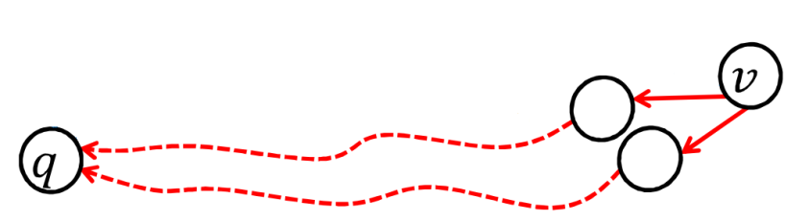


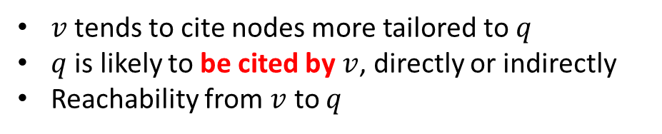





Generalize importance to specificity based on the same citation analogy
?
“lock”
ICDE
If node $v$ is specific to query $q$…
?
paper 1
paper 3
paper 6
$v$ tends to cite nodes more tailored to $q$
$q$ is likely to be cited by $v$, directly or indirectly
Reachability from $v$ to $q$
STDB (book)
paper 4
paper 5
paper 2
“spatio”
$$q$$
“cache”
Importance of $v$ to $q$
Specificity of $v$ to $q$
forward walk $q→v$
backward walk $v→q$

Slide 11











Unify forward and backward walks into a round trip for both importance & specificity
Importance of $v$ w.r.t. $q$
Walk forward in some $L$ steps
query
target
$$q$$
$$v$$
Specificity of $v$ w.r.t. $q$
Walk backward in some $L′$ steps
Random walk:
$$W_{0},W_{1},…,W_{L},W_{L+1},…,W_{L+L^{′}}$$
Round trip:
$$W_{0}=W_{L+L^{′}}$$
Target node:
$$W_{L}$$
RoundTripRank:
$$r\left(q,v\right)≜p(W_{L}=v|W_{0}=W_{L+L^{′}},W_{0}=q)$$

Slide 12
Challenge 2 How do we generalize our unified model to accommodate flexible trade-offs?
Based on the same principle of
random walk in a round trip.

Slide 13



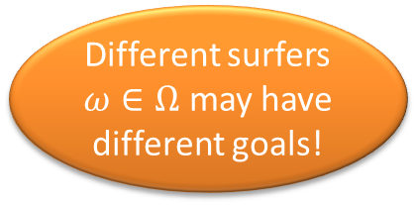

Further generalize RoundTripRank using hybrid random surfers of different goals
Single random surfer $ω$
Hybrid random surfer $Ω$
…
$$q v$$
Goal: balance b/w importance and specificity
Different surfers $ω∈Ω$ may have different goals!

Slide 14







Generalize the behaviors of hybrid random surfers for customizable trade-offs
…
Hybrid Surfers
SIGSPATIAL/GIS
balance
$$q v$$
$$Ω_{1}$$
…
$$Ω_{2}$$
VLDB
importance
$$q v$$
…
$$Ω_{3}$$
STDB
specificity
$$q v$$
RoundTripRank+
$$r_{Ω}\left(q,v\right)≜p(x=v|∀ω∈Ω:W_{0}^{ω}=W_{L+L^{′}}^{ω}=q,W_{L}^{ω}=x)$$
Adjusting Composition
mostly balanced
mostly important
$$β$$
mostly specific

Slide 15
Challenge 3 How do we efficiently compute the proximity measure?

Slide 16






Compute RoundTripRank by “divide & conquer”
$$q$$
$$v$$
“divide”
$$q$$
$$v$$
$$q$$
$$v$$
“conquer”
?
?

Slide 17

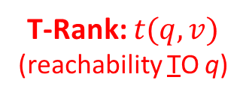

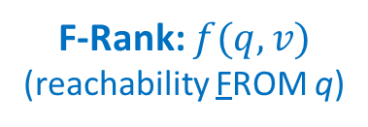



Compute RoundTripRank by “divide & conquer”
$$r\left(q,v\right) ∝$$
“divide”
$$p\left(W_{L}=v | W_{0}=q\right)$$
$$×$$
$$p(W_{L^{′}}=q|W_{0}=v)$$
“conquer”
F-Rank: $f(q,v)$
(reachability FROM q)
T-Rank: $t(q,v)$ (reachability TO q)
RoundTripRank: $r\left(q,v\right)∝f\left(q,v\right)t(q,v)$
RoundTripRank+: $r_{Ω}\left(q,v\right)∝{f\left(q,v\right)}^{1−β}{t\left(q,v\right)}^{β}$
Specificity bias: $β=\frac{|Ω_{1}|+|Ω_{3}|}{2\left|Ω_{1}\right|+\left|Ω_{2}\right|+|Ω_{3}|}∈[0,1]$

Slide 18
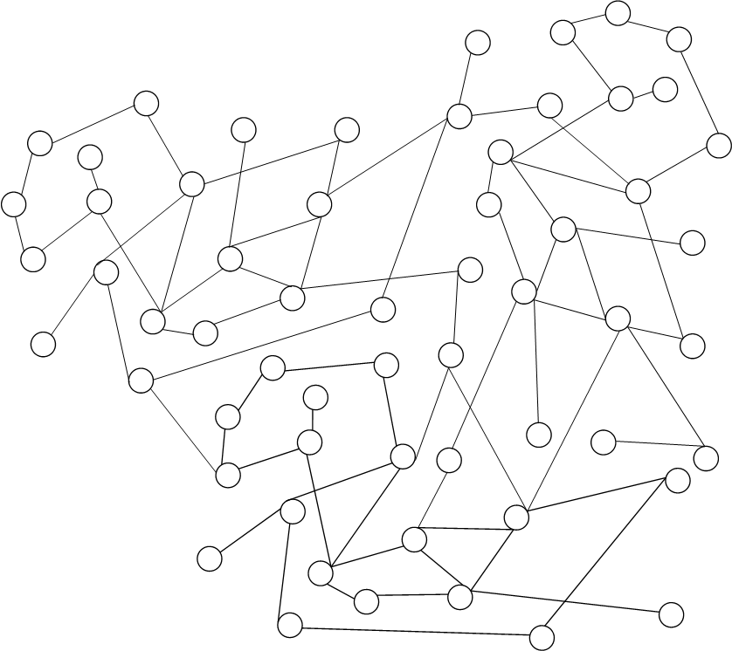
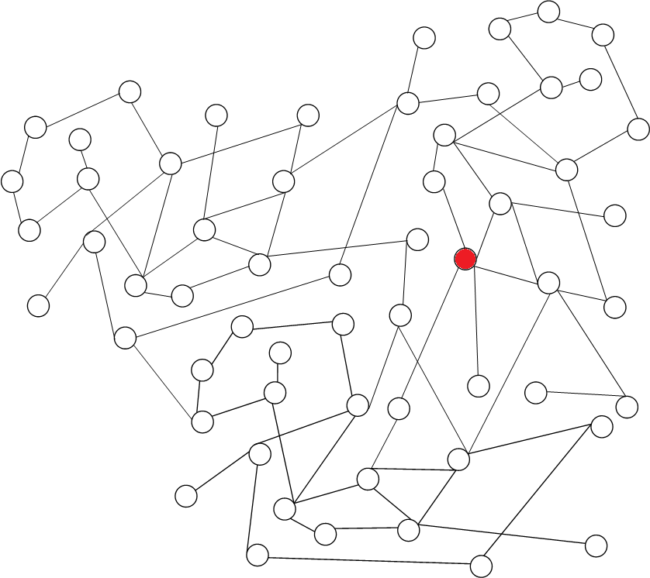
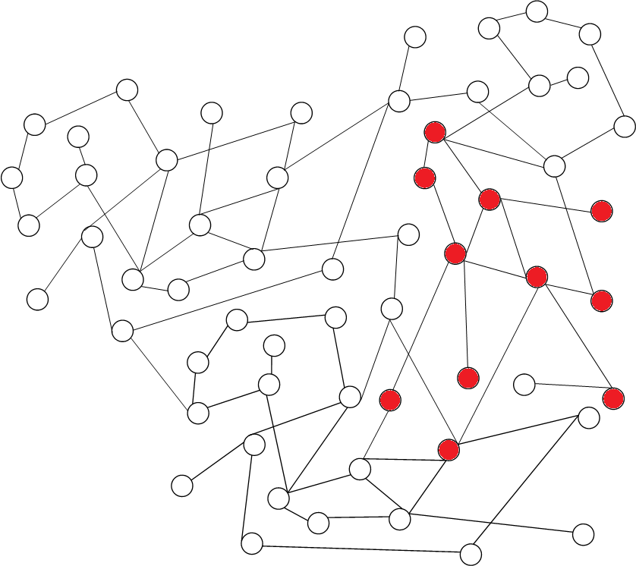
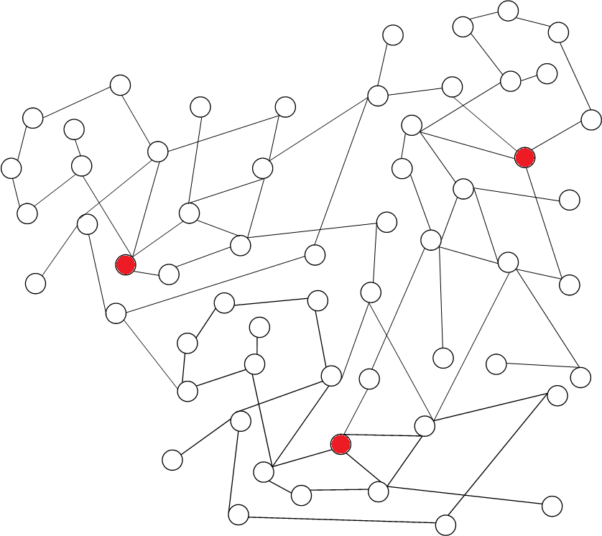
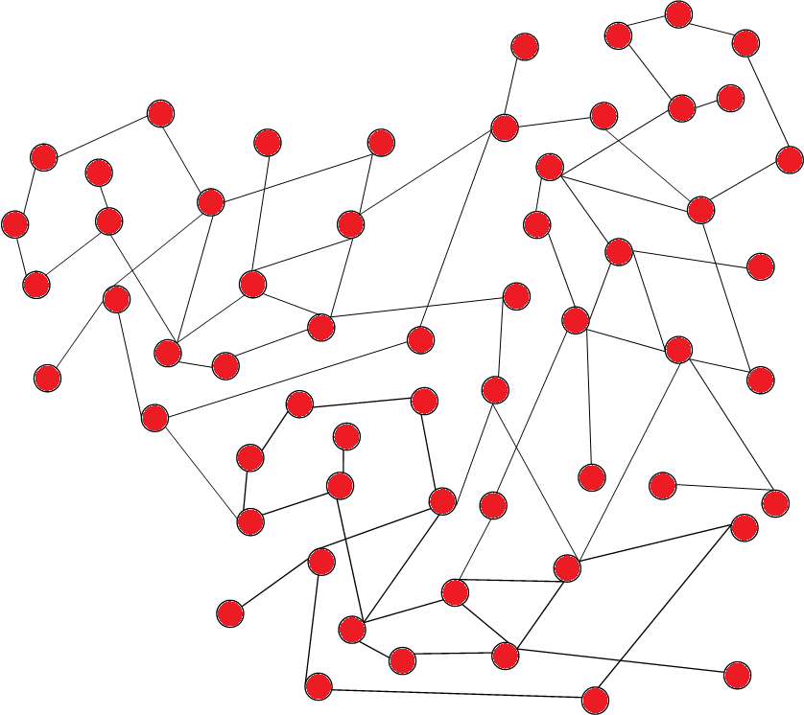
Top-K ranking is more practical & scalable
Full ranking [over the entire graph]
Top-K ranking [based on a neighborhood]

Slide 19

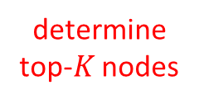




Branch-and-bound algorithm
Neighborhood expansion
…
$$q$$
$$q$$
$$q$$
Bounds
Given the current neighborhood $S$:
determine top-$K$ nodes

Slide 20













Is a candidate top-K ranking $v_{1},…,v_{K}$ correct?
Neighborhood $S$
$$v_{1}$$
lb of $v_{1}$
ub of $v_{2}$
$$v_{2}$$
$$v_{3}$$
…
$$v_{K}$$
$$v_{K+1}$$
$$v_{|S|}$$
$$v_{K+2}$$
…
$$− ε$$
$$− ε$$

Slide 21
Experiments

Slide 22
Experimental Setup
Graphs
Bibliographic network (BibNet)
Query log graph (QLog)
venue
paper 1
phrase 1
author 1
URL 1
term 1
?
phrase 2
paper 2
?
author 2
URL 2
term 2
phrase 3
Evaluation methodology
Hide-and-rediscover
Reserve nodes with known associations to query
Remove those associations from the graph
Can a proximity measure still rank those nodes highly?

Slide 23
Evaluation Tasks
4. Find equivalent phrase
more specificity
1. Find authors of a paper
2. Find venues of a paper
3. Find URL of a phrase
more importance

Slide 24
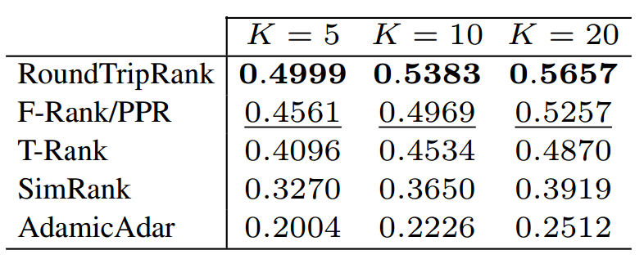
Both importance & specificity are needed
Finding 1
Venues matching “spatio temporal data”
Phrases similar to “dell notebook”
F-Rank/PPR
dell
dell com
dell computers
T-Rank
dell c1295
battery for dell inspiron 8000
312 0068
RoundTripRank
dell battery
battery for dell inspiron 8000
dell
F-Rank/PPR
dell
dell com
dell computers
T-Rank
dell c1295
battery for dell inspiron 8000
312 0068
RoundTripRank
dell battery
battery for dell inspiron 8000
dell
important
specific
balanced
important
specific
balanced
Quantitative evaluation (hide-and-rediscover)
NDCG
+ 8% ~ 10%

Slide 25
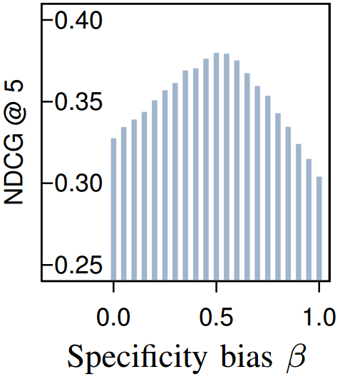
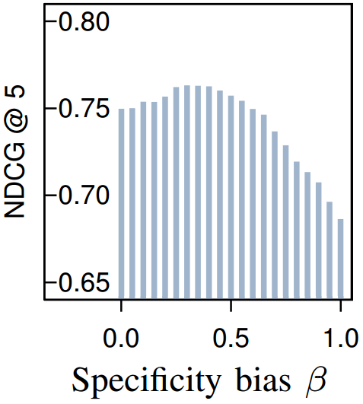
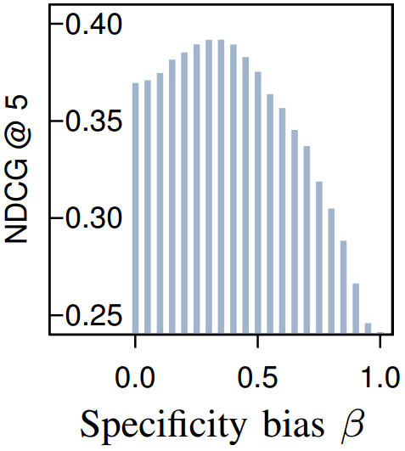
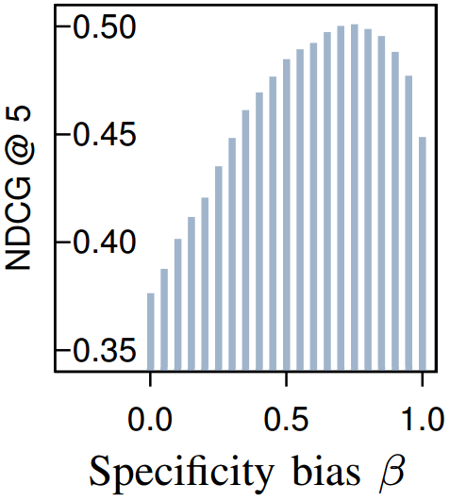















Optimal trade-offs $β^{∗}$ vary task by task
Finding 2
(1) $β^{∗}=0.50$
(2) $β^{∗}=0.35$
(3) $β^{∗}=0.20$
(4) $β^{∗}=0.70$
1
$$0.70$$
4. Find equivalent phrase
Specificity ($β$)
1. Find authors of a paper
$$0.50$$
$$0.35$$
2. Find venues of a paper
$$0.20$$
3. Find URL of a phrase
0
$$0.30$$
$$0.50$$
$$0.80$$
1
$$0.65$$
Importance ($1−β$)

Slide 26
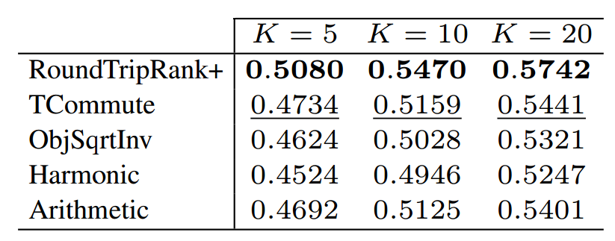
Optimal trade-offs $β^{∗}$ vary task by task
Finding 2
Comparison to non-customizable dual-sensed proximity
NDCG
+ 6% ~ 7%

Slide 27
Our top-K method is efficient & scalable
Finding 3
Efficiency
Scalability
x 7.4
300 ms
x 1.9

Slide 28
Conclusion
Importance as “Reachability” → Specificity as “Returnability”
“Reachability” + “Returnability” → a Round Trip

