Slide 1



Learning to Query:
Focused Web Page Harvesting for Entity Aspects
Yuan Fang¹, Vincent Zheng², Kevin Chang²³
ICDE 2016 @ Helsinki
¹ Institute for Infocomm Research, Singapore
² Advanced Digital Sciences Center, Singapore
³ University of Illinois at Urbana-Champaign, USA

Slide 2
In this talk
Problem: L2Q
Challenges and solution
Domain-awareness
Context-awareness
Experimental Study
Conclusion

Slide 3
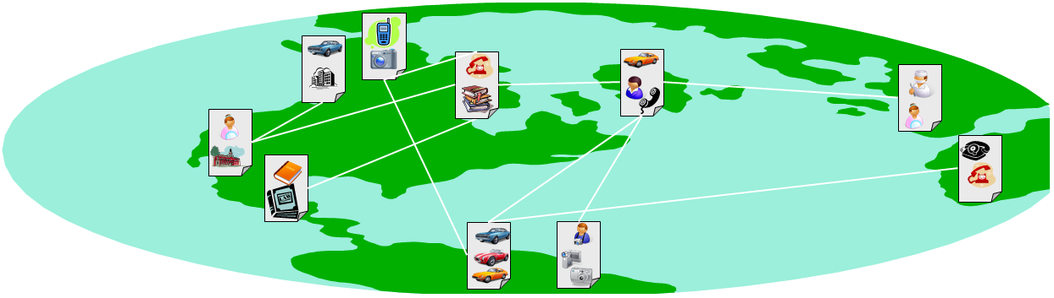
Entities and their aspects are abundant, but scattered, on the Web
People entities alone: 10% of Bing’s search volume
Entity type | Common aspects
celebrity | spouse, age, net worth, …
car | safety, cost, interior, …
business | address, opening hour, phone no., …

Slide 4


Motivation: Focused Web Page Harvesting for Entity Aspects
Business Analytics
Vertical portal or search

Slide 5
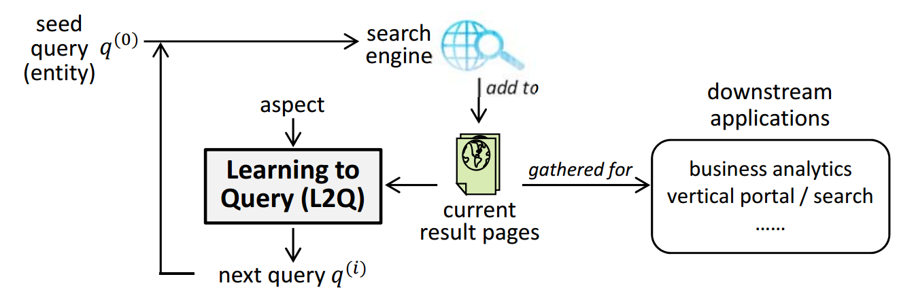

High level problem: Learning to query (L2Q)
Seed query
Keywords (uniquely) identifying the entity
Target aspect
A pre-trained classifier $Y$, mapping each page to “relevant” or “not relevant” to the target aspect
Utility (precision/recall)
In each iteration, $q^{∗}=\underset{q}{arg max}{𝒰^{\left(Y\right)}(q)}$

Slide 6
In this talk
Problem: L2Q
Challenges and solution
Domain-awareness
Context-awareness
Experimental Study
Conclusion

Slide 7


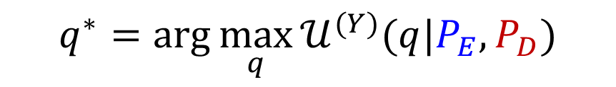

Subproblem #1: Domain-aware L2Q
Target Entity
Peer Entities
Marc Snir
Philips Yu
Andrew Ng
……
entity pages $P_{E}$
domain pages $P_{D}$
Gradually harvested in earlier iterations
Pre-collected / previously harvested pages
$$q^{∗}=\arg{\max_{q}{𝒰^{(Y)}(q|P_{E},P_{D})}}$$

Slide 8
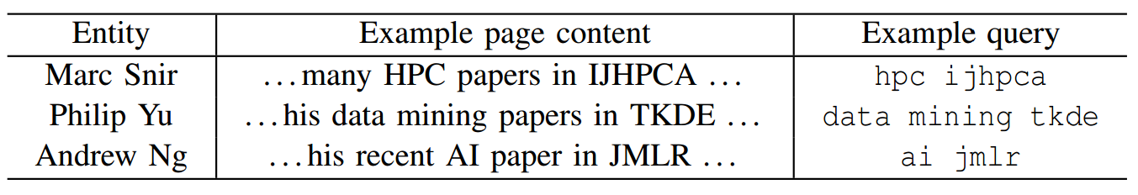
Subproblem #1: Vocabulary variations
topics
journals
hpc
data mining
ai
…
ijhpca
tkde
jmlr
…
<topic> <journal>
(template)

Slide 9
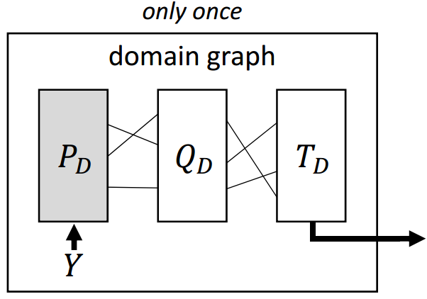
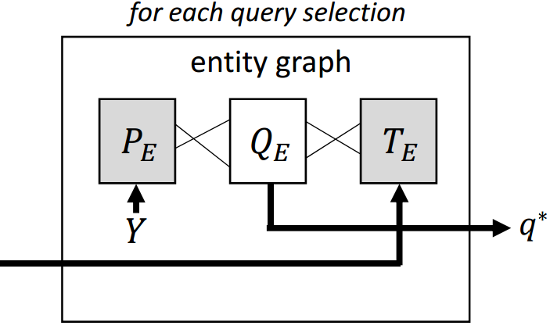

Subproblem #1: Bridging domain and entity phases
Domain Phase
Entity Phase
Utility regularization (i.e. supervision on target aspect)

Slide 10
In this talk
Problem: L2Q
Challenges and solution
Domain-awareness
Context-awareness
Experimental Study
Conclusion

Slide 11



Subproblem #2: Context-aware L2Q
In iteration-i, a context of already fired queries $Φ=\left\{q^{\left(0\right)},q^{\left(1\right)},…,q^{\left(i−1\right)}\right\}$.
Queries can retrieve redundant pages
Marc Snir HPC
Marc Snir Parallel

Slide 12
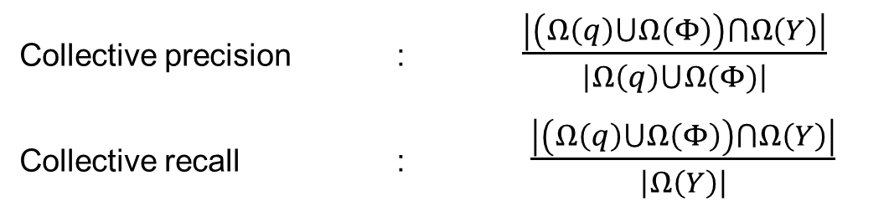
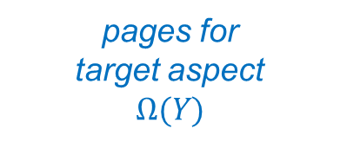

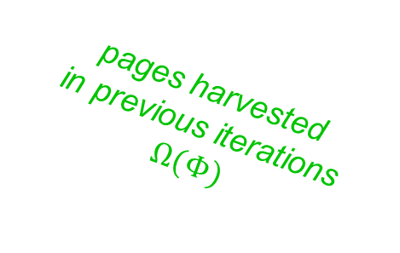
Subproblem #2: Accounting for redundancy
pages for
target aspect $$Ω(Y)$$
pages harvested
in previous iterations $$Ω(Φ)$$
pages of candidate query $Ω(q)$
Collective Utilities
Collective precision : $\frac{\left|\left(Ω\left(q\right)⋃Ω\left(Φ\right)\right)⋂Ω\left(Y\right)\right|}{\left|Ω\left(q\right)⋃Ω(Φ)\right|}$
Collective recall : $\frac{\left|\left(Ω\left(q\right)⋃Ω\left(Φ\right)\right)⋂Ω\left(Y\right)\right|}{\left|Ω\left(Y\right)\right|}$

Slide 13
In this talk
Problem: L2Q
Challenges and solution
Domain-awareness
Context-awareness
Experimental Study
Conclusion

Slide 14
Experiment setup
Datasets: two domains
996 researchers & 143 car models
Pre-collected pages to simulate the corpus
Search engine: language model
Dictionaries for templates
Gathered from existing knowledge base
Manually compiled
Entity aspects
7 attributes for each domain
Pre-trained aspect classifier with high accuracy

Slide 15
Experiment methodology
Utilities of two forms: precision & recall
Evaluation metrics
Precision, recall
Combined F-score
Metrics reported are normalized
Against ideal precision/recall
Ideal metrics computed by “peeking” at un-retrieved pages

Slide 16
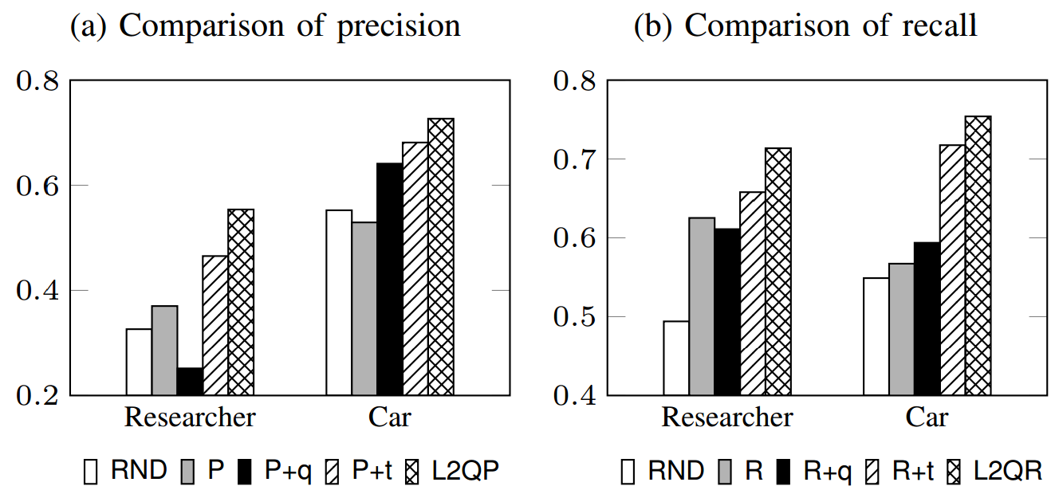
Finding #1: Effect of domain and context-awareness
RND: select query randomly
P/R: optimize precision/recall without domain and context-awareness
P/R+q: with domain pages, but do not employ templates, and without context
P/R+t: with domain pages and templates, without context
L2QP/L2QR: full approaches optimizing precision/recall

Slide 17
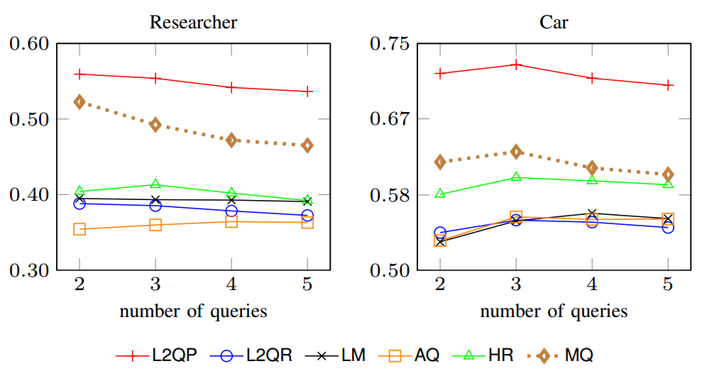
Finding #2(a): Comparing precision with indep. baselines
LM: language feedback model
AQ: adaptive querying for text databases
HR: harvest rate for hidden structured databases
MQ: manually designed queries

Slide 18
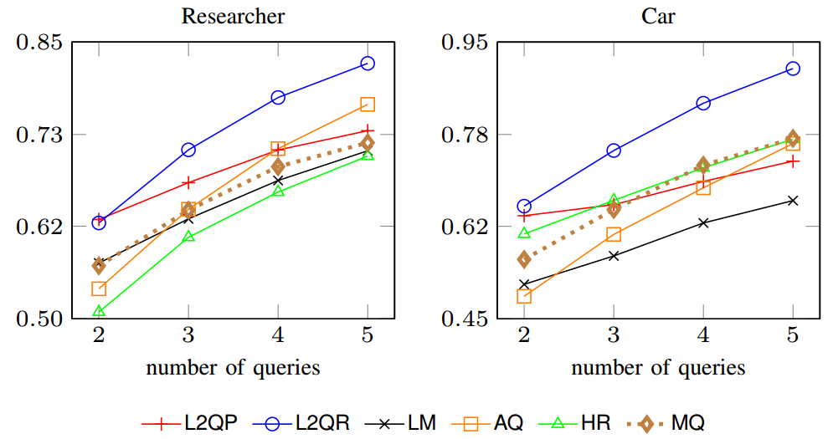
Finding #2(b): Comparing recall with indep. baselines
LM: language feedback model
AQ: adaptive querying for text databases
HR: harvest rate for hidden structured databases
MQ: manually designed queries

Slide 19
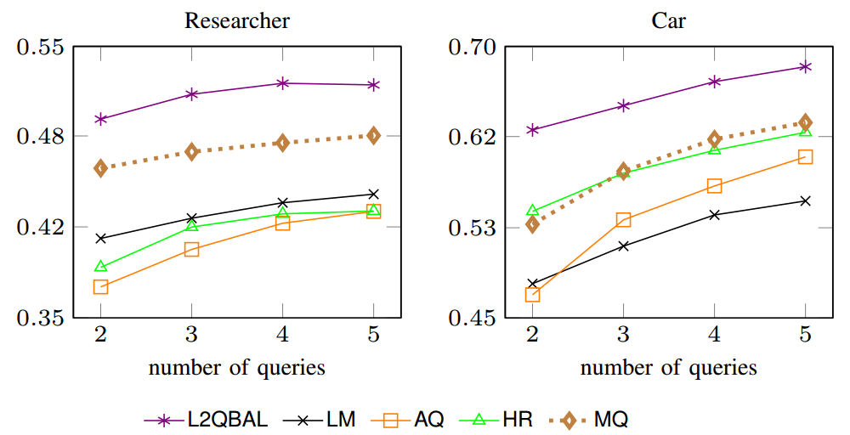
Finding #2(c): Comparing F-score with indep. baselines
L2QBAL: optimize for F-score, balancing L2QP & L2QR
LM: language feedback model
AQ: adaptive querying for text databases
HR: harvest rate for hidden structured databases
MQ: manually designed queries

Slide 20
In this talk
Problem: L2Q
Challenges and solution
Domain-awareness
Context-awareness
Experimental Study
Conclusion

Slide 21
Conclusion
L2Q: a novel paradigm of crawling
Domain-aware L2Q
Templates to handle vocabulary variations
Context-aware L2Q
Collective utilities to account for page redundancy

