Slide 1



Semantic Proximity Search on Graphs
with Metagraph-based Learning
Yuan Fang¹, Wenqing Lin¹, Vincent Zheng²,
Min Wu¹, Kevin Chang²³, Xiao-Li Li¹
ICDE 2016 @ Helsinki
¹ Institute for Infocomm Research, Singapore
² Advanced Digital Sciences Center, Singapore
³ University of Illinois at Urbana-Champaign, USA

Slide 2
In this talk
Problem and Motivation
Insights and Overall Framework
Challenges and Solution
Experimental Study
Conclusion

Slide 3
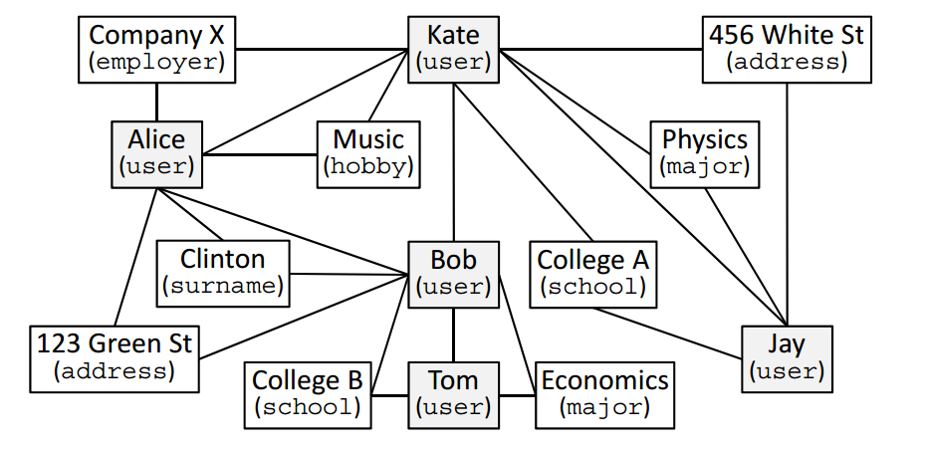
Objects and attributes can often be organized as a heterogeneous graph
“Typed” object graph: capturing users and their attributes on a social network
Object/Attribute
Type

Slide 4
Problem: Semantic Proximity Search
Which users are close to /related to Bob?
Family?
Classmates?

Slide 5
Key Criteria of Solution: Semantic differentiation + Online Search
Online Search
Existing graph proximity (personalized PageRank, SimRank, …)
?
Social circle learning
Relationship profiling
Semantic differentiation

Slide 6
In this talk
Problem and Motivation
Insights and Overall Framework
Challenges and Solution
Experimental Study
Conclusion

Slide 7
Each semantic class can often be explained by some underlying reasons
Family: [Bob & Alice / same surname & address]
Classmates: [Kate & Jay, Bob & Tom / same school & major]
Close friends: [Kate & Alice / same employer & hobby]
[Kate & Jay / roommate]

Slide 8
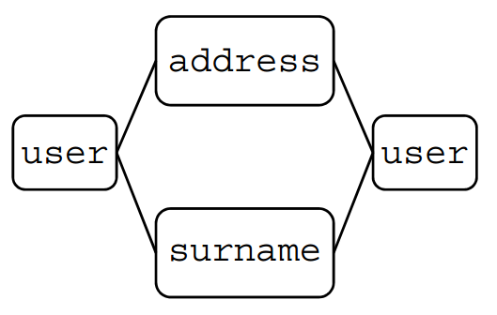
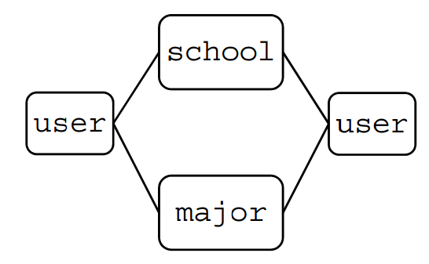
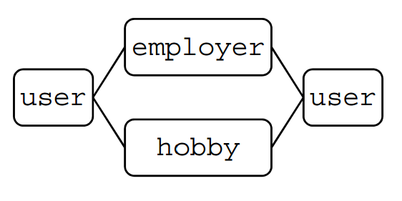
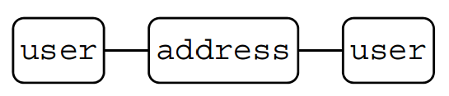
Insight: common substructures, or metagraphs, to “explain” semantic classes
Family
[same surname & address]
Classmates
[same school & major]
Close friends
[same employer & hobby]
[roommate]

Slide 9
Overall Framework
mining metagraphs
matching metagraphs (ie, finding instances)
indexing
training
Offline
Online
testing

Slide 10
In this talk
Problem and Motivation
Insights and Overall Framework
Challenges and Solution
Experimental Study
Conclusion

Slide 11
Challenges
Challenge #1: Metagraph-based proximity
Definition
Learning with efficiency
Challenge #2: Metagraph matching
Efficiency

Slide 12
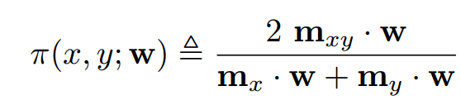

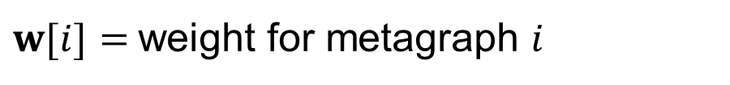
Challenge #1: Meta-graph based proximity (Definition of proximity)
Proximity of two nodes $x,y$ on graph
x, y co-occur in many important metagraphs
co-occurrence not by chance
$m_{xy}\left[i\right]=\#$ times $x,y$ co-occur in instances of metagraph $i$
$m_{x}\left[i\right]=\#$ times $x$ occurs in instances of metagraph $i$
$w[i]=$weight for metagraph $i$

Slide 13
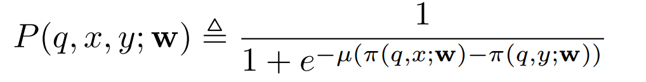
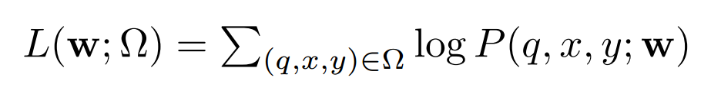

Challenge #1: Meta-graph based proximity (Basic learning model)
Pairwise learning to rank
Objective function
Each example is a triplet:
for query $q$, $x$ is ranked before y.

Slide 14
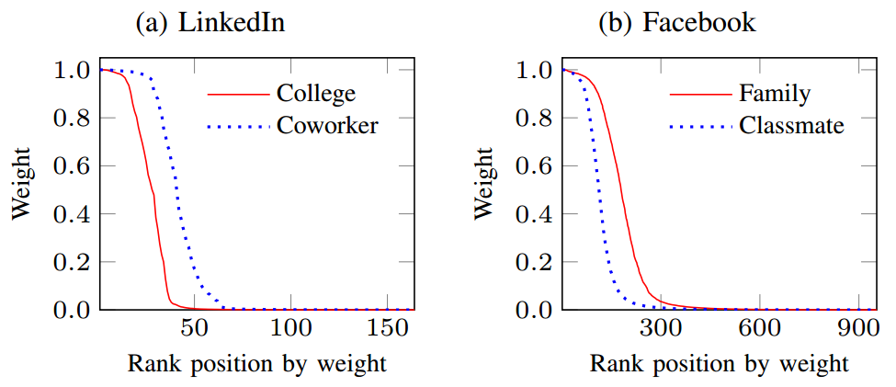
Challenge #1: Meta-graph based proximity (Need for efficient training)
Expensive to process & match all metagraphs
Yet not all metagraphs are useful

Slide 15
Challenge #1: Meta-graph based proximity (Dual-stage training)
Identify seed metagraphs
Learn with seed metagraphs
Based on weights of seed metagraphs and their structural relationship with other metagraphs
Select more metagraphs
Re-learn with seed + selected metagraphs

Slide 16
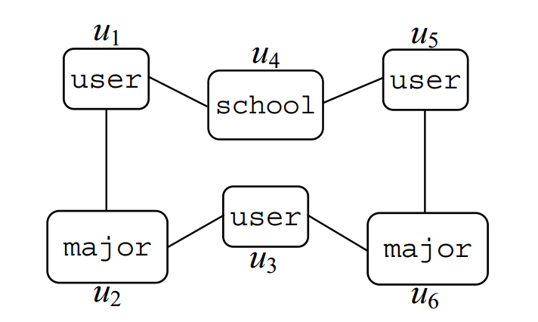
Challenge #2: Metagraph matching
Existing method: backtracking
DFS search node by node until an entire matched instance is found
Fail to leverage symmetric components
Symmetry-based matching
Many metagraphs are symmetric
Avoid redundant computation

Slide 17
In this talk
Problem and Motivation
Insights and Overall Framework
Challenges and Solution
Experimental Study
Conclusion

Slide 18
Experiment setup - datasets
LinkedIn ego networks
Join all into one bigger graph
Labelled relationships as semantic classes
“College” and “Coworker”
Facebook ego networks
Join all into one bigger graph
Rules to simulate circles
“Classmates”: same school, and same degree or major
“Family”: same surname, and same location or hometown

Slide 19
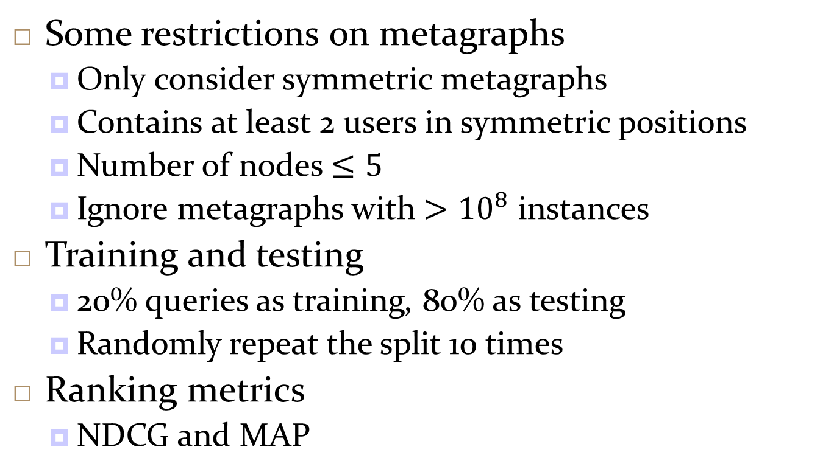
Experiment setup - methodology
Some restrictions on metagraphs
Only consider symmetric metagraphs
Contains at least 2 users in symmetric positions
Number of nodes $≤5$
Ignore metagraphs with ${>10}^{8}$ instances
Training and testing
20% queries as training, 80% as testing
Randomly repeat the split 10 times
Ranking metrics
NDCG and MAP

Slide 20
Experiment setup – baselines
MGP: metagraph-based proximity (our method)
MPP: metapath-based proximity
MGP-U: all metagraphs have uniform weights
MGP-B: only use the best metagraph
SRW: supervised random walk

Slide 21
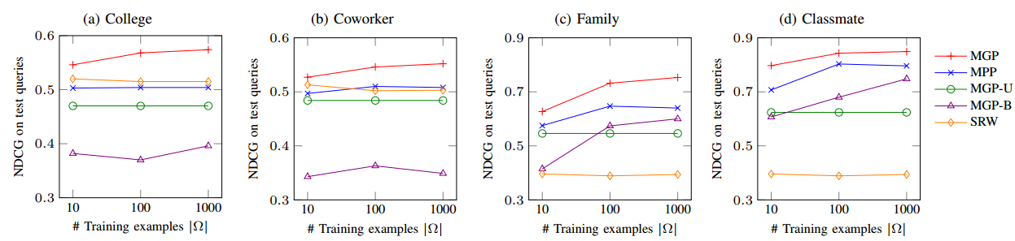
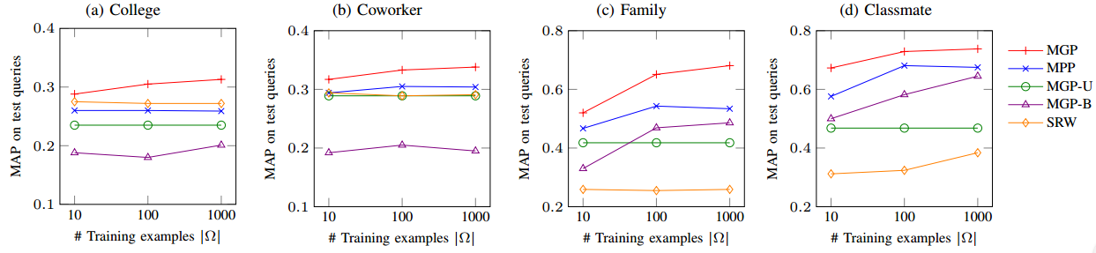
Finding #1: Metagraphs are powerful representations for semantic proximity

Slide 22
Finding #2 & #3
Dual-Stage training
reduce overall cost of metagraph matching by 83%
negligible compromise on accuracy
Symmetry-based matching
Reduce matching time for individual metagraphs by 52%

Slide 23
In this talk
Problem and Motivation
Insights and Overall Framework
Challenges and Solution
Experimental Study
Conclusion

Slide 24
Conclusion
Metagraphs are powerful
May be extended to other tasks on graph
Matching metagraphs are expensive
Improving its efficiency is crucial

